Slide 1
HappyAImen
WANG, Chenghui | 20552633
SHEN, Kairan | 20552932
WU, Shukun | 20549545
XIAO, Yuxiang | 20551433
LAM, Hiufung | 20476671

Slide 2
Content
1. Project Progress
· General review
· Introduction of Sentiment analysis
· Code display
2. Final Deliverable
3. Synthesis and Suggestion for further study

Slide 3
General review
· 1st Update Meeting: Research on the three selected approaches were conducted.
1. SenseTime AI Summit;
2. Potential policies with impact on SenseTime;
3. Current clients of Sense;
Challenge: limited public available information on target companies and their clients.
· 2st Update Meeting: Web scraping for news about SenseTime & tracking company’s project progress
Challenge: public information is not sufﬁcient to determine whether a project is still in progress or already closed. Nevertheless, web scraping still serves as an useful tool for data collection, which could be the main tool in the project.

Slide 4
What we want to do:
General review
Find out whether or not the leading AI startup company SenseTime has promotion bubbles.
The way we do it:
Sentiment Analysis:
(automated process of understanding an opinion about a given subject from written or spoken language)

Slide 5
Steps:
General review
Find all the information available about SenseTime
Feed all the information data into the sentiment analysis framework to determine the probability of positivity or negativity
Use Tencent Cloud service, i.e., Tencent AI open platform sentiment analysis API interface service.
Use Reptile technique to quickly capture all the information we want on a specific website.Also, we make some efforts to connect to the Tencent API interface service.

Slide 6
General review
Sentiment analysis brief introduction
A field within Natural Language Processing (NLP)
Identify and extract opinions within text.
Usually use machine learning techniques.
Modeled as a classification problem where a classifier is fed with a text and returns the corresponding category, e.g. positive, negative, or neutral
See final report to get more specific information

Slide 7
Code display
Crawl the news’ URL by using python request library
· delete the irrelevant news – news’ title do not have company name
· delete the repeated news
Extract the content (news) from each URL by using re and beautifulsoup library
Use Tencent API interface service to complete sentiment analysis.

Slide 8
Code display
Leifeng: https://colab.research.google.com/drive/1NrkMyd2OMvG3dUjAI5-9UnYl1pCsUM8n
Xinhua: https://colab.research.google.com/drive/1WKOErdQjYrJsrmWUe9EvJLVMg1aDIa7S
Renmin: https://colab.research.google.com/drive/1pbART3rZhYBgL2-dTanTtesNXlE_H7Vv
PEdaily: https://colab.research.google.com/drive/1agCrF6HED4wWSTxajDnczR-GyKG3SpFL

Slide 9
Final Deliverable
 | Sensetime | Malong | CloudWalk | Megvii | YITU
Xinhua | 29 | 10 | 29 | 15 | 8
Leifeng | 39 | 7 | 25 | 35 | 5
PEdaily | 18 | 2 | 3 | 10 | 9
Renmin | 27 | 6 | 10 | 25 | 7
5 companies: Sensetime, Malong, CloudWalk, Megvii and YITU
4 websites: Xinhua, Leifeng, Renmin and PEdaily
320 articles

Slide 10
Final Deliverable
 | Sensetime | Malong | CloudWalk | Megvii | YITU
Xinhua | 0.6898356 | 0.6756691 | 0.6692568 | 0.6860859 | 0.7050765
Leifeng | 0.6809414 | 0.6866832 | 0.6401622 | 0.6496635 | 0.6983780
PEdaily | 0.7063379 | 0.6794848 | 0.7133881 | 0.6945139 | 0.6664504
Renmin | 0.6794342 | 0.6891639 | 0.6462130 | 0.6773417 | 0.6693506
· Based on the crawling and text emotion analysis, we calculated the average points and got the results.
· The score of the emotion is the positive point of the article.

Slide 11
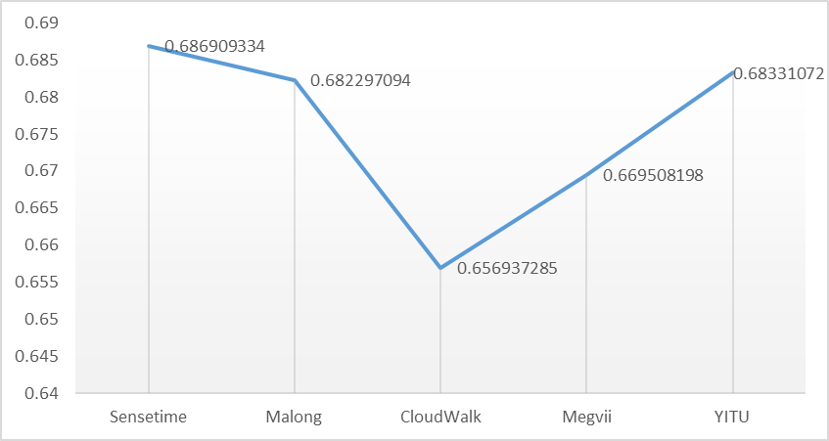
Final Deliverable
The five companies have very close points. Sensetime has the highest points, YITU comes second and Malong comes thrid. The media has a very positive comment on these three companies.

Slide 12
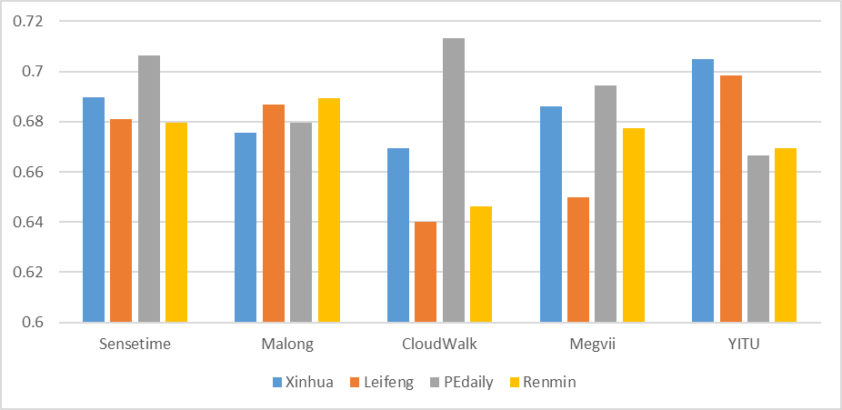
Final Deliverable
Sensetime and Malong has a balanced points from four different websites. However, CloudWalk, Megavii and YITU seem to impress differently in these 4 websites.

Slide 13
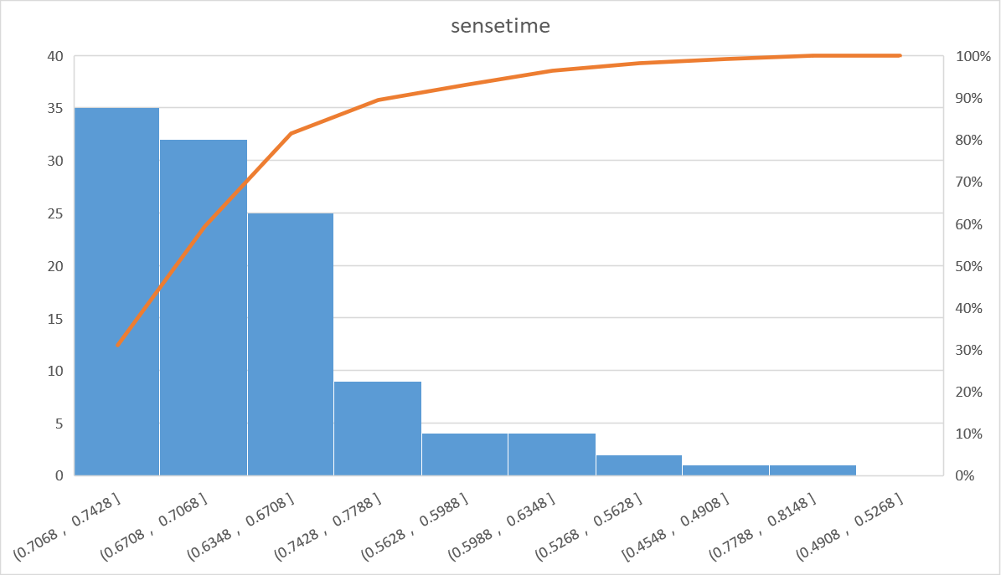
Final Deliverable
To analyze the company Sensetime, we draw a picture as below. The number of articles on Sensetime is 114. We can see that the points of these 114 articles concentrate on the range of [0.6348, 0.7428].

Slide 14
Synthesis and Suggestion for further study
Getting public opinions and comments from social media such as Sina Weibo, Twitter, Zhihu, etc., Then perform sentiment analysis on these texts and add weights to text information from different sources to get a more objective result.
For a specific company, perform sentiment analysis on the texts at different time periods, horizontally evaluate the public's evaluation of the company during its development process.
Tencent AI open platform sentiment analysis API was used for the sentiment analysis. However, it is suggested that a tailor-made sentiment analysis model can be employed in further study.
Other ideas: bubble model, unsupervised deep learning method of clustering

Slide 15

Thank you
HappyAImen

