Slide 1
Welcome to
AI Deep Learning using Python

Slide 2
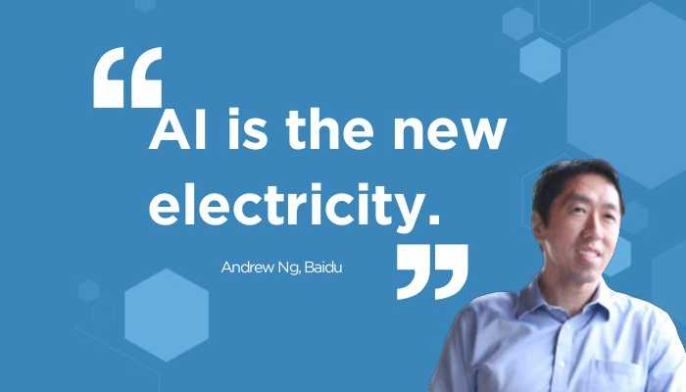

Slide 3
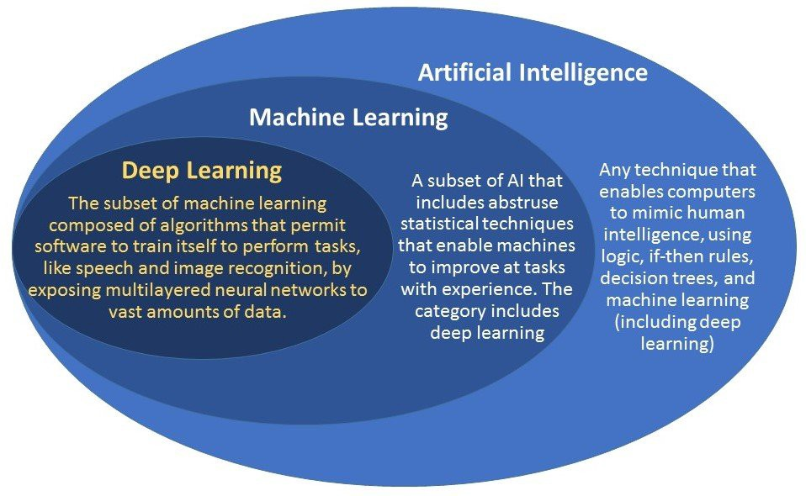
AI vs Machine Learning vs Deep Learning

Slide 4
Deep Learning
DL is the next evolution of machine learning.
DL algorithms are roughly inspired by the information processing patterns found in the human brain.
Whenever we receive a new information, the brain tries to compare it to a known item before making sense of it — which is the same concept deep learning algorithms employ.
For example, artificial neural networks (ANNs) are a type of algorithms that aim to imitate the way our brains make decisions.

Slide 5
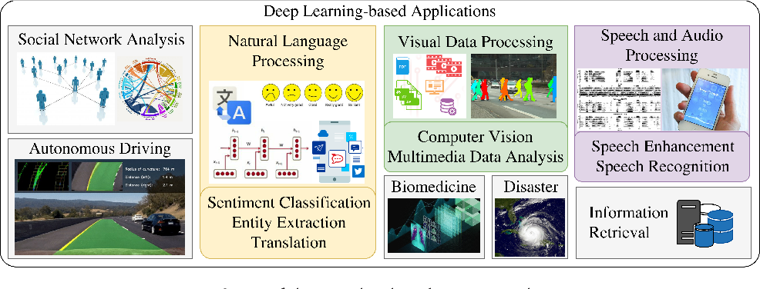

Slide 6
Why Python For Deep Learning?
Simple and consistent
Extensive selection of libraries and frameworks (Keras,TensorFlow,Pytorch,Theano)
Platform independence
Great community and popularity

Slide 7
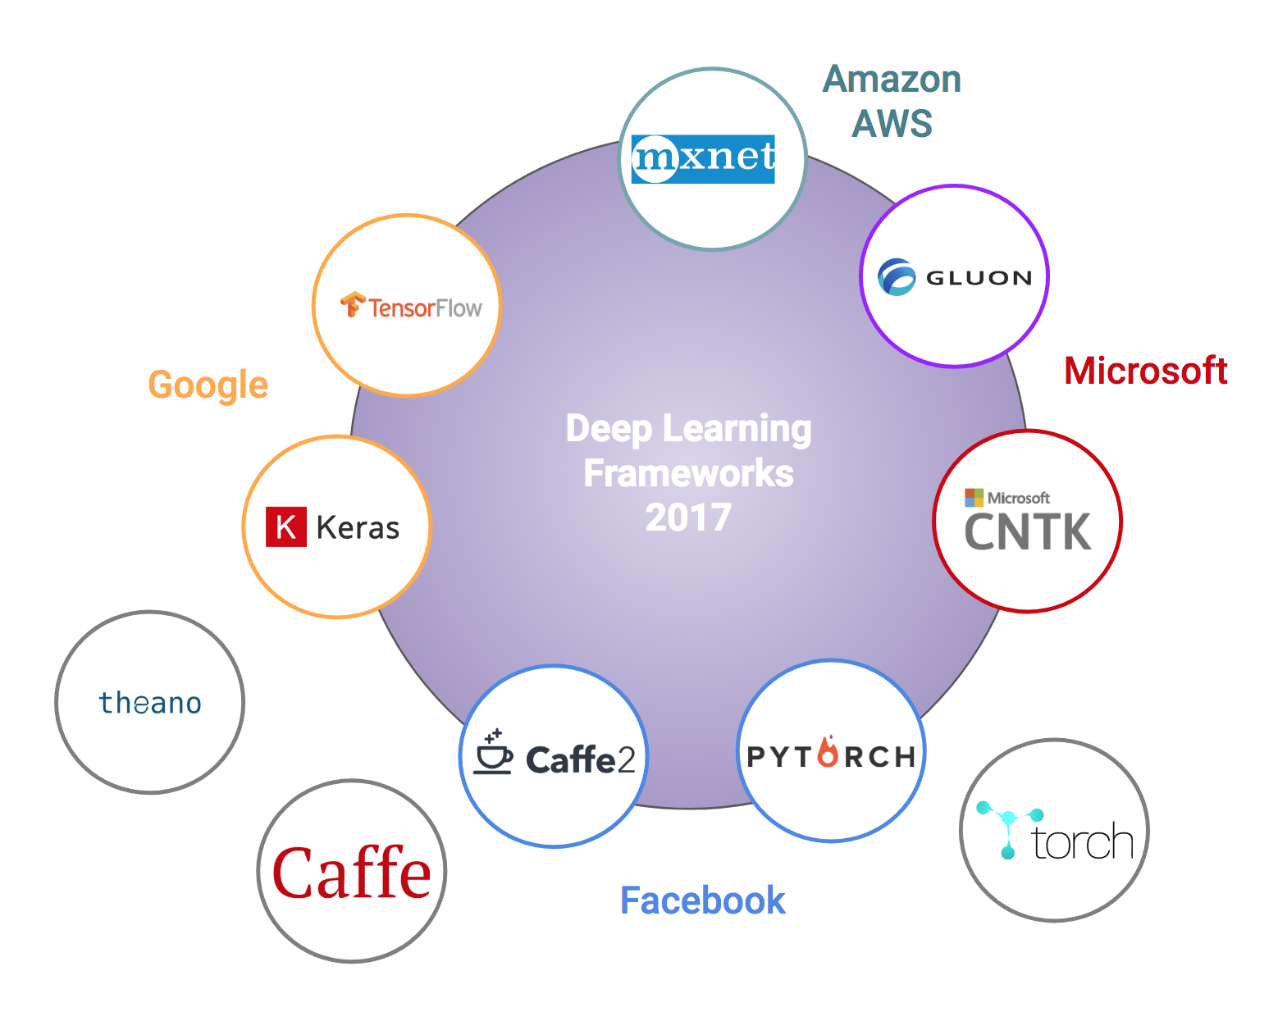
Deep Learning Frameworks

Slide 8
You will learn …
Python
Math for Deep Learning
Deep Learning Prerequisites
Deep Learning Frameworks(Pytorch,TensorFlow,Keras)
Neural Networks (CNN,RNN,GAN)
Open CV
Natural Language Processing
Deep Reinforcement Learning

Slide 9
Projects
Project 1: Image Classification
Project 2: Face Detection
Project 3: Image Creations with GAN
Project 4 : Create a Chatbot or LSTM-Sentiment Analysis

Slide 10
Thank You

