Slide 1
Foundations of Data Science & Analytics DSCI 633, Fall 2021
Lecture 12
(material sources cited in the last slide)
Nidhi Rastogi
Assistant Professor, GCCIS, RIT
September 30, 2021

Slide 2
Course Information
GitHub link - https://github.com/aiforsec/RIT-DSCI-633-FDS
Assignment 4 due at 11:59 pm on 09/30. No extensions.
Reach out to the TA/ Instructor during office hours, via Slack, or email for any questions, suggestions, concerns, or general chat about data science.

Slide 3
This Lecture
An end-to-end machine learning model pipeline
Classification, Clustering, Anomaly detection, …
Performance Measures
Error Analysis
Training Models – Linear
Linear Regression
Gradient Descent
Polynomial Regression
Regularized Linear Models
Logistic Regression

Slide 4
Clustering Models - Introduction
QUESTION: How to develop ML models that can classify unstructured, data correctly?
We find commonalities in the features that will be used to predict classes in new data.
But there is no supervision in the existing data.
we have the input features X, but we do not have the labels y

Slide 5
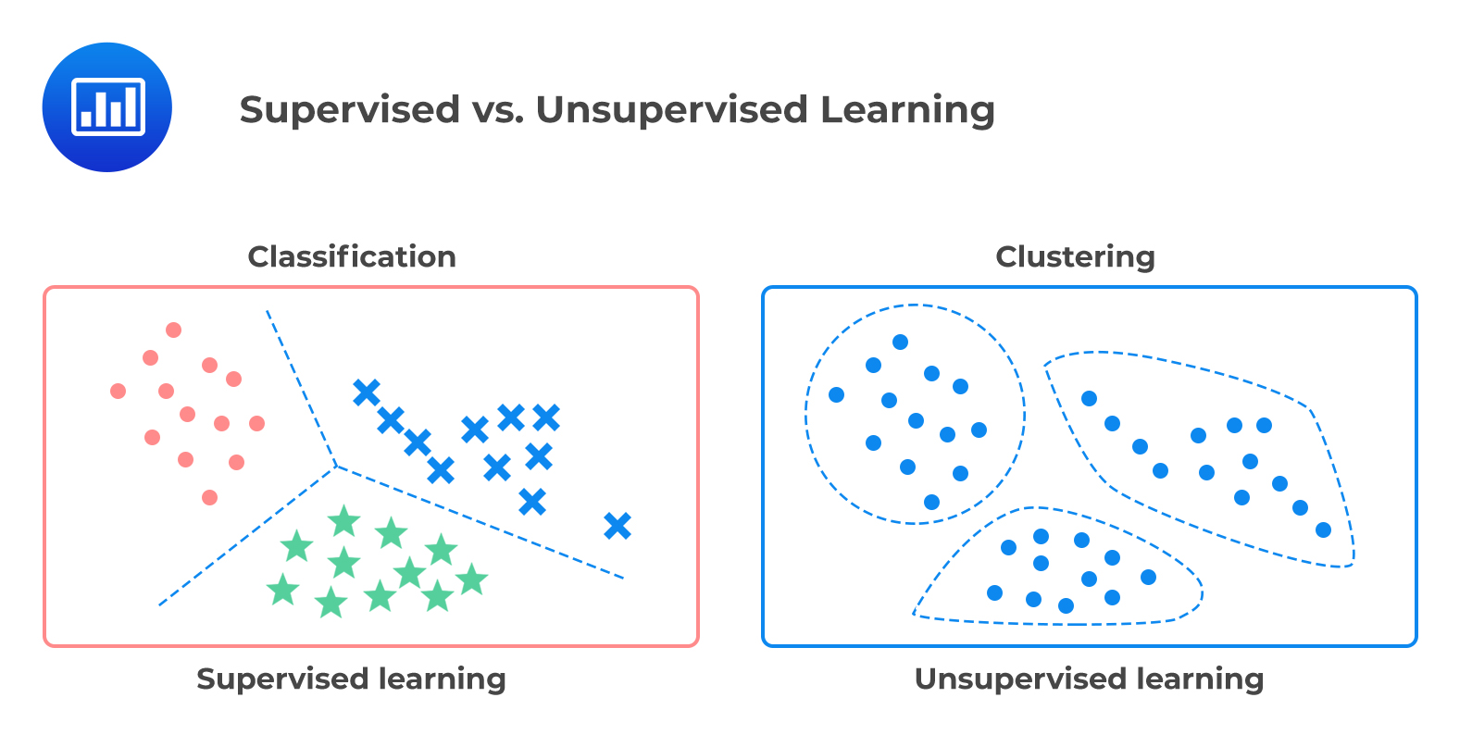
Clustering Models - Introduction

Slide 6
Clustering Models - Introduction
Clustering comes from
sort observations into clusters (groups)
observations within a cluster are similar
observations in different clusters are dissimilar
Goal of Clustering
Study the intrinsic (and commonly hidden)
structure of the data

Slide 7
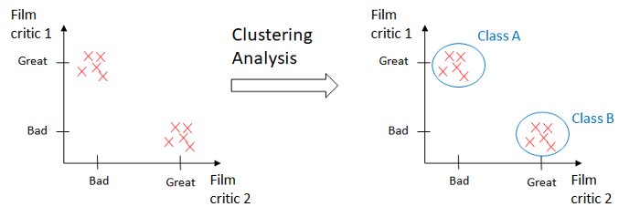
Clustering Analysis - Example
Dataset – Movies and their reviews. No labels (y).
Hypothesis
Classify movies based on reviews. EASY!

Slide 8
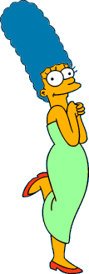








Clustering Analysis – Example Not so easy
What is a natural grouping among these images?

Slide 9
Clustering Analysis - Example
Clustering is subjective
Simpson's Family
School Employees
Females
Males

Slide 10

Defining Similarity
One option: Euclidean distance (squared)
Clustering results are crucially dependent on the measure of similarity (or distance) between “points” to be clustered

Slide 11
K-Means Clustering

Slide 12
K-Means
A type of Partitional Clustering
Nonhierarchical, each instance is placed in exactly one of K nonoverlapping clusters.
Since only one set of clusters is output, the user normally has to input the desired number of clusters K.

Slide 13
K-Means
An iterative clustering algorithm:
Decide on a value for k.
Initialize the k cluster centers (randomly, if necessary).
Decide the class memberships of the N objects by assigning them to the nearest cluster center.
Re-estimate the k cluster centers, by assuming the memberships found above are correct.
If none of the N objects changed membership in the last iteration, exit. Otherwise goto 3.

Slide 14
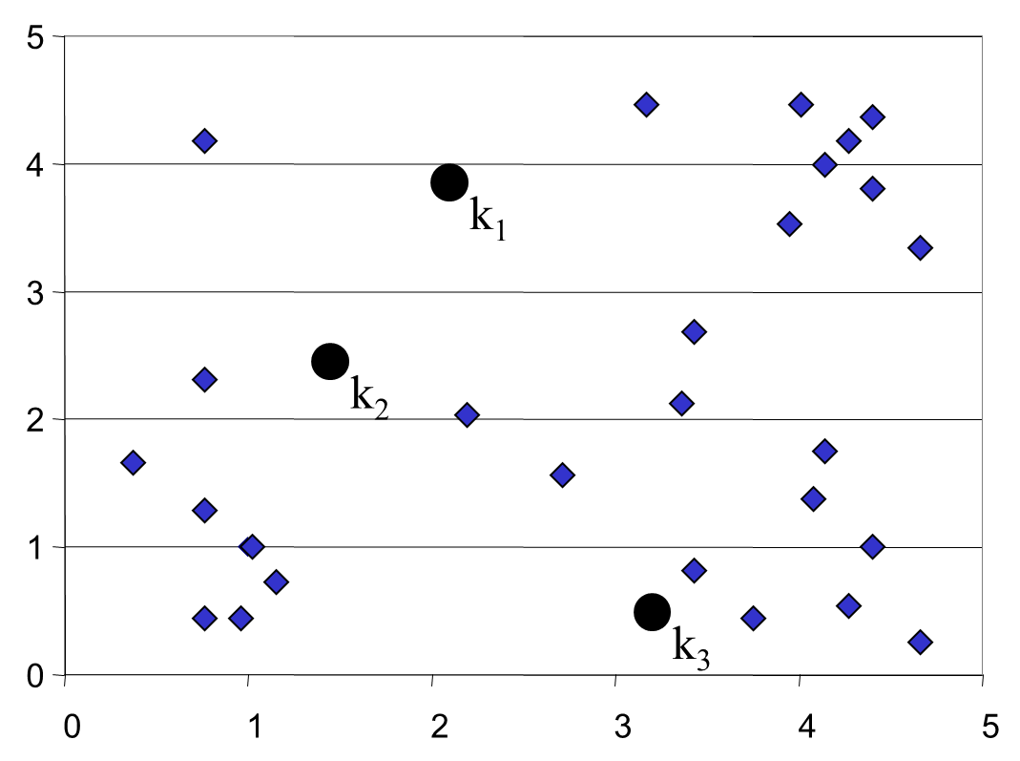
K-Means
An iterative clustering algorithm:
Decide on a value for k.
Initialize the k cluster centers (randomly, if necessary).
Decide the class memberships of the N objects by assigning them to the nearest cluster center.
Re-estimate the k cluster centers, by assuming the memberships found above are correct.
If none of the N objects changed membership in the last iteration, exit. Otherwise goto 3.
Algorithm: k-means, Distance Metric: Euclidean Distance

Slide 15
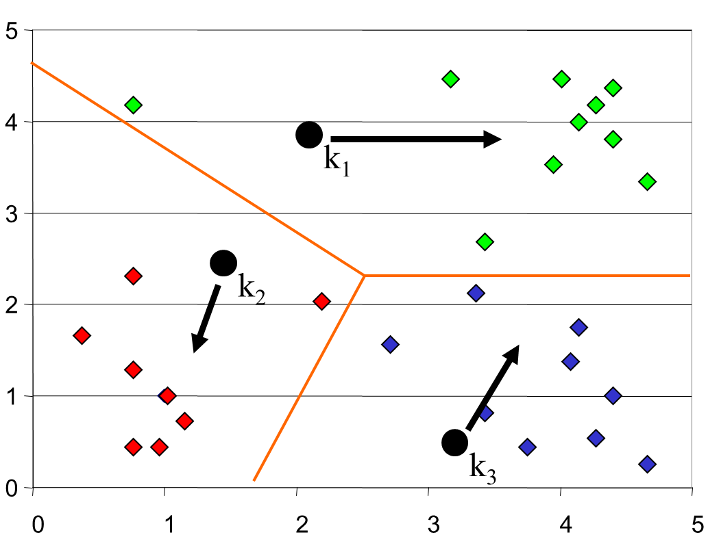
K-Means
An iterative clustering algorithm:
Decide on a value for k.
Initialize the k cluster centers (randomly, if necessary).
Decide the class memberships of the N objects by assigning them to the nearest cluster center.
Re-estimate the k cluster centers, by assuming the memberships found above are correct.
If none of the N objects changed membership in the last iteration, exit. Otherwise goto 3.
Algorithm: k-means, Distance Metric: Euclidean Distance

Slide 16
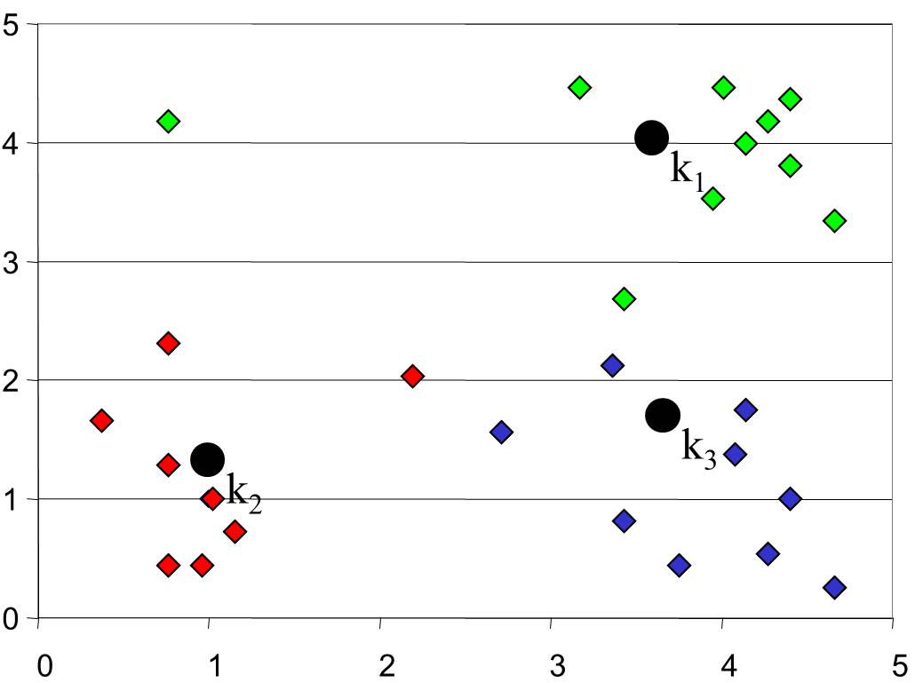
K-Means
An iterative clustering algorithm:
Decide on a value for k.
Initialize the k cluster centers (randomly, if necessary).
Decide the class memberships of the N objects by assigning them to the nearest cluster center.
Re-estimate the k cluster centers, by assuming the memberships found above are correct.
If none of the N objects changed membership in the last iteration, exit. Otherwise goto 3.
Algorithm: k-means, Distance Metric: Euclidean Distance

Slide 17
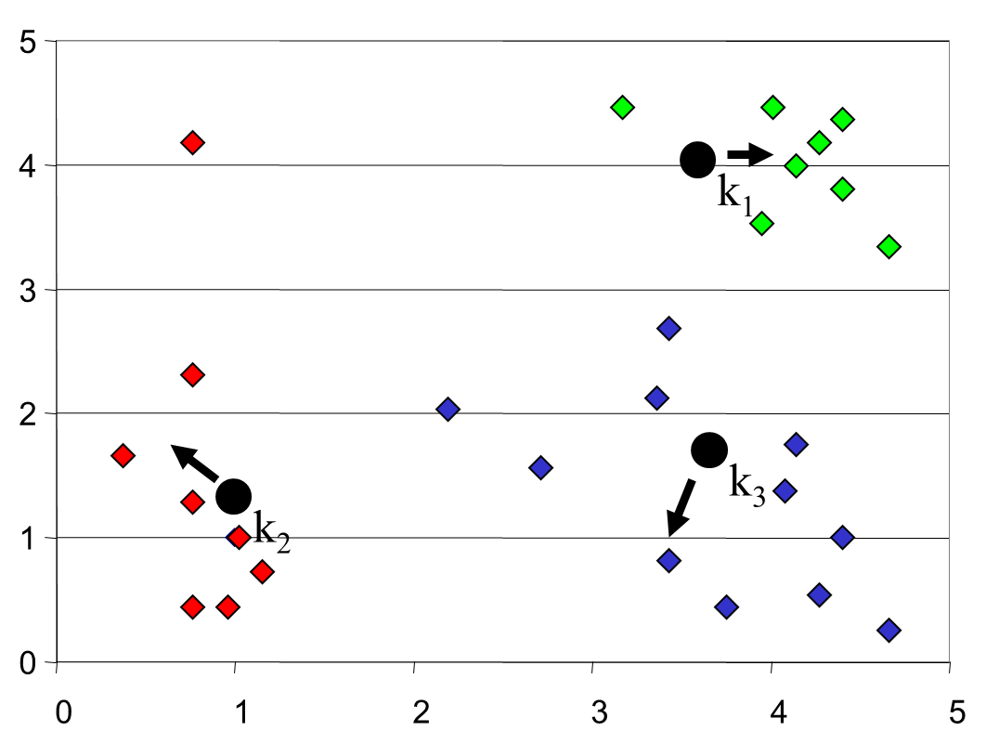
K-Means
An iterative clustering algorithm:
Decide on a value for k.
Initialize the k cluster centers (randomly, if necessary).
Decide the class memberships of the N objects by assigning them to the nearest cluster center.
Re-estimate the k cluster centers, by assuming the memberships found above are correct.
If none of the N objects changed membership in the last iteration, exit. Otherwise goto 3.
Algorithm: k-means, Distance Metric: Euclidean Distance

Slide 18
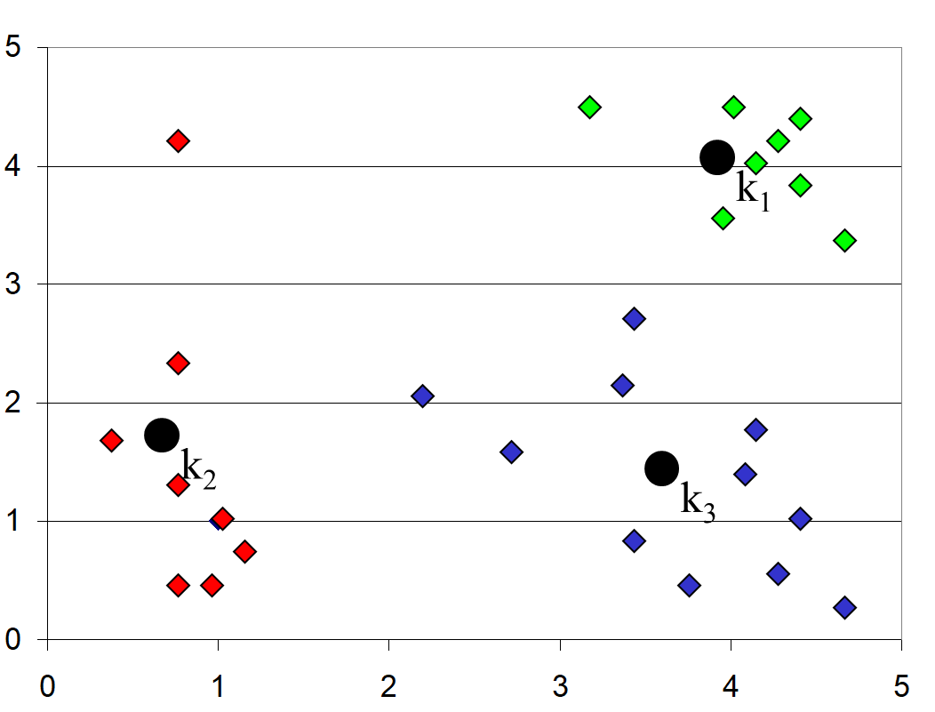
K-Means
An iterative clustering algorithm:
Decide on a value for k.
Initialize the k cluster centers (randomly, if necessary).
Decide the class memberships of the N objects by assigning them to the nearest cluster center.
Re-estimate the k cluster centers, by assuming the memberships found above are correct.
If none of the N objects changed membership in the last iteration, exit. Otherwise goto 3.
Algorithm: k-means, Distance Metric: Euclidean Distance

Slide 19
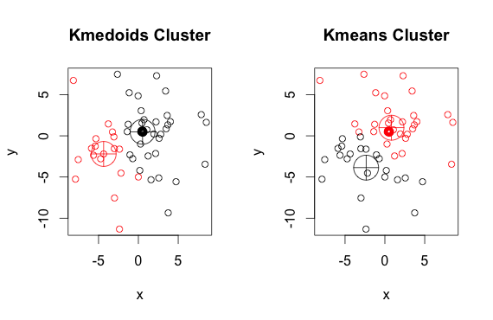
The K-Medoids Clustering Method

Slide 20
The K-Medoids Clustering Method
Find representative objects, called medoids, in clusters.
PAM (Partitioning Around Medoids, 1987)
starts from an initial set of medoids and iteratively replaces one of the medoids by one of the non-medoids if it improves the total distance of the resulting clustering
PAM works effectively for small data sets, but does not scale well for large data sets

Slide 21
How can we tell the right number of clusters?
In general, this is a unsolved problem. However there are many approximate methods. In the next few slides we will see an example.

Slide 22
Right number of K
10
9
For our example, we will use a dataset with 2 classes - class A /class B
However, in this case we are imagining that we do NOT know the class labels. We are only clustering on the X and Y axis values.
8
7
6
5
4
3
2
1
1
2
3
4
5
6
7
8
9
10

Slide 23
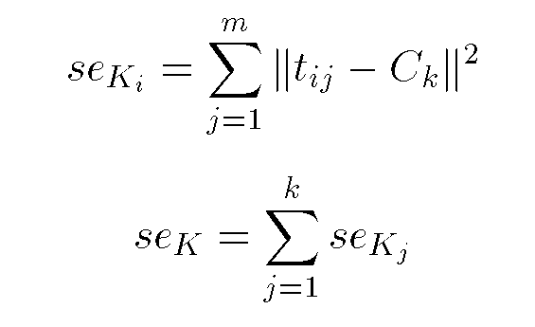
Objective Function
10
9
8
7
6
5
4
3
2
1
Squared Error: Objective Function
1
2
3
4
5
6
7
8
9
10

Slide 24
Right number of K
When k = 1, the objective function is 873.0
1
2
3
4
5
6
7
8
9
10

Slide 25
Right number of K
When k = 2, the objective function is 173.1
1
2
3
4
5
6
7
8
9
10

Slide 26
Right number of K
When k = 3, the objective function is 133.6
1
2
3
4
5
6
7
8
9
10

Slide 27
Right number of K
We can plot the objective function values for k equals 1 to 6…
The abrupt change at k = 2, is highly suggestive of two clusters in the data. This technique for determining the number of clusters is known as “knee finding” or “elbow finding”.
1.00E+03
9.00E+02
8.00E+02
7.00E+02
6.00E+02
Objective Function
5.00E+02
4.00E+02
3.00E+02
2.00E+02
1.00E+02
0.00E+00
k
1
2
3
4
5
6
Note that the results are not always as clear cut as in this toy example

Slide 28
Coding Example and Coding Exercise

