Slide 1
Foundations of Data Science & Analytics DSCI 633
Lecture 19
Nidhi Rastogi
Assistant Professor, GCCIS, RIT

Slide 2
Training Deep Neural Networks - 2

Slide 3
Topics Covered
Vanishing/Exploding Gradients
Glorot and He Initialization
Nonsaturating Activation Functions
Batch Normalization
Reusing Pretrained Layers
Transfer Learning w. Keras
Unsupervised Pretraining
Pretraining on an auxiliary Task
Faster Optimization
Avoiding Overfitting Through Regularization
l1 and l2 Regularization
Dropout
Monte-Carlo (MC) Dropout
Max-Norm Regularization

Slide 4
Topics Covered today
Vanishing/Exploding Gradients
Glorot and He Initialization
Nonsaturating Activation Functions
Batch Normalization
Reusing Pretrained Layers
Transfer Learning w. Keras
Unsupervised Pretraining
Pretraining on an auxiliary Task
Faster Optimization
Avoiding Overfitting Through Regularization
l1 and l2 Regularization
Dropout
Monte-Carlo (MC) Dropout (self-study)
Max-Norm Regularization (self-study)

Slide 5
Topics Covered today
Vanishing/Exploding Gradients
Glorot and He Initialization
Nonsaturating Activation Functions
Batch Normalization
Reusing Pretrained Layers
Transfer Learning w. Keras
Unsupervised Pretraining
Pretraining on an auxiliary Task
Faster Optimization
Avoiding Overfitting Through Regularization
l1 and l2 Regularization
Dropout
Monte-Carlo (MC) Dropout (self-study)
Max-Norm Regularization (self-study)

Slide 6
Unsupervised Pretraining
Supervised Pretraining – Use a model pretrained on similar task
Unsupervised
You do not have much labeled training data
You cannot find a model trained on a similar task.

Slide 7
Unsupervised Pretraining
Getting unlabeled data is cheap, labeling them is quite expensive.
What can you do?

Slide 8
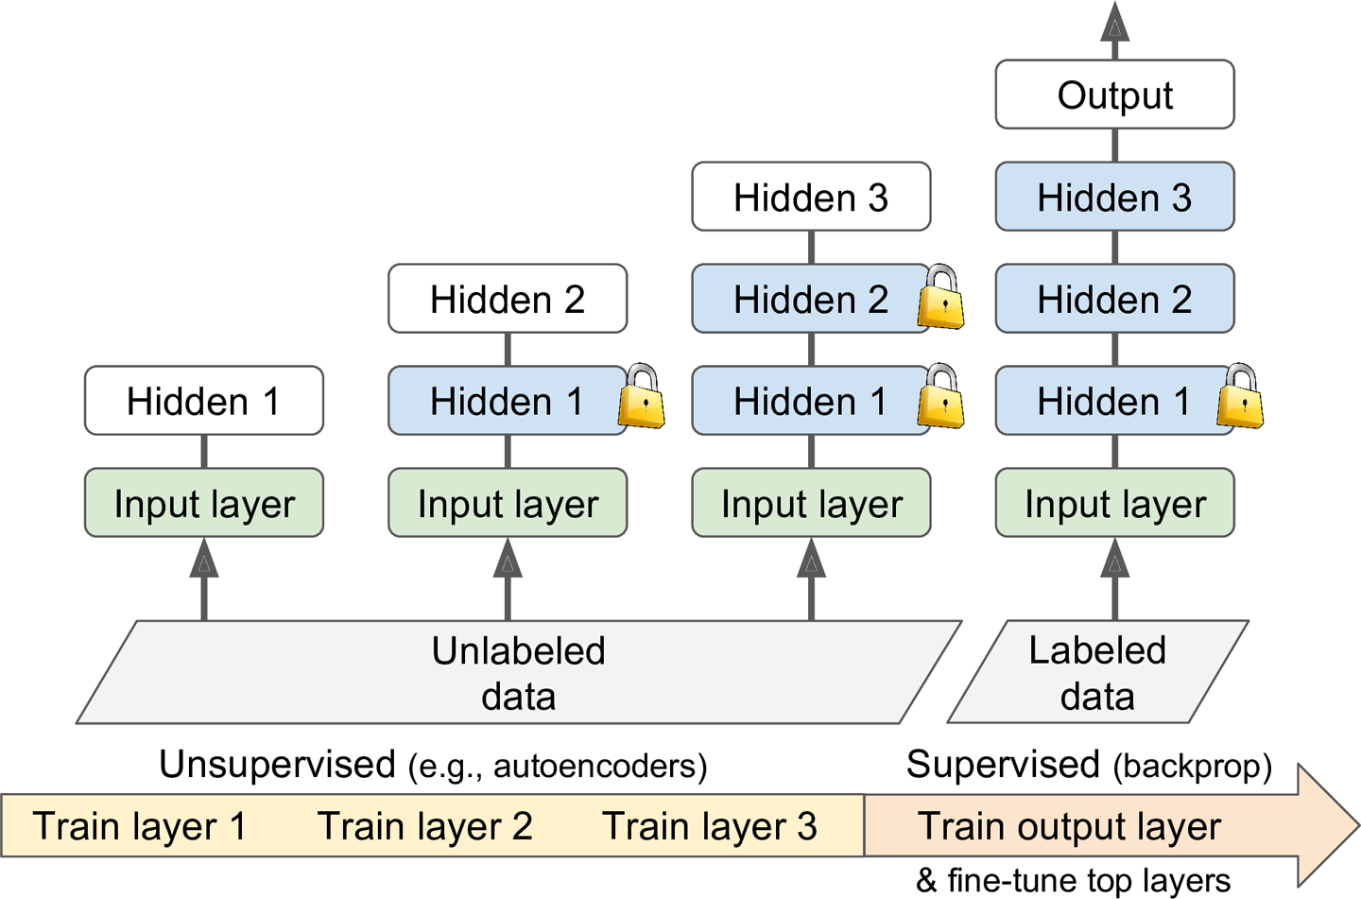
Unsupervised Pretraining
Use Unsupervised feature detector: Train layers one by one, starting with the lowest layer and then going up, using an unsupervised feature detector algorithm such as Restricted Boltzmann Machines or autoencoders.
Each layer is trained on output of previously trained layers
Keep all layers except the one being trained frozen
Once all layers have been trained this way, you can add output layer for your task, and fine-tune the final network using supervised learning (i.e., with the labeled training examples).
Unfreeze all pretrained layers, or just some of the upper ones.
Notes:
RBMs are generative stochastic artificial neural network that can learn a probability distribution over its set of inputs
Autoencoders: An autoencoder is a type of artificial neural network used to learn efficient codings of unlabeled data (unsupervised learning).^{[1]} The encoding is validated and refined by attempting to regenerate the input from the encoding. The autoencoder learns a representation (encoding) for a set of data, typically for dimensionality reduction, by training the network to ignore insignificant data (“noise”)
(src wiki)

Slide 9
Unsupervised Pretraining – a good option
Long and tedious process, but it often works well
Technique used by Geoffrey Hinton and his team in 2006
One of the reasons behind revival of neural networks and the success of Deep Learning.
NOTE: Until 2010, unsupervised pretraining was the norm for deep nets, and it was only after the vanishing gradients problem was alleviated that it became much more common to train DNNs purely using supervised learning.
Autoencoders most common way for unsupervised learning

Slide 10
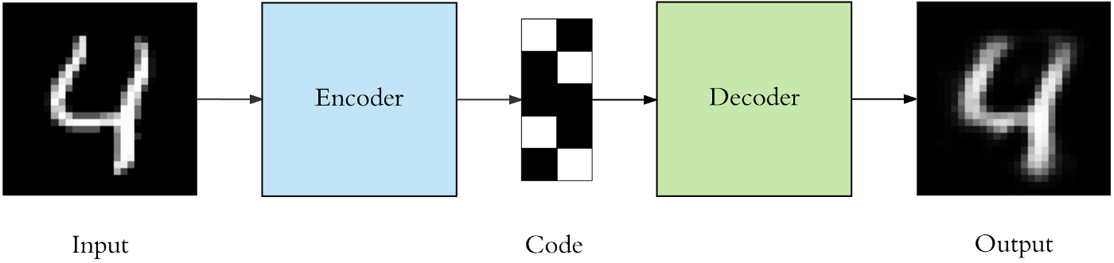
Autoencoders (review)
Specific type of feedforward neural networks
input same output
compress input into a lower-dimensional code and then reconstruct output from this representation.
code is a compact “summary” or “compression” of input, also called the latent-space representation.
https://towardsdatascience.com/applied-deep-learning-part-3-autoencoders-1c083af4d798
https://stats.stackexchange.com/questions/442352/what-is-a-latent-space

Slide 11
Topics Covered today
Vanishing/Exploding Gradients
Glorot and He Initialization
Nonsaturating Activation Functions
Batch Normalization
Reusing Pretrained Layers
Transfer Learning w. Keras
Unsupervised Pretraining
Pretraining on an auxiliary Task
Faster Optimization
Avoiding Overfitting Through Regularization
l1 and l2 Regularization
Dropout
Monte-Carlo (MC) Dropout (self-study)
Max-Norm Regularization (self-study)

Slide 12
Pretraining on an Auxiliary Task
Algorithm: Training a first neural network on an auxiliary task for which you can easily obtain or generate labeled training data, then reuse the lower layers of that network for your actual task. The first neural network’s lower layers will learn feature detectors that will likely be reusable by the second neural network.

Slide 13
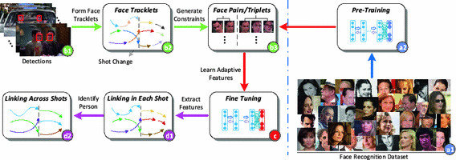
Pretraining on an Auxiliary Task
Application in Image detection
Example, if you want to build a system to recognize faces, you may only have a few pictures of each individual—clearly not enough to train a good classifier. Gathering hundreds of pictures of each person would not be practical. However, you could gather a lot of pictures of random people on the web and train a first neural network to detect whether or not two different pictures feature the same person. Such a network would learn good feature detectors for faces, so reusing its lower layers would allow you to train a good face classifier using little training data.

Slide 14
Pretraining on an Auxiliary Task
Application in natural language processing (NLP)
Download millions of text documents and automatically generate labeled data from it. For example, you could randomly mask out some words and train a model to predict what the missing words are (e.g., it should predict that the missing word in the sentence “What ___ you saying?” is probably “are” or “were”). If you can train a model to reach good performance on this task, then it will already know quite a lot about language, and you can certainly reuse it for your actual task, and fine-tune it on your labeled data.

Slide 15
Topics Covered today
Vanishing/Exploding Gradients
Glorot and He Initialization
Nonsaturating Activation Functions
Batch Normalization
Reusing Pretrained Layers
Transfer Learning w. Keras
Unsupervised Pretraining
Pretraining on an auxiliary Task
Faster Optimization
Avoiding Overfitting Through Regularization
l1 and l2 Regularization
Dropout
Monte-Carlo (MC) Dropout (self-study)
Max-Norm Regularization (self-study)

Slide 16
Faster Optimizers
Training DNN can be very slow process.
4 Ways we’ve seen to speed it up:
applying a good initialization strategy for the connection weights
using a good activation function
using Batch Normalization, and reusing parts of a pretrained network (possibly built on an auxiliary task or using unsupervised learning)
Faster optimizers
Faster Optimizers are Faster than regular GD optimizer

Slide 17
Faster Optimizers
Optimizers define the change in weights or learning rates of your neural network to reduce the losses

Slide 18
Faster Optimizers
Faster than regular GD optimizer
Different Types:
Momentum optimization
Nesterov Accelerated Gradient
AdaGrad
RMSProp
Adam and Nadam optimization.

Slide 19
Gradient Descent (review)
Most basic but most used optimization algorithm
Used heavily in linear regression and classification algorithms.
Backpropagation in neural networks also uses a gradient descent algorithm
First-order optimization algorithm which is dependent on the first order derivative of a loss function
Calculates which way the weights should be altered so that function can reach a minima
Through backpropagation, the loss is transferred from one layer to another and the model’s parameters also known as weights are modified depending on the losses so that the loss can be minimized.
GD Algorithm: θ=θ−α⋅∇J(θ)

Slide 20
Variations of Gradient Descent (review)
algorithm: θ=θ−α⋅∇J(θ)
SGD: θ=θ−α⋅∇J(θ;x(i);y(i)) ,
where {x(i) ,y(i)} are the training examples.
Mini-batch GD: θ=θ−α⋅∇J(θ; B(i)),
where {B(i)} are the batches of training examples

Slide 21
Summary on variations of GD (review)
 | Description | Pros | Cons
GD | most basic but most used optimization algorithm | Easy computation. Easy to implement. Easy to understand. | May trap at local minima. Weights are changed after calculating gradient on the whole dataset. So, if the dataset is too large than this may take years to converge to the minima. Requires large memory to calculate gradient on the whole dataset.
SGD | tries to update the model’s parameters more frequently. Model parameters are altered after computation of loss on each training example. | Frequent updates of model parameters hence, converges in less time. Requires less memory as no need to store values of loss functions. May get new minima. | High variance in model parameters. May shoot even after achieving global minima. To get the same convergence as gradient descent needs to slowly reduce the value of learning rate.
Mini-batch | best among all variations of gradient descent algorithms. It is an improvement on both SGD and standard gradient descent | Frequently updates the model parameters and also has less variance. Requires medium amount of memory. | Choosing an optimum value of learning rate. If the learning rate is too small than gradient descent may take ages to converge. Have a constant learning rate for all the parameters. There may be some parameters which we may not want to change at the same rate. May get trapped at local minima.

Slide 22
Momentum optimization
Intuition: Imagine a bowling ball rolling down a gentle slope on a smooth surface: it will start out slowly, but it will quickly pick up momentum until it eventually reaches terminal velocity.
In contrast, regular Gradient Descent will simply take small regular steps down the slope, so it will take much more time to reach the bottom.

Slide 23
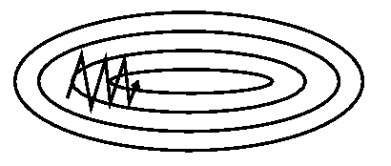
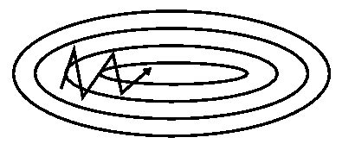
Momentum optimization
Invented for reducing high variance in SGD and softening the convergence.
Accelerates convergence towards relevant direction.
Reduces fluctuation to the irrelevant direction.
One more hyperparameter used - momentum symbolized by ‘γ’.
Now, the weights are updated by θ=θ−V(t).
γ usually set to 0.9 or a similar value.
SGD: θ=θ−α⋅∇J(θ;x(i);y(i)) ,
where {x(i) ,y(i)} are the training examples.
MO: V(t)=γV(t−1)+α.∇J(θ)
SGD without MO
SGD with MO

Slide 24
Momentum optimization
Advantages:
Reduces the oscillations and high variance of the parameters.
Converges faster than gradient descent.
Disadvantages:
One more hyper-parameter is added which needs to be selected manually and accurately.

Slide 25
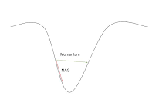
Nesterov Accelerated Gradient
if momentum too high algorithm may miss local minima
may continue to rise up
NAG introduced
is a look ahead method
since using γV(t−1) for modifying weights so, θ−γV(t−1) approximately tells future location
Instead, calculate cost based on future parameter.
V(t)=γV(t−1)+α. ∇J( θ−γV(t−1) )
and then update the parameters using θ=θ−V(t).

Slide 26
Nesterov Accelerated Gradient
Advantages:
Does not miss the local minima.
Slows if minima are occurring.
Disadvantages:
Still, the hyperparameter needs to be selected manually.

Slide 27
Adagrad
Disadvantages of all optimizers - learning rate constant for all parameters and for each cycle
Adagrad changes learning rate - ‘η’ for each parameter and at every time step ‘t’. It’s a type second order optimization algorithm. It works on derivative of an error function.

Slide 28


Adagrad
η modified for given parameter θ(i) at a given time based on previous gradients calculated for given parameter θ(i).
G: Sum of squares of the gradients w.r.t. θ(i) up to time step t are stored
ϵ is a smoothing term that avoids division by zero (usually on the order of 1e−8)
without square root operation, algorithm performs much worse.
It makes big updates for less frequent parameters and a small step for frequent parameters.
A derivative of loss function for
given parameters at a given time t.
Update parameters for given
input i and at time/iteration t

Slide 29
Adagrad
Advantages:
Learning rate changes for each training parameter.
Don’t need to manually tune the learning rate.
Able to train on sparse data.
Disadvantages:
Computationally expensive as a need to calculate the second order derivative.
The learning rate is always decreasing results in slow training.

Slide 30
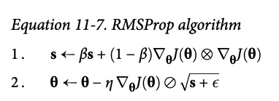
RMSProp
AdaGrad slows down a bit too fast
ends up never converging to global optimum
RMSProp algorithm fixes this
- by accumulating gradients only from most recent iterations
(as opposed to all the gradients since the beginning of training)
- does so by using exponential decay in the first step.
- decay rate β typically set to 0.9.
- Yes, it is once again a new hyperparameter, but this default value often works well, so you may not need to tune it at all.
optimizer = keras.optimizers.RMSprop(lr=0.001, rho=0.9)
NOTE: Except on very simple problems, this optimizer almost always performs much better than AdaGrad. Preferred optimization algorithm until Adam optimization came around.

Slide 31
Adam Optimization
Adam - combines the ideas of Momentum optimization and RMSProp
keeps track of an exponentially decaying average of past gradients (Momentum)
keeps track of an exponentially decaying average of past squared gradients (RMSProp)

Slide 32
Useful rules
Adam is the arguably the best optimizers. If one wants to train the neural network in less time and more efficiently than Adam is the optimizer.
For sparse data use the optimizers with dynamic learning rate.
If you want to use gradient descent algorithm than mini-batch gradient descent is the best option.

Slide 33
Learning Rate Scheduling
Self read from text book – Hands on..

Slide 34
Topics Covered today
Vanishing/Exploding Gradients
Glorot and He Initialization
Nonsaturating Activation Functions
Batch Normalization
Reusing Pretrained Layers
Transfer Learning w. Keras
Unsupervised Pretraining
Pretraining on an auxiliary Task
Faster Optimization
Avoiding Overfitting Through Regularization
l1 and l2 Regularization
Dropout
Monte-Carlo (MC) Dropout
Max-Norm Regularization

Slide 35
Avoiding overfitting through regularization
DNNs typically have tens of thousands of parameters, sometimes even millions.
Network has an incredible amount of freedom and can fit a huge variety of complex datasets.
But this great flexibility also means that it is prone to overfitting the training set.

Slide 36
Addressing overfitting
What is noise, how is it captured in the training data?
What is overfitting?
How do you detect overfitting?
How to alleviate overfitting?
Notes:
1. By noise we mean the data points that don’t really represent the true properties of your data, but random chance. Learning such data points, makes your model more flexible, at the risk of overfitting.
2. overfit model captures unnecessary details, noise, or too specific relationships within a dataset.
3. Overfitting occurs when a model fails to generalize well to the data. Thus, an overfit model is not very stable and it usually behaves unexpectedly. In general, overfitting results in poor performance on previously unseen data. Overfitting is a serious problem in machine learning. We can never trust an overfit model and put it into production. It is full of surprises, but not the ones that make you happy. The predictions might change dramatically even if there are very small changes in the feature values.
There are some strong indicators of overfitting. If there is a substantial amount of difference between the accuracies on the training and test set, we are likely to have an overfit model. Another indicator is getting very different results with different test sets.
4. Cross validation,

Slide 37
We need Regularization!

Slide 38
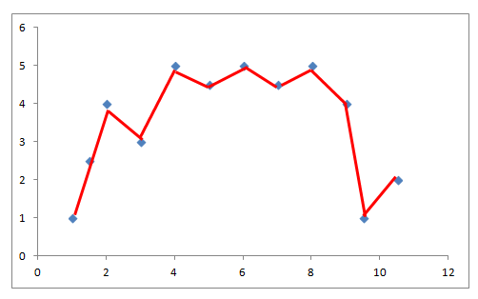
Regularization
If…
a model is too complex w.r.t. data, it likely result in overfitting.
a model tries to capture each and every detail about all data points
it fails to generalize well to the trend in the dataset.
This model is too complex with respect to the data (blue dots). Hence, we have an overfitting problem. We can solve this problem by reducing the complexity of model.
Regularization reduces this model complexity

Slide 39
Regularization
Controls model complexity
by adding a penalty for higher terms.
Normally, model aims to minimize loss according to loss function.
Regularization adds a term so that model minimizes both complexity and loss.

Slide 40
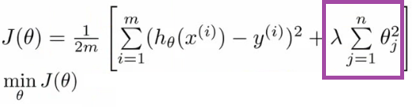
Regularization
Term added

Slide 41
Regularization Techniques
Regularization reduces complexity by using
l1 and l2 technique
Dropout
Max-norm regularization (self study)
But first, how is complexity added?

Slide 42
Complexity in a model
Total number of features
The weights of features

Slide 43
Regularization
Regularization reduces complexity by using
l1 and l2 technique
Dropout
Max-norm regularization (self study)
But first, how is complexity added?

Slide 44

L1 regularization
L1 regularization - handles complexity due to total number of features.
acts like a force that subtracts a small amount from weights at each iteration.
some weights eventually become zero.
also called lasso regularization

Slide 45

L2 regularization
L2 regularization - handles complexity due to magnitude of feature weights.
acts like a force that removes a small percentage from weight at each iteration.
weights decrease but never become zero
Also called ridge regularization

Slide 46

l1 and l2 Regularization
Apply l2 regularization to a Keras layer’s connection weights, using a regularization factor of 0.01

Slide 47
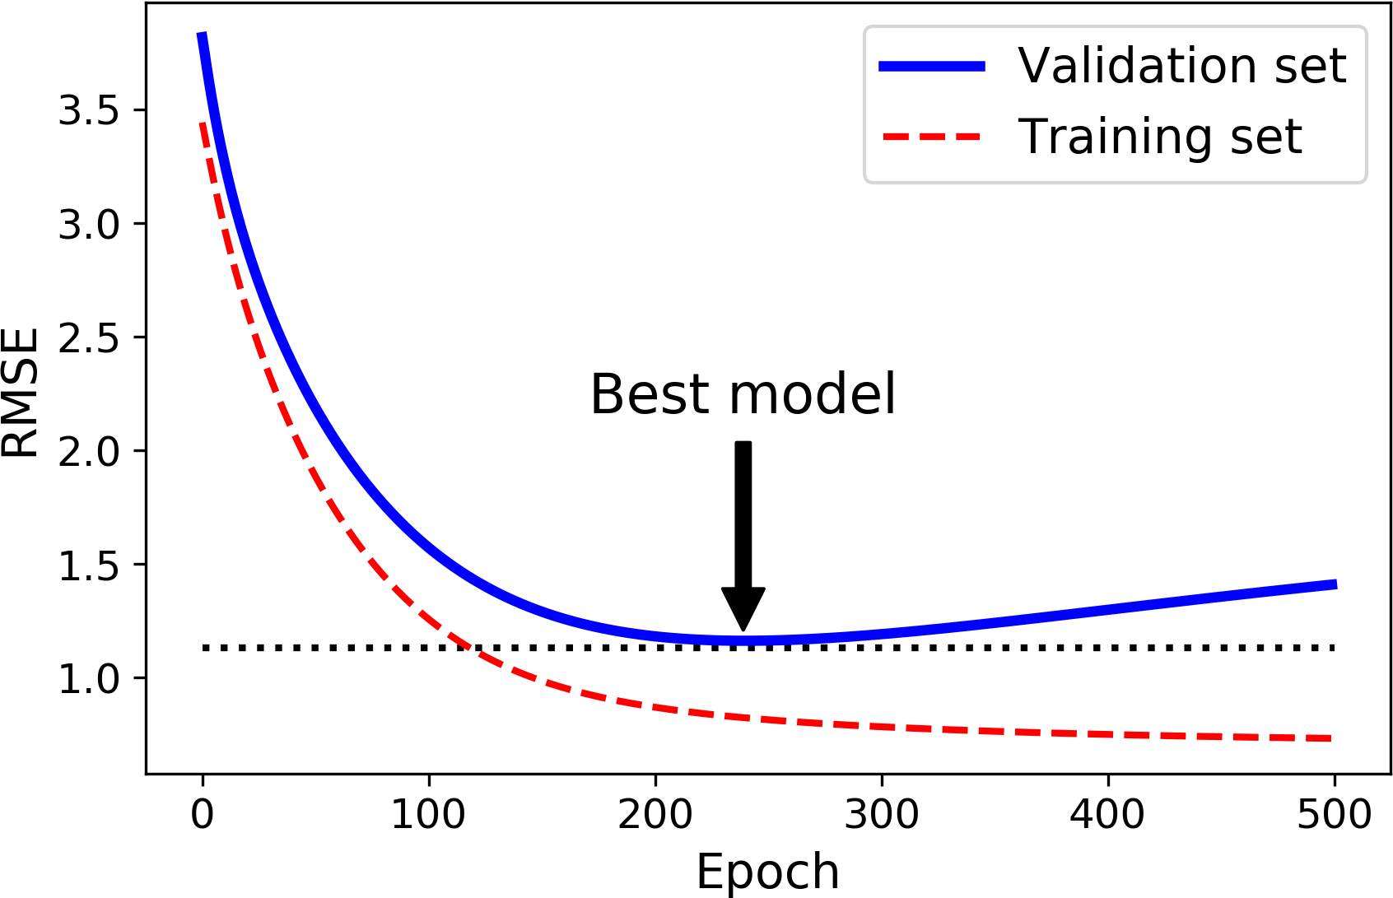
Other methods to minimize model complexity
We can also reduce the model complexity by tuning the hyperparameters. Each algorithm has its own hyperparameters. In case of a random forest model, tree depth has a large impact on the model complexity.
one of the best regularization techniques in Chapter 10: early stopping.
Stop training as soon as validation error reaches a minimum
Early stopping regularization

Slide 48
Other methods to minimize model complexity
Note: With SGD and Mini-batch Gradient Descent, the curves are not so smooth, and it may be hard to know whether you have reached the minimum or not. One solution is to stop only after the validation error has been above the minimum for some time (when you are confident that the model will not do any better), then roll back the model parameters to the point where the validation error was at a minimum.
Early stopping regularization

Slide 49
Regularization
Regularization reduces complexity by using
l1 and l2 technique
Dropout
Max-norm regularization (self study)
But first, how is complexity added?

Slide 50
Dropout Regularization
Proposed* by Geoffrey Hinton in 2012
highly successful, even the state-of- the-art neural networks (95% accuracy) got a 1–2% accuracy boost simply by adding dropout
what this means -> getting a 2% accuracy boost means dropping the error rate by almost 40% (going from 5% error to roughly 3%).
* Improving neural networks by preventing co-adaptation of feature detectors by G. Hinton et al. (2012).

Slide 51
Dropout - Intuition
Real world Analogy - Would a company perform better if its employees were told to toss a coin every morning to decide whether or not to go to work? Well, who knows; perhaps it would! The company would obviously be forced to adapt its organization; it could not rely on any single person to fill in the coffee machine or perform any other critical tasks, so this expertise would have to be spread across several people. Employees would have to learn to cooperate with many of their coworkers, not just a handful of them. The company would become much more resilient. If one person quit, it wouldn’t make much of a difference. It’s unclear whether this idea would actually work for companies, but it certainly does for neural networks.
NN - Neurons trained with dropout cannot co-adapt with their neighboring neurons; they have to be as useful as possible on their own. They also cannot rely excessively on just a few input neurons; they must pay attention to each of their input neurons. They end up being less sensitive to slight changes in the inputs. In the end you get a more robust network that generalizes better.

Slide 52
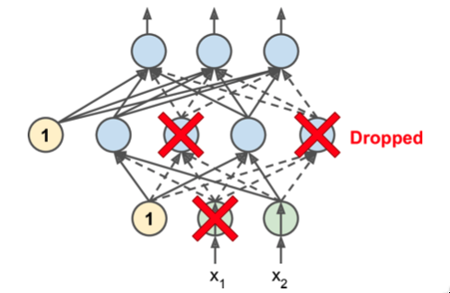
Dropout - Algorithm
at every training step, every neuron (including input neurons, always excluding output neurons) has a probability p of being temporarily “dropped out”,
dropped neuron entirely ignored during this training step
it may be active during next training step
hyperparameter p
called dropout rate
typically set to 50%.
after training, neurons don’t get dropped
anymore.

Slide 53
Power of dropout
Another way to understand the power of dropout is to realize that a unique neural network is generated at each training step. Since each neuron can be either present or absent, there is a total of 2N possible networks (where N is the total number of droppable neurons). This is such a huge number that it is virtually impossible for the same neural network to be sampled twice. Once you have run a 10,000 training steps, you have essentially trained 10,000 different neural networks (each with just one training instance). These neural networks are obviously not independent since they share many of their weights, but they are nevertheless all different. The resulting neural network can be seen as an averaging ensemble of all these smaller neural networks.
There is one small but important technical detail. Suppose p = 50%, in which case during testing a neuron will be connected to twice as many input neurons as it was (on average) during training. To compensate for this fact, we need to multiply each neuron’s input connection weights by 0.5 after training. If we don’t, each neuron will get a total input signal roughly twice as large as what the network was trained on, and it is unlikely to perform well. More generally, we need to multiply each input connection weight by the keep probability (1 – p) after training. Alternatively, we can divide each neuron’s output by the keep probability during training (these alternatives are not perfectly equivalent, but they work equally well).

Slide 54
Power of dropout
If you observe that the model is overfitting, you can increase the dropout rate. Conversely, you should try decreasing the dropout rate if the model underfits the training set. It can also help to increase the dropout rate for large layers, and reduce it for small ones. Moreover, many state-of-the-art architectures only use dropout after the last hidden layer, so you may want to try this if full dropout is too strong.
Dropout does tend to significantly slow down convergence, but it usually results in a much better model when tuned properly. So, it is generally well worth the extra time and effort.

Slide 55
Coding Exercise

Slide 56
Attributions
Some of these slides are based on material from Hands-On Machine Learning, 2nd Edition, some search on Internet...
Coding exercise are from the text book and from Kaggle

