Slide 1
Foundations of Data Science & Analytics DSCI 633
Lecture 6
Nidhi Rastogi
Assistant Professor, GCCIS, RIT

Slide 2
This Lecture
An end-to-end machine learning model pipeline
Classification, Clustering, Anomaly detection, …
Performance Measures
Error Analysis
Training Models – Linear
Linear Regression
Gradient Descent
Polynomial Regression
Regularized Linear Models
Logistic Regression

Slide 3
Pre - Decision Tree
Previous models have consisted of real-valued feature vectors (or discrete-valued) and natural measures of distance (e.g., MSE, RMSE).
Now, consider a classification problem that involves nominal data – data described by a list of attributes (e.g., categorizing people as short or tall using gender, height, age, and ethnicity).
How can we use such nominal data for classification? How can we learn the categories of such data?
Non-metric methods such as decision trees provide a way to deal with such data.

Slide 4
Decision Trees
Decision trees attempt to classify a pattern through a sequence of questions.
For example, attributes such as gender and height can be used to classify people as short or tall. But the best threshold for height is gender dependent.

Slide 5
Why use Trees
Yields relatively simple and easy to comprehend models
Method can sift through any number of variables
Picture of the tree gives valuable insights into which variables are important and where.
Can separate relevant from irrelevant predictors
Universally applicable to both classification and regression problems with no assumptions on the data structure.
Have several benefits over neural network-type approaches, including interpretability and data-driven learning.

Slide 6
Types of Decision Trees
Classification Tree: When Y (outcome) is binary/unordered categorical, you want to assign each subject to a class.
- Error assessment through misclassification cost.
Regression Tree: Y is continuous or ordered discrete values.
- Prediction error measured by squared or relative absolute difference between observed and predicted values (MSE, RMSE..)

Slide 7
Types of Decision Trees
Classification Tree: When Y (outcome) is binary/unordered categorical, you want to assign each subject to a class.
- Error assessment through misclassification cost.

Slide 8
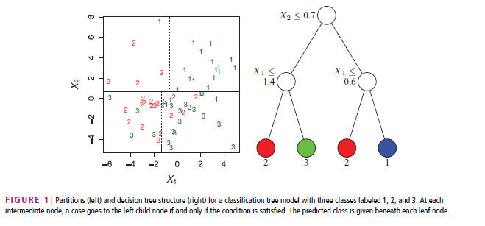
Classification Tree
3 class labels – 1(blue), 2 (red), and 3(green), two predictors (X₁,X₂), partition X space (feature space) into rectangular sets.
Types of nodes:
Root node
Intermediate node
Child node
Question enters at Root note
At each intermediate node, question goes to left or right node depending on the condition that is satisfied.
Predicted class given beneath each leaf node.
Root
Intermediate
Child

Slide 9
Example Decision Tree
Leaves – denote classes (1,2,3) are the outputs of the tree. Final classification
Input data consists of values of different attributes.
Using these attribute values, decision tree generates a class as the output for each input data.
Binary trees, like the one shown, are the most popular type of tree.
Nodes can contain one more question. In a binary tree, by convention, if the answer to a question is “yes,” the left branch is selected.
Note: same question can appear in multiple places in the tree.

Slide 10
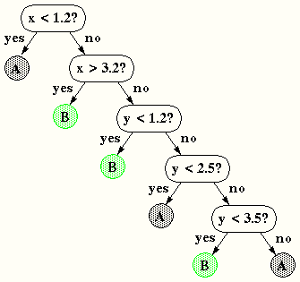
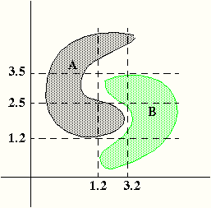
Non-linear Decision Surface
Decision trees can produce nonlinear decision surfaces:
Alternative to other classifiers we have studied because they are data-driven and can give arbitrarily high levels of precision on the training data.
But… generalization becomes a challenge.

Slide 11
Specific Example of Decision Tree

Slide 12
Decision Tree
A possible Decision tree for the data
House has <=5 bedrooms
Y
N
Lot size <= 8500sqft.
Lot size <= 12000sqft
Y
N
Y
N
Predicted price: $140,000
Predicted price: 180,000
Predicted price: 170,000
Predicted price: 230,000

Slide 13
Decision Tree – training data
ID | house_median Age (yrs) | Total_rooms | Total_bedrooms | Ocean_proximity | Median House Value
1 | 60 | 8 | 5 | Near bay | 180k
2 | 40 | 9 | 6 | Near ocean | 250k
3 | 65 | 9 | 6 | Near bay | 170k
4 | 83 | 6 | 4 | Inland | 140k
 | x1 | x2 | x3 | x4 | Label
X
Y

Slide 14
Decision Tree – training data
ID | house_median Age (yrs) | Total_rooms | Total_bedrooms | Ocean_proximity | Median House Value
1 | 60 | 8 | 5 | Near bay | 180k
2 | 40 | 9 | 6 | Near ocean | 250k
3 | 65 | 9 | 6 | Near bay | 170k
4 | 83 | 6 | 4 | Inland | 140k
House has <=5 bedrooms
Y
N
Lot size <= 8500sqft.
Lot size <= 12000sqft
Y
N
Y
N
Predicted price: $140,000
Predicted price: 180,000
Predicted price: 170,000
Predicted price: 230,000

Slide 15
Decision Tree – training data
ID | house_median Age (yrs) | Total_rooms | Total_bedrooms | Ocean_proximity | Median House Value
1 | 60 | 8 | 5 | Near bay | 180k
2 | 40 | 9 | 6 | Near ocean | 250k
3 | 65 | 9 | 6 | Near bay | 170k
4 | 83 | 6 | 4 | Inland | 140k
House median age < 45
Y
N
Predicted price: $140,000
Is it next to Bay?
Y
N
Predicted price: $140,000
Is it next to Ocean?
Same training data, Different Decision Tree
N
Y
Predicted price: 170,000
Predicted price: 230,000

Slide 16
Decision Tree – training data
ID | house_median Age (yrs) | Total_rooms | Total_bedrooms | Ocean_proximity | Median House Value
1 | 60 | 8 | 5 | Near bay | 180k
2 | 40 | 9 | 6 | Near ocean | 250k
3 | 65 | 9 | 6 | Near bay | 170k
4 | 83 | 6 | 4 | Inland | 140k
dTypes | continuous | continuous | continuous | categorical | prediction

Slide 17
Decision Tree – training data
ID | house_median Age (yrs) | Total_rooms | Total_bedrooms | Ocean_proximity | Median House Value
1 | 60 | 8 | 5 | Near bay | 180k
2 | 40 | 9 | 6 | Near ocean | 250k
3 | 65 | 9 | 6 | Near bay | 170k
4 | 83 | 6 | 4 | Inland | 140k
 | numerical | numerical | numerical | categorical | prediction
Decision Trees can handle both numerical and categorical data

Slide 18
Decision Tree – test data
ID | house_median Age (yrs) | Total_rooms | Total_bedrooms | Ocean_proximity | Median House Value
5 | 65 | 8 | 6 | Near Ocean | ???

Slide 19
Decision Tree – Test data
ID | house_median Age (yrs) | Total_rooms | Total_bedrooms | Ocean_proximity | Median House Value
5 | 65 | 8 | 6 | Near Ocean | ???
House has <=5 bedrooms
Start here (depth = 0)
True!
Y
N
Check this variable
(depth = 1)
Lot size <= 8500sqft.
Lot size <= 12000sqft
True!
Y
N
Y
N
Assign median house value
Predicted price: $140,000
Predicted price: 180,000
Predicted price: 170,000
Predicted price: 230,000

Slide 20
Decision Tree – Deeper Dive
Fundamental component of Random Forests (covered in later lectures)
Can use one of the following algorithms to build the decision tree:
Hunt’s algorithm
CART
ID3, C4.5
SLIQ, SPRINT

Slide 21
Decision Tree – Deeper Dive
Fundamental component of Random Forests (covered in later lectures)
Can use one of the following algorithms to build the decision tree:
Hunt’s algorithm
CART
ID3, C4.5
SLIQ, SPRINT

Slide 22
CART Algorithm
Classification and Regression Tree (CART) algorithm
Produces only binary trees: non-leaf nodes always have two children
(i.e., questions only have yes/no answers)
Note:
ID3 can produce Decision Trees with nodes that have more than two children
To read more about other algorithms, refer to : https://scikit-learn.org/stable/modules/tree.html#tree-algorithms-id3-c4-5-c5-0-and-cart

Slide 23
CART Algorithm - Intuition
d1
d0
d0, d1 are decision boundaries

Slide 24
CART – Basic Algorithm Requirements
For top-down learning of Decision Trees
Consider a set labeled training data and a set of features.
How do we organize the tree to produce the lowest classification error?
Any decision tree will successively split data into smaller subsets.
Ideal if all samples associated with a leaf node from small class
Such a subset, or node, is considered pure in this case.
CART - successively splits nodes until they are pure.

Slide 25
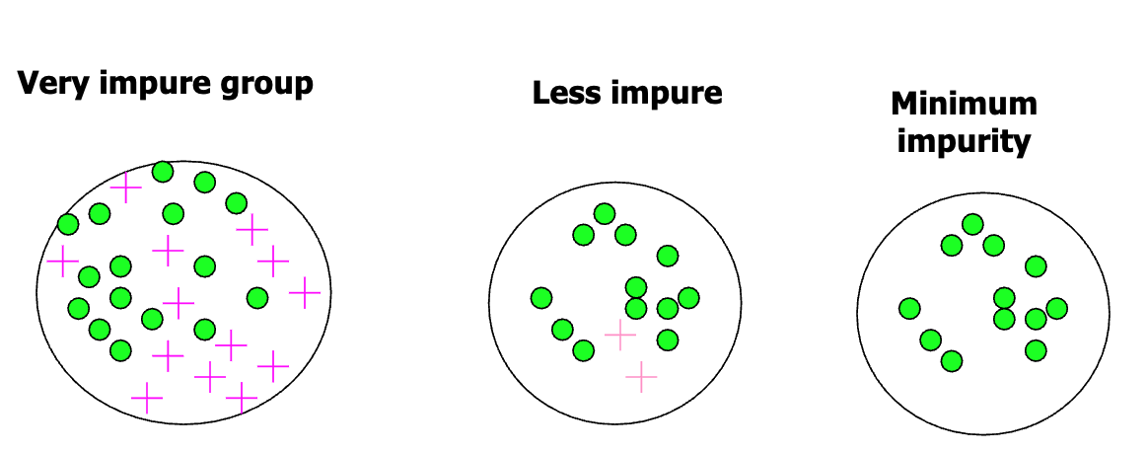
Pure Nodes
In Classification
all the data samples at that node belong to a single class
E.g., a decision tree to classify fruits as either apple or banana based on features like weight and color, a pure node might be one where every sample is an apple.
quantified using metrics like Gini impurity (will study later)

Slide 26
Pure Nodes
In Regression
when variance of the target variable values at that node is very low or zero.
samples at a node have almost the same target value, then further splitting doesn't provide much additional information. quantified using metrics like Gini impurity

Slide 27
Significance of Pure Nodes
Often the objective of the splitting criterion.
Decision trees will continue splitting nodes until a certain purity level is achieved or until other stopping criteria are met (e.g., maximum depth of tree).

Slide 28
CART – Basic Algorithm
node= root of decision tree
Main loop:
A ← the “best” decision attribute for the next node.
Assign A as decision attribute for node.
For each value of A, create a new descendant of node.
Sort training examples to leaf nodes.
If training examples are perfectly classified, stop.
Else, recurse over new leaf nodes

Slide 29
Start with the entire dataset.
Check for stopping criteria:
For Classification: If all data points in the dataset belong to the same class, STOP
For Regression: If the variance of the data points is below a threshold (for regression), STOP.
If other stopping criteria, such as maximum depth, are met, STOP.
For each feature:
a. Sort the data points based on the feature values.
b. For every unique value of the feature, try splitting the data into two subsets:
One where the feature value is below or equal to the split point.
One where the feature value is above the split point.
c. Compute the splitting criterion for each possible split:
For Classification: Gini impurity or information gain (entropy).
For Regression: Variance reduction or MSE.
d. Select the split that provides the maximum improvement in the splitting criterion.
4. Choose the best split from all features:
Select the feature and split point that provide the maximum improvement in the splitting criterion.
5. Partition the dataset:
Split the dataset into two subsets based on the selected feature and split point from step 4.
6. Recursively apply the algorithm:
Apply the CART algorithm recursively to the two subsets obtained in step 5.
7. Tree Pruning (Post-processing):
After constructing the tree, prune branches that have little importance or might cause overfitting. This is often done using a validation dataset and a cost-complexity algorithm.
CART Algorithm in detail

Slide 30
How do we choose which attribute is best?

Slide 31
How do we choose which attribute is best?
Key problem: choosing which attribute to split
Some possibilities are:
Random: Select any attribute at random
Least-Values: Choose attribute with smallest number of possible values
Most-Values: Choose attribute with largest number of possible values
Max-Gain: Choose attribute that has largest expected information gain
i.e., attribute that results in smallest expected size of subtrees rooted at its children
Based on slide by Pedro Domingos
Notes:
Occam's razor, Ockham's razor, Ocham's razor, or the principle of parsimony or law of parsimony is the problem-solving principle that entities should not be multiplied beyond necessity, sometimes inaccurately paraphrased as the simplest explanation is usually the best one

Slide 32
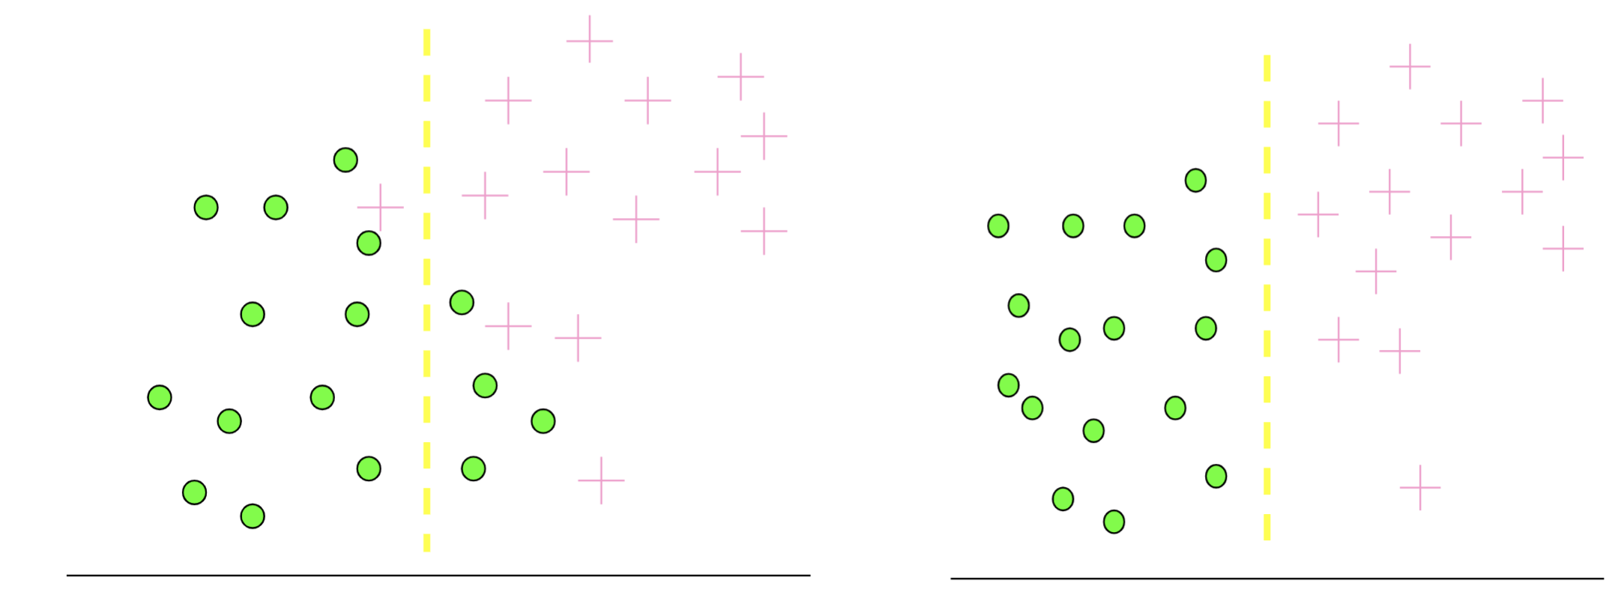
Information Gain (intuition)
Which test is more informative?
Split over whether #room <=5
Split over whether house age <=45 years
#room <=5 #room >5 house age<=45 house age>45
Based on slide by Pedro Domingos
Notes:
Occam's razor, Ockham's razor, Ocham's razor, or the principle of parsimony or law of parsimony is the problem-solving principle that entities should not be multiplied beyond necessity, sometimes inaccurately paraphrased as the simplest explanation is usually the best one

Slide 33
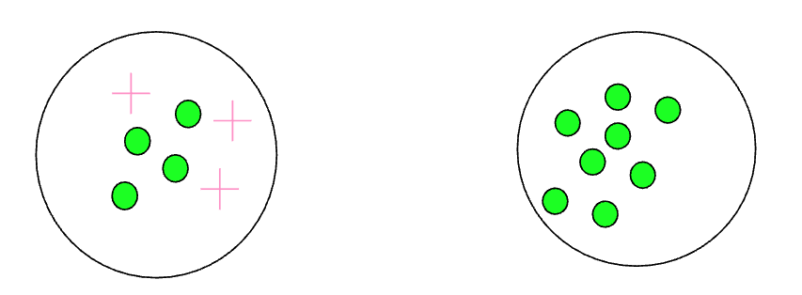
Information Gain (intuition)
Measures the level of impurity in a group of examples
Based on slide by Pedro Domingos
Notes:
Occam's razor, Ockham's razor, Ocham's razor, or the principle of parsimony or law of parsimony is the problem-solving principle that entities should not be multiplied beyond necessity, sometimes inaccurately paraphrased as the simplest explanation is usually the best one

Slide 34
Information Gain (intuition)
You have a mixed bag of red and green balls, and you want to separate them using various criteria like size, texture, or weight.
Information gain will quantify the effectiveness of each criterion in achieving this separation.
The criterion that provides the highest IG would be the most effective.
Based on slide by Pedro Domingos
Notes:
Occam's razor, Ockham's razor, Ocham's razor, or the principle of parsimony or law of parsimony is the problem-solving principle that entities should not be multiplied beyond necessity, sometimes inaccurately paraphrased as the simplest explanation is usually the best one

Slide 35
Information Gain
IG quantifies how well a feature separates the data into classes.
Definition: IG is the expected reduction in entropy of target variable Y for data sample S, due to sorting.
A reduction of entropy is often called an information gain.
We want to determine which attribute in a given set of training feature vectors is most useful for discriminating between the classes to be learned.
Information gain tells us how important a given attribute of the feature vectors is.
We will use it to decide the ordering of attributes in the nodes of a decision tree
Based on slide by Pedro Domingos, Sli
Notes:
Occam's razor, Ockham's razor, Ocham's razor, or the principle of parsimony or law of parsimony is the problem-solving principle that entities should not be multiplied beyond necessity, sometimes inaccurately paraphrased as the simplest explanation is usually the best one

Slide 36

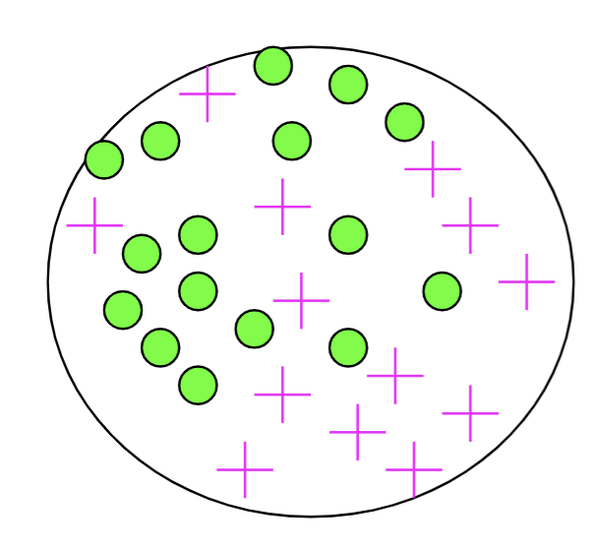
Entropy
Entropy – A common way to measure impurity
n is the # of possible values for X
Where, p_{i,k} is the probability of class k.
Compute it as the proportion of class k in the training set
Note: Entropy comes from information theory. The higher the entropy the more the information content.
Based on slide by Pedro Domingos
Notes:
Occam's razor, Ockham's razor, Ocham's razor, or the principle of parsimony or law of parsimony is the problem-solving principle that entities should not be multiplied beyond necessity, sometimes inaccurately paraphrased as the simplest explanation is usually the best one

Slide 37
Alternate Splitting Criteria
Variance impurity: because this is related to the variance of a distribution associated with the two classes.
Gini Impurity: The expected error rate at node N if the category label is selected randomly from the class distribution present at node N.
Misclassification impurity: measures the minimum probability that a training pattern would be misclassified at node N.
In practice, simple entropy splitting (choosing the question that splits the data into two classes of equal size) is very effective.

Slide 38
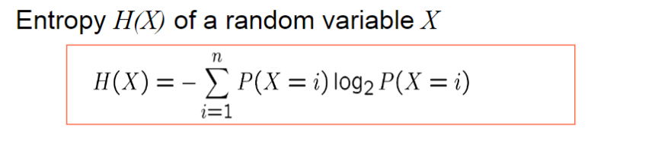
From Entropy to Information Gain
Based on slide by Tom Mitchell
Notes:
Occam's razor, Ockham's razor, Ocham's razor, or the principle of parsimony or law of parsimony is the problem-solving principle that entities should not be multiplied beyond necessity, sometimes inaccurately paraphrased as the simplest explanation is usually the best one

Slide 39

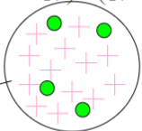
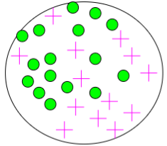

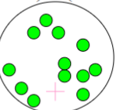

Calculating Information Gain
IG: entropy(parent)- [average entropy (children)]
child entropy
Training dataset (30 instances)
(17 instances)
child entropy
parent entropy
(13 instances)
Based on slide by Pedro Domingos
Notes:
Occam's razor, Ockham's razor, Ocham's razor, or the principle of parsimony or law of parsimony is the problem-solving principle that entities should not be multiplied beyond necessity, sometimes inaccurately paraphrased as the simplest explanation is usually the best one

Slide 40

Calculating Information Gain
child entropy
Training dataset (30 instances)
(17 instances)
child entropy
Lower entropy for a purer class
parent entropy
(13 instances)
(Weighted) Average Entropy of Children =
IG: .996-.615 = .38
Based on slide by Pedro Domingos
Notes:
Occam's razor, Ockham's razor, Ocham's razor, or the principle of parsimony or law of parsimony is the problem-solving principle that entities should not be multiplied beyond necessity, sometimes inaccurately paraphrased as the simplest explanation is usually the best one

Slide 41
CART Algorithm
Six key questions:
Should the questions be binary (e.g., is gender male or female) or numeric (e.g., is height >= 5’4”) or multi-valued (e.g., race)?
Which features should be tested at each node?
When should a node be declared a leaf?
If the tree becomes too large, how can it be pruned?
If the leaf node is impure, what category should be assigned to it?
How should missing data be handled?

Slide 42
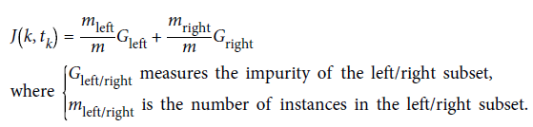
CART Algorithm – Cost Function
- Once it has successfully split the training set in two, it splits the subsets using the
same logic, then the sub-subsets and so on, recursively.
- It stops recursing once it reaches the maximum depth (defined by the max_depth hyperparameter), or if it cannot find a split that will reduce impurity.

Slide 43
CART Algorithm – Greedy Algorithm
Greedily searches for an optimum split at top level
Repeats greedy search for each level
Does NOT check if the split will lead to best predicted price
Greedy algorithm produces reasonably good solutions
Not guaranteed to be optimal solution

Slide 44
CART Algorithm
Prefer trees that are simple and compact. Why? (Hint: Occam’s Razor).
We split data at a node to increase the purity at that node.
To split data at a node, we need to find the question that results in the greatest entropy reduction (removes uncertainty in the data)
Notes:
Occam's razor, Ockham's razor, Ocham's razor, or the principle of parsimony or law of parsimony is the problem-solving principle that entities should not be multiplied beyond necessity, sometimes inaccurately paraphrased as the simplest explanation is usually the best one

Slide 45
Overfitting in Decision Trees
If we continue to grow the tree until each leaf node has the lowest impurity, then the data will be overfit.
Noisy data can occur in the examples
Two examples have same attribute/value pairs, but different classifications
Some values of attributes are incorrect because of errors in the data acquisition process or the preprocessing phase
The instance was labeled incorrectly (+ instead of -)
Also, some attributes are irrelevant to the decision-making process
e.g., color of a die is irrelevant to its outcome
Notes:
Occam's razor, Ockham's razor, Ocham's razor, or the principle of parsimony or law of parsimony is the problem-solving principle that entities should not be multiplied beyond necessity, sometimes inaccurately paraphrased as the simplest explanation is usually the best one

Slide 46
Overfitting in Decision Trees
Irrelevant features can result in overfitting training example data
Two strategies: (1) stop tree from growing or (2) grow and then prune the tree.
A traditional approach to stopping splitting relies on cross-validation:
Validation: train a tree on 80% of the data and test on 20% of the data
Cross-validation: repeat for several independently chosen partitions.
Stopping Criterion: Continue splitting until the error on the held-out data is minimized.
Reduction In Impurity: stop if the candidate split leads to a marginal reduction of the impurity (drawback: leads to an unbalanced tree).
Cost-Complexity: use a global criterion function that combines size and impurity:
Notes:
Occam's razor, Ockham's razor, Ocham's razor, or the principle of parsimony or law of parsimony is the problem-solving principle that entities should not be multiplied beyond necessity, sometimes inaccurately paraphrased as the simplest explanation is usually the best one

Slide 47
CART Algorithm
Question: When to stop Splitting?
Do until further pruning is harmful:
1. Evaluate impact on validation set of pruning each possible node (plus those below it)
2.Greedily remove the node that most improves validation set accuracy

