Slide 1
Foundations of Data Science & Analytics DSCI 633, Fall 2023
Nidhi Rastogi
Assistant Professor, GCCIS, RIT

Slide 2
Class Announcements
Reference material for most classes added to course webpage.
Contact TA for any questions,
You can ask questions on slack channel or email them and/or the instructor.
Python Assessment (0 credit) is due on Friday, 09/01.
First HW Assignment next Tuesday, 09/05.

Slide 3
Learning Objectives
Machine Learning (ML) Models
Identify different types of ML models
Identify their applications
Overview of ML Pipeline
Study and analyze data
Select the right model for the problem and the data
Train the model
Predict using the trained model
Class Exercise to identify ML model for a given application
First Model - Naïve Bayes Model
In class exercise for Hands-On Practice

Slide 4
Types of Machine Learning models
Supervised
Unsupervised
Anomaly Detection
Reinforcement Learning
Notes:
In supervised learning, the training data you feed to the algorithm includes the desired solutions, called labels

Slide 5
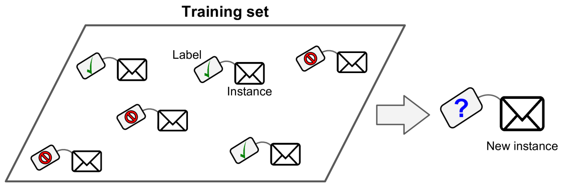
Supervised Learning
Classification
Trained with many example emails along with their class (spam or ham)
It must learn how to classify new emails
Notes:
In supervised learning, the training data you feed to the algorithm includes the desired solutions, called labels

Slide 6
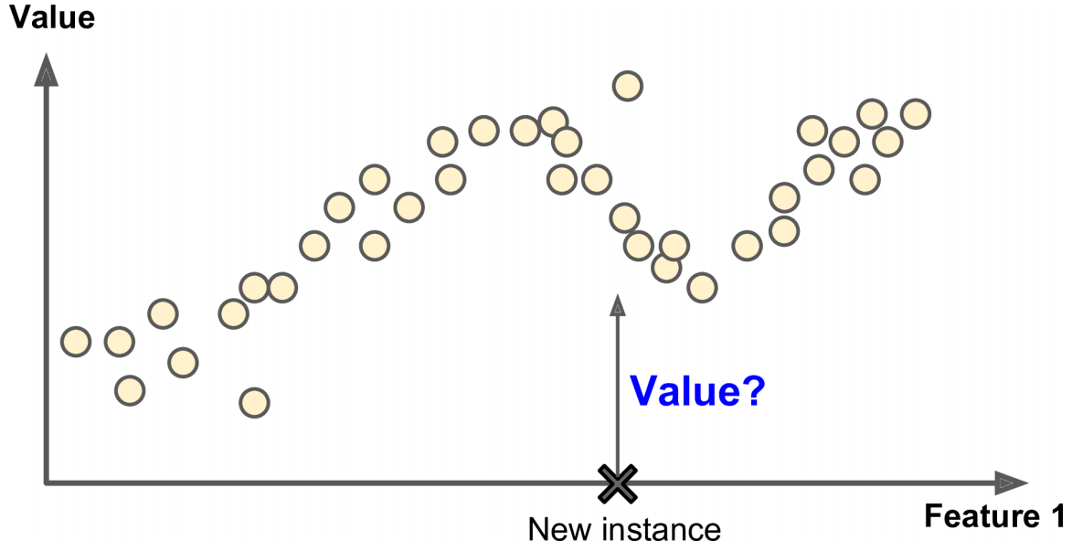
Supervised Learning
Regression
Predict target numeric value price of a car, given a set of features (mileage, age, brand, etc.) called predictors.
Some regression algorithms can be used for classification as well
Logistic Regression: can output a value that corresponds to the probability of belonging to a given class
e.g., 20% chance of being spam

Slide 7
Supervised Learning, we will study
Regression – Simple, Linear, Logistic
Decision Trees
Support Vector Machines (SVMs)
Nearest Neighbors
Ensemble Learning
Random Forests
Neural networks (later)

Slide 8
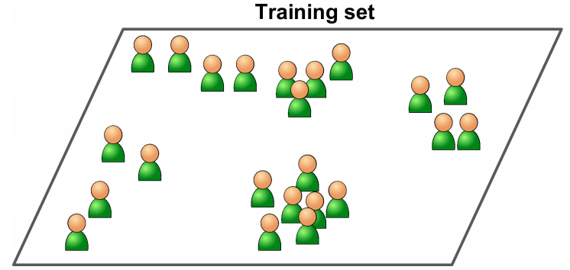
Unsupervised Learning
Learn without a teacher
Clustering
K-Means, DBSCAN, Hierarchical Cluster Analysis (HCA)
Anomaly detection and novelty detection
One-class SVM, Isolation Forest
Visualization and dimensionality reduction
Principal Component Analysis (PCA), Kernel PCA, Locally-Linear Embedding (LLE), t-distributed Stochastic Neighbor Embedding (t-SNE)

Slide 9
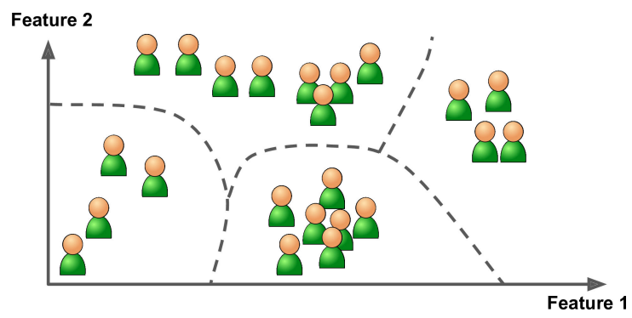
Clustering
run a clustering algorithm
to detect groups of similar visitors

Slide 10
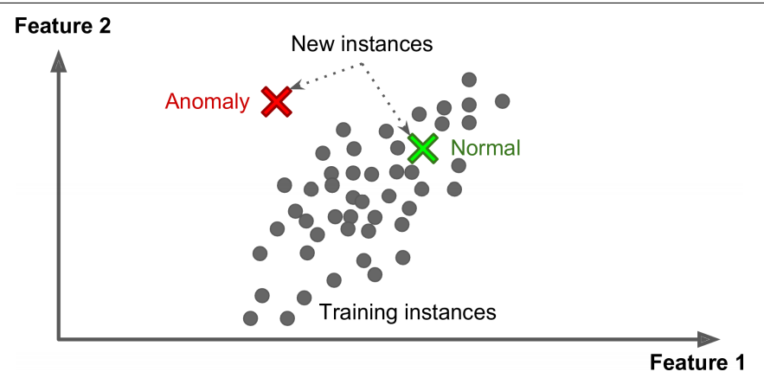
Anomaly Detection
Input: System is shown mostly normal instances during training
Model: learns to recognize normal.
Therefore, can tell whether a new instance looks like a normal one or whether it is likely an anomaly
Examples:
Detecting unusual credit card transactions to prevent fraud
Catching manufacturing defects
Automatically removing outliers from a dataset before feeding it to another learning algorithm

Slide 11
Association Rules
- Dig into large amounts of data and discover interesting relations between
attributes.
Example, suppose you own a supermarket
Running an association rule on your sales logs may reveal that people who purchase barbecue sauce and potato chips also tend to buy steak. Thus, you may want to place these items close to each other.
Will not be covered in this course.

Slide 12
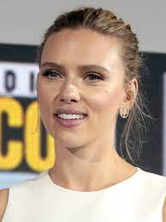

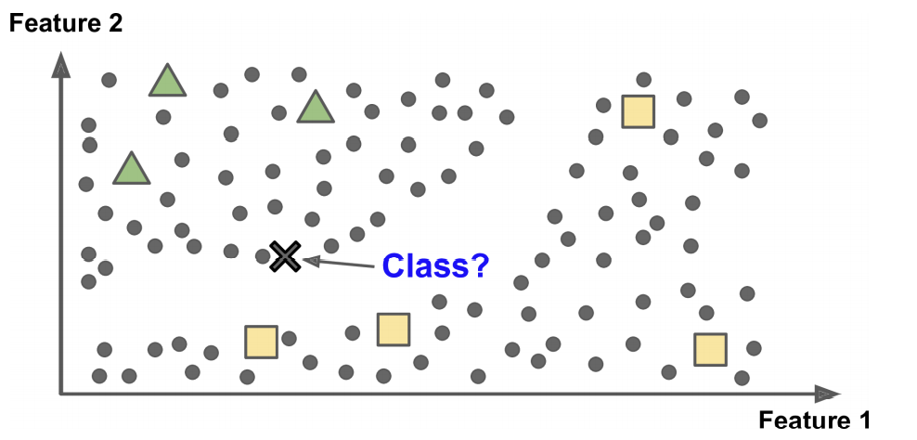
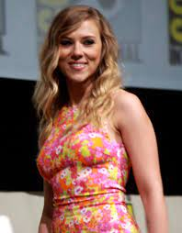

Semi supervised Learning
Algorithms can deal with partially labeled training data
Example - Google Photos
automatically recognizes person A, B
1 label per person.
It will name everyone in every photo
useful for searching photos
This is the unsupervised part of the algorithm
Most of them are combinations of unsupervised and supervised algorithms

Slide 13
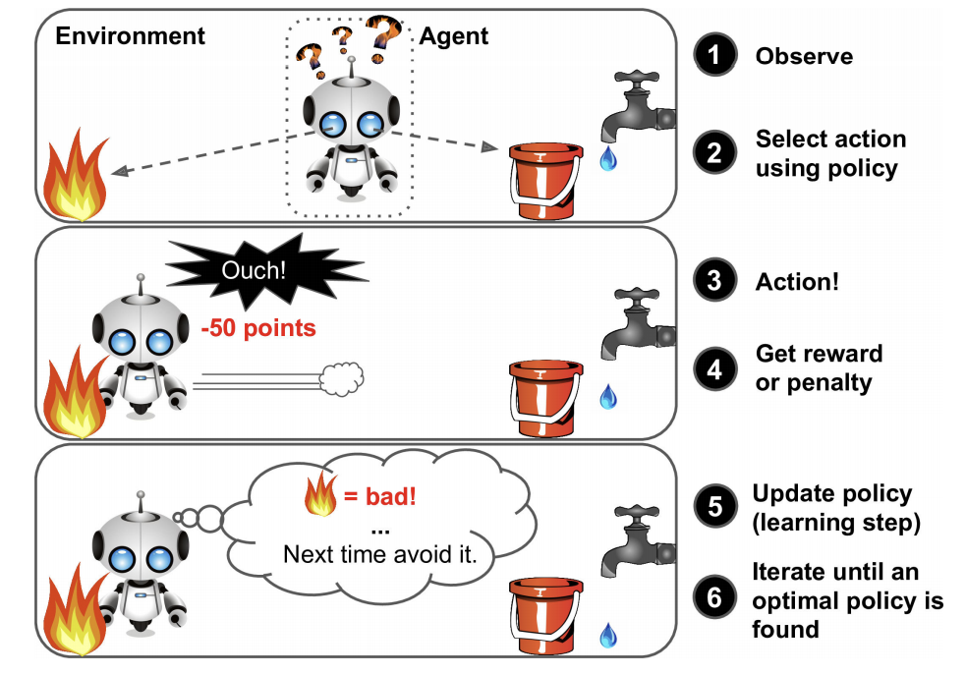
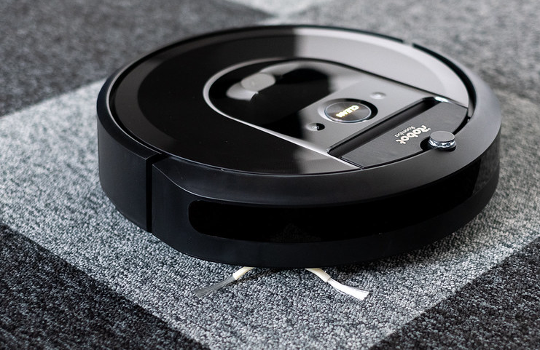
Reinforcement Learning
Agent : the learning system
Observe the environment
Select and perform actions
Rewarded or Penalized
Self-learning, called policy,
Goal: to get the most reward over time
Roomba, the home vacuum cleaner

Slide 14
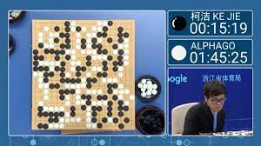
Reinforcement Learning
Example- DeepMind’s AlphaGo program
made headlines in May 2017
beat Go world champion Ke Jie
Learned its winning policy
by analyzing millions of games
playing many games against itself
More details in future lecture.

Slide 15
Types of Machine Learning Systems
Whether or not they are trained with human supervision (Supervised, Unsupervised, Semi-supervised, and Reinforcement Learning)
Whether or not they can learn incrementally on the fly (online versus batch learning)
Whether they work by simply comparing new data points to known data points, or instead detect patterns in the training data and build a predictive model, much like scientists do (instance-based versus model-based learning).

Slide 16
Batch and Online Learning
Batch learning
System trained using all the available data
Takes a lot of time and computing resources (CPU, memory space, disk space, disk I/O, network I/O, etc.)
$$$$
typically done offline.
System is trained -> launched into production -> runs without learning anymore
For new learning (such as a new type of spam)
train a new version of system from scratch on the full dataset (old and new)
replace system with new one
Examples… ?
If your system needs to adapt to rapidly changing data (e.g., to pre‐ dict stock prices), then you need a more reactive solution

Slide 17
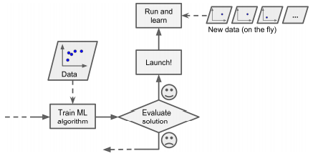
Batch and Online Learning
Online learning
Train system incrementally – feed data instances sequentially (individually or by small groups called mini-batches)
Learning is on-the-fly
Great for systems that receive data as a continuous flow
and need to adapt to change rapidly or autonomously
Example - ?
Good option limited computing resources – once learning done, instances not needed
Used to train systems on huge datasets that cannot fit in one machine’s main memory
online learning

Slide 18
Batch and Online Learning
Learning Rate – Speed at which system should adapt to changing data.
high learning rate – system adapts fast to new data
Forgets quickly too!!!
low learning rate – high system inertia, learn more slowly
but less sensitive to noise in the new data or to sequences of nonrepresentative data points (outliers).
Constant monitoring is required to prevent learning from bad data.
Adversarial learning – An ML technique that attempts to fool models by supplying deceptive input.
Most common reason is to cause a malfunction in a machine learning model. [Wikipedia]
System performance will decline gradually
Worse in live systems
Example : Malfunctioning sensor on a robot
online learning

Slide 19
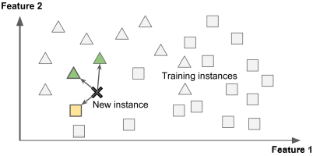
Instance- and Model-based Learning
Instance-based: Learns by example
Such as spam filter programmed to flag emails similar to known spam emails
Measure of similarity between two emails
A VERY basic similarity measure between two emails
# common words

Slide 20
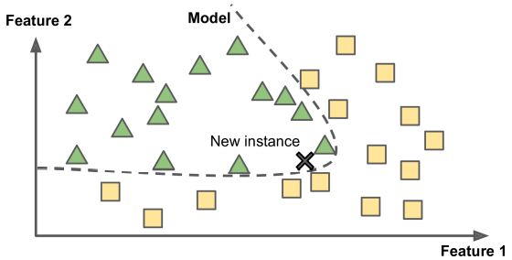
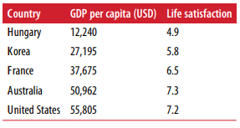
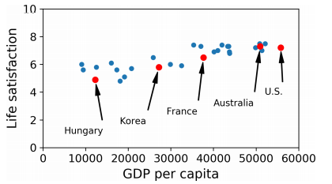
Instance- and Model-based Learning
Model-based: generalize from a set of examples. Build a model of these examples, then use that model to make predictions.
Example: Does money makes people happy?
Download
“Better Life Index” data from the OECD’s website
GDP per capita from the IMF’s website.
Plot the data for a few random countries
Model Selection – Linear Model

Slide 21
Class Exercise:
Categorize tasks into Types of ML Models

Slide 22
Movie Recommendation System: A system that suggests movies to users based on movies they've previously liked.
Customer Segmentation for a Supermarket: Analyzing purchase data to group customers into different clusters or segments based on their shopping patterns.
Credit Card Fraud Detection: Monitoring credit card transactions to flag suspicious activities that don't align with a user's typical behavior.
Playing Chess Against a Computer: Training a computer program to improve its chess game by playing thousands of games and learning from its moves.
Predicting House Prices: Using features like the number of rooms, location, and age of a house to predict its sale price.
Image Compression: Reducing the size of an image file without significantly reducing its quality, by grouping similar pixel values.
Identifying Topics in News Articles: Going through thousands of news articles and determining the main topics or themes without prior labels.
Self-driving Car: Training a car to drive on its own by navigating and reacting to its environment.
Identifying Customers Who Might Churn: Based on a customer's activity, purchase history, and feedback, predicting if they might leave the service.
Detecting Manufacturing Defects: Monitoring a manufacturing assembly line to detect products that don't meet the quality standards.
(Answer in Speaker Notes section.)
Notes:
Supervised Learning: Movie Recommendation System, Predicting House Prices, Identifying Customers Who Might Churn.
Unsupervised Learning: Customer Segmentation for a Supermarket, Image Compression, Identifying Topics in News Articles.
Anomaly Detection: Credit Card Fraud Detection, Detecting Manufacturing Defects.
Reinforcement Learning: Playing Chess Against a Computer, Self-driving Car.

Slide 23
ML Models

Slide 24
Supervised Classification Models
Naïve Bayes

Slide 25
Naïve Bayes Classifier
Classification Algorithm
Application: Binary and multi-class classification problems
Called naïve Bayes
Makes calculation simple
so calculation of probabilities for each hypothesis is simplified.
It’s a probabilistic classifier based on applying Bayes' theorem
makes the naïve assumption of independence between every pair of features.

Slide 26
Naïve Bayes Classifier
(contd…)It’s a probabilistic classifier based on applying Bayes' theorem
makes the naïve assumption of independence between every pair of features.
What does Assumption of independence mean?
Changing the value of one feature, does not directly influence or change the value of any of the other features used in the algorithm.
- Makes coding the predictions easy and quick.

Slide 27
Naïve Bayes Classifier - Analogy
Scenario: Guess the fruit (apple, banana, orange) sitting in a basket
- Use the features (shape, texture, smell) of the fruit to guess
Prior Knowledge: Prior probability based on past experiences.
Example: 50% chance of an apple if half the fruits you've seen were apples.
Feature Evidence: Using fruit features to refine guess.
Example: Round & smooth? Probably not a banana. Citrusy smell? Likely an orange.
Notes:
Naive Bayes is like your brain's internal process when making that guess.
Prior Knowledge: You know from past experiences (or based on the fruits you saw before closing your eyes) how many of each fruit are generally in the basket. This is your base rate or prior probability. For instance, if half of the fruits you've seen in your life were apples, then, without any other information, there's a 50% chance any given fruit you pick is an apple.
Feature Evidence: Now, consider the fruit's features. If the fruit feels round and smooth, it might be an apple or an orange but likely not a banana. If it smells citrusy, it's probably an orange. Each of these features gives you evidence to update your guess.
Combining Information: Naive Bayes combines your prior knowledge with the feature evidence to give a more informed guess about the fruit's identity.
"Naive" Assumption: The "naive" part is because the algorithm assumes each feature (like shape or smell) is independent of the other. In our example, it would mean the shape of the fruit doesn't affect its smell, which might not always be true, but this simplification often works surprisingly well in practice.
In summary, Naive Bayes uses prior knowledge and feature evidence to make educated guesses, while simplifying things by treating each feature as independent.

Slide 28
Naïve Bayes Classifier - Analogy
Combining Information: Merges prior knowledge with evidence for an educated guess.
Prior knowledge + Evidence = educated guess
"Naive" Assumption: Each feature (e.g., shape, smell) is treated as independent of others.
Notes:
Naive Bayes is like your brain's internal process when making that guess.
Prior Knowledge: You know from past experiences (or based on the fruits you saw before closing your eyes) how many of each fruit are generally in the basket. This is your base rate or prior probability. For instance, if half of the fruits you've seen in your life were apples, then, without any other information, there's a 50% chance any given fruit you pick is an apple.
Feature Evidence: Now, consider the fruit's features. If the fruit feels round and smooth, it might be an apple or an orange but likely not a banana. If it smells citrusy, it's probably an orange. Each of these features gives you evidence to update your guess.
Combining Information: Naive Bayes combines your prior knowledge with the feature evidence to give a more informed guess about the fruit's identity.
"Naive" Assumption: The "naive" part is because the algorithm assumes each feature (like shape or smell) is independent of the other. In our example, it would mean the shape of the fruit doesn't affect its smell, which might not always be true, but this simplification often works surprisingly well in practice.
In summary, Naive Bayes uses prior knowledge and feature evidence to make educated guesses, while simplifying things by treating each feature as independent.

Slide 29
Naïve Bayes Classifier
What is a hypothesis here?
In machine learning/ classification problem
we want to select the best hypothesis (h)
given data (d)
hypothesis (h): class to assign for a new data instance (d)

Slide 30
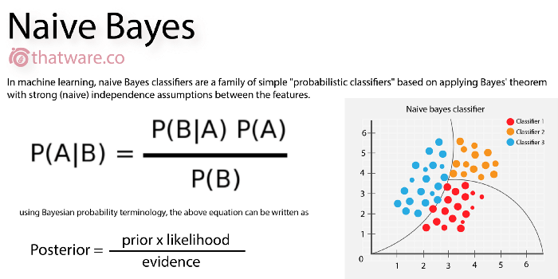
Naïve Bayes Classifier
- Naïve Bayes classifier calculates conditional probability

Slide 31
Example: Naïve Bayes Classifier
Example: We have a bunch of emails and we want to determine which one is ham and which one is spam.
2 classes : spam and ham Hypothesis: Spam or ham
Training Dataset: Using the frequency of words occurring in both classes:
Probability of word “money” occurring in the class spam is 1/8. p(money|spam) = 1/8
Probability of word “dear” occurring in the class ham is 1/10. p(dear|ham) = 1/10
Probability of word “send” occurring in the class spam is 1/15. p(send|spam) = 1/15
….and so on
These are probabilities of discrete, individual words -> independent features.

Slide 32
Bayes Classifier
p(money|spam) = 1/8
p(dear|ham) = 1/10
p(send|spam) = 1/15
Also given, 10 out of 15 messages are ”ham”. p(ham) = (10/10+5) = 0.67
0.67 is the prior probability of “ham”. therefore, p(spam) = 0.33
Testing: A new email arrives, and your classifier needs to label it as spam or ham. The email has content that says = “send money”
Start with a normal guess, “spam” = p(spam) = 0.33
p(spam) x p(send|spam) x p(money|spam) = 0.33 x 0.06 x 0.125 = .0024
Repeat for ham and compare result.
Assign class with greater value to the new email.
DONE
Just built an Email classifier based on naïve bayes.

Slide 33
Homework: Naïve Bayes Classifier
Use iris dataset. Link:https://archive.ics.uci.edu/ml/datasets/iris
(Downloadable link to dataset folder provided)
The iris dataset contains the following data:
50 samples of 3 different species of iris (150 samples total)
Measurements: sepal length, sepal width, petal length, petal width
The format for the data: (sepal length, sepal width, petal length, petal width)

Slide 34
Homework: Naïve Bayes Classifier
2. Open google colab: https://colab.research.google.com/
Starting code provided
You only have to code the naïve bayes from scratch.
Thursday class 10 mins end of class for questions on homework
3. Next Monday (09/11) 11:59 pm submission deadline
4. Next Tuesday (09/12): follow along code in class

Slide 35
Supervised Classification Models Linear Model

Slide 36
Simple Linear Model
Example: Does money makes people happy?
Data available for Download
“Better Life Index” data from the OECD’s website
GDP per capita from the IMF’s website.
Plot the data for a few random countries
Model Selection – Linear Model

Slide 37
Simple Linear Model
A linear model for Life satisfaction:
life_satisfaction = θ₀ ₊ θ₁ x GDP_per_capita
where,
, the two model parameters are, θ₀ and θ₁
,tweak them to make your model represent any linear function.

Slide 38
Simple Linear Model
Before you use your linear model, you need to define the parameter values of θ₀ and θ_{1.}
those that make your model perform best
Utility Function – measures how good your model is
Cost Function – measures how bad your model is

Slide 39
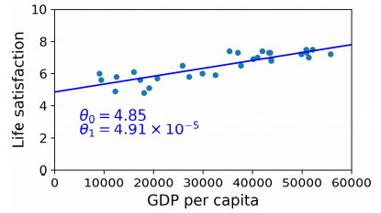
Linear Regression Model
Cost Function : measures the distance between the linear model’s predictions and the training examples; the objective is to minimize this distance.
Model Training: Input your training data to a LR model, and it will find the parameters that make the model fit best to your data.
In the figure, model fits the training data closely
Linear model that fits the training data best

Slide 40
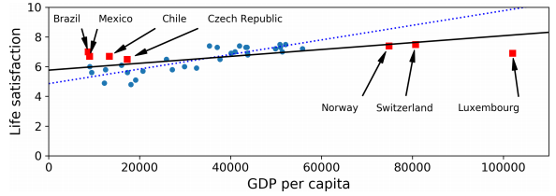
Challenges in ML
Insufficient quantity of training data
Nonrepresentative Training Data – Can make inaccurate predictions
Sampling Noise – sample data too small
Sampling Bias – sample data there but non-representative. Due to flawed sampling method

Slide 41
Challenges in ML contd…
Poor Quality Data
Irrelevant Features
Overfitting Training Data
Underfitting Training data
Data Mismatch

Slide 42
Testing and Validating
Only way to know how well a model will generalize
Split data into 2 sets (usually 80:20)
Training Set
Testing Set
Generalization Error – error rate on new cases (also called out-of-sample error)
Arrive at it by evaluating model on test data
Compare training error with Generalization error - If the training error is low (i.e., your model makes few mistakes on the training set) but the generalization error is high, it means that your model is overfitting the training data.

Slide 43
Put it all together Let’s build a model

Slide 44
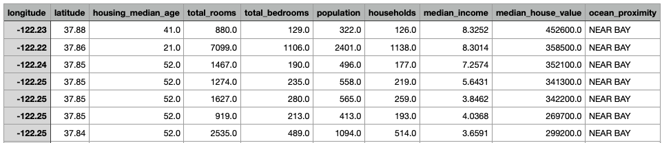
Build a model
Housing prices in California (CA)
Data : CA census data, it has metrics such as population, median income, median housing price, and so on for each block group in California. Snapshot below:
Goal: Predict median housing price in any district, given all the other metrics.
What should you do next?

Slide 45
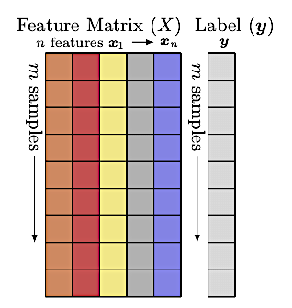
Build a model
Understand the data
What are the features and label?
Frame the Problem
Label, y
Features – X=x₁,x₂,…
x_{i}

Slide 46
Build a model
Frame the Problem - Design a model that takes the features as input and predicts the median housing price.
Start designing your system –
Is it supervised, unsupervised, or reinforcement learning?
Is it a classification, regression or some other task?
Should you use batch or online learning?
Lets Discuss

Slide 47
Build a model
One approach
Supervised learning task - since you are given labeled training examples (each instance comes with the expected output, i.e., the district’s median housing price)
Regression task, since you are asked to predict a value.
More specifically, this is a multiple regression problem since the system will use multiple features to make a prediction (it will use the district’s population, the median income, etc.).
It is also a univariate regression problem since we are only trying to predict a single value for each district.
No continuous flow of data coming in the system, there is no particular need to adjust to changing data rapidly, and the data is small enough to fit in memory, so plain batch learning should do just fine.

Slide 48

Model Performance
5. Select a Model Performance measure
Root mean square error (RMSE) – gives you an idea of how much error a system typically makes in its predictions
Higher weight for large errors
where, m is the number of instances in the dataset you’re measuring the RMSE on,
x^{(i)} is a vector of all the feature values (excluding the label) of the i^{th} instance in the dataset, and y^{(i)} is its label (the desired output value for that instance).
X is a matrix containing all the feature values (excluding labels) of all instances in the dataset.

Slide 49
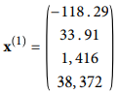
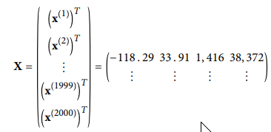
Model Performance
where, m is the number of instances in the dataset you’re measuring the RMSE on.
Features – latitude, longitude, #inhabitants, median income, median house $$
x^{(i)} is a vector of all the feature values (excluding the label) of the i^{th} instance in the dataset, and y^{(i)} is its label (the desired output value for that instance).
X is a matrix containing all the feature values (excluding labels) of all instances in the dataset. There is one row per instance and the i^{th} row is equal to the transpose of x^{(i)}, noted (x^{(i)})^{T.4}

Slide 50
Model Performance
h is your system’s prediction function, also called a hypothesis. When your system is given an instance’s feature vector x^{(i)}, it outputs a predicted value ŷ^{(i)} = h(x^{(i)}) for that instance
If your system predicts that the median housing price in the first district is $158,400, then
ŷ^{(i)} = h(x^{(i)}) => $158,400
Prediction rate: ŷ^{(i)} -y^{(i)} = $2,000

Slide 51
Questions..

Slide 52
Resources
Concepts from : Hands-on machine learning with Scikit learn, Keras & TensorFlow by Aurelien Geron, Chapter 1, 2

