Slide 1
Foundations of Data Science & Analytics DSCI 633
Nidhi Rastogi
Assistant Professor, GCCIS, RIT

Slide 2
Ensemble Classifiers

Slide 3
Classification Models
Base classification models
Linear Regression (covered in previous class)
Decision Trees
Instance-based (Nearest-neighbor)
Naïve Bayes
Support Vector Machines
Ensemble Classifiers
Boosting, Bagging, Random Forests

Slide 4
Goal of Supervised Learning?
Minimize the probability of model prediction errors on future data
Two Competing Methodologies
Build one really good model
Traditional approach
Build many models and average the results
Ensemble learning (more recent)

Slide 5
Ensemble Philosophy
Build many models and combine them.
Only through averaging do we get at the truth!
It’s too hard (impossible?) to build a single model that works best
Two types of approaches:
Models that don’t use randomness
Models that incorporate randomness

Slide 6
Scenario – Buy a Car
How do I research for the right car?

Slide 7
Scenario – Buy a Car
Browse a few automobile websites and check for options
Check reviews
Check prices, other factors..
Ask your friends and colleagues for their opinion
….

Slide 8
Scenario – Buy a Car
Make an informed decision!!

Slide 9
Ensemble learning
Ensemble models combine decisions from multiple models to improve the overall performance.

Slide 10
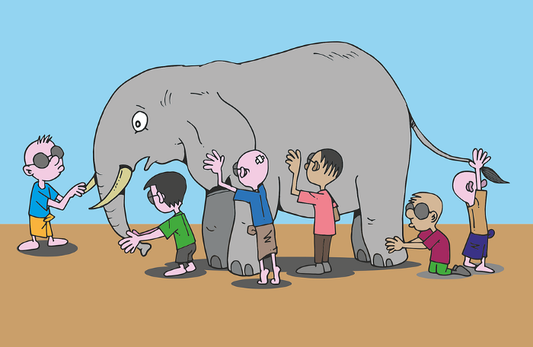
Scenario – Guess the animal
Blindfolded kids playing “touch and tell”

Slide 11
Scenario – Guess the animal
Each has a (somewhat) different version of how an elephant looks like

Slide 12
Scenario – Guess the animal
Grouping every kids version of how an elephant looks like can collectively give an accurate description of an elephant.

Slide 13
Scenario – Guess the animal
Ensemble methods employ a group of models where the combined result out of them is almost always better in terms of prediction accuracy as compared to using a single model.

Slide 14
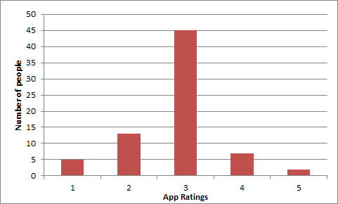
Simple Ensemble techniques
1. Taking mode of the results- most frequently occurring number in a set of numbers
Multiple models used to make predictions for each data point
Example - rating beta version of health and
fitness app from the user community
Assume each user as a model
Output, Mode =3 (majority people voted this)

Slide 15
Simple Ensemble techniques
2. Taking average of the results- average of predictions from all the models and use it to make the final prediction
AVERAGE= sum(Rating*Number of people)/Total number of people
= (1*5)+(2*13)+(3*45)+(4*7)+(5*2)/72 = 2.833
~=3
Output = 3

Slide 16
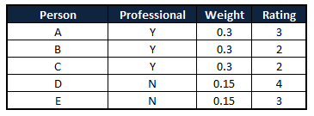
Simple Ensemble techniques
3. Taking weighted average of the results
All models assigned different weights defining the importance of each model for prediction
Pro app developers get higher weight
WEIGHTED AVERAGE
= (0.3*3)+(0.3*2)+(0.3*2)+(0.15*4)+(0.15*3)
= 3.15
~= 3

Slide 17
Advance Ensemble Approaches
Bagging
Bootstrap aggregating
Stacking
Boosting
Random Forests

Slide 18
Ensemble Approaches
Bagging:
fitting many decision trees on different samples of same dataset
averaging their predictions.
Stacking
fitting many different models types on the same data
using another model to learn how to best combine the predictions
Boosting
adding ensemble members sequentially that correct the predictions made by prior models and outputs a weighted average of the predictions

Slide 19
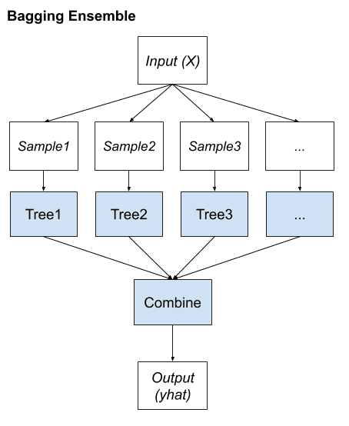
Bagging Ensemble Learning
Comes from the term - Bootstrap AGGregatING.
Uses a single machine learning algorithm
almost always an unpruned decision tree
Trains each model on a different sample of the same training dataset.
Predictions made by the ensemble members are then combined using simple statistics, such as voting or averaging

Slide 20
Bagging Ensemble Learning
Main Assumption behind prediction:
Combining many unstable predictors to produce an ensemble (stable) predictor.
Unstable Predictor: small changes in training data produce large changes in the model.
e.g. Neural Networks, Trees
Stable Predictor: SVM (sometimes), Nearest Neighbor.

Slide 21
The Bagging Algorithm
Given data:
For m = 1:M
Obtain bootstrap sample D_{m} from the training data D
Build a model G_{m}(x) from bootstrap data, D_{m}

Slide 22
Bagging Details
Examples (rows) are drawn from dataset at random, although with replacement
Called bootstrap samples
Bootstrap sample of N instances is obtained by drawing N examples at random, with replacement.
On average each bootstrap sample has 63% of instances
Encourages predictors to have uncorrelated errors
This is why it works

Slide 23
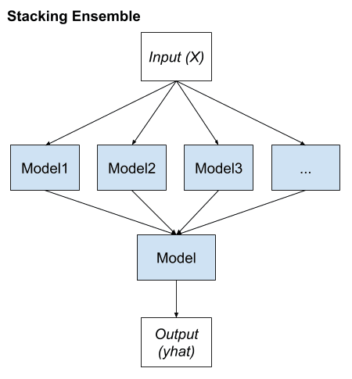
Bagging vs Stacking

Slide 24
Stacking
Seeks a diverse group of members
varies model types fit on training data
uses a model to combine predictions
1 learner trained to combine individual learners

Slide 25
Stacking
Seeks a diverse group of members
varies model types fit on training data
uses a model to combine predictions
1 learner trained to combine individual learners
First-level
learners
Second-level
learner OR meta learner

Slide 26
Stacking
2 level hierarchy most common approach
Any ML model can be used to aggregate the predictions
Common to use linear regression for regression and logistic regression for binary classification
simple models to learn how to harness the variety of predictions made
model complexity resides at lower-level ensemble member models

Slide 27
Stacking - dataset
Dataset – same for all models
Diversity comes from various different machine learning models
Use models that are learned in different ways
ensures they make different predictions
have less correlated prediction errors

Slide 28
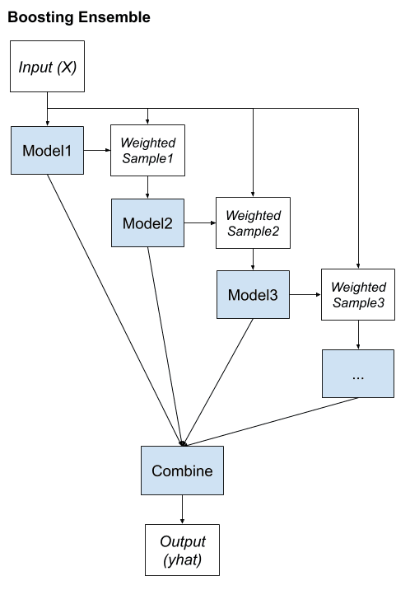
Bagging vs Stacking vs Boosting

Slide 29
Boosting
Main Assumption:
Combining many weak predictors to produce an ensemble predictor
training dataset for each subsequent classifier increasingly focuses on instances misclassified by previously generated classifiers.
Notes:
Weak learners - models that are only slightly better than random guessing, such as small decision trees

Slide 30
Boosting
Models are fit and added to the ensemble sequentially
Second model attempts to correct the predictions of the first model, the third corrects the second model, and so on…
Weights: contributions are weighed proportional to their performance or capability

Slide 31
Boosting
Final Classifier
Each classifier G_{m}(x) is trained from a weighted sample of training data
Biased training sample
Instances (training examples) with high error are weighted higher than those with lower error
Difficult instances get more attention
This is the motivation behind boosting
G_{m}(x)
Weighted Sample
.
.
.
G₃(x)
Weighted Sample
G₂(x)
Weighted Sample
G₁(x)
Training Sample

Slide 32
Boosting
Final Classifier
Objective: develop a “strong-learner” from several “weak-learners”
Training dataset remains same.
G_{m}(x)
Weighted Sample
.
.
.
G₃(x)
Weighted Sample
G₂(x)
Weighted Sample
G₁(x)
Training Sample

Slide 33
Boosting
Creating a Complementary Ensemble:
Each learner is different because it focuses on different parts of the data. The learners complement each other, covering different aspects of the problem.
This diversity in the learners makes the ensemble robust. While one learner might be good at classifying a certain type of instance, another might be better at a different type. Together, they cover a wider range of instances effectively.

Slide 34
Boosting
Reducing Bias and Variance:
Boosting can reduce bias (the error due to oversimplifying the problem) by making the model pay more attention to the underfitting parts of the dataset.
It also helps in reducing variance (the error due to overfitting to the training data) by averaging out the errors. Each learner might overfit to different parts, but when combined, their overfitting errors can cancel each other out.

Slide 35
Boosting
Why Not Just Correct Misclassifications?:
Simply correcting misclassifications without adjusting weights might lead to a model that overfits to specific, perhaps noisy, instances
Weight adjustments maintain a balance between focusing on misclassified instances and not losing sight of the overall distribution of the data.

Slide 36
Boosting
Final Classifier
Popular boosting approaches:
AdaBoost (canonical boosting)
Gradient Boosting Machines
Stochastic Gradient Boosting (XGBoost and similar)
G_{m}(x)
Weighted Sample
.
.
.
G₃(x)
Weighted Sample
G₂(x)
Weighted Sample
G₁(x)
Training Sample

Slide 37
Boosting
Popular boosting approaches:
AdaBoost (canonical boosting): among first successful boosting methods
Gradient Boosting Machines
Stochastic Gradient Boosting (XGBoost and similar): most effective techniques for classification and regression on tabular (structured) data

Slide 38
AdaBoost - Motivation
Remember decision trees?
House has <=5 bedrooms
A possible Decision
Y
N
Lot size <= 8500sqft.
Lot size <= 12000sqft
Y
N
Y
N
Predicted price: $140,000
Predicted price: 180,000
Predicted price: 170,000
Predicted price: 230,000

Slide 39
AdaBoost - Motivation
A tree made using AdaBoost
House has <=5 bedrooms
Y
N
Just a node and two leaves
Lot size <= 8500sqft.
Lot size <= 12000sqft

Slide 40
AdaBoost - Motivation
A tree made using AdaBoost
House has <=5 bedrooms
Y
N
Just a node and two leaves = STUMPS
Lot size <= 8500sqft.
Lot size <= 12000sqft

Slide 41
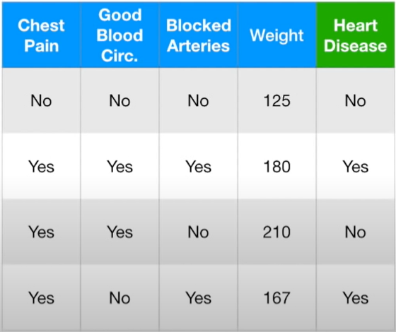
AdaBoost - Motivation
STUMPS bad at classification
Example dataset – for classifying patients with heart disease

Slide 42
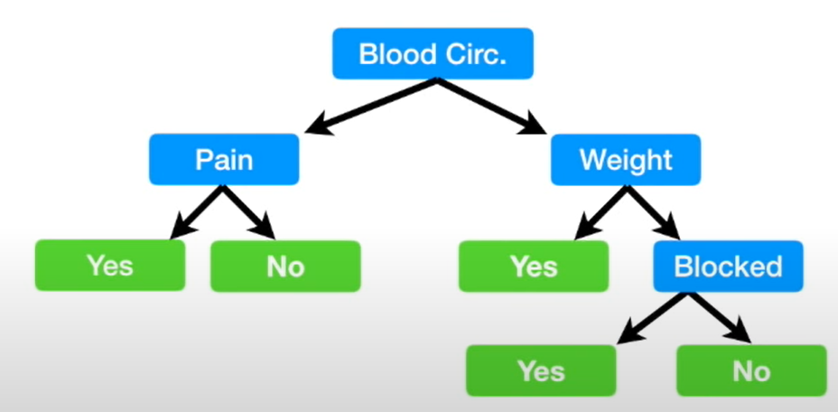
AdaBoost - Motivation
Example dataset – for classifying patients with heart disease
Full sized decision tree

Slide 43
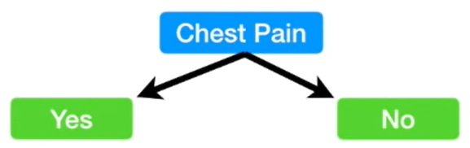
AdaBoost - Motivation
Example dataset – for classifying patients with heart disease
Stump uses only one variable to make a decision
Weak learners!

Slide 44
AdaBoost - Motivation
Example dataset – for classifying patients with heart disease
Stump uses only one variable to make a decision
Weak learners!
Basis of AdaBoost!

Slide 45
AdaBoost
Each weak classifier trained on a random subset of total training set.
Subsets can overlap
AdaBoost assigns weight to each training example.
Weight determines probability of each example to occur in training set

Slide 46
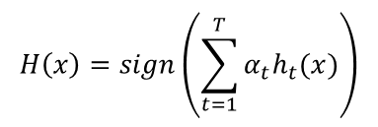
AdaBoost
Increases weight of misclassified training example
These examples make up a larger part of the next classifier’s training set.
Output:

Slide 47
AdaBoost
T = weak classifiers
h_{t}(x) = output of weak classifier, t
alpha = weight applied to classifier t
H(x) = linear combination of all classifiers
Final decision: looking at sign of this sum

Slide 48
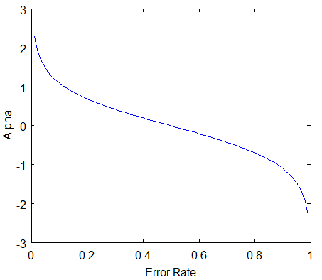
AdaBoost, errors
classifier’s error rate, ‘e_t’: number of misclassifications over the training set / training set size.
Intuition about error rate:
Classifier weight grows exponentially as the error approaches 0. Better classifiers are given exponentially more weight.
Classifier weight =0 if the error rate is 0.5. A classifier with 50% accuracy is no better than random guessing, so we ignore it.
Classifier weight grows exponentially negative as error approaches 1. We give a negative weight to classifiers with worse than 50% accuracy. “Whatever that classifier says, do the opposite!”.

Slide 49
Review: Decision Trees
To learn a decision tree model, we take a greedy approach:
Start with an empty decision tree (undivided feature space)
Choose the ‘optimal’ predictor on which to split and choose the ‘optimal’ threshold value for splitting by applying a splitting criterion, purity of the regions for classification, and MSE for regression.
Recurse on each new node until the stopping condition is met
For classification, we label each region in the model with the label of the class to which the plurality of the points within the region belong
For regression, we predict with the average of the output values of the training points contained in the region.

Slide 50
Review: Bagging vs Stacking vs Boosting

Slide 51
Random Forests
RF is an ensemble of Decision Trees, generally trained via the bagging method, typically with max_samples set to the size of the training set.
BaggingClassifier and passing it a DecisionTreeClassifier
is the same as
using RandomForestClassifier class
more convenient and optimized for Decision Trees
Similarly, RandomForestRegressor class for regression

Slide 52
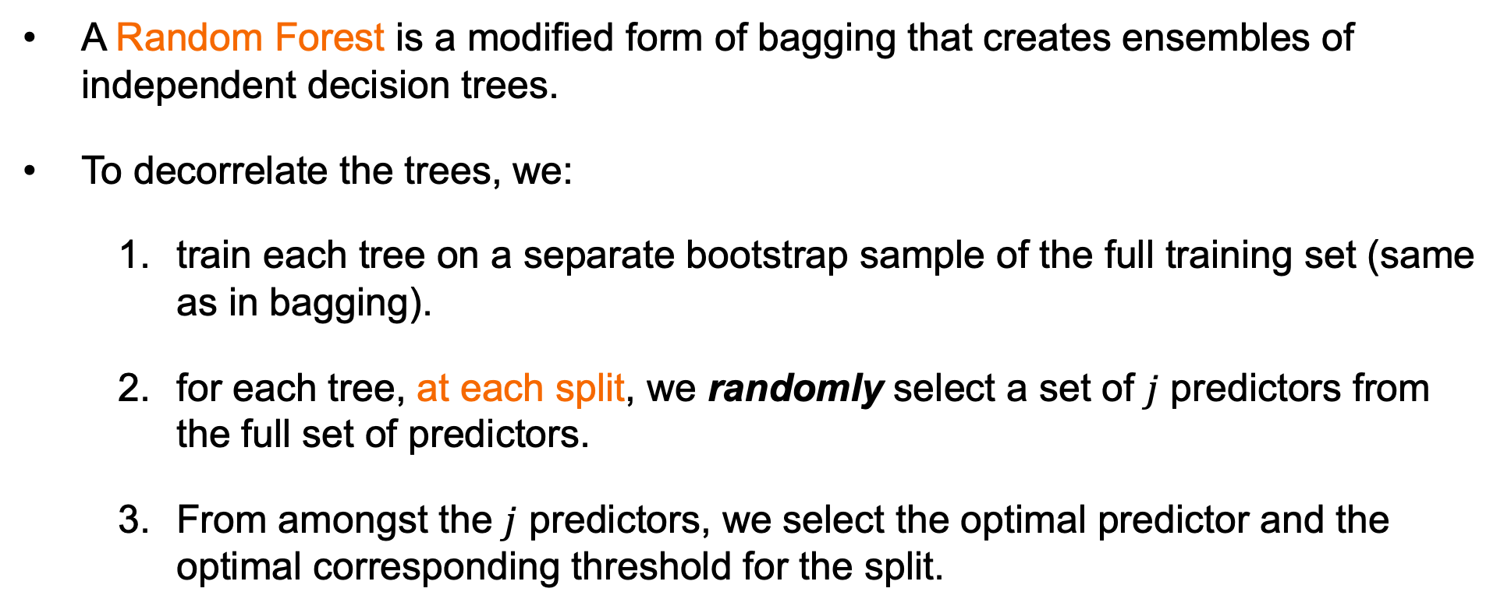
Random Forests
A Random Forest is a modified form of bagging that creates ensembles of independent decision trees.
To decorrelate the trees, we:
train each tree on a separate bootstrap sample of the full training set (same as in bagging).
for each tree, at each split, we randomly select a set of $j$ predictors from the full set of predictors.
From amongst the $j$ predictors, we select the optimal predictor and the optimal corresponding threshold for the split.

Slide 53
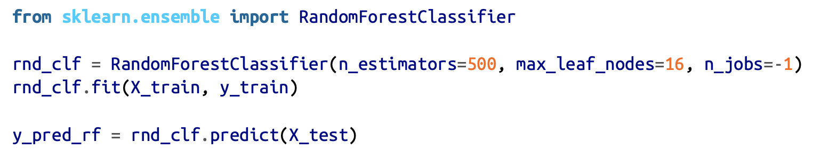
Random Forests
Following code trains a Random Forest classifier with 500 trees (each limited to maximum of 16 nodes), using all available CPU cores:

Slide 54
Random Forests
class sklearn.ensemble.RandomForestRegressor(n_estimators=10, criterion=’mse’, max_depth=None, min_samples_split=2, min_samples_leaf=1, min_weight_fraction_leaf=0.0, max_features=’auto’, max_leaf_nodes=None, min_impurity_decrease=0.0, min_impurity_split=None, bootstrap=True, oob_score=False, n_jobs=1, random_state=None, verbose=0, warm_start=False
Need to remember:
n_estimators, max_depth, min_samples_leaf, and max_features
n_estimators is simply the number of trees. The more uncorrelated trees in our forest, the closer their errors get to average.
max_depth is how many splits deep you want each tree to go. max_depth = 50, for example, would limit trees to at most 50 splits down any given branch.
min_samples_leaf= 10 tells each tree to stop splitting if doing so would result in the end node of any resulting branch having less than 10 leaves.
max_features tells each tree how many features to check when looking for the best split to make

Slide 55
Random Forests
Introduces extra randomness when growing trees;
Instead of searching for the very best feature when splitting a node, it searches for the best feature among a random subset of features.
this results in a greater tree diversity
this trades a higher bias for a lower variance
generally yielding an overall better model
Notes:
We say our model is biased if it systematically under or over-predicts the target variable. In machine learning, this is often the result of either the statistical assumptions made by our model of choice or of bias in the training data.
Variance, on the other hand, in some sense captures the generalizability of the model. Put more precisely. It measures how much our prediction would change if we trained it on different data. High variance typically means we are overfitting our training data, finding patterns and complexity that are a product of randomness instead of some real trend. Generally, a more complex or flexible model will tend to have high variance due to overfitting. Still, lower bias because by averaging over several predictions, our model more accurately predicts the target variable.
On the other hand, an underfit or oversimplified model, while having a lower variance, will likely be more biased since it lacks the tools to capture trends in the data fully.

Slide 56
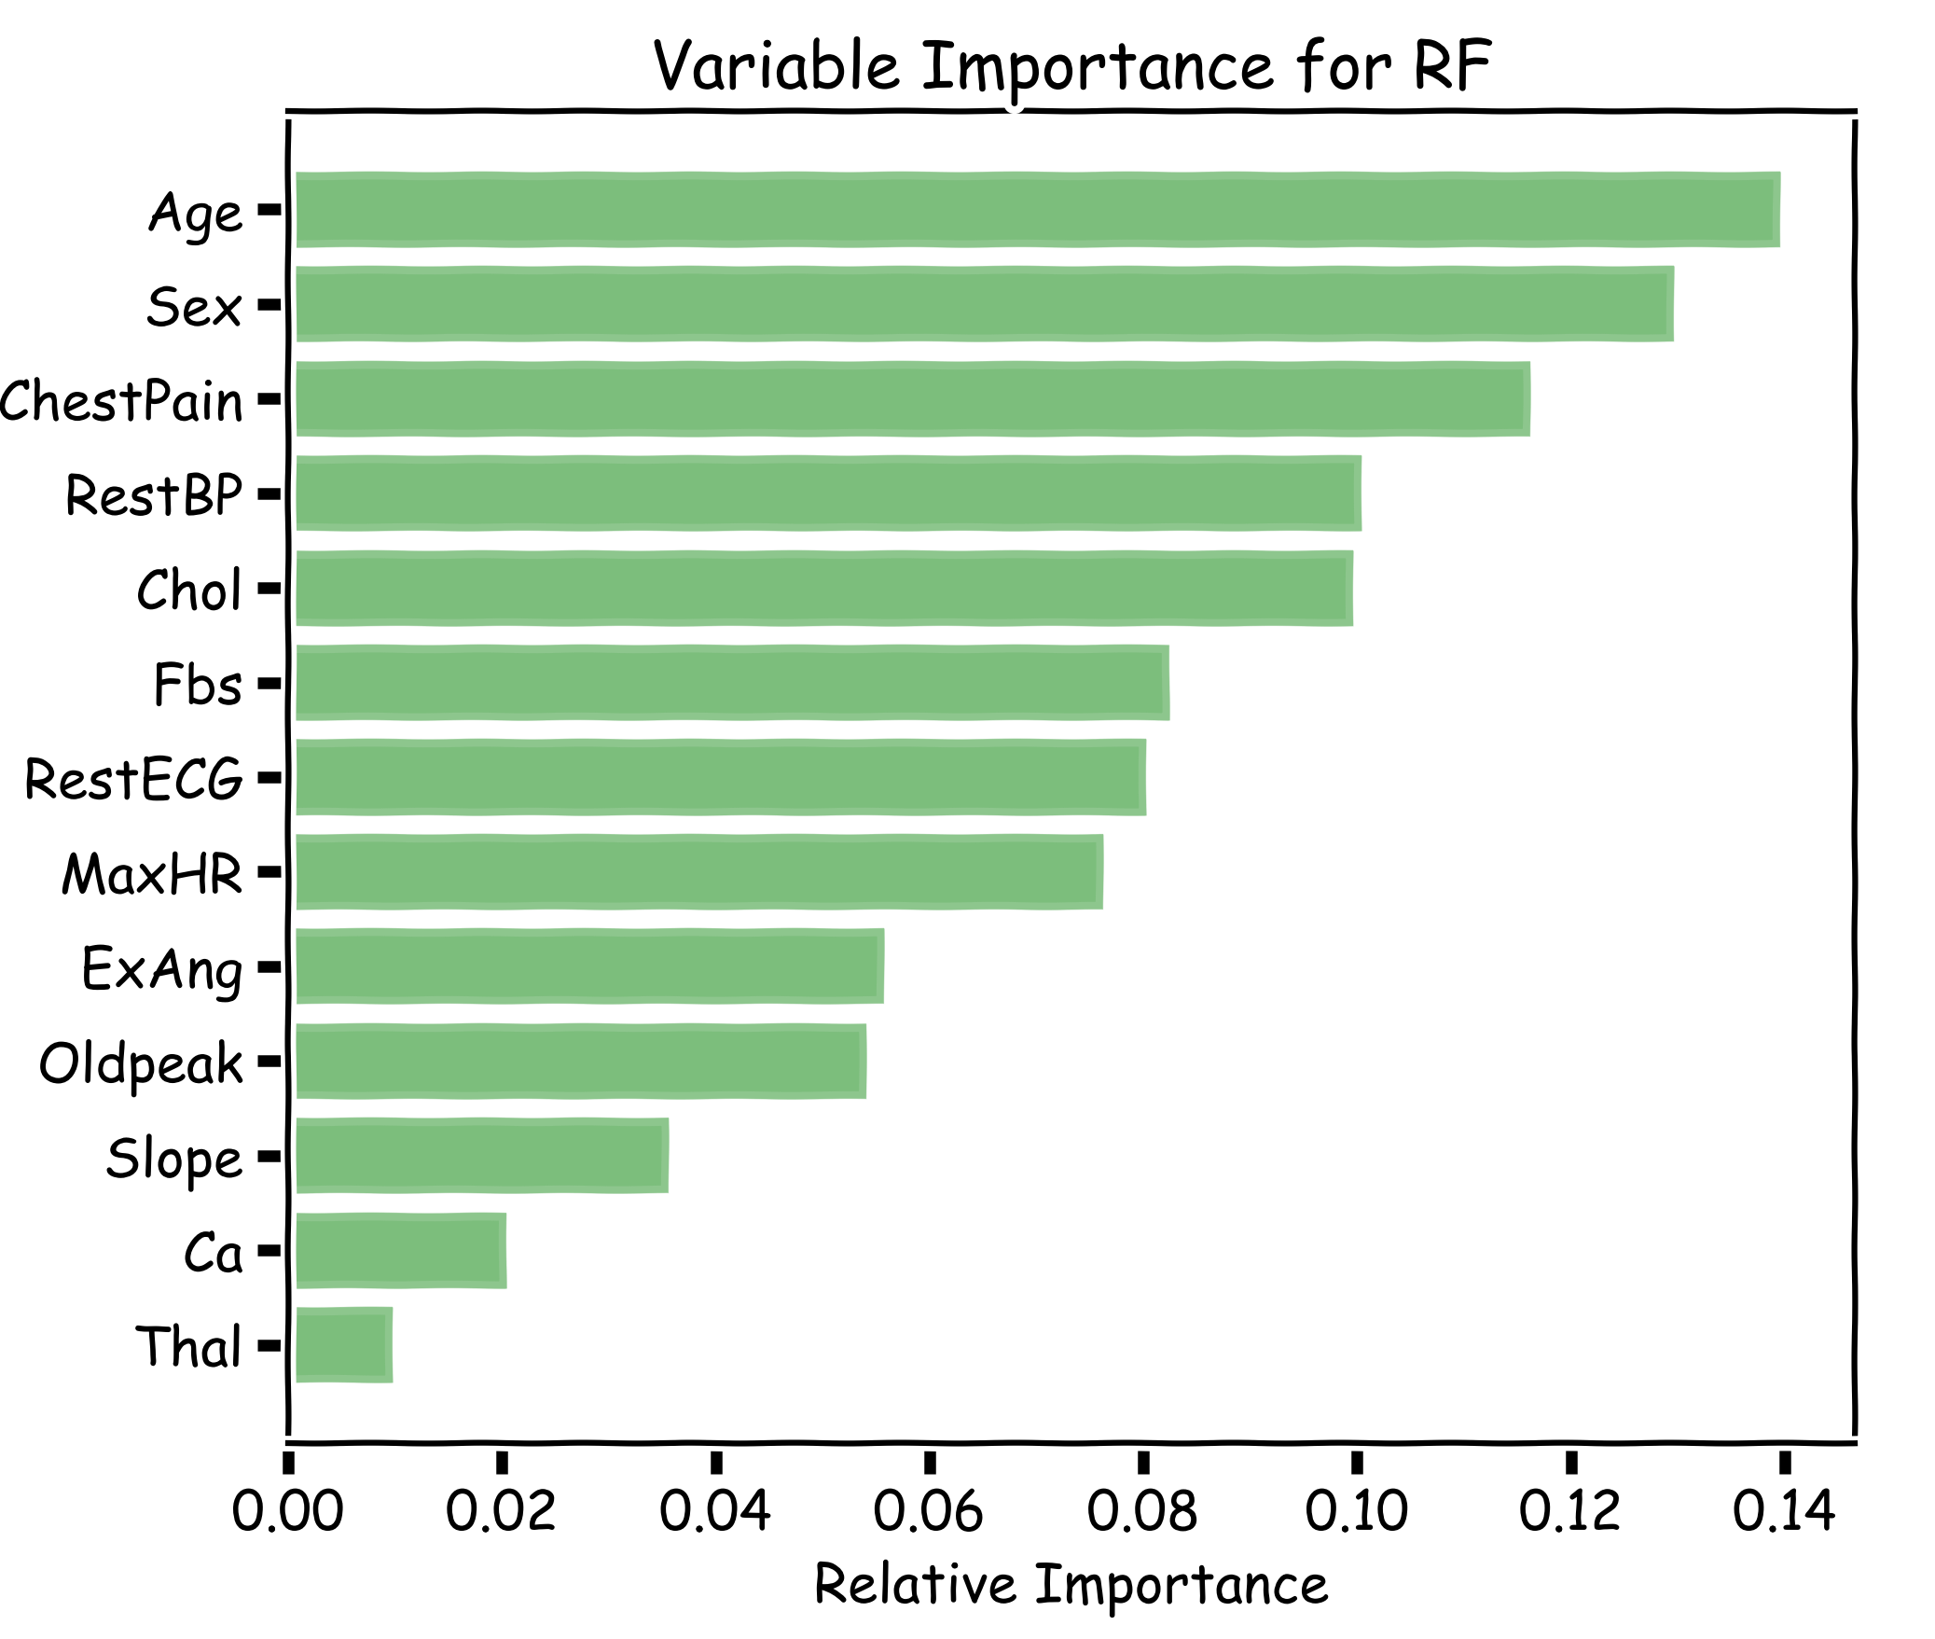
Explanations using Random Forests
Explaining predictions from tree models is always desired; the patterns uncovered by a model are, in some applications, more important than the model’s prediction performance.
A drawback of RF, Bagging, and other ensemble methods, is that the averaged model is no longer easily interpretable - i.e. one can no longer trace the logic of an output through a series of decisions based on predictor values!

