Slide 1
Foundations of Data Science & Analytics DSCI 633
Lecture 8
Nidhi Rastogi
Assistant Professor, GCCIS, RIT

Slide 2
Lecture Agenda
K-Nearest Neighbors

Slide 3
Classification Models
Base classification models
Linear Regression (covered in previous class)
Decision Tree
Instance-based (Nearest-neighbor)
Rule-based
Support Vector Machines
Neural Networks and Deep Learning (Taught in Neural Networks course)
Ensemble Classifiers
Boosting, Bagging, Random Forests

Slide 4
Classification Problem
So far studied learning problems
using linear classifier
Class 1
x2
Class 2
x1

Slide 5
Introduction: Instance-based Learning
Recall : Linear regression is an example of a parametric approach - assumes a linear functional form for f(X).
Instance-based - Do not form a general hypothesis regarding target function
non-parametric - does not make any assumption of the data distribution. Training data is simply stored.
When new query instance (test instance) is encountered, a set of similar, related instances is retrieved from memory.
used to classify new query instance (test instance).
They simply compute classification of each new query instance, as needed

Slide 6
k-Nearest Neighbor (k-NN) approach
Simplest, most used instance-based learning algorithm
Assumes all instances are points in some n-dimensional space and defines neighbors in terms of distance
k is the number of neighbors considered

Slide 7
k-NN approach
Supervised method: Training
Record labeled instances and feature-value vectors
Goal: For each new, unlabeled instance
Identify “nearest” labeled instance
Assign same label
Assume - property is same as that of the nearest reference case.

Slide 8
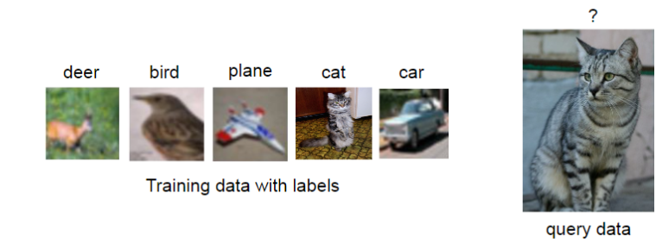
k-NN Example

Slide 9
k-NN Example
classify test object/
new query using k-NN
feature₁
feature₂

Slide 10
k-NN Example
classify image using k-nn
feature₁
feature₂

Slide 11
k-NN – Basic Idea
Given a query, assign majority category label of its
k-nearest training samples

Slide 12
k-NN Algorithm
For each training instance t = (x, f(x))
Add t to the set of tr_instances
Given a query instance q (or test instance) to be classified
Let x₁, …, x_{k} be the k training instances in tr_instances nearest to q
return
where, v is the finite set of target class values
δ(a,b)=1 if a=b, and 0 otherwise (Kronecker function)
Notes:
Kronecker Function

Slide 13
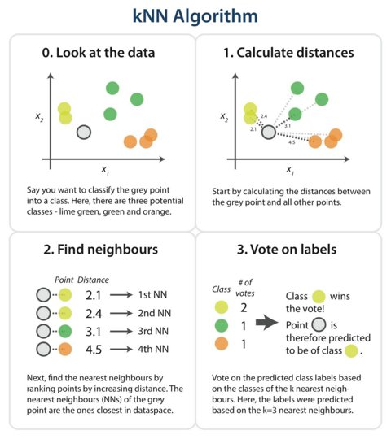
k-NN Algorithm (on twitter)
k=4
https://twitter.com/dataiku/status/798981230960246785/photo/1

Slide 14
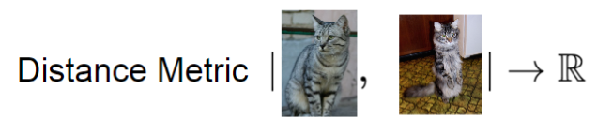
k-NN Example
find k-nearest neighbors -> how to measure “nearest”

Slide 15
Distance Metric
find k-nearest neighbors -> how to measure “nearest”
feature₁
(a₁, a₂)
(b₁, b₂)
feature₂

Slide 16
Common Approaches
Measuring “nearest”
Standard Euclidean distance metric
- two-dimensional:
dist(a,b) = sqrt((a₁ – b₁)² + (a₂ – b₂)²)
- n-dimensional:
dist(a,b) = sqrt(Σ_{i} (a_{i} – b_{i})²)
(a₁, a₂)
(b₁, b₂)

Slide 17
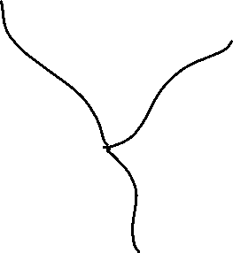
k-NN decision boundaries
Where are decision boundaries for k-NN?
k-NN gives locally defined decision boundaries between classes
feature₁
feature₂

Slide 18
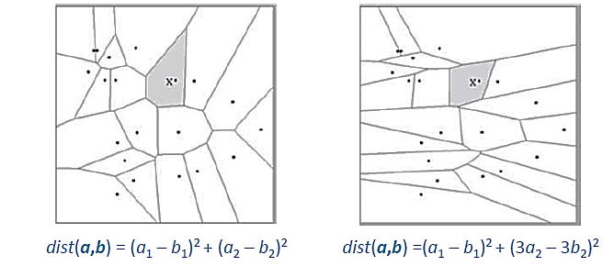
k-NN decision boundaries
Can be changed by different distance metrics
Becomes more complex as more examples are stored

Slide 19
k-NN decision boundaries
To classify instance x :
Find k nearest neighbors of x
Choose as label the majority label within k nearest neighbors
How do we choose k?

Slide 20
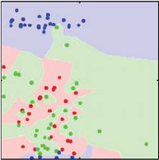
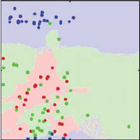
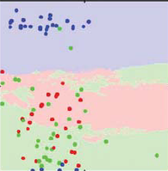
Impact of k
Role of k?
How does it relate to overfitting and underfitting?
k= 1 k= 3 k=31

Slide 21
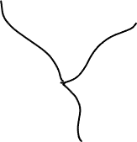
Impact of k
Choosing k
Often data-dependent and heuristic-based
Common heuristic – choose odd number (3,5,7..)
Use validation data instead of using only train/test
Avoid too small or too large values of k
too small (algorithm would be more sensitive to outliers)
too large (neighborhood may include too many points from other classes)
feature₁
feature₂

Slide 22
Variant of k
Weighted k-NN
Modified version of k-NN
Instead of treating all examples equally, weight “vote” of examples
Closer examples to have more vote/weight
feature₁
feature₂

Slide 23
Weighted k-NN
Normalized data looks like:
[id = 0, 0.32, 0.43, class = 0]
[id = 0, 0.52, 0.23, class = 4]
…
[id = 29, 0.71, 0.22, class = 2]
Nearest Neighbors (k=6) to (0.62, 0.35):
Id: 9 (0.61 0.42) class = 0, distance = 0.0707
Id: 7 (0.55 0.32) class = 0, distance = 0.0762
Id: 6 (0.55 0.41) class = 1, distance = 0.0922
Id: 8 (0.64 0.24) class = 2, distance = 0.1118
Id: 3 (0.49 0.32) class = 0, distance = 0.1334
Id: 1 (0.71 0.22) class = 2, distance = 0.1581
nearest k points are given a weight using a function called kernel function
IDT most common kernel function
Weights (inverse distance techniques)
0.2323
0.2157
0.1782
0.1469
0.1231
0.1039
Predicted class [0] 0.5711
[1] 0.1782
[2] 0.2508

Slide 24
Weighted k-NN
Weighted Euclidean distance: Once we have some idea of the relative importance of each variable, we can weight them:
WAS (non-weighted):
- n-dimensional:
dist(a,b) = sqrt(Σ_{i} (a_{i} – b_{i})²)
Weighted distance
- n-dimensional:
dist(a,b) = sqrt(Σ_{i} w_{k}(a_{i} – b_{i})²)

Slide 25
Issues with Distance Metrics
1. Most distance measures were designed for linear/real-valued attributes
Two important questions in the context of machine learning:
How best to handle nominal attributes
also called categorical, non-ordinal, non-numeric.
What to do when attribute types are mixed

Slide 26
Scale Effects
2. Different features may have different measurement scales
E.g., patient weight in kg (range [50,200]) vs. blood protein values in ng/dL (range [-3,3])
Consequences
Patient weight will have a much greater influence on the distance between samples
May bias the performance of the classifier

Slide 27
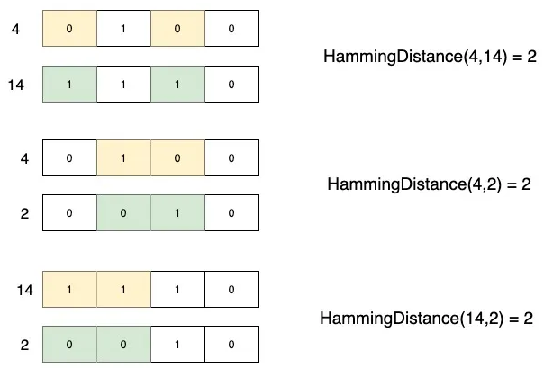
Solution: Use Other distance measures
Binary-valued features
Hamming distance dist(a,b) = Σ_{i} I(a_{i} ≠ b_{i})
Counts number of features where two examples disagree
Mixed feature types (some real, some binary, some nominal)
Mixed distance measures
E.g. Euclidean for real part, hamming for binary
Can also assign weights to features
dist(a,b) = Σ_{i} w_{i} .d(a_{i} ,b_{i})
Measuring “nearest”
(a₁, a₂)
(b₁, b₂)

Slide 28
Accuracy of k-NN

Slide 29
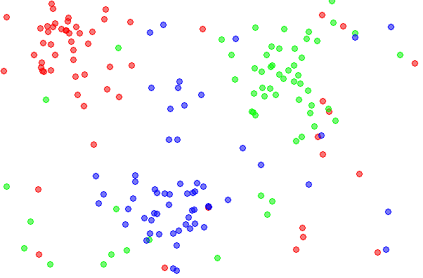
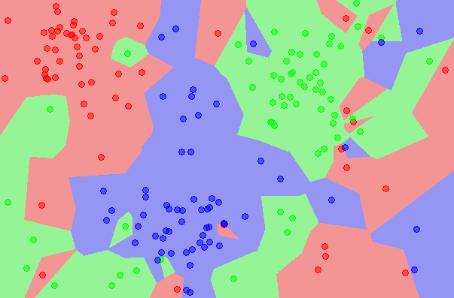
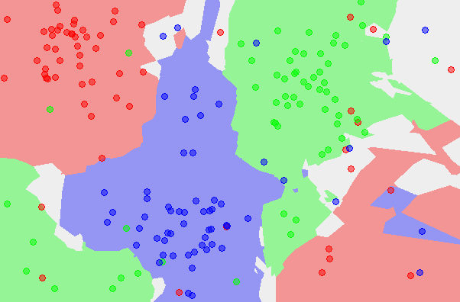
Accuracy of k-NN
What is the accuracy of the k-nearest neighbor classifier on the training data?

Slide 30
Accuracy of kNN
What is the best distance to use?
What is the best value of k to use?
i.e. how do we set the hyperparameters?

Slide 31
Accuracy of kNN
- Bias and Variance are prediction errors
- Tradeoff between a model’s ability to minimize bias and variance.
Bias
Average Prediction - Actual
Model with high bias pays very little attention to the training data and oversimplifies the model.
High bias leads to high error on training and test data.
Also a function of called model complexity and flexibility
More complex models have low bias, consider several features

Slide 32
Accuracy of kNN
- Bias and Variance are prediction errors
- Tradeoff between a model’s ability to minimize bias and variance.
Variance:
Variability of model prediction for a given data point or a value which tells us spread of our data.
Models with high variance pays a lot of attention to training data and does not generalize on the data which it hasn’t seen before.
As a result, such models perform very well on training data but have high error rates on test data.

Slide 33
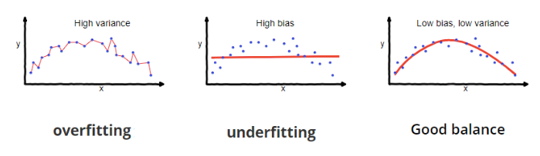
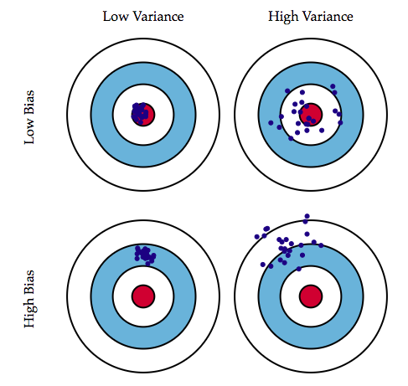
Accuracy of kNN
- Bias and Variance are prediction errors
- Tradeoff between a model’s ability to minimize bias and variance.
When we are tuning parameter controls, we are
trying to make the model more flexible.
bias
bias
variance
variance
tuning parameters
center of the target (red part) is the correct values of the data. As we move away from that region, the error becomes larger and larger.

Slide 34

Bias
Bias : Error that occurs when model unable to learn underlying pattern in training data
Why?
Model is too simple and cannot capture complexity of the data.
Training data not representative of real-world data.
Model biased towards certain parts of data.
Difference between true label and prediction
bias
bias
variance
variance
center of the target (red part) is the correct values of the data. As we move away from that region, the error becomes larger and larger.
tuning parameters

Slide 35

Variance
Variance: Error that occurs when the model too sensitive to training data. Model will make different predictions for same input data, depending on the specific training data that it was trained on.
Why?
Model is too complex and overfits training data.
Training data noisy or contains outliers.
Model is not regularized enough
(model will not generalize enough to new data. will likely to overfit;
will learn specific patterns in training data too well)
Expectation of squared deviation of a random variable from its mean
bias
bias
variance
variance
center of the target (red part) is the correct values of the data. As we move away from that region, the error becomes larger and larger.
tuning parameters

Slide 36
Bias Variance Tradeoff
Bias-variance trade-off : Impossible to have a model with both low bias and low variance.
Why?
If you reduce the bias of a model, you will increase the variance, and vice versa. This is because more complex models can learn more complex patterns in the data, but they are also more sensitive to noise and outliers.
bias
bias
variance
variance
center of the target (red part) is the correct values of the data. As we move away from that region, the error becomes larger and larger.
tuning parameters

Slide 37
Discussion: kNN (Bias vs Variance)
What is the best distance to use?
What is the best value of k to use?
i.e. how do we set the hyperparameters?
Very problem-dependent.
Must try them all out and see what works best.

Slide 38
Example Exercise
Consider an extreme case, K=1, what will it happen?
What happens when we increase K?

Slide 39
Example Exercise
The training data will be perfectly predicted, right? The bias will be 0 when K=1, however, when it comes to new data (in test set), it has higher chance to be an error, which causes high variance.
When we increase K, the training error will increase (increase bias), but the test error may decrease at the same time (decrease variance). We can think that when K becomes larger, since it has to consider more neighbors, its model is more complex. Now we can split the data into training and validation set and decide what K should be like.

