Slide 1
Foundations of Data Science & Analytics DSCI 633
Lecture 5
Nidhi Rastogi
Assistant Professor, GCCIS, RIT

Slide 2
Lecture Objective
Study and Implement Training Models
Linear Regression
Gradient Descent - recap
Regularized Linear Models
Logistic Regression
Softmax Regression

Slide 3


Review of Formal Definitions
for a linear model, the prediction y is calculated as:
here,
Notes:
Hello World of machine learning.

Slide 4
Review of Formal Definitions
Approach to Training Process: The θ values are learned during the training process, where the model tries to minimize a loss function, such as the Mean Squared Error (MSE).
Notes:
Hello World of machine learning.

Slide 5
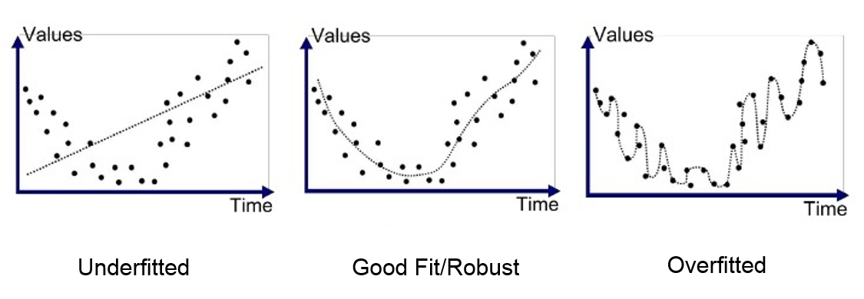
Why should we study regularization?
Underfitting
Fitting
Overfitting
Notes:
Hello World of machine learning.

Slide 6
Regularization
Notes:
Hello World of machine learning.

Slide 7
Regularized Linear Models
Conceptually,
Reduces overfitting to regularize the model (i.e., to constrain it)
How -> Reduces the degrees of freedom the model has so it is harder to overfit the data (number of values in the final calculation of a statistic that are free to vary)
Notes:
Hello World of machine learning.

Slide 8
Regularized Linear Models
Previous Approach to Training Process: The θ values are learned during the training process, where the model tries to minimize a loss function, such as the Mean Squared Error (MSE),
New addition to training process-> while also considering the Regularization Term.
Notes:
Hello World of machine learning.

Slide 9
Regularized Linear Models
For a linear model, regularization is typically achieved by constraining the weights of the model.
2 common ways to constraint the weights:
Ridge Regression – Also called L2 Regression
Lasso Regression – Also called L1 Regression
Notes:
Hello World of machine learning.

Slide 10

Ridge Regression
Regularized version of Linear Regression
a regularization term equal to is added to the cost function
Notes:
Hello World of machine learning.

Slide 11
Ridge Regression
Forces learning algorithm to not only fit the data but also keep the model weights as small as possible.
Note that the regularization term should only be added to cost function during training.
Once the model is trained, you want to evaluate the model’s performance using the unregularized performance measure.
Notes:
Hello World of machine learning.

Slide 12

Regularized Linear Models
Alpha is the hyperparameter here.
Alpha is the Learning Rate.
What is a hyperparameter?
help estimate model parameters
Is specified manually, not from the data
What happens if alpha = 0?
Ridge Cost Function
Ridge = Linear
Notes:
Hello World of machine learning.

Slide 13
Regularized Linear Models
Ridge Cost Function
J(θ) = Cost function
MSE (θ) = Mean Squared Error
NOTE:
- if w = vector of feature weights (θ₁ to θ_{n}), then regularization term is simply equal to ½ (∥w∥²)₂, where ∥w∥₂ represents the ℓ2 norm of the weight vector.
- for Gradient Descent, just add αw to the MSE gradient vector.
- θ₀ (bias term) is not regularized (the sum starts at i = 1, not 0)
Notes:
Hello World of machine learning.

Slide 14
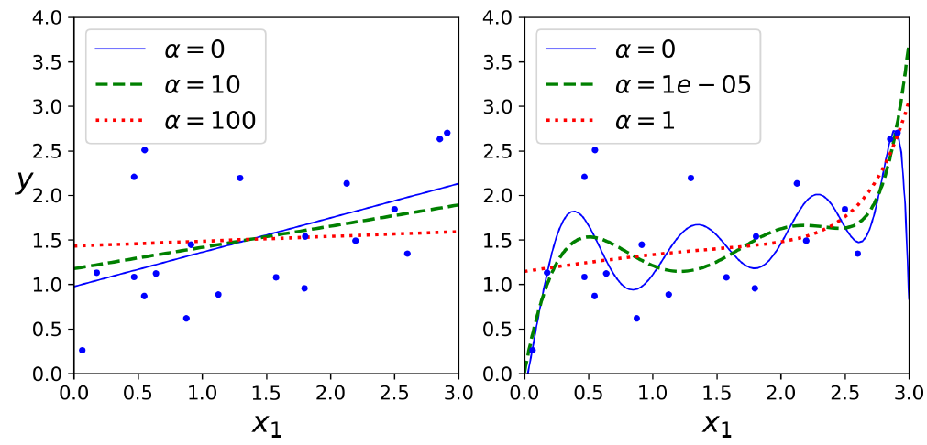
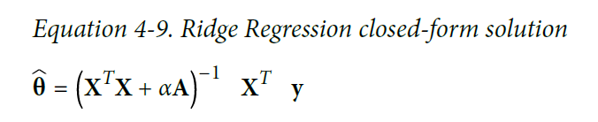
Ridge Regression (extra slide)
As with Linear Regression, we can perform Ridge Regression either by computing a
closed-form equation or by performing Gradient Descent.
See graphs where A is the (n + 1) × (n + 1)
Notes:
Hello World of machine learning.

Slide 15
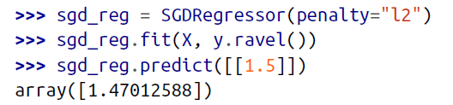
Ridge Regression with Scikit-Learn
The penalty hyperparameter sets the type of regularization term to use. Specifying
”L₂" indicates that you want SGD to add a regularization term to the cost function
equal to half the square of the ℓ2 norm of the weight vector.
- This is simply Ridge Regression.
Using Stochastic Gradient Descent:14
Notes:
Hello World of machine learning.

Slide 16

Lasso Regression
Least Absolute Shrinkage and Selection Operator Regression (simply called Lasso Regression)
Like Ridge, adds a regularization term to the cost function,
Uses the ℓ1 norm of the weight vector, unlike Ridge which uses half the square of the ℓ2 norm
Notes:
Hello World of machine learning.

Slide 17
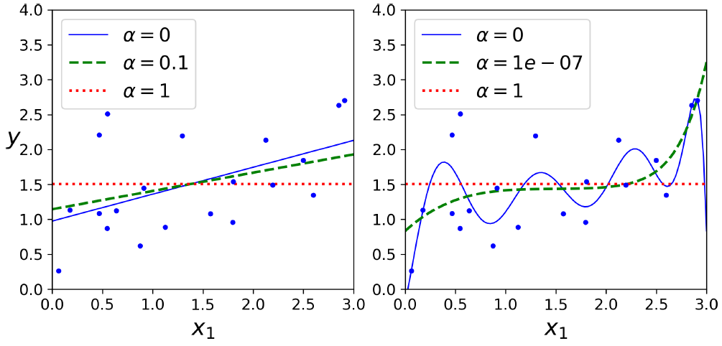
Important characteristic of Lasso
- tends to completely eliminate
the weights of the least important features (i.e., set them to zero).
For example, the dashed line in the right plot on figure (with α = 10⁻⁷) looks quadratic, almost linear: all the weights for the high-degree polynomial features are equal to zero.
In other words, Lasso Regression automatically performs feature selection and outputs a sparse model (i.e., with few nonzero feature weights).
Notes:
Hello World of machine learning.

Slide 18
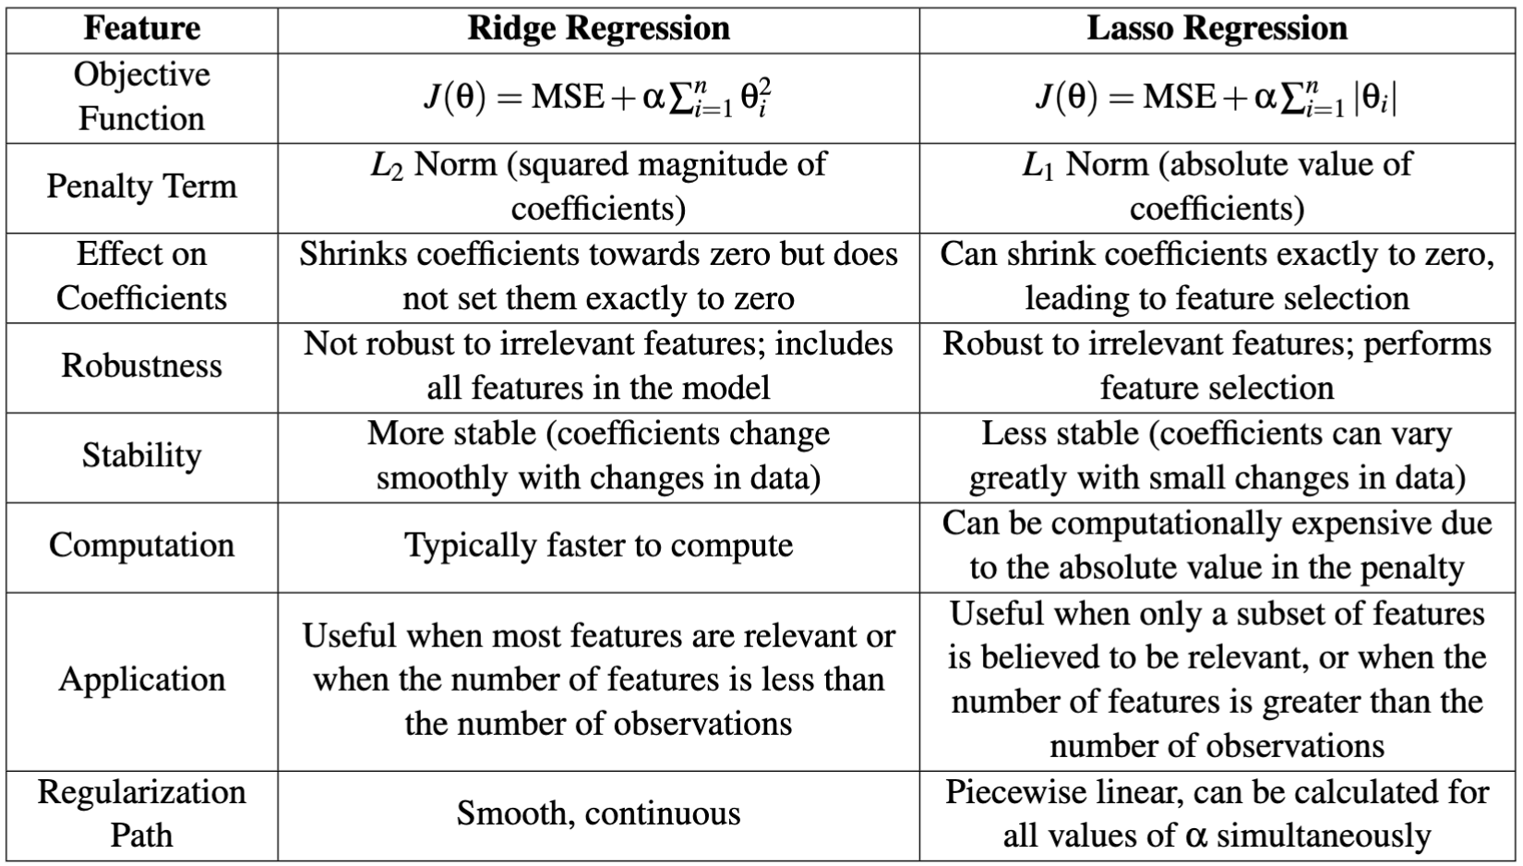
Differences between Ridge and Lasso Regression
Notes:
Hello World of machine learning.

Slide 19
Logistic Regression
middle ground between Ridge Regression and Lasso Regression
regularization term is a simple mix of both Ridge and Lasso’s regularization terms, and you can control the mix ratio r.
Can be used for classification as well
Class + the Probability of a class.
Notes:
Hello World of machine learning.

Slide 20

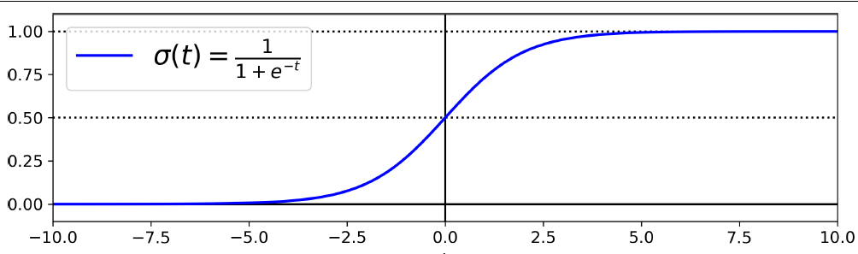
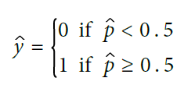
Mathematically, Logistic Regression estimates probabilities
Computes a weighted sum of input features plus a bias term
(like linear regression)
Logistic is a sigmoid function
Outputs a number between 0 and 1
For Spam/Ham question
If it is > 0.5, then email is spam
σ(t) < 0.5 when t < 0, and σ(t) ≥ 0.5 when t ≥ 0,
Logistic Regression model predicts:
1 if x^{T} θ is positive
0 if x^{T} θ is negative.
Notes:
Hello World of machine learning.

Slide 21
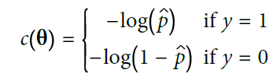

Training and Cost Function (θ)
GOAL: set parameter vector θ so that model estimates high probabilities for positive instances (y =1) and low probabilities for negative instances (y = 0)
cost function over the whole training set is simply the average cost over all training instances.
How to calculate θ, goal is minimize cost function
Cost function of a single training instance, x
Cost function of Logistic Regression
Notes:
Hello World of machine learning.

Slide 22

Can use Gradient Descent
partial derivatives of the cost function with regards to the j^{th} model parameter θ_{j} is given by
training instance
Cost function
prediction error
Notes:
Hello World of machine learning.

Slide 23

Softmax Regression
Logistic Regression model can be generalized to support multiple classes directly, without having to train and combine multiple binary classifiers
Also called multinomial Logistic Regression
Model
for each instance x, compute a score s_{k}(x) for each class.
estimate the probability of each class by applying the softmax function
equation similar to linear regression
Softmax score for class k

Slide 24
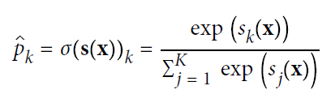
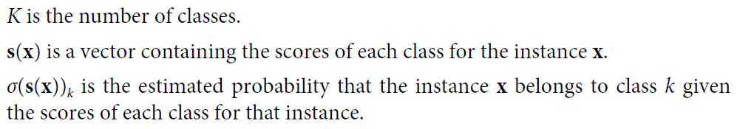
Softmax Regression
each class has its own dedicated parameter vector θ(k).
All these vectors are typically stored as rows in a parameter matrix Θ
You can estimate probability of an instance belonging to a class k by running scores through softmax function
Softmax function computes exponential of every score, then normalizes them (dividing by sum of all exponentials).
Scores generally called logits
Softmax score for class k
Notes:
Hello World of machine learning.

Slide 25


Softmax Regression
Predicts class with highest estimated probability (class with highest score)
argmax operator returns the value of a variable that maximizes a function. In this equation, it returns the value of k that maximizes the estimated probability σ(s(x))_{k}.
Cross entropy is frequently used to measure how well a set of estimated class probabilities match the target classes. Cost function.
y_{k}^{(i)} = target probability that the i_{th} instance belongs to class k. It is either equal to 1 or 0, depending on whether the instance belongs to the class or not. When (K = 2), this cost function is equivalent to the Logistic Regression’s cost function
Notes:
Hello World of machine learning.

Slide 26

Softmax Regression
Minimizing cost function using GD
Cross entropy gradient vector for class k
Notes:
Hello World of machine learning.

Slide 27
Softmax Regression
Minimizing cost function using GD
Cross entropy gradient vector for class k
Notes:
Hello World of machine learning.

Slide 28
Recap of Gradient Descent (GD)
Why do we need GD?
When do we need GD?
What happens when we apply GD?
What if we do not use GD?
Notes:
Hello World of machine learning.

Slide 29
Recap of Gradient Descent
1. Why do we need Gradient Descent?
Optimization: Many problems in machine learning and statistics involve finding the minimum of a function (loss function) that measures the difference between the actual and the predicted data by the model. GD helps in finding the minimum of this function, which helps optimize the model.
Efficiency: For large datasets or high-dimensional parameter spaces, to compute the optimal solution GD can be more efficient for these problems.
Notes:
Hello World of machine learning.

Slide 30
Recap of Gradient Descent
2. When do we need Gradient Descent?
Machine Learning Models: When training machine learning models like linear regression, neural networks (will study in later classes), etc., where the goal is to minimize the loss function.
Large Scale Problems: For problems involving large datasets or high-dimensional parameter spaces.
Notes:
Hello World of machine learning.

Slide 31
Recap of Gradient Descent
What happens when we apply Gradient Descent?
Parameter Updates: The parameters of the model are iteratively updated in the direction of the negative gradient of the loss function with respect to the parameters. This helps in reducing the loss.
Convergence: Ideally, the algorithm converges to a local (or global) minimum of the loss function, resulting in optimized model parameters.
Learning Rate: The step size or learning rate is crucial. If it is too large, the algorithm might overshoot the minimum, and if it is too small, it might take a very long time to converge or get stuck in a local minimum.
Notes:
Hello World of machine learning.

Slide 32
Recap of Gradient Descent
What if we do not use Gradient Descent?
Computational Inefficiency: For some problems, especially large-scale ones, not using GD could result in computational inefficiency, making it difficult to find the optimal solution.
Suboptimal Solutions: Without proper optimization, the model might not perform as well, leading to suboptimal results and poor generalization to unseen data.
Notes:
Hello World of machine learning.

