Slide 1
Foundations of Data Science & Analytics (DSCI 633)
Nidhi Rastogi
Assistant Professor, GCCIS
Rochester Institute of Technology
August 25, 2022

Slide 2
Where to begin?
Motivating Questions Asked
Which models should I learn?
Can I use the data for any task
Should I start with Machine learning or Deep learning first?
How to get good at Data Science
…?

Slide 3
Use Case
Software Defect Prediction

Slide 4
Task: Given a piece of code, predict whether it has defects or not.
Binary Classification
int minval(int *A, int n) {
int currmin;
for (int i=0; i<n; i++)
if (A[i] < currmin)
currmin = A[i];
return currmin;
}
Model
Bug?

Slide 5
Data Availability
Supervised Learning
10 different software projects
Each has 5 releases
Each release has around 100 code modules
All code modules are labeled as buggy or non-buggy
Around 20% code modules have bugs

Slide 6
Task Specification
Within-project prediction
For project i, given past releases as training data, predict code modules in current release.
Cross-project prediction
For project i, given other projects as training data, predict defect code modules in project i.

Slide 7
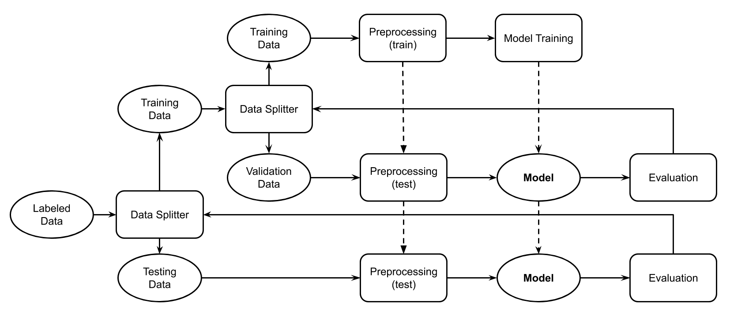
Within-Project Prediction
Release j < i
Release 1 to m-1
Release i
Release
m

Slide 8
Cross-Project Prediction
Other Projects
Other Projects
Project i
Project k

Slide 9
Evaluation
Precision
Recall
F1
AUC
For the buggy class!!!

Slide 10
Preprocessing
Very domain-specific
Best way to start:
Understand baseline approaches
Review existing models (github, Kaggle, …)
check how other researchers featurize the code modules

Slide 11
Preprocessing
Software metrics:
E.g. lines of code, number of inputs
Only has abstract information
Can use tools to extract
Low dimensionality (10 - 20)
Text mining features:
Treat codes as natural language
High dimensionality (thousands to millions)

Slide 12
Software Metrics
Normalize on columns
name | loc | wmc | dit | noc | cbo | rfc | lcom
org.apache.lucene.analysis.WhitespaceAnalyzer | 10 | 2 | 2 | 0 | 3 | 4 | 1
org.apache.lucene.search.QueryTermVector | 278 | 10 | 1 | 0 | 4 | 37 | 0
org.apache.lucene.analysis.PorterStemmer | 1174 | 27 | 1 | 0 | 1 | 43 | 13

Slide 13
Text Mining Features
Normalize on rows
int minval(int *A, int n) {
int currmin;
for (int i=0; i<n; i++)
if (A[i] < currmin)
currmin = A[i];
return currmin;
}
int minval int a int n int currmin for int i 0 i n i if a i currmin currmin a i return currmin
Term Frequency
Tokenize
int | minval | a | n | currmin | for | i | 0 | if | return
5 | 1 | 3 | 1 | 4 | 1 | 5 | 1 | 1 | 1

Slide 14
Preprocessing
Data Balancing:
Target is minority
Data Balancing is critical
Dimensionality Reduction?
Principal Component Analysis (PCA)
Linear Discriminant Analysis (LDA)

Slide 15
Model
Naive Bayes
SVM
Random Forest
Decision Tree

Slide 16
Model / Parameter Selection
Tuning:
Evolutionary algorithms (GA, SA, DE, ...)
Grid search / Random search
Surrogate models (Bayesian Optimization)

Slide 17
Testing
Collect performance metrics on test data
Discuss with customer to check whether the results satisfy the requirements
Make improvements based on customer feedback

