Slide 1
Foundations of Data Science & Analytics DSCI 633, Fall 2022
Lecture 4
Nidhi Rastogi
Assistant Professor, GCCIS, RIT

Slide 2
Course Information
HW2 will go live today.
Grades for HW1 will be posted by end of week.

Slide 3
Lecture Objective
Study and Implement Training Models
Linear Regression
Gradient Descent
Regularized Linear Models
Logistic Regression
Softmax Regression

Slide 4


ML Models as Black boxes
Working with ML Models without knowing anything about what’s under the hood
Black boxes do not give you a good understanding of “how things work”
White boxes do:
Narrow down the appropriate model - right training algorithm to use
A good set of hyperparameters for your task
Debug issues
Perform error analysis more efficiently
Understanding, building, and training neural networks
Notes:
Hello World of machine learning.

Slide 5
Linear Regression Model
One of the simplest model. Teaches how to identify patterns in data.
2 ways to train model:
1. using a direct “closed-form” equation called normal equation
directly computes model parameters that best fit model to training set (model parameters that minimize cost function over the training set)
2. using iterative optimization approach, called Gradient Descent (GD)
gradually tweaks the model parameters to minimize the cost function over the training set
eventually converging to same set of parameters as first method.
Stochastic GD. Batch GD, Mini-batch GD left for self-study.
Notes:
Hello World of machine learning.

Slide 6
Linear Regression Model
One of the simplest model. Teaches how to identify patterns in data.
2 ways to train model:
1. using a direct “closed-form” equation called normal equation
directly computes model parameters that best fit model to training set (model parameters that minimize cost function over the training set)
2. using iterative optimization approach, called Gradient Descent (GD)
gradually tweaks the model parameters to minimize the cost function over the training set
eventually converging to same set of parameters as first method.
Stochastic GD. Batch GD, Mini-batch GD left for self-study.
Notes:
Hello World of machine learning.

Slide 7
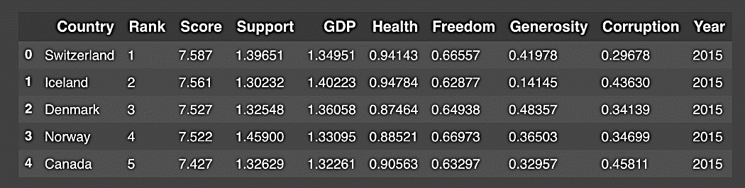
Linear Regression contd…
Simple regression model learnt in last classes (and in Assignment 2)
life_satisfaction = θ0 + θ1 × GDP_per_capita
where, θ0 + θ1 are model parameters
GDP_per_capita input feature
Linear function
Notes:
Hello World of machine learning.

Slide 8

Linear Regression contd…
life_satisfaction = θ0 + θ1 × GDP_per_capita
ŷ = θ0 + θ1 × GDP_per_capita
θ₁ x₁ + θ₂ x₂ + ⋯ + θ_{n} x_{n}
predicted value
bias term
vectorized form
where, n is the number of features
x_{i} is the i^{th} feature value
θj is the j^{th} model parameter (including θ0 , as the bias term and θ1 , θ2 ,... ,θn the feature weights)
Notes:
Hello World of machine learning.

Slide 9
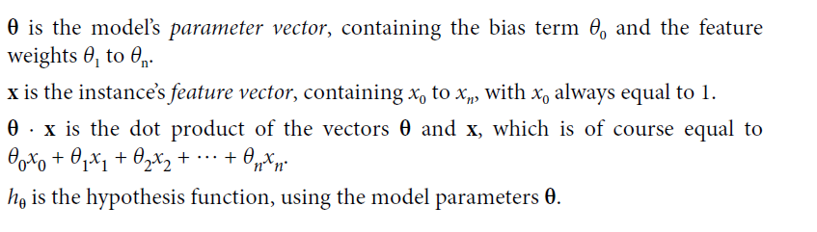
Linear Regression contd…
Notes:
Hello World of machine learning.

Slide 10
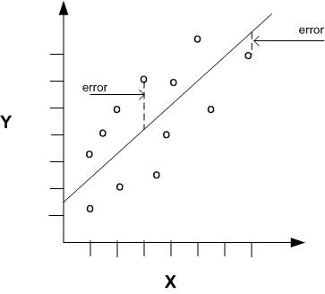
Linear regression training
GOAL: Training a model means setting its parameters so that the model BEST fits the training set.
Quality : how well predictions match up against actual values
Graphically, find a line that minimizes the prediction error of all the data points
Notes:
Hello World of machine learning.

Slide 11
Linear regression performance measure
But how do we actually evaluate quality?
RMSE (Root mean square error) measures how well or poorly a model fits the training data.
Find θ that minimizes RMSE
Notes:
Hello World of machine learning.

Slide 12
Linear regression training
Clearer Goal: Find θ that minimizes RMSE
Remember - RMSE is the standard deviation of the residuals (prediction errors).
What does minimizing RMSE mean?
Minimizing Error!
Notes:
Hello World of machine learning.

Slide 13
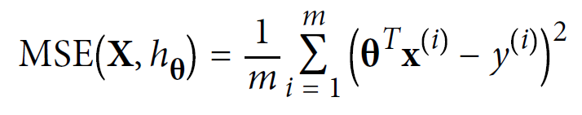
Linear regression training
In practice, it is simpler to minimize the Mean Square Error (MSE) than the RMSE, and it leads to the same result (because the value that minimizes a
function also minimizes its square root).
where, m is the number of instances in training dataset you’re measuring the MSE on,
x^{(i)} is a vector of all the feature values (excluding the label) of the i^{th} instance in the dataset, and y^{(i)} is its label (the desired output value for that instance).
Notes:
Hello World of machine learning.

Slide 14

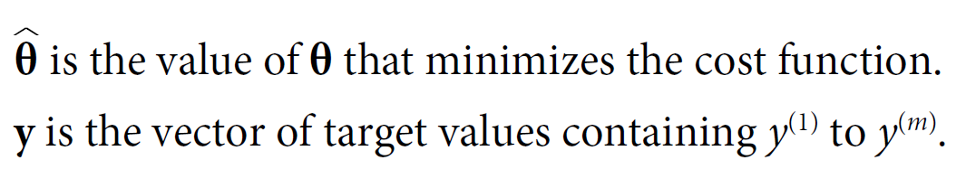
Linear regression training
To find the value of θ that minimizes the cost function, there is a closed-form solution called Normal Equation
mathematically,
where,
Notes:
Hello World of machine learning.

Slide 15
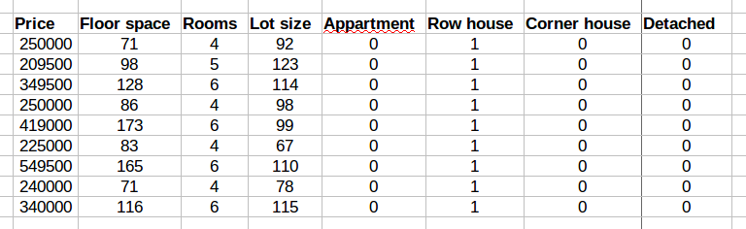
Example
House price prediction
Y=
X =
Notes:
Hello World of machine learning.

Slide 16
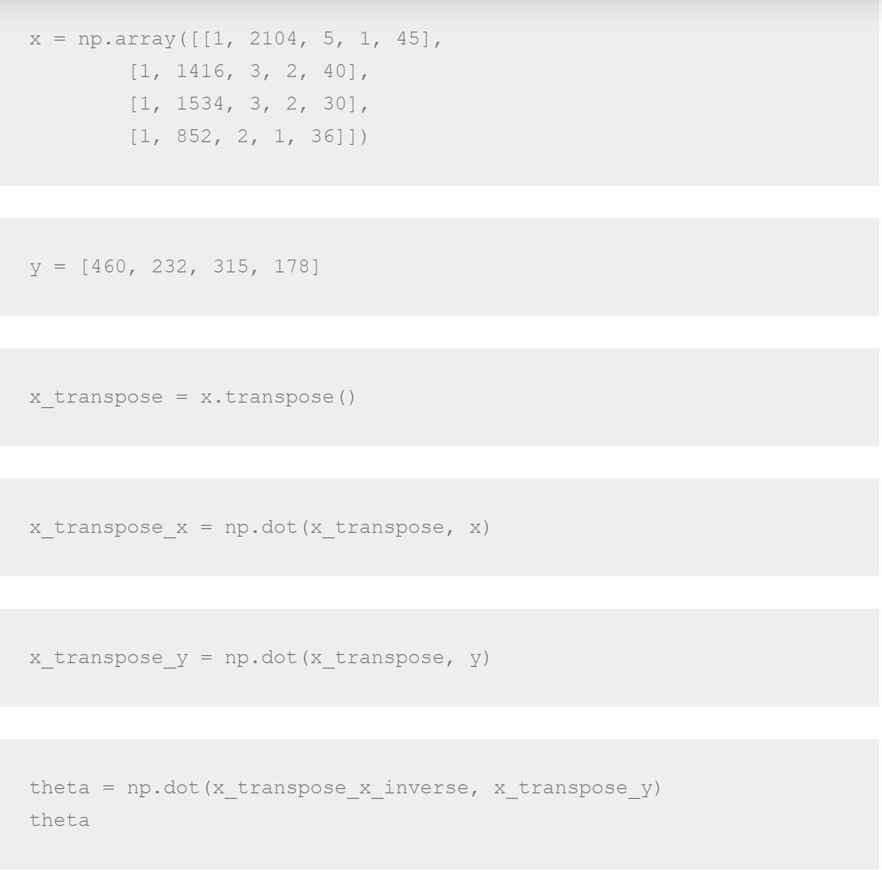
Using pandas
Notes:
Hello World of machine learning.

Slide 17
Computational Complexity
For n features, what is the computational complexity in a normal equation?
Normal equation computes the inverse of X^{T} X : an (n + 1) × (n + 1) matrix
The computational complexity of inverting such a matrix is typically about O(n^{2.4}) to O(n³) (depending on the implementation).
Notes:
Hello World of machine learning.

Slide 18
Linear Regression Model
One of the simplest model. Teaches how to identify patterns in data.
2 ways to train model:
1. using a direct “closed-form” equation called normal equation
directly computes model parameters that best fit model to training set (model parameters that minimize cost function over the training set)
2. using iterative optimization approach, called Gradient Descent (GD)
gradually tweaks the model parameters to minimize the cost function over the training set
eventually converging to same set of parameters as first method.
Stochastic GD. Batch GD, Mini-batch GD left for self-study.
Notes:
Hello World of machine learning.

Slide 19


Gradient Descent (GD)
Intuition: Tweak parameters iteratively in order to minimize a cost function
Common Analogy - you are lost in the mountains in a dense fog; you can only feel the slope of the ground below your feet.
A good strategy to get to the bottom of the valley quickly is to go downhill in the direction of the steepest slope.
GD: measures local gradient of the error function vis-à-vis θ,
goes in the direction of descending gradient.
once the gradient = 0, θ reached a minimum
minimum
Notes:
Hello World of machine learning.

Slide 20
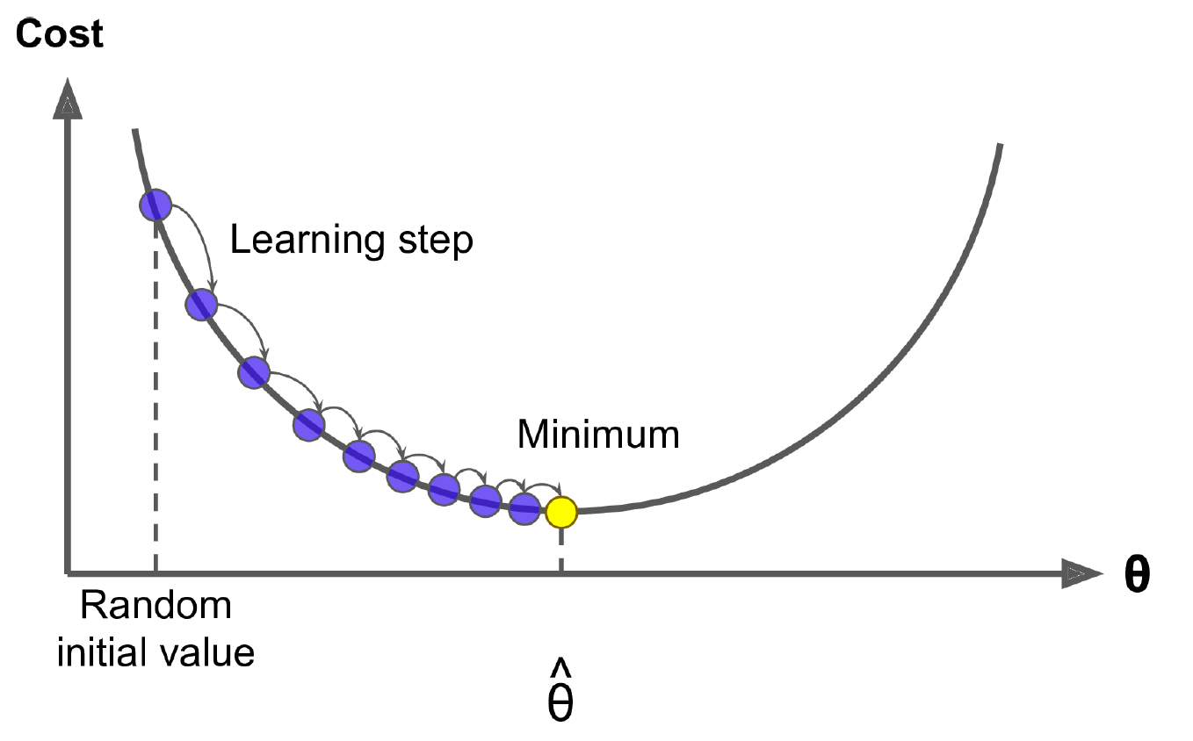
Start by filling θ with random values (this is called random initialization)
Improve it gradually - Each step attempting to decrease the cost function (e.g., the MSE), until the algorithm converges to a minimum
What is an important parameters of GD?
size of the steps, determined by the learning rate hyperparameter.
If too small, then ….
the algorithm will have to go through many iterations to converge, which will take a long time.
If too big, then ….
the algorithm might diverge, with larger and larger values, failing to find a good solution
Notes:
Hello World of machine learning.

Slide 21
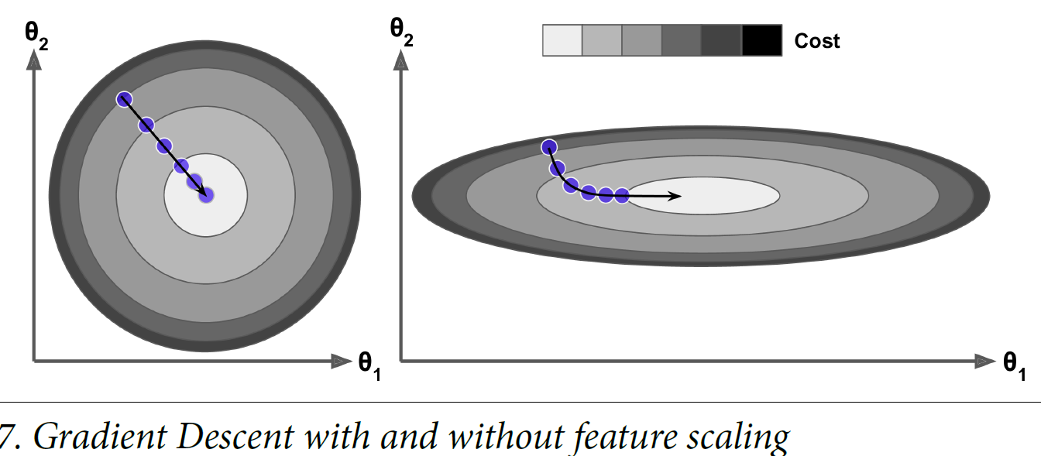
Shape of cost function : A bowl
Elongated : If the features have very different scales.
training set where feature 1 has much smaller values than feature 2
Left: GD algorithm goes straight toward minimum
Reaching quickly
Right: GD first goes in a direction almost orthogonal to direction of global minimum
Eventually reaches minimum, but it will
take a long time.
Note: Training a GD model means searching for a
combination of model parameters that minimizes a cost function (over the training
set).
Since, search in the model’s parameter space: the more parameters a model has, the more dimensions this space has, and the harder the search is.
Gradient Descent on a training set where features 1 and 2 have the same scale
Notes:
Hello World of machine learning.

Slide 22
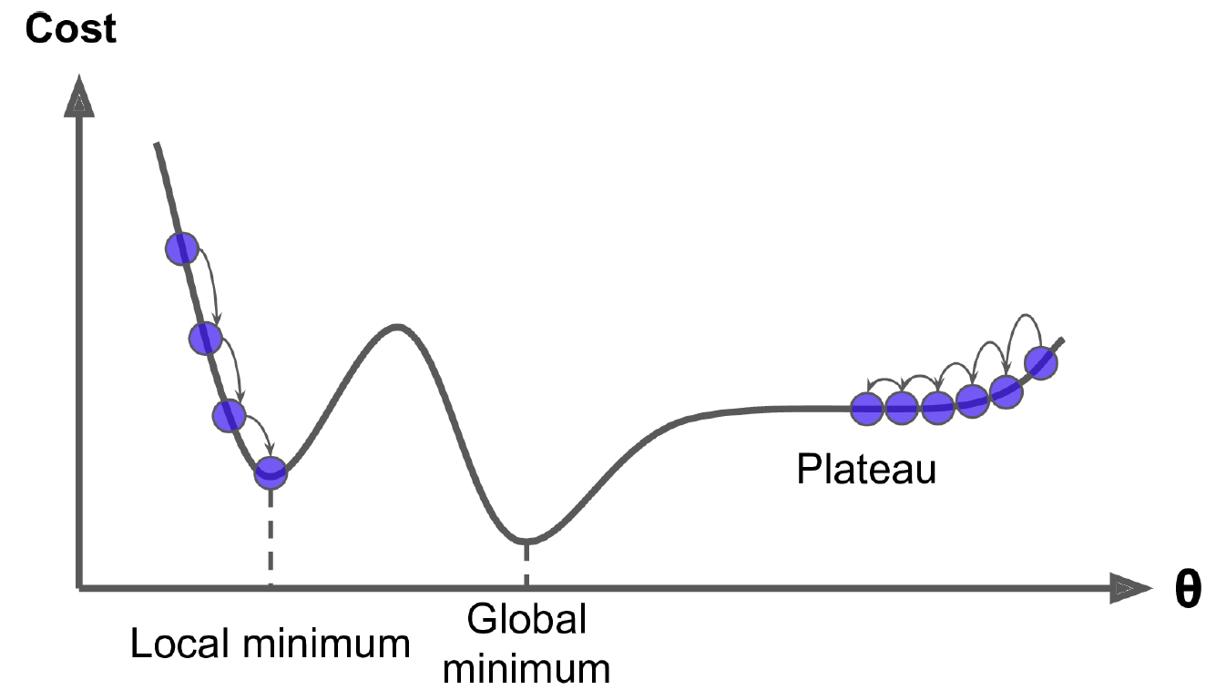
What about this curve?
Notes:
Hello World of machine learning.

Slide 23
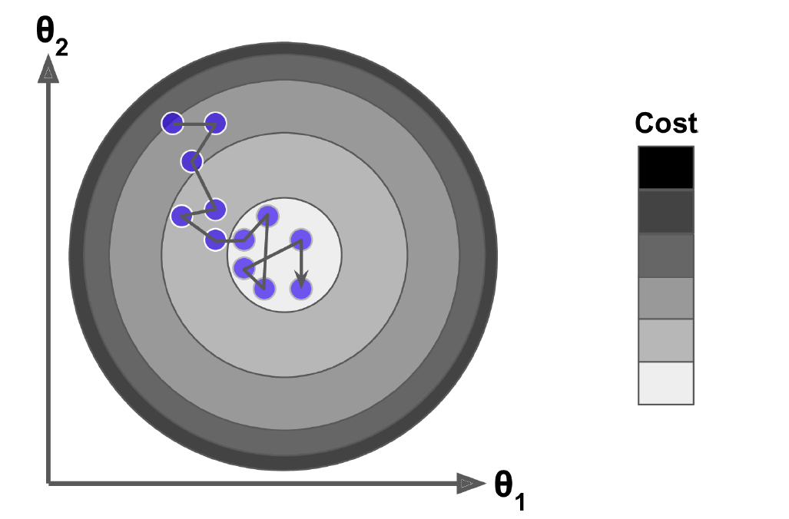
Stochastic Gradient Descent
Picks random instance in training set at every step
Computes gradients based only on that single instance
Makes the algorithm much faster, very little data to manipulate at every iteration
Cost function will bounce up and down, decreasing only on average.
Over time it will end up very close to the minimum, but once it gets there it will
continue to bounce around, never settling down.
Do we reach minima?
Once GD algorithm stops, the final parameter values are good, but not optimal.
Notes:
Hello World of machine learning.

Slide 24
Other Gradient Descent
Batch GD
Mini-batch GD
left for self-study
Notes:
Hello World of machine learning.

Slide 25
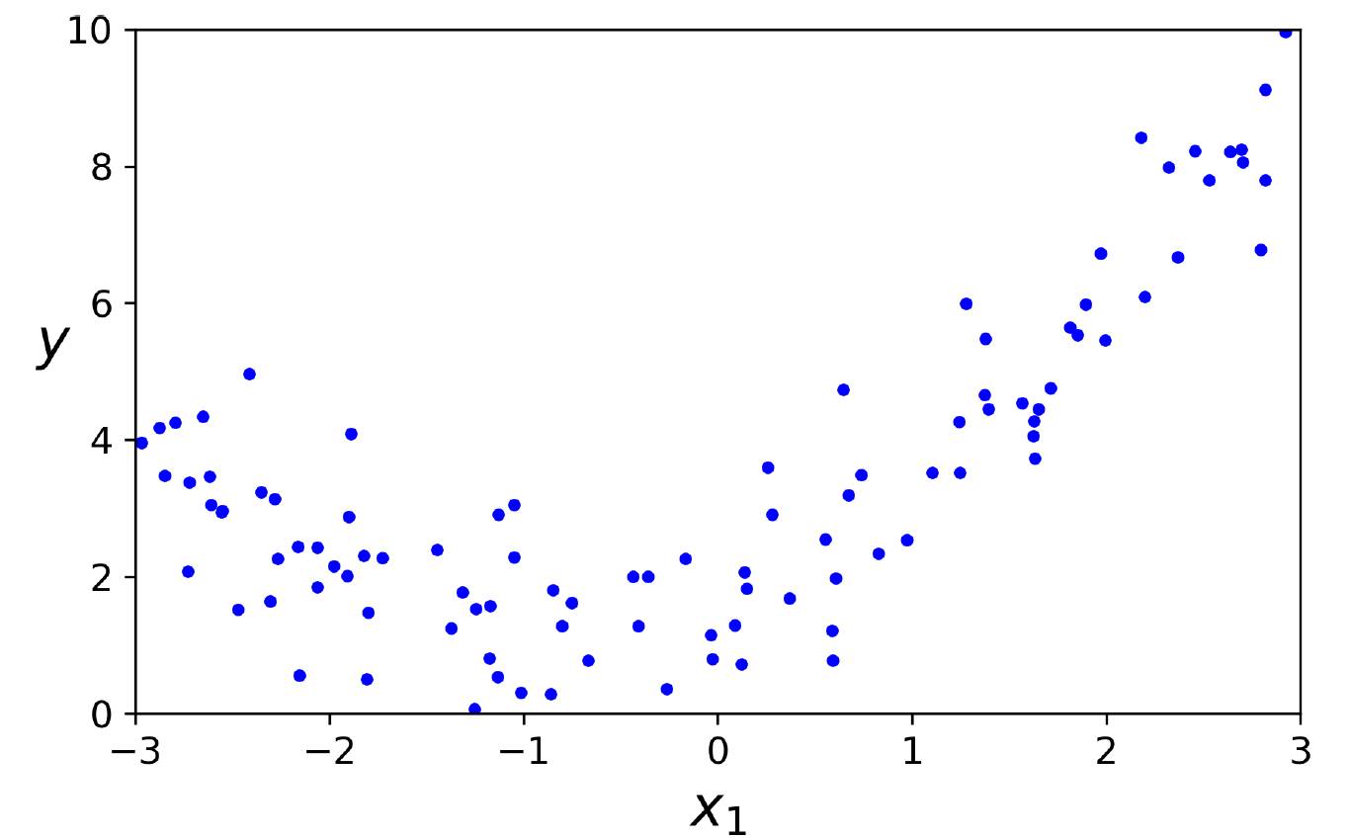
How will a straight line pass through this data?
Notes:
Hello World of machine learning.

