Slide 1
Foundations of Data Science & Analytics DSCI 633, Fall 2021
Lecture 6
Nidhi Rastogi
Assistant Professor, GCCIS, RIT
September 09, 2021

Slide 2
Course Information
GitHub link - https://github.com/aiforsec/RIT-DSCI-633-FDS
Assignment 2 was due today at 7:59 am
After allowing an extension last time

Slide 3
Lecture Objective
Study and Implement Training Models
Linear Regression
Gradient Descent
Regularized Linear Models
Logistic Regression
Softmax Regression

Slide 4
Class Discussion

Slide 5
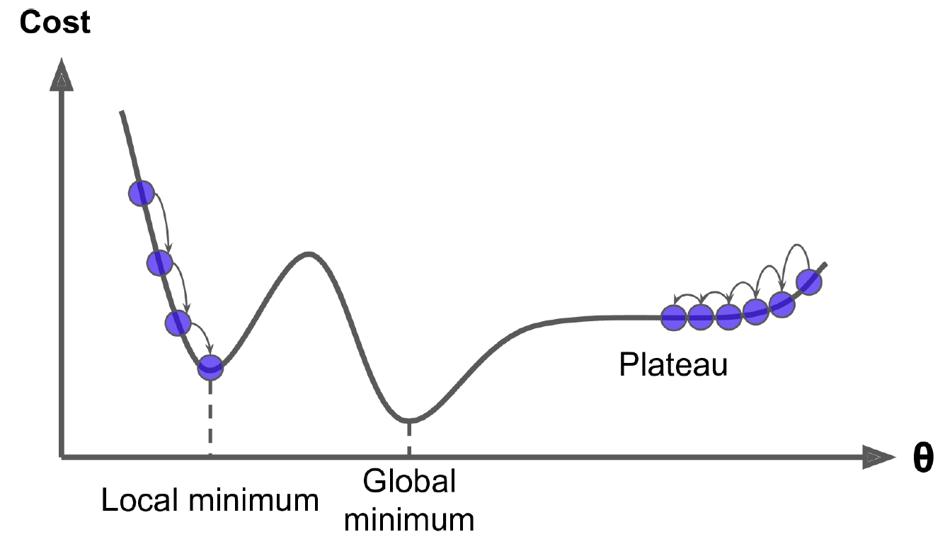
What about this curve?
Notes:
Hello World of machine learning.

Slide 6
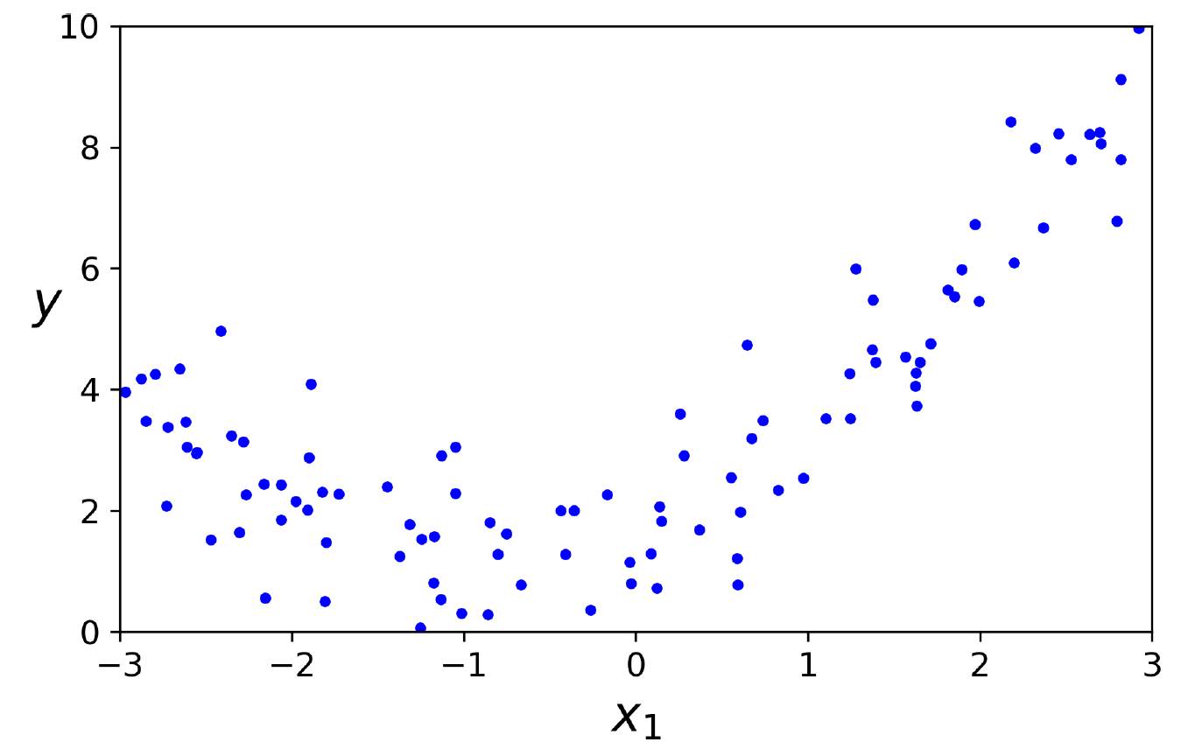
How will a straight line pass through this data?
Notes:
Hello World of machine learning.

Slide 7


How will a straight line pass through this data?
Data is more complex than a simple straight line
We can use linear models to fit non-linear data
How?
Add powers of each feature as new features, then train a linear model on this extended set of features
Technique called Polynomial Regression.
Notes:
Hello World of machine learning.

Slide 8
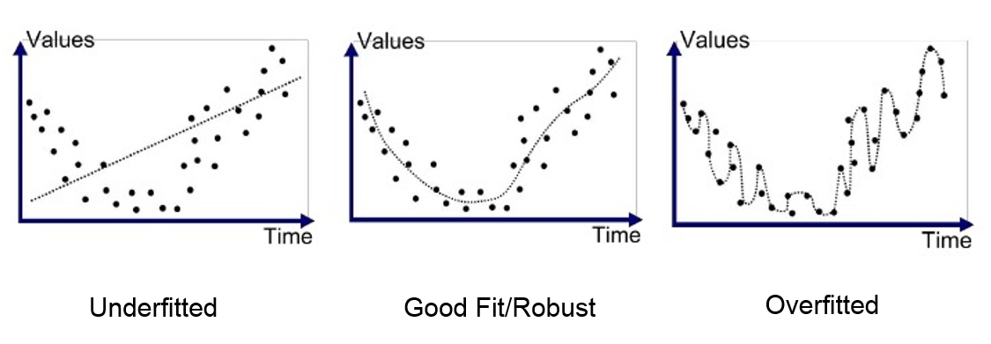
What is …
Fitting
Overfitting
Underfitting
Scaling - It is important to scale the data (e.g., using a StandardScaler) before performing Ridge Regression, as it is sensitive to the scale of the input features. This is true of most regularized models.
Notes:
Hello World of machine learning.

Slide 9
Regularized Linear Models
to reduce overfitting is to regularize the model (i.e., to constrain it)
fewer degrees of freedom it has, the harder it will be for it to overfit the data
(number of values in the final calculation of a statistic that are free to vary)
One way to regularize a polynomial model is to reduce the number of polynomial degrees.
For a linear model, regularization is typically achieved by constraining the weights of the model.
3 ways to constraint the weights:
Ridge Regression, Lasso Regression, and Elastic Net (self study)
Notes:
Hello World of machine learning.

Slide 10

Ridge Regression
regularized version of Linear Regression
a regularization term equal to is added to the cost function
forces learning algorithm to not only fit the data but also keep the model weights as small as possible.
Note that the regularization term should only be added to cost function during training.
Once the model is trained, you want to evaluate the model’s performance using the unregularized performance measure.
Notes:
Hello World of machine learning.

Slide 11

Regularized Linear Models
Alpha is the hyperparameter here.
What is a hyperparameter?
What happens if alpha = 0?
What happens if alpha is a very large number
Ridge = Linear
All weights end up very close to zero and result is a flat line going through the data’s mean
Ridge Cost Function
Notes:
Hello World of machine learning.

Slide 12
Regularized Linear Models
Ridge Cost Function
J(θ) = Cost function
MSE (θ) = Mean Squared Error
NOTE:
- θ₀ (bias term) is not regularized (the sum starts at i = 1, not 0)
- if w = vector of feature weights (θ₁ to θ_{n}), then regularization term is simply equal to ½ (∥w∥²)₂, where ∥w∥₂ represents the ℓ2 norm of the weight vector.
- for Gradient Descent, just add αw to the MSE gradient vector.
Notes:
Hello World of machine learning.

Slide 13
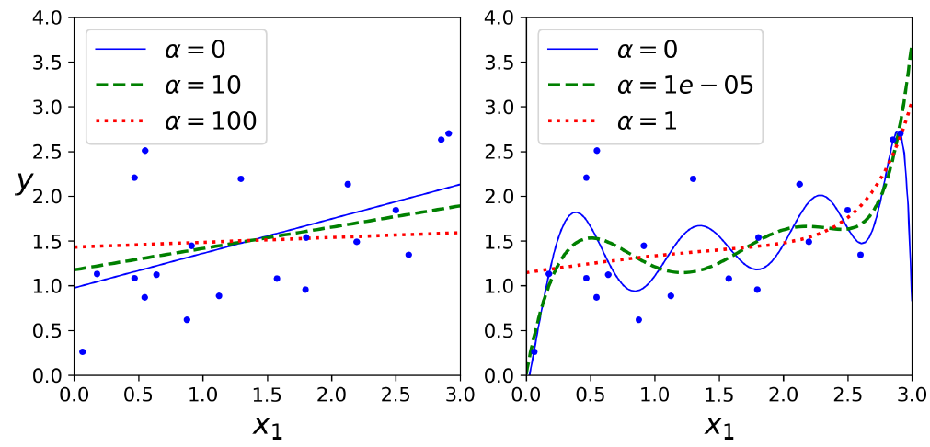
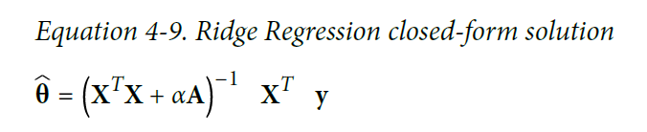
Ridge Regression
As with Linear Regression, we can perform Ridge Regression either by computing a
closed-form equation or by performing Gradient Descent.
See graphs where A is the (n + 1) × (n + 1)
Notes:
Hello World of machine learning.

Slide 14
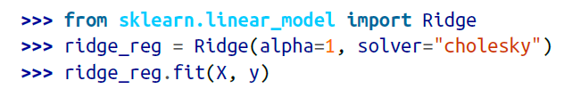

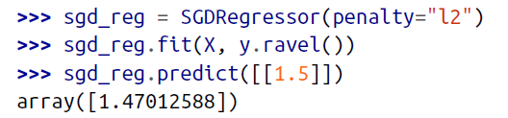
Ridge Regression with Scikit-Learn
Closed-form solution
Cholesky – matrix factorization technique
The penalty hyperparameter sets the type of regularization term to use. Specifying
"l2" indicates that you want SGD to add a regularization term to the cost function
equal to half the square of the ℓ2 norm of the weight vector: this is simply Ridge
Regression.
And using Stochastic Gradient Descent:14
Notes:
Hello World of machine learning.

Slide 15

Lasso Regression
Least Absolute Shrinkage and Selection Operator Regression (simply called Lasso Regression)
Like Ridge, adds a regularization term to the cost function,
Uses the ℓ1 norm of the weight vector, unlike Ridge which uses half the square of the ℓ2 norm
Notes:
Hello World of machine learning.

Slide 16
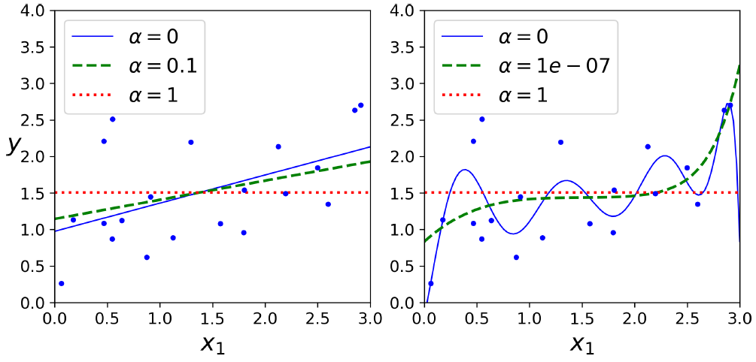
Important characteristic of Lasso
- tends to completely eliminate
the weights of the least important features (i.e., set them to zero).
For example, the dashed line in the right plot on figure (with α = 10⁻⁷) looks quadratic, almost linear: all the weights for the high-degree polynomial features are equal to zero.
In other words, Lasso Regression automatically performs feature selection and outputs a sparse model (i.e., with few nonzero feature weights).
Notes:
Hello World of machine learning.

Slide 17
Logistic Regression
middle ground between Ridge Regression and Lasso Regression
regularization term is a simple mix of both Ridge and Lasso’s regularization terms, and you can control the mix ratio r.
Can be used for classification as well
Class + the Probability of a class.
Notes:
Hello World of machine learning.

Slide 18

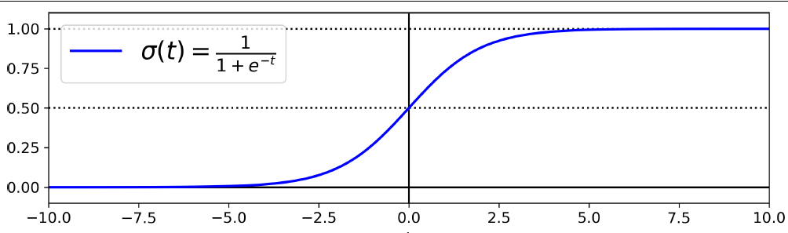
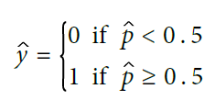
Estimating Probabilities
Computes a weighted sum of input features plus a bias term
(like linear regression)
Logistic is a sigmoid function
Outputs a number between 0 and 1
For Spam/Ham question
If it is > 0.5, then email is spam
Notes:
Hello World of machine learning.

Slide 19
Estimating Probabilities
σ(t) < 0.5 when t < 0, and σ(t) ≥ 0.5 when t ≥ 0,
Logistic Regression model predicts:
1 if x^{T} θ is positive
0 if x^{T} θ is negative.
Notes:
Hello World of machine learning.

Slide 20
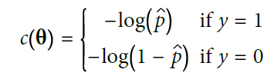

Training and Cost Function
GOAL: set parameter vector θ so that model estimates high probabilities for positive instances (y =1) and low probabilities for negative instances (y = 0)
cost function over the whole training set is simply the average cost over all training instances.
How to calculate θ, goal is minimize cost function
Cost function of a single training instance, x
Cost function of Logistic Regression
Notes:
Hello World of machine learning.

Slide 21

No known Normal Equation/ closed-form equation
Can use Gradient Descent (SGD, Batch..)
partial derivatives of the cost function with regards to the jth model parameter θj is given by
training instance
Cost function
prediction error
Notes:
Hello World of machine learning.

Slide 22

Softmax Regression
Logistic Regression model can be generalized to support multiple classes directly, without having to train and combine multiple binary classifiers
Also called multinomial Logistic Regression
Model
for each instance x, compute a score s_{k}(x) for each class.
estimate the probability of each class by applying the softmax function
equation similar to linear regression
Softmax score for class k
Notes:
Hello World of machine learning.

Slide 23
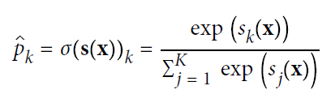
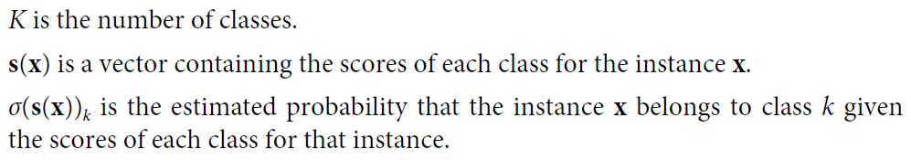
Softmax Regression
each class has its own dedicated parameter vector θ(k).
All these vectors are typically stored as rows in a parameter matrix Θ
You can estimate probability of an instance belonging to a class k by running scores through softmax function
Softmax function computes exponential of every score, then normalizes them (dividing by sum of all exponentials).
Scores generally called logits
Softmax score for class k
Notes:
Hello World of machine learning.

Slide 24
Softmax Regression
each class has its own dedicated parameter vector θ(k).
All these vectors are typically stored as rows in a parameter matrix Θ
You can estimate probability of an instance belonging to a class k by running scores through softmax function
Softmax function computes exponential of every score, then normalizes them (dividing by sum of all exponentials).
Scores generally called logits
Softmax score for class k
Notes:
Hello World of machine learning.

Slide 25


Softmax Regression
Predicts class with highest estimated probability (class with highest score)
argmax operator returns the value of a variable that maximizes a function. In this equation, it returns the value of k that maximizes the estimated probability σ(s(x))_{k}.
Cross entropy is frequently used to measure how well a set of estimated class probabilities match the target classes. Cost function.
y_{k}^{(i)} = target probability that the i_{th} instance belongs to class k. It is either equal to 1 or 0, depending on whether the instance belongs to the class or not. When (K = 2), this cost function is equivalent to the Logistic Regression’s cost function
Notes:
Hello World of machine learning.

Slide 26

Softmax Regression
Minimizing cost function using GD
Cross entropy gradient vector for class k
Notes:
Hello World of machine learning.

Slide 27
Open Floor

