Slide 1
Foundations of Data Science & Analytics DSCI 633
Nidhi Rastogi
Assistant Professor, GCCIS, RIT

Slide 2
Dimensionality Reduction

Slide 3
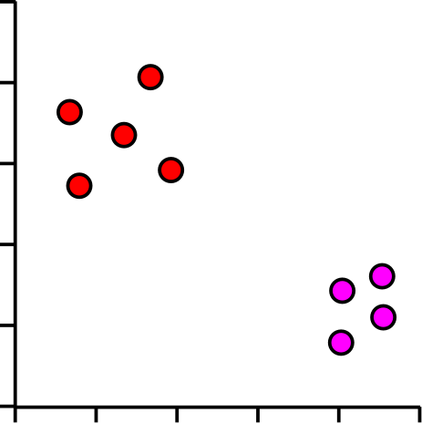
Motivation: Why use dimensionality reduction?
Gene | Description | Cell 1 | Cell 2 | Cell 3 | Cell 4 | Cell 5
Inpp5d | inositol polyphosphate-5-phosphatase D | 7.00 | 5.45 | 5.89 | 6.03 | 5.75
Aim2 | absent in melanoma 2 | 3.01 | 4.37 | 4.59 | 4.38 | 4.18
Gldn | gliomedin | 3.48 | 3.63 | 4.61 | 4.70 | 4.74
Frem2 | Fras1 related extracellular matrix protein 2 | 4.75 | 4.66 | 3.46 | 3.74 | 3.45
Rps3a1 | ribosomal protein S3A1 | 6.10 | 7.23 | 7.44 | 7.36 | 7.34
Slc38a3 | solute carrier family 38, member 3 | 1.90 | 3.16 | 3.52 | 3.61 | 3.19
Mt1 | metallothionein 1 | 5.07 | 6.49 | 6.46 | 6.04 | 6.05
C1s1 | complement component 1, s subcomponent 1 | 2.74 | 3.02 | 3.86 | 4.10 | 4.10
Cds1 | CDP-diacylglycerol synthase 1 | 4.55 | 4.22 | 3.80 | 3.16 | 3.12
Ifi44 | interferon-induced protein 44 | 4.82 | 4.52 | 3.87 | 3.42 | 3.59
Lefty2 | left-right determination factor 2 | 6.95 | 6.28 | 5.88 | 5.60 | 5.61
Fmr1nb | fragile X mental retardation 1 neighbor | 4.28 | 2.78 | 3.10 | 3.25 | 2.57
Tagln | transgelin | 7.93 | 7.91 | 7.20 | 7.02 | 6.68
Table: Gene Data
Each dot is a cell
Groups of dots are similar cells
Separation of groups could be interesting biology

Slide 4
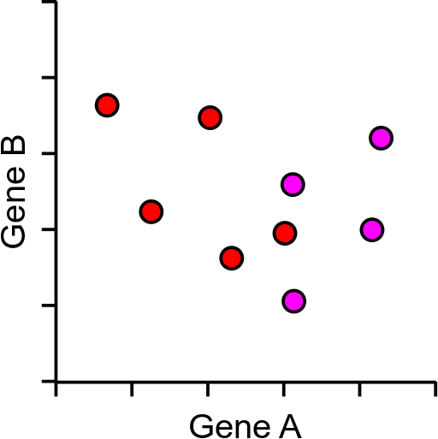
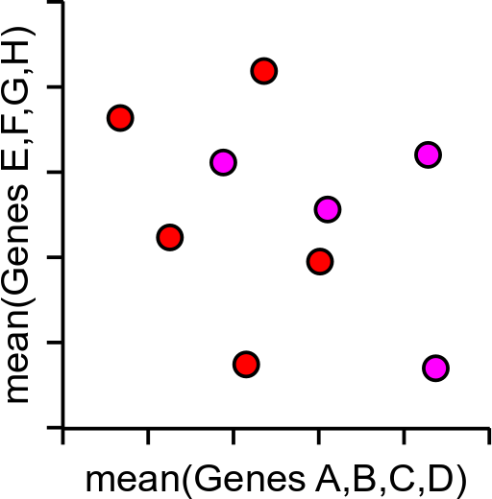
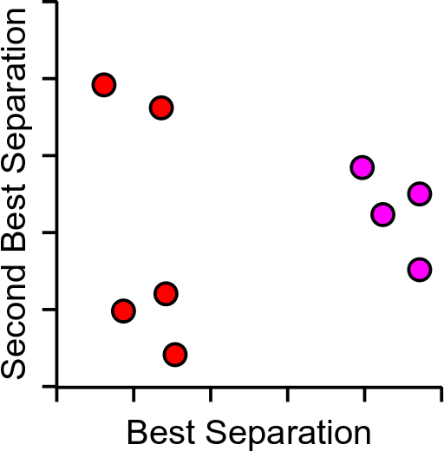
Too much data!
5000 cells and 2500 measured genes
Realistically only 2 dimensions can be plotted (x,y)

Slide 5
Curse of Dimensionality
Increasing the number of features will not always improve classification accuracy.
In practice, the inclusion of more features might actually lead to worse performance.
The number of training examples required increases exponentially with dimensionality d (i.e., k^{d}).
, when k=3
3¹ bins
k-> number of bins per feature
bins per feature is # intervals into which a feature is divided for the purpose of binning.
3² bins
3³ bins
Notes:
Feature binning is a method of turning continuous variables into categorical values using pre-defined number of bins. It is effective when a continuous feature has too many unique values or few extreme values outside the expected range.

Slide 6
Binning Example
E.g., continuous feature called age.
Age can be divided into three bins:
"young" (age < 18)
"adult" (18 <= age < 65)
"senior" (age >= 65).
This would give us a categorical feature with three possible values.
, when k=3
3¹ bins
3² bins
3³ bins
Notes:
Feature binning is a method of turning continuous variables into categorical values using pre-defined number of bins. It is effective when a continuous feature has too many unique values or few extreme values outside the expected range.

Slide 7
Objective: Dimensionality Reduction
Choose an optimum set of features of lower dimensionality to improve classification accuracy.
Different methods can be used to reduce dimensionality:
Feature extraction
Feature selection

Slide 8
Dimensionality Reduction
Feature Extraction: finds a set of new features (i.e., through some mapping f()) from the existing features.
Feature Selection: chooses a subset of the original features.
The mapping f() could be linear or non-linear
K<<N
*we focus on FE only

Slide 9
Feature Extraction
Linear combinations are particularly attractive because they are simpler to compute and analytically tractable.
Given x ϵ R^{N}, find a K x N matrix T such that:
y = Tx ϵ R^{K} where K<<N
Note: This is a projection from the N-dimensional space to a K-dimensional space.

Slide 10
Feature Extraction - criteria
From a mathematical point of view, finding an optimum mapping y=𝑓(x) is equivalent to optimizing an objective criterion.
Different methods use different objective criteria, e.g.,
Minimize Information Loss: represent the data as accurately as possible in the lower-dimensional space.
Maximize Discriminatory Information: enhance the class-discriminatory information in the lower-dimensional space.

Slide 11
Feature Extraction – objective criteria
Minimize Information Loss: represent the data as accurately as possible in the lower-dimensional space.
One way to measure information loss is to use the reconstruction error, which is the difference between the original data and the reconstructed data in the lower-dimensional space.
Maximize Discriminatory Information: enhance the class-discriminatory information in the lower-dimensional space.
One way to measure discriminatory information is to use the Fisher criterion, which is a measure of the ratio between the within-class variance and the between-class variance.

Slide 12
Feature Extraction
Popular linear feature extraction methods:
Principal Components Analysis (PCA): Seeks a projection that preserves as much information in the data as possible.
Linear Discriminant Analysis (LDA): Seeks a projection that best discriminates the data.

Slide 13
Background on Vectors

Slide 14
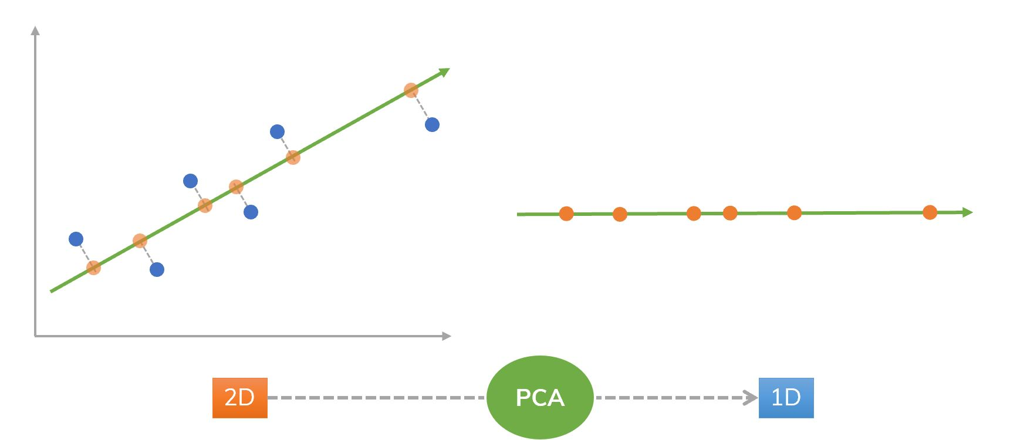
Intuition
Feature Extraction

Slide 15
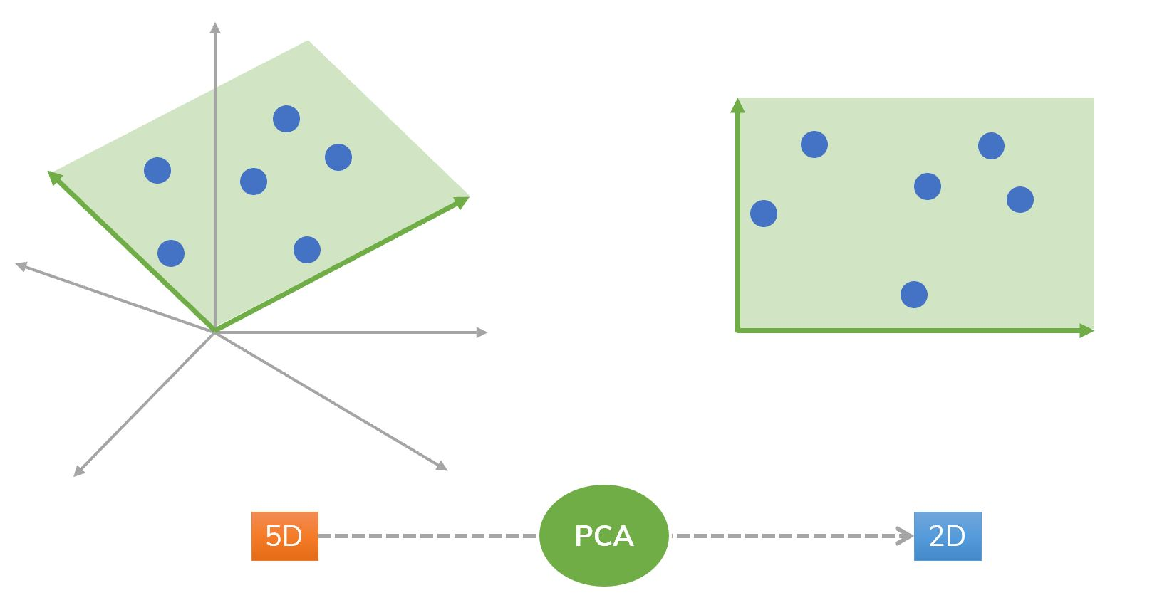
Intuition
Feature Extraction

Slide 16
Intuition
Feature Extraction
Feature Extraction
How can we choose the green arrows
(their directions and their magnitudes)

Slide 17
Vector Representation
A vector x ϵ R^{n} can be represented by n components:
Assuming the standard base <v₁, v₂, …, v_{N}> (i.e., unit vectors in each dimension), x_{i} can be obtained by projecting x along the direction of v_{i}:
x can be “reconstructed” from its projections as follows:
Since the basis vectors are the same for all x ϵ R^{n} (standard basis), we typically represent them as a
n-component vector.

Slide 18
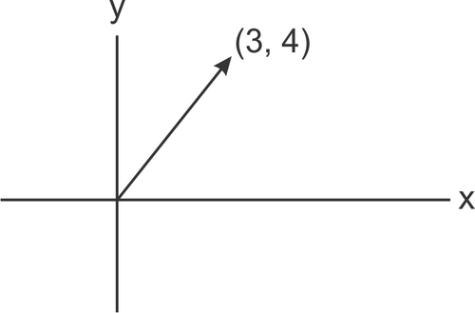
Vector Representation (example)..
Example assuming n=2:
Assuming the standard base <v₁=i, v₂=j>, x_{i} can be obtained by projecting x along the direction of v_{i}:
x can be “reconstructed” from its projections as follows:
j
i
x_{i} is magnitude and v_{i} is the direction

Slide 19
Principal Component Analysis (PCA)
If x∈R^{N}, then it can be written a linear combination of an orthonormal set of N basis vectors <v₁,v₂,…,v_{𝑁}> in R^{N}:
v : basis vectors
Wikipedia: an orthonormal basis for an inner product space V with finite dimension is a basis for V whose vectors are
orthonormal, that is, they are all unit vectors and orthogonal to each other.

Slide 20
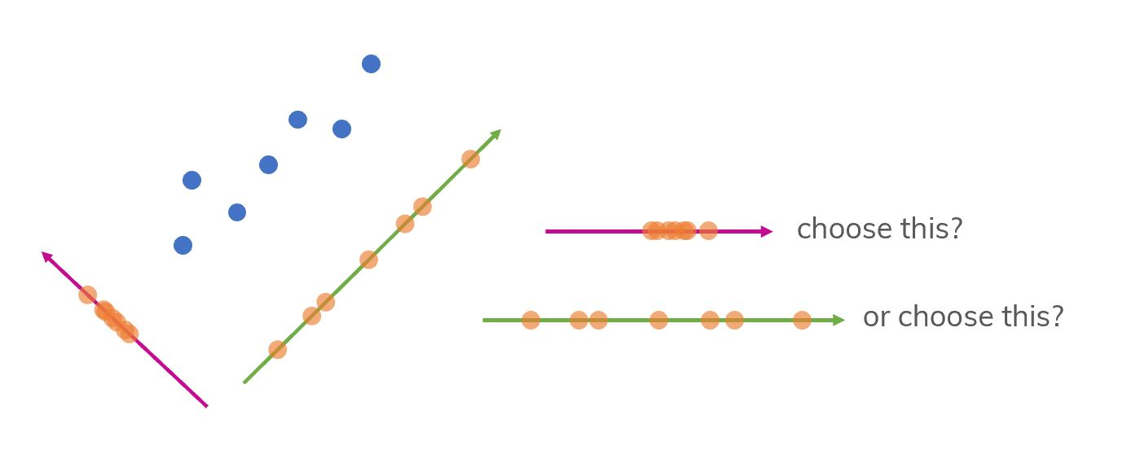
Intuition
We will project the points to the green line or the violet line? Which one is the best choice?

Slide 21
Intuition
Intuitively, the green line is better with more separated points. But how can we choose it "mathematically" (precisely)? We need to know about:
Mean: finds the most balanced point in the data.
Variance: measures the spread of data from the mean. However, variance is not enough. There are many different ways in that we get the same variance (see next slide).
Covariance: indicates the direction in that data are spreading.
It is the mean value of the product of the deviations of two variates from their respective means.
It is an indicator of the extent to which 2 random variables are dependent on each other.

Slide 22
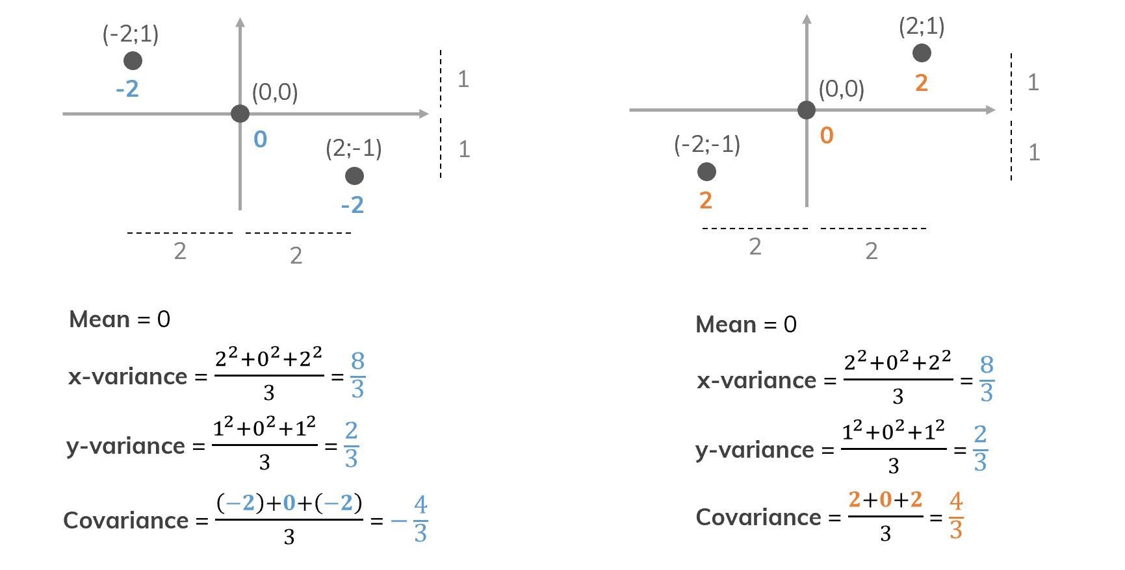
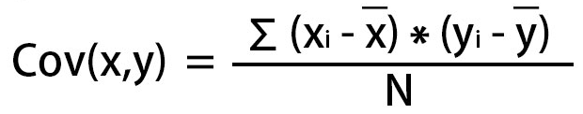
Why covariance is needed?
Different data but the same mean and variance. That's why we need covariance!

Slide 23
Principal Component Analysis (PCA)
PCA seeks to approximate x in a subspace of R^{N} using a new set of K<<N basis vectors <u₁, u₂, …,u_{K}> in R^{N}:
such that is minimized!
(i.e., minimize information loss)
(reconstruction)

Slide 24
Principal Component Analysis (PCA)
Finding the “optimal” set of basis vectors <u₁, u₂, …,u_{K}>

Slide 25
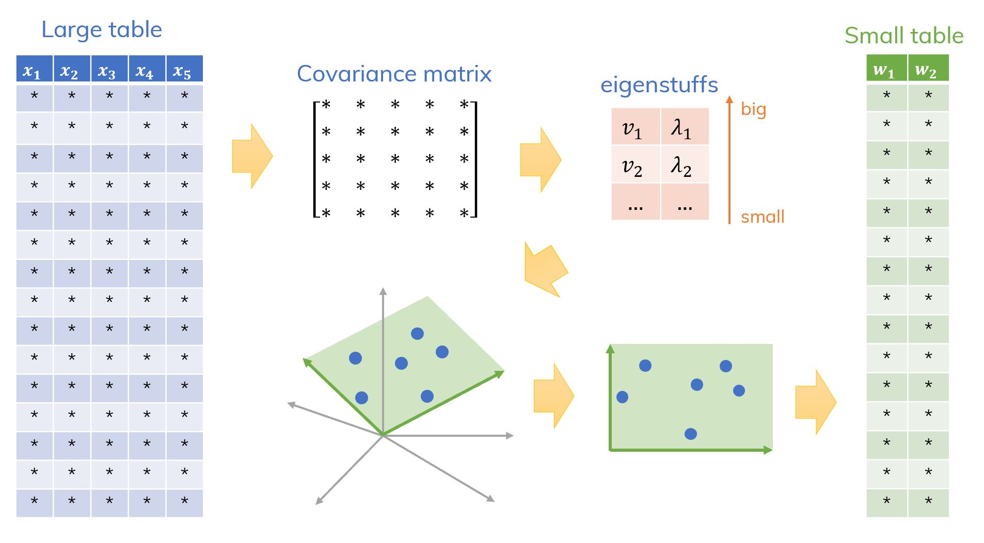
Principal Component Analysis (PCA)
A big picture of the idea of PCA algorithm.
“Eigenstuffs” are eigenvalues and eigenvectors.

Slide 26
Discussion
Why is the covariance matrix important in PCA?

Slide 27
Principal Component Analysis (PCA)
Step 1: Subtract the mean to move to the original axes. From the original data (a lot of features x₁, x₂, …, x_{N),} we construct a covariance matrix U.
Find the eigenstuffs of that matrix :
eigenvalues λ₁,λ₂​,…
& correspondent eigenvectors v₁​,v₂​,… .
Choose K < N pairs of λ and v (the highest eigenvalues) and we get a reduced matrix U_{K}​.
Step 2: Choose the K “largest” eigenvectors u_{𝑖} (i.e., corresponding to the K “largest” eigenvalues 𝜆_{𝑖}). We refer to the “largest” eigenvectors u_{𝑖} as principal components.
Step 3: Project original data point to the principal components.

Slide 28
Principal Component Analysis (PCA)
(1) Find the eigenvectors u_{𝑖} of the covariance matrix of the (training) data Σ_{x}
Σ_{x} u_{𝑖}= 𝜆_{𝑖} u_{𝑖}
(2) Choose the K “largest” eigenvectors u_{𝑖} (i.e., corresponding to the K “largest” eigenvalues 𝜆_{𝑖})
<u₁, u₂, …,u_{K}> correspond to the “optimal” basis!
We refer to the “largest” eigenvectors u_{𝑖} as principal components.

Slide 29
PCA Steps contd..
Step 4: compute the eigenvalues/eigenvectors of Σ_{x}
Since Σ_{x} is symmetric, <u₁,u₂,…,u_{N}> form an orthogonal basis in R^{N} and we can represent any x∈R^{N} as:
where we assume
Note : most ML packages return the eigenvalues (and corresponding eigenvectors) in decreasing order.
If not, you can explicitly put them in this order.
i.e., this is
just a “change”
of basis!
Note : most ML packages normalize u_{i} to unit length to simplify calculations; if not, you can explicitly normalize them

Slide 30
PCA – Steps contd..
Step 5: dimensionality reduction step – approximate x using only the first K eigenvectors (K<<N) (i.e., corresponding to the K largest eigenvalues where K is a parameter):
approximate
using first K eigenvectors only
note that if K=N, then
(i.e., zero reconstruction error)

Slide 31
Choosing K
K is typically chosen based on how much information (variance) we want to preserve:
If T=0.9, for example, we “preserve” 90% of the information (variance) in the data.
If K=N, then we “preserve” 100% of the information in the data (i.e., just a “change” of basis and )
Choose the smallest
K that satisfies the following inequality:

Slide 32
Error
The approximation error (or reconstruction error) can be computed by:
It can also be shown that the approximation error can be computed as follows:
where,

Slide 33
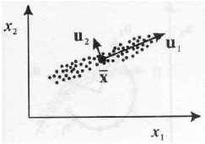
Interpretation of PCA
PCA chooses the eigenvectors of the covariance matrix corresponding to the largest eigenvalues.
The eigenvalues correspond to the variance of the data along the eigenvector directions.
Therefore, PCA projects the data along the directions where the data varies most.
PCA preserves as much information in the data by preserving as much variance in the data.
u₁: direction of max variance
u₂: orthogonal to u₁

Slide 34
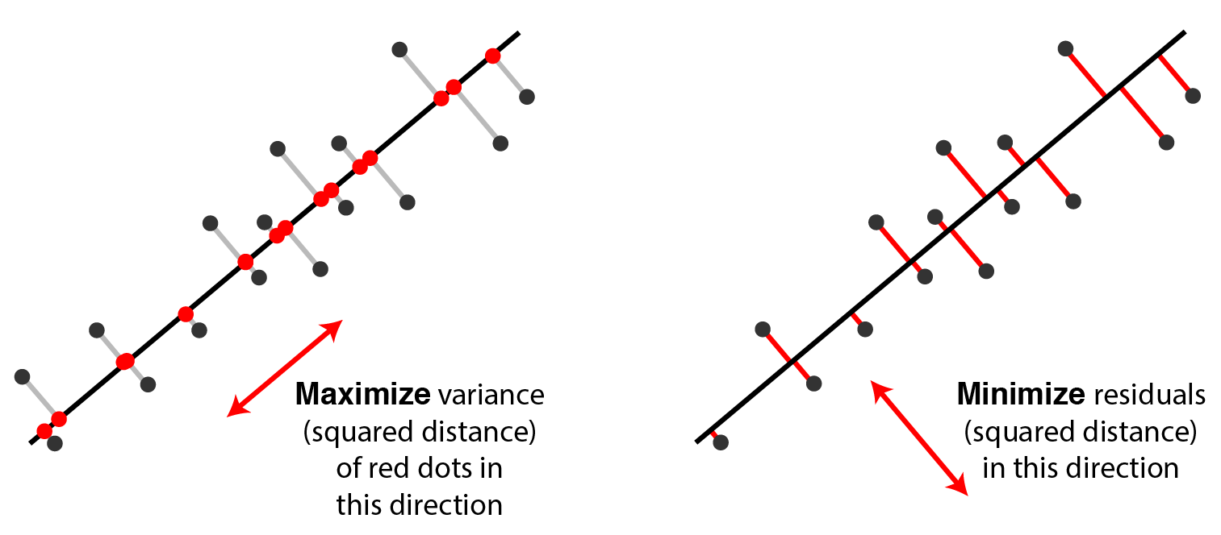
Interpretation of PCA

Slide 35
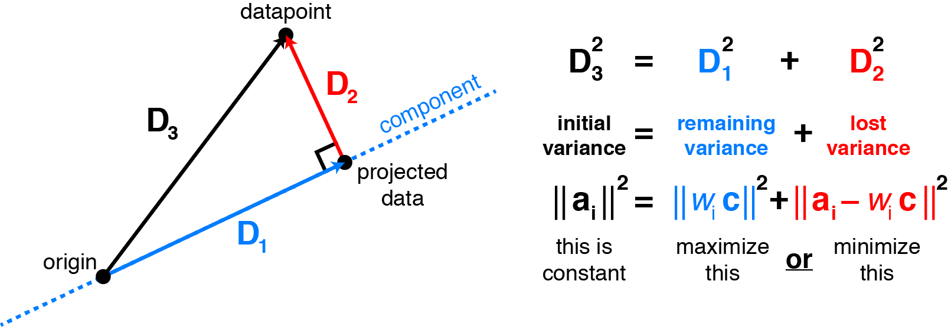
Interpretation of PCA
Maximizing variance in principal component space is equivalent to minimizing least-squares reconstruction error.

Slide 36
Good Practice prior to PCA -Data Normalization
The principal components are dependent on the units used to measure the original variables as well as on the range of values they assume.
Data should always be normalized prior to using PCA.
A common normalization method is to transform all the data to have zero mean and unit standard deviation:
where μ and σ are the mean and standard
deviation of the i-th feature x_{i}

