Slide 1


R-intro: Introduction 2.0
Sine Zambach 2021
Researcher at CBS and author of ”Kvinde kend din kode”
Ph.d. in AI

Slide 2
Recap from last time
R is great for visualisations and stat. And can do most of the ML-stuff that Python also does – but often slower
Last time we did talk about
Calculate stuff in R
Data Frames
Input file formats
Functions

Slide 3


Plan for today
After session 2, you will be able to wrangle even more data and have the basics for modelling and statistical tests for you to go on with more sophisticated R-work.
Topics
A bit more on data frames and wrangling
Introduction to modelling (linear models, t-test, fisher's test)
Visualization in R (R is great for visualization! We try out histogram, barplot, scatter plot, dot-and-whiskers plot)
The pipe

Slide 4
Dataframes and Wrangling

Slide 5
Data frames
Inspect dataframe:
View()
str()
summary()
Paraphrasing of dataframes
df[rows,columns]
df$columns[row]
Example: the same element in the data frame
df[,1]
df[,”X1”]
df$X1

Slide 6
Wrangling and visualizations
Need some more packages:
library(tidyverse)
library(ggplot2)
And now you can look at data and wrangle it using the most common standards”

Slide 7

Basic wrangling
left_join() # add information from another table: leftjoin / VLOOKUP
count() # counts instances in a data frame
mutate() # create a new column
group_by() # group summaries

Slide 8
Basic ggplot
ggplot(dataframe, aes(var1,var2)) = begins a plot
aes mapping variables to “aesthetics”
“Geoms”, e.g. geom_point(), geom_col() … creates the chart types
Layer is what you add to the plot
Cheat cheet: https://github.com/rstudio/cheatsheets/blob/master/data-visualization-2.1.pdf

Slide 9

Tests and modelling
https://pxhere.com/en/photo/1198013

Slide 10

Functions have arguments
The data
Settings

Slide 11
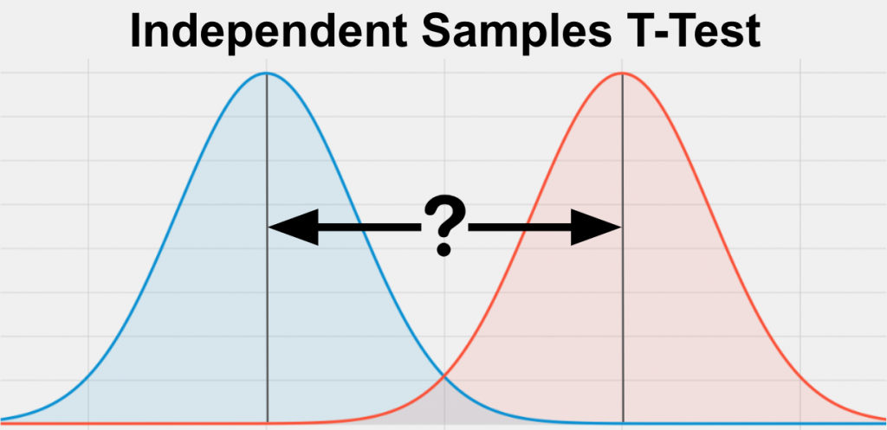
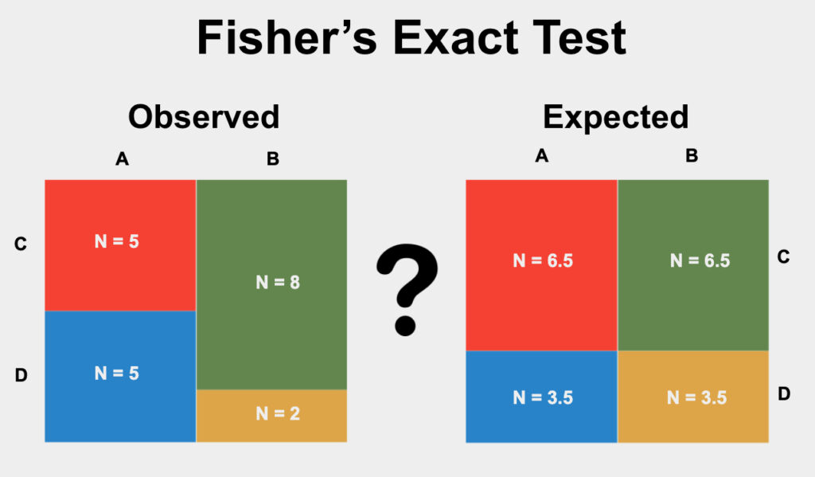
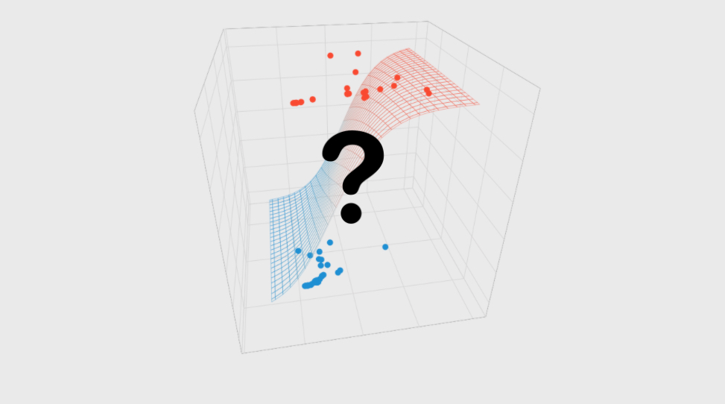
Tests and Models
Test (not really models, but we use them along)
T-test for continous data (e.g. comparing two averages)
Fishers test for categories/discrete data (comparing a treatment)
Models:
linear regression
logistic regression
Random Forest and other awesome ML-stuf
Figures from: https://www.statstest.com/

Slide 12
Tests
T-test for continous data (e.g. comparing two averages)
t.test(x,y)
# to vectors with numeric values
t.test(BOO$prize ~ BOO$foodLabel)
# vector with values and vector with cathegories
Fishers test for categories/discrete data (comparing a treatment)
fisher.test(TeaTasting, alternative = "greater")
#2x2 matrix

Slide 13
Models
Grammar
Function(y~x, data=df)
Example of today: Linear model
lm(prize ~ origin + foodLabel, data=BOO)

Slide 14
The pipe %>%
Good when you are doing a lot of different things to the same dataframe

