Slide 1
Automation Status and Future Play - M&S International
Notes:
11/21/2024
1
1

Slide 2
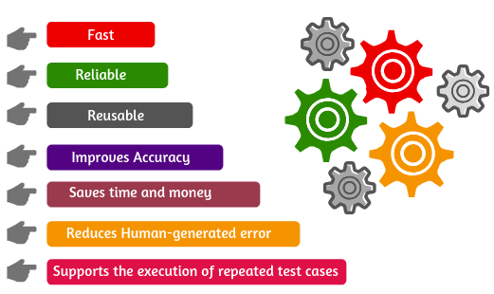
Automation Introduction
Automation Testing:
Automation testing is a software testing technique that uses automated tools and scripts to execute test cases, compare the actual outcomes with expected results, and report the findings.
Why Automation Testing:
Notes:
11/21/2024
2
2

Slide 3
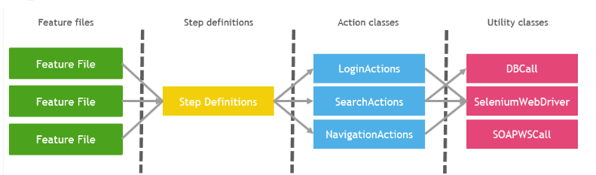
Automation Framework and Scope
Automation Framework
Cucumber Framework + Selenium + Java + Maven + Extent Reports
Scope for DRB and IBT:
Test Automation Failure analysis and fixes of the Legacy automation Test scripts.
Scope for Pricing:
To build an automation Test suite for API and UI Regression Testcases.
Notes:
11/21/2024
3
3

Slide 4
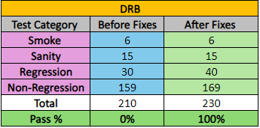
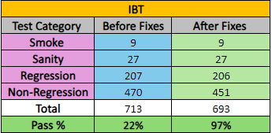
Overview of Fixes and Improvements
Initially, there were 210 test cases in DRB, but none of them were in a working state.
All 210 test cases were failing due to lack of maintenance over the past two years.
We thoroughly analyzed, debugged, and fixed the issues, resulting in 100% pass rate for all 210 test cases.
During the process, we identified and automated an additional 20 scenarios.
In total, DRB now has 230 fully functional and passing test cases.
In IBT, a total of 713 test cases were available, and during the initial analysis, only 156 basic test cases passed.
The team prioritized fixing the Regression test cases, specifically 207 complex P1 and P2 test cases, achieving a 100% pass rate for all Regression tests.
Afterward, both Sanity and Smoke test cases were fixed, also achieving a 100% pass rate.
Feature-specific test cases, categorized as P3 and P4, were addressed as well.
Currently, the overall pass percentage is 97%, with the remaining 3% failures being related to feature-specific test cases. These failures are due to existing open issues in IBT, like:
  In the AOM screen, when downloading a size-level order template and creating an order by updating/uploading the size, the status incorrectly appears as 'Submitted' instead of 'In Progress’.
These issues have been documented on the IBT open issues Confluence page: IBT Open Issues.
Notes:
11/21/2024
4
4

Slide 5
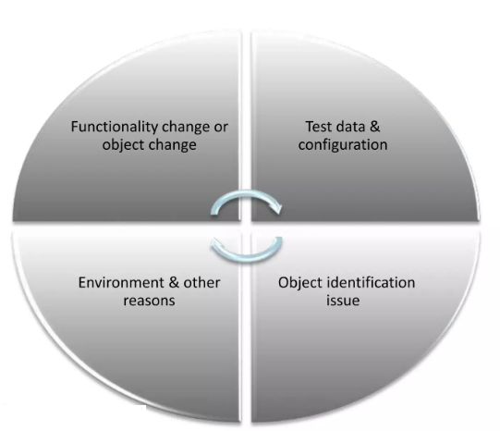
Automation Script Failure Categorization – IBT & DRB
Script Corrections and Updates
Test data changes
Element locator updates
Env changes and Dependency updates
Test Optimization
New Feature Tests
Notes:
11/21/2024
5
5

Slide 6

Pricing - Overview
Pricing Implementation Highlights:
      Automation Framework development from scratch.
      Implementation of Rest API calls and Response validations.
      Implementation of Kafka Producer and Consumer to Post and Read the Events from Topics.
      Implementation of Mongo DB Validations.
      Secrets and GitHub Actions Implementation to run testcases from CI/CD pipeline.
​​
Newly built automation​​
test suite from scratch
Notes:
11/21/2024
6
6

Slide 7
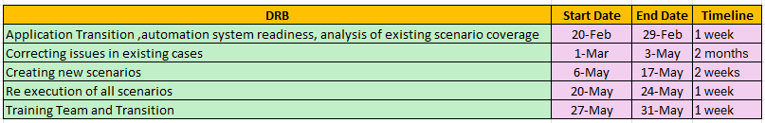
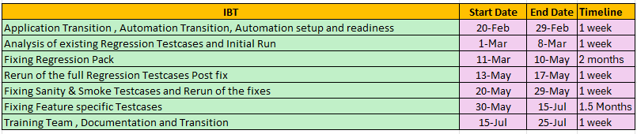
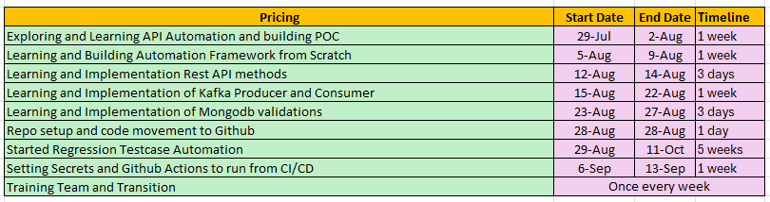
Automation Timeline –DRB & IBT
Transition & Analysis
FEB
Executing work on Existing use cases
MAR
Identifying New scenarios
APR
Fixes Deployment and Execution Validation
MAY
Training & Handover
June & July
Next Steps – Pricing work…
Notes:
11/21/2024
7
7

Slide 8
General Guidelines
      General Guidelines suggested to the engineers:
      Regular Maintenance of the Test Script is required.
      On feature/functionality change, respective automation test scripts need to be identified and updated.
      For every Season change, test data needs to be updated for the respective screens based on the current active season data.
      On DB refresh ,some test scripts might fail due to data issue. On such cases, need to debug and fix those test scripts.
      Team needs to check the test data correctness before executing any testcases and required knowledge is provided to the team on test data update.
      For every release, its mandatory to execute Smoke Testcases and Sanity Testcases along with required Regression testcases.
      KT was provided to the engineers on the Automation Framework, including topics such as Cucumber, Selenium, test data updates, test script execution, and other necessary automation-related details.
Notes:
11/21/2024
8
8

Slide 9


Notes:
11/21/2024
9
9

