Slide 1
Test Cases
Alec Goodner
Thatcher Rickertsen

Slide 2
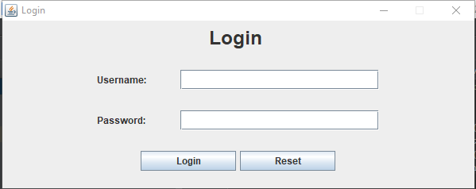
Logging In

Slide 3
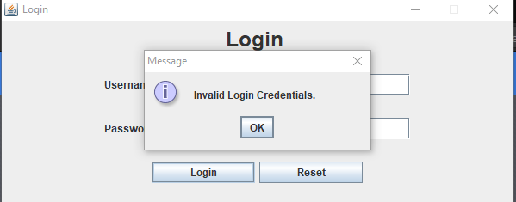
Logging In (Incorrect Username)

Slide 4
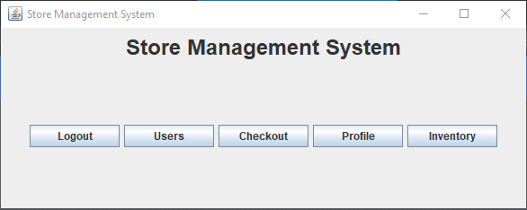
Logging In (Correct Username)

Slide 5
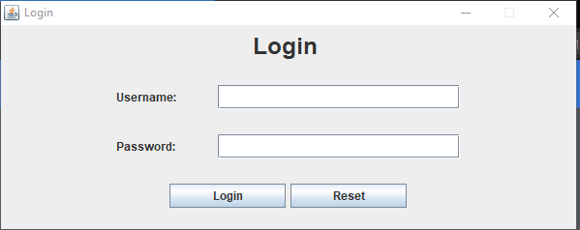
Logging Out

Slide 6
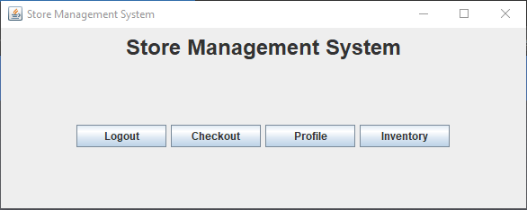
Logging in as Cashier (instead of Manager)

Slide 7
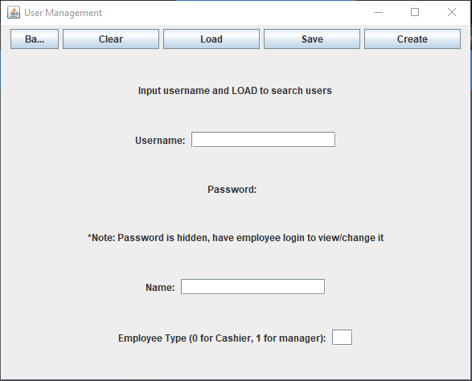
Going to “Users” Menu

Slide 8
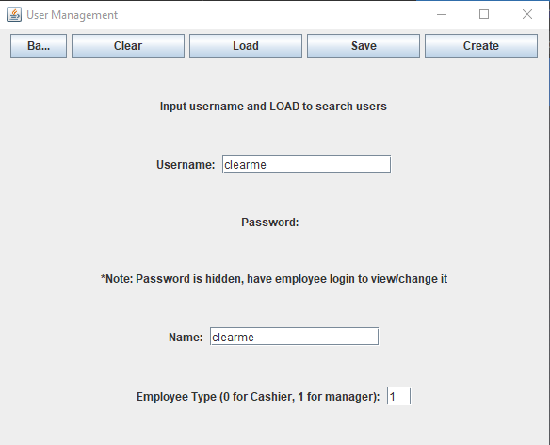
Testing “Clear” Button

Slide 9
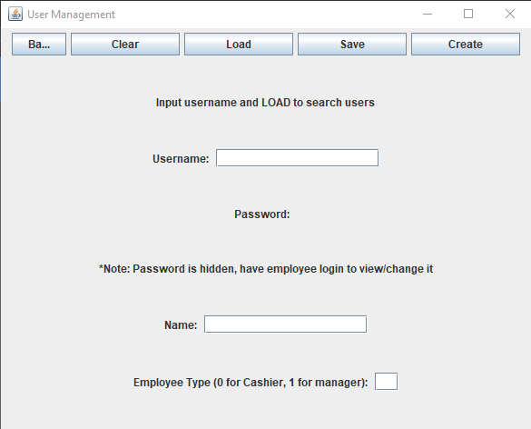
Testing “Clear” Button

Slide 10
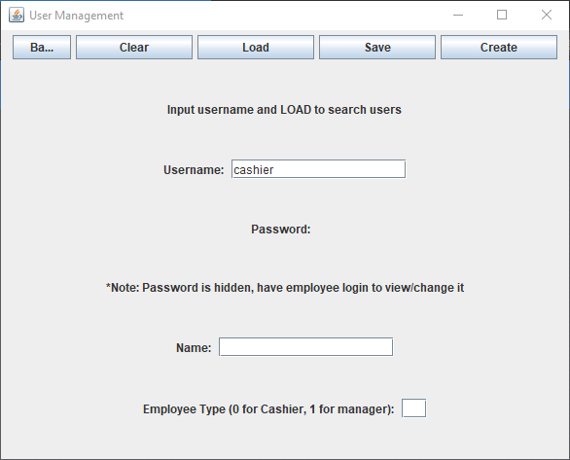
Loading a User by Username

Slide 11
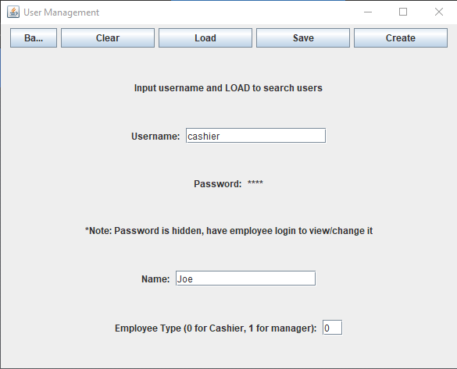
Loading a User by Username

Slide 12
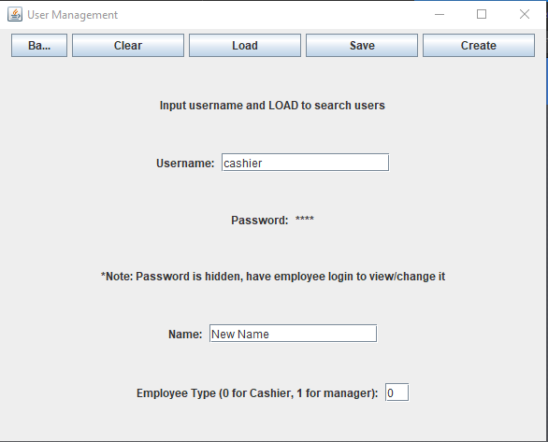
Saving New Info on User

Slide 13
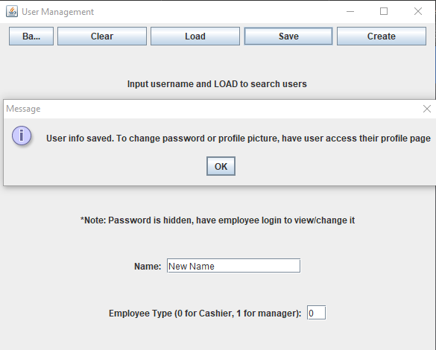
Saving New Info on User

Slide 14
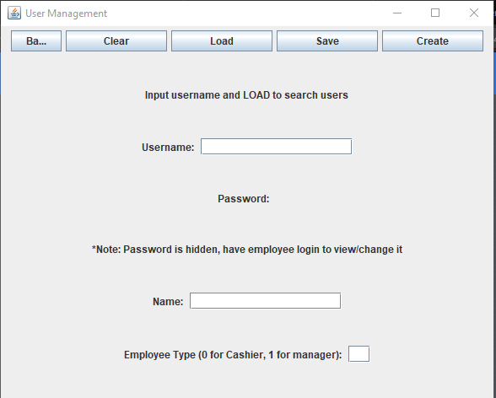
Creating New User (Invalid)

Slide 15
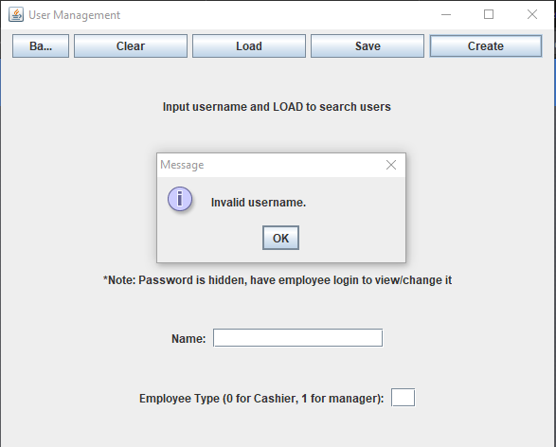
Creating New User (Invalid)

Slide 16
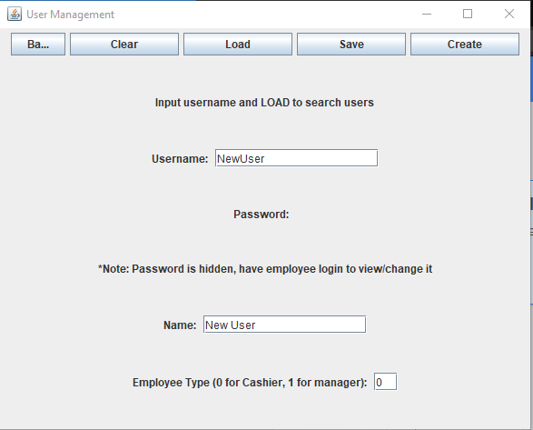
Creating New User

Slide 17
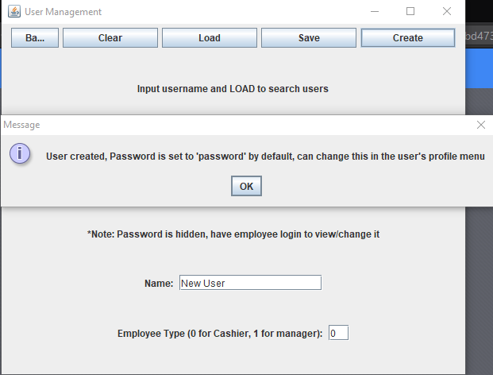
Creating New User

Slide 18
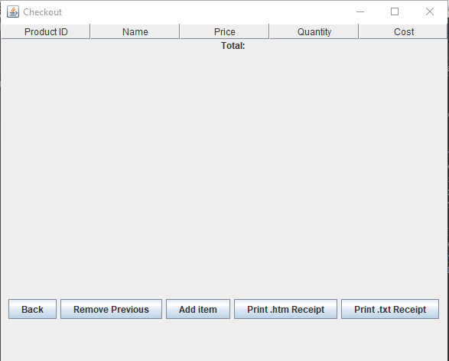
Add Item to Checkout

Slide 19
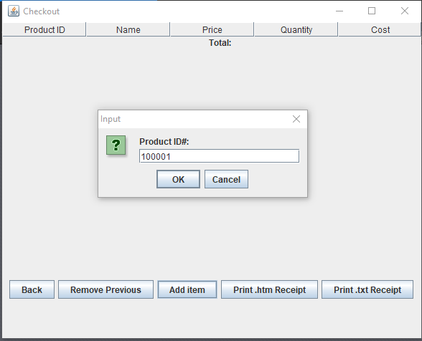
Add Item to Checkout

Slide 20
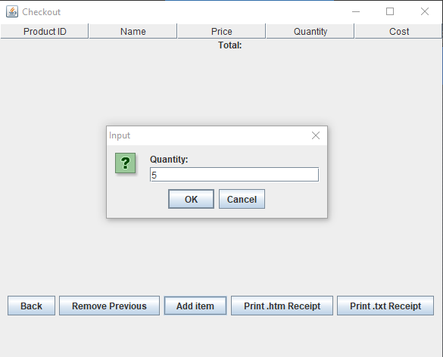
Add Item to Checkout

Slide 21
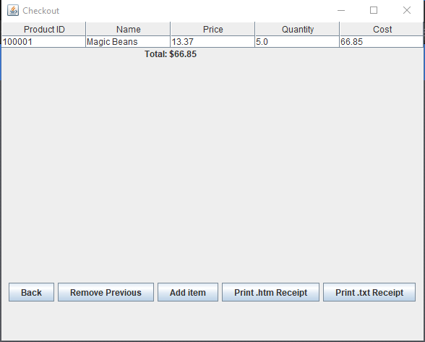
Add Item to Checkout

Slide 22
Remove Previous from Checkout

Slide 23
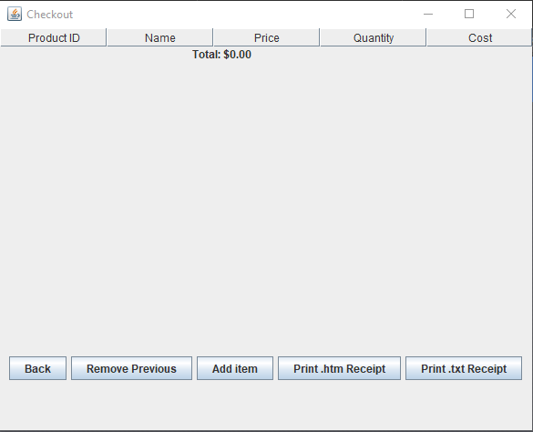
Remove Previous from Checkout

Slide 24
Print Receipt

Slide 25
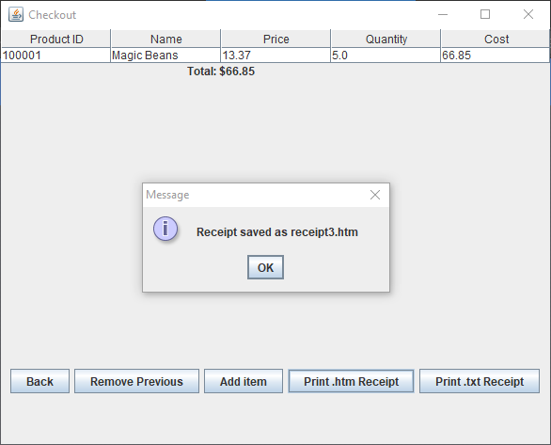
Print Receipt (HTML)

Slide 26
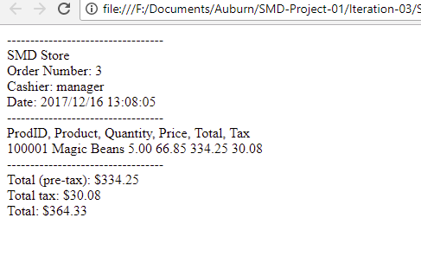
receipt3.htm

Slide 27
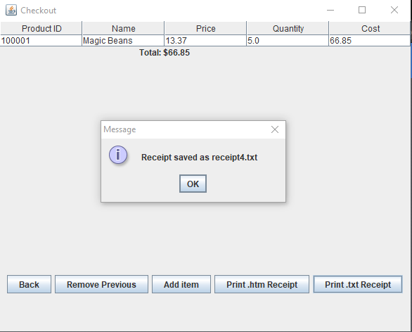
Print Receipt (TXT)

Slide 28
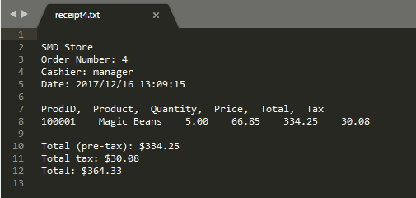
receipt4.txt

Slide 29
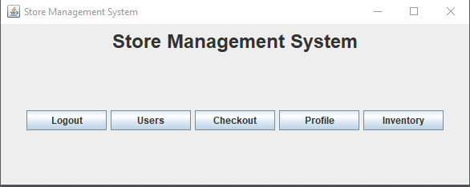
Change Profile Picture

Slide 30
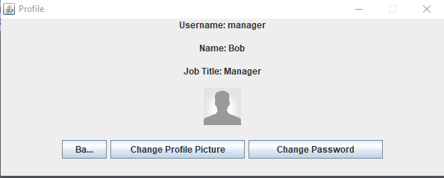
Change Profile Picture

Slide 31
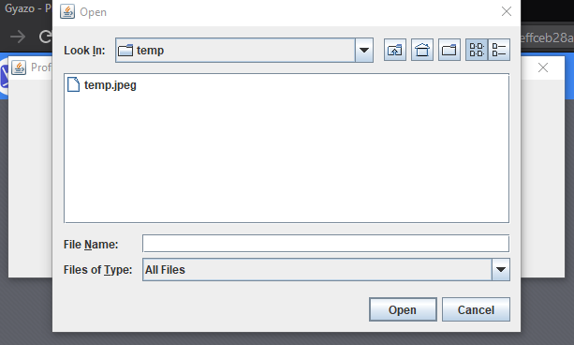
Change Profile Picture

Slide 32
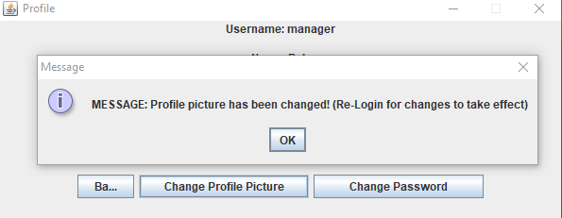
Change Profile Picture

Slide 33
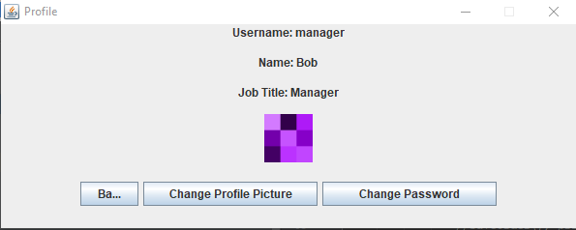
Change Profile Picture (After Restart)

Slide 34
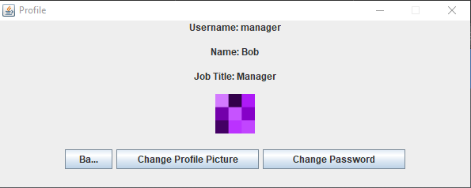
Change Password

Slide 35
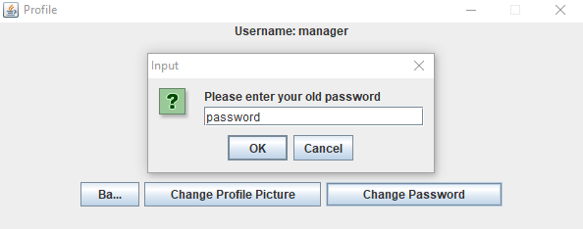
Change Password

Slide 36
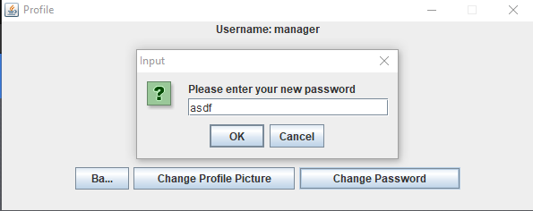
Change Password

Slide 37
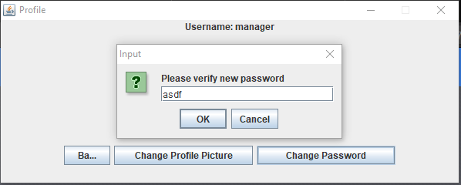
Change Password

Slide 38
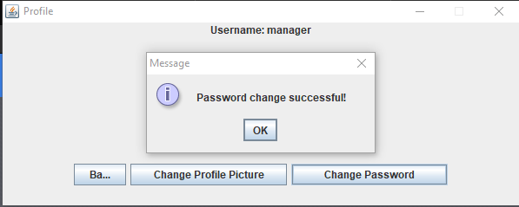
Change Password

Slide 39
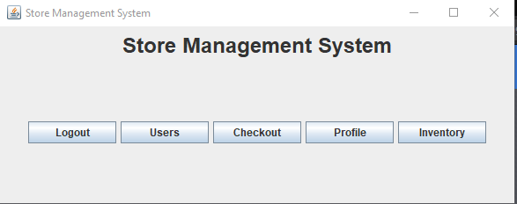
Managing Inventory

Slide 40
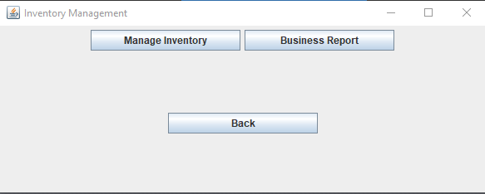
Managing Inventory

Slide 41
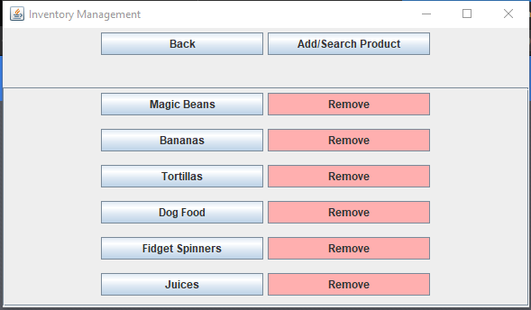
Managing Inventory

Slide 42
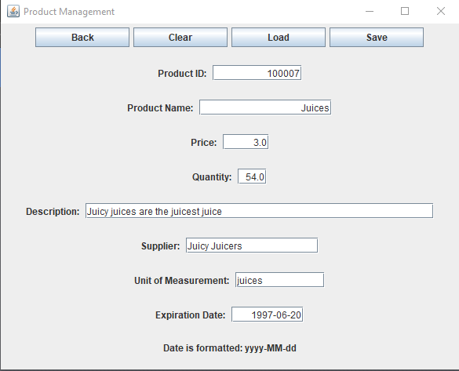
Managing Inventory (View “Juices” Item)

Slide 43
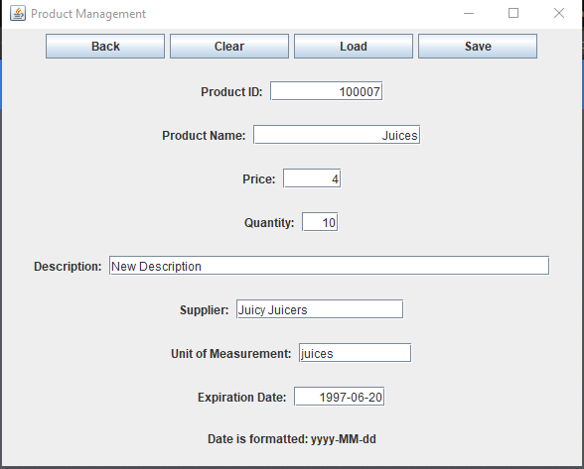
Managing Inventory (Modify “Juices” Item)

Slide 44
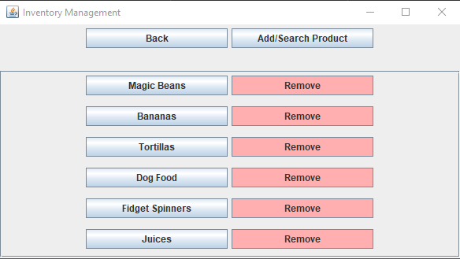
Managing Inventory (Remove “Juices” Item)

Slide 45
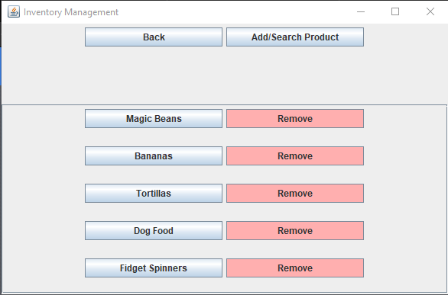
Managing Inventory (Remove “Juices” Item)

Slide 46
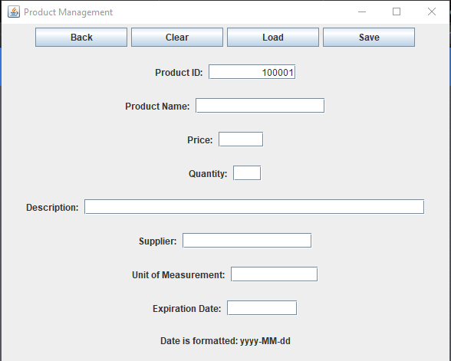
Managing Inventory (Load Item)

Slide 47
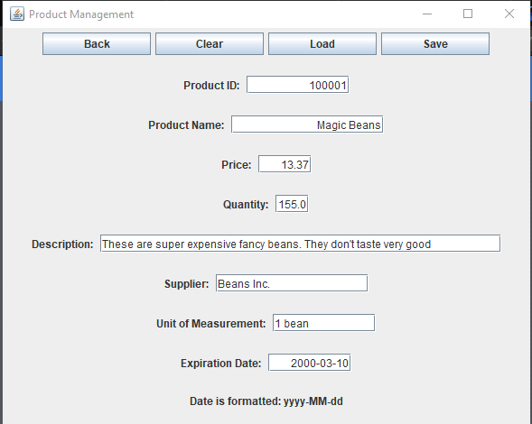
Managing Inventory (Load Item)

Slide 48
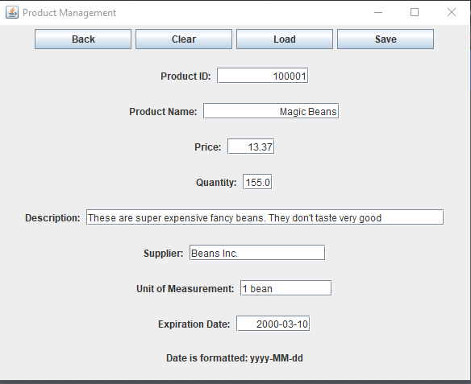
Managing Inventory (Clear Item)

Slide 49
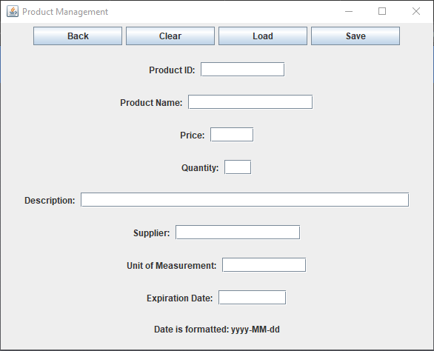
Managing Inventory (Clear Item)

Slide 50
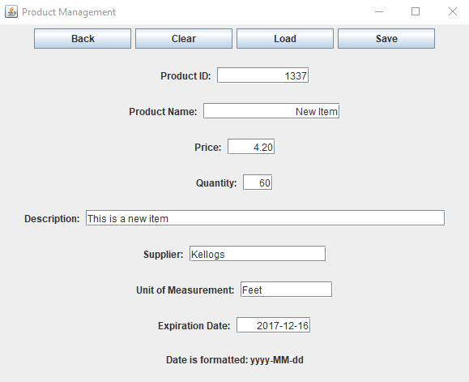
Managing Inventory (Add Item)

Slide 51
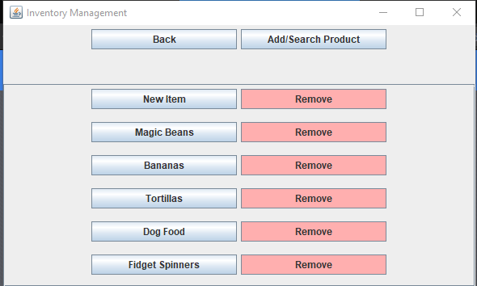
Managing Inventory (Add Item)

Slide 52
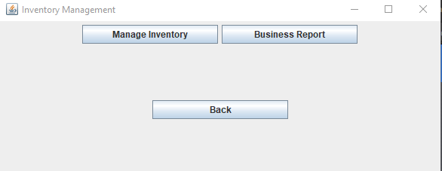
Business Report

Slide 53
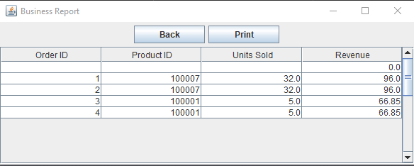
Business Report

Slide 54

Business Report (Print)

Slide 55

Multiple Database Access

