Slide 1
//todo: TEAM NAME
AN INTRODUCTION TO Dark Sky API and team based collaboration

Slide 2
The dev team
Cait potridge – software engineering – junior
Alec goodner – software engineering – junior
Michael Sullivan – software engineering – junior
Thatcher rickertsen – computer science – junior

Slide 3
technology
Angular (Typescript)
Html, css
Notepad++
Npm
Nodejs

Slide 4
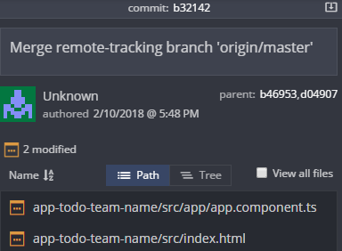
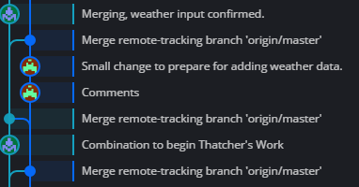
collaboration
Discord – organized for api tracking and information storage
Gitkraken – github gui

Slide 5
Setbacks and accomplishments
Changing non dark-sky api elements overtime
Github file limitations/desync
Compatibility between mac os and windows os
Introduction to web development

