Slide 1
A Dockerfile seems like a pancake?
AYANO Tetsuro
@aigamo
aigamosan@gmail.com

Slide 2
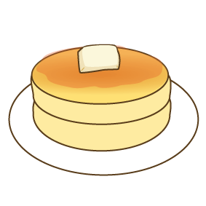
if (Dockerfile === Pancake )
Layer 0
FROM dockerfile/ubuntu
# Install Nginx.
RUN \
add-apt-repository -y ppa:nginx/stable && \
apt-get update && \
apt-get install -y nginx && \
rm -rf /var/lib/apt/lists/* && \
echo "\ndaemon off;" >> /etc/nginx/nginx.conf && \
chown -R www-data:www-data /var/lib/nginx
VOLUME ["/etc/nginx/sites-enabled", "/etc/nginx/certs", "/etc/nginx/conf.d", "/var/log/nginx", "/var/www/html"]
WORKDIR /etc/nginx
CMD ["nginx"]
EXPOSE 80
EXPOSE 443
Layer 1
Dockerfile can divide to individual layers
It seems like a pancake?
Layer 2
Layer 3
Layer 4
Layer 5
Layer 6

Slide 3
Select a pancake sheet
form pancake database
Pancake Editor
Pancake Sheet Database
FROM layer
apply
RUN layer
Swap or merge layers
VOLUME Layer
Choose a sample Dockerfile form Docker Hub
CMD Layer
Dockerfile
Docker Hub
EXPOSE Layer
Building Dockerfiles made easy and fun
just pick and pile pancake pieces on the editor!

Slide 4
Related works
Imagelayers.io
https://imagelayers.io/
It can visualize Dockerfiles but not editable

