Slide 1
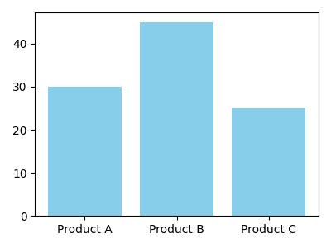
Sales Overview
Product A 30
Product B 45
Product C 25

Slide 2
Problem
- Manual work is slow
- Data is overwhelming

Slide 3
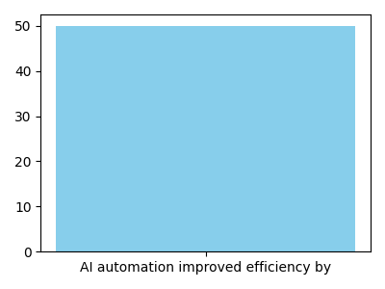
Solution
AI automation improved efficiency by 50

