Slide 1
3D Reconstruction Using Aerial Images
A Dense Structure from Motion pipeline
Ramakrishna Vedantam
CTT IN, Bangalore
Notes:
Title change – done.

Slide 2
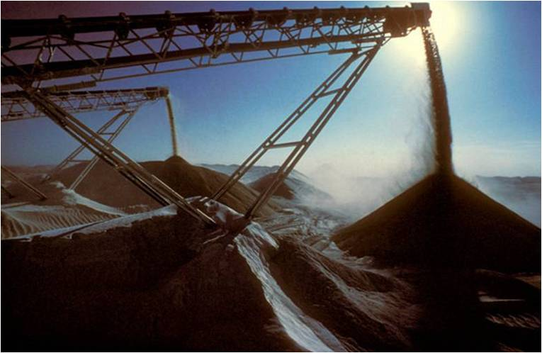
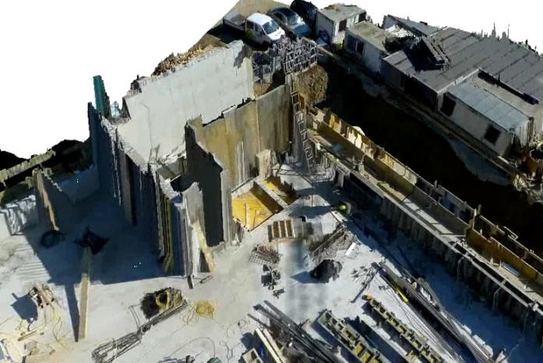
Project Goal
3D capture of ground structures using aerial imagery
Volume Estimation of mine dumps
Infrastructure development monitoring
Augmented Reality
Notes:
Volume of ground structures
3D modeling of structures
Relevant applications snapshots

Slide 3
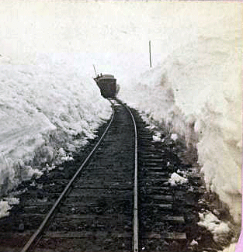
3D from Images : Stereo?
Notes:
Added the gif train animation. See it in stereo !

Slide 4
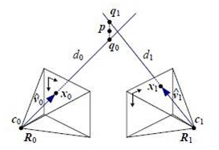
Stereo
3D information can be ascertained if an object is visible from two views separated by a baseline
This helps us to estimate the depth of the scene

Slide 5
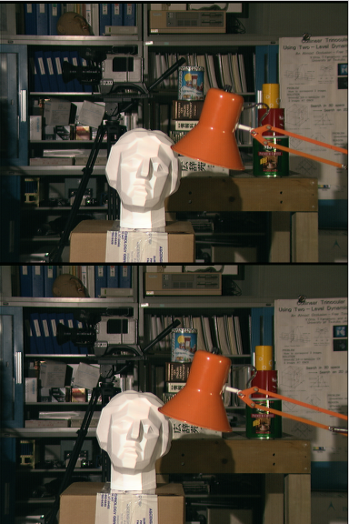
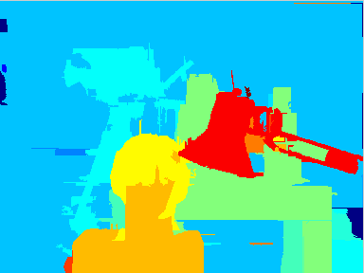
Disparity/ Depth Image
Disparity / Depth Image
Stereo Input Images

Slide 6
Multi View Stereo (MVS)
Images from multiple views at short baselines used.
Give Better Precision and reduce matching ambiguity
Case for Multi View Stereo
Disparity
baseline, focal length and matching.
Camera Model
Needed !

Slide 7
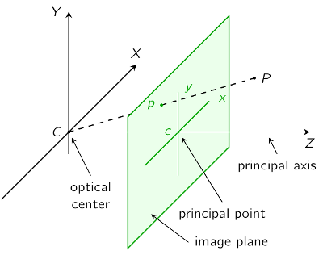
Calibration of a Camera Model
Internal parameters
Focal length, pixel aspect ratio etc
External camera parameters
Rotation and Translation in global frame of reference
Calibration: finding the internal parameters of the camera

Slide 8
STRUCTURE FROM Motion
Notes:
Find keypoints in each image. Use the SIFT detector. Use some matching crierion with arobust estimator like RANSAC to refine the matches. Compute a candidate fundamental matrix using the 8 point algorithm.
After finding a set of geometrically consistent matches between each image pair, organize them into tracks, where a track is a connected set of matching keypoints across different images.
Recover a set of camera parameterss and a 3D location fro each track. The revocered parameters should be consistent, in that the repojection error, sum of distances between the projections of each track and its corresponding image features, Is minimized. This minimization problem is formulated as a non linear optimization problem and is solved using the standard levendberg- marquardt optimizattion technique.
Begun by estimating the parameters of a single pair of cameras. This intial pair should have a large number of matches, but alos have a large baseline, so that the 3 D locations of the observed points are well-conditioned. We therefore choose the pair of images that has the largest number of mnatches, subject ot the condition that those two pairs are not related by a homography.
Next we add another camera to the optimization, slect the camera that observes the largest number of tracks whose 2D locations have already been estimatede, and intialize the new camer’s extrinsic parameteres using the DLT inside a RANSACC procedure. The DLT also gives an estimate of the intrinsic parametere matrix K as a general upper-trianglular matrix. We use K and the focal length estimated from the EXIF tags of the image to initialize the focal legnth of the new camera.
Finally, we add tracks observed by the new camera into the optimization. A track is added if it is observed by atleast one other recovered camera anf I triangluatying the track gives a well condtioned estimate of its location. Te procedure is repeated, one camera at a time,, until no remaining camera observes any reconstructed 3D point.
Sparse bundle adjustment is used. After reconstructing we optionally run a post-processing step to detect 2D line segments in the scene using a line segment reconstruction technique.

Slide 9
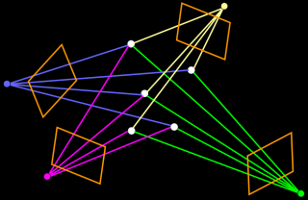
Structure from Motion (SFM)
Finding the complete 3D object model and complete camera parameters from a collection of images taken from various view-points.
Involves
Stereo Initialization
Triangulation
Bundle Adjustment.

Slide 10
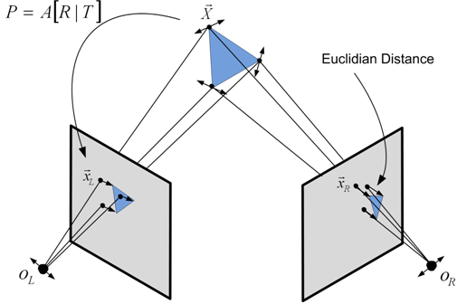
Bundle Adjustment
Stereo Initialization:
Finding relation between features in two initial scenes.
Bundle Adjustment:
Iteratively minimizing reprojection error while adding more cameras and views.
Computationally Expensive !
Initialization is Key

Slide 11
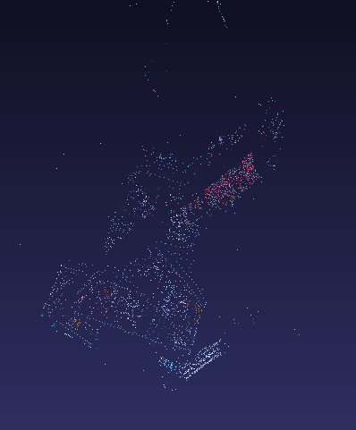

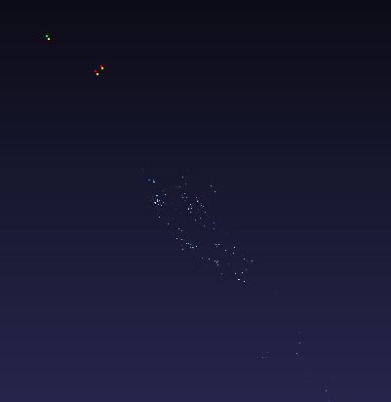
SFM: Reconstruction
SFM: 2 images
SFM: 5 images
SFM: 20 images
Clearly, not suitable for dense reconstruction.

Slide 12
SFM -> Multi-View Stereo Pipeline
SFM
Multi-View Stereo
Typically involves matching of sparse features and triangulation of those features.
Generates Camera Parameters.
Patch based “every pixel” methods used to estimate the disparity/ depth for the whole of a scene.
Uses Camera Parameters to give dense depth estimates.
SFM to MVS pipeline gives dense reconstructions !

Slide 13
Accurate, Dense and Robust MVS
      Extract features
      Get a sparse set of initial matches
      Iteratively expand matches to nearby locations
      Use visibility constraints to filter out false matches
Notes:
**
Accurate Dense and Robust multiview stereopsis
> no initialization required
> aurotmatic detection and discarding of outliers and obstacles
> local photometric constustency, global visibility constrints
> implemented as a match expand and filter procedure
The recent formulations of multi-view stereo have been posed as a problem of finding the surface minimizing a global photometric discrepancy functional, regularized by explicit smoothness constraints.
Optimization techniques range from local methods such as graditent descent , level stes or expectation minimization to global methods like graph cuts.
There are theree classes of datasets: objects, crowd and scenes.
All of them are handled well by the system presented.
1. Matching: Features found using DOG and Harris metched acrioss inmages yeilding a sparse set of patheches associated with salient image regions.
2. Expansion: initial matches are spread to nearby pixels to obtain a dense set of patches.
3. Filtering: Constraubnts used to eliminate incorrect matches lying in front or behind the surfaces. The expansion adn filtering are done iteratively.
Patch Models:
> The method used to accurately reconstruct a patch once the corresponding image fragments have been matchred and determine ints visibility.
patch p -> rectangle c(p)-> center n(p) -> normal
r(p) -> reference image s(p)-> visible image t(p)-> truly found
Two constraints:
> Photometric consistency: each patch's tectures have to be sonsistent in atleast k images. t(p)>k
> visibility consistency: no patch p be occluaded by another patch in any image in S(P)
Image Models:
a grid of some BxB cells C(i,j) and recobnstruct a patch in each cell.
C(i,j) keeps track fo two different sets Qt(i,j) and Qf(i,j) of reconstructed patches potentially visible in C(i,j) : p stired in Qt(i,j) if I belongs to T(p) and in Qf (i,j) if I belongs to S(P) - T(p).
Also associate with C(i,j) a depth of the center of the patch in Qt(i,j) closest to the optical center of the corresponding camera.
Enforcing Photometric Consistency
Use normalized crosss correlation fo projections of a patch 'P' into the images I and J to measure photmetric consistency.
uxu grid overlaid on p and projected into the two images the correlated values are obtained thru billinear interpolation.
The search space constrained to the ray joining optical center of camera to the corresponding image point. Thus it is reduced to a 3-D serach problem.
As with most optimization problems, the initial guess for c(p) is ofcourse important as with most optimization problems.
Enforcing visibility constistency:
Some constraints depending upon the density of the map generated so far.
Algo
Matching-> Expansion -> Filtering
Reconstruction:
Reconstructed patches from an oriented point model. We want to turn into surface meshes. The adopted apprach is iterative deformation.

Slide 14
The Missing Link
Multi View Stereo
SFM
Images
Where do the Images come from ?

Slide 15
Localizing the camera

Slide 16
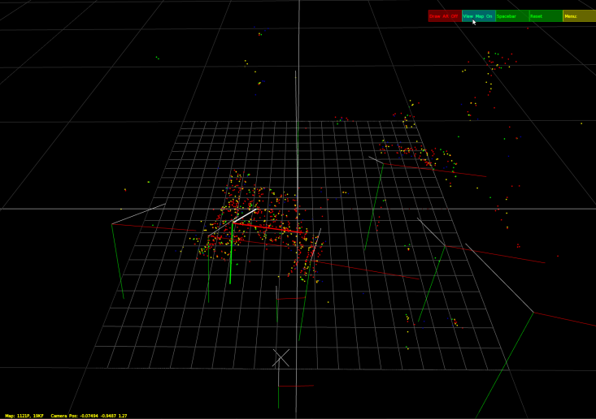
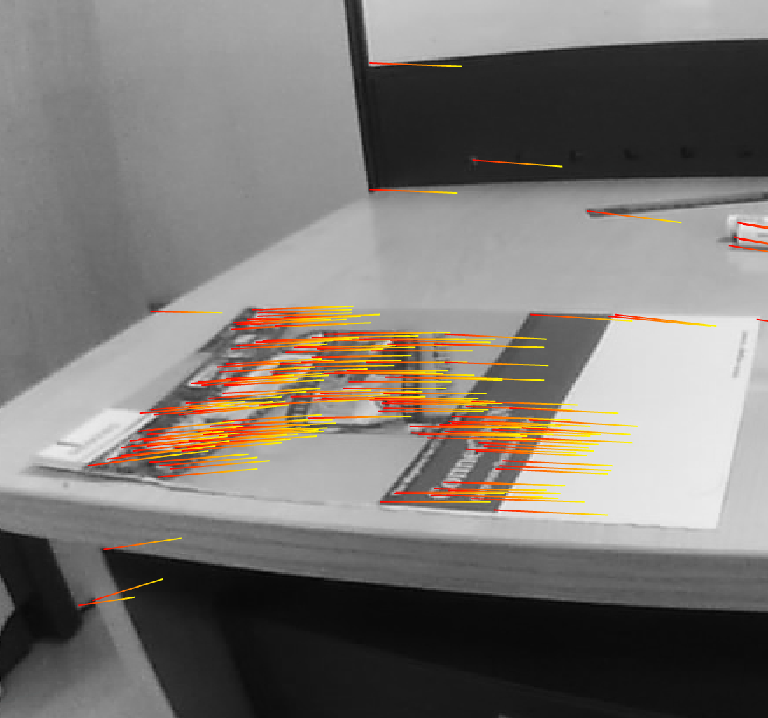
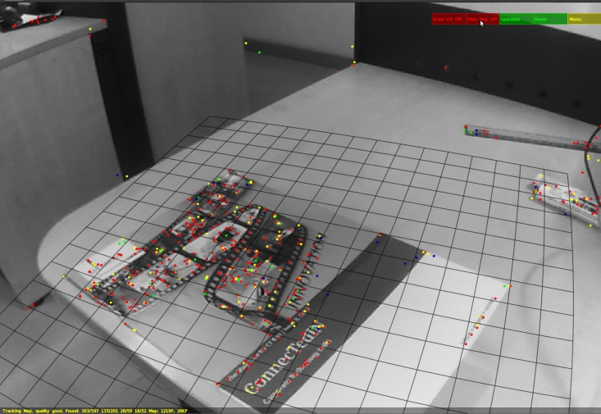
PTAM: Parallel Tracking and Mapping
Tracking
Stereo Initialization
PTAM: Key frame selection
Mapping
Notes:
**********************************
PTAM : Klien and Murray
**********************************
PTam is based on extensible tracking , that is we add more and more features to an initial map so that tracking happens even when the original landmarks are out of range.
Applicable only for small AR workspaces or araeas.
Estimates a large flat plate as well in the scene, for AR applications such as games.
> Tracking and mapping runs on two independent threads.
> Mapping based on keyframes and bundle adjustment.
> Initilization from a stereo pair,
> Thousands of points mapped.
This method is basically meant for a hand held camera for which a motion model is tought to generate and data association errors occur, resulting in bad maps.
There is a difference between mappiong and reconstruction, in reconstruction redundancy reinforces the model and in mappning redundancy is not as useful.
PTAM has a mapping driven keyframe criterion.
An initial map is buiilt form 5 point stereo and then camera tracked using local bundle adjustment over the N most recent camera poses : Refer recent developmens on direct relative orientation, useful to find a good initialization to ensure that the bundle adjustment converges.
Each keyframe stores a fourlevel pyramoid of greyscale images.
Tracking:
Tracking is done by using an initial pose estimation which is obtained using a motion model for a hand held camera, which is incrementally refined by optimizing for the pose wrt the projection of some 50 initial points. This estimate is then refined for 1000 points by projecting them.
Affine warping is used for matching the patches.
Mapping:
The initial map is built using a 5 point match algorithm which is incrementally refined as we keep on getting more and more keyframes. When we get a new point, we look for the keyframes around it and try to triangulate it and estimate it using RANSAC, if the triangulated point does not exist in the map it is added to it.
Incremental bundle adjustment at both local and global levels keeps happening. Finally when the mapping thread is idle, that is no new keyframes are coming, the Data association refinement step is performed which makes the map more robust by looking for the same map in more views if possible and triangulating it with lesser possible error.
PTAM has emerged as a good alternative to monocular visual SLAM in which the mapping and tracking were sequential and dependent.The method is very suitable for our use, other than the disadvantage that the map generated by PTAM may not be much of a 3D model.

Slide 17
PTAM
Tracking and mapping are done in parallel allowing more features to be added to map as they are detected.
Bundle Adjustment is done after every few frames.
Enforces a pose change and time heuristic to select key frames.

Slide 18
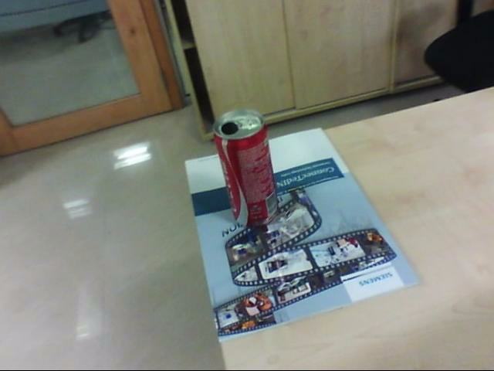
KeyFrames

Slide 19

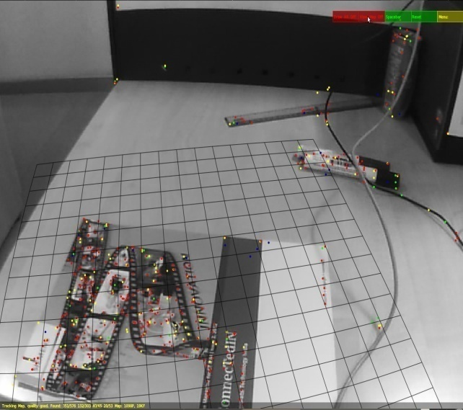
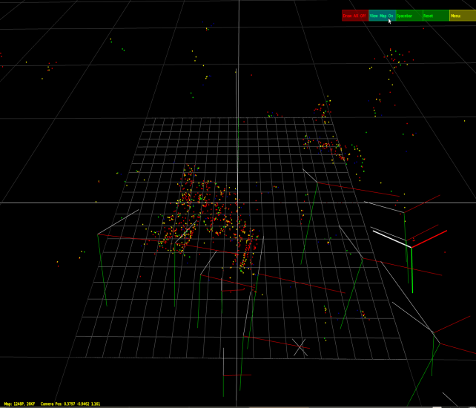

PTAM – Pose

Slide 20
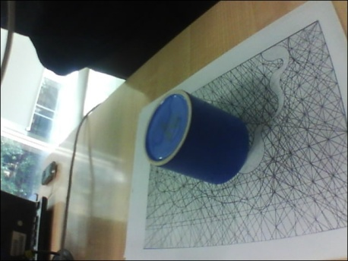
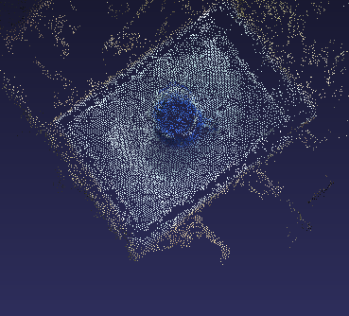
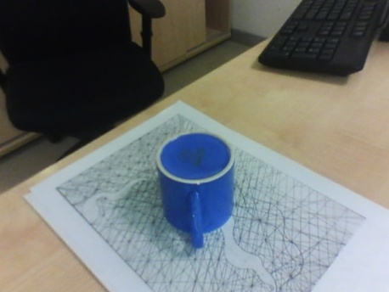
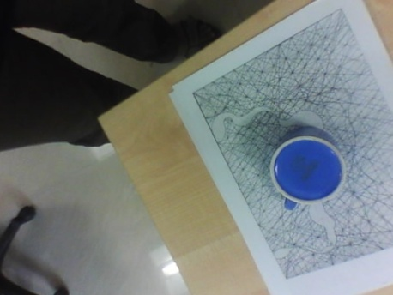
PTAM -> SFM -> MVS Block Results
CUP_60 dataset

Slide 21
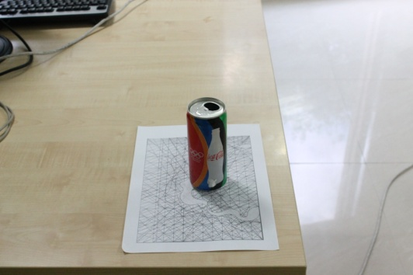
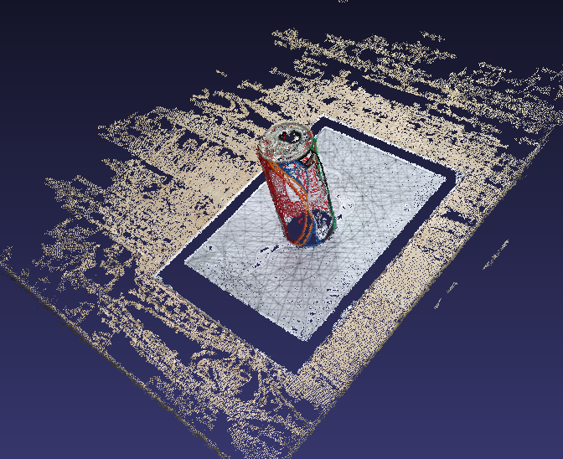
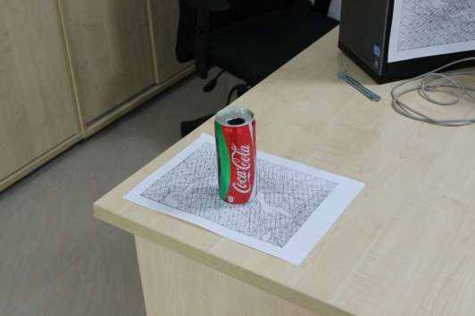
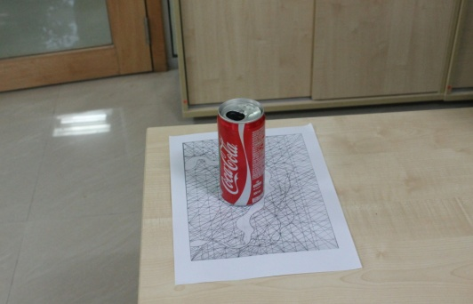
PTAM -> SFM -> MVS Block Results
Olympic Coke CAN

Slide 22
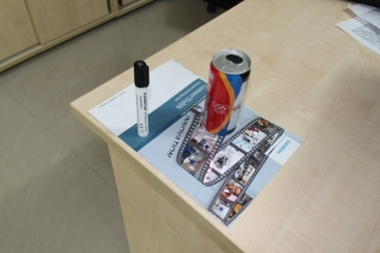
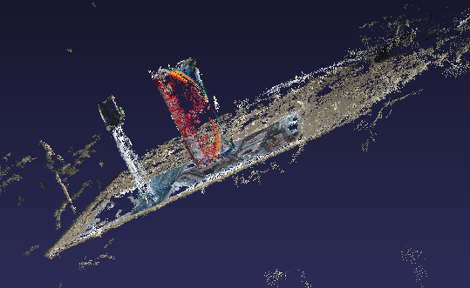
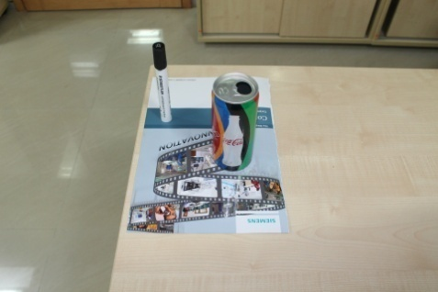
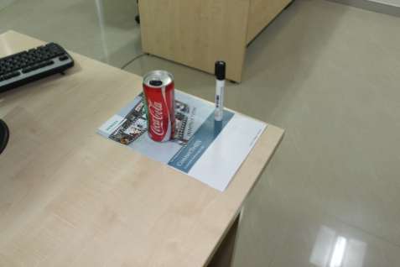
PTAM -> SFM -> MVS Block Results
Olympic Coke CAN + Pen

Slide 23
System Block Diagram – So Far
Multi View Stereo
SFM
Keyframes
PTAM
Bundler
PMVS-2
3 stage dense reconstruction pipeline

Slide 24
Volume Estimation
3D reconstructions stored as point clouds, a set of points in space with color information.
From a point cloud, planar features are segmented out.
Remaining points are clustered.
User views clusters and gives the reference ground truth data and the cluster whose volume is to be estimated.

Slide 25
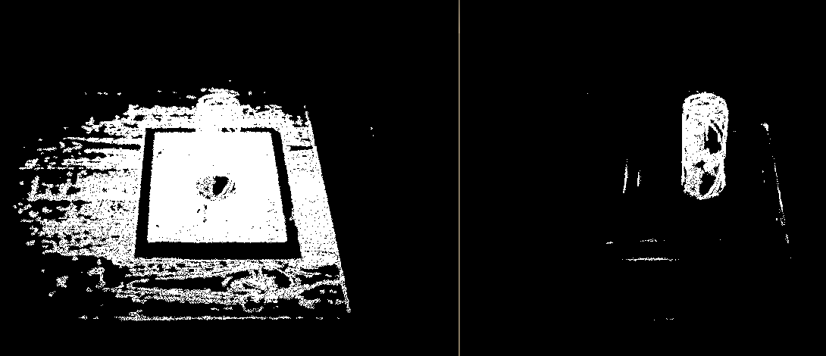
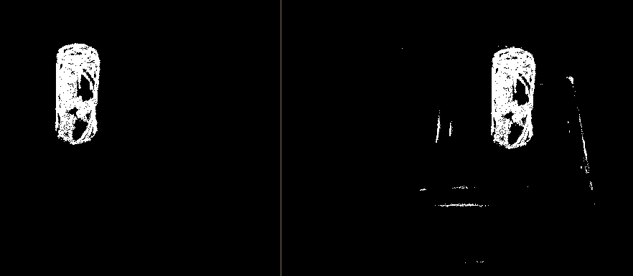
Segmentation and Filtering

Slide 26
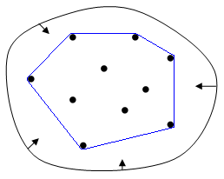
Volume Estimation
After segmenting the point cloud, the volume is estimated by finding the convex hull of the 3-D point cloud.

Slide 27
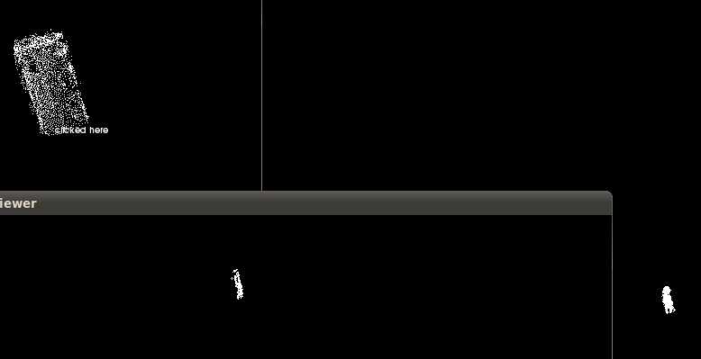
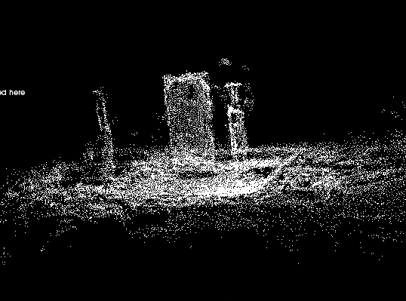
Volume Estimation
Original Point cloud
Clusters

Slide 28

Volume Estimation - Dataset
Ground Truth data : 16.2 cm distance between pens
Height of Cylinder : 12.9 cm
Radius of Cylinder : 2.9 cm
Volume of Cylinder :

Slide 29
Volume Estimation - Dataset
Volume for PTAM dataset: 398.617 cu cm
Image Resolution: 640 x 480
Accuracy : ground truth is 85.4 % of volume
Number of Images: 102
Volume for DSLR dataset: 417.69 cu cm
Image Resolution: 1920x1480
Accuracy : ground truth is 81.4 % of volume
Number of Images: 30

Slide 30
Volume Accuracy
The multi view stereo algorithm gives 98.7% of points 1.25 mm of the reconstruction for reference datasets.
Cameras parameters are noisy, affecting volume accuracy.
Pose information given by the IMU can improve camera parameters.
Clustering done without a-priori shape information, if given, outliers can be filtered out and geometric consistency enforced.

Slide 31
Scope for Improvement
Use sensor data from IMU to estimate camera pose
Make it a real time, live dense reconstruction system
Improve accuracy of volume estimation
Plan the flight of the UAV doing the reconstruction
Making the reconstruction interactive

Slide 32
Related work
Dense Reconstruction on the fly (TU Graz) :
      Real time reconstruction
      User interaction with live reconstruction
      Successfully adapted to UAV
Dense Tracking and Mapping (Imperial College, UK):
      Real time dense reconstruction using GPU
      Superior Tracking performance, blur resistant
Live dense reconstruction from Monocular Camera (IC) :
      Real time monocular dense reconstruction
      Sparse Tracking

Slide 33
THANK YOU !

