Slide 1


Aigents® for Cities
and Communities
Anton Kolonin
akolonin@aigents.com
Telegram: akolonin
https://singularitynet.io
https://www.nsu.ru
AIGENTS
https://aigents.com

Slide 2
Architecture of collective intelligence and social
engineering in online environments
Online environment
Profiling &
Monitoring
Soft
management
Manipulation &
Social enginnering
Posts
and
Comments
Status
And
Location
Changes
Push
Notifi-
cations
Search
Queries
Search
Results
Emails
Chats
Human community

Slide 3
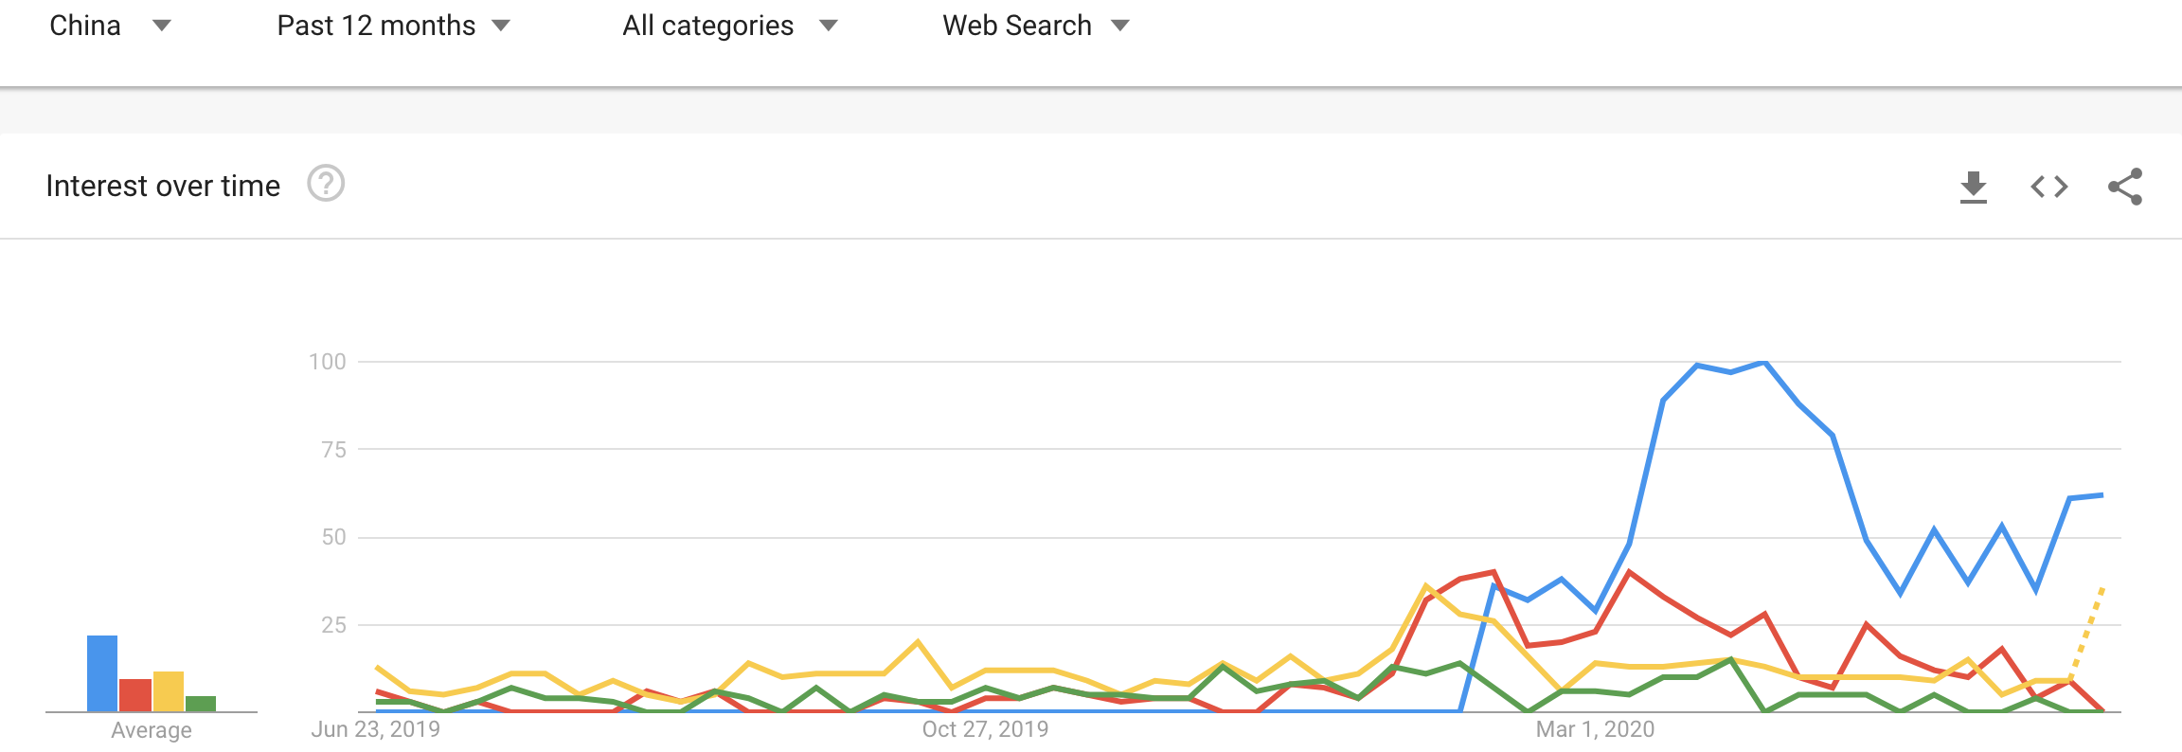
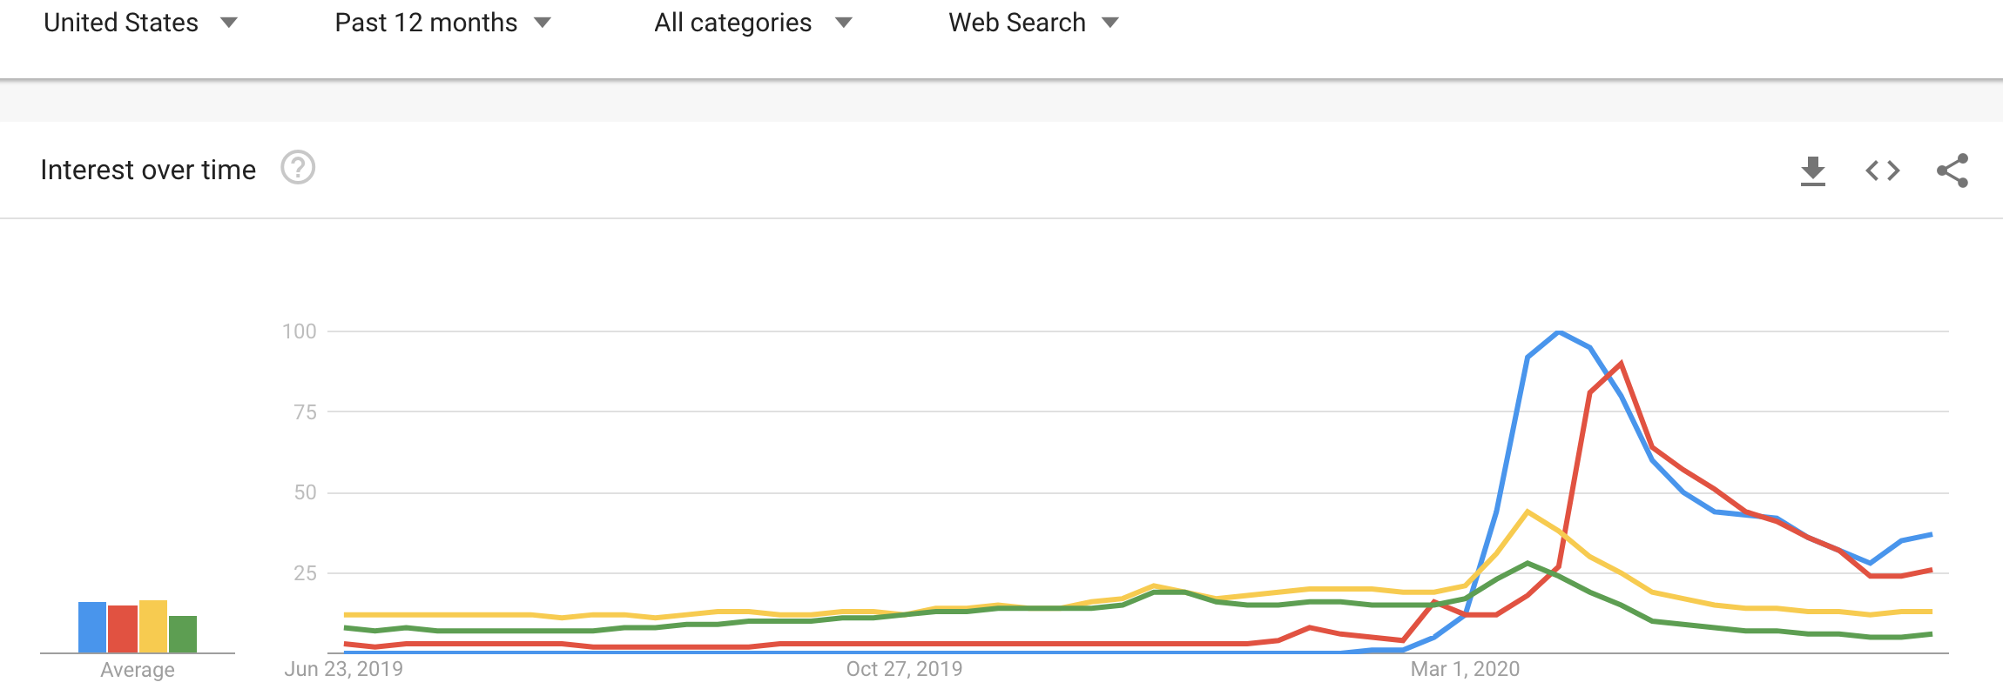
What do search queries talk about?
https://trends.google.com/trends/explore?geo=CN&q=covid-19,face%20mask,fever,cough
China
https://trends.google.com/trends/explore?geo=US&q=covid-19,face%20mask,fever,cough
Источник:
https://arxiv.org/abs/2204.12928
US

Slide 4
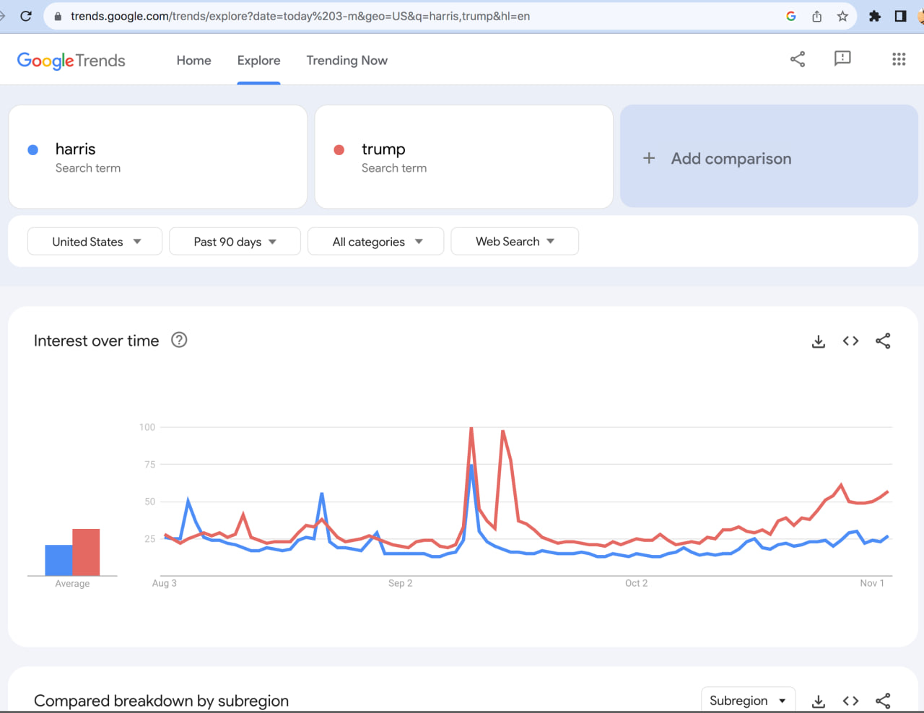
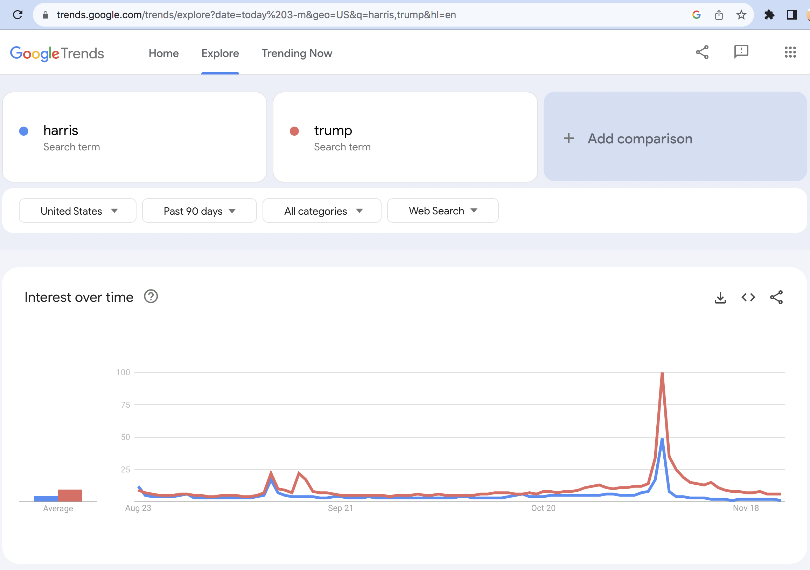
What do search queries talk about?
https://trends.google.com/trends/explore?date=today%203-m&geo=US&q=harris,trump&hl=en
Before US elections on November 5, 2024
On the day of elections and after

Slide 5
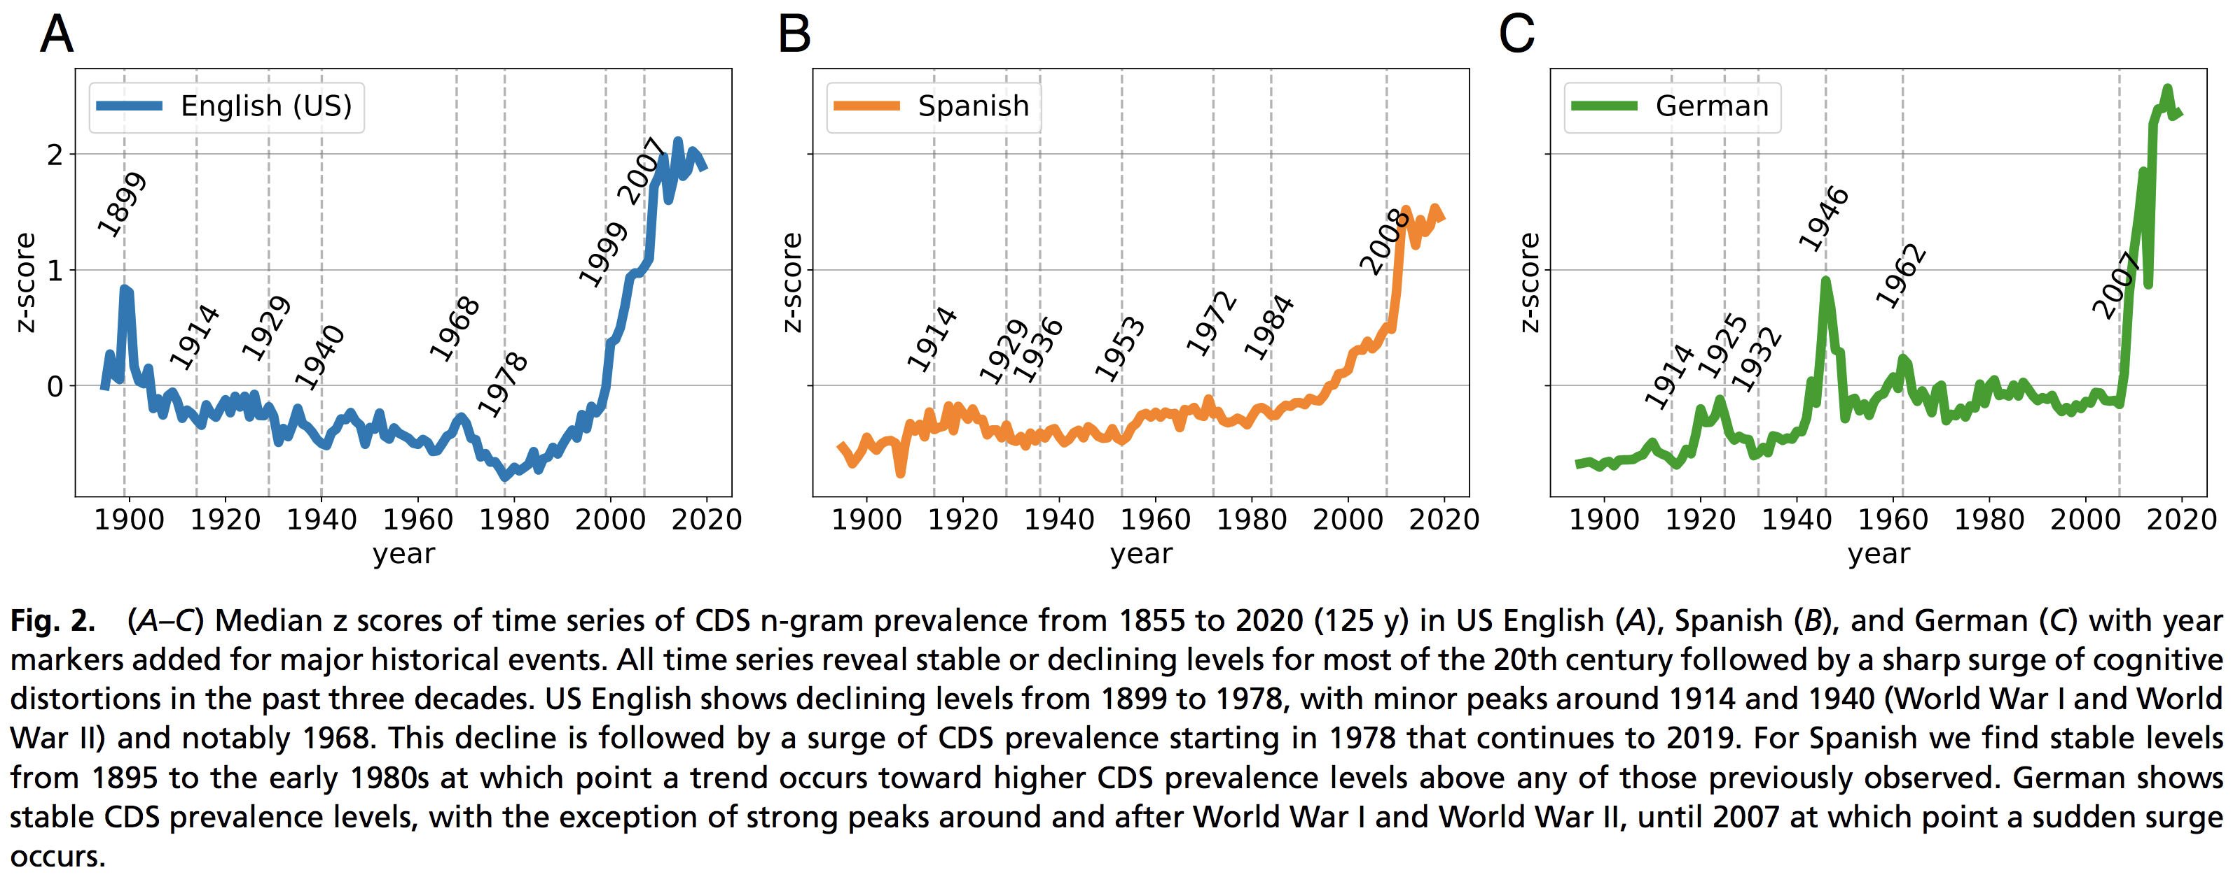
What can be learned about the psyche of a society from its texts?
Cognitive Distortions (Cognitive-Behavioral Therapy)
Source: https://www.pnas.org/doi/pdf/10.1073/pnas.2102061118

Slide 6
Socially-”aligned” emphatic AI-agents
Aigent A’
B’
A’
B
B’
A
B
Human A
B’
A’
A
Aigent B’
Human B
A’
A
B

Slide 7
Decision support systems (DSS) relying on collective intelligence for communities
Collective Aigent
Human A
A
Human B
B
С
Human С

Slide 8
Enforcing/preventing manipulation
(applied “belief engineering”)
PsyOps,
Social Engineering
Scam
Sales,
Marketing,
Ads
Sales,
Marketing,
Ads
Psychology,
Psychotherapy,
Psychoanalysis

Slide 9
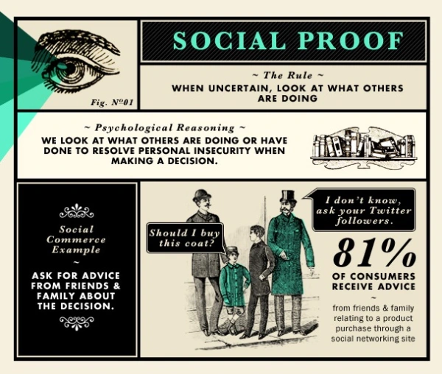
Robert Cialdini: Social Proof
Social proof is a psychological and social phenomenon wherein people copy the actions of others in choosing how to behave in a given situation. The term was coined by Robert Cialdini in his 1984 book Influence: Science and Practice, and the concept is also known as informational social influence.
https://www.amazon.com/Influence-Practice-Robert-B-Cialdini/dp/0205609996
1984

Slide 10
Computable cognitive-behavioral model based on social evidence and restricted by resources
B.Goertzel, A.Kolonin, J.Pressing, C.Pennachin: Compassion-based artificial psyche design (1999-2000)
https://www.goertzel.org/benzine/WakingUpFromTheEconomyOfDreams.htm
A.Kolonin: Computable cognitive model based on social evidence and restricted by resources (2015)
https://ieeexplore.ieee.org/document/7361869
Anton Kolonin, Evgenii Vityaev, Yuriy Orlov: Cognitive Architecture of Collective Intelligence Based on Social Evidence (2016)
https://www.sciencedirect.com/science/article/pii/S1877050916317239
A.Kolonin: Resource-Constrained Social Evidence Based Cognitive Model for Empathy-Driven Artificial Intelligence (2018)
https://link.springer.com/chapter/10.1007/978-3-319-97676-1_10
Social
referee
Social
referee
Self-
esteem
Social
referee
1998-2018

Slide 11
Social evidence-based resource-constrained
cognitive-behavioral model
Unquestioned truths and beliefs
Foundation
Graph
Beer is a drink
Coffee is a drink
Tea is a drink
Juice is a drink
Social connections,
with account to levels of trust
Mary is my best friend
Peter is my friend
Bob is Peter's friend
Social
Graph
Facts weighed based on
their social sources and assessments,
in the light of unquestioned beliefs
Probabilistic
Inference
Imagination
Graph
★★★ I like juice very much
★★ I like tea
★ I may try coffee
I won’t try beer
Facts obtained from sources
with different levels of trust
Evidence
Graph
Bob said beer is good
Mary said beer is not good
Mary said juice is good
Mary said tea is good
Peter said juice is good
Peter said coffee is good
https://ieeexplore.ieee.org/document/7361869
https://www.sciencedirect.com/science/article/pii/S1877050916317239
https://link.springer.com/chapter/10.1007/978-3-319-97676-1_10
https://link.springer.com/article/10.1186/s40708-026-00294-1
2018-2026

Slide 12
Perception & Action driven by Believed Social Evidence
i – person of consideration
j – concept (action) of consideration (exposed evidence)
l – person’s belief item (of foundation graph of size L - personal preference base)
k – person’s correspondent (of social graph of size K - social reference base)
B_{il} – person’s i mental attachment to l (personal preference)
S_{ik} – person’s i social bind to k (social reference)
P_{ij} = Σ_{l=1,L}( E^{B}_{ijl} * B_{il} ) * Σ_{k=1,K}( E^{S}_{ijk} * S_{ik} ) (what we think)
E^{B}_{ik} – concept (action) j agreement or compatibility with l in mind of i (believed evidence)
E^{S}_{ik} – concept (action) j expression or confirmation by k in view of i (social evidence)
P_{ij} – concept (action) j power for i (personal evidence)
C_{ij} = L + K + R^{B} + R^{S} (why we don’t think about that)
C_{ij} – concept (action) cost j cost for i (personal cost)
R^{B}
R^{S}
recursion

Slide 13
Social evidence-based resource-constrained
cognitive-behavioral model
Unquestioned truths and beliefs
B_{il} – person’s i mental attachment to l
l – person’s belief item
(of foundation graph of size L)
Social connections,
with account to levels of trust
S_{ik} – person’s i social bind to k
k – person’s correspondent
(of social graph of size K)
P^{B}_{ij}=Σ_{l=1,L}(E^{B}_{ijl}*B_{il})
C_{ij}
Facts weighed based on
their social sources and assessments,
in the light of unquestioned beliefs
P^{S}_{ij}=Σ_{k=1,K}(E^{S}_{ijk}*S_{ik} )
P_{ij} = Σ_{l=1,L}( E^{B}_{ijl} * B_{il} ) * Σ_{k=1,K}( E^{S}_{ijk} * S_{ik} )
Facts obtained from sources
with different levels of trust
E_{ij} - exposed evidence
https://ieeexplore.ieee.org/document/7361869
https://www.sciencedirect.com/science/article/pii/S1877050916317239
https://link.springer.com/chapter/10.1007/978-3-319-97676-1_10
https://link.springer.com/article/10.1186/s40708-026-00294-1

Slide 14
Basic technique of applied “belief engineering”
“Redundant temporal evidence”
“Highly valable social evidence”
yesterday
Cigarette pack
today
Unpleasant
Image
Schwarzenegger
Not smoking
tomorrow
Not a fun
Not a fun
Good guy
Me
Smoking
Fun
Me Smoking
Fun
“Redundant social evidence”
“Implicit evidence injection”
People in the park
Sports disregard
smoking
Girls disregard
smoking
People in the cinema
Not smoking
Girls like
sports
Girls disregard
me
People in the office
Not a fun
Girls
Not a fun
Me
Smoking
Me like girls
People
Fun
Me
Smoking
Fun

Slide 15
Social evidence-based cognitive-behavioral model
Helps to understand social dynamics
A
B
C
A
B
C
A
B
C
A
B
C
A
B
C
A
B
C
A
B
C
A
B
C
A
B
A
B
A
B
A
B
A
B
C
x
A
B
C
x
A
B
C
X
z
C
A
B
C
X
z
C
C
C
A
B
C
X
A
B
C
X
Interaction
Interaction
Time
Time
B
B
B
B
C
C
C
C
Y
Y
Z
Z
X
Y
Z
X
Y
Z
X
Y
X
Y
X
Y
Z
c
X
Y
Z
c
X
Y
Z
c
Z
X
Y
Z
c
X
Y
Z
X
Y
Z
X
Y
Z
X
Y
Z
https://ieeexplore.ieee.org/document/7361869
https://www.sciencedirect.com/science/article/pii/S1877050916317239
https://link.springer.com/chapter/10.1007/978-3-319-97676-1_10
https://link.springer.com/article/10.1186/s40708-026-00294-1

Slide 16
Social evidence-based cognitive-behavioral model
Makes it possible to build or destroy societies
Ethnic
domination
Religious
intolerance
Healthy life
and sports
We are all -
one family
https://ieeexplore.ieee.org/document/7361869
https://www.sciencedirect.com/science/article/pii/S1877050916317239
https://link.springer.com/chapter/10.1007/978-3-319-97676-1_10
https://link.springer.com/article/10.1186/s40708-026-00294-1

Slide 17
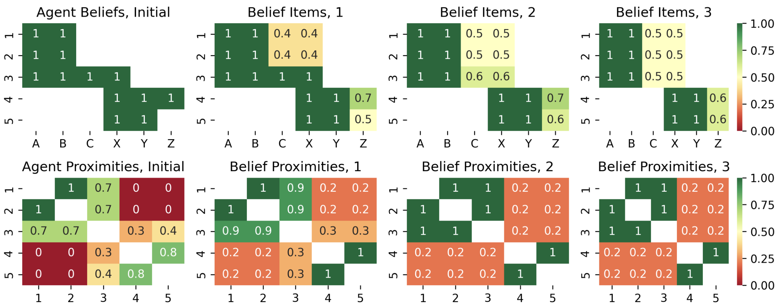
Simulation: socially limited, cognitively unlimited
Results of three rounds of multi-agent simulation with the forgetting threshold peer threshold = 0.5, the social relationship threshold forgetting threshold = 0.0 (limiting social connections K without constraint on belief capacity L). Top row: values of belief items A, B, C, X, Y, Z for five agents 1, 2, 3, 4, 5. Bottom row: social proximity matrices between agents, estimated as the cosine similarity of their beliefs. From left to right: the initial state before the simulation, and then the updated states of beliefs and proximities after three subsequent rounds of multi-agent communication.
https://link.springer.com/article/10.1186/s40708-026-00294-1

Slide 18
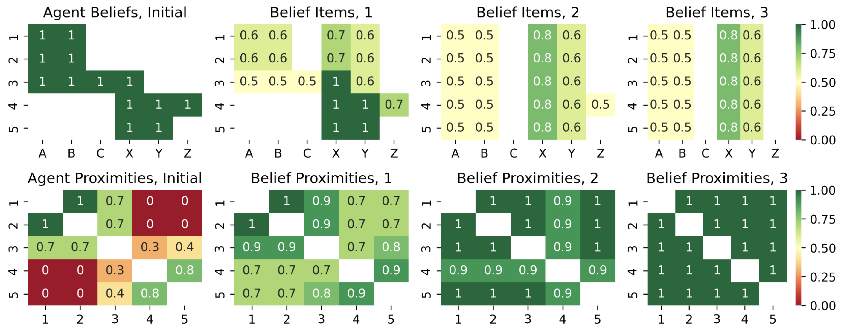
Simulation: socially unlimited, cognitively limited
Results of three rounds of multi-agent simulation with the forgetting threshold forgetting threshold = 0.5, the social relationship threshold peer threshold = 0.0 (limiting belief capacity L without constraint on social connections K). Top row: values of belief items A, B, C, X, Y, Z for five agents 1, 2, 3, 4, 5. Bottom row: social proximity matrices between agents, estimated as the cosine similarity of their beliefs. From left to right: the initial state before the simulation, and then the updated states of beliefs and proximities after three subsequent rounds of multi-agent communication.
https://link.springer.com/article/10.1186/s40708-026-00294-1

Slide 19
Consensus – technology to govern distributed multi-agent systems such as blockchains or societies, resistant to takeover and scam.
$
$
$
$
$
$
$
$
$
$
$
$
$
$$$

Slide 20

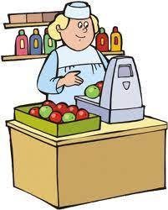
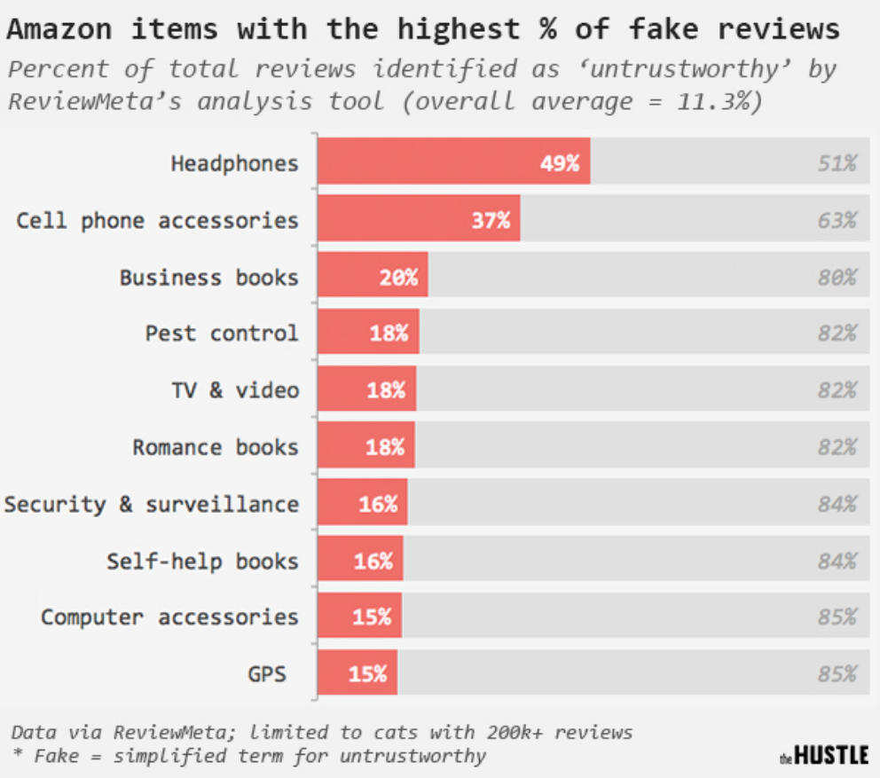


Real Pain: Resisting Reputation Gaming
Honest vendor
Cheaters
Fake accounts with churning and reputation gaming bots
Honest buyers

Slide 21
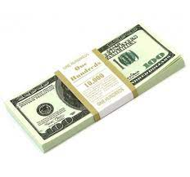
Bad reputation (rating) system
Honest vendors lose profits
Cheaters earn
Fake account and bot farm owners are sponsors are paid
Honest buyers lose money

Slide 22
Right reputation (rating) system
Honest vendors gain profits
Cheaters lose profits
Fake account and bot farm owners are sponsors are still paid for no purpose
Honest buyers get goods

Slide 23

Marketplace imitation modeling
Virtual marketplace
Fake
goods
Real
goods
Honest vendor
Cheaters
Real
reviews
Фэйковые
отзывы
Fake
reviews
Fake
buys
Real
buys
Fake accounts with churning and reputation gaming bots
We select the parameters for the rating system based on a “weighted liquid rank” to maximize losses for cheaters and gains for honest vendors and minimize losses for honest buyers.
Honest buyers

Slide 24
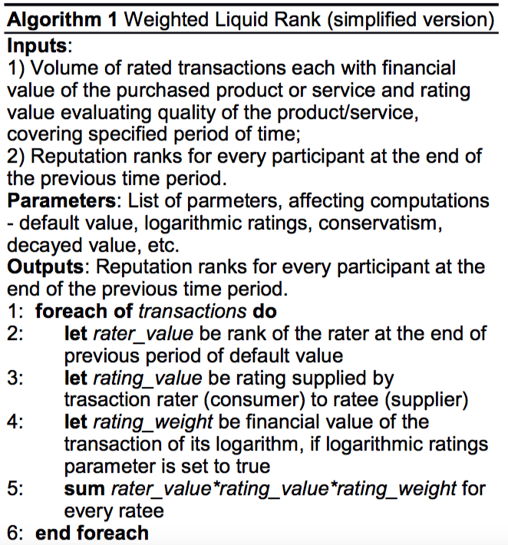
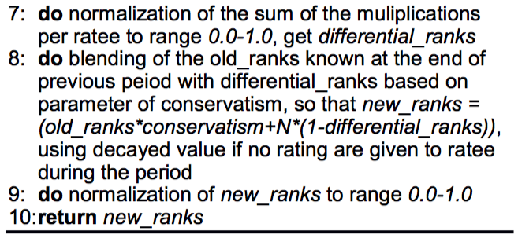
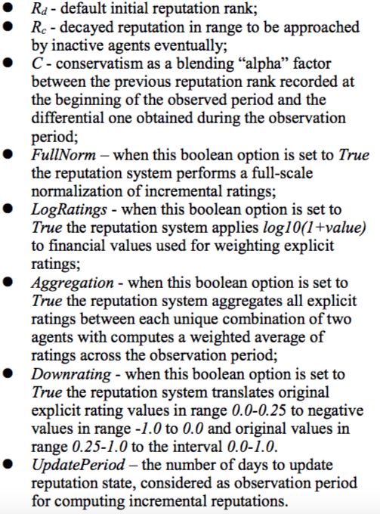
Weighted Liquid Rank
https://singularitynet.io
https://arxiv.org/pdf/1806.07342

Slide 25

Reputation System for Marketplaces
https://singularitynet.io
https://medium.com/singularitynet/minimizing-recommendation-fraud-7dabbee8fc00
Using Reputation System for protection from scam identifying dishonest suppliers.

Slide 26
Aigents® - Personal Assistant
Personal Aigent
Me
You
He
She
A. Kolonin, "Aigents: Adaptive Personal Agents for Social Intelligence",
KESW, 6th International Conference Proceedings, ISSN 1865-0929, 2015
https://link.springer.com/chapter/10.1007/978-3-319-24543-0_22
A.Kolonin, "Adaptive experiential learning for business intelligence
agents", CSGB Symposium Proceedings, 2016
https://ieeexplore.ieee.org/document/7587679
2015-2016

Slide 27
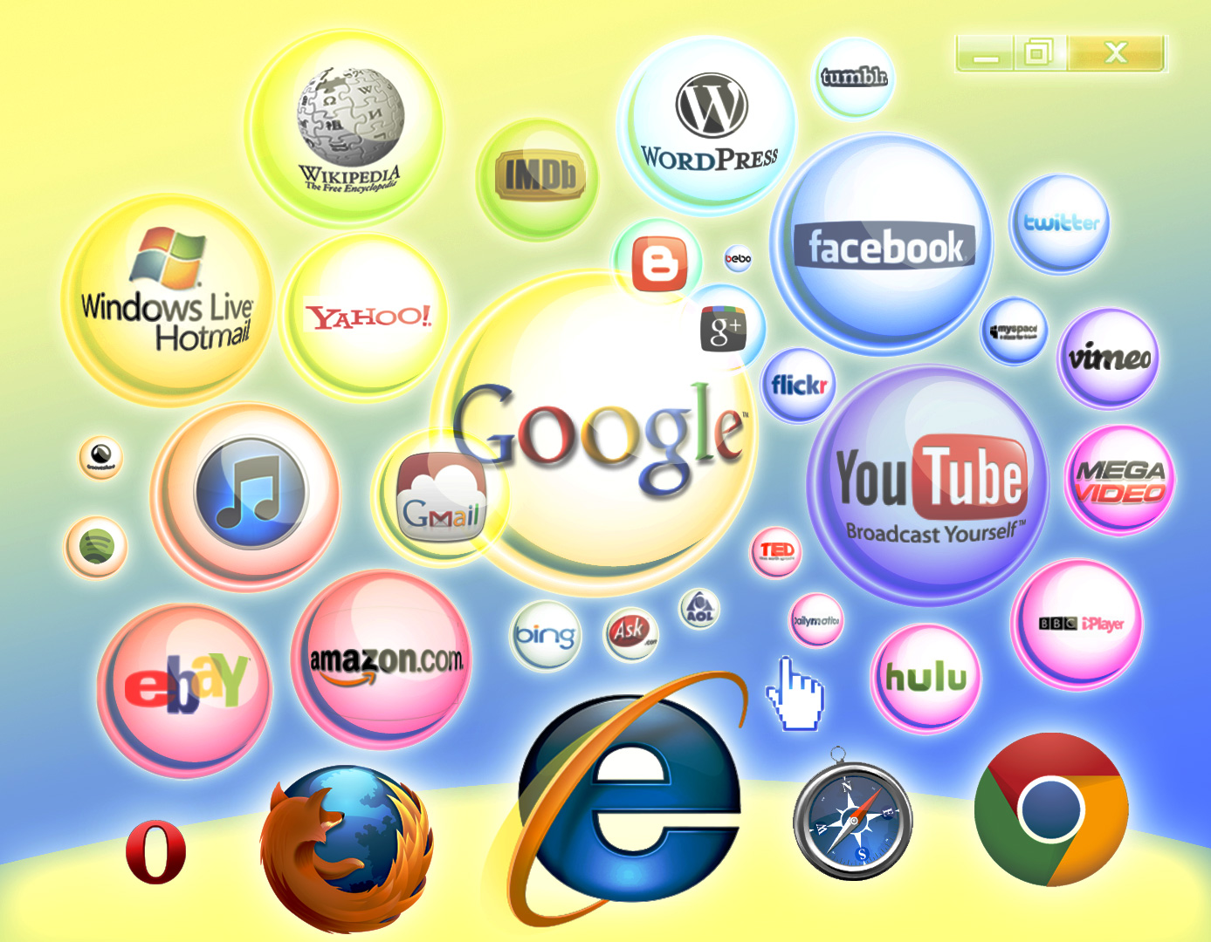















Aigents® - Social computing platform
News
Me
Ethereum
PayPal
You
Steemit
WWW
Golos.id
Google
VKontakte
RSS
Facebook
Discourse
Friends
https://aigents.com/
Messenger
Twitter
https://github.com/aigents
https://www.youtube.com/aigents
Slack
Reddit
Telegram

Slide 28
Aigents® - Social computing platform
Topics
Interests of connections
Personal interests
Similarities
Friends, colleagues, peers, connections
Person
Followers
Social
peer
Leaders
Likes, votes, messages, payments, interactions
Activity period
Likes, votes, ratings
1
Likes, votes, ratings
Publications, messages, transactions
Behavioral model
Календарный
период
Publication,
transaction
https://link.springer.com/chapter/10.1007/978-3-030-03402-3_25
https://ieeexplore.ieee.org/document/8109887
https://www.sciencedirect.com/science/article/pii/S1877050918300383
https://ieeexplore.ieee.org/document/8071965
https://ieeexplore.ieee.org/document/7587680
Usage
Words, phrases
Comments,
reviews

Slide 29
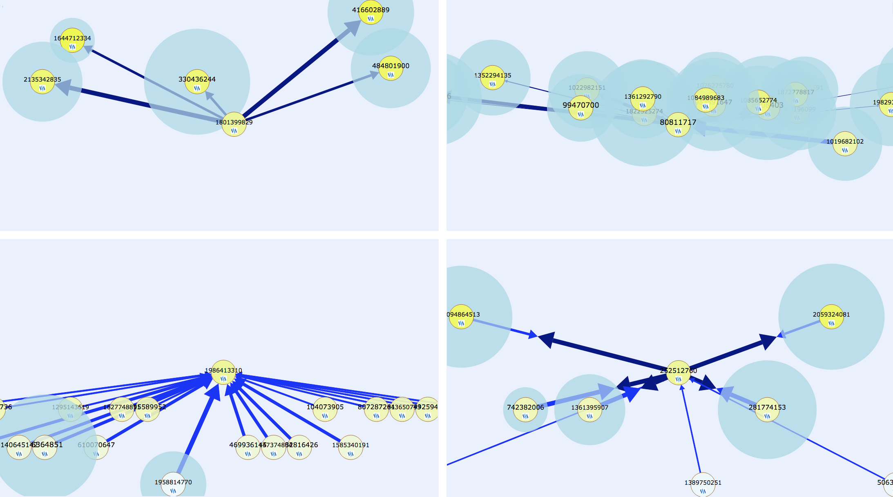
Solution: Identification and discovery of socio-communicative types, profiles and structures, social circles and audiences, opinion leaders, and information dissemination channels.
Social type:
Follower
Social type:
Peer/colleague/friend
Social type:
Leader
Social type:
Hub/propagator
Social type:
follower
Social type:
peer
Social type:
opinion leader
Social type:
connector

Slide 30
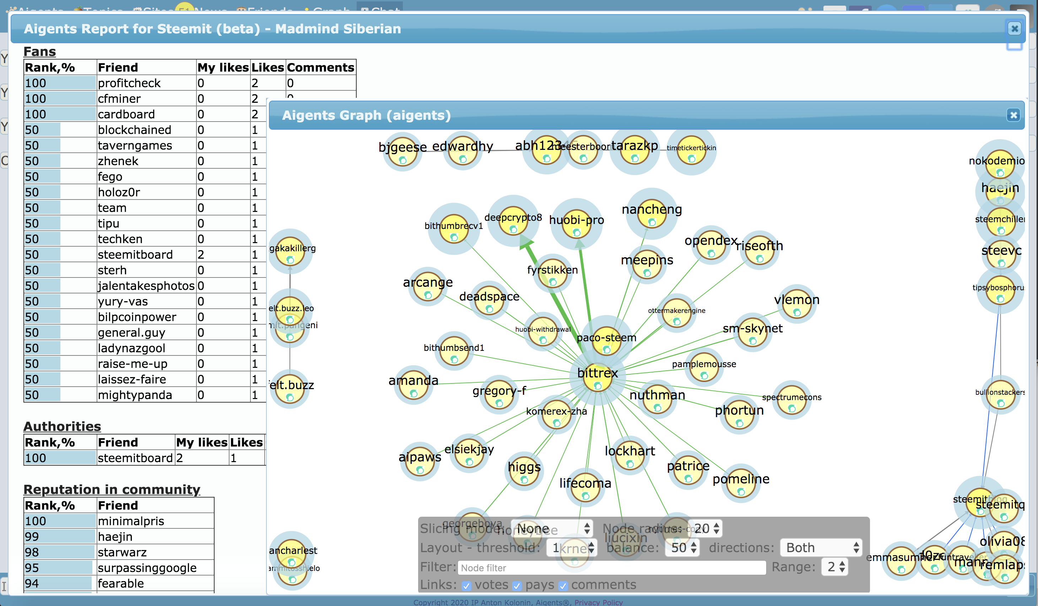
Solution: Quantitative assessment of reputation and trust levels, as well as the nature, quantity, and quality of interpersonal relationships within large-scale online communities.

Slide 31
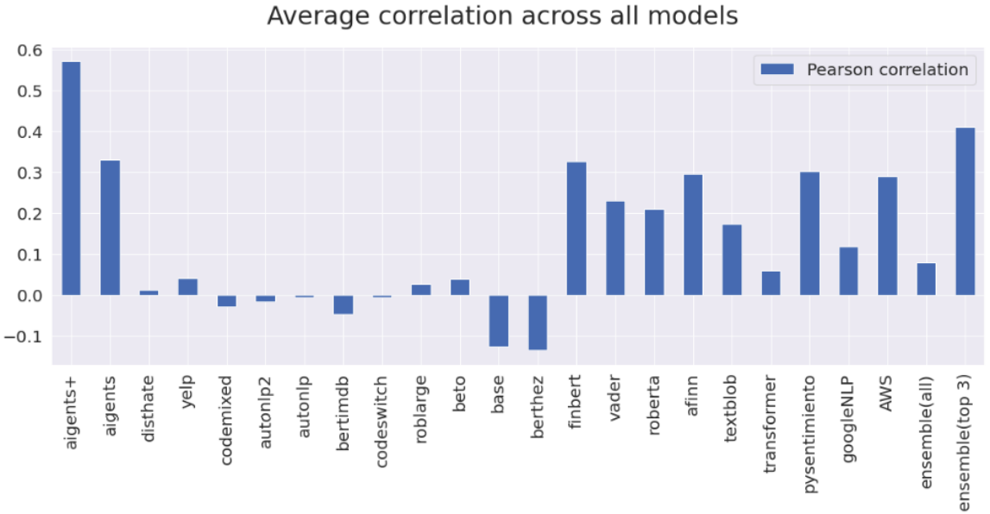
How do you determine the tone or sentiment of a text?
Metrics: Sentiment, Positiveness, Negativeness, Contradictiveness
Our
interpretable («trustworthy») model
https://arxiv.org/abs/2204.10185

Slide 32
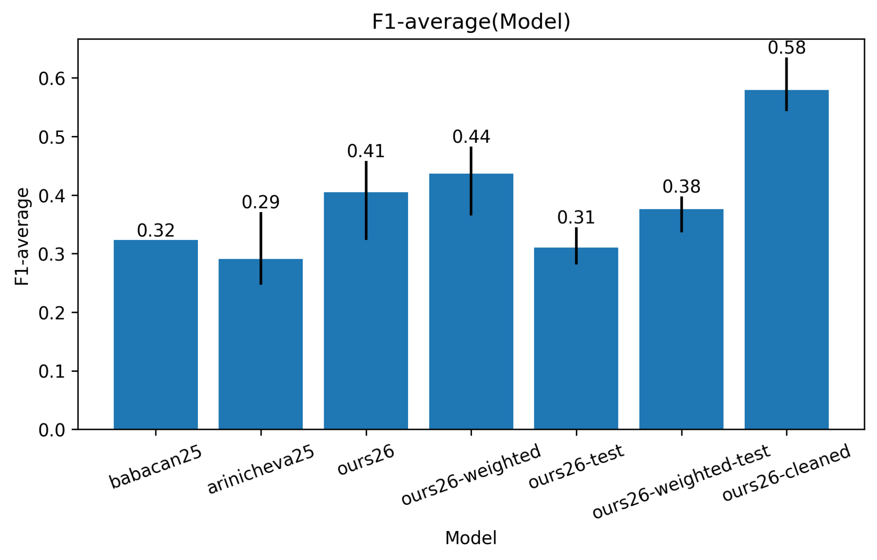
Automated detection of cognitive distortions - state of the art
Our
interpretable («trustworthy») model
https://peerj.com/articles/cs-3699/ https://arxiv.org/abs/2511.05969

Slide 33
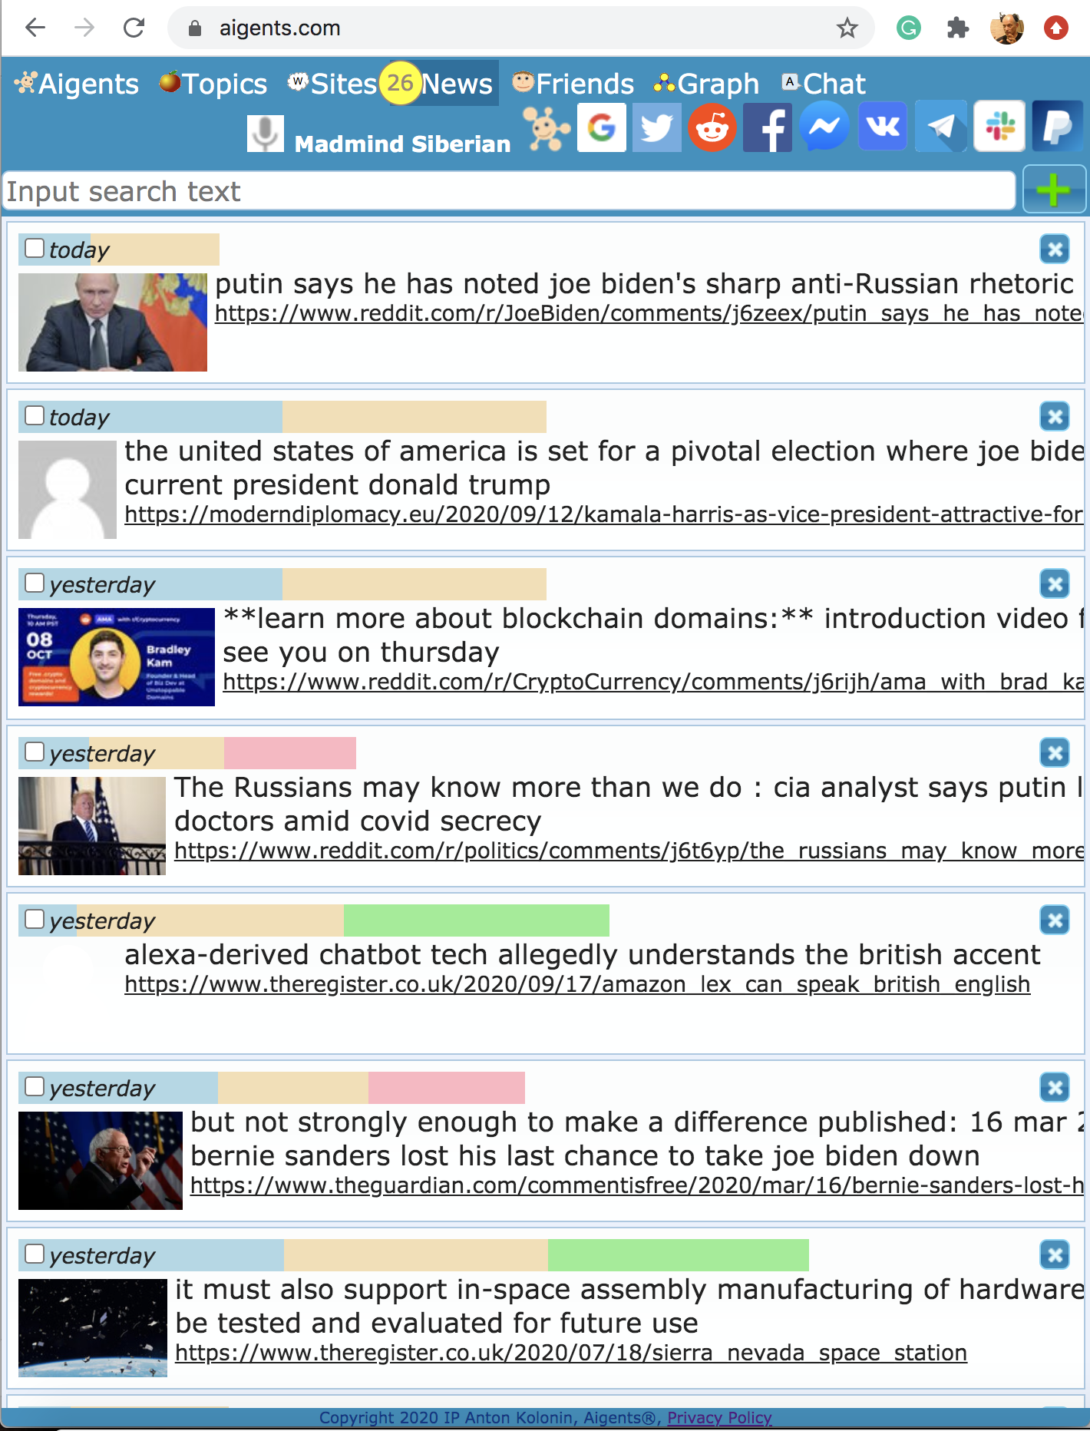
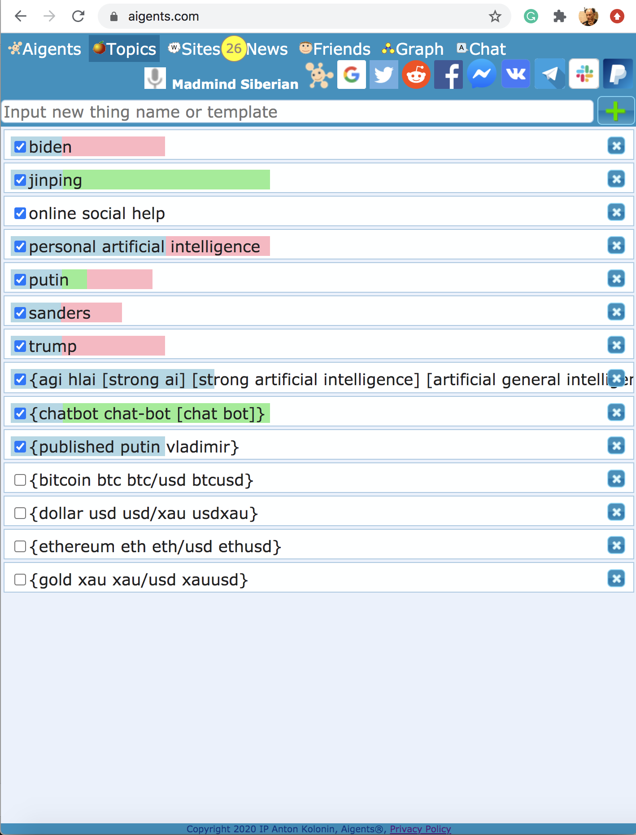
Solution: News filtering, recommendation, and tagging
based on sentiment, cognitive distortions and social relevance
News with positive (green) and
negative (red) sentiment
and social relevance (yellow)
Topics
by news with positive (green) and
negative (red) sentiment
https://blog.singularitynet.io/aigents-sentiment-detection-personal-and-social-relevant-news-be989d73b381

Slide 34
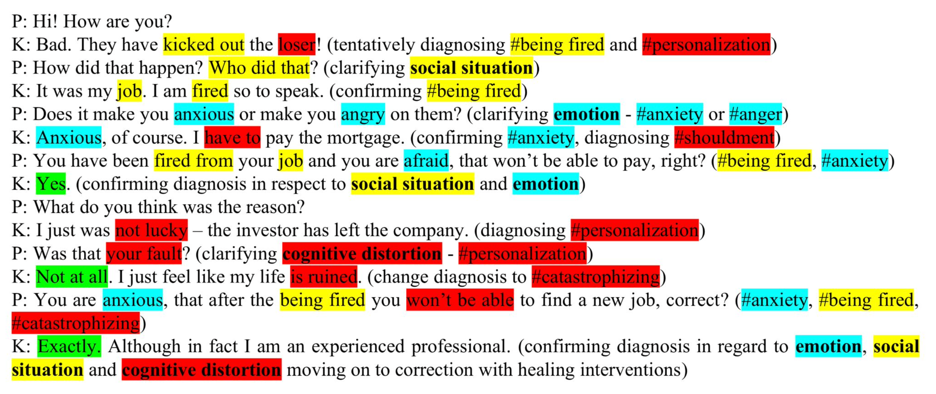
Automated detection of cognitive distortions,
emotions and social situations
https://doi.org/10.1016/j.procs.2022.11.054

Slide 35
Social Cybernetics for «Smart City»
Community
forums
Finding
values
Basic
principles
and goals
Goal
posing
Social
networks
Social links
with levels
of trust
PBij=Σl=1,L(EBijl*Bil)
Decision
making
Groups in
messengers
PSij=Σk=1,K(ESijk*Sik )
Conclusions
and decisions
Social
structure
Open
Internet
PBij = Σl=1,L( EBijl * Bil )
* Σk=1,K( ESijk * Sik )
Facts obtained
from sources with
varying levels
of trust
Psycho
-emotional
and mental
states
Internet
search
Monitoring
City and
corporate CRM
systems
https://ieeexplore.ieee.org/document/7361869
https://www.sciencedirect.com/science/article/pii/S1877050916317239
https://link.springer.com/chapter/10.1007/978-3-319-97676-1_10

Slide 36
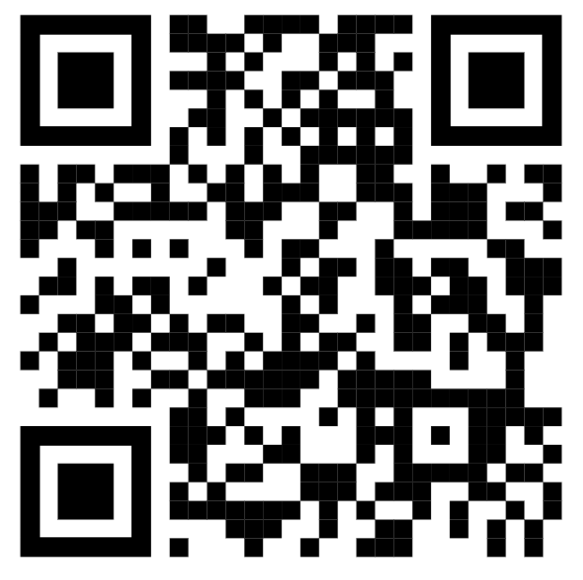
Thank you for attention!
More on YouTube:
Anton Kolonin
akolonin@aigents.com
Telegram: akolonin
https://www.nsu.ru
AIGENTS
https://aigents.com
https://singularitynet.io

