Slide 1


Computational Concept and Architecture of Artificial Psyche
Anton Kolonin
akolonin@aigents.com
Telegram: akolonin
https://www.nsu.ru
AIGENTS
https://agirussia.org
https://aigents.com

Slide 2



General Intelligence:
Reaching complex goals in different complex environments, using limited resources under uncertainty
(Ben Goertzel + Pei Wang + Shane Legg + Marcus Hutter)
Intelligent
Agent

Slide 3
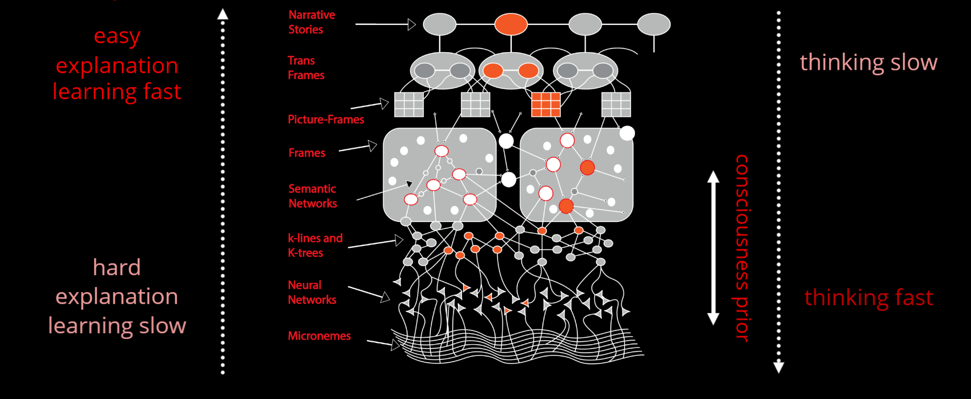
“Fast and Slow Thinking” – Daniel Kahneman
“System 1”
“System 2”
https://towardsdatascience.com/explainable-ai-vs-explaining-ai-part-1-d39ea5053347

Slide 4
Medium: “neuro-symbolic” “knowledge graph”
Explicit (conscious) “symbolic” knowledge
“System 2”
Social knowledge
what
if
Self-consciousness
he
she
then
this
I
we
they
when
my
our
where
“System 1”
Implicit (unconscious) “sub-symbolic” knowledge
https://www.amazon.com/Thinking-Fast-Slow-Daniel-Kahneman/dp/0374533555
https://amit02093.medium.com/atomspace-hyper-graph-information-retrieval-system-450cab9d751e

Slide 5



Neuro-Symbolic Integration for Interpretable AI
Hooves
Tail
White
Black
Brown
Red
0.5
0.5
0.5
0.5
1.0
0.5
0.5
0.5
0.5
Σ
Σ
Σ
Explain
AND
AND
1.0
1.0
1.0
1.0
1.0
Σ
Σ
OR
Transfer
0.5
0.5
0.5
0.5
Σ
AND
“System 1”
“System 2”
(Hooves AND Tail) AND NOT Red
((White and Black) OR Brown)
=> Horse
https://www.springerprofessional.de/neuro-symbolic-architecture-for-experiential-learning-in-discret/20008336

Slide 6
Functional equivalence of neural network
tensor and graph (symbolic) models
Strokes, letters, words and phrases
Words
Sentences
strokes , letters words and phrases
Letters
w o r d s
Strokes
\ /
Pedro Domingos, Tensor Logic: The Language of AI
https://arxiv.org/pdf/2510.12269

Slide 7

Typed tensor logic for different kinds of AI-s
(logical, sub-symbolic, probabilistic/non-axiomatic)
Truth-Value Tensor
Numerical Tensor
Boolean Tensor
Property
Property
Property
0.0123456
=750/60750
“False”
striped
striped
~0.01
striped
horse
horse
horse
Subject
Subject
Subject
Life-long
learning?
Pedro Domingos, Tensor Logic: The Language of AI
https://arxiv.org/pdf/2510.12269

Slide 8
Problem of dimensionality (reduction)
and discreteness (increase)
Retail store optimization case for “trousers”
Remove
Waist size
Size
Length
90
48
Redefine
large
80
46
44
medium
70
42
Pockets
60
40
small
38
Rescale
trousers breeches shorts
longs shorts
4
3
2
1
male
Kind
male
Kind
female
female
Keep
Sex
Sex

Slide 9
The psyche /ˈsaɪki/ is currently used to describe the totality of the human mind, conscious and
unconscious.
https://en.wikipedia.org/wiki/Psyche
Psyche
Unconscious
Conscious

Slide 10
System = Intelligent agent
Psyche = Operating system
Intelligence = Decision making system
Subconsciousness
(Intuition)
“System 1”
(“Fast”)
Consciousness
(Reasoning)
“System 2”
(“Slow”)
Emotions
Motivation
Expectations
Space of states
Sensations
Needs
Actions
Decisions
Perceptions
Sensors
Actuators
Anton Kolonin & Vladimir Kryukov,
Computational Concept of the Psyche,
Neuroinformatics-2025
https://arxiv.org/pdf/2509.07009
Sensations
Actions
Outer world = Operational environment

Slide 11
Psyche = Operating system
Intelligence = Decision making system
Models s (“invariants”) of states with utilities U and probabilities P of transitions
U({sτ}τ∈{-Τ,-1}​,s’0) = L( x⋅(yt - yt-1), (s’t - st), E(at-1)) s’t=argmaxs(U({sτ}τ∈{t-Τ,t-1}​,s’t),P({sτ}τ∈{t-Τ,t-1}​,s’t))
Experiential learning
Decision making
Space of states and episodic memory (“precedents”)
State st-1 (past)
State st (present)
State st+1 (future)
Reality
(“fact”) st-1
Expectation
(“plan”) s’t
Reality
(“fact”) st
Expectation
(“plan”) s’t+1
Sensations
ft-1
Ощущения
f’t
Sensations
ft
Sensations
f’t+1
Sensations
f’t
Needs
yt-1
Потребности
x’t
Needs
yt
Needs
y’t+1
Needs
y’t
Actions
at-1
Действия
a’t
Actions
at
Actions
a’t+1
Actions
a’t
Anton Kolonin & Vladimir Kryukov,
Computational Concept of the Psyche,
Neuroinformatics-2025
https://arxiv.org/pdf/2509.07009
Decisions
Perceptions
Actuators
Sensors

Slide 12
Energy-efficiency
of a
Psyche = Operating system
Optimal decision and expectation of s
Predictability
of s
Intelligence = Decision making system
Expected
utility of s
Models s (“invariants”) of states with utilities U and probabilities P of transitions
U({sτ}τ∈{-Τ,-1}​,s’0) = L( x⋅(yt - yt-1), (s’t - st), E(at-1)) s’t=argmaxs(U({sτ}τ∈{t-Τ,t-1}​,s’t),P({sτ}τ∈{t-Τ,t-1}​,s’t))
Experiential learning
Decision making
Expected probability
of s
Satisfaction
of y
Space of states and episodic memory (“precedents”)
State st-1 (past)
State st (present)
State st+1 (future)
Reality
(“fact”) st-1
Expectation
(“plan”) s’t
Reality
(“fact”) st
Expectation
(“plan”) s’t+1
Sensations
ft-1
Ощущения
f’t
Sensations
ft
Sensations
f’t+1
Sensations
f’t
Needs
yt-1
Потребности
x’t
Needs
yt
Needs
y’t+1
Needs
y’t
Actions
at-1
Действия
a’t
Actions
at
Actions
a’t+1
Actions
a’t
Decisions
Perceptions
x⋅yt — “motivation vector”
V. F. Petrenko and A. P. Suprun, “Goal oriented systems, evolution, and the subjective aspect in systemology,” Tr. Inst. Sistem. Analiza RAN 62 (1) (2012)
Actuators
Sensors

Slide 13
Decision making as operational risk management
s’t+1
st
s't+1
U
P
∑U*P
s’t=argmaxs(U,P)
a’
y’
f’
a’t=argmaxa(U,P)
s1
s’2
a’1
y’1
...
1.0
0.5
0.7
s1
s'3
a’1
y’2
...
0.4
0.5
s1
s’4
a’2
y’3
...
1.0
0.8
0.8
a’1
a’2
a’3
a’4
s1
s’5
a’2
y’4
...
0.0
0.2
s’2
s’4
s’6
s’7
s1
s’6
a’3
y’5
...
0.6
1.0
0.6
* Tversky & Kahneman: most people choose a’3 и s’6
(“smaller profit with
greater reliability”)
s1
s’7
a'4
y’6
...
0.0
1.0
0.0

Slide 14
Mutual dependency of state variable subgraphs tensors
Percept feelings
Satisfied needs
Decided & committed actions
Tiger
Replenish resource
Get resource
Cat
Avoid loss
Make
step
Learn new stuff
Conserve
resources
Mewing
Claws
Stretch
leg
Furry tail
Confirm learned stuff
Bend
leg
Anton Kolonin & Vladimir Kryukov,
Computational Concept of the Psyche,
Neuroinformatics-2025
https://arxiv.org/pdf/2509.07009

Slide 15
Hierarchy of values/goals/subgoals/tasks/subtasks
Needs/Values
Goals
Give a birth to next generations
Subgoals
Tasks
Get married
Get married
Get married
Get married
Subtasks
Make a marriage offer
Make a marriage offer
Make a marriage offer
Actions
Make the visit
Spell the words
Reach the house
Сlimb the stairs
Knock at the door
Make a step on the way
Make a step on the way
Make a step on the way
Bend a knee
Straighten a leg

Slide 16
Space of needs/goals/values
Self-determination...
Self-implementation...
Psychological
According to the ideas of A. Maslow, any goal can be represented as a combination (superposition) of basic needs
Feeding and
self-cleaning...
Survival and
reproduction...
Physical
(Physiological)
Routine
(Everyday)
Existential
(Life-long)
Anton Kolonin & Vladimir Kryukov,
Computational Concept of the Psyche,
Neuroinformatics-2025
https://arxiv.org/pdf/2509.07009

Slide 17
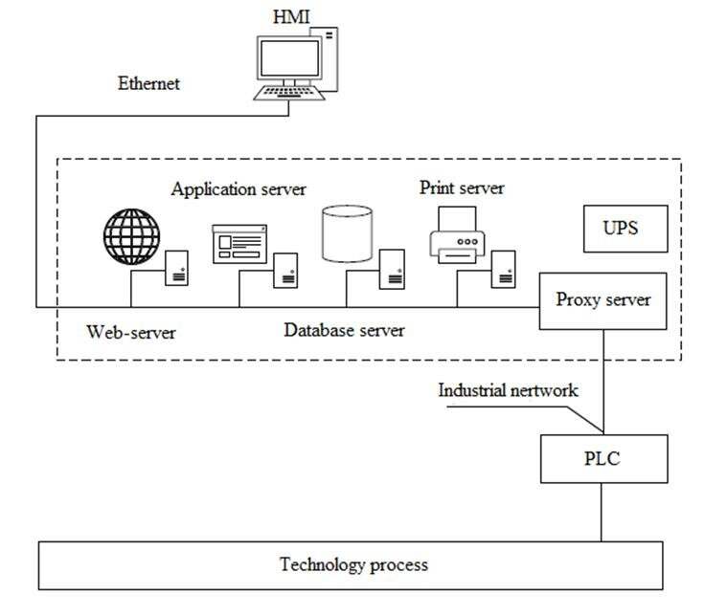
Application cases
А) Automated Process Control Systems (APCS)
Programmable logic
IEC 61131 (synchronous)
IEC 61499 (asynchronous)
Control
impacts
Field
signals
https://www.researchgate.net/publication/311662442_Adaptive_Intelligent_Manufacturing_Control_Systems

Slide 18
Application cases
B) “Smart Home”
User Intents
PRESENTATION LAYER
(User Interfaces: Mobile Apps, Web UI, Voice Assistants)
Home Assistant UI / Mobile App (Android/iOS) / Smart Speakers (Google Assistant, Alexa) / Custom Dashboards / Voice Interfaces
LOGIC LAYER
(Automation, Scenes, AI/NLP, Decision Engine)
Home Assistant Automations & Scripts / AI/NLP Integration (e.g., OpenAI GPT, Rasa, etc.) / Voice/Text Intent Handling / Context Engine / User Preferences
INTEGRATION / SERVICE LAYER
(APIs, Device Managers, Cloud Services, 3rd Party APIs)
Home Assistant Integrations / OpenAI API / Weather APIs, Location Services / Voice Services (STT/TTS engines, e.g., Whisper, Polly) / HomeKit, Google Smart Home, Alexa APIs
Predictive models?
Automation rules and scripts
Sensory and Command Logs
Control
impacts
Field
signals
DEVICE ABSTRACTION LAYER
(Drivers, Protocol Adapters, Message Brokers)
MQTT Broker / Zigbee/Z-Wave Adapters (e.g., Zigbee2MQTT, Z-Wave JS) / Bluetooth/Wi-Fi Controllers / Device Drivers (Light, Thermostat, Lock, etc.)
PHYSICAL DEVICE LAYER
(Actual smart home devices and sensors)
Smart Bulbs, Switches, Plugs / Thermostats, Cameras, Motion Sensors / Door Locks, Blinds, HVAC / Custom DIY Sensors (ESPHome, Tasmota, etc.)

Slide 19
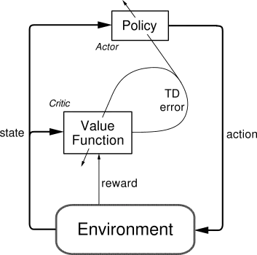
Implementation options
1) Reinforcement learning based on “actor-critic” model
https://medium.com/intro-to-artificial-intelligence/the-actor-critic-reinforcement-learning-algorithm-c8095a655c14

Slide 20
Implementation options
2) Cognitive architecture based on LLM and (active) GraphRAG
LLM
Tools
GraphRAG
Reasoner
Model Data
Response
Knowledge Graph
Model Parameters
Goals
Interaction Logs (RLHF)
Domain Knowledge
Request
Setup

Slide 21
Implementation options
3) Cognitive architecture based on probabilistic logic
Motivation-
Request to achieve a goal G
Afferentation about situation
P₁,…,P_{m}
Evgenii Vityaev, Alexander Demin: Adaptive Control of Modular Robots // Conference Paper in Advances in Intelligent Systems and Computing, Conference: First International Early Research Career Enhancement School on Biologically Inspired Cognitive Architectures, Springer, August 2018
Evgenii E. Vityaev: Purposefulness as a Principle of Brain Activity // Anticipation: Learning from the Past, (ed.) M. Nadin. Cognitive Systems Monographs, V.25, Chapter No.: 13. Springer, 2015, pp. 231-254.
Витяев Е.Е. Логика работы мозга. Подходы к моделированию мышления. (сборник под ред. д.ф.-м.н. В.Г. Редько). УРСС Эдиториал, Москва, 2014г., стр. 120-153.
AFFERENT
SYNTHESIS
Set PR of rules ⟨P₁,…,P_{k}, A⟩ → G
that forecast achievement of the goal G in situation P₁,…,P_{m} if fulfil A
and subgoals P₁,…, P_{n}
Forecast for result G
RESULT R
ACTIONS
RESULTS
ACCEPTOR
Anticipation of
result G
RESULT
EVALUATION
G ≈ R
Reinforcement/
punishment
Forecast for goal G
achievement
DECISION MAKING
Selection of actions A and subgoals P₁,…, P_{n}, providing maximum probability of the goal G achievement
RESULT R
Backward
afferentation
RESULTS
R₁,…,R_{n}
Subgoals P₁,…, P_{n}
Actions
A
Forecast for subgoals
P₁,…, P_{n}

Slide 22
Implementation options
4) Cognitive architecture of value-based experiential learning
Agent
Supervisor
Compressor
Predicates Graph
Base Values
goal(be(happy))
Outer environment
Inferred Models
cause(make(love),be(happy))
Predictor
Observed Evidence
feel(war,t1)
Perception: war
Decider
Directed Action Log
make(love,t2)
Action: love
Kolonin, A. (2022). Neuro-Symbolic Architecture for Experiential Learning in Discrete and Functional Environments. In: Goertzel, B., Iklé, M., Potapov, A. (eds) Artificial General Intelligence. AGI 2021. Lecture Notes in Computer Science(), vol 13154. Springer, Cham.
https://doi.org/10.1007/978-3-030-93758-4_12
Time line

Slide 23
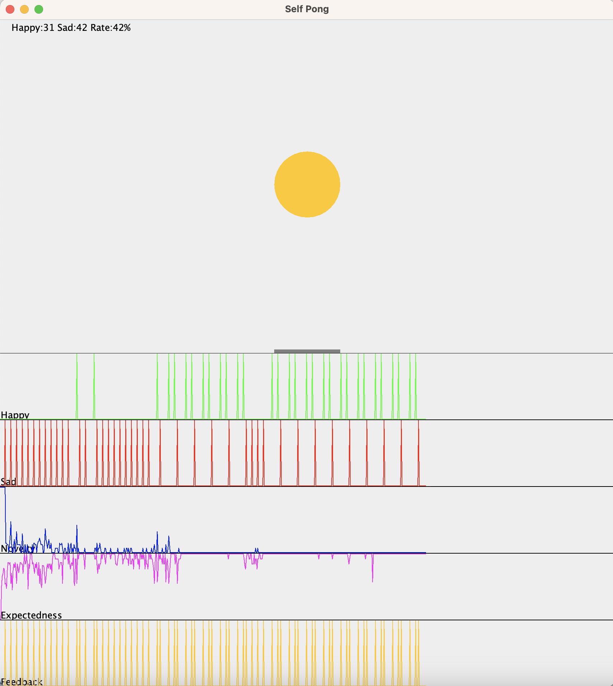
Cognitive architecture of value-based experiential learning
Sad(t)
Happy(t)
Left(t)
Stay(t)
Right(t)
Agent
Comp-
ressor
Xball(t)
Yball(t)
Xracket(t)
Sad(t)
Happy(t)
Predicates
Base Values
Pre-
dictor
Models
Evidence Log
Decider
Action Log
Move(t)
Anton Kolonin & Vladimir Kryukov,
Computational Concept of the Psyche,
Neuroinformatics-2025
https://arxiv.org/pdf/2509.07009

Slide 24
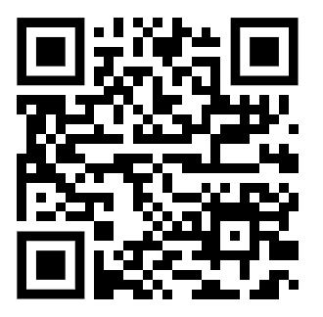
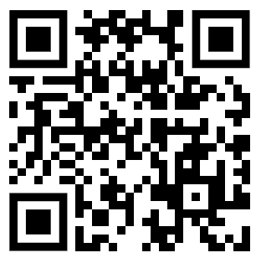
Thank you for attention! Questions?
Anton Kolonin
akolonin@aigents.com
Telegram/GitHub: akolonin
Workshop recording
on the subject
Anton Kolonin & Vladimir Kryukov, Computational Concept of the Psyche, Neuroinformatics-2025

