Slide 1

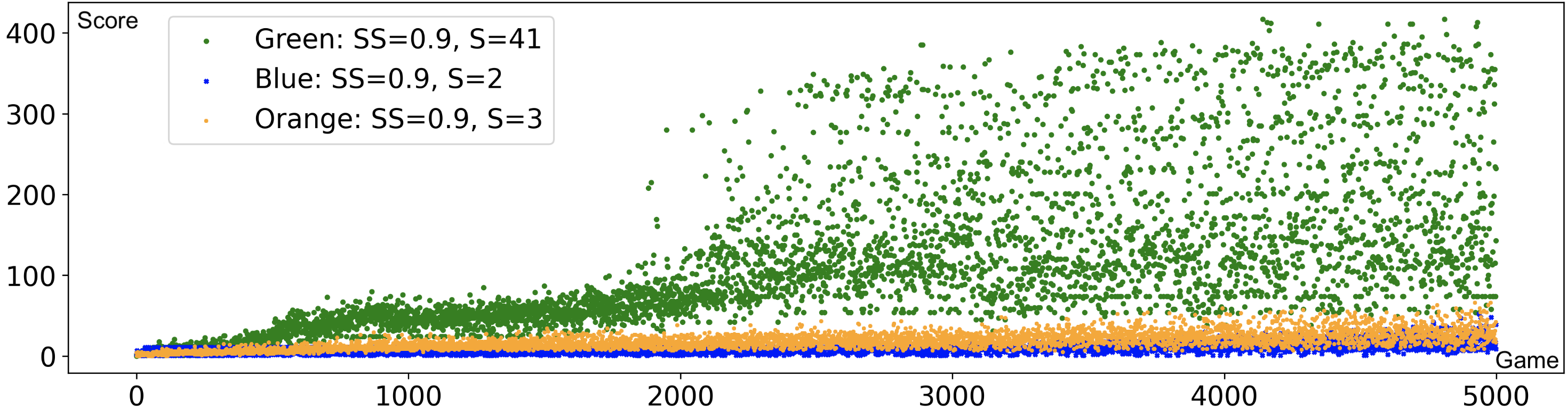
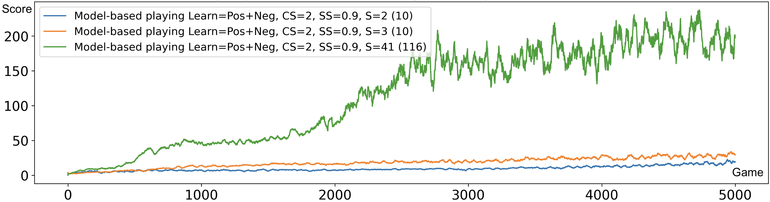

Computational Concept of the Psyche
Anton Kolonin^{1,2,3 [0000−0003−4180−2870]} akolonin@gmail.com
Vladimir Krykov ^{2 [0009−0008−4930−4618]}
¹ Novosibirsk State University, Pirogova 1, 630090, Novosibirsk, Russia, https://nsu.ru
² Aigents, Pravdy 6, Novosibirsk, 630090, Russia, https://aigents.com/
³ SingularityNET Foundation, Baarerstrasse 141, Zug, 6300, Switzerland, https://singularitynet.io
Abstract. This article presents an overview of approaches to model- ing the human psyche in the context of constructing an artificial one. Based on this overview, a concept of cognitive architecture is proposed, in which the psyche is viewed as the operating system of a living or artifi- cial subject, comprising a space of states, including the state of needs that determine the meaning of a subject’s being in relation to stimuli from the external world, and intelligence as a decision-making system regard- ing actions in this world to satisfy these needs. Based on this concept, a computational formalization is proposed for creating artificial general intelligence systems for an agent through experiential learning in a state space that includes agent’s needs, taking into account their biological or existential significance for the intelligent agent, along with agent’s sen- sations and actions. Thus, the problem of constructing artificial general intelligence is formalized as a system for making optimal decisions in the space of specific agent needs under conditions of uncertainty, maximizing success in achieving goals, minimizing existential risks, and maximizing energy efficiency. A minimal experimental implementation of the model is presented.
Keywords: artificial agent · artificial general intelligence · cognitive ar- chitecture · experiential learning · psyche model · space of needs · space of states.
System = Intelligent agent
Energy-efficiency
of a
Psyche = Operating system
Optimal decision and expectation of s
Psyche = Operating system
Predictability
of s
Intelligence = Decision making system
Expected
utility of s
Intelligence = Decision making system
Models s (“invariants”) of states with utilities U and probabilities P of transitions
U({sτ}τ∈{-Τ,-1}​,s’0) = L( x⋅(yt - yt-1), (s’t - st), E(at-1)) s’t=argmaxs(U({sτ}τ∈{t-Τ,t-1}​,s’t),P({sτ}τ∈{t-Τ,t-1}​,s’t))
Subconsciousness
(Intuition)
“System 1”
(“Fast”)
Consciousness
(Reasoning)
“System 2”
(“Slow”)
Satisfaction
of y
Experiential learning
Decision making
Expected probability
of s
Space of states and episodic memory (“precedents”)
State st-1 (past)
State st (present)
State st+1 (future)
Emotions
Motivation
Expectations
Reality
(“fact”) st-1
Expectation
(“plan”) s’t
Reality
(“fact”) st
Expectation
(“plan”) s’t+1
Sensations
ft-1
Ощущения
f’t
Sensations
ft
Sensations
f’t+1
Space of states
Sensations
f’t
Needs
yt-1
Потребности
x’t
Needs
yt
Needs
y’t+1
Sensations
Needs
Actions
Decisions
Needs
y’t
Actions
at-1
Действия
a’t
Actions
at
Actions
a’t+1
Perceptions
Actions
a’t
Sensors
Actuators
Decisions
Actuators
Perceptions
Sensations
Actions
x⋅yt — “motivation vector”
V. F. Petrenko and A. P. Suprun, “Goal oriented systems, evolution, and the subjective aspect in systemology,” Tr. Inst. Sistem. Analiza RAN 62 (1) (2012)
Sensors
E.E. Vityaev , A.V. Demin, Cognitive architecture based on the functional systems theory, 2018
https://doi.org/10.1016/j.procs.2018.11.072
Outer world = Operational environment
Attention, context, model and memories
Reinforcement learning – experiential learning and decision making
based and transitions between state series and “global feedback”
Attention focus
Top DQN level
Attention period
Average DQN level
Short-term memory (STM)
“Context”
Scope
(modalities)
&
Accuracy
(precision)
Average human level
Context period
“Model”
GPT/DNN Parameters
“Model size”
Invariants, Rules, Indexes
Average DQN level
Long-term memory (LTM), including “episodic memory”
Precedents or “Data”
Retention period
Average human level
Open AI Gym
Atari Breakout
https://arxiv.org/abs/2603.15586 https://arxiv.org/abs/2605.00940

