Slide 1


Cognitive Architecture for
Neuro-Symbolic
Experiential Learning
Anton Kolonin
akolonin@aigents.com
Telegram: akolonin
https://www.nsu.ru
AIGENTS
https://agirussia.org
https://aigents.com

Slide 2
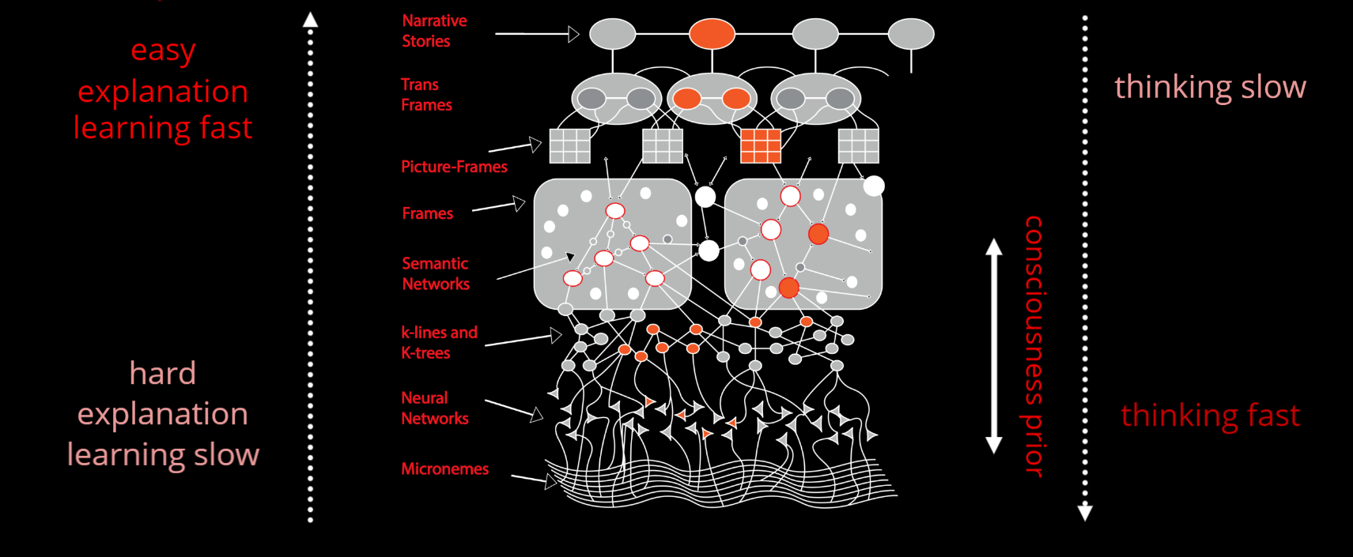
“Fast and Slow Thinking” – Daniel Kahneman
“System 1”
“System 2”
https://www.linkedin.com/pulse/explainable-ai-vs-explaining-part-1-ahmad-haj-mosa/
Xing, F., Cambria, E., Welsch, R. (2019). Theoretical Underpinnings on Text Mining. In: Intelligent Asset Management. Socio-Affective Computing, vol 9. Springer, Cham.
https://doi.org/10.1007/978-3-030-30263-4_3
M. Minsky, The Emotion Machine: Commonsense Thinking, Artificial Intelligence, and the Future of the Human Mind (Simon & Schuster Paperbacks, Princeton, 2007)

Slide 3



Neuro-Symbolic Integration for Interpretable AI
Hooves
Tail
White
Black
Brown
Red
0.5
0.5
0.5
0.5
1.0
0.5
0.5
0.5
0.5
Σ
Σ
Σ
Explain
AND
AND
1.0
1.0
1.0
1.0
1.0
Σ
Σ
OR
Transfer
0.5
0.5
0.5
0.5
Σ
AND
“System 1”
“System 2”
(Hooves AND Tail) AND NOT Red
((White and Black) OR Brown)
=> Horse
https://www.springerprofessional.de/neuro-symbolic-architecture-for-experiential-learning-in-discret/20008336

Slide 4
Functional equivalence of neural network
tensor and graph (symbolic) models
Strokes, letters, words and phrases
Words
Sentences
strokes , letters words and phrases
Letters
w o r d s
Strokes
\ /
Pedro Domingos, Tensor Logic: The Language of AI
https://arxiv.org/pdf/2510.12269

Slide 5

Typed tensor logic for different kinds of AI-s
(logical, sub-symbolic, probabilistic/non-axiomatic)
Truth-Value Tensor
(NARS/PLN)
Numerical Tensor
(ANN/Bayesian Logic)
Boolean Tensor
(Boolean Logic)
Property
Property
Property
0.0123456
=750/60750
“False”
striped
striped
~0.01
striped
horse
horse
horse
Subject
Subject
Subject
Life-long
learning?
Pedro Domingos, Tensor Logic: The Language of AI
https://arxiv.org/pdf/2510.12269

Slide 6
System = Intelligent agent
Psyche = Operating system
Intelligence = Decision making system
Subconsciousness
(Intuition)
“System 1”
(“Fast”)
Consciousness
(Reasoning)
“System 2”
(“Slow”)
Emotions
Motivation
Expectations
Space of states
Sensations
Needs
Actions
Decisions
Perceptions
Sensors
Actuators
Anton Kolonin & Vladimir Kryukov,
Computational Concept of the Psyche,
Neuroinformatics-2025
https://arxiv.org/pdf/2509.07009
Sensations
Actions
Outer world = Operational environment

Slide 7
Psyche = Operating system
Intelligence = Decision making system
Models s (“invariants”) of states with utilities U and probabilities P of transitions
U({sτ}τ∈{-Τ,-1}​,s’0) = L( x⋅(yt - yt-1), (s’t - st), E(at-1)) s’t=argmaxs(U({sτ}τ∈{t-Τ,t-1}​,s’t),P({sτ}τ∈{t-Τ,t-1}​,s’t))
Experiential learning
Decision making
Space of states and episodic memory (“precedents”)
State st-1 (past)
State st (present)
State st+1 (future)
Reality
(“fact”) st-1
Expectation
(“plan”) s’t
Reality
(“fact”) st
Expectation
(“plan”) s’t+1
Sensations
ft-1
Ощущения
f’t
Sensations
ft
Sensations
f’t+1
Sensations
f’t
Needs
yt-1
Потребности
x’t
Needs
yt
Needs
y’t+1
Needs
y’t
Actions
at-1
Действия
a’t
Actions
at
Actions
a’t+1
Actions
a’t
Anton Kolonin & Vladimir Kryukov,
Computational Concept of the Psyche,
Neuroinformatics-2025
https://arxiv.org/pdf/2509.07009
Decisions
Perceptions
Actuators
Sensors

Slide 8
Energy-efficiency
of a
Psyche = Operating system
Optimal decision and expectation of s
Predictability
of s
Intelligence = Decision making system
Expected
utility of s
Models s (“invariants”) of states with utilities U and probabilities P of transitions
U({sτ}τ∈{-Τ,-1}​,s’0) = L( x⋅(yt - yt-1), (s’t - st), E(at-1)) s’t=argmaxs(U({sτ}τ∈{t-Τ,t-1}​,s’t),P({sτ}τ∈{t-Τ,t-1}​,s’t))
Experiential learning
Decision making
Expected probability
of s
Satisfaction
of y
Space of states and episodic memory (“precedents”)
State st-1 (past)
State st (present)
State st+1 (future)
Reality
(“fact”) st-1
Expectation
(“plan”) s’t
Reality
(“fact”) st
Expectation
(“plan”) s’t+1
Sensations
ft-1
Ощущения
f’t
Sensations
ft
Sensations
f’t+1
Sensations
f’t
Needs
yt-1
Потребности
x’t
Needs
yt
Needs
y’t+1
Needs
y’t
Actions
at-1
Действия
a’t
Actions
at
Actions
a’t+1
Actions
a’t
Decisions
Perceptions
x⋅yt — “motivation vector”
V. F. Petrenko and A. P. Suprun, “Goal oriented systems, evolution, and the subjective aspect in systemology,” Tr. Inst. Sistem. Analiza RAN 62 (1) (2012)
Actuators
Sensors

Slide 9
Decision making as operational risk management
s’t+1
st
s't+1
U
P
∑U*P
s’t=argmaxs(U,P)
a’
y’
f’
a’t=argmaxa(U,P)
s1
s’2
a’1
y’1
...
1.0
0.5
0.7
s1
s'3
a’1
y’2
...
0.4
0.5
s1
s’4
a’2
y’3
...
1.0
0.8
0.8
a’1
a’2
a’3
a’4
s1
s’5
a’2
y’4
...
0.0
0.2
s’2
s’4
s’6
s’7
s1
s’6
a’3
y’5
...
0.6
1.0
0.6
* Tversky & Kahneman: most people choose a’3 и s’6
(“smaller profit with
greater reliability”)
s1
s’7
a'4
y’6
...
0.0
1.0
0.0

Slide 10
Implementation design
Cognitive architecture of value-based experiential learning
Agent
Supervisor
Compressor
Predicates Graph
Base Values
goal(be(happy))
Outer environment
Inferred Models
cause(make(love),be(happy))
Predictor
Observed Evidence
feel(war,t1)
Perception: war
Decider
Directed Action Log
make(love,t2)
Action: love
Kolonin, A. (2022). Neuro-Symbolic Architecture for Experiential Learning in Discrete and Functional Environments. In: Goertzel, B., Iklé, M., Potapov, A. (eds) Artificial General Intelligence. AGI 2021. Lecture Notes in Computer Science(), vol 13154. Springer, Cham.
https://doi.org/10.1007/978-3-030-93758-4_12
Time line

Slide 11
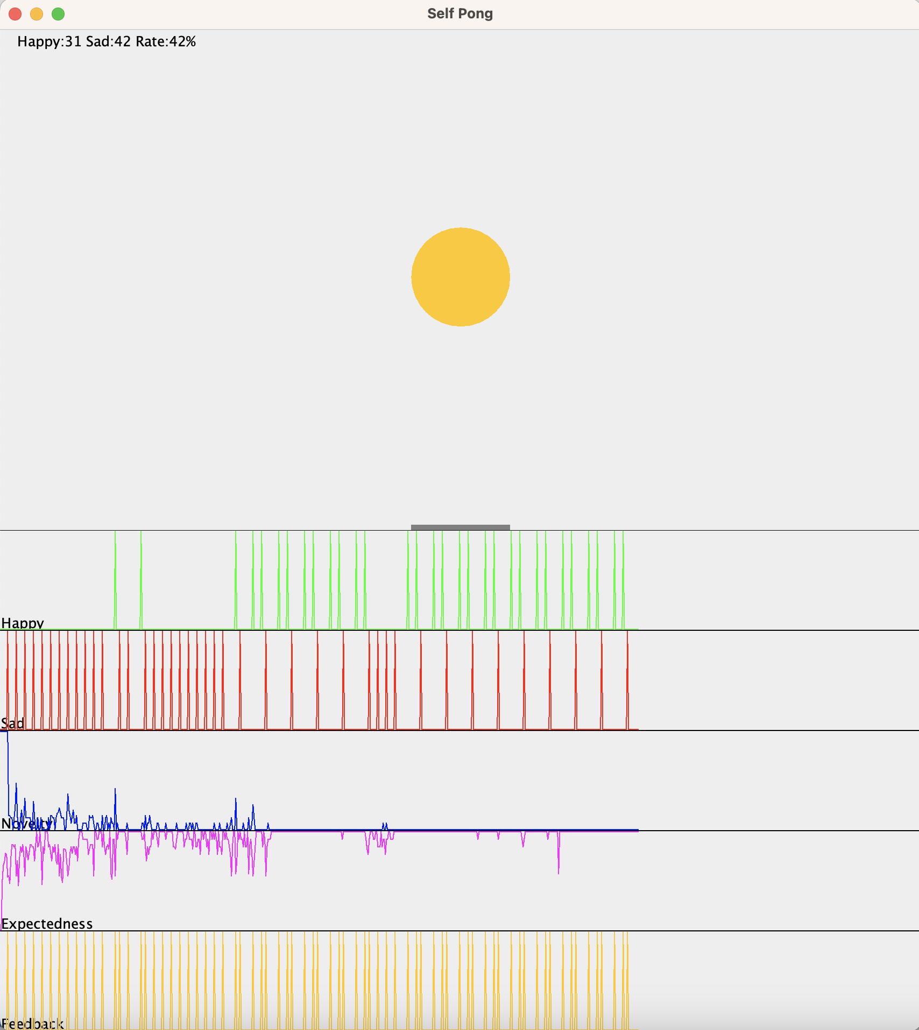

Cognitive architecture of value-based experiential learning
Sad(t)
Happy(t)
Left(t)
Stay(t)
Right(t)
Agent
Comp-
ressor
Xball(t)
Yball(t)
Xracket(t)
Sad(t)
Happy(t)
Predicates
Base Values
Pre-
dictor
Models
Evidence Log
Decider
Action Log
Move(t)
Anton Kolonin & Vladimir Kryukov, Computational Concept of the Psyche
https://arxiv.org/pdf/2509.07009
Anton Kolonin, Neuro-Symbolic Architecture for Experiential Learning in Discrete and Functional Environments
https://doi.org/10.1007/978-3-030-93758-4_12

Slide 12
Learning Play “Pong” at Object Level
predicate
argument
Position
Happy
Move
RacketX
BallX
BallY
Boolean
Horizontal
Vertical
False
True
statement :=
predicate(argument)
Left
Center
Right
Top
Center
Bottom
BallY(Top)
BallX(Left)
RacketX(Left)
Happy(False)
=> Move(Left)
BallY(Top)
BallX(Center)
RacketX(Center)
Happy(False)
=> Move(Right)
BallY(Bottom)
BallX(Right)
RacketX(Right)
Happy(False)
=> Move(Right)
BallY(Bottom)
BallX(Right)
RacketX(Right)
Happy(True)
=> Move(Left)
Global
Feedback
https://www.youtube.com/watch?v=2LPLhJKh95g

Slide 13
Learning Play “Pong” at Pixel Level
predicate
argument
Pixel
Move
Happy
Boolean
Number
Horizontal
False
True
statement :=
predicate(argument)
Row
Column
Left
Center
Right
Pixel(1,0)
Pixel(4,1)
Happy(False)
=>
Move(Left)
Pixel(0,2)
Pixel(4,2)
Happy(False)
=>
Move(Right)
Pixel(3,4)
Pixel(4,4)
Happy(False)
=>
Move(Left)
Pixel(0,4)
Pixel(4,3)
Happy(True)
=>
Move(Left)
Global
Feedback
https://www.youtube.com/watch?v=2LPLhJKh95g

Slide 14
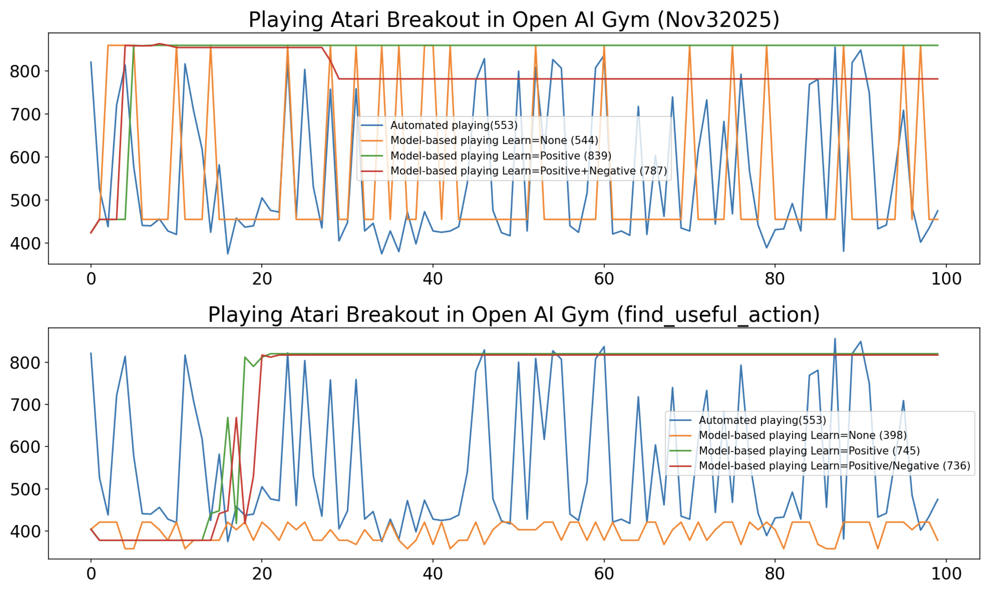

Imitation learning – decision making on “pre-trained” model
864

Slide 15
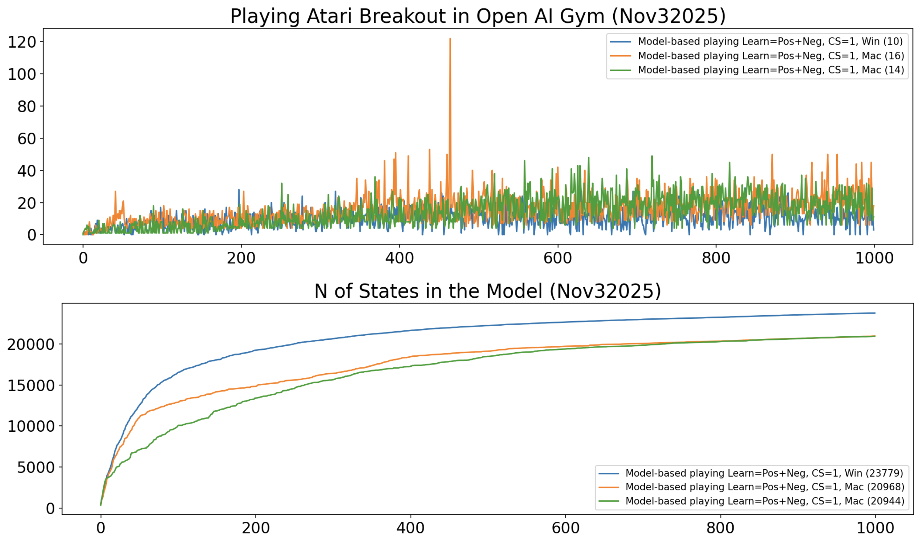
Reinforcement learning – experiential learning and decision making
Average human level
U({sτ}τ∈{-Τ,-1}​,s’0) = L( x⋅(yt - yt-1), (s’t - st), E(at-1) )
s’t=argmaxs(U({sτ}τ∈{t-Τ,t-1}​,s’t),P({sτ}τ∈{t-Τ,t-1}​,s’t) )
T=1

Slide 16
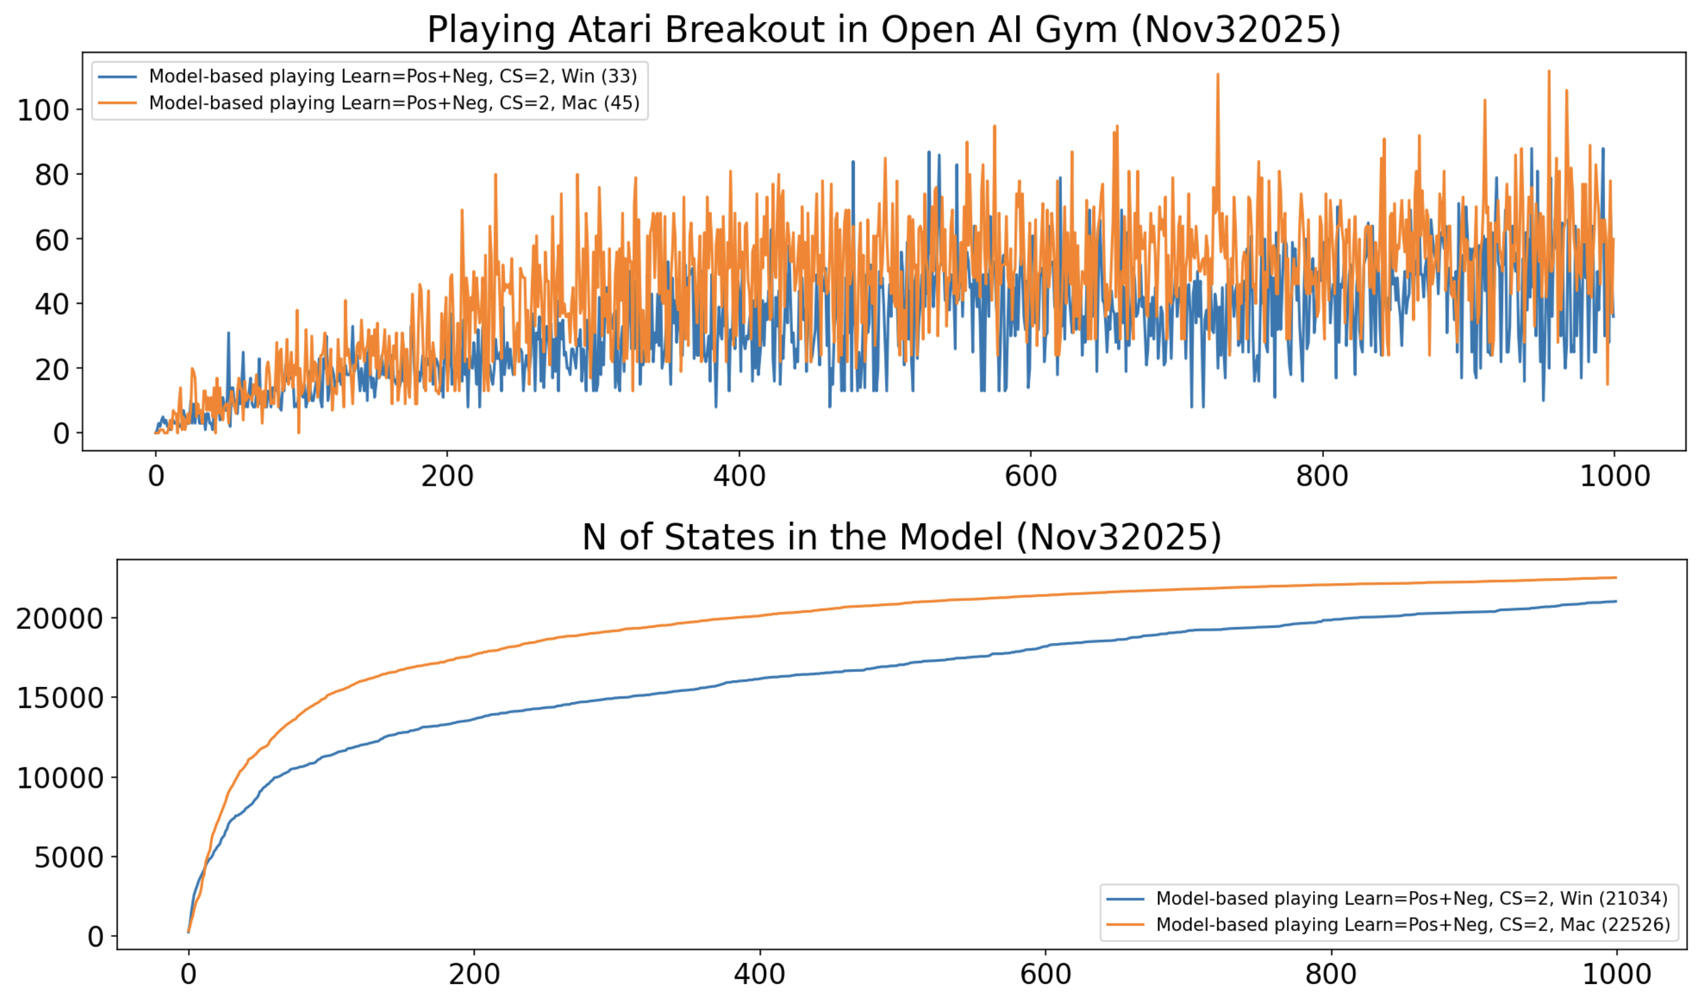
Reinforcement learning – experiential learning and decision making
Average human level
U({sτ}τ∈{-Τ,-1}​,s’0) = L( x⋅(yt - yt-1), (s’t - st), E(at-1) )
s’t=argmaxs(U({sτ}τ∈{t-Τ,t-1}​,s’t),P({sτ}τ∈{t-Τ,t-1}​,s’t) )
T=2

Slide 17


Thank you for attention! Questions?
Anton Kolonin
akolonin@aigents.com
Telegram/GitHub: akolonin
Workshop recording
on the subject
Anton Kolonin & Vladimir Kryukov, Computational Concept of the Psyche, Neuroinformatics-2025

