Slide 1


Knowledge Editors & Languages and
in Webstructor and Agents®
+ Graph Engines for Uncertain Inference
Anton Kolonin
akolonin@aigents.com
https://singularitynet.io
AIGENTS®
https://aigents.com

Slide 2


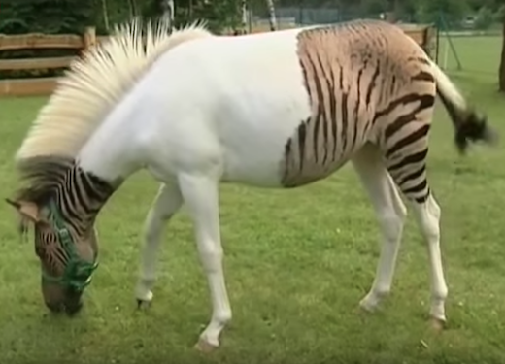
Bridging the Symbolic-Subsymbolic gap
for “explainable AI” and “transfer learning”
Hooves
Tail
White
Black
Brown
Red
0.5
0.5
0.5
0.5
0.5
0.5
0.5
0.5
1.0
AND
AND
Explain
Σ
Σ
Σ
1.0
1.0
1.0
1.0
1.0
OR
Transfer
Σ
Σ
0.5
0.5
0.5
0.5
AND
Σ
(Hooves AND Tail) AND
((White and Black) OR Brown)
=> Horse

Slide 3
Foundation Ontologies for
Distributed (Multi-Agent) Systems
Foundation
Ontology
Thing
Property
Has
Thing
Property
Has
Brand
Upper
Ontology
Drug
Has
Brand
Drug
Has
Has
Substance
Brand
Medana
Brand
Medana
Ibufen
Ibufen
Substance
Ibuprofen
Agent A
Agent B

Slide 4
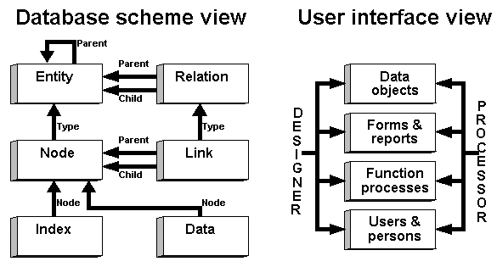
Foundation Ontologies - Applications
CRM
General
Ledger
Shop
Data4: 1995
Inventory
Payroll

Slide 5
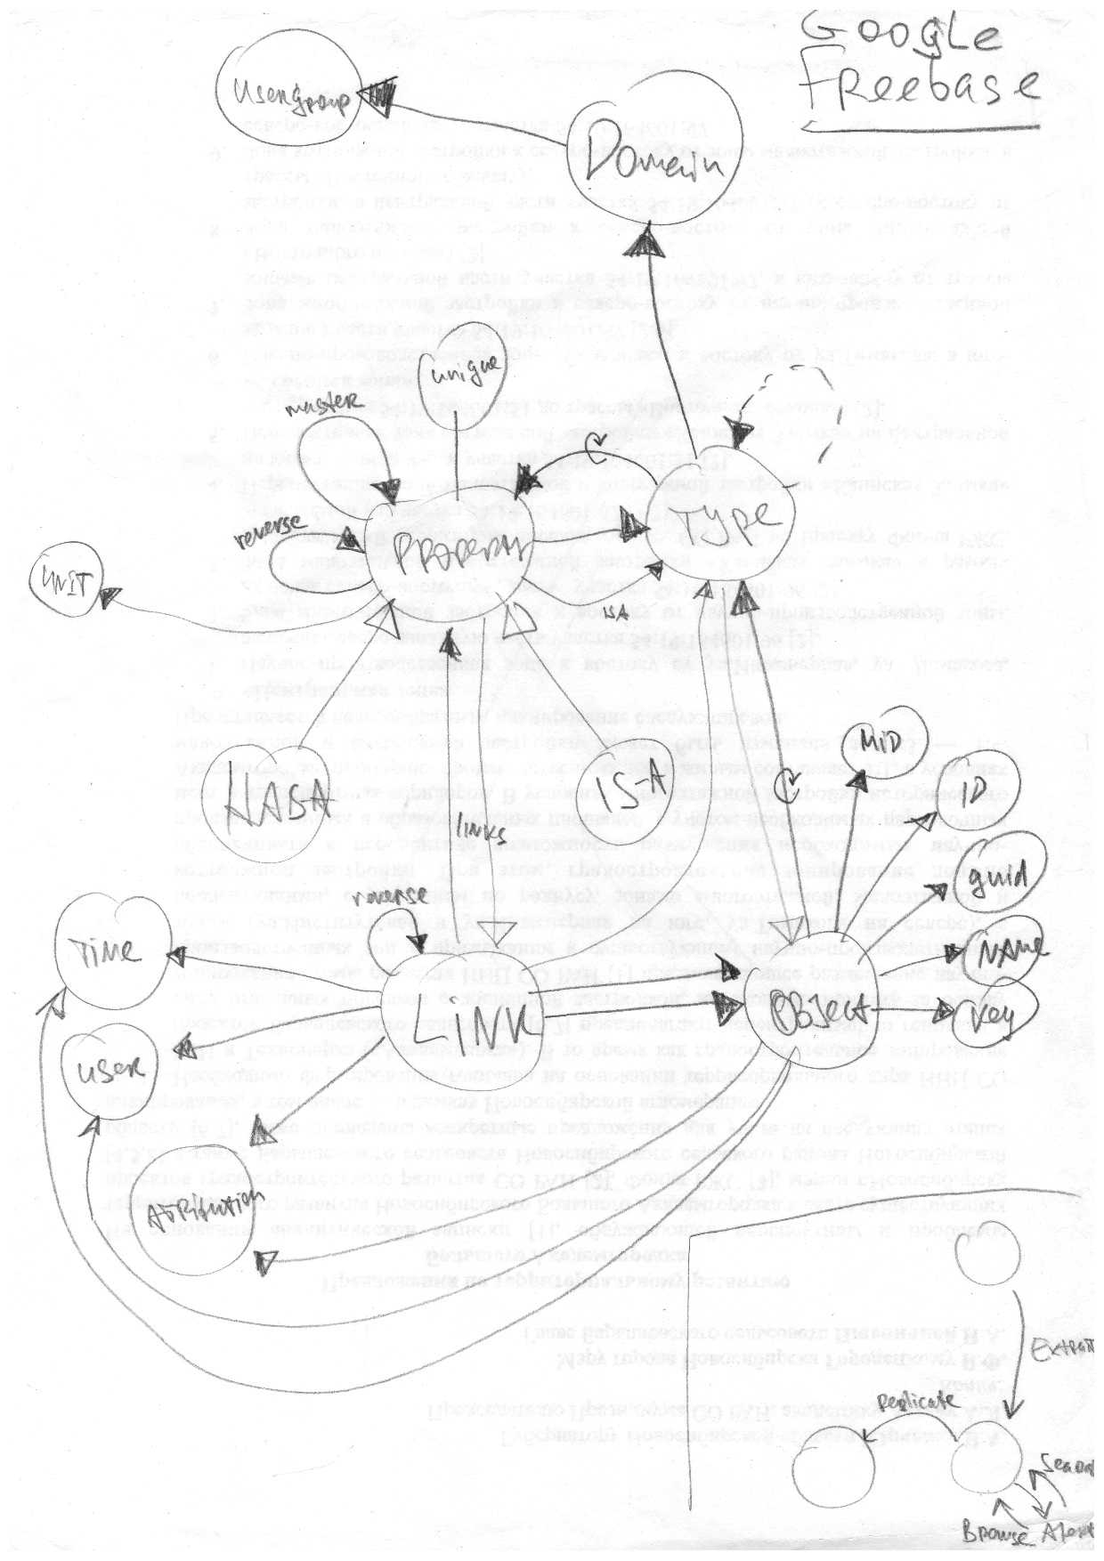
Foundation Ontologies - History
Data4: 1995
Freebase: 2007
Knowledge Graph: 2013

Slide 6
Lessons Learned:
1. Class is an Object
2. Object may be a Class
3. Link can be a Node
Is
Object
Is
John Doe
Mary Ann
Consumer
Is
Supplier
Is
Interest
John Doe
Time
Address
Is
Is
May 12, 2018
London, UK
Dr. John Doe
Mr. John Doe

Slide 7
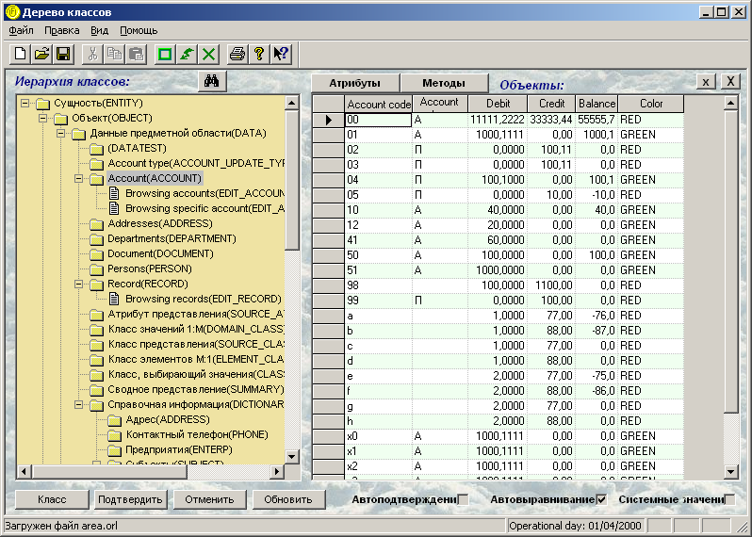
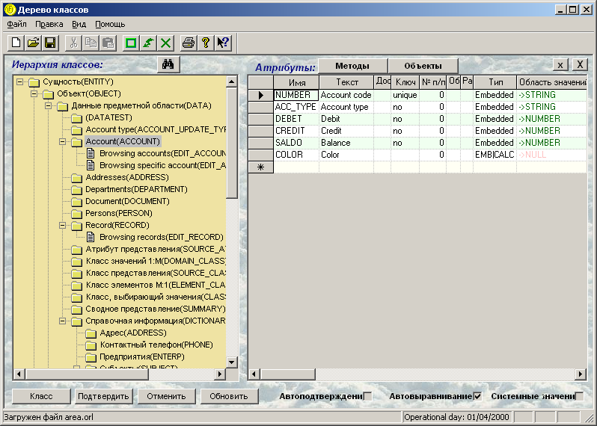
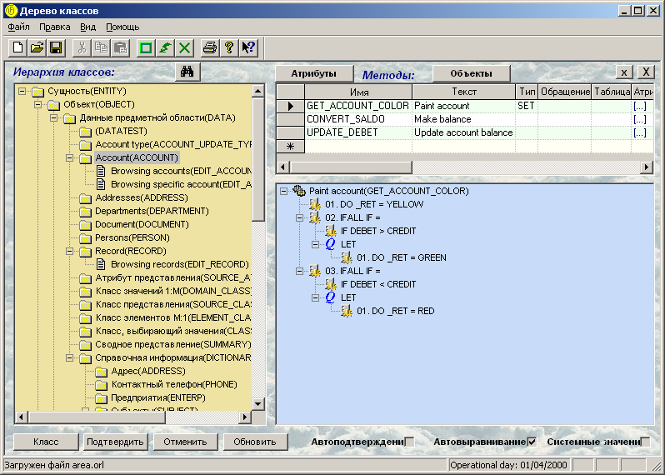
Semantic Modeling of Business Processes
UFO/ORL: 1997-1999
Project: ProPro Group obtains the order from RTS Stock Exchange to develop Back-Office automation system.
Requirements: Tremendous amount of initial business rules and forms. Possibility to amend and extend the business rules and forms during the system life cycle.
Problem: The RTS analysts are not capable to supply the representative scope of initial business rules and forms timely enough so develoment can start fitting the given time frame
Decision: ProPro gives RTS analysts a language to encode the business rules and forms so the rules and forms can be quickly uploaded into the system when done. ProPro develops a system which can upload business rules and forms, play them in the course of system operation and provide an UI for the amendment and extension of rules and forms on the fly.
Solution: Object-Relational Language (ORL) effectively usable by analysts and software system at the same time. Universal Financial Object (UFO) three-tier (client, middleware and server) system using ORL for bootstrapping as well as intra-tier communications (instead of DCOM).

Slide 8
Semantic Modeling of Business Processes
UFO/ORL: 1997-1999
Foundation Ontology
Owner
Object
Is
Is
Parent
Stack
This
Class
InstanceOf
Process
Has
Is
Domain
InstanceOf
Attribute
Method
Call

Slide 9
Lesson Learned:
Can have only one, language for DDL, DML, PL, QL instead of many.
SQL-DDL
OWL
Semantic
Language
SQL-DML
RDF
SQL-TSV
PL-SQL
SPARQL

Slide 10
Object Relational Language (ORL)
Semantic Modeling of Business Processes
English | ORL
Here are the items A, B and C where A has properties X and Y while B and C are in relationship Z. | ITEM A,B,C;; A HAS (X), (Y);; B Z(C);;
In order to reach goal 1 one needs condition 2 and 3 to be held true while 2 can be true only if condition 4 happens. | CONDITION C2,C3,C4;; GOAL G1 REQUIRES (C2),(C3);; CONDITION(C2) REQUIRES (C4);;
Each morning need to perform this and that in order, having such and such done at once next. | PROCESS TIME “8:00”; REPEAT (DAILY); ORDER DO THIS, DO THAT;, FORK DO SUCH, DO SUCH;;;
What is that my stuff you mentioned yesterday or the day before? | STUFF(OWNER (ME), UPDATE (AUTHOR (YOU), {TIME “2013-03-22”, TIME “2013-03-21”}).TELL;
What were the relationships between P and Q last year? | PROPERTY(OWNER (P), THING (Q), TIME “2012”).TELL;
Let me know once they roll out next version of the product. | DO EMAIL TO “me@at.org”;; WHEN PRODUCT(VENDOR (THEY)).VERSION CHANGE;;

Slide 11
Distributed Knowledge Editor
Webstructor: 2001-2006
Foundation
Ontology
Thing
Property
Thing
Property
Is
Is
Is
Is
Has
Has
Has
Has
Is
Has
Is
Has
Applet|Server|Desktop
Agent
Applet|Server|Desktop
Agent
Knowledge
Exchange
2D/3D
Ontology
Graph
Editor
ORL
Interactive
Console
2D/3D
Ontology
Graph
Editor
ORL
Interactive
Console
Agent A
Agent B

Slide 12
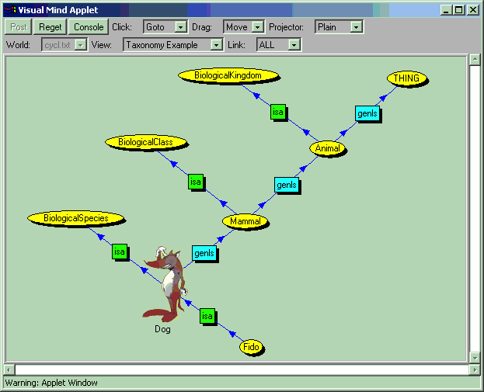
Visual ontology editor - representing Cyc «micro-theory»
Webstructor: Distributed Knowledge Editor
Fragment of «biological kingdom» of Cyc «upper ontology»
http://webstructor.net/

Slide 13
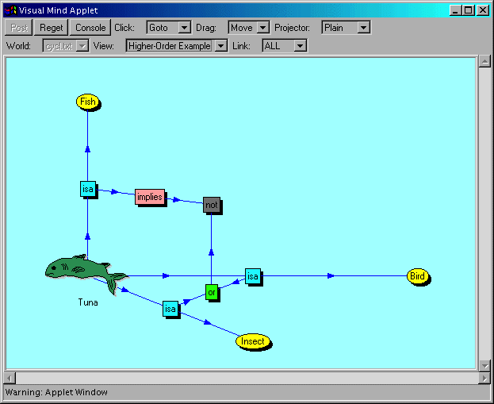
Visual ontology and predicate logic formula editor
Webstructor: Distributed Knowledge Editor
Expression: «If tuna is a fish, that implies it is not an insect or a bird.»

Slide 14
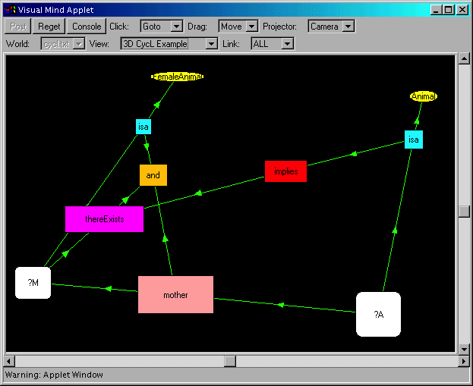
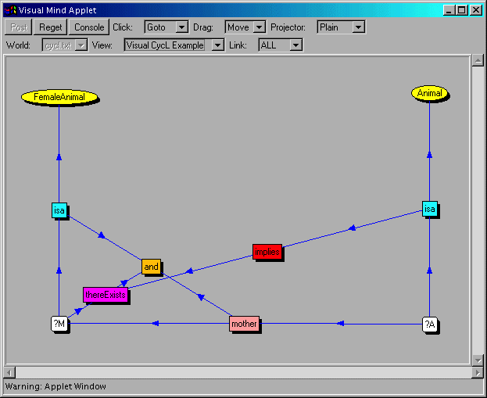
Visual 2D/3D editor of logical assertions (e.g. CycL)
Webstructor: Distributed Knowledge Editor
(implies (isa ?A Animal) (thereExists ?M (and (mother ?A ?M) (isa ?M FemaleAnimal))))
= Mother of an animal is a female animal.
http://webstructor.net/

Slide 15
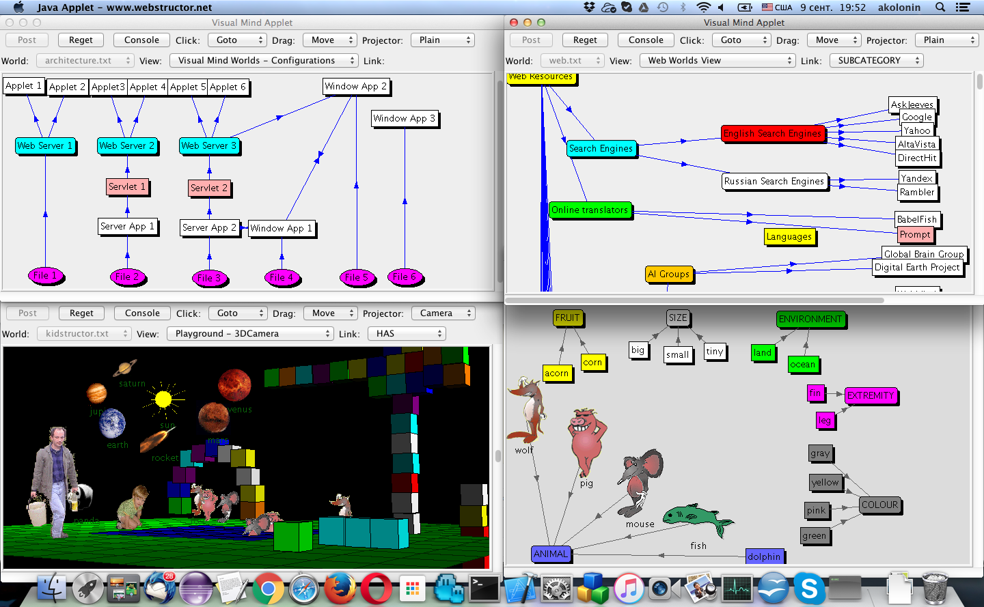
Webstructor: Distributed 2D/3D Editor
http://webstructor.net/

Slide 16
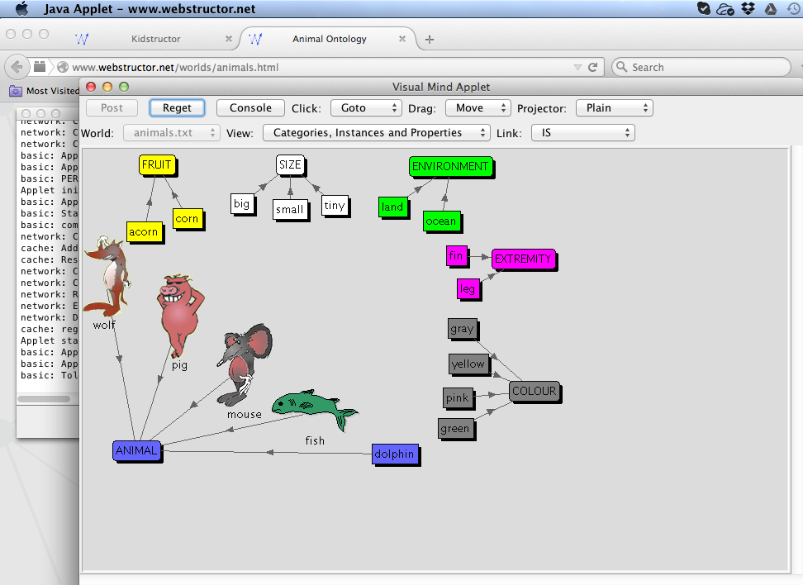
Webstructor: 2D Knowledge Editor Online
http://webstructor.net/

Slide 17
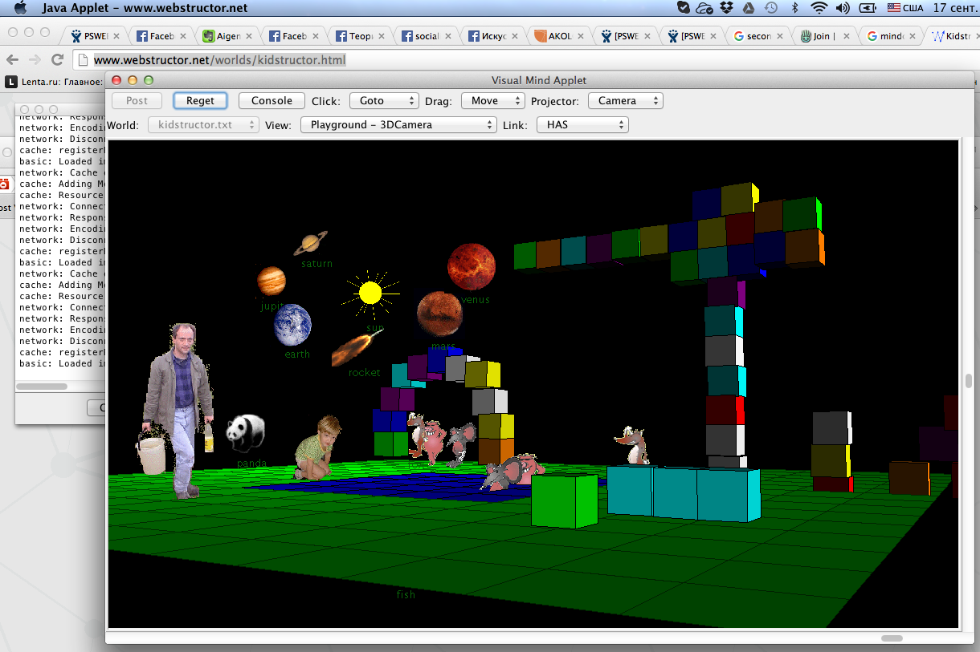
Webstructor: 3D Hyper-World Editor Online
http://webstructor.net/

Slide 18
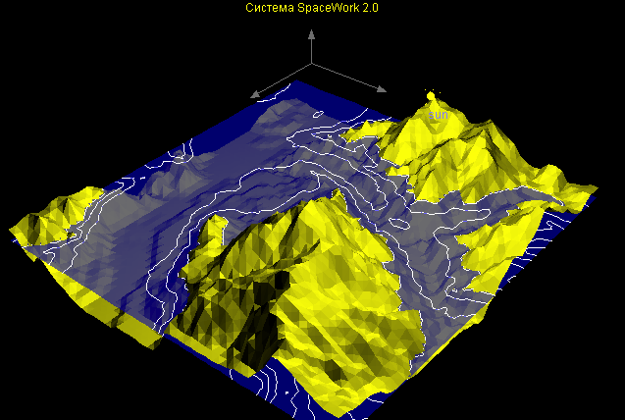
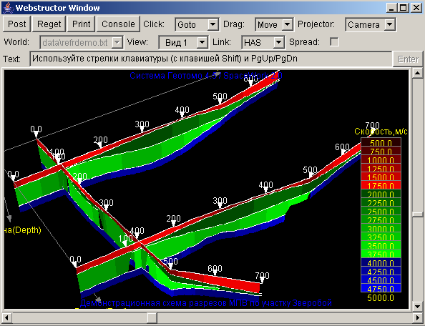
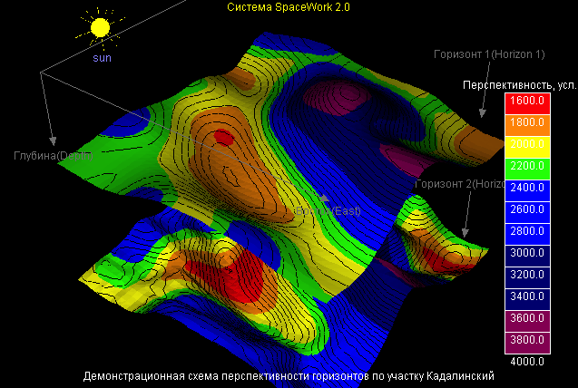
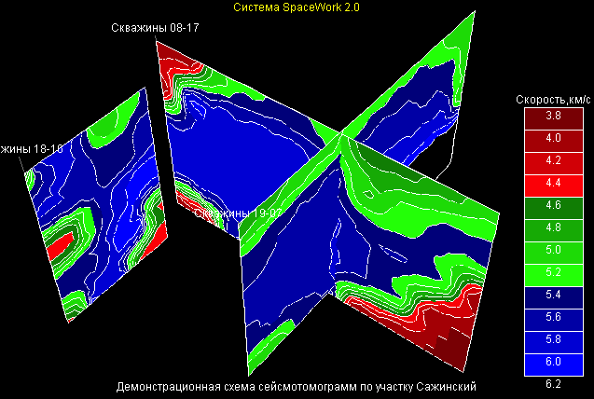
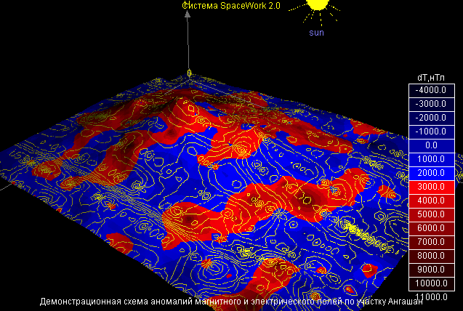
Webstructor: 4D Complex Data Viewer
http://webstructor.net/geotomo/

Slide 19
Webstructor: Architecture
Distributed multi-agent (peer-to-peer) architecture
Servlet
Agent(s)
Server
Agent(s)
Server
Agent(s)
Visual
Knowledge
Editor
(2D/3D)
Console
(ORL)
Visualization for
scientific data (3D)
Applet
Agent(s)
Applet
Agent(s)
Visual
Knowledge
Editor
(2D/3D)
Console
(ORL)
Visualization for
scientific data (3D)
Communication cloud -
over HTTP or TCP, using
Object-Relational Language (ORL)
http://webstructor.net/

Slide 20
Webstructor: ”3D-Net” - Worlds and Views
Webstructor: Sharing “world” data visible in “views”
Agent A
World:
Shared
hyper-graph
View 1
Agent B
View 3
View 2
Agent D
View 4
View 5
View 6
http://webstructor.net/

Slide 21
Lessons Learned:
1. 2D graphs are fun but not always practical
2. 3D graphs are even more fun but even more less practical
3. Distributed removal of knowledge (and its truth assessment) needs account for evidence and social reference

Slide 22









Aigents® Language for
Distributed Personal AI Agents
Ethereum
Slack
Steemit
Telegram
Monitoring content and social dynamics in online networks
Golos.io
Google+
Leader
ВКонтаке
Facebook
Messenger
Friend
Colleague
Every thing
Follower
for every one
Anton Kolonin
akolonin@aigents.com
AIGENTS.COM

Slide 23
Social-Evidence based
Knowledge Representation Model
Focusing
Foundation
Hardwiring
Long-term
Imagination
Short-term
Social
Non-Social
Inference
Inference
Forgetting
Evidence
Top layer - “foundation graph” of basic knowledge, which is necessary for social system to be shared by all of its members in order to communicate. Middle layer - “imagination graph” keeping “inferred” knowledge.
Bottom layer - “evidence graph” containing everyday life-time experiences.

Slide 24
Using “Semantic Language” for Knowledge Transfer
between Software Agents and Human Users
Lisp, AIML/XML,
RDF/OWL/XML + SPARQL,
Turtle, JSON-LD
Too complex and unfriendly?
“Interlingua”
“Controlled language”
“Semantic language”
Just right!
Human
User
Artificial
Agent
Lojban,
Esperanto,
English
Too complex and ambiguous?

Slide 25
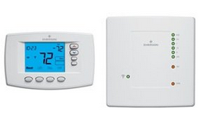
Agent Language (AL) for Home Automation
and Internet-of-Things (IoT) – multilingual example
A: My is appliance, agent, thermostat, device.
A: My has shape, color, voltage.
A: My has location.
A: My shape rectangular, color white, voltage 220, location kitchen.
A: My has temperature, humidity, CO2, feeling.
A: Temperature, humidity, CO2 is number.
A: Feeling is good or bad.
H: What your feeling, temperature, humidity?
A: My feeling good, temperature 20, humidity 72.
A: Моя это прибор, агент, термостат, устройство.
A: Моя иметь форма, цвет, питание.
A: Моя иметь место.
A: Моя форма прямоугольный, цвет белый, питание 220, место кухня.
A: Моя иметь температура, влажность, CO2, самочувствие.
A: Температура, влажность, CO2 это число.
A: Самочувствие это хорошо или плохо.
H: Как твоя самочувствие, температура, влажность?
A: Моя самочувствие хорошо, температура 20, влажность 72.

Slide 26
Agent Language (AL) as a “Labeled Turtle”
Common domain-specific ontology for “controlled interlingua”
$thermostat_13
$property
$humidity
$isa
$number
Russian name space
моя
$name
иметь
влажность
это
English name space
my
число
has
humidity
is
number

Slide 27
Agent Language (AL) as a Graph Manipulation
Interrogation:
What is thermostat, location kitchen real temperature, target temperature?
Declaration:
Is thermostat, location kitchen real temperature 30, target temperature 25.
Direction:
Is thermostat, location kitchen target temperature 20!
30
real
temperature
thermostat
is
target
temperature
25
?
location
target
temperature
kitchen
20

Slide 28
Agent Language - EBNF
<message> := ( <statement> | <acknowledgement> )*
<acknowledgement> := ( 'ok' | ('true' | 'yes' | <number>) | ('no' | 'false' | 0) ) '.'
<statement> := <interrogation> | <confirmation> | <declaration> | <direction>
<interrogation> := 'what' ? <expression> '?' (* “open” incomplete graph *)
<confirmation> := 'if' ? <expression-set> '?' (* “closed” complete graph *)
<declaration> := ( <expression-set> ) '.' (* “closed” complete graph *)
<direction> := 'do' ? <expression-set> '!' (* “closed” complete graph *)
<expression> := <term> (' ' <term>)* (* separated by spaces *)
<expression-set> := <all-set> | <any-set> | <seq-set> (* different kinds of sets *)
<term> := <negation>? ( <anonymous>? | <self> | <peer> | <id> | <name> | <value> | <qualifier> )
<qualifier> := <expression> | <expression-set>
<any-set> := <or-list> | ( '{' <or-list> '}' )
<all-set> := <and-list> | ( '(' <and-list> ')' )
<seq-set> := <next-list> | ( '[' <next-list> ']' )
<or-list> := <expression> ( (',' | 'or' ) <expression> )*
<and-list> := <expression> ( (',' | 'and' ) <expression> )*
<then-list> := <expression> ( (',' | 'next' ) <expression> )*
<negation> := 'not' | 'no' | '~'
<anonymous> := ('there' ('is'|'are')) | 'any' | 'anything' ?
<self> := 'my'|'i'|'we'|'our'
<peer> := 'your'|'you'
<value> := <number> | <date> | <time> | <string>
That is all!
There rest is done by means of domain-specific ontology and providing national-specific name space

Slide 29
Agent Language - comparisons
English
What is your feeling?
If your feeling is good?
Your feeling is good.
Have your feeling good!
Agent Language - written
I (can (eat, sleep), want (dance, sing)).
I {can (eat, sleep), want (dance, sing)}.
I (can {eat, sleep}, want {dance, sing}).
You [eat (rice, meat), drink {tea, beer}]!
Agent Language
A C (D,E).
A (C D, F G).
A (C (D,E), F (G,H)).
(A,B) C D.
(A,B) (C (D,E), F (G,H)).
Agent Language
Your feeling?
Your feeling good?
Your feeling good.
Your feeling good!
Russian (with tonal modulation)
Твое ощущение? (rising tone)
Твое ощущение хорошее? (rising tone)
Твое ощущение хорошее. (neutral tone)
Твое ощущение хорошее! (lowering tone)
Agent Language - spoken
I can eat and sleep and want dance and sing.
I can eat and sleep or want dance and sing.
I can eat or sleep and want dance or sing.
You eat rice and meat next drink tea or beer!
Term logic
A C D. A C E.
A C D. A F G.
A C D. A C E. A F G. A F H.
A C D. B C D.
A C D. A C E. B C D. B C E. A F G. A F H. B F G. B F H.
Turtle
A C D,E.
A C D; F G.
A C D,E; F G,H.

Slide 30
Aigents® Upper Ontology for Online Media Monitoring & Studies
Social Graph – person-to-person trust/confidence relationships
(type-subject-subject):
- Followers/Takes
- Sharers/Gives
Personal Graph - person-to object relationships map
(type-subject-object):
- Topics (in Things)
- Shares
- Likes
User
Followers
Sharers
Things Users
Shares
Likes
Things Users
Shares
Likes
Things Users
Shares
Likes
- owners/properties
- classes/instances
- parents/children
References
Subdomains
Snapshots
Site
Topics
Origins
Thing
(Entity)
Properties
(Relationships)
Web Graph – linked web pages and things on them
(type-uri-uri,
type-uri-object):
- References
- Subdomains
- Snapshots
- Sources
Objective Graph of interconnected classes, objects, attributes and values
- Properties
(type-object-object)
Times
Things
Times
Things
Times
Things
Temporal Graph –
time-to-object
experiences
(type-object-time):
-timestamps
-beginnings
-endings
Patterns
(Templates)
Timetime
- Subinterval
- Equivalence
Time
Patterns
(Templates)
Linguistic/
Symbolic
Graph – language-bound network of hierarchical tokens/symbols linked to sites and things (type-symbol-symbol, type-uri-symbol,
type-object-sybbol)
Patterns
(Templates)
Pattern
Language

Slide 31
Aigents® Personal Social Analytics Domain Model
Topic
Ethereum
Steemit
Golos.io
Interests of friends
My interests
Google+
VKontakte
Facebook
Similar to me
Messenger
Best friends
Slack
Friend
Fans; Like and comment me
Authorities; Liked by me
Me
Telegram
Follow, Unfollow, Pay, Comment
My karma
by periods
Like, Vote, Comment
Like, Vote, Comment
My linguistic &
psycho model
My attention
1
Post
Use
Word, phrase
Calendar
period
Comment

Slide 32
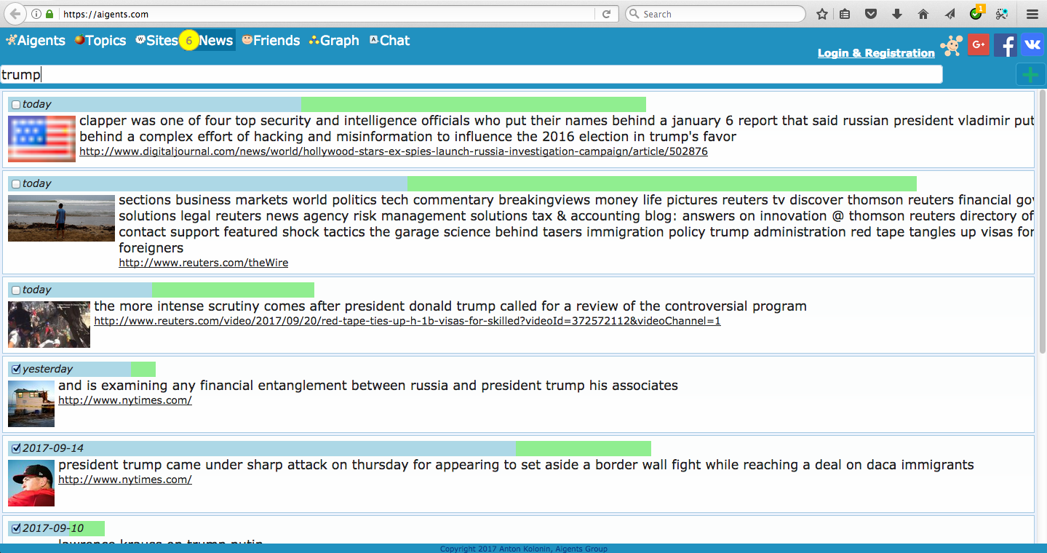
Case 1: Collaborative News Filtering:
Monitoring web pages and extracting textual information with account to
Personal and Social relevances
Me
Friends

Slide 33
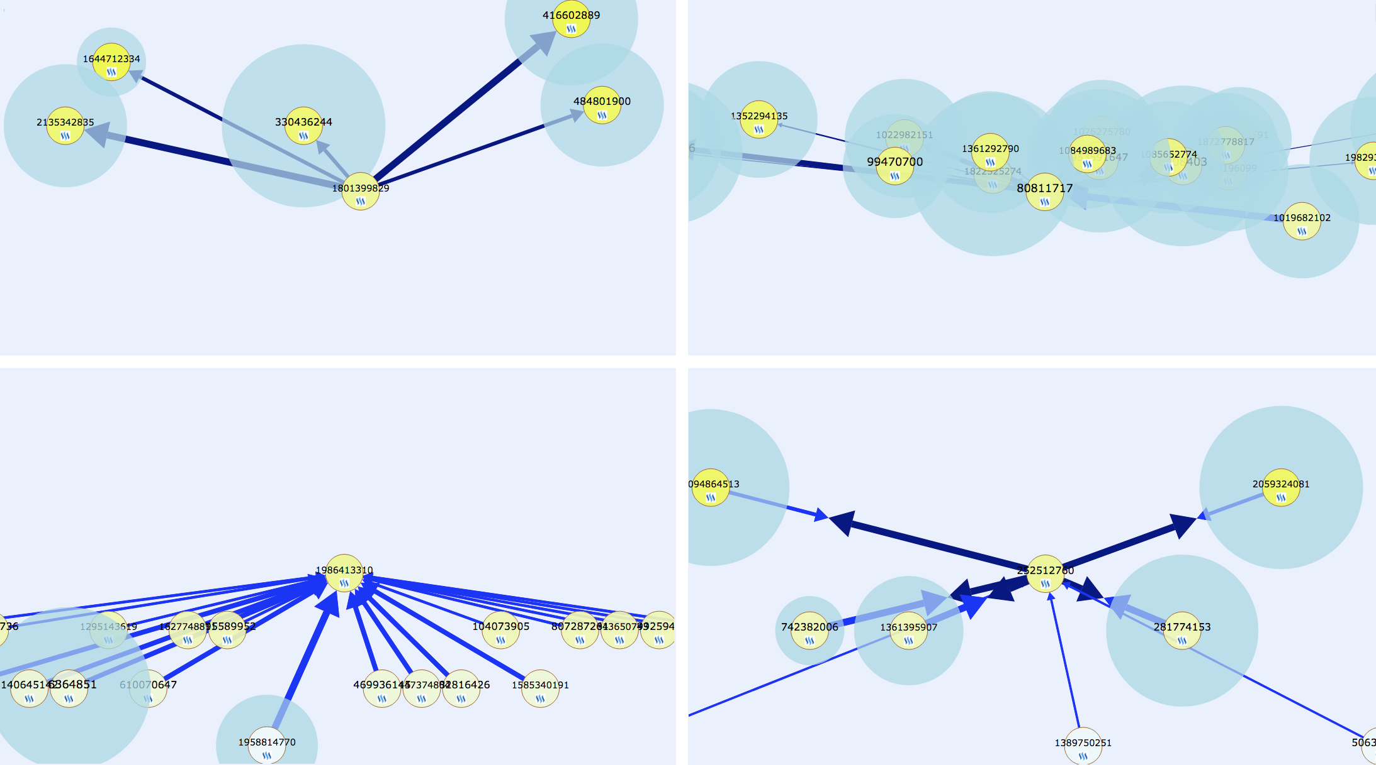
Case 2: Helping users to understand themselves better and
perform more efficiently online – using their tracks in social networks and online resources, capture their interests, relationships, communication patterns and social structures.
Social type:
follower
Social type:
peer
Social type:
opinion leader
Social type:
connector
Social type:
follower
Social type:
peer
Social type:
opinion leader
Social type:
connector

Slide 34
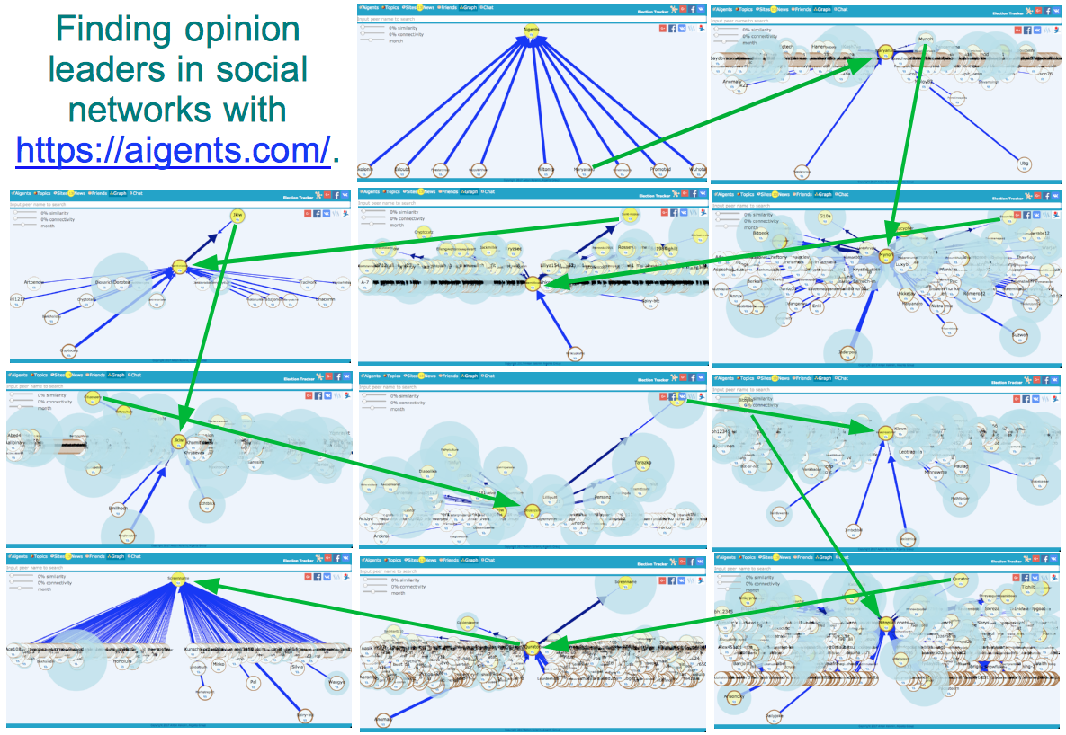
Case 3:

Slide 35
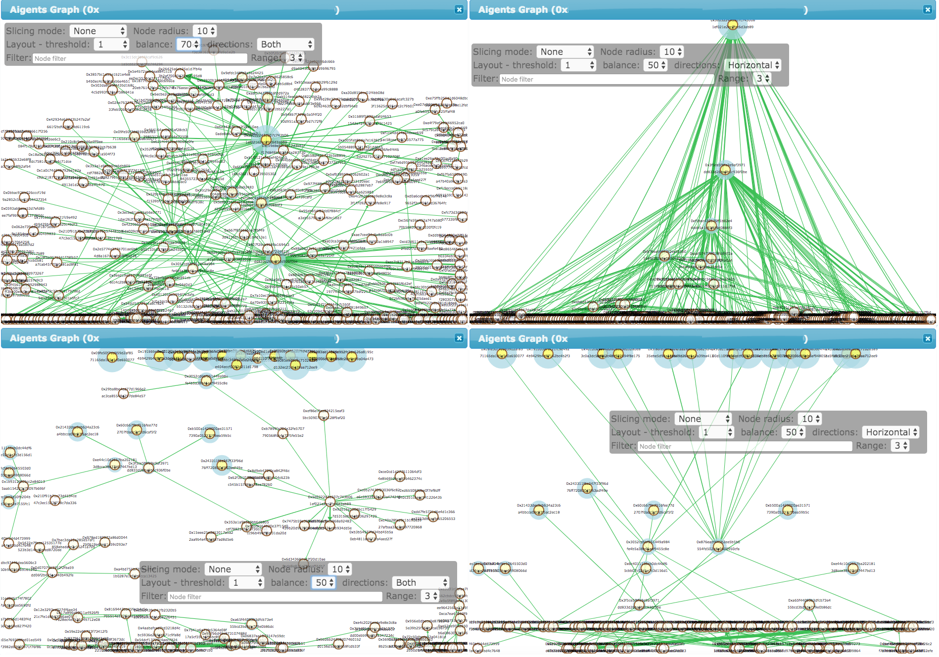
Aigents®: Ethereum cash flow graph study

Slide 36
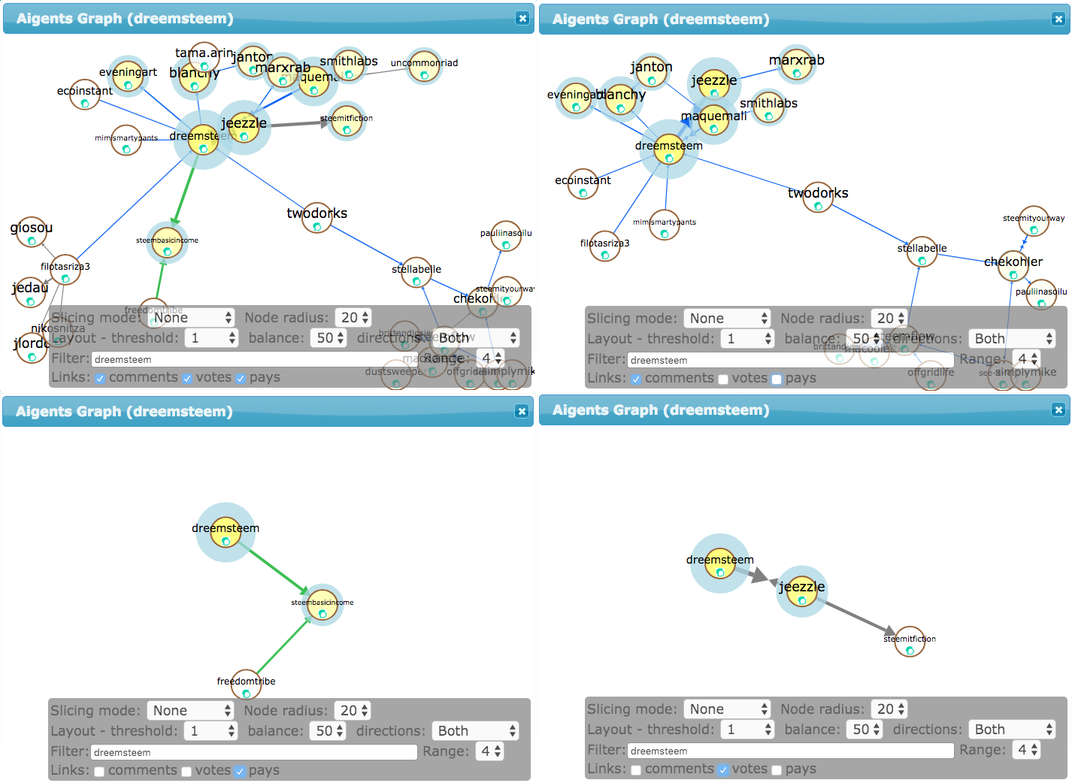
Aigents®: Steemit social network graph study

Slide 37
Lessons Learned:
1. People and users don’t like to learn new languages (including controlled, pidgin and graphical)
2. They like to use their own language or usable GUI-s
3. Selling is hard :-)

Slide 38
Foundation Ontology
No-ontology
Cyc Knowledge Base
Freebase/Google Knowledge Graph
OpenCog Atomspace
Webstructor/Aigents®
Custom Domain
Graph Storage
Semantic Language
Any RDBMS + time & triple indexing
Any “Triple Store” + time indexing
TimeScale DB + triple indexing
OpenCog AtomSpace
Aigents® Temporal Graphs
RDF/OWL/Turtle/JSON-LD/SparQL
CycL – Cyc Language (D.Lenat)
ORL (A.Kolonin, L.Kuzin)
D0SL (V.Gumirov, D.Sviridenko)
OpenCog Atomese (B.Goertzel)
Narsese (P.Wang, P.Hammer)
AL – Aigents® Language (A.Kolonin)
Premise (M.Miller)
Inference Engine
Non-Axiomatic Reasoning System – NARS (P.Wang, et. al.)
Logical Prediction System – “Discovery” (E.Vityaev et.al.)
OpenCog Probabilistic Logic Network – PLN (B. Goertzel et. al.)

Slide 39
What is all you need?
 | Inference Engine | Semantic Language | Graph Database | Foundation Ontology | License
OpenCog | Unified Rule Engine (URE)/ Probabilistic Logic Network (PLN) | Atomese | AtomSpace | AtomSpace Atom Types | GPL
Non-Axiomatic Reasoning System (NARS) | Non-Axiomatic Reasoning System (NARS) | Narsese | Internal In-memory | Ontology-agnostic? | MIT
Discovery + D0SL | Discovery | D0SL | Internal in-memory | D0SL | GPL + Commercial
Webstructor/Aigents® | TBD | ORL, AL | Aigents Graphs | Aigents | MIT

Slide 40
Complex Truth Values for Probabilistic Logic
Probabilistic Logic: Separating Strength and Confidence
(based on Evidence)
60/100
Low strength
High confidence
9/10
High strength
Low confidence
90/100
High strength
High confidence
Bad
nutrition
Weakened
immune system
Infection
6/10
Low strength
Low confidence
Cold
Truth value:
P. Wang, NARS, 1993
E. Vityaev, Discovery, 2001
B. Goertzel et al., PLN, 2008
Strength, Confidence

Slide 41
Complex Truth Values for Probabilistic Logic
Example: Non-Axiomatic Reasoning System (NARS)
Deduction
Always
Revision
Bad
nutrition
Weakened
immune system
Infection
Abduction
Yesterday
Today
Induction
Cold
Truth value:
P. Wang, NARS, 1993
E. Vityaev, Discovery, 2001
B. Goertzel et al., PLN, 2008
Strength, Confidence

Slide 42
AtomSpace - Generalized (Link-as-Node)
Hyper-Graph is a Meta-Graph (in Atomese)
Geography
SetLink
InheritanceLink
InheritanceLink
SetLink
ImplicationLink
AndLink
ConceptNode «Air Humidity»
ConceptNode «Low Pressure»
AndLink
ConceptNode «Fog»
SequentialAndLink
ConceptNode «Cloud»
ConceptNode «Rain»
ConceptNode «Flood»
ConceptNode «Georgraphy»
AndLink
Air Humidity
Low Pressure
ImplicationLink
AndLink
Fog
Cloud
SequentialANDLink
Rain
Flood

Slide 43
AtomSpace - Meta-Graphs with Hyper-Graphs and Links-on-Links
Geography
Geography
InheritanceLink
MemberLink
MemberLink
MemberLink
MemberLink
MemberLink
MemberLink
SetLink
Wind
ImplicationLink
Wave
Wind
ImplicationLink
Wave
Cloud
ImplicationLink
Rain
Cloud
ImplicationLink
Rain
MemberLink
ConceptNode «Wind»
ConceptNode «Georgraphy»
MemberLink
ConceptNode «Wave»
ConceptNode «Georgraphy»
MemberLink
ImplicationLink
ConceptNode «Wind»
ConceptNode «Wave»
ConceptNode «Georgraphy»
MemberLink
ConceptNode «Cloud»
ConceptNode «Georgraphy»
MemberLink
ConceptNode «Rain»
ConceptNode «Georgraphy»
MemberLink
ImplicationLink
ConceptNode «Cloud»
ConceptNode «Rain»
ConceptNode «Georgraphy»
InheritanceLink
SetLink
ImplicationLink
ConceptNode «Wind»
ConceptNode «Wave»
ImplicationLink
ConceptNode «Cloud»
ConceptNode «Rain»
ConceptNode «Georgraphy»

Slide 44
OpenCog AtomSpace, what’s inside
Types
(Type Codes)
Define scope that set of Atoms belong to, on application-specific basis
Spaces
(Segments)
Define Artity and Ordered/Unordered properties of Atoms and other type-specific semantics
Can be used to split AtomSpace into separate spaces or segments for different purposes
Atoms
(Relations)
Each Atom can be linked by other Atoms (as Links) and can link other Atoms itself
Values
(Properties)
Keep truth values (count, strength, confidence) and other atom-specific properties
https://github.com/opencog/atomspace/blob/master/opencog/atoms/base/atom_types.script

Slide 45
OpenCog Atoms - Inference
Id | Type | Space | Name (Label) | Level in Meta-Graph | Arity | Argu-ments | Truth Value: Count, Strength, Confidence
11 | SequentialANDLink | 5 | - | 2 | 2 | 13, 14 | 22 0.5 (22/44=50%) 1.0 («surely»)
12 | SequentialANDLink | 5 | - | 2 | 3 | 13, 14, 15 | 11 0.25 (11/44=25%) 0.5 («probably»)
13 | ConceptNode | 5 | «Cloud» | 0 | 0 | - | 44 1.0 1.0 («fact»)
14 | ConceptNode | 5 | «Rain» | 0 | 0 | - | 22 1.0 1.0 («fact»)
15 | ConceptNode | 5 | «Flood» | 0 | 0 | - | 11 1.0 0.5 («just news»)
Atom Type is used to infer if atom is link and if it is
Ordered/directed or
Unordered/undirected
Cloud
SequentialANDLink
Rain
Flood
SequentialANDLink
https://github.com/opencog/atomspace/blob/master/opencog/atoms/base/atom_types.script

Slide 46
Social evidence-based resource-constrained
cognitive-behavioral model
Unquestioned truths and beliefs
Foundation
Graph
Beer is a drink
Coffee is a drink
Tea is a drink
Juice is a drink
Social connections,
with account to levels of trust
Mary is my best friend
Peter is best fiend
Bob is Peter's friend
Social
Graph
Facts weighed based on
their social sources and assessments,
in the light of unquestioned beliefs
Probabilistic
Inference
Imagination
Graph
★★★ I like juice very much
★★ I like tea
★ I may try coffee
I won’t try beer
Facts obtained from sources
with different levels of trust
Evidence
Graph
Bob said beer is good
Mary said beer is not good
Mary said juice is good
Mary said tea is good
Peter said tea is good
Peter said coffee is good
2015-2018
https://ieeexplore.ieee.org/document/7361869
https://www.sciencedirect.com/science/article/pii/S1877050916317239
https://link.springer.com/chapter/10.1007/978-3-319-97676-1_10

Slide 47
Social evidence-based resource-constrained
cognitive-behavioral model
Unquestioned truths and beliefs
B_{il} – person’s i mental attachment to l
l – person’s belief item
(of foundation graph of size L)
Social connections,
with account to levels of trust
S_{ik} – person’s i social bind to k
k – person’s correspondent
(of social graph of size K)
P^{B}_{ij}=Σ_{l=1,L}(E^{B}_{ijl}*B_{il})
C_{ij}
Facts weighed based on
their social sources and assessments,
in the light of unquestioned beliefs
P^{S}_{ij}=Σ_{k=1,K}(E^{S}_{ijk}*S_{ik} )
P_{ij} = Σ_{l=1,L}( E^{B}_{ijl} * B_{il} ) * Σ_{k=1,K}( E^{S}_{ijk} * S_{ik} )
Facts obtained from sources
with different levels of trust
E_{ij} - exposed evidence
2015-2018
https://ieeexplore.ieee.org/document/7361869
https://www.sciencedirect.com/science/article/pii/S1877050916317239
https://link.springer.com/chapter/10.1007/978-3-319-97676-1_10

Slide 48
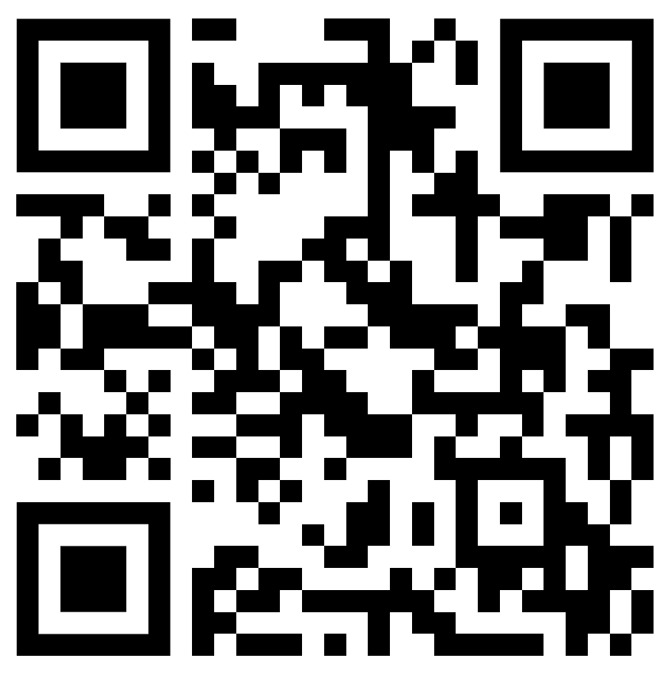
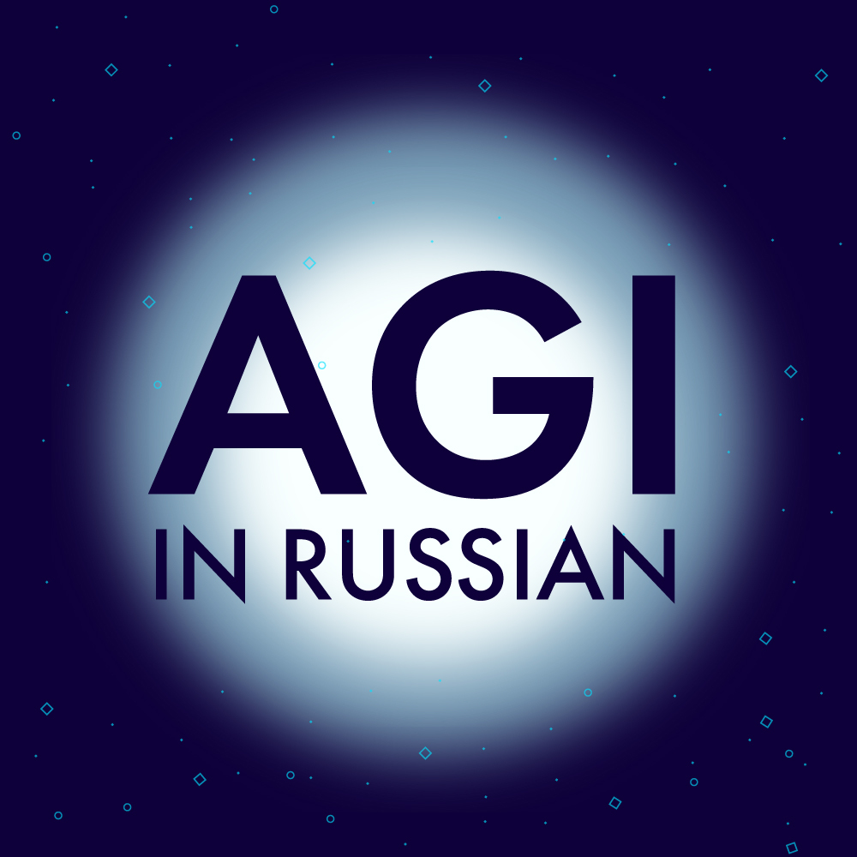
Thank you for attention!
Full version:
Thank you for attention!
Full version:
Anton Kolonin
akolonin@aigents.com
Telegram: akolonin
Anton Kolonin
akolonin@aigents.com
Telegram: akolonin
https://www.nsu.ru
https://www.nsu.ru
AIGENTS
AIGENTS
https://agirussia.org
https://aigents.com
https://agirussia.org
https://aigents.com

Slide 49
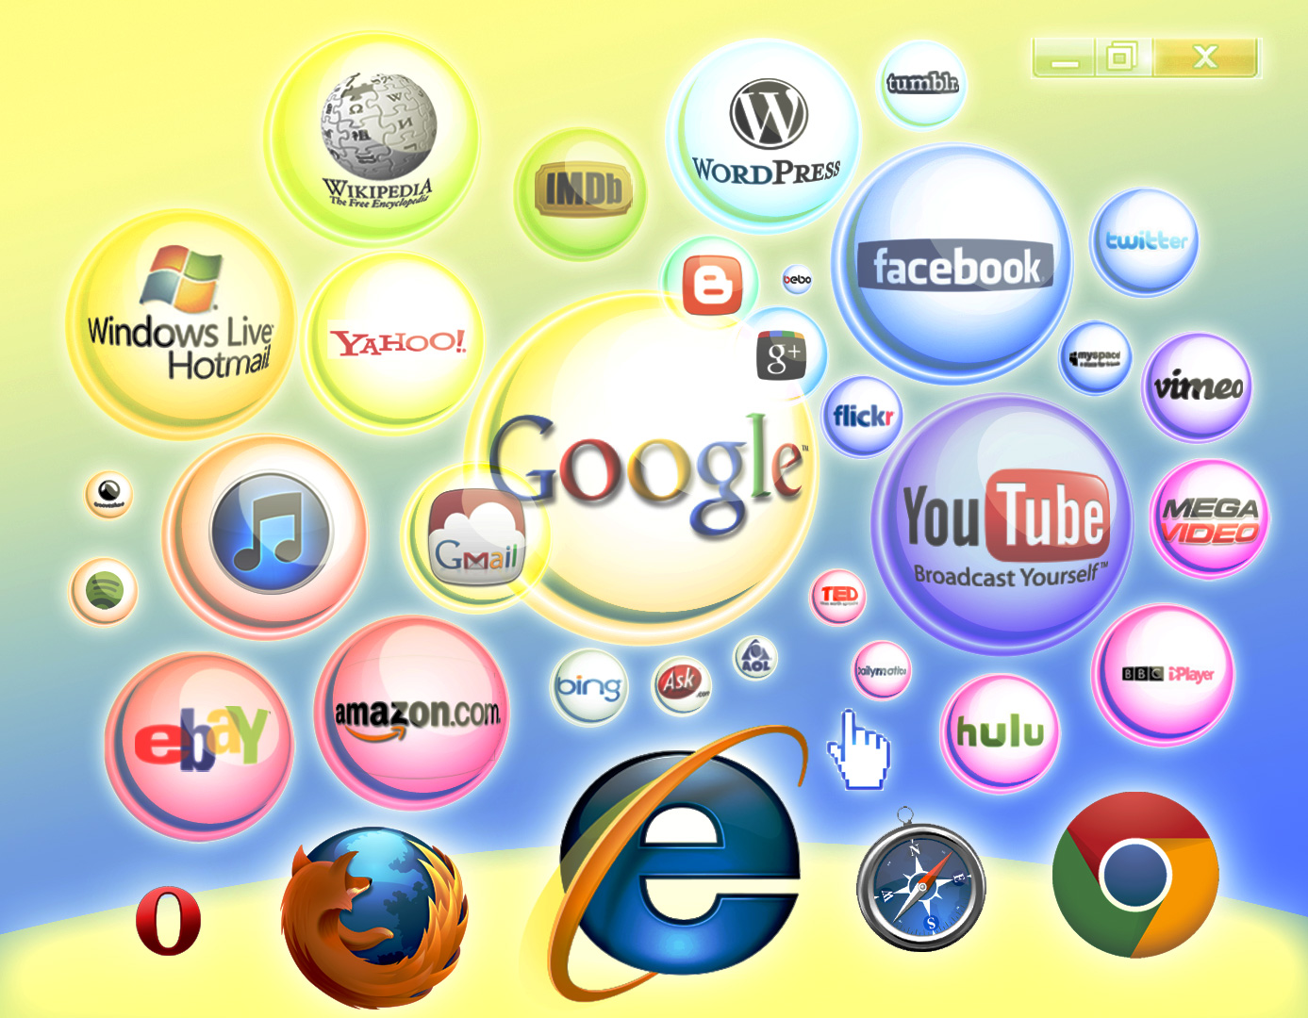







Aigents® - Social computing platform
News
Me
Ethereum
PayPal
You
Steemit
WWW
Golos.id
Google
VKontakte
Facebook
RSS
Discourse
Messenger
Friends
Twitter
https://aigents.com/
https://github.com/aigents
Slack
Reddit
Telegram

