Slide 1


Reputation System
Generalized Ontology, Temporal Graph Architecture,
Temporal Weighted Liquid Rank
Anton Kolonin
akolonin@aigents.com
Messengers: akolonin
AIGENTS
https://aigents.com

Slide 2
Reputation System – Solving Problems
Marketplaces
Churning and gaming ratings
News filtering
Fake news, information wars
Social Networking
Spam, abuse, harassment
Socio-psychological security
Broken relationships
Financial security
Scam
Blockchain consensuses
Consensus takeover
Democratic Governance
State instability

Slide 3
Reputation System - Ingredients
Data:
Principles:
Results:
Ratings
Stakes
Payments
Spendings
Reviews
Mentions
Tips
etc.
Liquid ranking!
Weighted ranking!
Time scoping!
Data openness!
Code openness?
Human precedence?
Non-anonymity?
No right to oblivion?
Rank
Reputation
Karma
Social capital

Slide 4
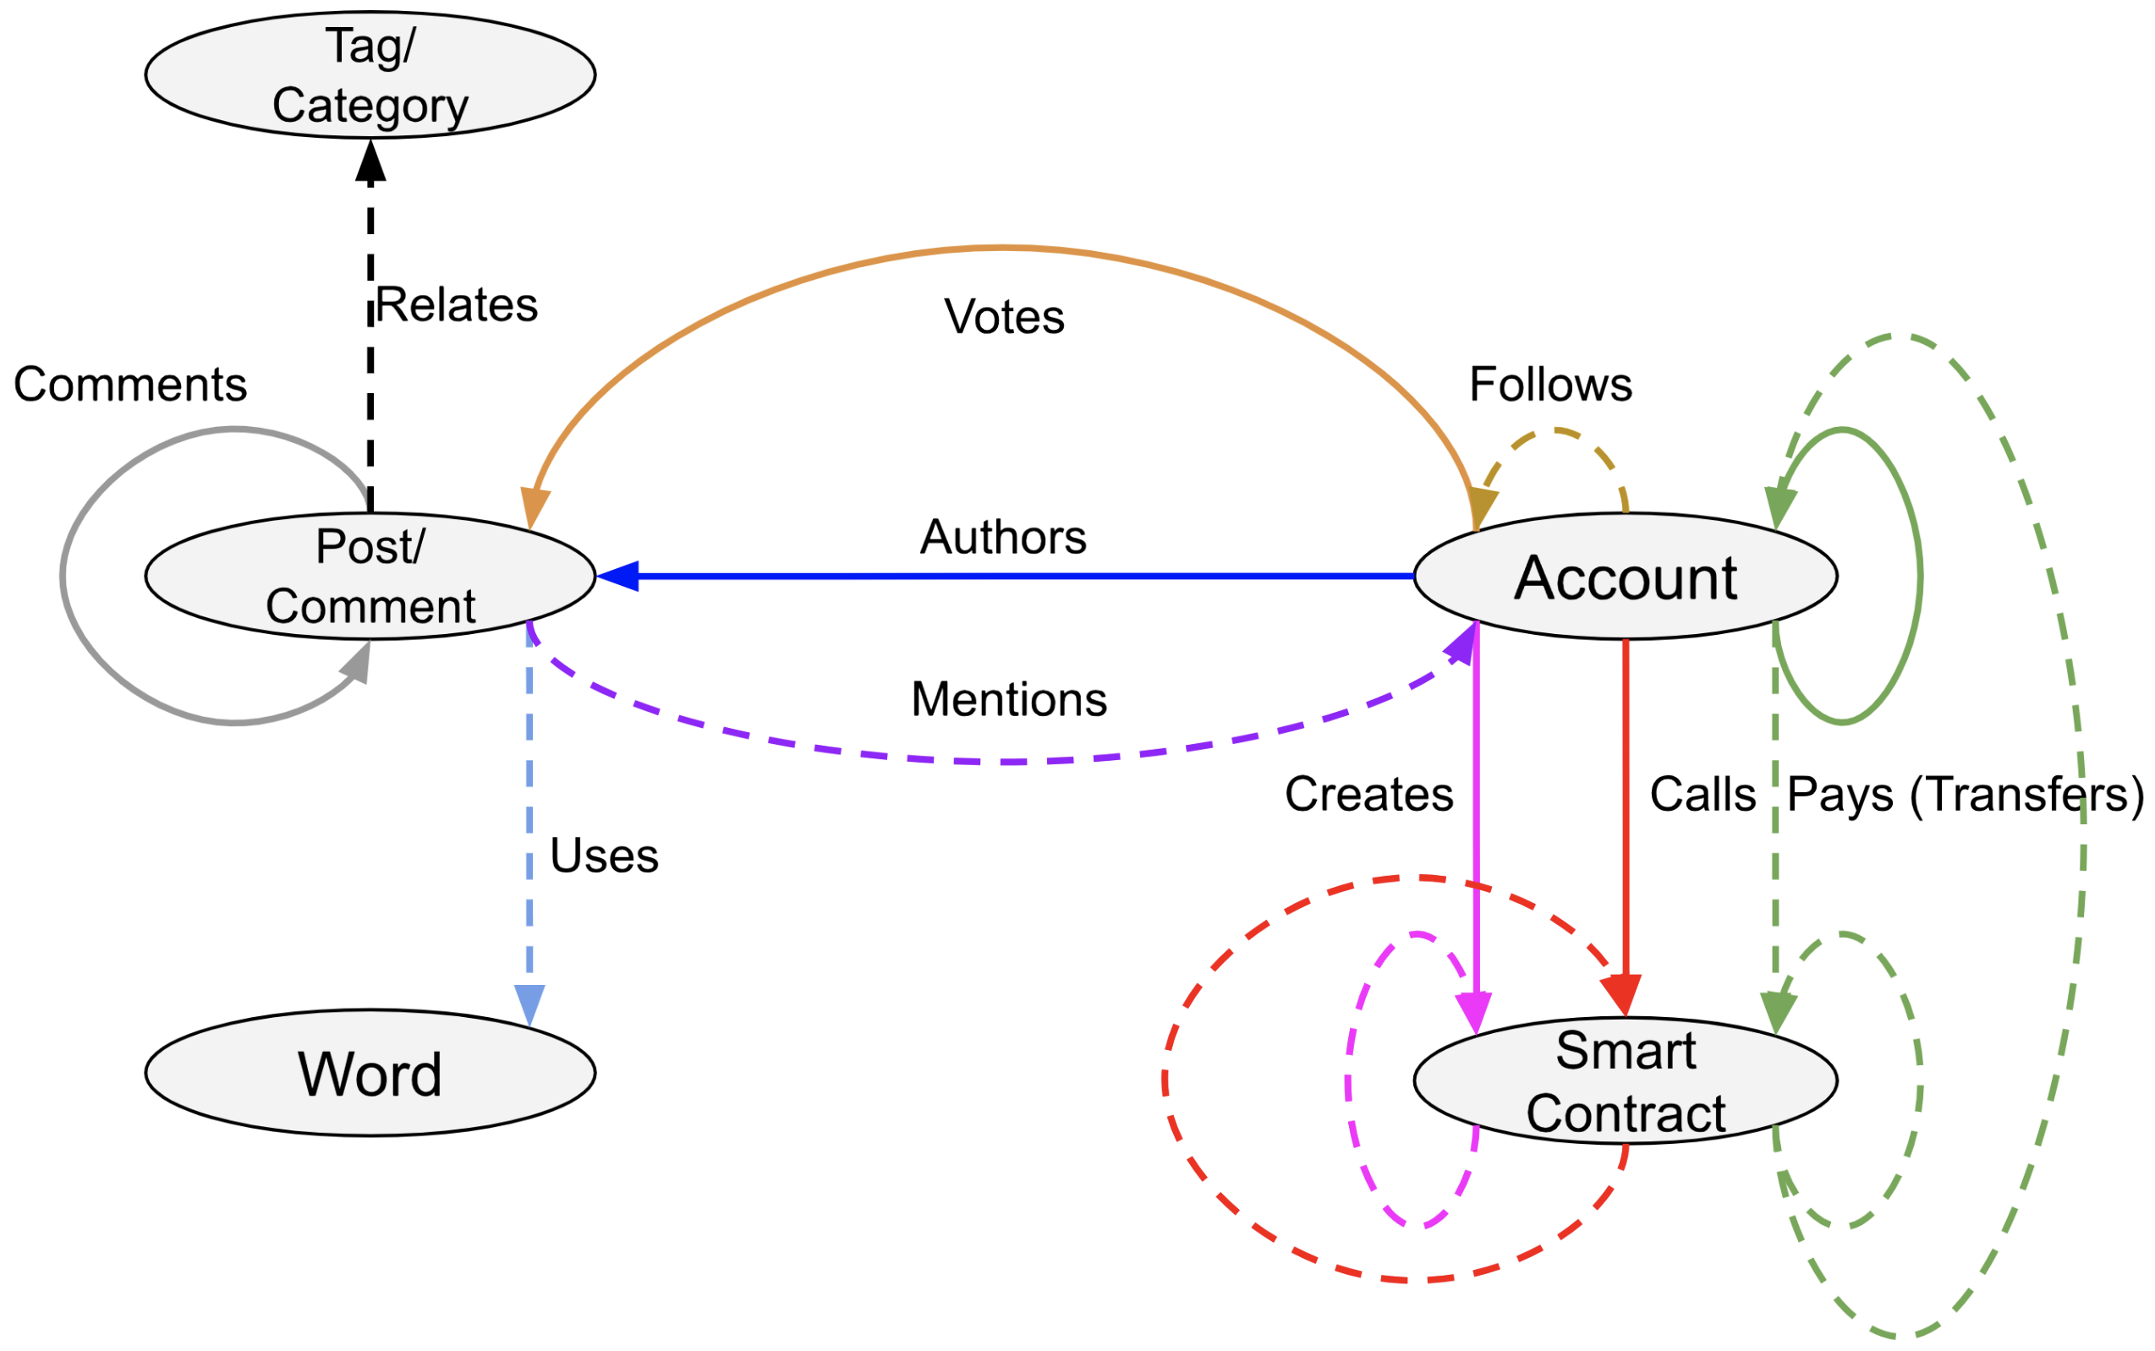
Reputation System – Generalized Ontology

Slide 5
Reputation Temporal Graph and Synchronization Options
Blockchain
Blockchain
$
$
$
$
$
$
$
$
$
$
$
$
Reputation
Snapshot
1 day/hour
Reputation
Snapshot
Reputation
Snapshot
Reputation
Snapshot
Reputation
Snapshot
Reputation
Snapshot
Reputation
Snapshot
Blockchain
Snapshot
Blockchain
Snapshot
Block-wise
(expensive)
Transaction-wise
(prohibitively expensive)
Periodic
(optimal)
A Reputation System for Artificial Societies
Anton Kolonin, Ben Goertzel, Deborah Duong, Matt Ikle
https://arxiv.org/pdf/1806.07342.pdf

Slide 6
Reputation Snapshots and Rating Sources
Blockchain
$
$
$
$
$
$
$
$
$
$
$
$
$
Endorsing Ratings
Follows
Stakes
Stars
Transactional Ratings
Reputation Engine
Implicit Ratings
Explicit Ratings
Tips
Likes
Transactions
Mentions
Stars
Comments
Reputation
Snapshot
Reputation
Snapshot
A Reputation System for Artificial Societies
Anton Kolonin, Ben Goertzel, Deborah Duong, Matt Ikle
https://arxiv.org/pdf/1806.07342.pdf

Slide 7
Reputation Consensus Engine – Design Options
$
$
$
$
$
$
$
$
Reputation
Snapshot
Reputation
Snapshot
Reputation
Snapshot
Reputation
Snapshot
Centralized off-chain
Decentralized off-chain
$
$
$
$
$
$
$
$
Reputation
Snapshot
Reputation
Snapshot
Reputation
Snapshot
Reputation
Snapshot
Reputation
Snapshot
Reputation
Snapshot
Decentralized on-chain (reputation mining)
Decentralized side-chain (reputation consensus)
A Reputation System for Artificial Societies
Anton Kolonin, Ben Goertzel, Deborah Duong, Matt Ikle
https://arxiv.org/pdf/1806.07342.pdf

Slide 8
Temporal
Weighted
Liquid Rank
A Reputation System for Multi-Agent Marketplaces
Anton Kolonin, Ben Goertzel, Cassio Pennachin, Deborah Duong, Matt Iklé , Nejc Znidar, Marco Argentieri
https://arxiv.org/pdf/1905.08036.pdf
https://github.com/singnet/reputation
https://github.com/aigents/aigents-java/blob/master/src/main/java/net/webstructor/peer/Reputationer.java
A Reputation System for Artificial Societies
Anton Kolonin, Ben Goertzel, Deborah Duong, Matt Ikle
https://arxiv.org/pdf/1806.07342.pdf

Slide 9
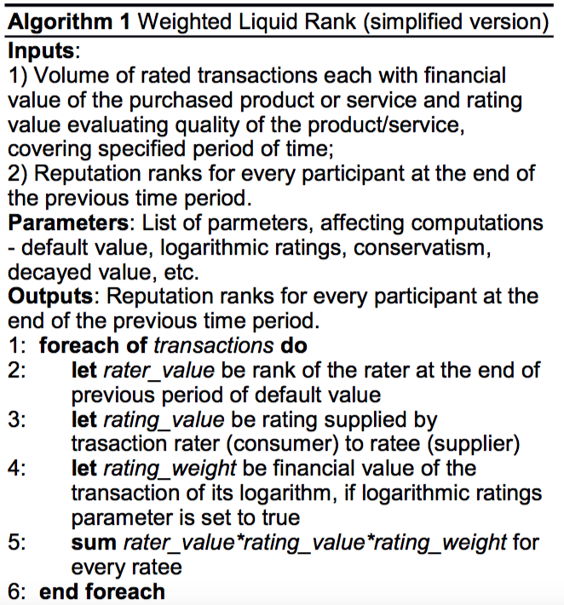
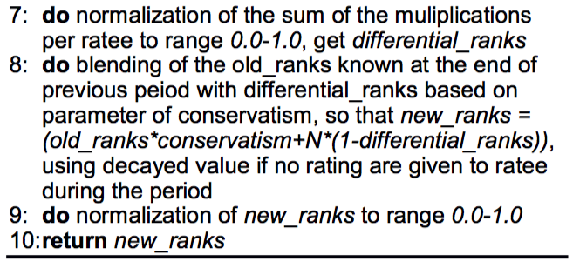
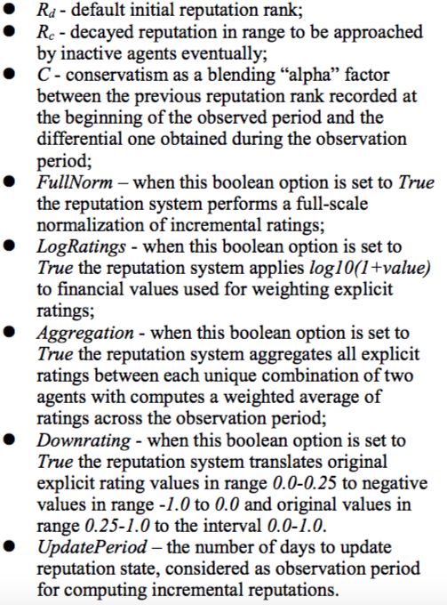
Reputation System Engine
A Reputation System for Multi-Agent Marketplaces
Anton Kolonin, Ben Goertzel, Cassio Pennachin, Deborah Duong, Matt Iklé , Nejc Znidar, Marco Argentieri
https://arxiv.org/pdf/1905.08036.pdf
https://github.com/singnet/reputation
https://github.com/aigents/aigents-java/blob/master/src/main/java/net/webstructor/peer/Reputationer.java

Slide 10









Reputation System for Social and Online Media
Aigents® Social Computing Platform
Ethereum
VKontakte
Blockchains
Steemit
Social
Networks
Golos.id
Twitter
Reddit
Messengers
Slack
Discourse
Forums
Telegram
Unified Liquid Rank Reputation computation across diverse social media platforms
https://aigents.com/
https://github.com/aigents/aigents-java
https://arxiv.org/abs/1912.00176
https://aigents.medium.com/aigents-bot-for-telegram-groups-1dba32140047

Slide 11

Reputation System - Fraud Resistance
“Weighted Liquid Rank” algorithm for protection from scam identifying dishonest suppliers.
https://arxiv.org/pdf/1905.08036.pdf
https://blog.singularitynet.io/minimizing-recommendation-fraud-7dabbee8fc00
https://aiforgood2019.github.io/papers/IJCAI19-AI4SG_paper_28.pdf
https://singularitynet.io

Slide 12
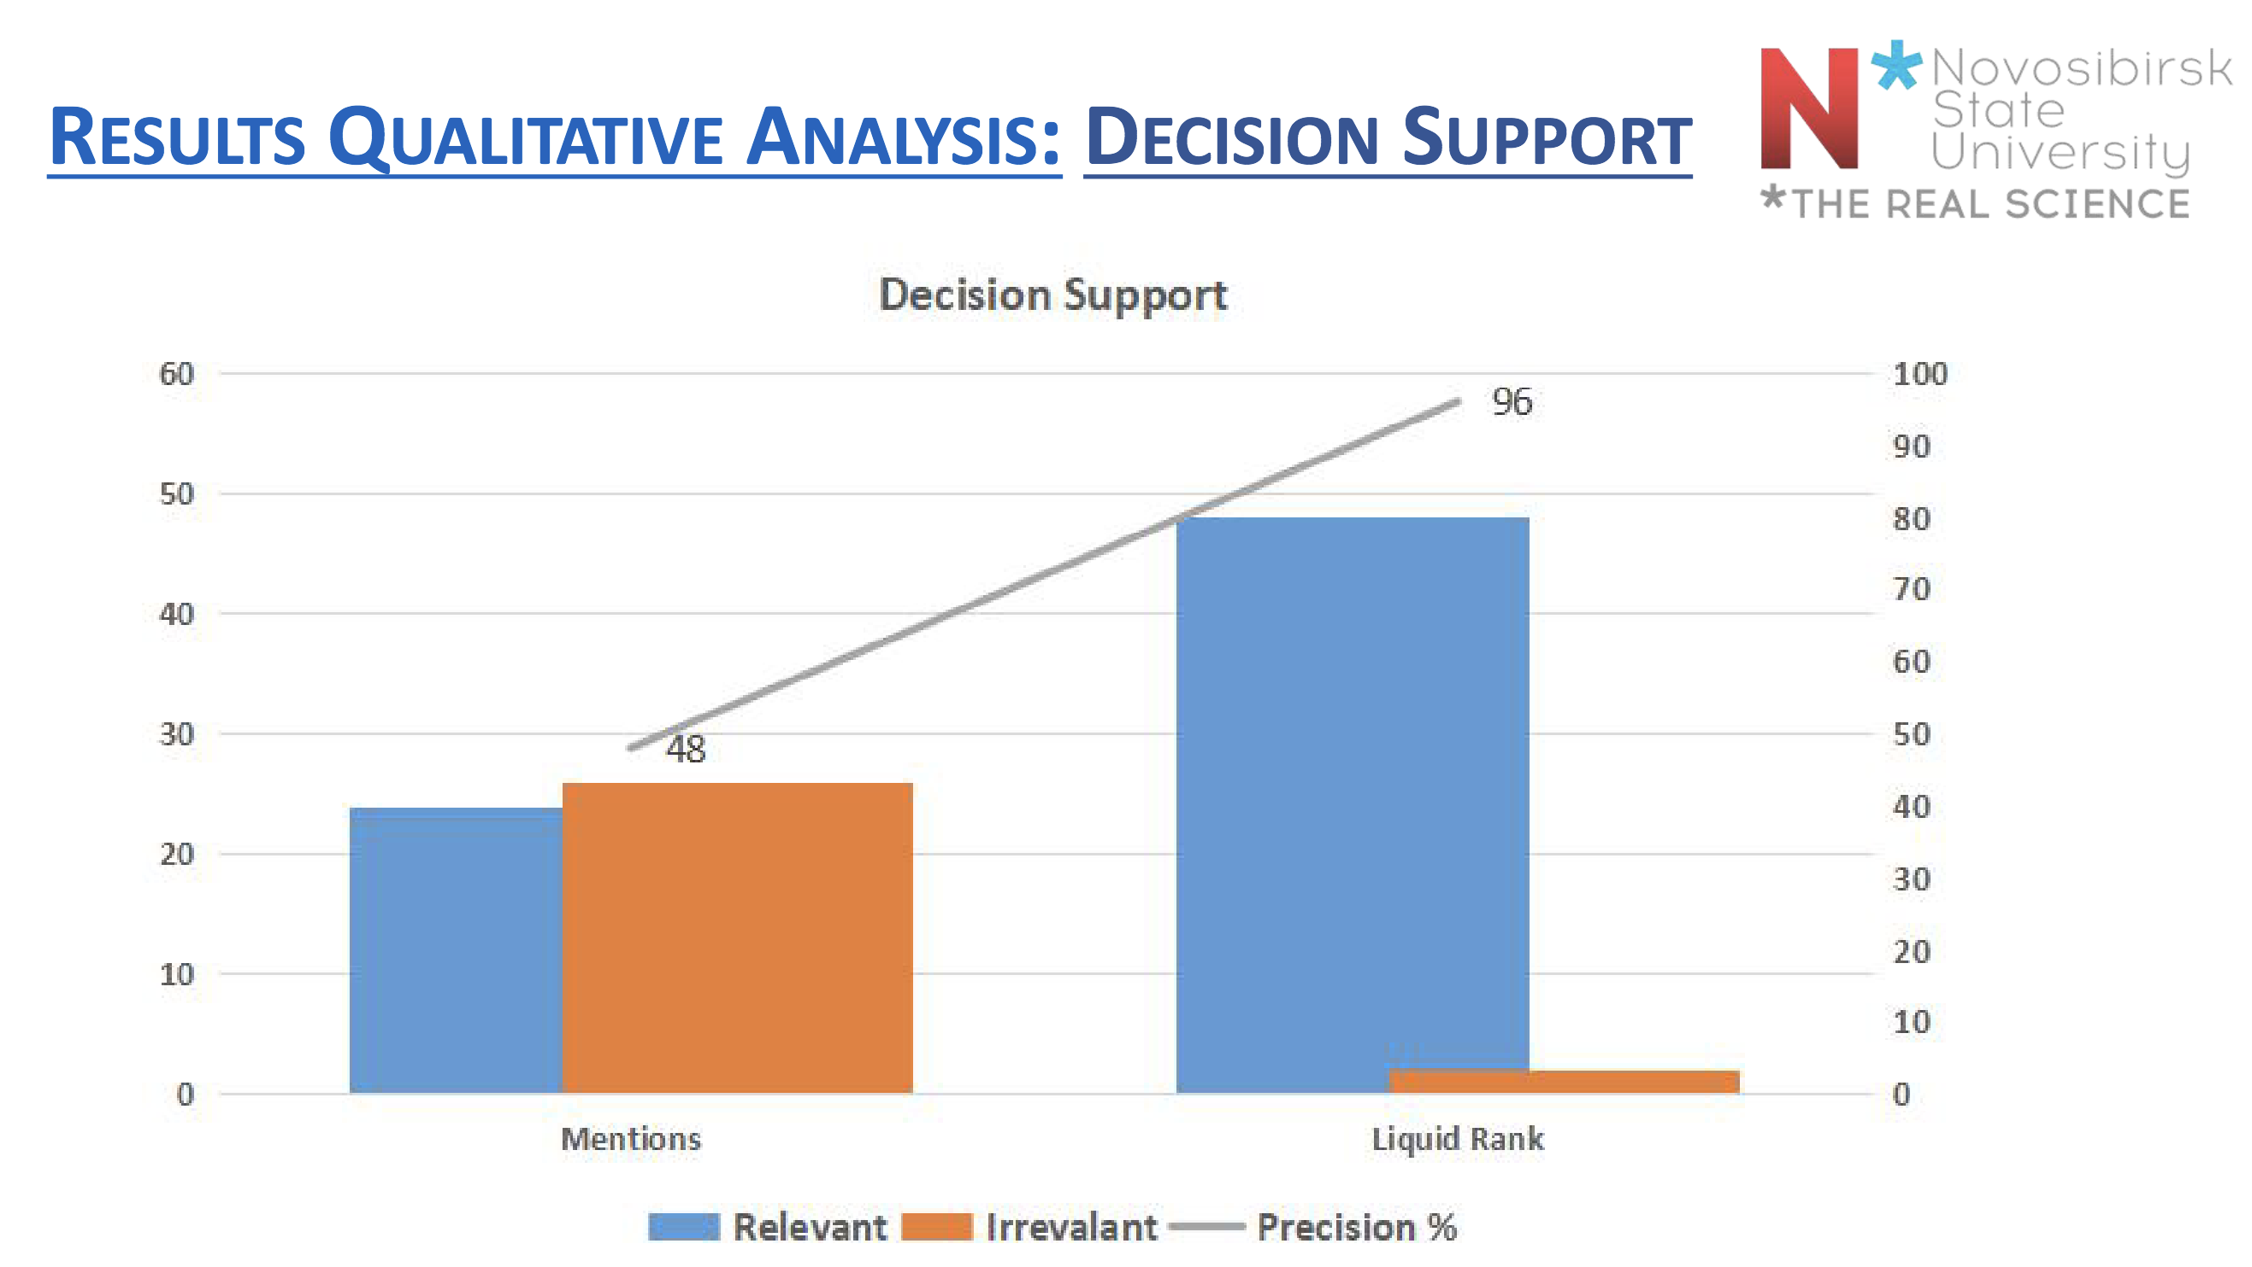
Reputation System - Content Recommendation
https://arxiv.org/abs/2209.07641
https://ieeexplore.ieee.org/document/9923352

Slide 13
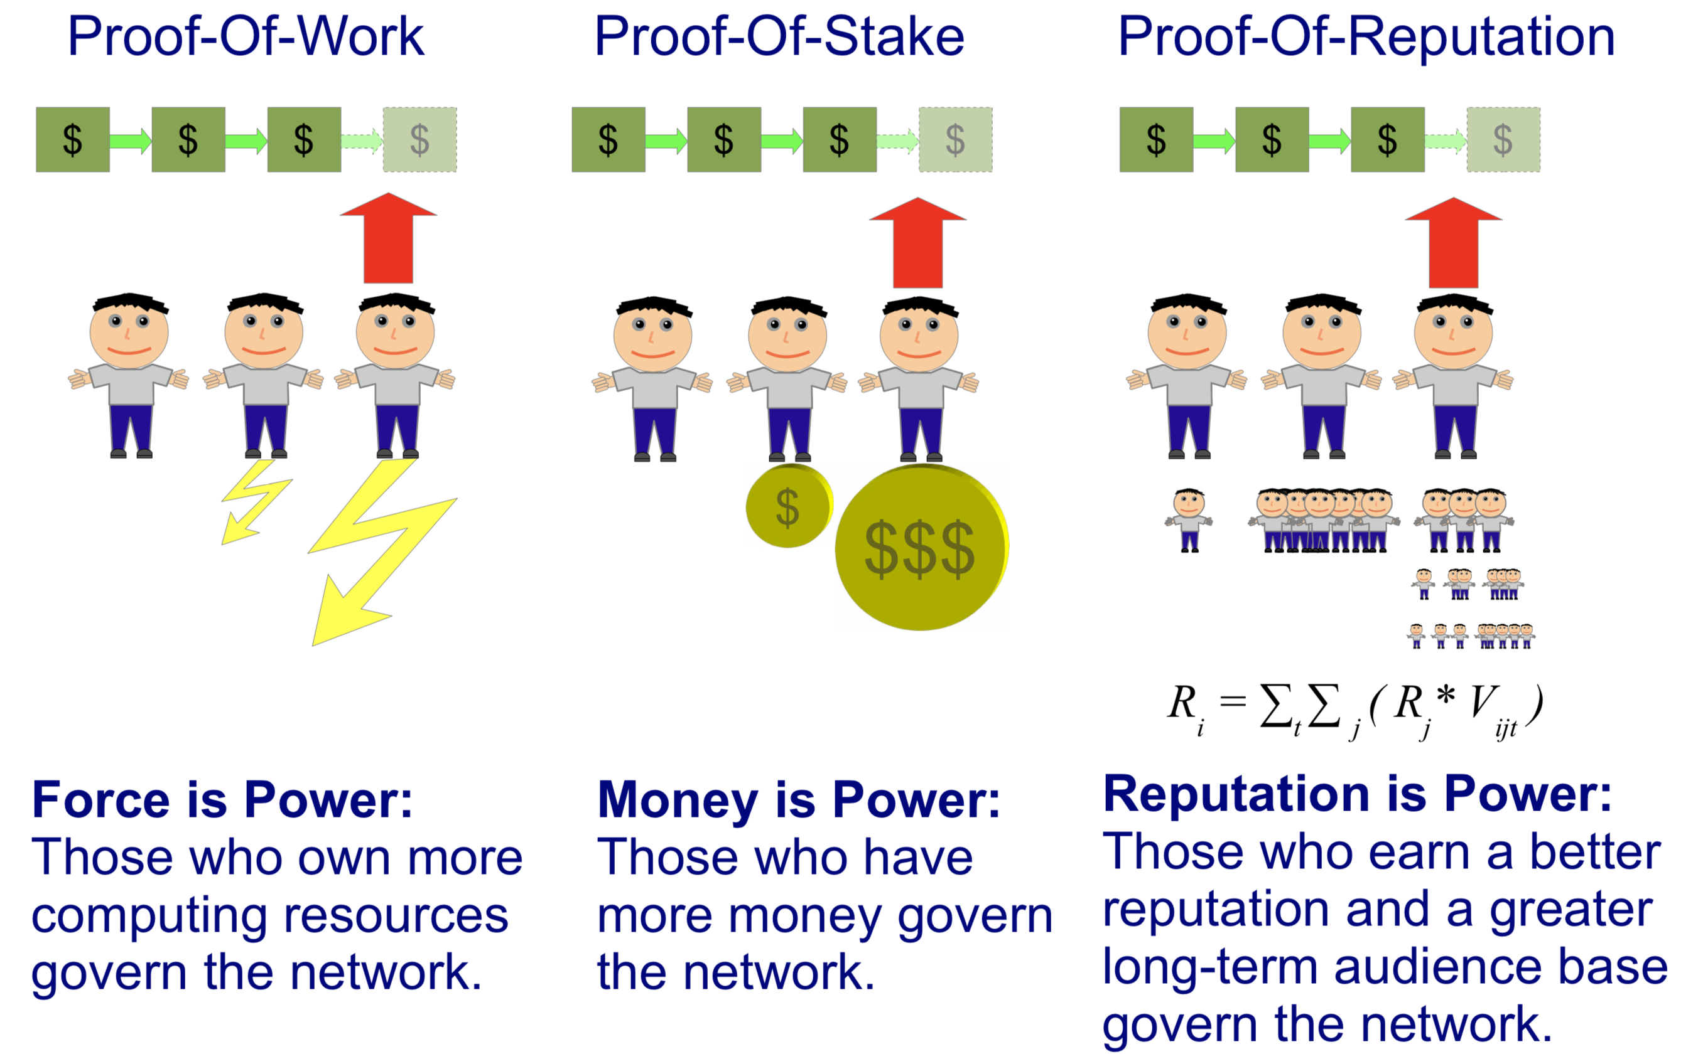
Reputation System for Blockchain Consensus
https://steemit.com/blockchain/@aigents/proof-of-reputation-as-liquid-democracy-for-blockchain
https://research.nsu.ru/en/publications/reputation-systems-for-human-computer-environments
https://ieeexplore.ieee.org/document/8109887

Slide 14
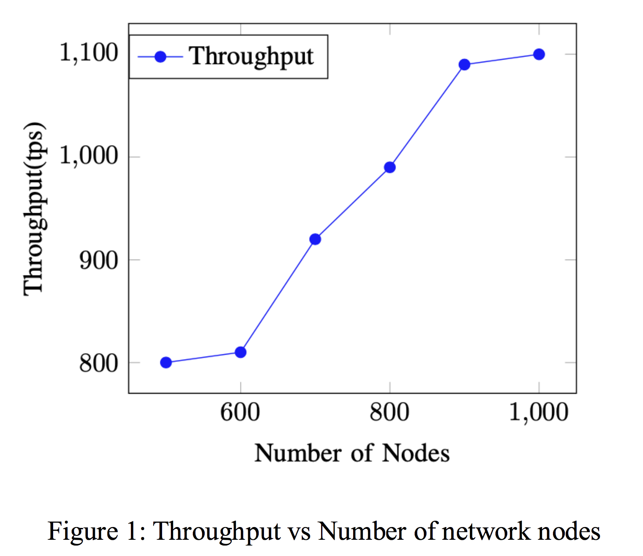
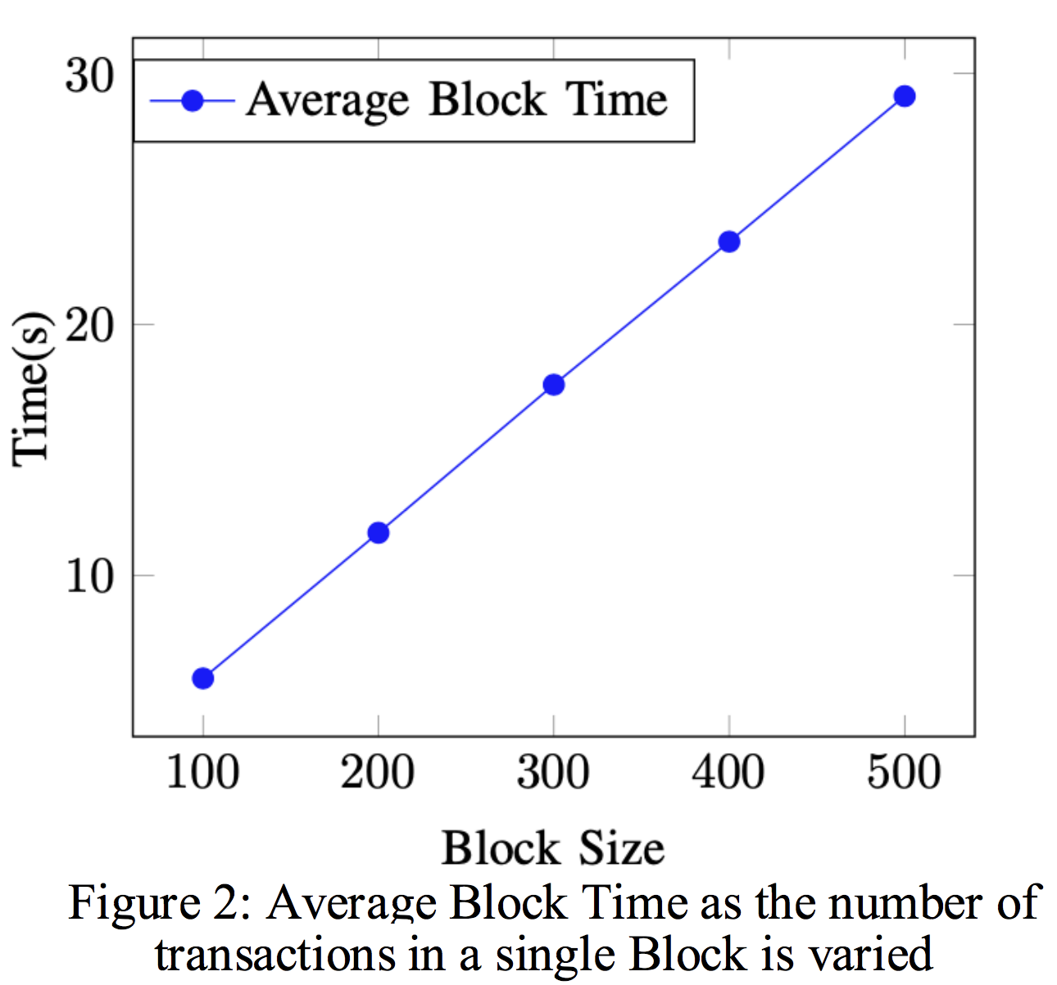
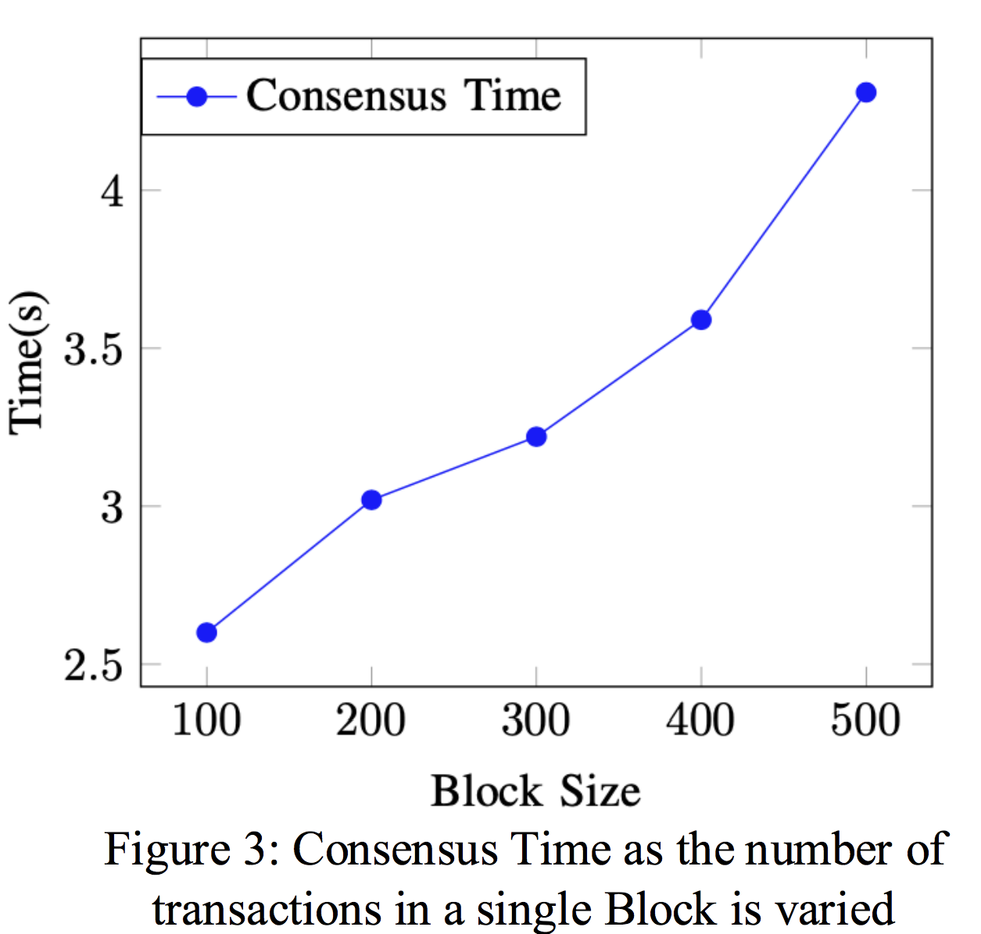
Reputation Consensus for Blockchain - Experiments
Proof-of-Reputation: An Alternative Consensus
Mechanism for Blockchain Systems
Oladotun Aluko, Anton Kolonin
https://arxiv.org/abs/2108.03542
https://aircconline.com/ijnsa/V13N4/13421ijnsa03.pdf
Proof-of-Reputation: An Alternative Consensus
Mechanism for Blockchain Systems
Oladotun Aluko, Anton Kolonin
https://arxiv.org/abs/2108.03542
https://aircconline.com/ijnsa/V13N4/13421ijnsa03.pdf

Slide 15
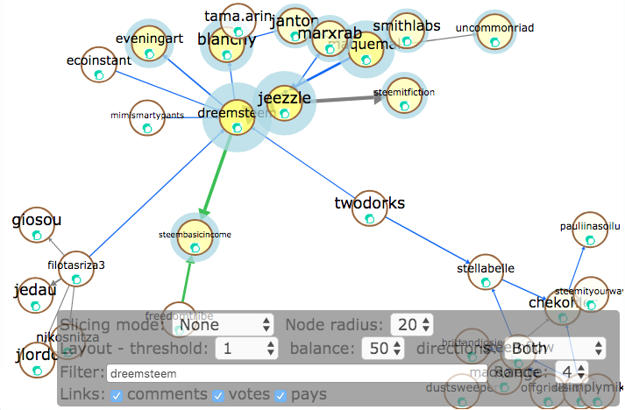
Reputation System for Financial Security
Making sense of complex socio-financial network dynamics based on synergy of financial, textual and emotional interactions in distributed online platform such as Steemit
Social type:
follower
Social type:
peer
Social type:
opinion leader
Social type:
connector

Slide 16
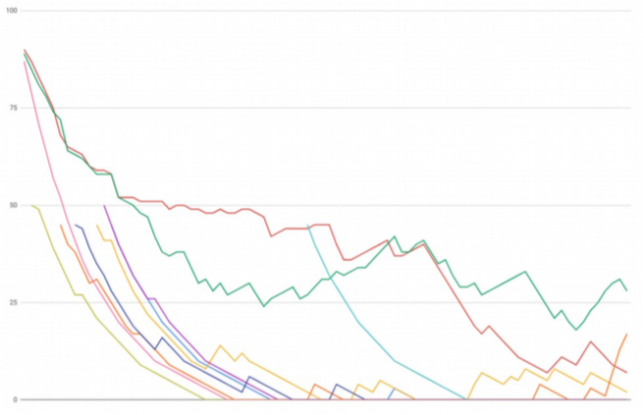
Reputation System for Financial Security
Evaluate trustworthiness and its dynamics for anonymous accounts in open public networks based on reputations computed on explicit and implicit rating data
Reputation ranks in Steemit blockchain on
combined social and financial interactions
over time period
Social type:
follower
Social type:
peer
Social type:
opinion leader
Social type:
connector

Slide 17
Next: Resisting Reputation Gaming (Churning) [1.0..-1.0]
A
A
B
A
B
1.0
Default
1
1.0
Default
A
0
A
0
B
“Organic” Ratings
C
C
1
C
C
1
C
D
D
Default
Default
0
-1
“Cleaned”
0
0.75
E
E
E
1.0
C
F
D
G
D
1
C
-1.0
F
1
E
F
“Cleaned”
1
0
G
1.0
1
G
D
1
1
1.0
D
F
0
“Cleaned”
G
Reputation Gaming
(“Voting Rings”)
0
“Cleaned”
Abused Reputation Snapshot
Rescued Reputation Snapshot

Slide 18
Next: Resisting Reputation Gaming (Churning)
A
A
B
0.5
A
B
1.0
Default
1
1.0
Default
A
A
0
B
“Organic” Ratings
C
C
1
C
C
1
0.5
C
D
D
Default
Default
0
“Cleaned”
0
0.75
E
0
E
E
1.0
D
F
D
G
1
C
F
1
E
F
“Cleaned”
1
0
G
1.0
1
G
D
1
1
1.0
D
F
0
“Cleaned”
G
Reputation Gaming
(“Voting Rings”)
0
“Cleaned”
Abused Reputation Snapshot
Rescued Reputation Snapshot

Slide 19
Thank You and Welcome!
Anton Kolonin
akolonin@aigents.com
Messengers: akolonin
AIGENTS
https://aigents.com

