Slide 1


Make experiential learning interpretable life-long!
Anton Kolonin
akolonin@aigents.com
Telegram/Github: akolonin
https://www.nsu.ru
AIGENTS
https://agirussia.org
https://aigents.com

Slide 2
What are the problems?
Slow learning
Uninterpretable models
Catastrophic forgetting
Expensive, resource-consuming training

Slide 3



Neuro-Symbolic integration for interpretable AI
Hooves
Tail
White
Black
Brown
Red
0.5
0.5
0.5
0.5
1.0
0.5
0.5
0.5
0.5
Σ
Σ
Σ
Explain
AND
AND
1.0
1.0
1.0
1.0
1.0
Σ
Σ
OR
Transfer
0.5
0.5
0.5
0.5
Σ
AND
“System 1”
“System 2”
(Hooves AND Tail) AND NOT Red
((White and Black) OR Brown)
=> Horse
https://www.springerprofessional.de/neuro-symbolic-architecture-for-experiential-learning-in-discret/20008336

Slide 4
Functional equivalence of graph (symbolic)
and neural network tensor models
Strokes, letters, words and phrases
Words
Sentences
strokes , letters words and phrases
Letters
w o r d s
Strokes
\ /
Pedro Domingos, Tensor Logic: The Language of AI
https://arxiv.org/pdf/2510.12269
Вершина графа - измерение
Ребро графа - вектор
Гиперграф - тензор

Slide 5

Typed tensor logic for different kinds of AI-s
(logical, sub-symbolic, probabilistic/non-axiomatic)
Truth-Value Tensor
(NARS/PLN/...)
Numerical Tensor
(ANN/Bayesian Logic)
Boolean Tensor
(Boolean Logic)
Property
0.0123456
=750/60750
Property
Property
~0.01
False
striped
striped
striped
horse
horse
horse
Life-long
learning?
Subject
Subject
Subject
Pei Wang: Non-Axiomatic Logic
https://www.worldscientific.com/worldscibooks/10.1142/14486
Pedro Domingos, Tensor Logic: The Language of AI
https://arxiv.org/pdf/2510.12269

Slide 6
System = Intelligent agent
Psyche = Operating system
Intelligence = Decision making system
Subconsciousness
(Intuition)
“System 1”
(“Fast”)
Consciousness
(Reasoning)
“System 2”
(“Slow”)
Emotions
Motivation
Expectations
Space of states
Sensations
Needs
Actions
Decisions
Perceptions
Sensors
Actuators
Anton Kolonin & Vladimir Kryukov,
Computational Concept of the Psyche,
Neuroinformatics-2025
https://arxiv.org/pdf/2509.07009
Sensations
Actions
Outer world = Operational environment

Slide 7
Psyche = Operating system
Intelligence = Decision making system
Models s (“invariants”) of states with utilities U and probabilities P of transitions
U({sτ}τ∈{-Τ,-1}​,s’0) = L( x⋅(yt - yt-1), (s’t - st), E(at-1)) s’t=argmaxs(U({sτ}τ∈{t-Τ,t-1}​,s’t),P({sτ}τ∈{t-Τ,t-1}​,s’t))
Experiential learning
Decision making
Space of states and episodic memory (“precedents”)
State st-1 (past)
State st (present)
State st+1 (future)
Reality
(“fact”) st-1
Expectation
(“plan”) s’t
Reality
(“fact”) st
Expectation
(“plan”) s’t+1
Sensations
ft-1
Ощущения
f’t
Sensations
ft
Sensations
f’t+1
Sensations
f’t
Needs
yt-1
Потребности
x’t
Needs
yt
Needs
y’t+1
Needs
y’t
Actions
at-1
Действия
a’t
Actions
at
Actions
a’t+1
Actions
a’t
Decisions
Perceptions
Anton Kolonin & Vladimir Kryukov,
Computational Concept of the Psyche,
Neuroinformatics-2025
https://arxiv.org/pdf/2509.07009
Actuators
Sensors

Slide 8
Energy-efficiency
of a
Psyche = Operating system
Optimal decision and expectation of s
Predictability
of s
Intelligence = Decision making system
Expected
utility of s
Models s (“invariants”) of states with utilities U and probabilities P of transitions
U({sτ}τ∈{-Τ,-1}​,s’0) = L( x⋅(yt - yt-1), (s’t - st), E(at-1)) s’t=argmaxs(U({sτ}τ∈{t-Τ,t-1}​,s’t),P({sτ}τ∈{t-Τ,t-1}​,s’t))
Experiential learning
Decision making
Expected probability
of s
Satisfaction
of y
Space of states and episodic memory (“precedents”)
State st-1 (past)
State st (present)
State st+1 (future)
Reality
(“fact”) st-1
Expectation
(“plan”) s’t
Reality
(“fact”) st
Expectation
(“plan”) s’t+1
Sensations
ft-1
Ощущения
f’t
Sensations
ft
Sensations
f’t+1
Sensations
f’t
Needs
yt-1
Потребности
x’t
Needs
yt
Needs
y’t+1
Needs
y’t
Actions
at-1
Действия
a’t
Actions
at
Actions
a’t+1
Actions
a’t
Decisions
Perceptions
x⋅yt — “motivation vector”
V. F. Petrenko and A. P. Suprun, “Goal oriented systems, evolution, and the subjective aspect in systemology,” Tr. Inst. Sistem. Analiza RAN 62 (1) (2012)
Actuators
Sensors

Slide 9
Attention, context, model and memories
Attention focus
Attention period
Short-term memory (STM)
“Context”
Scope
(modalities)
&
Accuracy
(precision)
Context period
“Model”
GPT/DNN Parameters
Invariants, Rules, Indexes
“Model size”
Long-term memory (LTM), including “episodic memory”
Precedents or “Data”
Retention period

Slide 10
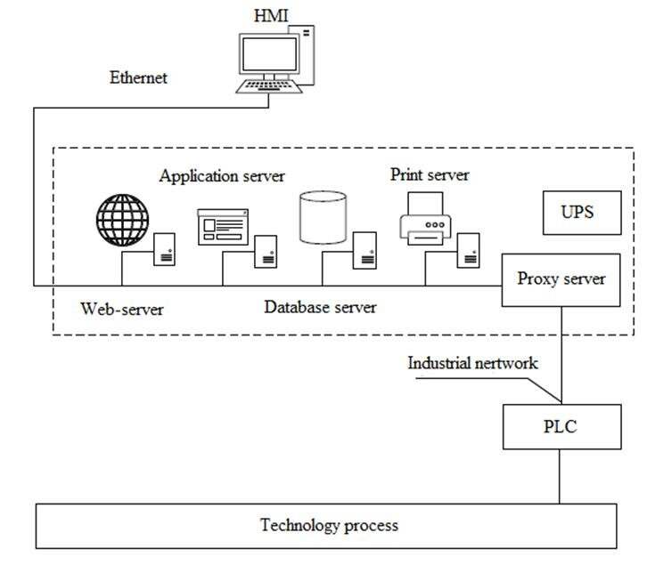
Application cases
А) Automated Process Control Systems (APCS)
Upper layer
Programmable logic
IEC 61131 (synchronous)
IEC 61499 (asynchronous)
“Black-box”
AI
Lower layer
Control
Actions
Field
Signals
https://www.researchgate.net/publication/311662442_Adaptive_Intelligent_Manufacturing_Control_Systems

Slide 11

Application cases
B) Virtual gaming environment: OpenAI Gym (Atari Breakout)
Reward/feedback
rules
Agent
Observations
Model &
Policy
Actions
Left
Fire
Right

Slide 12
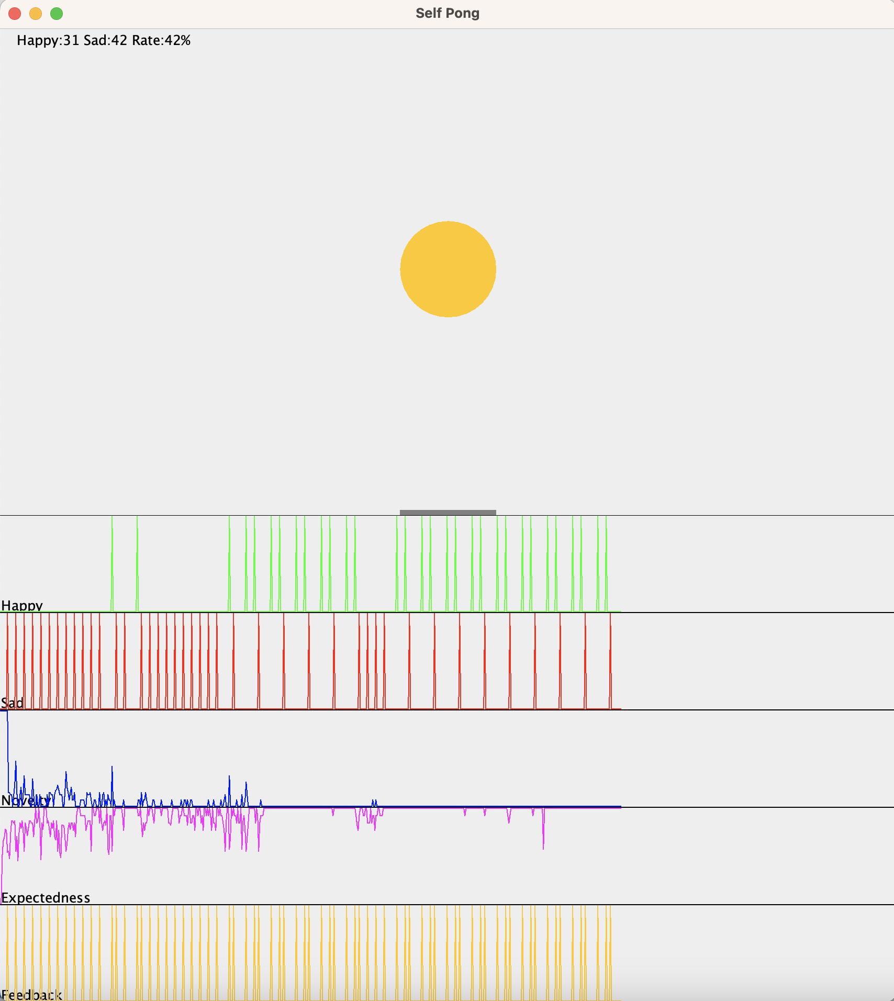

State-based History-aware Artificial Reinforcement Intelligence Kernel (Sharik)
Sad(t)
Happy(t)
Left(t)
Stay(t)
Right(t)
Agent
Comp-
ressor
Xball(t)
Yball(t)
Xracket(t)
Sad(t)
Happy(t)
Predicates
Base Values
Pre-
dictor
Models
Evidence Log
Decider
Action Log
Move(t)
А.Г.Колонин, В.Г.Крюков:
Вычислительная концепция психики,
Статья подана на конференцию
Нейроинформатика-25

Slide 13
Playing “Single-player Ping-Pong” at pixel level
predicate
argument
Pixel
Move
Happy
Boolean
Number
Horizontal
False
True
statement :=
predicate(argument)
Row
Column
Left
Center
Right
Pixel(1,0)
Pixel(4,1)
Happy(False)
=>
Move(Left)
Pixel(0,2)
Pixel(4,2)
Happy(False)
=>
Move(Right)
Pixel(3,4)
Pixel(4,4)
Happy(False)
=>
Move(Left)
Pixel(0,4)
Pixel(4,3)
Happy(True)
=>
Move(Left)
Global
Feedback
https://www.youtube.com/watch?v=2LPLhJKh95g

Slide 14
Playing “Single-player Ping-Pong” at object level
predicate
argument
Position
Happy
Move
RacketX
BallX
BallY
Boolean
Horizontal
Vertical
False
True
statement :=
predicate(argument)
Left
Center
Right
Top
Center
Bottom
BallY(Top)
BallX(Left)
RacketX(Left)
Happy(False)
=> Move(Left)
BallY(Top)
BallX(Center)
RacketX(Center)
Happy(False)
=> Move(Right)
BallY(Bottom)
BallX(Right)
RacketX(Right)
Happy(False)
=> Move(Right)
BallY(Bottom)
BallX(Right)
RacketX(Right)
Happy(True)
=> Move(Left)
Global
Feedback
https://www.youtube.com/watch?v=2LPLhJKh95g

Slide 15
Problem of dimensionality (reduction)
and discreteness (increase)
Re-defining environment in Atari Breakout
Pixel Y
Red
255
160
Pixel Y
Redefine
144
Ball X
Green
Redefine
1
1
Redefine
144
1
1 210
1
255
Redefine
1
1 178
Redefine
1
Pixel X
1
dXt-1
Pixel X
1
1
1
1 178
1 178
50
255
Racket X
1
Racket X
-50 50
255
1
Gray
dXt
Blue
-50
Interpretable representation learning for 3D multi-piece intracellular structures using point clouds
https://www.nature.com/articles/s41592-025-02729-9

Slide 16
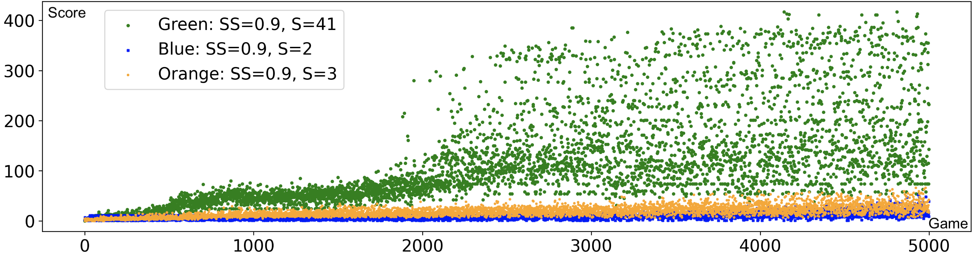
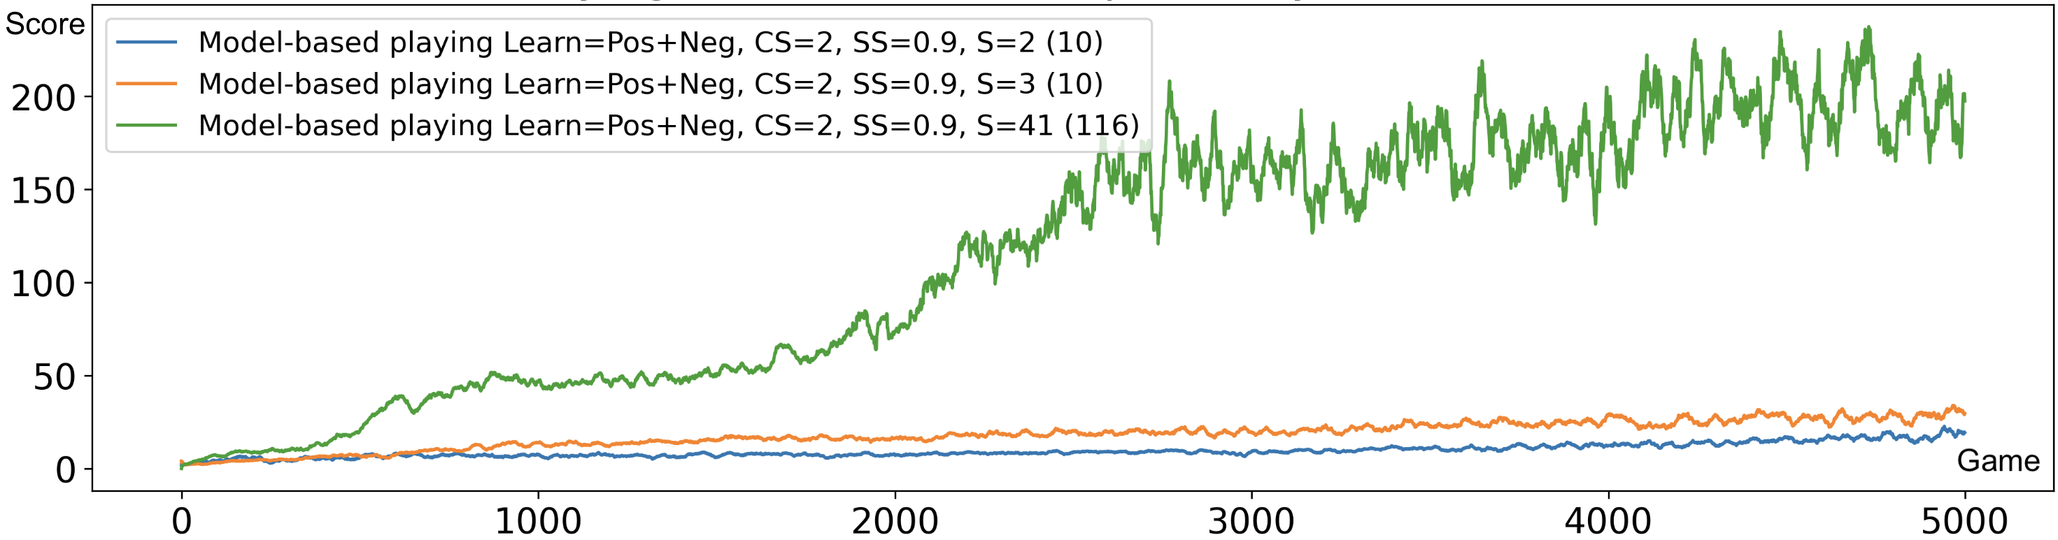
Reinforcement learning – experiential learning and decision making
based and transitions between state series and “global feedback”
Top DQN level
Average DQN level
Average human level
Average DQN level
Average human level

Slide 17
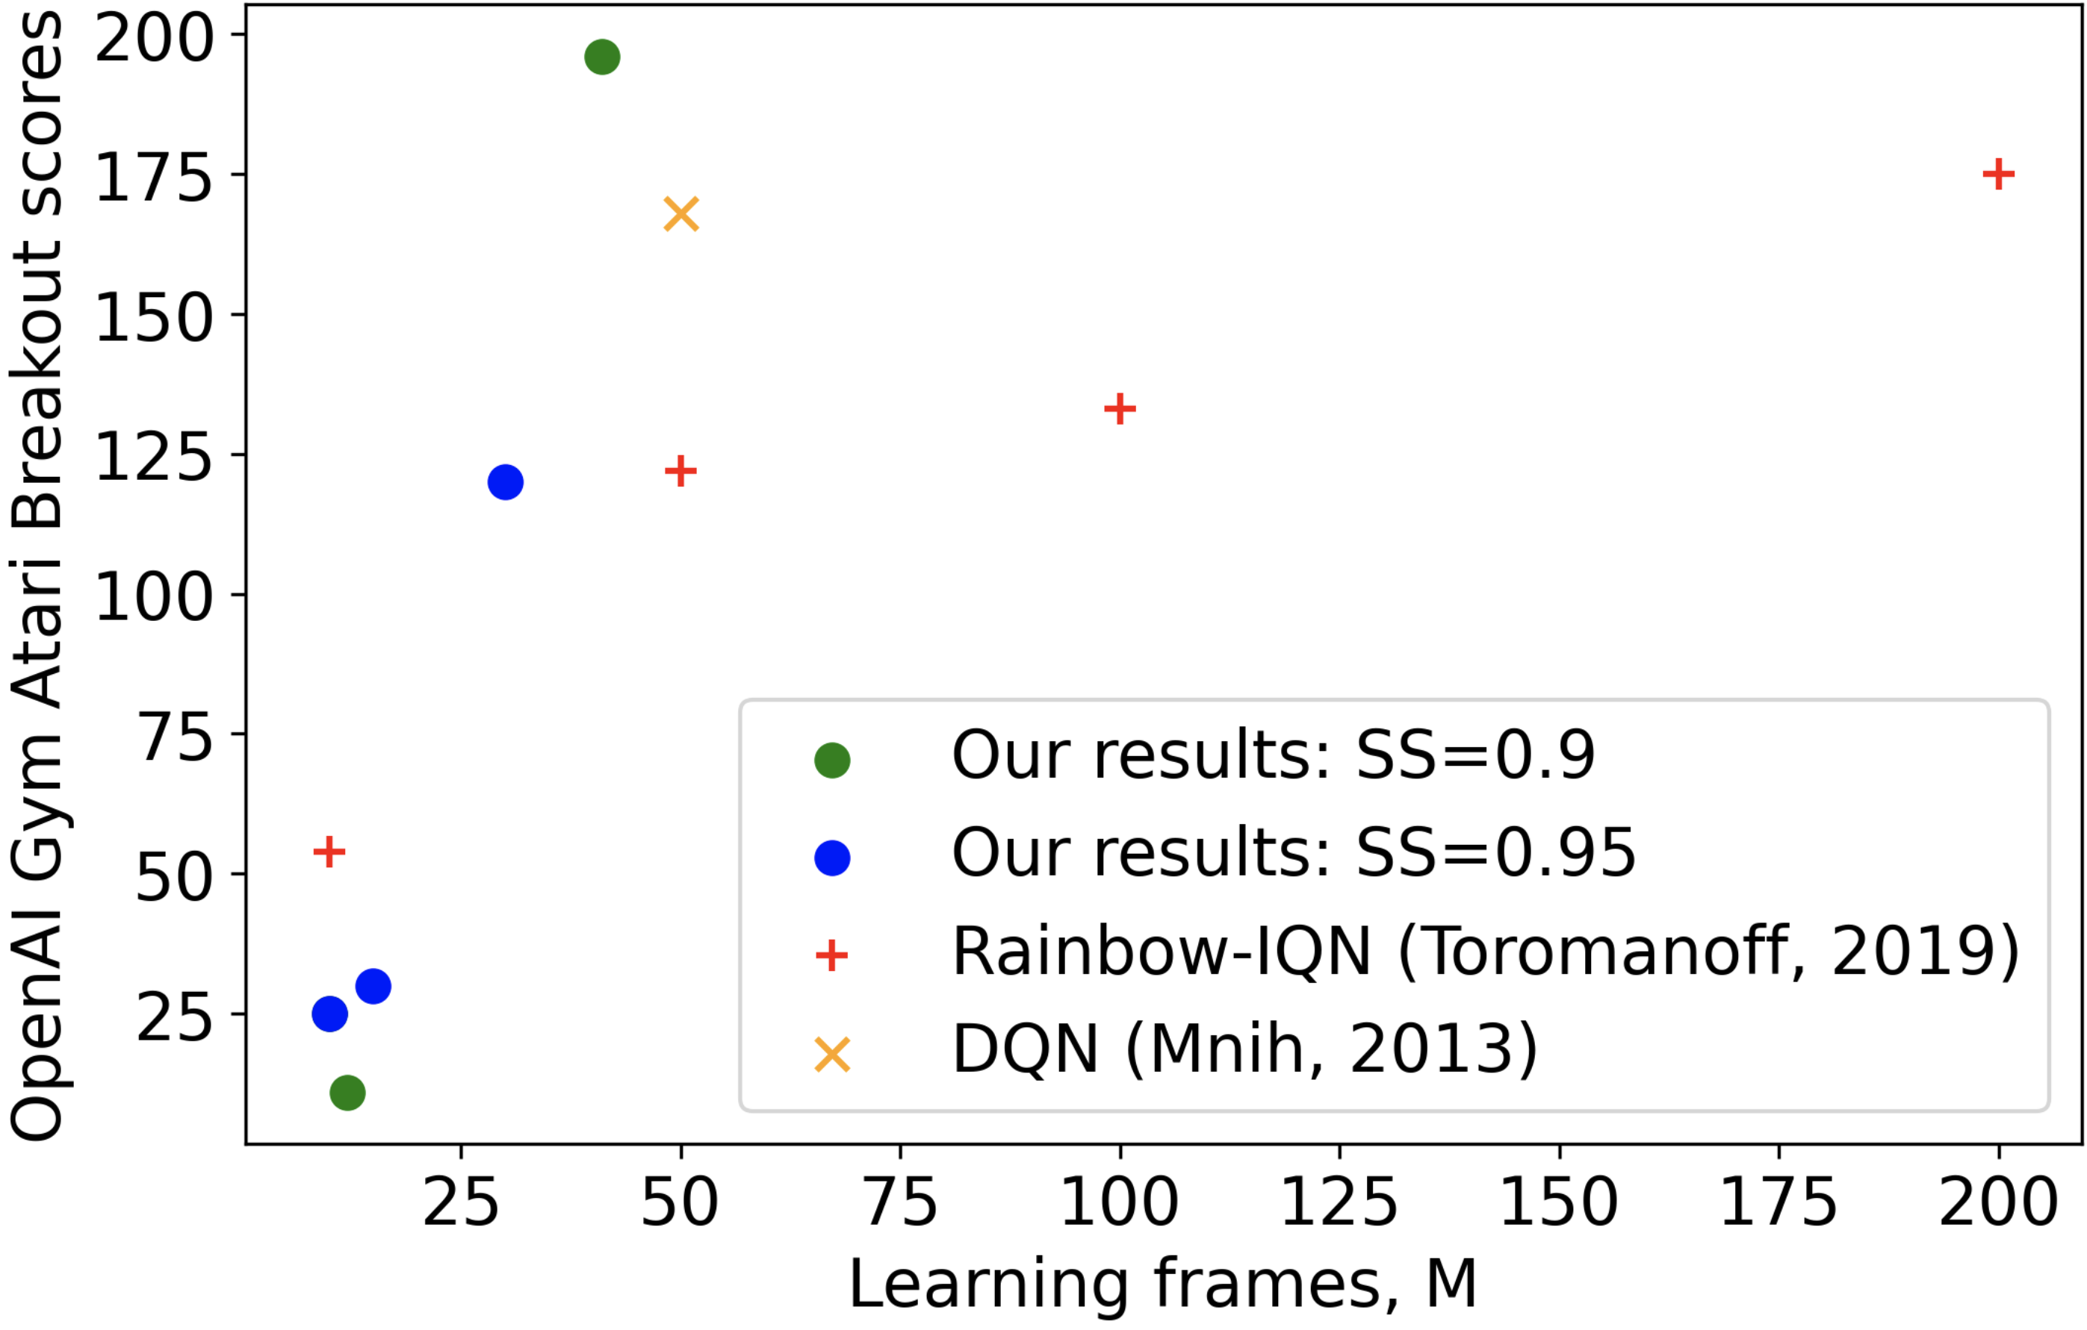
Reinforcement/experiential learning – comparing to “baselines”

Slide 18
What’s next?
1. Make learning stable!
2. Reduce dimensionality in interpretable way!
3. More different environments!
4. Cluster/segment state of space and concurrent execution of the segments (“two-handed pong with two balls”)?
5. Applied cases – industrial automation?
6. Heterarchies of spaces of states and state series?*
7. Formal translation of transition graphs to programmable logic languages (“supercompilation”)?**

Slide 19
Industrial Automation – Interpretable AI Setup Options
Alerts and recommendations
“Super compilation”
- adjustment, optimization and extension of programmable logic based on learned models
(sequential state transition graphs)
Interpretable AI
(“upper layer”)
Control
Actions
Field
Signals
???
Alerts and recommendations
Programmable logic
IEC 61131 (synchronous)
IEC 61499 (asynchronous)
Interpretable AI
(“lower layer”)
Control
Actions
Field
Signals
???

Slide 20


Thank you for attention! Questions?
Anton Kolonin
akolonin@aigents.com
Telegram/GitHub: akolonin
Recording from workshop on the subject
Paper preprint from Neuroinformatics-2025
conference

