Slide 1




Interpretable Natural Language Processing
Applied results and fundamental studies
Anton Kolonin
akolonin@aigents.com
Facebook: akolonin
Telegram: akolonin
AIGENTS
https://agirussia.org
https://aigents.com

Slide 2



The riddle: find English, Chinese and Russian!
Language 1
Language 2
Language 3

Slide 3
The plan
Introduction
Applications
Entity extraction and attribution
Mining for sentiment and cognitive distortions
Language parsing and segmentation
Language generation and question answering
Fundamental studies
Language Learning for Grammar
Language Learning for Lexicon, Punctuation and Morphology

Slide 4
Introduction

Slide 5
Bridging the Symbolic-Subsymbolic gap in NLP
+--------Os-------+
| +-----Ds-----+
+Sp*i+ | +---A--+---Mg--+
| | | | | |
I.p saw.v the rusty.a saw.n sawing.v
Formal
Link Grammar
Deep
Language Model
I
saw
the
rusty
saw
sawing
I
saw
the
rusty
saw
sawing
Explain
0.5
0.5
0.5
0.5
0.5
Sp*I
Os
Ds
A
Mg
Σ
Σ
Σ
Σ
Transfer
“Link”
0.3
0.3
0.3
0.3
AND
AND
Σ
DNF
Soft-DNF
“Disjunct”
1.0
1.0
OR
Σ
Noun
https://link.springer.com/chapter/10.1007/978-3-319-97676-1_11
https://doi.org/10.1007/978-3-030-27005-6_11
https://github.com/singnet/language-learning/
Noun

Slide 6
Discovering NLP patterns (words, punctuation, phrases) for unsupervised language learning (Aigents® “Deep Patterns”)
NOUN
VERB
SUBJECT PREDICATE OBJECT
OR
OR
“procedure”
“drug”
“negative effect”
“positive effect”
“disease”
OR
OR
OR
OR
AND
AND
cold
aspirin
treat
reduces
OR
head
tylenol
acetylsalicylic acid
treats
reduce
existential
frustration
acetaminophen
anxiety
acetaminophen may significantly reduce feelings of existential anxiety
https://ieeexplore.ieee.org/document/7361868
https://github.com/aigents/aigents-java

Slide 7
Applications

Slide 8
Aigents® “Deep Patterns” - Generalized Text Mining
Classification
Case/Relationship
Extraction
Property Attribution
Entity Extraction
Category:
“Healthcare”
IS
Brand: Tylenol
Substance: acetaminophen
Reliability: medium
Effect: positive
Diagnosis: Anxiety
Reporter: Daniel Randles
Entity (Case): “Treatment:
Healing anxiety with Tylenol”
tylenol
acetaminophen
placebo
HAS
significantly
reduce
feelings
study
Here’s the Tylenol twist: Before they began writing, half of each group received acetaminophen while the other half swallowed a placebo. Even among those people who wrote about death, the Tylenol takers set bail at roughly $300—a sign that acetaminophen may significantly reduce feelings of existential anxiety, explains study lead author Daniel Randles, a PhD candidate in UBC’s department of... psychology.
acetaminophen
may
reduce
anxiety
explains
“acetaminophen may significantly reduce feelings of existential anxiety, explains study lead author Daniel Randles”
acetaminophen may significantly reduce feelings of existential anxiety, explains study lead author Daniel Randles.
https://ieeexplore.ieee.org/document/7361868?arnumber=7361868
https://github.com/aigents/aigents-java

Slide 9
Aigents® “Deep Patterns” - Property Attribution
<set> := <disjunctive-set> | <conjunctive-set> | <M-skip-N-gram>
<disjunctive-set> := { <pattern> * }
<conjunctive-set> := ( <pattern> * )
<N-gram> := [ <pattern> * ]
<pattern> := <token> | <regexp> | <variable> | <set>
Variables may have domain restrictions
in ontology and/or refer to other
patterns as subgraphs
Example:
{[$description catheter] [$coating coating] [$inner-diameter
{diameter inner-diameter}] [$tip tip] [$pattern pattern]}
X
“Convey Guiding Catheter. Unique hydrophilic coating.
Small atraumatic soft tip. Ultra-thin 1 × 2 flat wire braid pattern”
=
{ coating : "hydrophillic", description : "convey guiding",
pattern : "ultra-thin 1 × 2 flat wire braid", tip : "soft" }
https://ieeexplore.ieee.org/document/7361868?arnumber=7361868
https://github.com/aigents/aigents-java

Slide 10

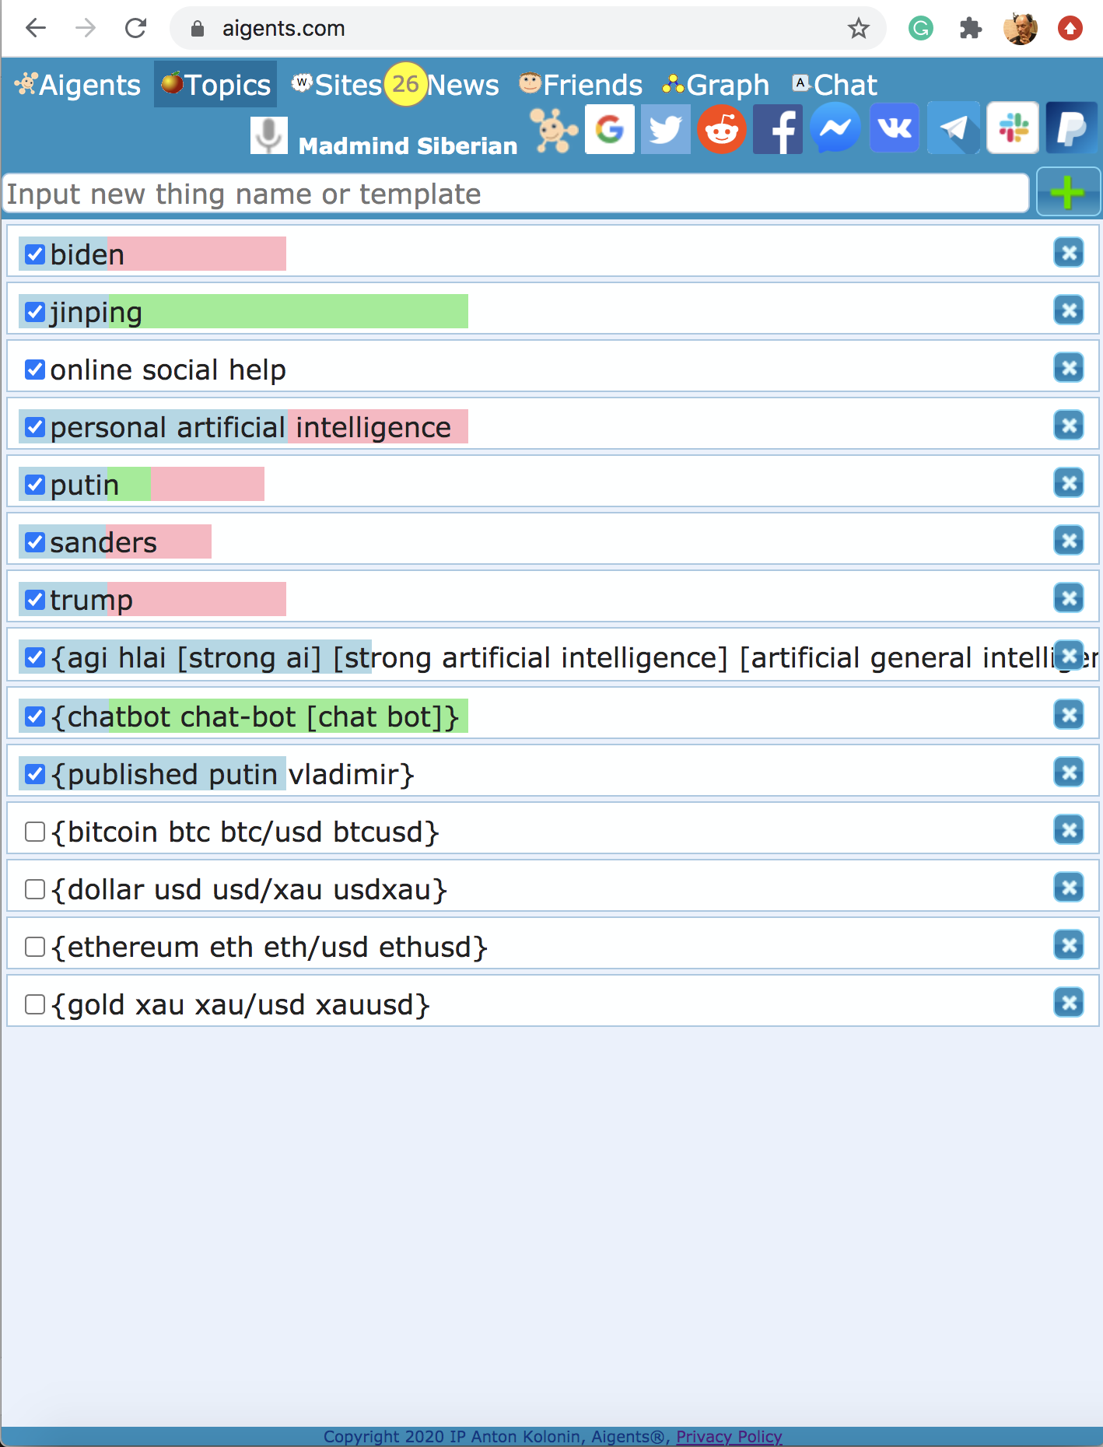
N-M-skip-grams for Aigents® Sentiment Analysis
N-M-skip-grams for Aigents® Sentiment Analysis
https://blog.singularitynet.io/aigents-sentiment-detection-personal-and-social-relevant-news-be989d73b381

Slide 11
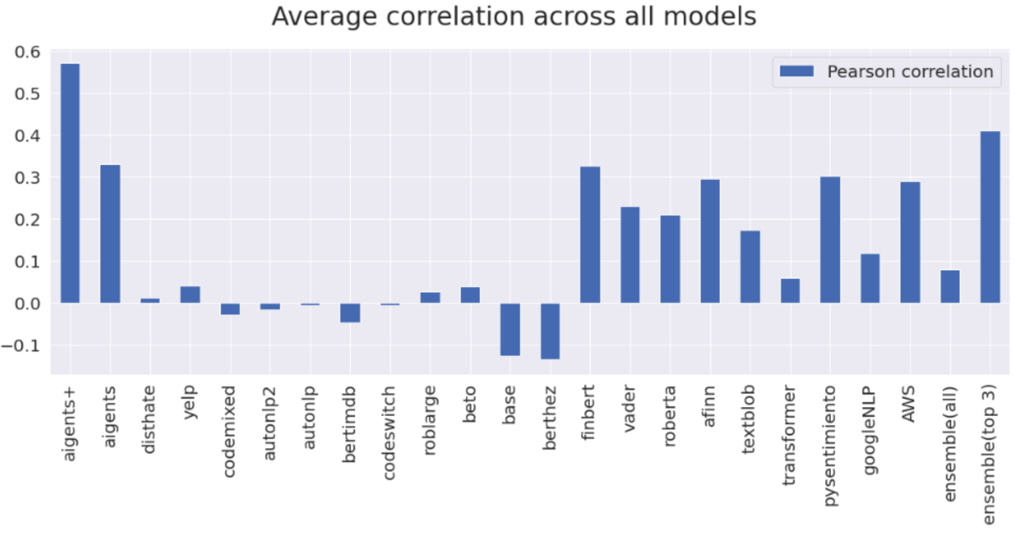
Sentiment Analysis – Models’ Fight
Aigents® “interpretable” model vs. Bert fine-tuned on financial data
https://arxiv.org/abs/2204.10185
https://blog.singularitynet.io/aigents-sentiment-detection-personal-and-social-relevant-news-be989d73b381

Slide 12
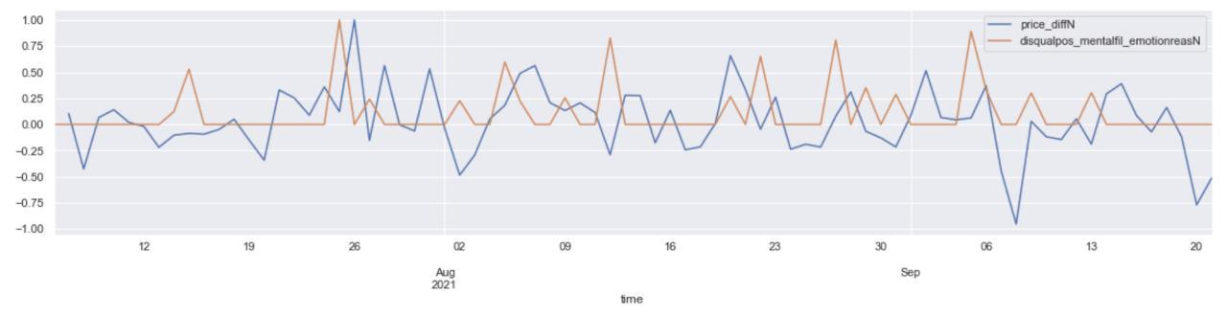
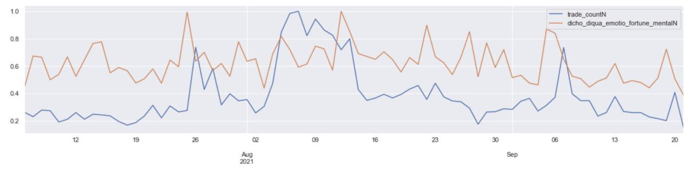
Mining Cognitive Distortions for FinTech
Price difference/derivative (BTC/USDT)
Disqualify positive
Mental filtering
Emotion reasoning
Dichotomy reasoning
Disqualify positive
Fortune telling
Mental filtering
Emotion reasoning
Trade count (BTC/USDT)
https://arxiv.org/pdf/2303.02342.pdf
https://link.springer.com/chapter/10.1007/978-3-031-19907-3_4
https://www.pnas.org/content/118/30/e2102061118

Slide 13
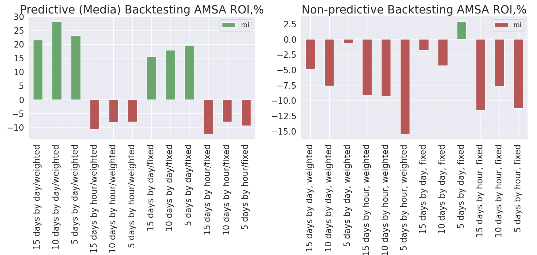
Applying Cognitive Distortions in Crypto-Trading
https://arxiv.org/abs/2303.02342
https://link.springer.com/chapter/10.1007/978-3-031-33469-6_19

Slide 14

Grammar & Ontology Graph - Structure
Hand
giving
#noun
#verb
#body-part
#interaction
#process
#language
#mood
#hand_giving
#english
#russian
#indicative
#imperative
#hand
#give
SEQ
->
SEQ
<-
AND
AND
hand
give
given
рука
руку
подана
подай

Slide 15
Grammar & Ontology Graph - Generation
Hand
giving
#noun
#verb
#body-part
#interaction
#process
#language
#mood
#hand_giving
#english
#russian
#indicative
#imperative
#hand
#give
SEQ
->
SEQ
<-
AND
AND
AND
SEQ
->
SEQ
->
hand
give
given
рука
руку
подана
подай
руку
подай
подай
руку

Slide 16
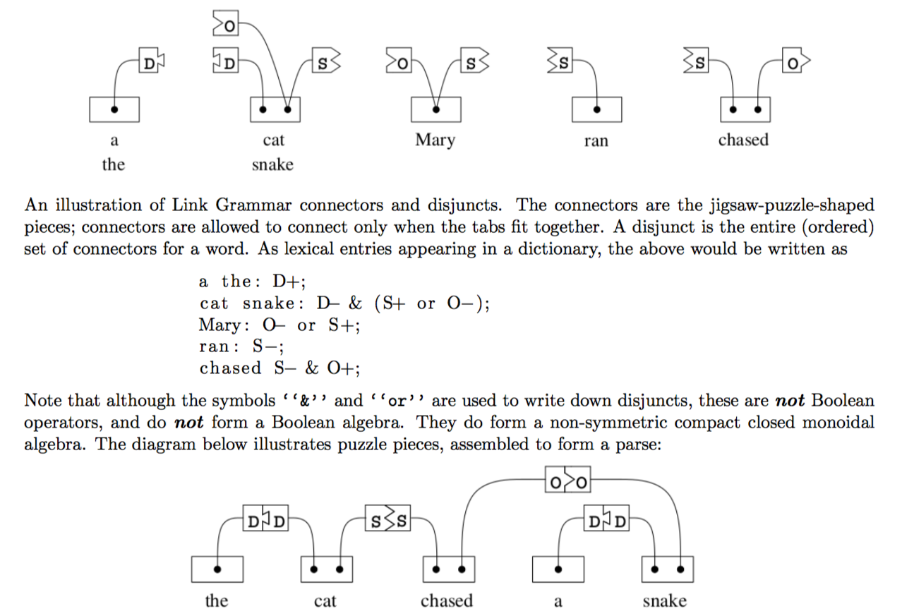
Link Grammar Connectors & Disjuncts
https://arxiv.org/abs/1401.3372
B. Goertzel, L. Vepstas, 2014

Slide 17
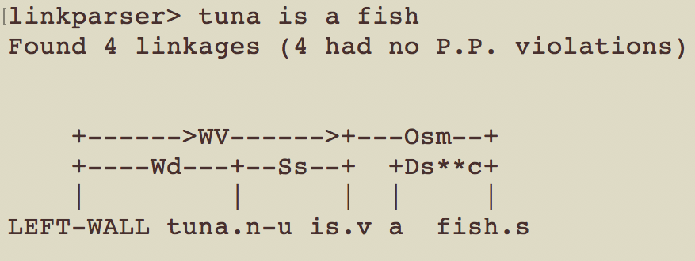
Link Grammar – not just for parsing only
Parsing
Segmentation
Generation
Dictionary
file
Tuna is a fish.
anne smothered a
smile there was enough
cold water thrown to
discourage any society
caught
mouse
cat
a
the
Loader
Parser
Segment(er)
Link
Grammar
Dictionary
Generator
Anne smothered a
smile.
There was enough
cold water thrown to
discourage any society.
The cat caught
a mouse.
Code: https://github.com/aigents/aigents-java-nlp
Segmentation: https://ieeexplore.ieee.org/document/9303220
Generation: https://arxiv.org/abs/2105.00830
V. Ramesh, A. Kolonin, 2020-2021

Slide 18
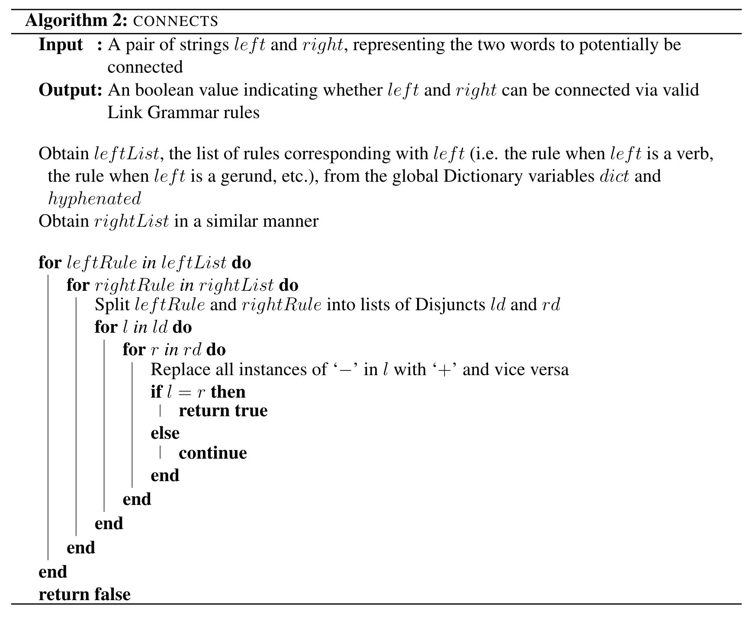
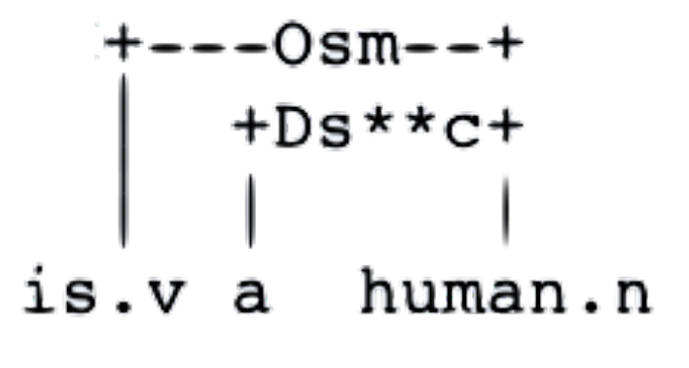
Grammatical Language Generation
Generator determines what sentences can be formed from a given list of words via valid Link Grammar rules:
1) Given a list of words, the Generator determines a subset of all orderings of those words that satisfies initial checks of the planarity and connectivity metarules.
2) For each ordering in the subset, the Generator determines if that ordering is valid; specifically, it ensures that every pair of consecutive words can be connected via links part of the Dictionary objects. To do so, the Generator uses the connects() function, which returns a boolean value indicating whether its two parameters left and right can be linked together.
Planarity metarule: links do not cross
Connectivity metarule: links and words of a sentence must form a connected graph that can be completely traversed via one path
connects() is not always applicable. For instance, when the determiner “a” is present in the phrase “is a human,” the links are not “is” → “a” and “a” → “human” but rather “is” → “human” and “a” → “human” as shown in this Link Grammar parse:
a
The
mouse
caught
cat
https://arxiv.org/abs/2105.00830 V. Ramesh, A. Kolonin, 2021

Slide 19
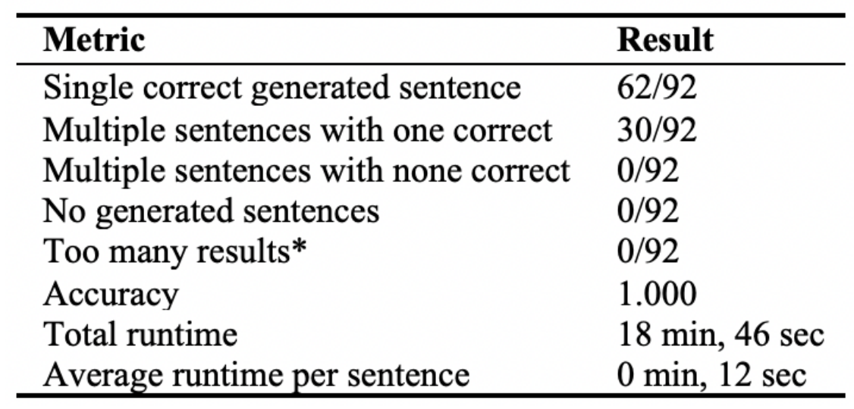
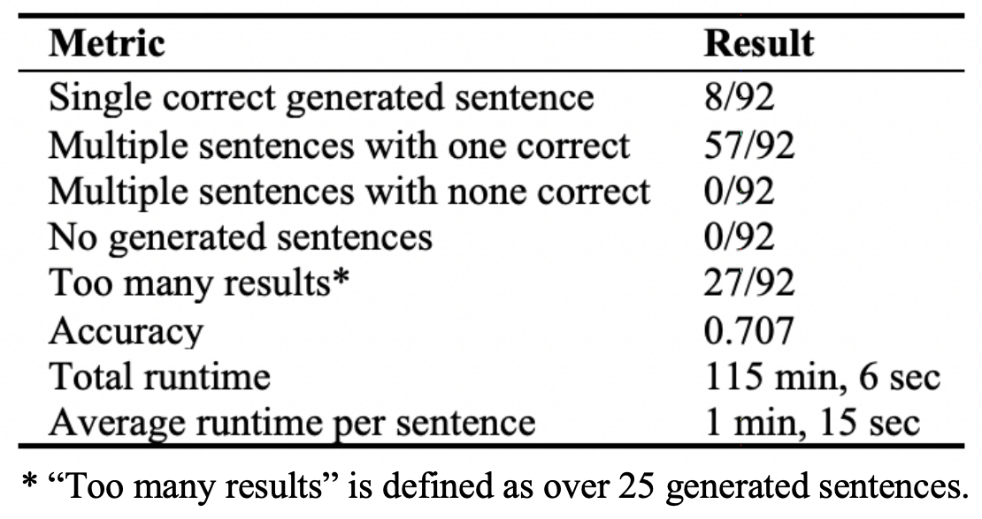
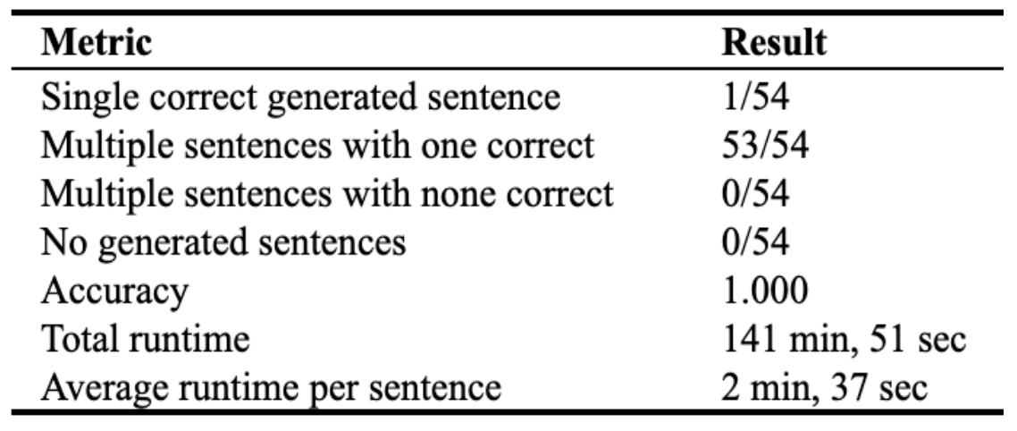
Grammatical Language Generation - Results
Our algorithm was primarily tested on 92 sentences with words all part of SingularityNET’s “small world” POC-English corpus. For this purpose, we have used the Link Grammar dictionary (automatically inferred from high quality Link Grammar parses created by SingularityNET’s ULL pipeline) containing 42 total words and 5 total word clusters.
When tested on the same 92 sentences while using the complete Link Grammar dictionary for English, the algorithm achieved the following results. The decrease in “Single correct generated sentence” and increase in “Multiple sentences with one correct” is a direct result of the increased grammatical and semantic ambiguity from using Link Grammar instead of “small world” grammar. Since the “small world” grammar was created from the “small world” corpus itself, each of the words in the corpus contains only a subset of the grammatical or semantic contexts that Link Grammar does.
Our NLG architecture was also tested on 54 sentences part of Charles Keller’s production of Lucy Maud Montgomery’s “Anne’s House of Dreams” as found in the Gutenberg Children corpus and performed as follows
POC-English – Proof-of-Concept corpus made of artificially selected sentences on limited number of topics (“small world”).
Gutenberg Children (GC) - compendium of books for children contained within Project Gutenberg (https://www.gutenberg.org), following the selection used for the Children’s Book Test of the Babi CBT corpus https://research.fb.com/down-loads/babi/
https://github.com/aigents/aigents-java-nlp
https://arxiv.org/abs/2105.00830 V. Ramesh, A. Kolonin, 2021

Slide 20
Grammatical Generation for Question Answering
Applications
Limitations
Grammatical ambiguity: same word may have different roles in a sentence
“I saw the saw.”
First “saw” – verb, second “saw” – noun (different sets of grammar rules for each instance of “saw” – semantic/word sense disambiguation)
Subject-object ambiguity: a specific case of grammatical ambiguity which refers to the potential interchangeability of the subject and object in a sentence
[“mouse”, “a”, “the”, “caught”, “cat”]
Result 1: “The cat caught a mouse.”
Result 2: “The mouse caught a cat.”
Both results are grammatically valid, but “The cat caught a mouse” is more contextually valid. Implementing grammatical and semantic disambiguation to solve these issues will be a product of our future work, along with extending the algorithm’s generation capabilities to languages other than English (including those that require heavy morphology usage, such as Russian).
Question Answering
Natural Language Comprehension (NLC)
Performing semantic
interpretation (extract
concept represented
by query and determine
relationships between
parts of the query
Parsing the question
(input query) based on
formal grammar
(Link Grammar)
Natural Language Generation (NLG)
Semantic query
execution (determining
answer to query based
on relationships from
the NLC step
Construct grammatically
valid sentences from the
words associated with the
semantic relationships
derived during query
execution
We are here
https://github.com/aigents/aigents-java-nlp
https://arxiv.org/abs/2105.00830 V. Ramesh, A. Kolonin, 2021

Slide 21
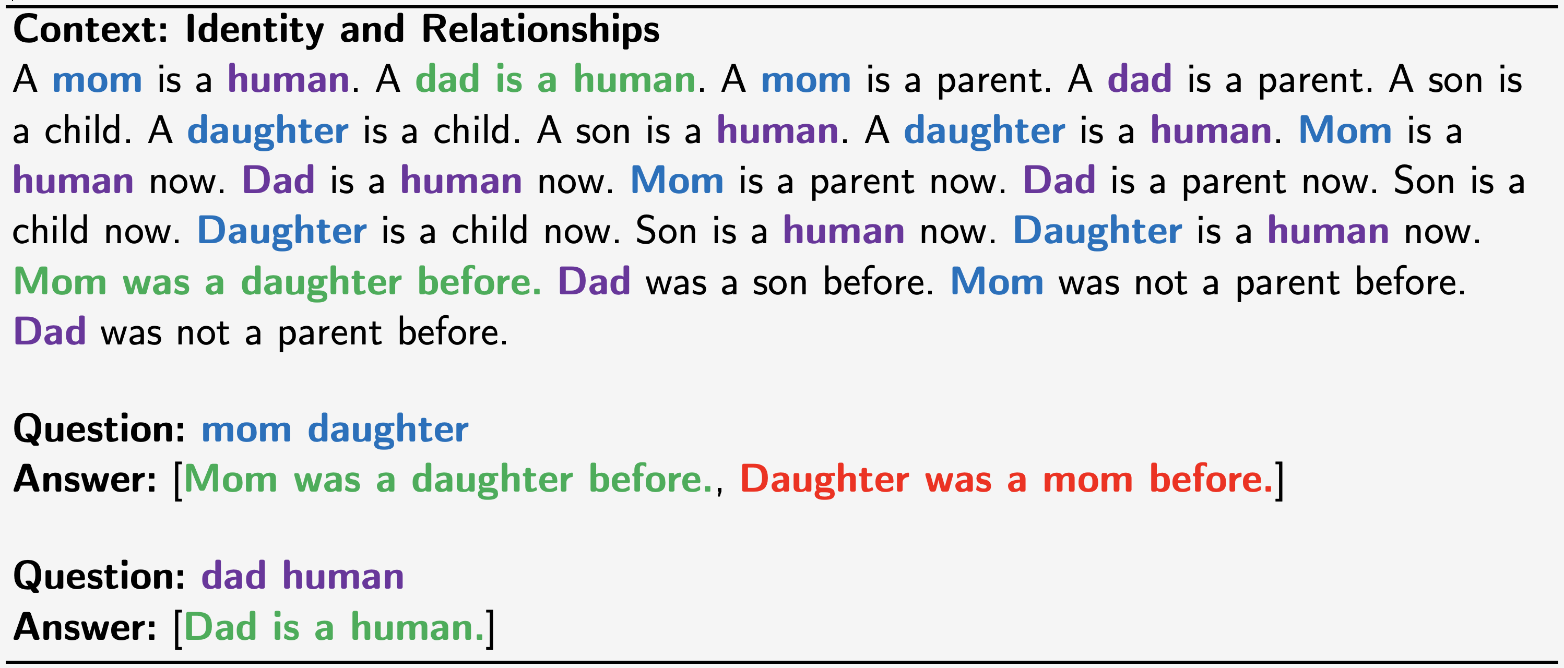
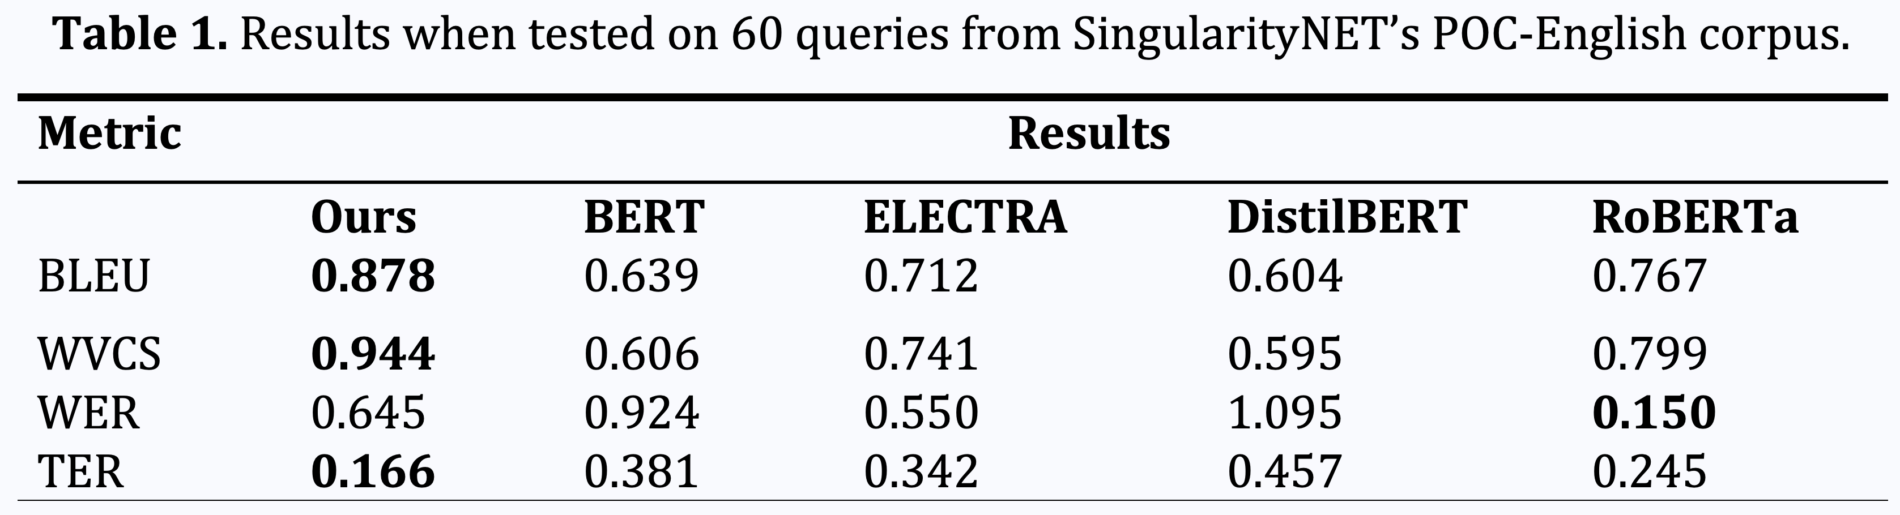
Question Answering with Link Grammar
https://www.youtube.com/watch?v=MKlOqO9FRq0
https://link.springer.com/chapter/10.1007/978-3-030-93758-4_22 V. Ramesh, A. Kolonin, 2021

Slide 22
Fundamental studies

Slide 23
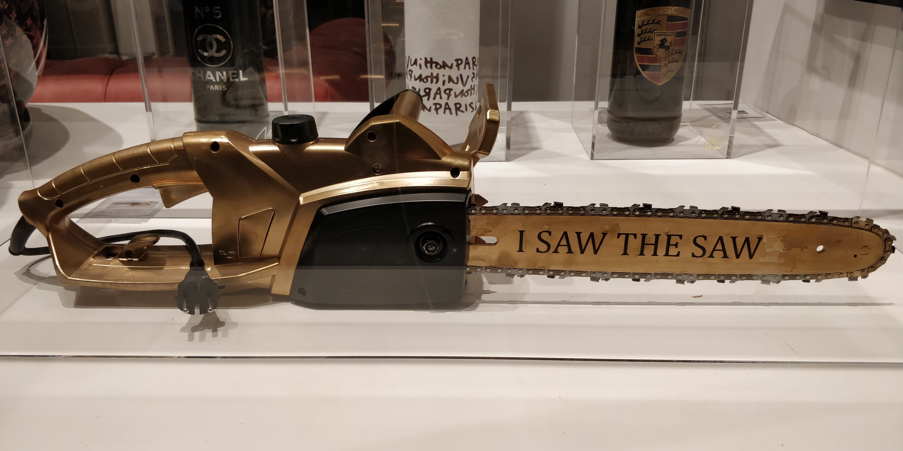


Unsupervised Link Grammar Learning
PRONOUN
ARTICLE
VERB
NOUN
https://www.springerprofessional.de/unsupervised-language-learning-in-opencog/15995030
https://www.springerprofessional.de/en/programmatic-link-grammar-induction-for-unsupervised-language-le/17020348

Slide 24
Text Parsing for Link Grammar
Text Parser
Output Parses
Mutual
Information
Observer
Mutual
Information
Minimum
Spanning
Tree
(MST)
Parser
I saw the saw
I saw the truth
I see the sea
Input Corpus
Google BERT
DNN Training
and
Contextual Information
Extraction
I saw the saw
I saw the truth
I see the sea
Contextual
Information
Grammar Learner
“Random” Parser
Link Grammar
“Sequential” (“Linked List”) Parser
Subj
Verb
Det
Obj
Link Grammar Parser
I
the
sea
see
truth
saw
https://www.springerprofessional.de/unsupervised-language-learning-in-opencog/15995030
https://www.springerprofessional.de/en/programmatic-link-grammar-induction-for-unsupervised-language-le/17020348

Slide 25
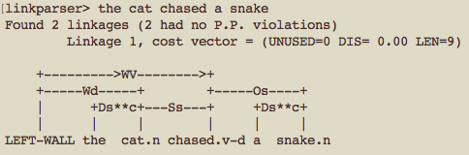
MST Parses vs. Link Parses
Corpus:
...
There is a snake
The boy saw a snake
The dog chased a snake
The cat chased a snake
...
English
Grammar
English
Link Grammar
MST Parser
MI Observer
Mutual
Information
Link Parser
Parser
Link Parse:
MST Parse:
the cat chased a snake
0 ###LEFT-WALL### 2 cat
0 ###LEFT-WALL### 3 chased
1 the 2 cat
2 cat 3 chased
3 chased 5 snake
4 a 5 snake
LEFT-WALL

Slide 26
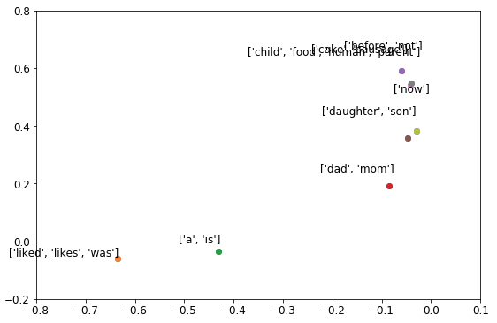
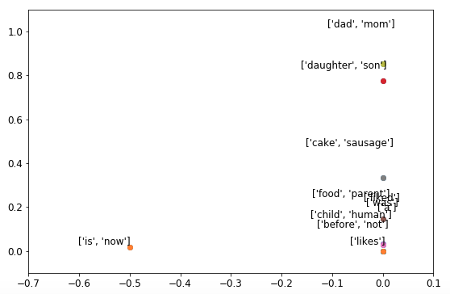
Learning Grammatical and Semantic Categories in Vector Spaces of Connectors and Disjuncts
POC-English
(Connectors)
POC-English
(Disjuncts)
https://github.com/singnet/language-learning
https://www.youtube.com/watch?v=cwgtcOfA3KI
https://www.springerprofessional.de/en/programmatic-link-grammar-induction-for-unsupervised-language-le/17020348

Slide 27
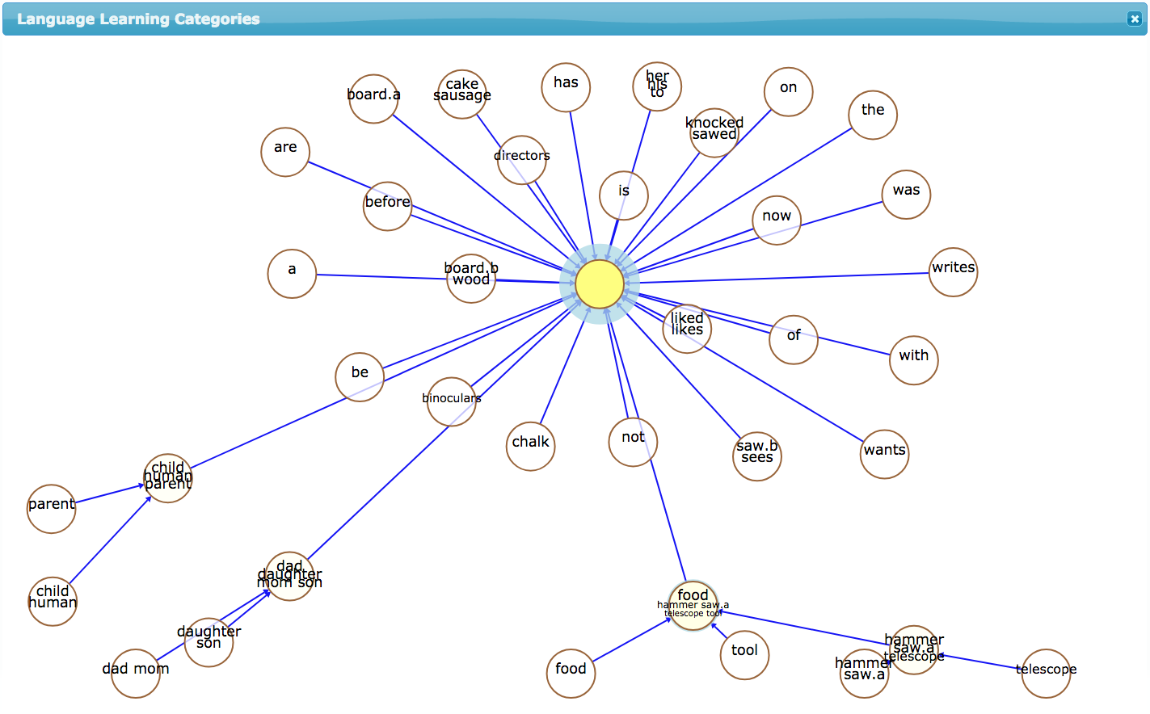
Learning Grammar and Ontology from Parses
POC-English
corpus
https://www.springerprofessional.de/unsupervised-language-learning-in-opencog/15995030
https://www.springerprofessional.de/en/programmatic-link-grammar-induction-for-unsupervised-language-le/17020348

Slide 28
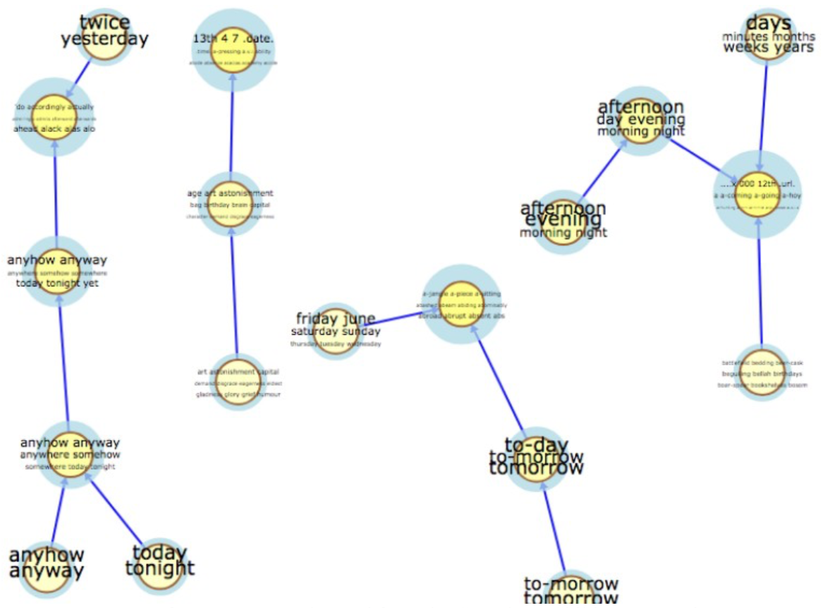
Learning Grammar and Ontology from Parses
Gutenberg
Children
corpus
https://www.springerprofessional.de/unsupervised-language-learning-in-opencog/15995030
https://www.springerprofessional.de/en/programmatic-link-grammar-induction-for-unsupervised-language-le/17020348

Slide 29
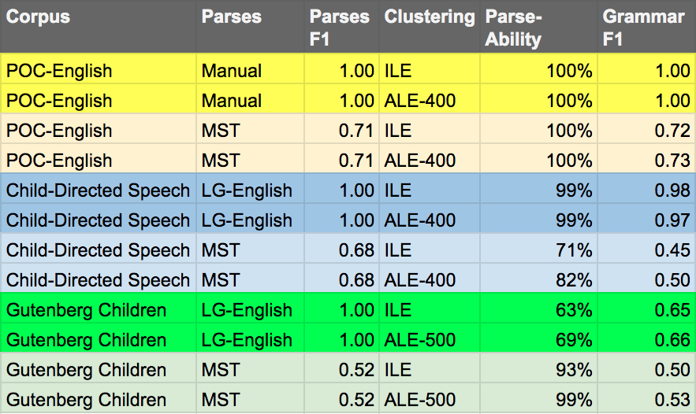
Grammar Learning F1 Across the Corpora
https://www.springerprofessional.de/unsupervised-language-learning-in-opencog/15995030
https://www.springerprofessional.de/en/programmatic-link-grammar-induction-for-unsupervised-language-le/17020348

Slide 30
Learning Lexicon, Punctuation, Morphology and Grammar
Clustering, Segmentation and Parsing
Vowels
Consonants
aa i i e
W
hh t s pp nn g
What is happening
Sub-word segmentation
Tokenization

Slide 31
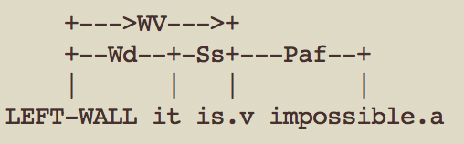
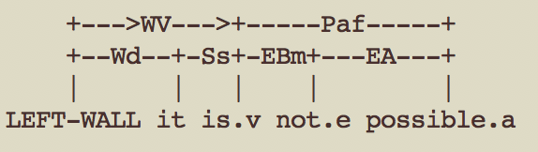
Blurring boundaries between grammatical parsing and
morphological parsing causes tokenization ambiguity
这不可能
(Google)
这 不 可能
(Jieba)

Slide 32
Unsupervised Learning for Text Segmentation
based on Probability and Uncertainty Measures
to
168M
people
10000M
do
130M
times
Metrics/Indicators:
Mutual Information¹
Conditional Probability^{1,2}
Transition Freedom^{2,3}
1930M
5
4
how
1230M
many
14M
countries
892M
long
4M
states
330M
1
are
132M
you
¹ https://scholarsarchive.byu.edu/cgi/viewcontent.cgi?article=6983&context=etd
² https://www.ncbi.nlm.nih.gov/pmc/articles/PMC2655800/
³ Karl Friston. The free-energy principle: a unified brain theory? https://www.nature.com/articles/nrn2787

Slide 33
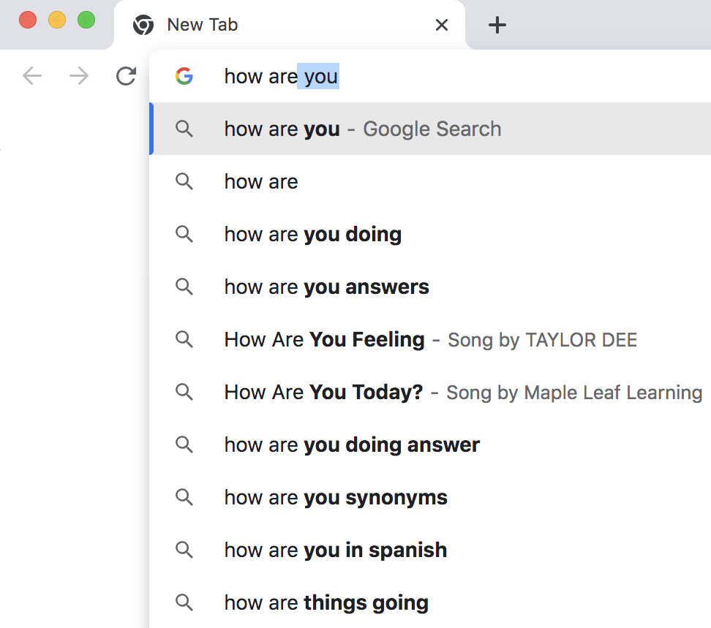
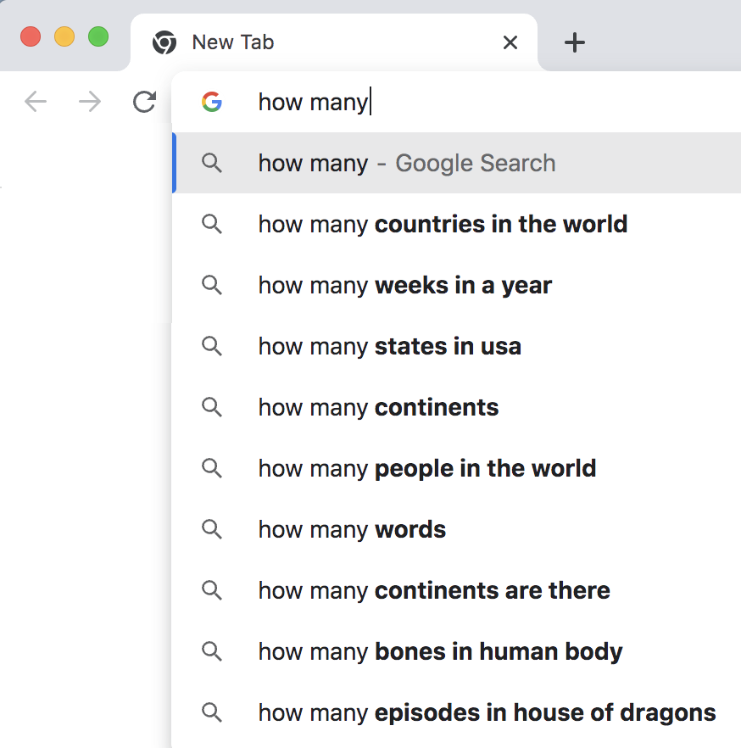
Minimizing Uncertainty
https://aclanthology.org/2022.emnlp-main.239/
https://arxiv.org/pdf/2303.02427.pdf

Slide 34

Unsupervised Text Segmentation (Tokenization)
Metrics/Indicators:
Ngram (Character)
Conditional
Probability
(of Transition)
P(Ngram_{n+1})/P(Ngram_{n})
P(“m ”)/P(“m”)
False positives
False negatives

Slide 35
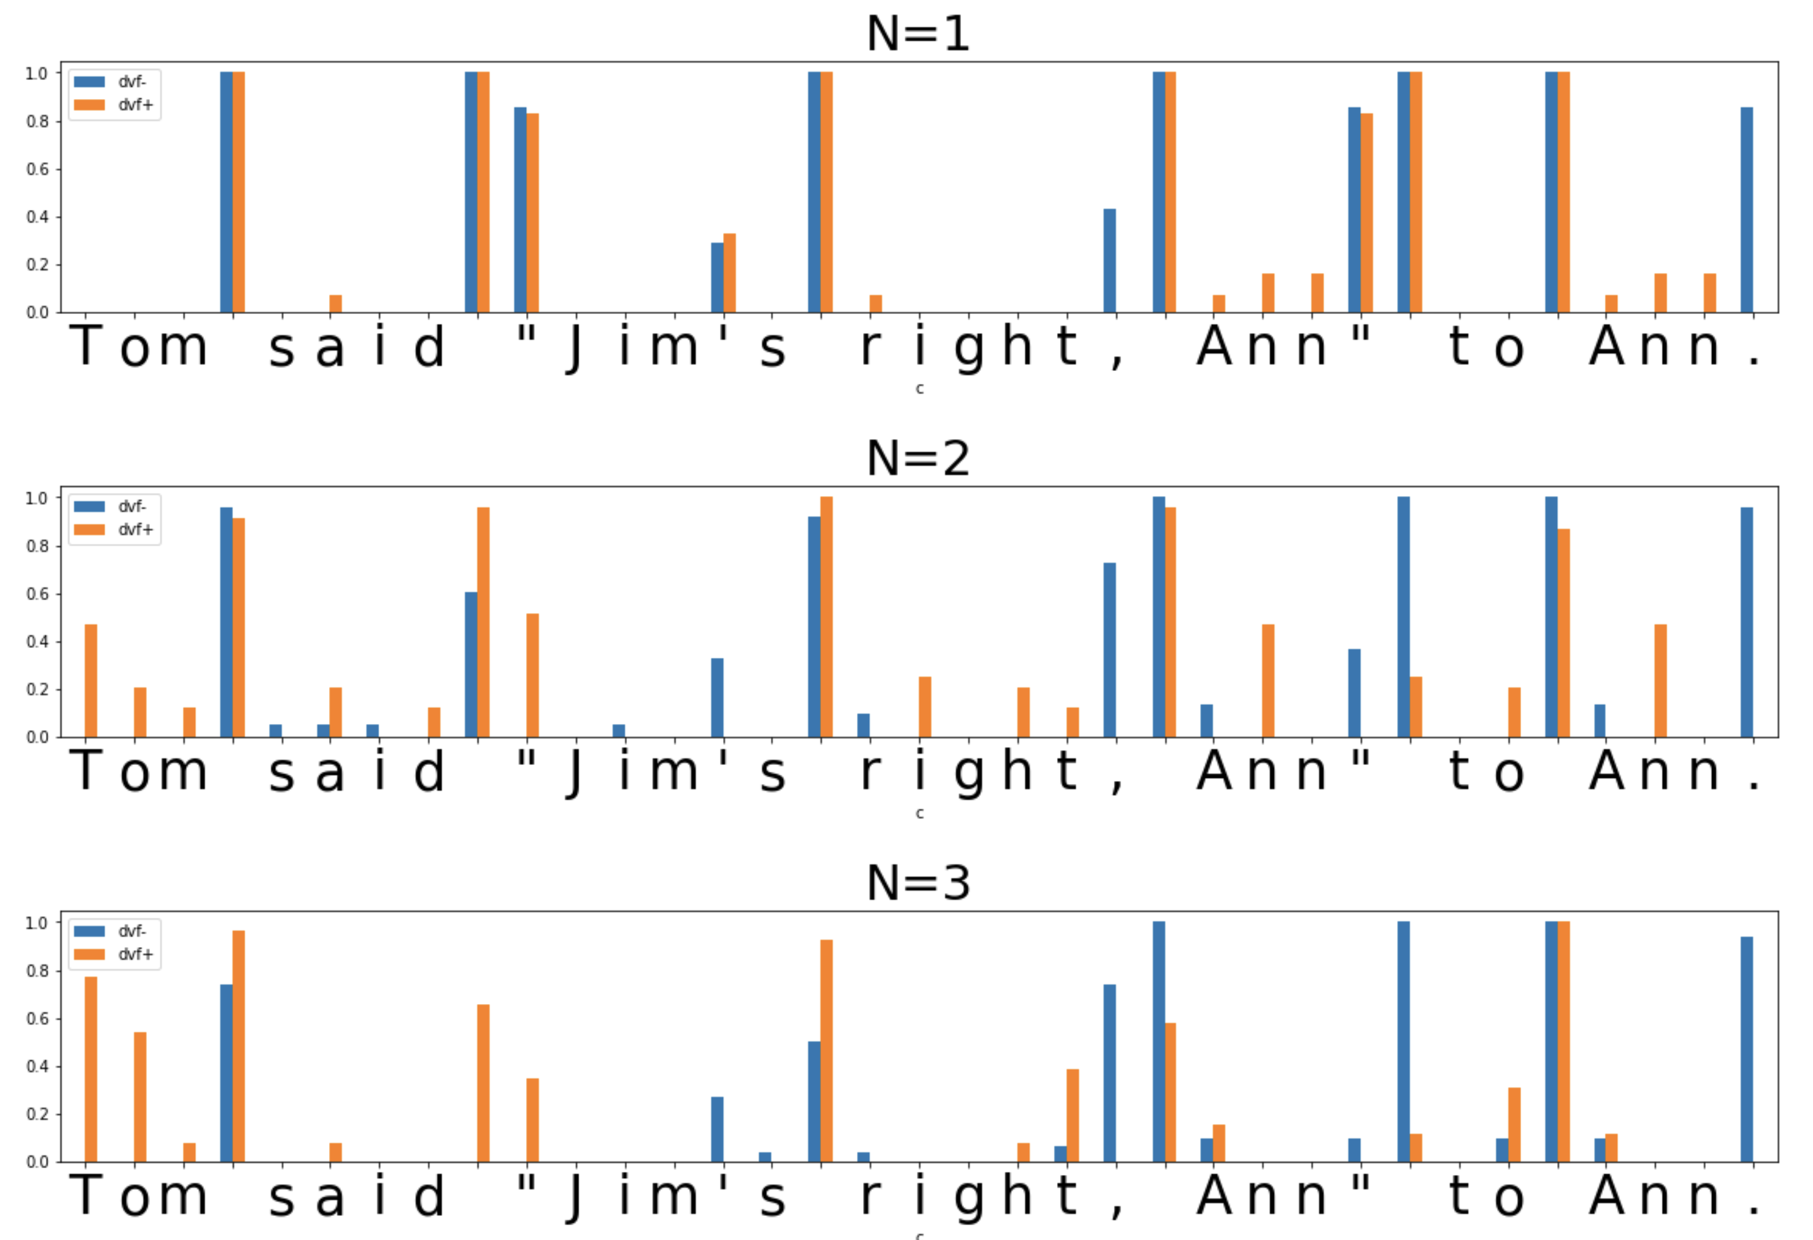
Unsupervised Text Segmentation (Tokenization)
Metrics/
Indicators:
Transition
Freedom
Deviation
(varying “N”
of N-gram)
False positive
False negative

Slide 36
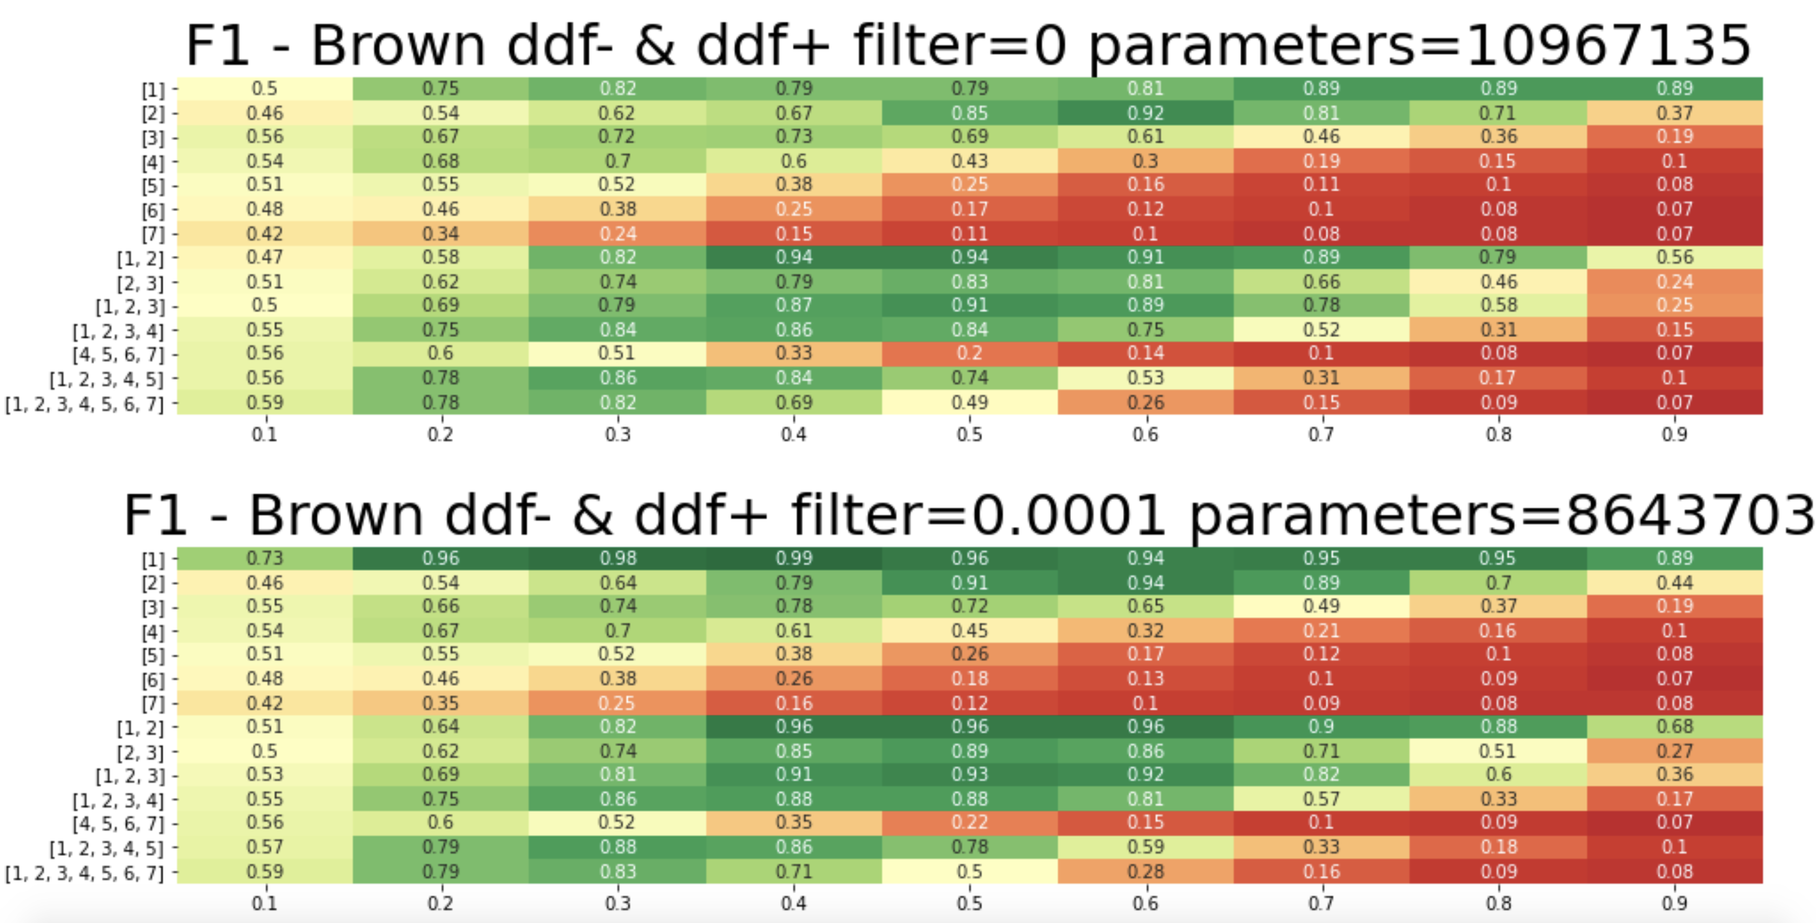
Unsupervised Text Segmentation (Tokenization)
English
Hyper-
Parameters:
Metric:
Transition
Freedom
Threshold
for model
compression
Combination
of Ngram N-s
Threshold for
segmentation

Slide 37
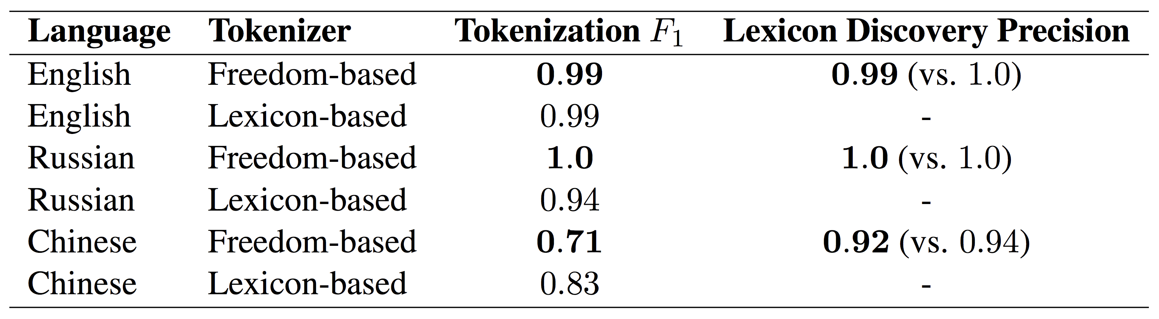
Results – Freedom-based Tokenization against
Lexicon-based one (referring to Rule-based)
*
*
*
*Lexicon-based Tokenization - greedy/beam search on word length (optimal) or frequency
Preprint: https://arxiv.org/abs/2205.11443
EMNLP-2022

Slide 38




Unsupervised Character Category Learning
Agglomerative Clustering in space of Transitions
RusAge Test/Small, Cosine Similarity

Slide 39
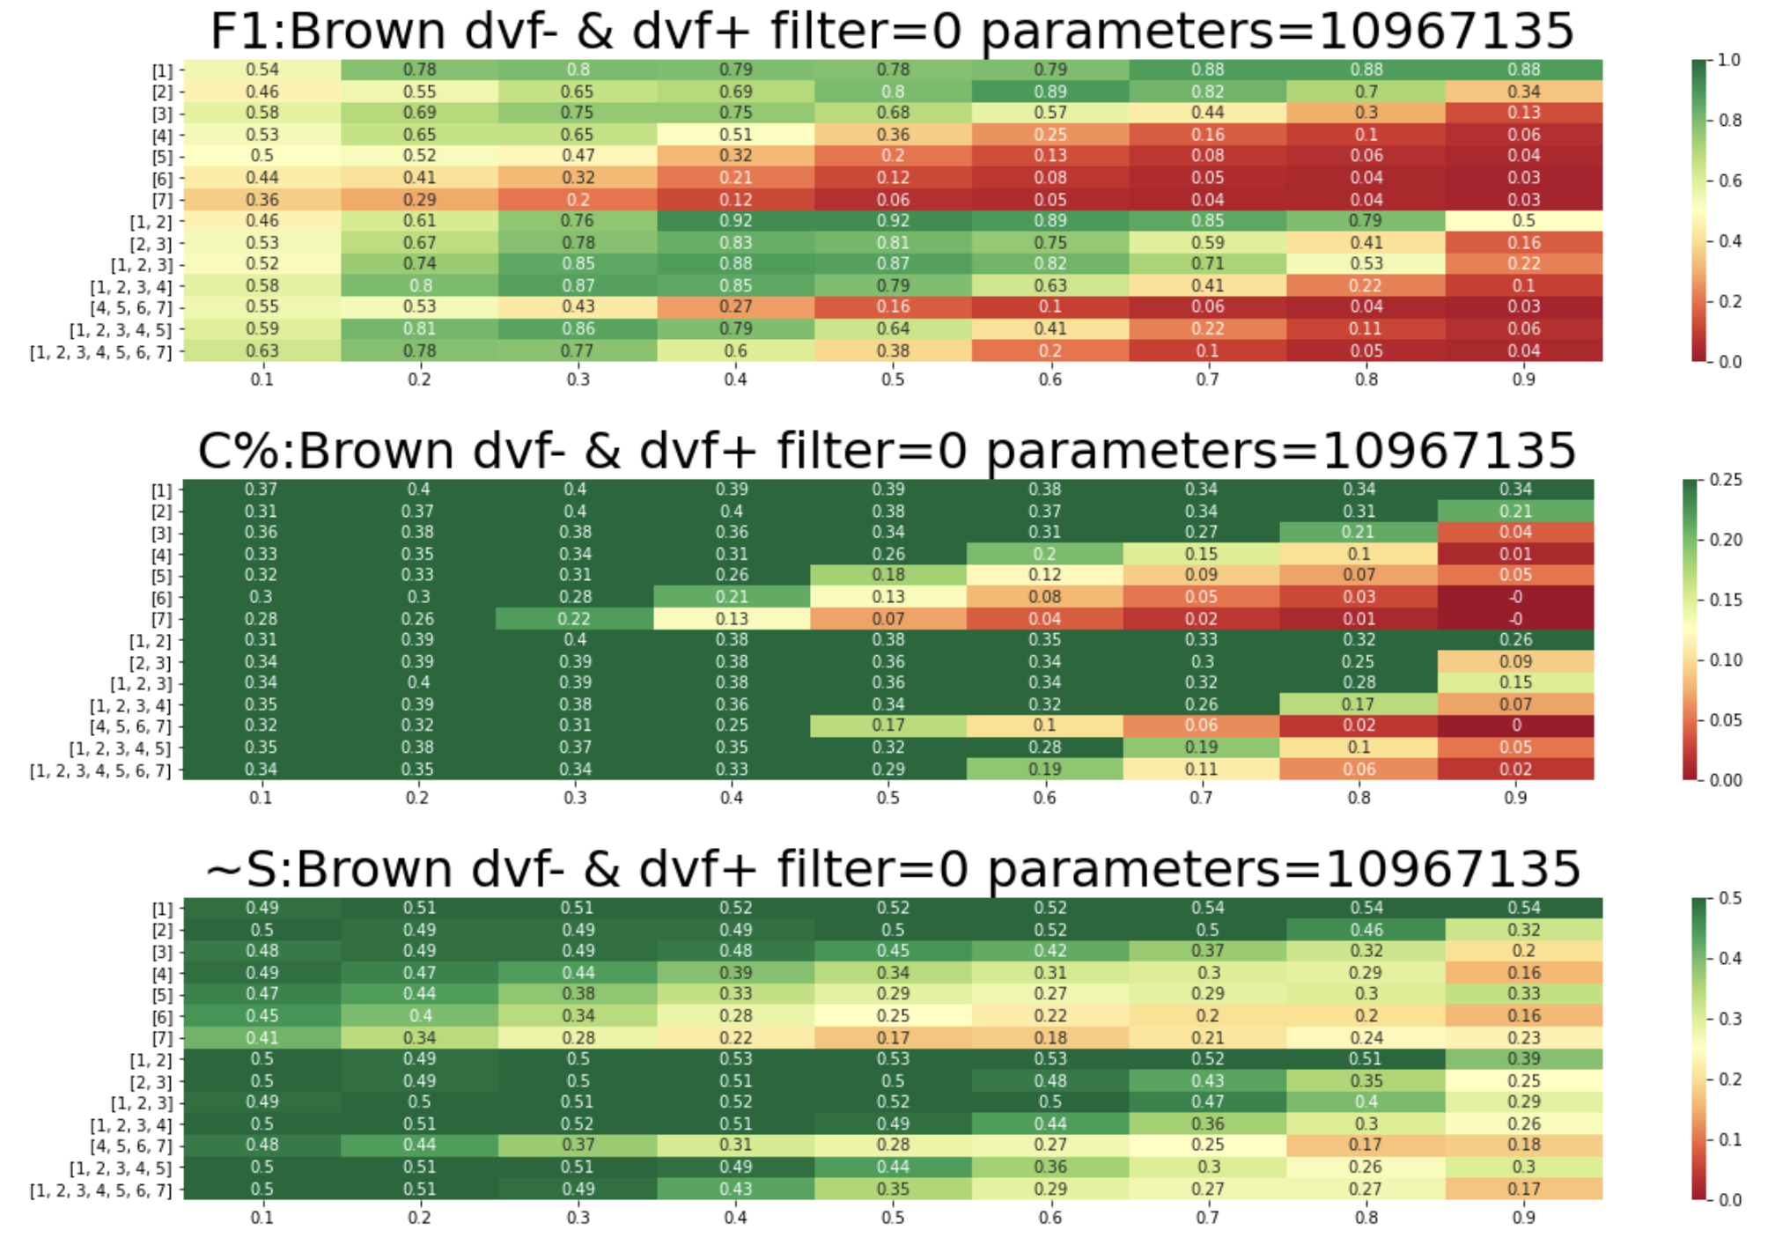
Hyper-parameters: F1 vs. language-agnostic metrics
English,
Brown corpus
Maximizing F1, compression factor (C%) and normalized anti-entropy (~S) in the space of hyper-parameters
https://arxiv.org/abs/2303.02427

Slide 40
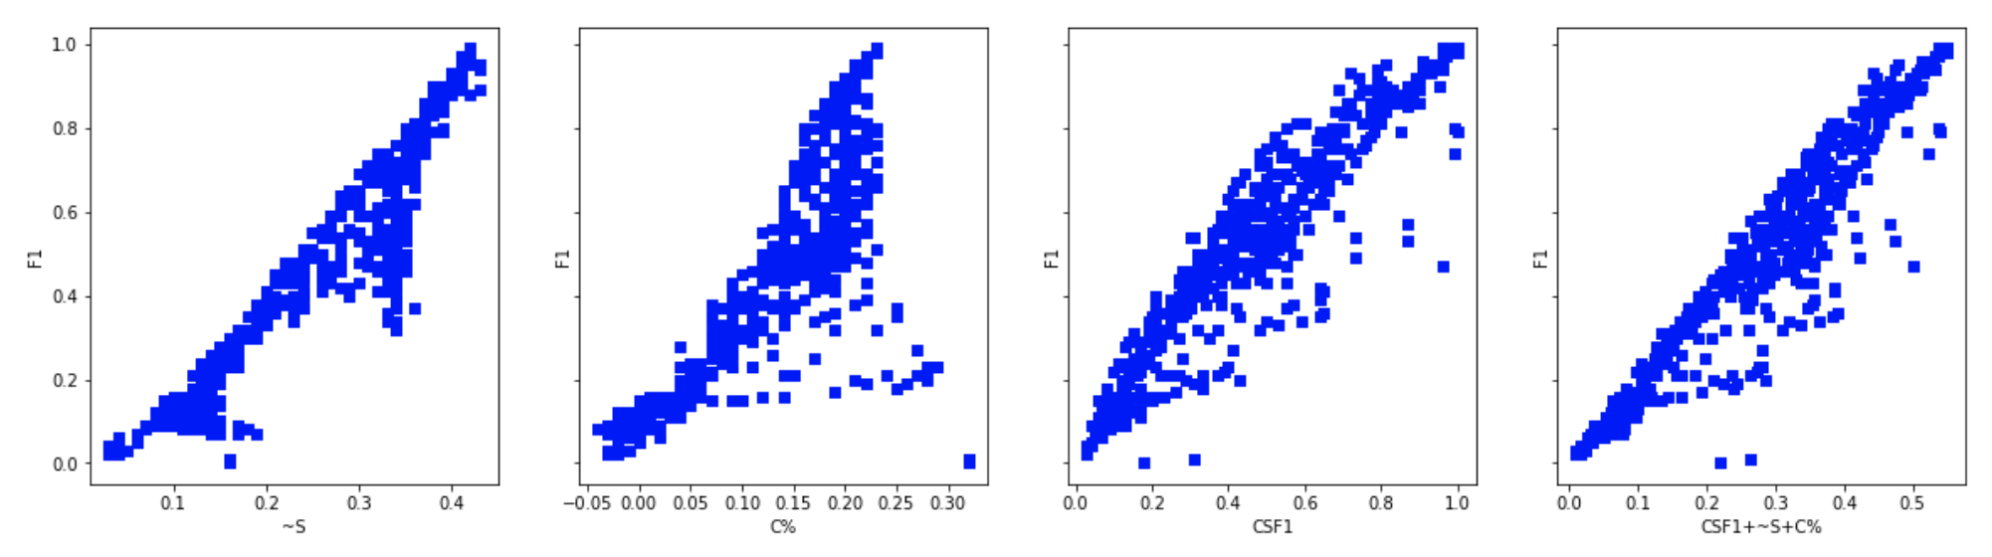

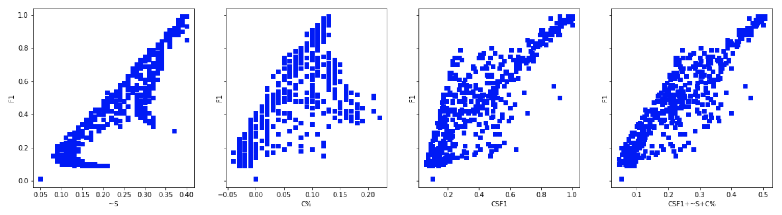

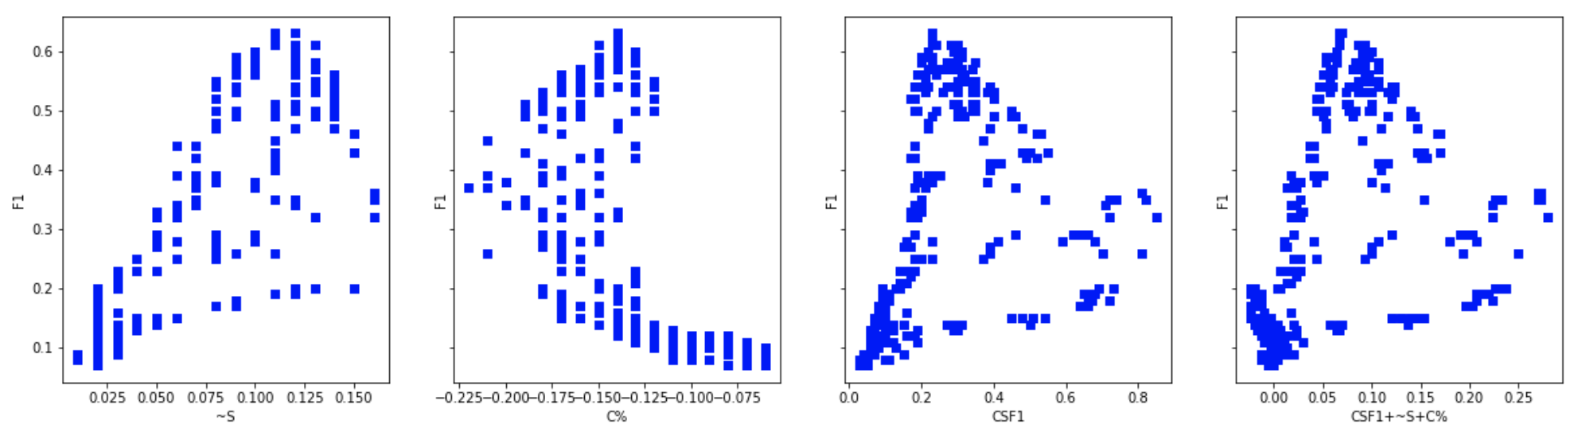

Different corpora, different sizes
English, Train: Brown, Test: Brown 1000
English, Train: Brown, Test: MagicData 100
https://github.com/aigents/pygents/blob/main/notebooks/nlp/english/en_tokenizer_auto.ipynb
Russian, Train: RusAge, Test: RusAge 1000
Russian, Train: Brown, Test: MagicData 100
https://github.com/aigents/pygents/blob/main/notebooks/nlp/russian/ru_tokenizer_auto.ipynb
Chinese, Train: CLUE News, Test: CLUE News 1000
Chinese, Train: Brown, Test: MagicData 100
https://github.com/aigents/pygents/blob/main/notebooks/nlp/chinese/zh_tokenizer_auto.ipynb
https://github.com/aigents/pygents/blob/main/notebooks/nlp/tokenization/brown/tokenization_brown_en_ru_zh.ipynb

Slide 41
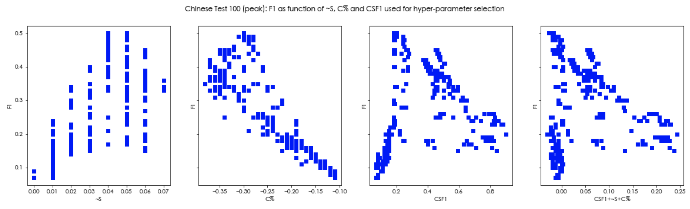
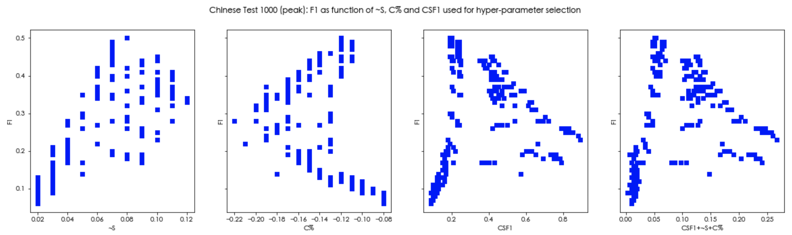
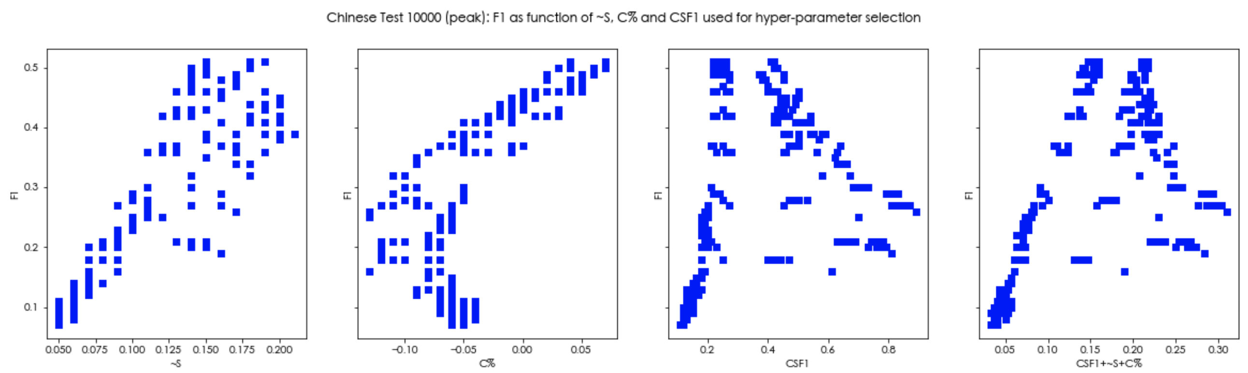
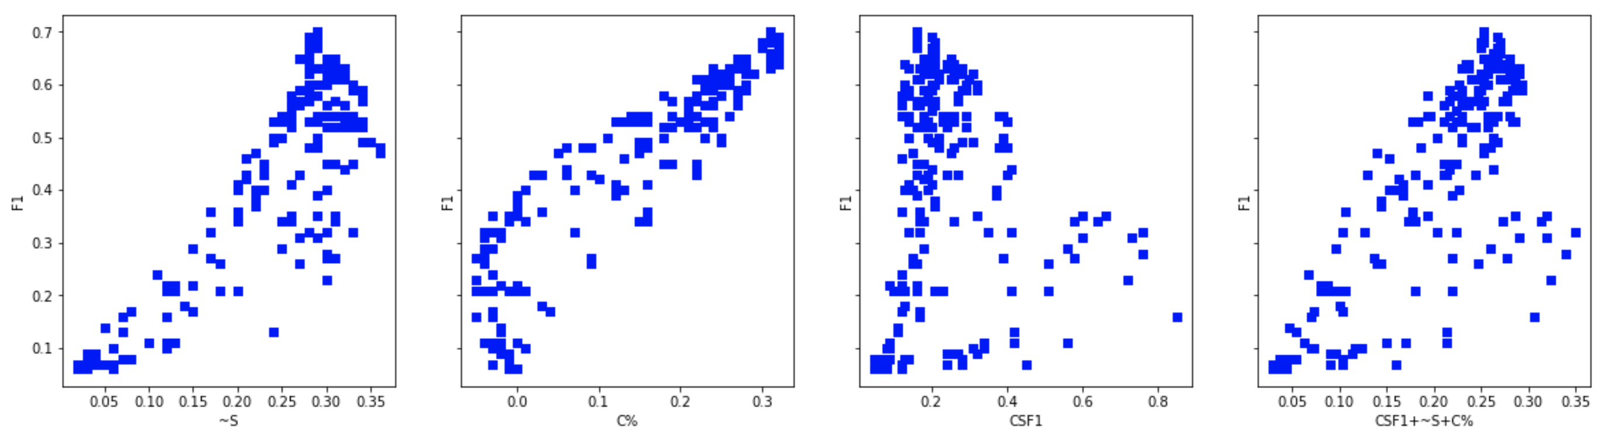
Chinese corpora, different sizes
Chinese, Train: Brown, Test: sighan2005/as_test_gold 100
Chinese, Train: Brown, Test: MagicData 100
https://github.com/aigents/pygents/blob/main/notebooks/nlp/tokenization/brown/tokenization_brown_en_ru_zh.ipynb
Chinese, Train: Brown, Test: sighan2005/as_test_gold 1000
Chinese, Train: CLUE News, Test: CLUE News 1000
Chinese, Train: CLUE News, Test: CLUE News 10000
Chinese, Train: Brown, Test: sighan2005/as_test_gold 10000
https://github.com/aigents/pygents/blob/main/notebooks/nlp/chinese/zh_tokenizer_auto.ipynb
https://github.com/aigents/pygents/blob/main/notebooks/nlp/chinese/zh_tokenizer_multi-criteria-cws.ipynb

Slide 42
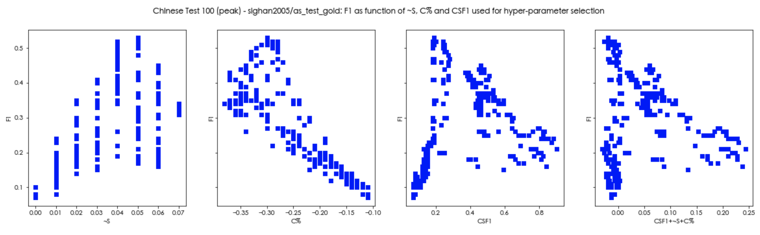
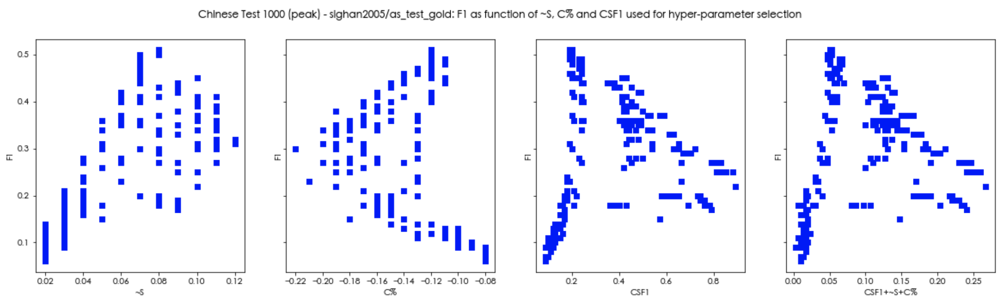
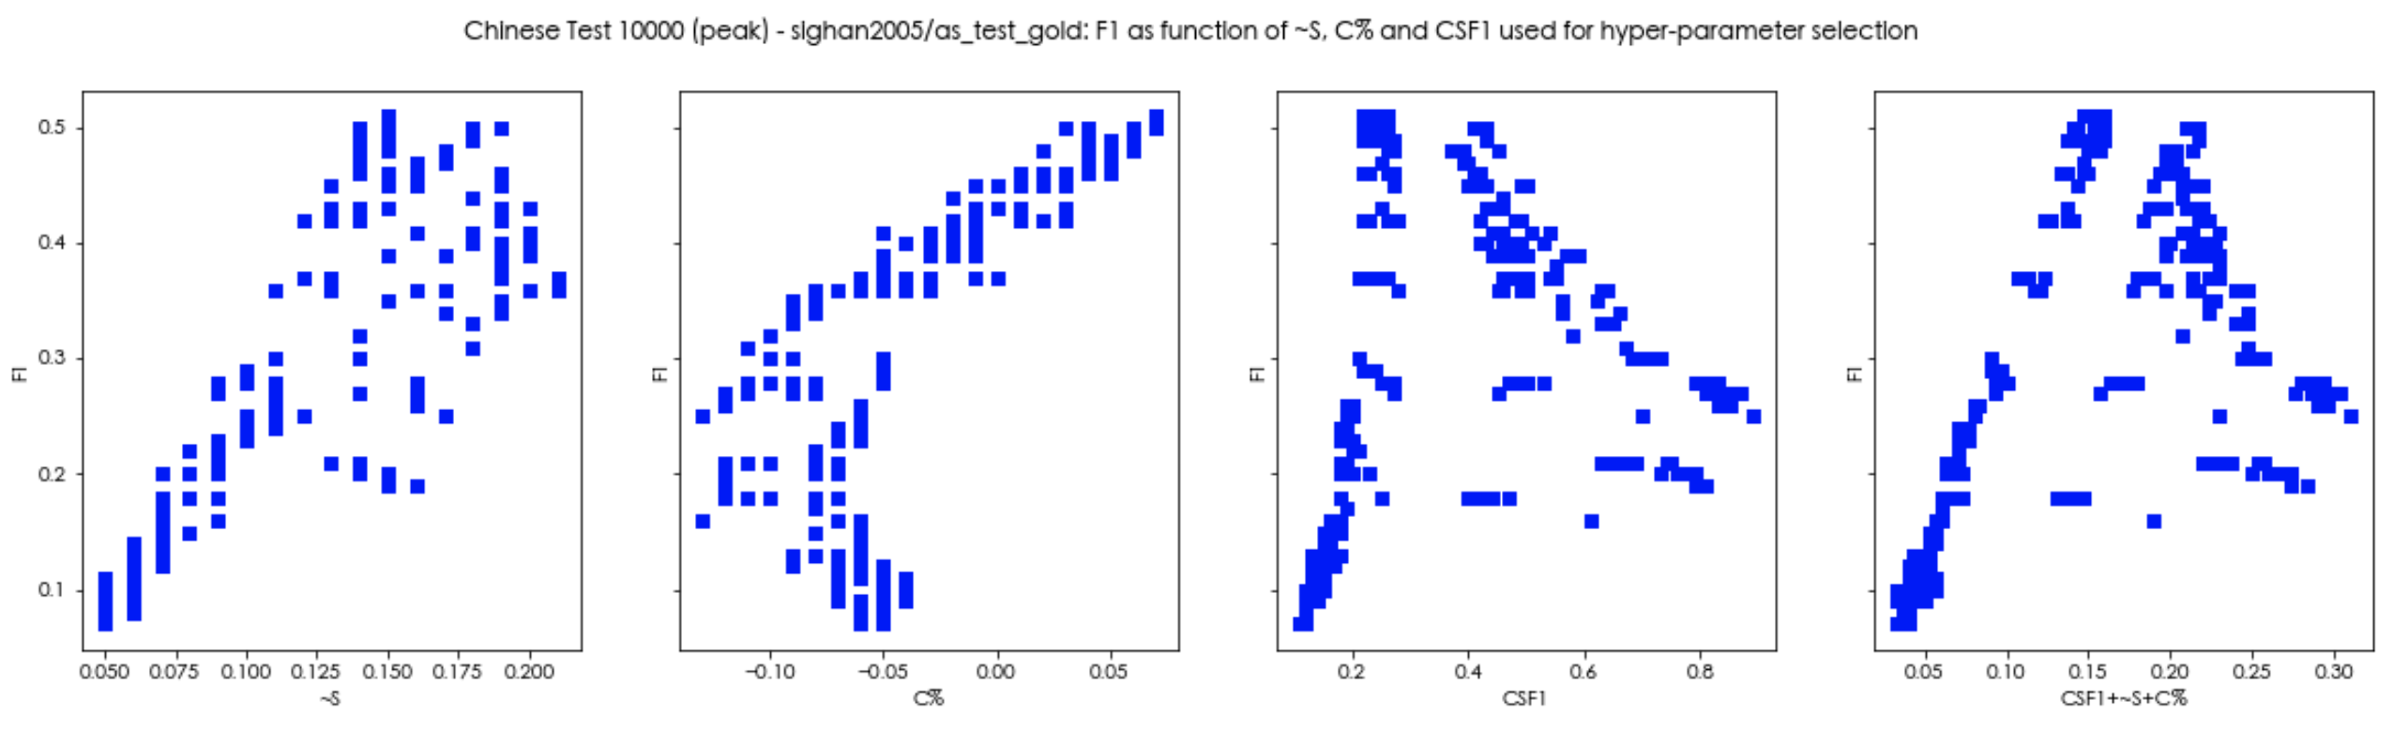
Chinese corpora, different “ground truth” tokenizers
Ground truth: sighan2005
Chinese, Train: Brown, Test: sighan2005/as_test_gold 100
Ground truth: Jieba
Chinese, Train: Brown, Test: sighan2005/as_test_gold 1000
Chinese, Train: Brown, Test: sighan2005/as_test_gold 10000
https://github.com/aigents/pygents/blob/main/notebooks/nlp/chinese/zh_tokenizer_multi-criteria-cws.ipynb
https://github.com/aigents/pygents/blob/main/notebooks/nlp/chinese/zh_tokenizer_multi-criteria-cws-jieba.ipynb

Slide 43
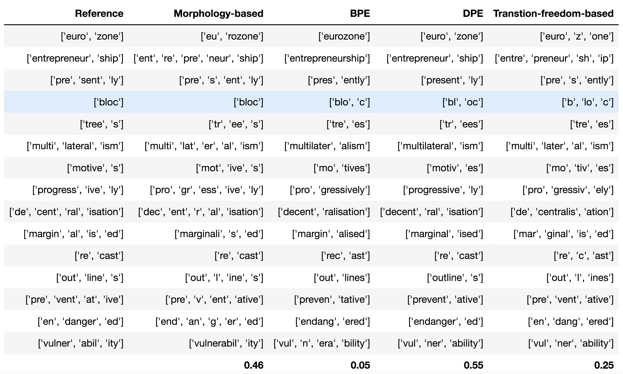
Unsupervised learning for subword segmentation
F1
Ref:
https://arxiv.org/pdf/2005.06606.pdf
https://github.com/aigents/pygents/blob/main/data/corpora/English/morphology/prefixes.txt
https://github.com/aigents/pygents/blob/main/data/corpora/English/morphology/suffixes.txt

Slide 44
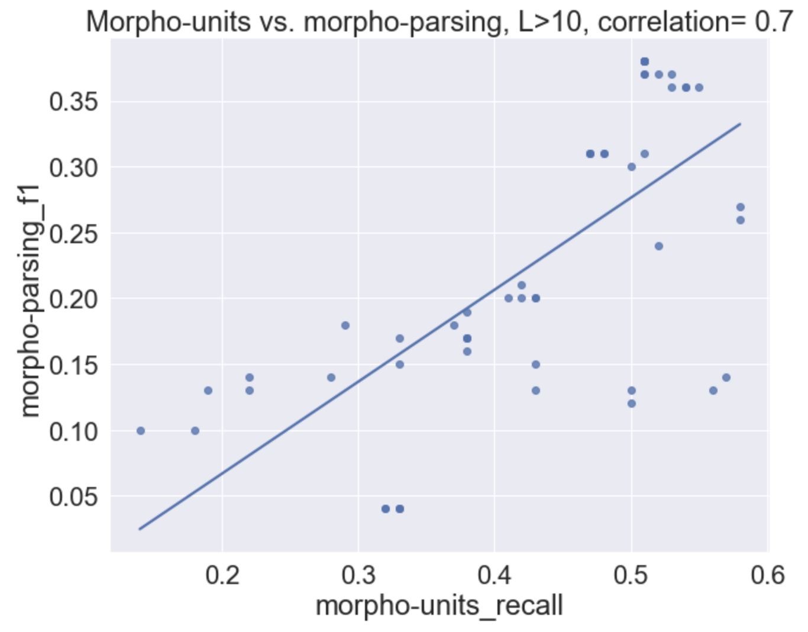
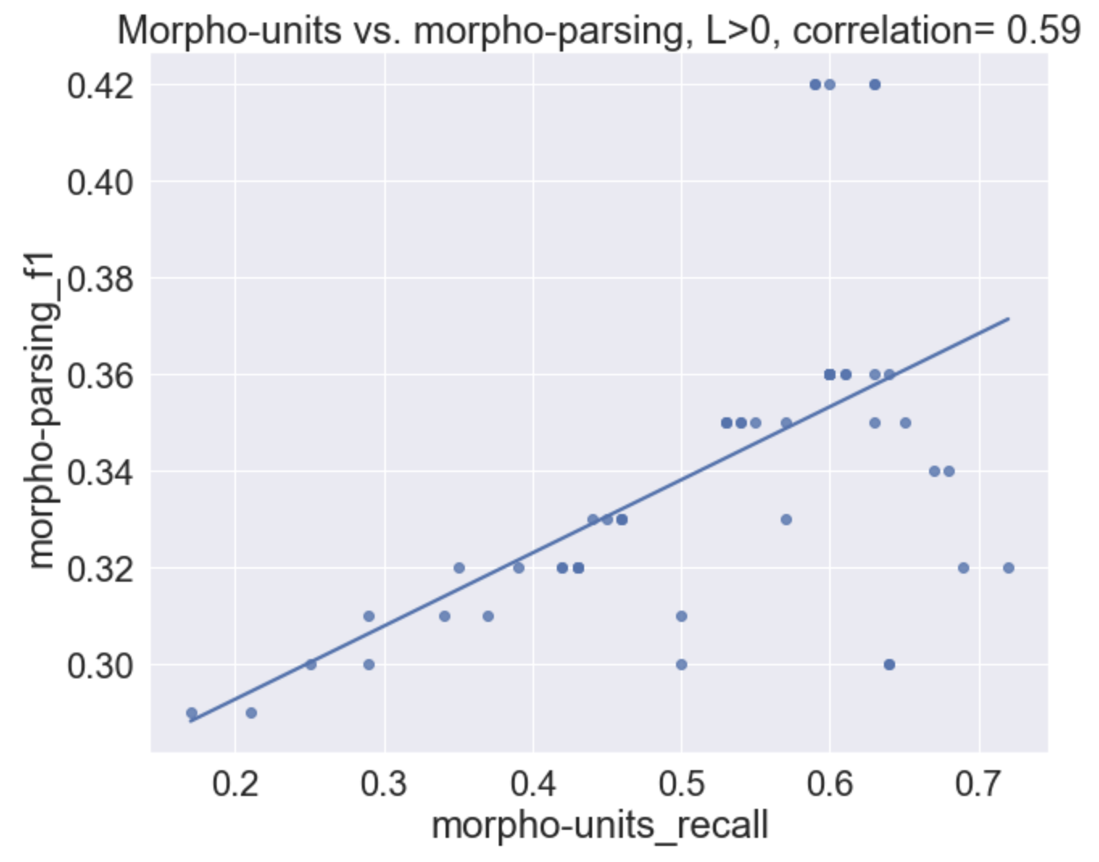
Unsupervised learning for subword segmentation
Correlating recall of discovery of morphological units vs. F1 score of morphgological parsing

Slide 45
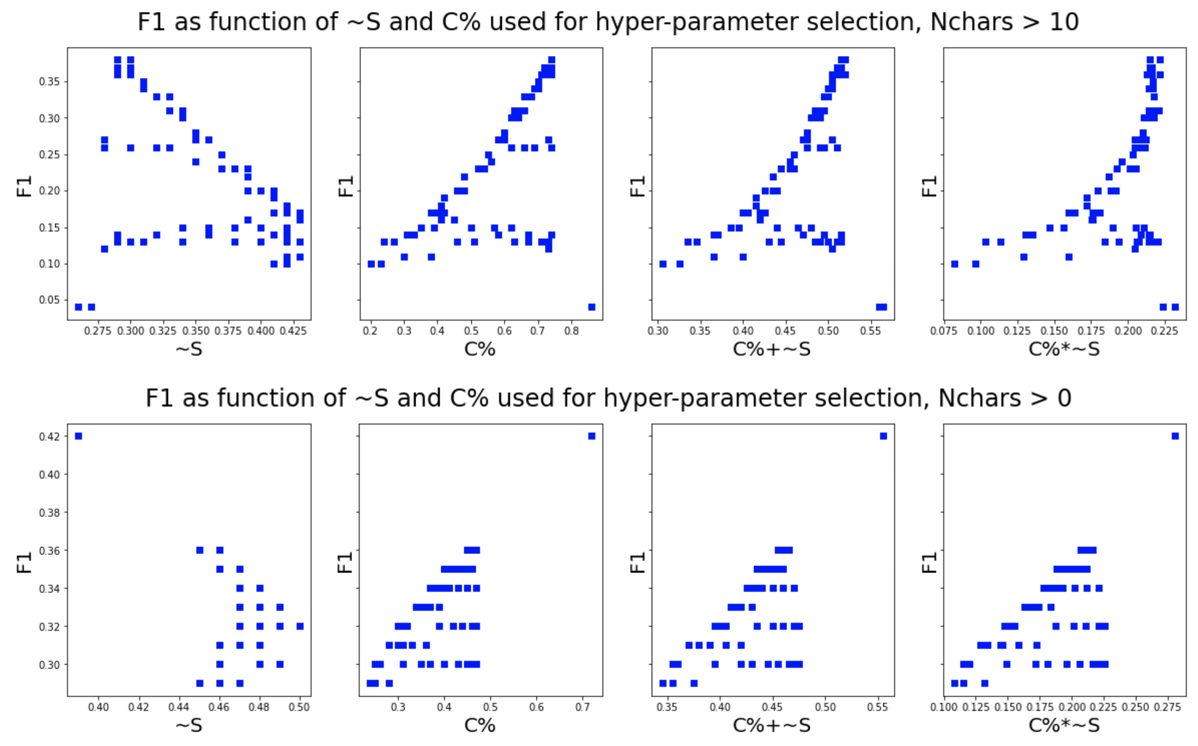
Unsupervised learning for subword segmentation
Word boundaries are NOT counted as letters
F1max = 0.42, N=1

Slide 46
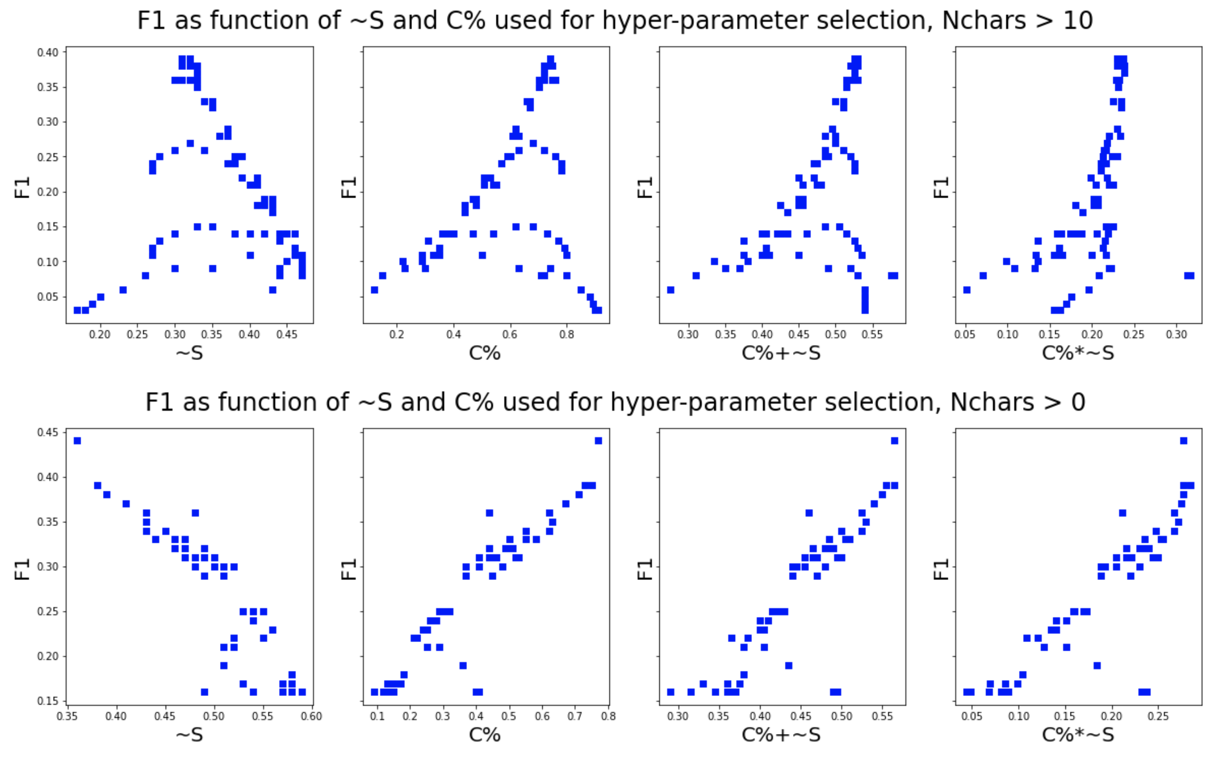
Unsupervised learning for subword segmentation
Word boundaries are NOT counted as letters,
F1max = 0.44, N = 2

Slide 47
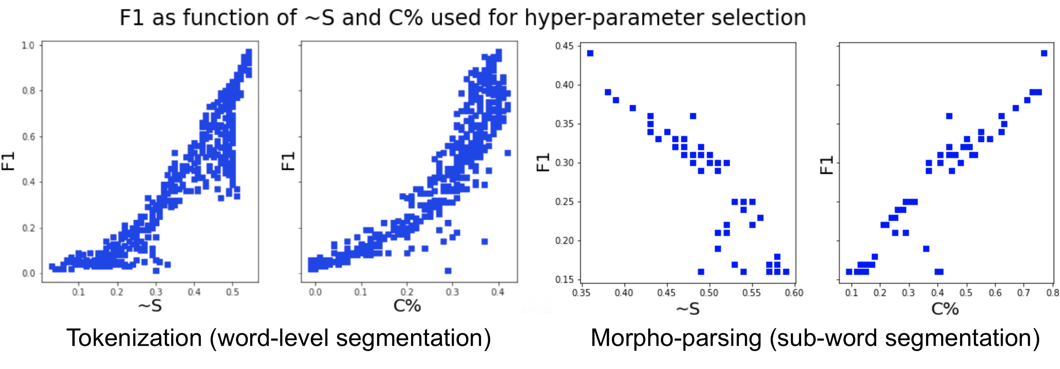
Tokenization vs. sub-word segmentation
F1 connection to anti-entropy and compression factor
(English)

Slide 48
Takeaways
Grammar and syntactic/semantic word categories can be learned, given we can learn tokenization and parses unsupervisedly.
Parses can not be learned well given bulk (non-curriculum) unsupervised learning using mutual information, BERT and MST-parsing.
Tokenization and character categories can be learned unsupervisedly based on transition freedom metric.
Hyper-parameters for unsupervised text segmentation learning can be found based on culture-agnostic metrics such as compression factor (and anti-entropy in case of tokenization).
Unsupervised learning for morphological units and morpho-parsing may be possible but remains non-trivial and needs more study.

Slide 49
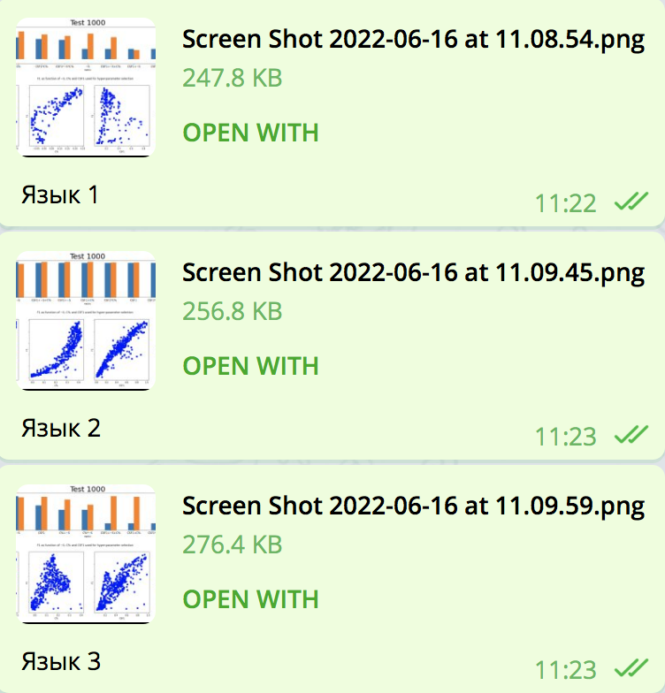
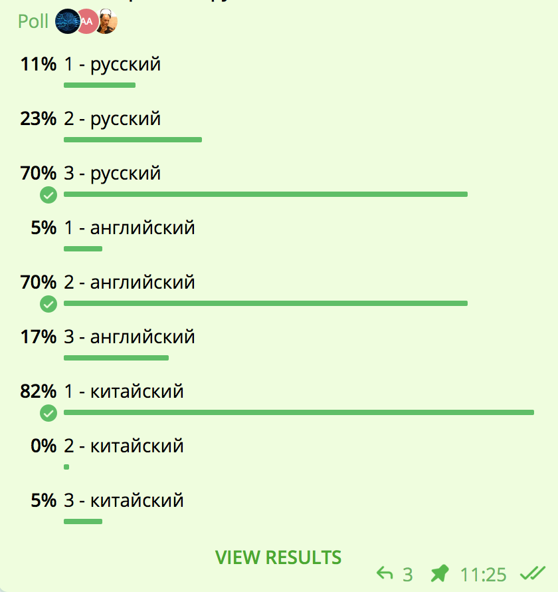
The riddle - answer: you have got it!
Russian
Russian
Language 1
Russian
English
English
Language 2
English
Chinese
Chinese
Chinese
Language 3

Slide 50
Welcome to the Interpretable Natural Language Processing Community and Series of Workshops
Telegram English
https://t.me/internlp
Telegram Russian
https://t.me/agibots
INLP 2023 Workshop (Stockholm, Sweden & Virtual)
https://aigents.github.io/inlp/2023/
INLP Workshop 2022 (Past)
https://aigents.github.io/inlp/2022/

Slide 51
Thank You and Welcome!
Anton Kolonin
akolonin@aigents.com
Facebook: akolonin
Telegram: akolonin
AIGENTS
https://agirussia.org
https://aigents.com

