Slide 1



Interpretable Natural Language Processing
Fundamental studies for applied results
Anton Kolonin
akolonin@aigents.com
Messengers: akolonin
AIGENTS
https://agirussia.org
https://aigents.com

Slide 2
The Plan
A bit of theory
Few cases
A bit more theory
A few more cases

Slide 3
Why do we need NLP in LLM/DL/GPT era?
Fighting Hallucinations with OAG/RAG at Palantir
Prompt
Query
Response
LLM/GPT
Ontology
Injection
Semantic
Filtering
Grounding Functions (Oracles)
Ontology / Semantic Graph / Knowledge Graph
https://blog.palantir.com/reducing-hallucinations-with-the-ontology-in-palantir-aip-288552477383

Slide 4
A bit of theory:
Fuzzy/probabilistic/soft-logic symbolic “models”

Slide 5
Bridging the Symbolic-Subsymbolic gap in NLP
+--------Os-------+
| +-----Ds-----+
+Sp*i+ | +---A--+---Mg--+
| | | | | |
I.p saw.v the rusty.a saw.n sawing.v
Formal
Link Grammar
Deep
Language Model
I
saw
the
rusty
saw
sawing
I
saw
the
rusty
saw
sawing
0.5
0.5
Explain
0.5
0.5
0.5
0.5
0.5
0.5
0.5
0.5
Sp*I
Os
Ds
A
Mg
Σ
Σ
Σ
Σ
Transfer
“Link”
0.3
0.3
0.3
0.3
0.3
0.3
0.3
0.3
AND
AND
Σ
DNF
Soft-DNF
“Disjunct”
1.0
1.0
1.0
1.0
OR
Σ
Noun
Noun
https://link.springer.com/chapter/10.1007/978-3-319-97676-1_11
https://doi.org/10.1007/978-3-030-27005-6_11
https://github.com/singnet/language-learning/

Slide 6
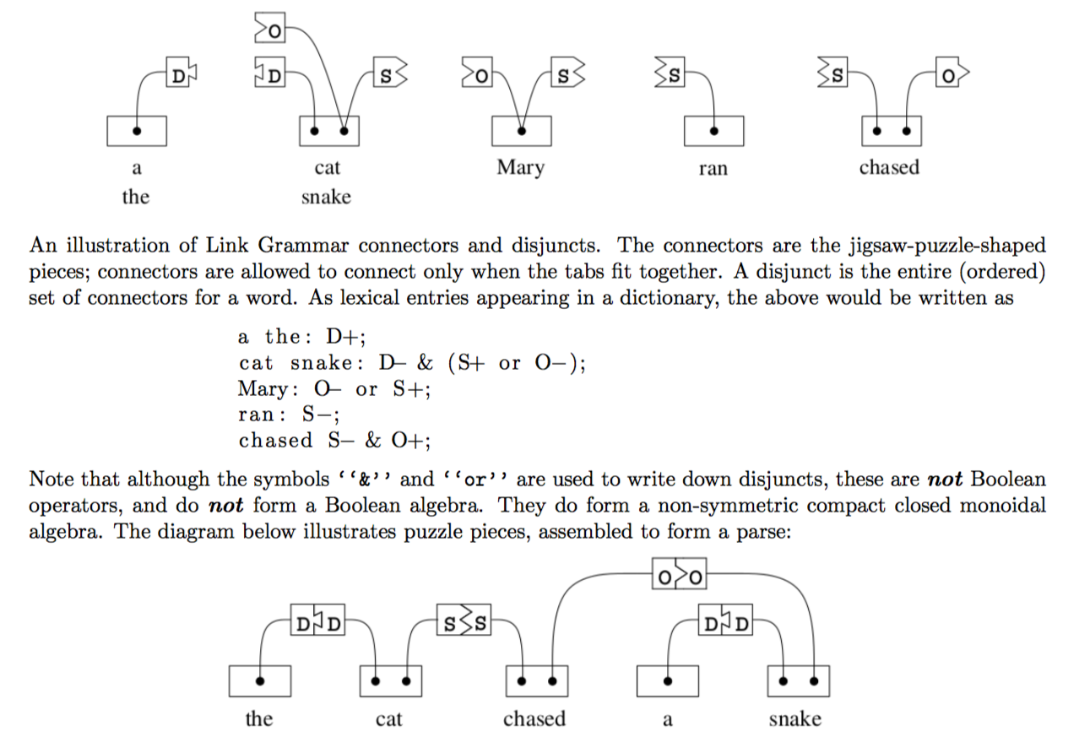
Link Grammar – Connectors/Costs, Disjuncts
1.0
0.5
Connectors & Costs
Disjuncts of Connectors
https://arxiv.org/abs/1401.3372
https://en.wikipedia.org/wiki/Link_grammar
https://github.com/opencog/link-grammar

Slide 7
NLP patterns (words, punctuation, phrases) for Interpretable Natural Language Processing (Aigents® “Deep Patterns”)
NOUN
VERB
SUBJECT PREDICATE OBJECT
OR
OR
0.35
0.65
0.29
0.71
“procedure”
“drug”
“negative effect”
“positive effect”
“disease”
OR
OR
OR
OR
AND
AND
0.83
0.78
0.90
0.10
cold
0.96
0.17
0.22
0.14
aspirin
treat
reduces
OR
0.33
head
tylenol
acetylsalicylic acid
treats
reduce
existential
0.67
frustration
acetaminophen
anxiety
acetaminophen may significantly reduce feelings of existential anxiety
https://ieeexplore.ieee.org/document/7361868
https://github.com/aigents/aigents-java

Slide 8
Generalized Text Mining with Aigents® “Deep Patterns”
Classification
Case/Relationship
Extraction
Property Attribution
Entity Extraction
Category:
“Healthcare”
IS
Brand: Tylenol
Substance: acetaminophen
Reliability: medium
Effect: positive
Diagnosis: Anxiety
Reporter: Daniel Randles
Entity (Case): “Treatment:
Healing anxiety with Tylenol”
tylenol
acetaminophen
placebo
HAS
significantly
reduce
feelings
study
Here’s the Tylenol twist: Before they began writing, half of each group received acetaminophen while the other half swallowed a placebo. Even among those people who wrote about death, the Tylenol takers set bail at roughly $300—a sign that acetaminophen may significantly reduce feelings of existential anxiety, explains study lead author Daniel Randles, a PhD candidate in UBC’s department of... psychology.
acetaminophen
may
reduce
anxiety
explains
“acetaminophen may significantly reduce feelings of existential anxiety, explains study lead author Daniel Randles”
acetaminophen may significantly reduce feelings of existential anxiety, explains study lead author Daniel Randles.
https://ieeexplore.ieee.org/document/7361868
https://github.com/aigents/aigents-java

Slide 9
Few cases:
Using symbolic “models”

Slide 10
Case 1: Property Attribution / Aigents® “Deep Patterns”
<set> := <disjunctive-set> | <conjunctive-set> | <M-skip-N-gram>
<disjunctive-set> := { <pattern> * }
<conjunctive-set> := ( <pattern> * )
<N-gram> := [ <pattern> * ]
<pattern> := <token> | <regexp> | <variable> | <set>
Variables may have domain restrictions
in ontology and/or refer to other
patterns as subgraphs
Example:
{[$description catheter] [$coating coating] [$inner-diameter
{diameter inner-diameter}] [$tip tip] [$pattern pattern]}
X
“Convey Guiding Catheter. Unique hydrophilic coating.
Small atraumatic soft tip. Ultra-thin 1 × 2 flat wire braid pattern”
=
{ coating : "hydrophillic", description : "convey guiding",
pattern : "ultra-thin 1 × 2 flat wire braid", tip : "soft" }
https://ieeexplore.ieee.org/document/7361868
https://github.com/aigents/aigents-java

Slide 11
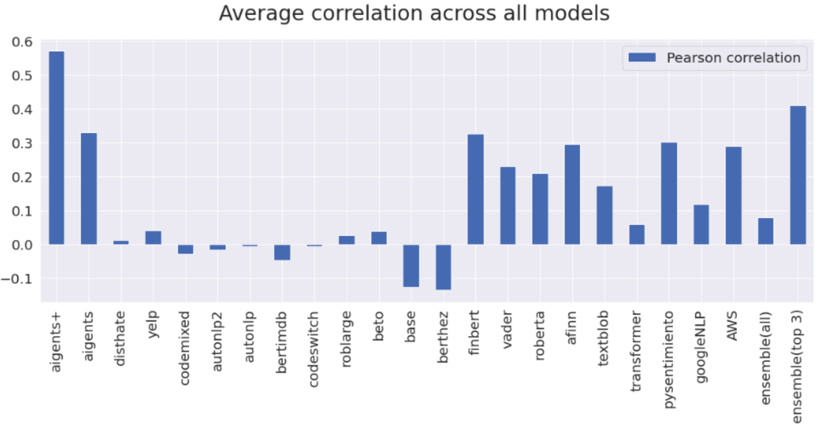

Case 2: Interpretable Sentiment Analysis
Aigents® “interpretable” model vs. Bert fine-tuned on financial data
https://arxiv.org/abs/2204.10185
https://blog.singularitynet.io/aigents-sentiment-detection-personal-and-social-relevant-news-be989d73b381

Slide 12
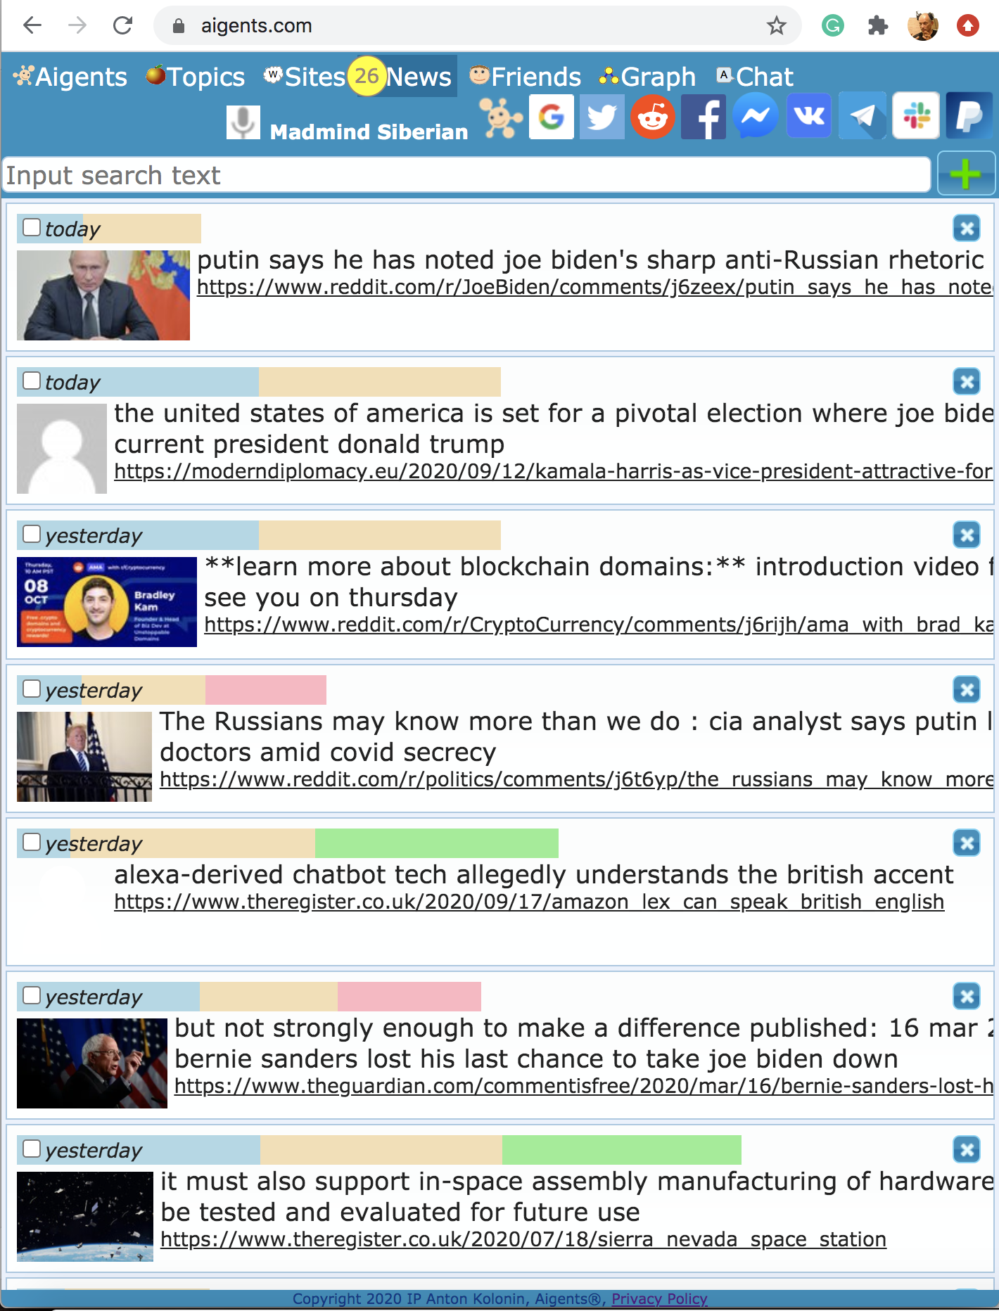
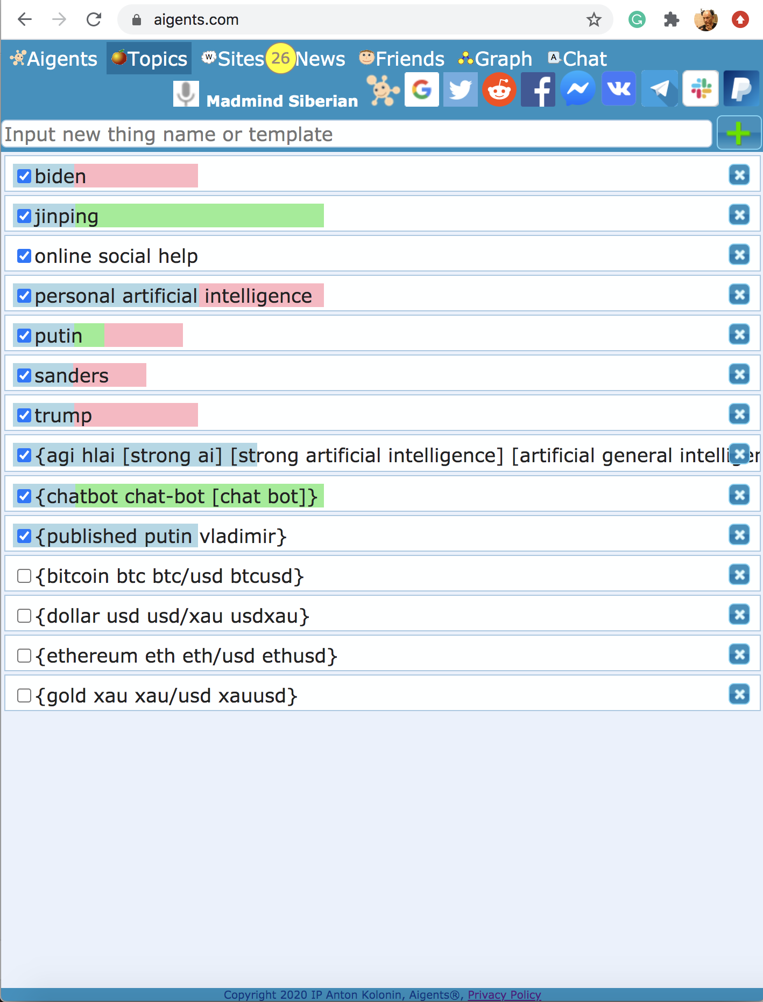
Case 2.1: Aigents® News Feed Sentiment Analysis
https://blog.singularitynet.io/aigents-sentiment-detection-personal-and-social-relevant-news-be989d73b381

Slide 13
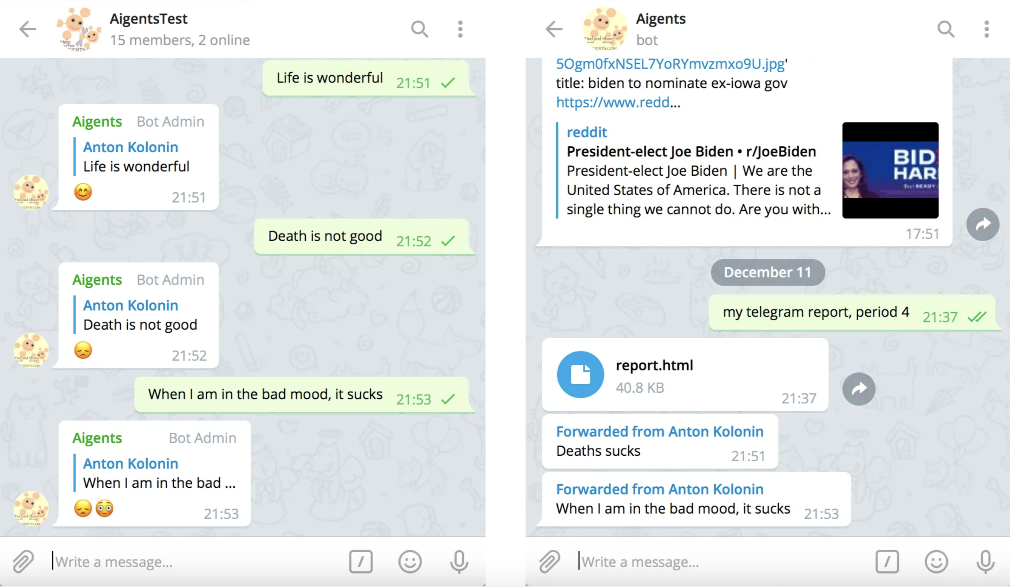
Case 2.2: Aigents® Bot Sentimental Reactions in Chats
https://t.me/AigentsBot
https://aigents.medium.com/aigents-bot-for-telegram-groups-1dba32140047

Slide 14
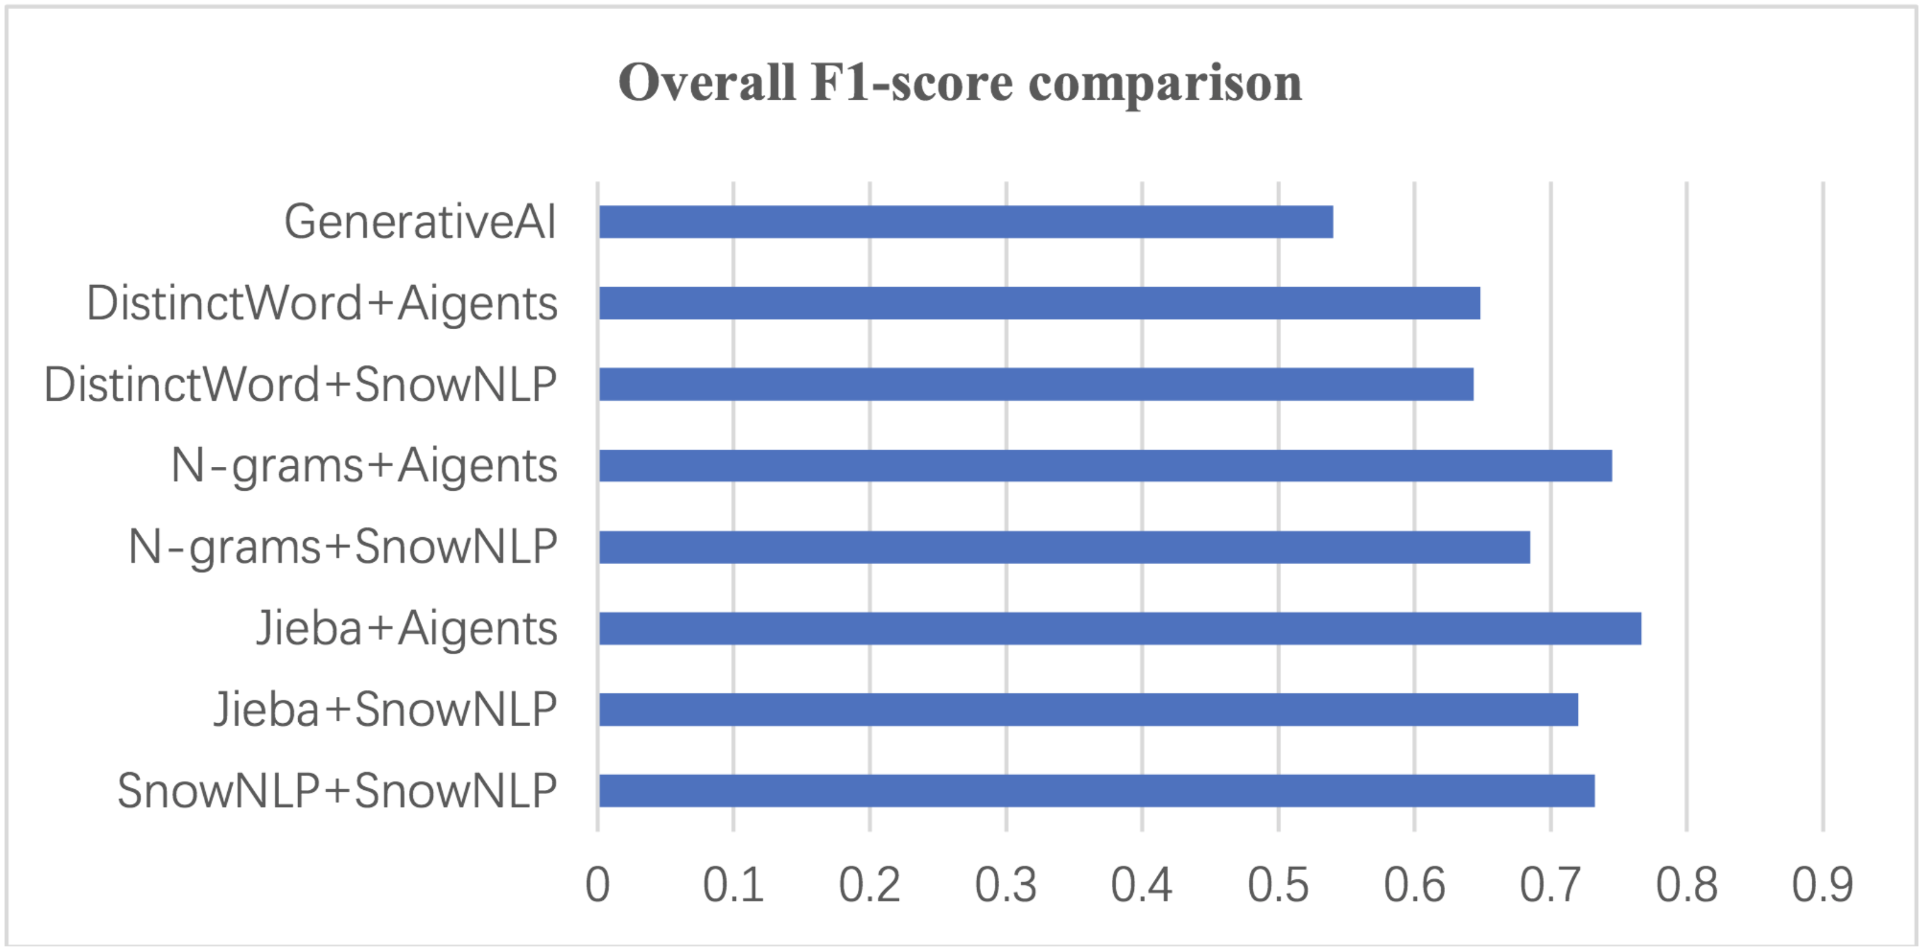
Case 2.3: Social Media Sentiment Analysis
H. Zhenghao, A. Kolonin: INTERPRETABLE SENTIMENT ANALYSIS AND TEXT SEGMENTATION FOR CHINESE LANGUAGE. 2024
https://github.com/aigents/pygents/blob/main/pygents/aigents_api.py
https://github.com/aigents/pygents/blob/main/notebooks/nlp/sentiment/sentiment_test.ipynb

Slide 15
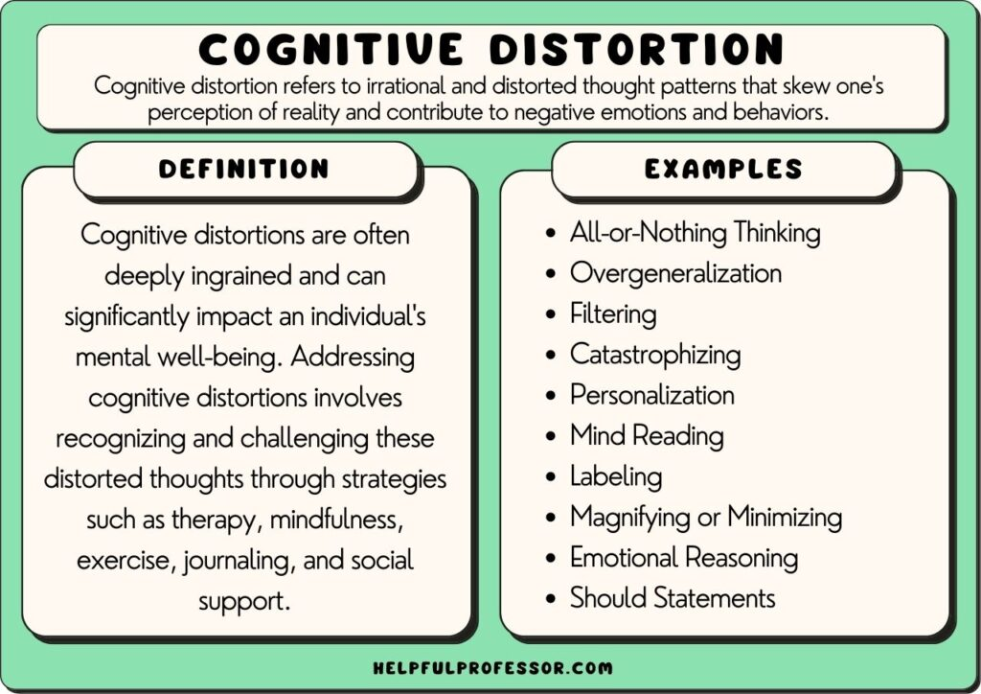
Case 3: Exploring Cognitive Distortions

Slide 16
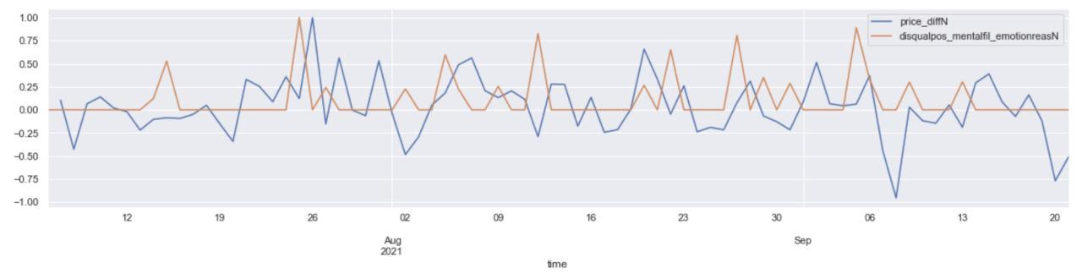
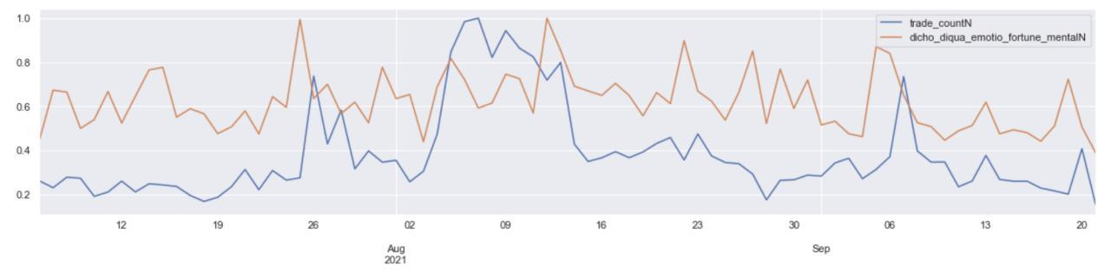
Case 3.1: Cognitive Distortions on Media vs. Market
Price difference/derivative (BTC/USDT)
Disqualify positive
Mental filtering
Emotion reasoning
Dichotomy reasoning
Disqualify positive
Fortune telling
Mental filtering
Emotion reasoning
Trade count (BTC/USDT)
https://arxiv.org/pdf/2303.02342.pdf
https://link.springer.com/chapter/10.1007/978-3-031-19907-3_4
https://www.pnas.org/content/118/30/e2102061118

Slide 17
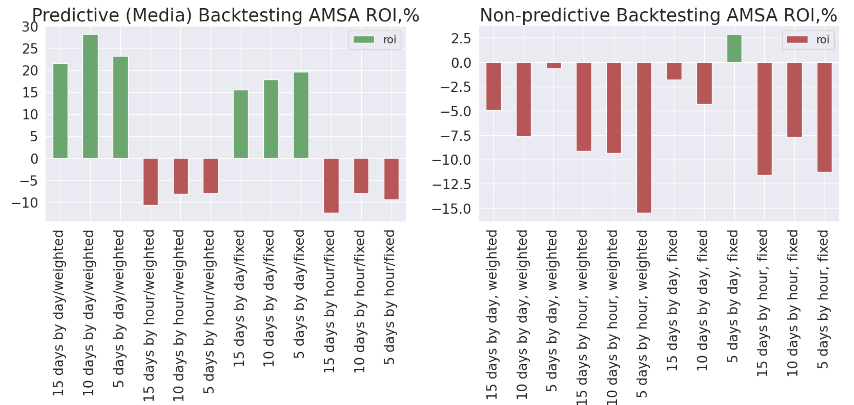
Case 3.1: Market Prediction on Cognitive Distortions
https://arxiv.org/abs/2303.02342
https://link.springer.com/chapter/10.1007/978-3-031-33469-6_19

Slide 18
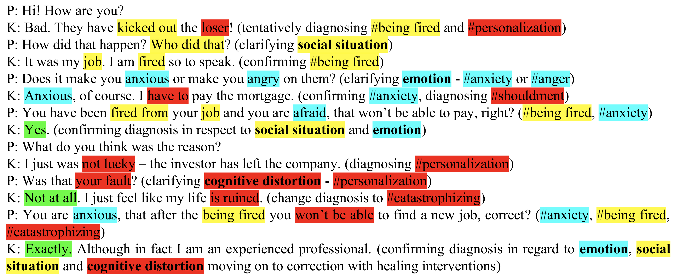

Cognitive Behavioral Therapy case:
“Anxiety due to catastrophization of being fired”
Case 3.3: Cognitive Distortions for Psycho-Therapy
https://www.sciencedirect.com/science/article/pii/S1877050922017458
https://arxiv.org/abs/2302.09377

Slide 19
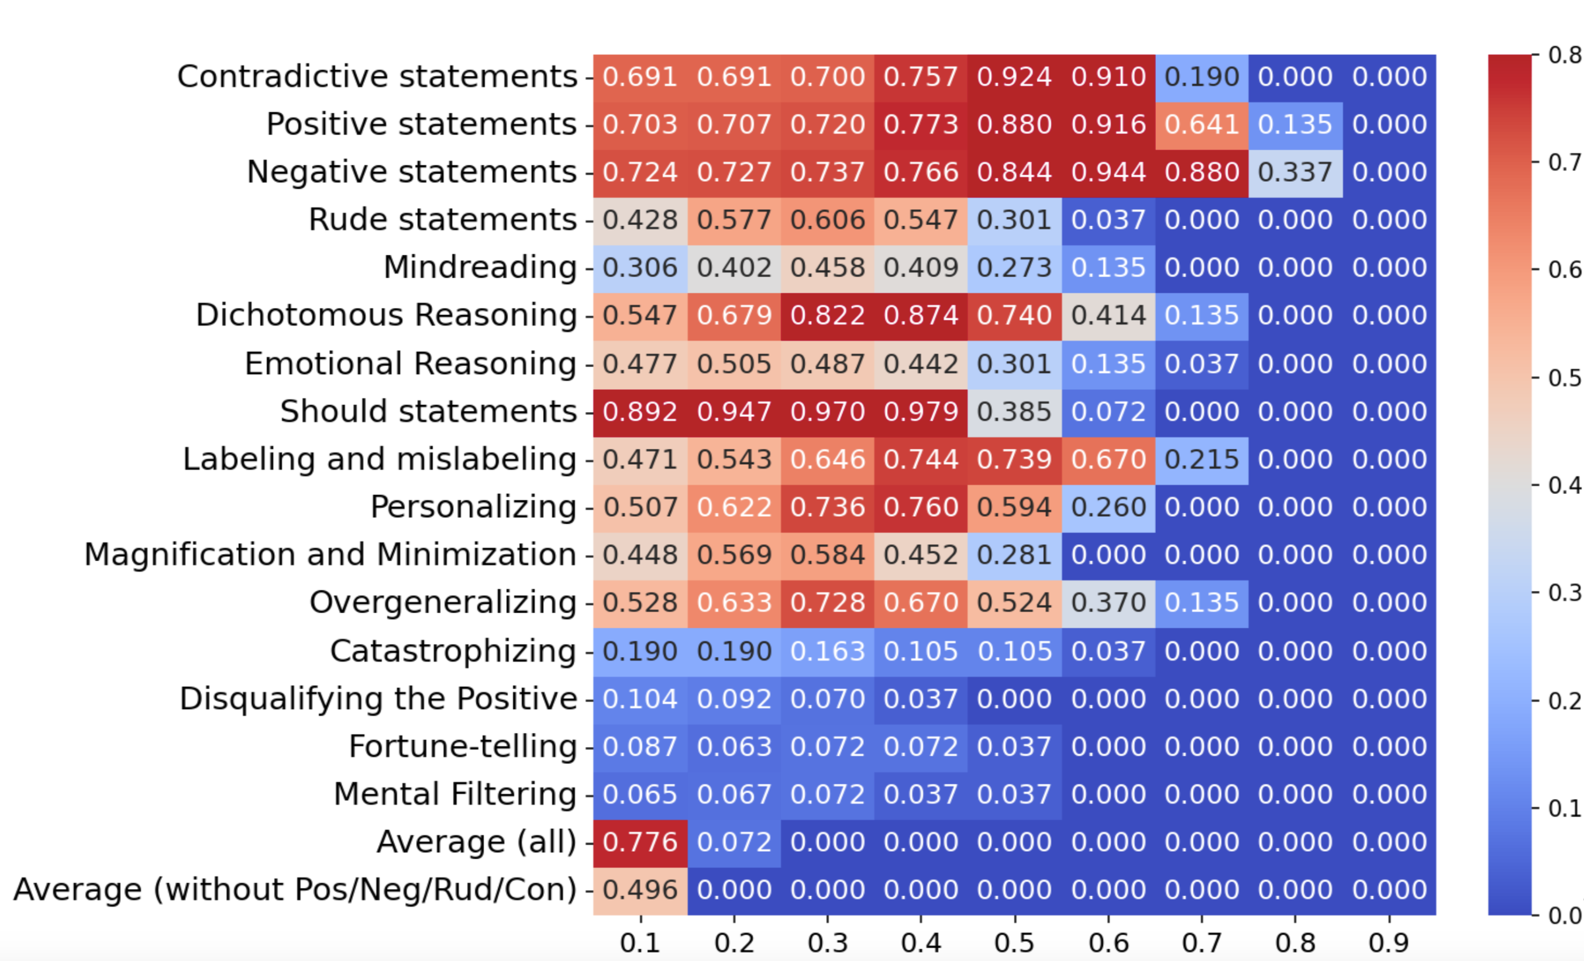
Case 3.3: Cognitive Distortions for Psycho-Therapy
A. Arinicheva, A. Kolonin: Diagnosis of Cognitive Distortions in Public, Group, and Personal Text Communications. 2024
Different thresholds
F_{β} score, β=0.1
https://github.com/aigents/pygents/blob/main/pygents/aigents_api.py
https://github.com/aigents/pygents/blob/main/notebooks/nlp/sentiment/distortions_test.ipynb

Slide 20
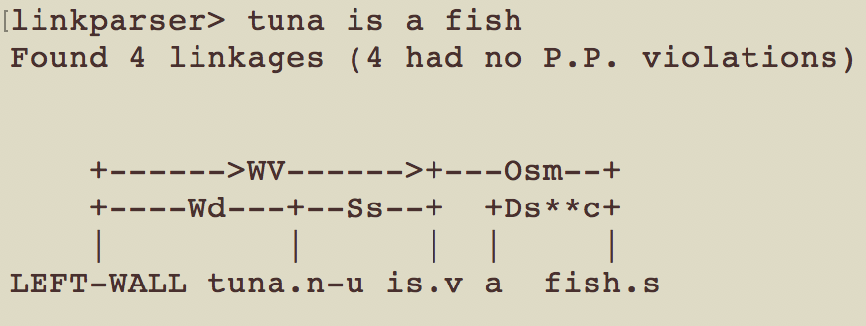
Case 4: Link-Grammar based applications
Parsing
Segmentation
Generation
Dictionary
file
Tuna is a fish.
anne smothered a
smile there was enough
cold water thrown to
discourage any society
caught
mouse
cat
a
the
Loader
Parser
Segmenter
Link
Grammar
Dictionary
Generator
Anne smothered a
smile.
There was enough
cold water thrown to
discourage any society.
The cat caught
a mouse.
Code: https://github.com/aigents/aigents-java-nlp
Segmentation: https://ieeexplore.ieee.org/document/9303220
Generation: https://arxiv.org/abs/2105.00830
V. Ramesh, A. Kolonin, 2020-2021

Slide 21
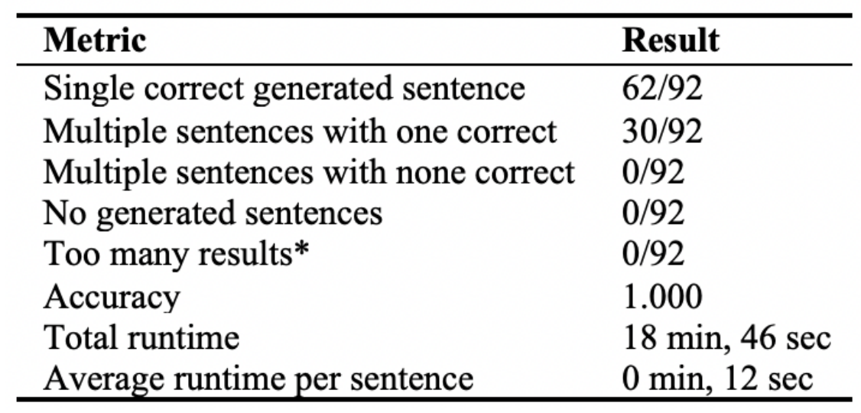
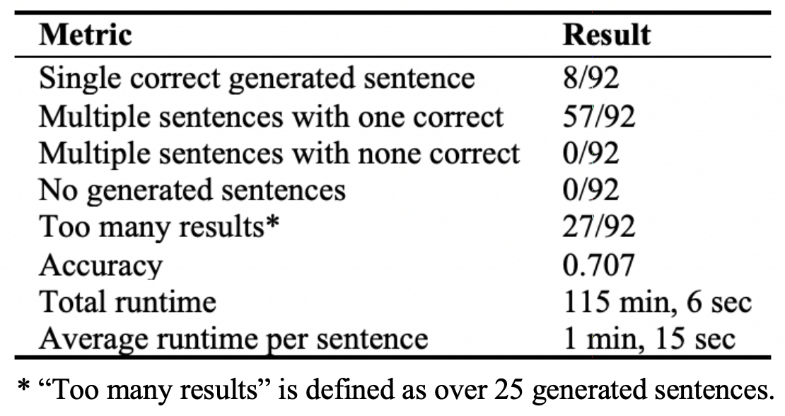
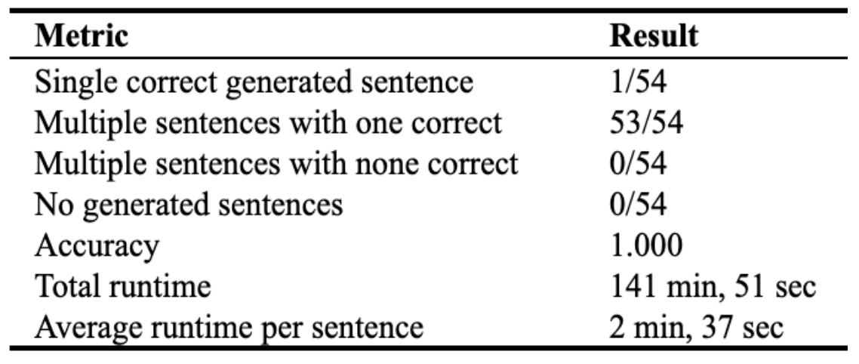
Case 4.2: Grammatical Language Generation
Generator determines what sentences can be formed from a given list of words via valid Link Grammar rules:
1) Given a list of words, the Generator determines a subset of all orderings of those words that satisfies initial checks of the planarity and connectivity metarules.
2) For each ordering in the subset, the Generator determines if that ordering is valid; specifically, it ensures that every pair of consecutive words can be connected via links part of the Dictionary objects. To do so, the Generator uses the connects() function, which returns a boolean value indicating whether its two parameters left and right can be linked together.
Planarity metarule: links do not cross
Connectivity metarule: links and words of a sentence must form a connected graph that can be completely traversed via one path
a
The
mouse
caught
cat
https://github.com/aigents/aigents-java-nlp
https://arxiv.org/abs/2105.00830 V. Ramesh, A. Kolonin, 2021

Slide 22
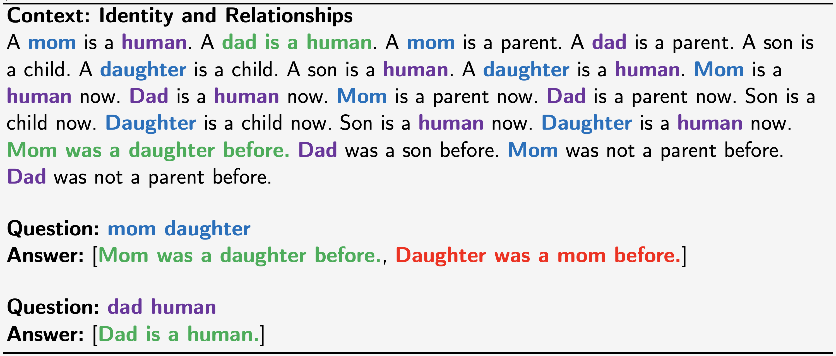
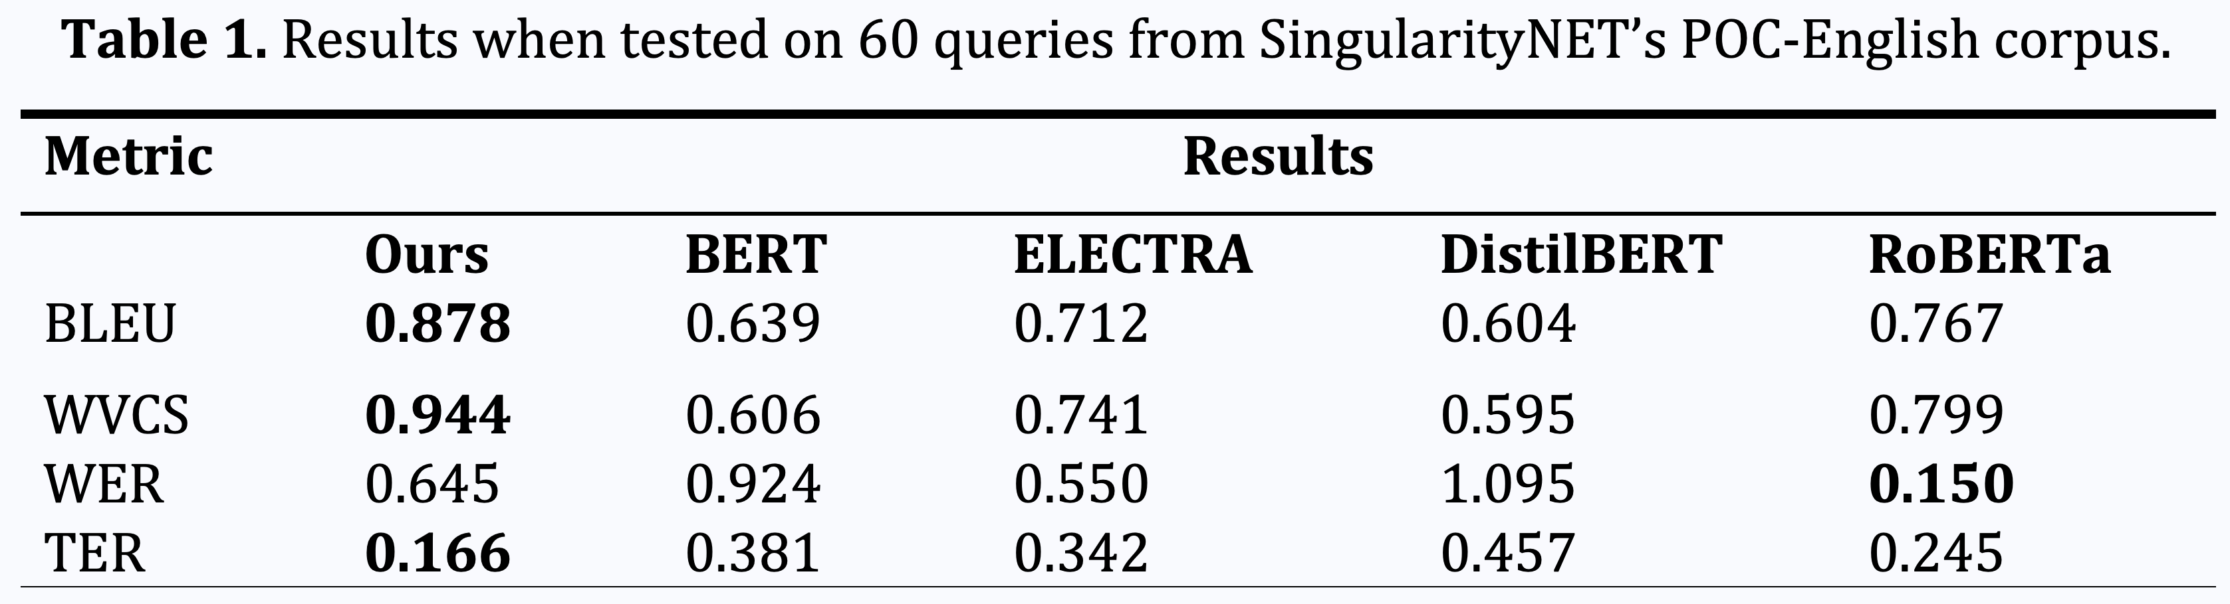
Case 4.3: Question Answering with Link Grammar
https://www.youtube.com/watch?v=MKlOqO9FRq0
https://link.springer.com/chapter/10.1007/978-3-030-93758-4_22 V. Ramesh, A. Kolonin, 2021

Slide 23
A bit more theory:
Learning symbolic “models”

Slide 24
Learning Lexicon, Punctuation, Morphology and Grammar
Clustering, Segmentation and Parsing
Vowels
Consonants
aa i i e
W
hh t s pp nn g
What is happening
Sub-word segmentation
Tokenization

Slide 25
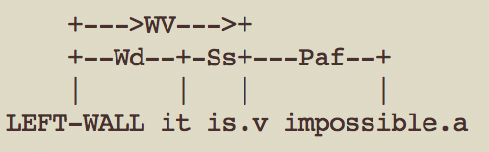
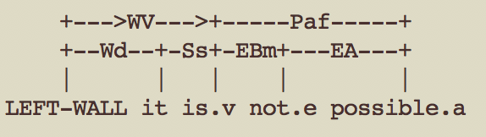
Blurring boundaries between grammatical parsing and
morphological parsing causes tokenization ambiguity
这不可能
(Google)
这 不 可能
(Jieba)

Slide 26
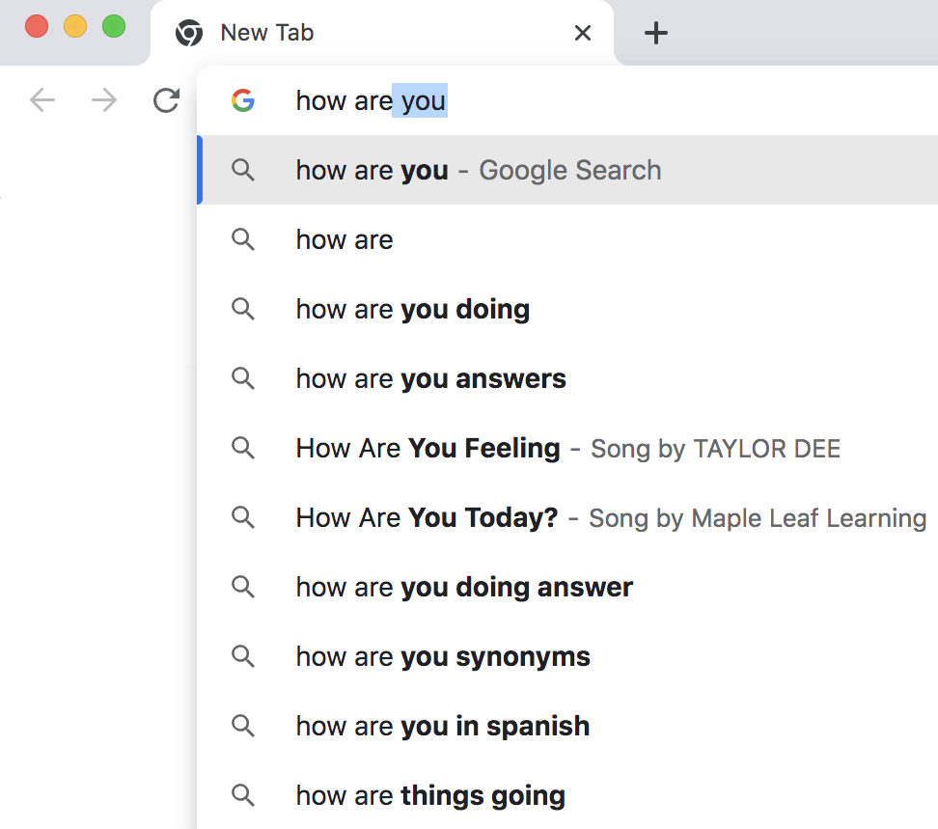
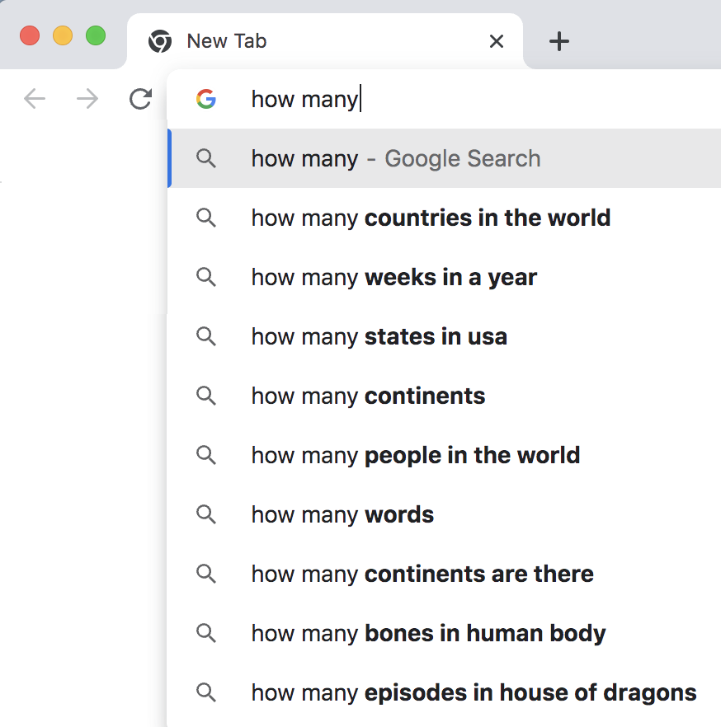
Minimizing Uncertainty
https://aclanthology.org/2022.emnlp-main.239/
https://arxiv.org/pdf/2303.02427.pdf

Slide 27
Unsupervised Learning for Text Segmentation
based on Probability and Uncertainty Measures
to
168M
people
10000M
do
130M
times
Metrics/Indicators:
Mutual Information¹
Conditional Probability^{1,2}
Transition Freedom^{2,3}
1930M
5
4
how
1230M
many
14M
countries
892M
long
4M
states
330M
1
are
132M
you
¹ https://scholarsarchive.byu.edu/cgi/viewcontent.cgi?article=6983&context=etd
² https://www.ncbi.nlm.nih.gov/pmc/articles/PMC2655800/
³ Karl Friston. The free-energy principle: a unified brain theory? https://www.nature.com/articles/nrn2787

Slide 28
A few more cases:
Learning and using symbolic “models”

Slide 29

Case 5: Unsupervised Text Segmentation (Probability)
Metrics/Indicators:
Ngram (Character)
Conditional
Probability
(of Transition)
P(Ngram_{n+1})/P(Ngram_{n})
P(“m ”)/P(“m”)
False positives
False negatives
https://aclanthology.org/2022.emnlp-main.239/

Slide 30
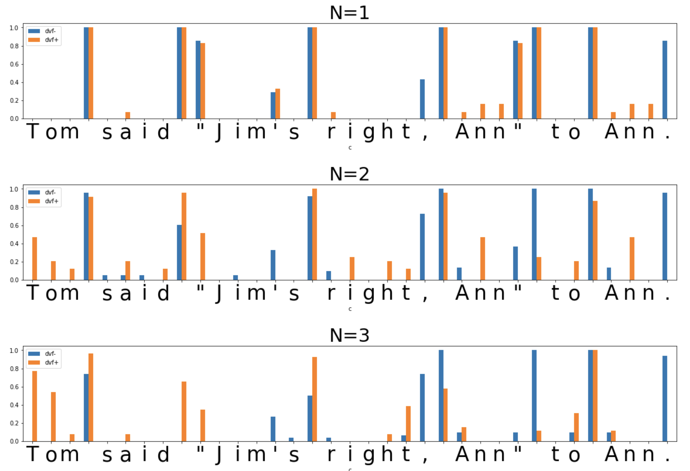
Case 5: Unsupervised Text Segmentation (Uncertainty)
Metrics/
Indicators:
Transition
Freedom
Deviation
(varying “N”
of N-gram)
False positive
False negative
https://aclanthology.org/2022.emnlp-main.239/

Slide 31
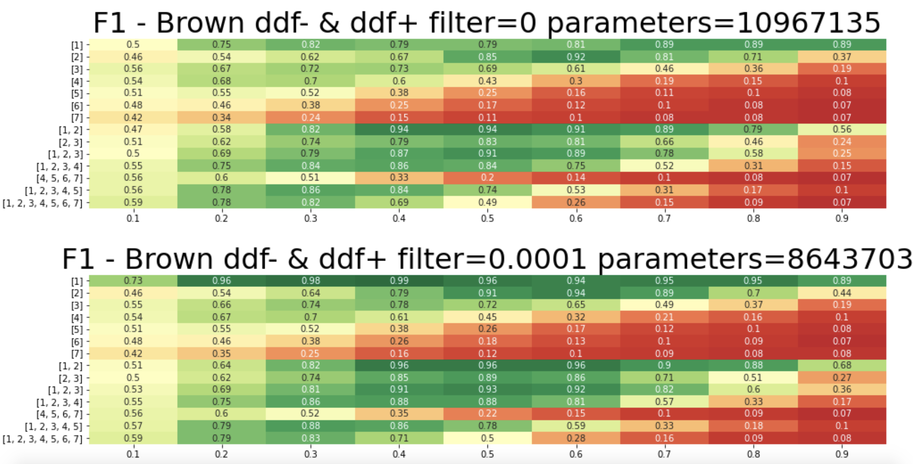
Case 5: Unsupervised Text Segmentation (Hyper-parameters)
English
Hyper-
Parameters:
Metric:
Transition
Freedom
Threshold
for model
compression
Combination
of Ngram N-s
Threshold for
segmentation
https://aclanthology.org/2022.emnlp-main.239/

Slide 32
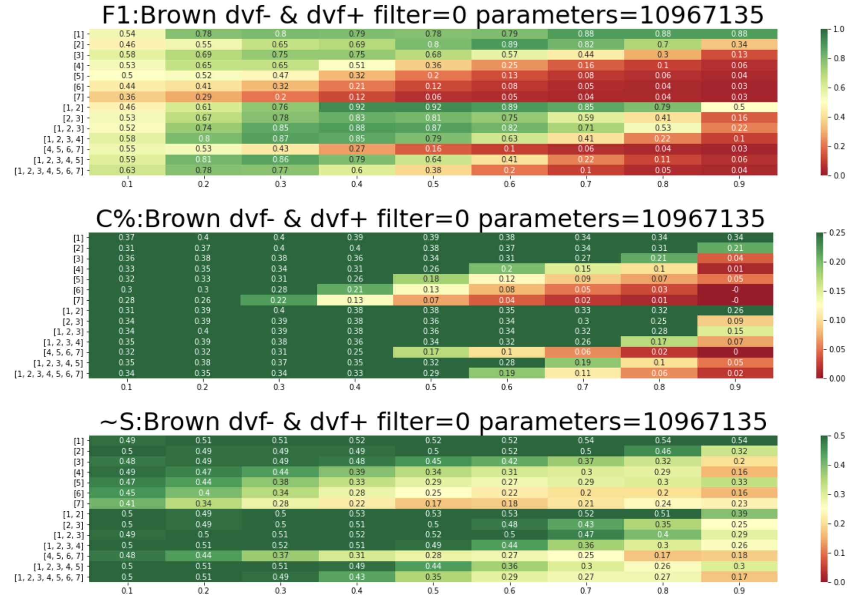
Case 5: Unsupervised Text Segmentation (Auto-learning)
English,
Brown corpus,
F1 vs.
culture-agnostic
metrics
Maximizing F1, compression factor (C%) and normalized anti-entropy (~S) in the space of hyper-parameters
https://ieeexplore.ieee.org/document/10347856
https://link.springer.com/chapter/10.1007/978-3-031-44865-2_1

Slide 33

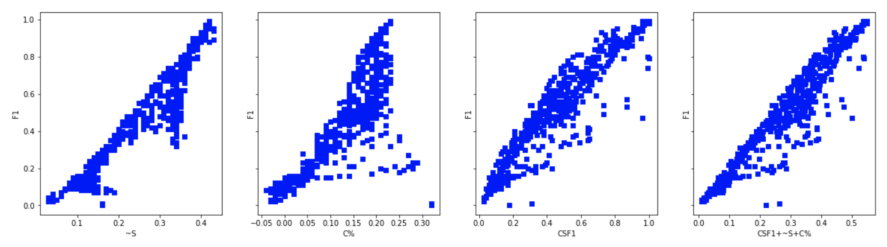


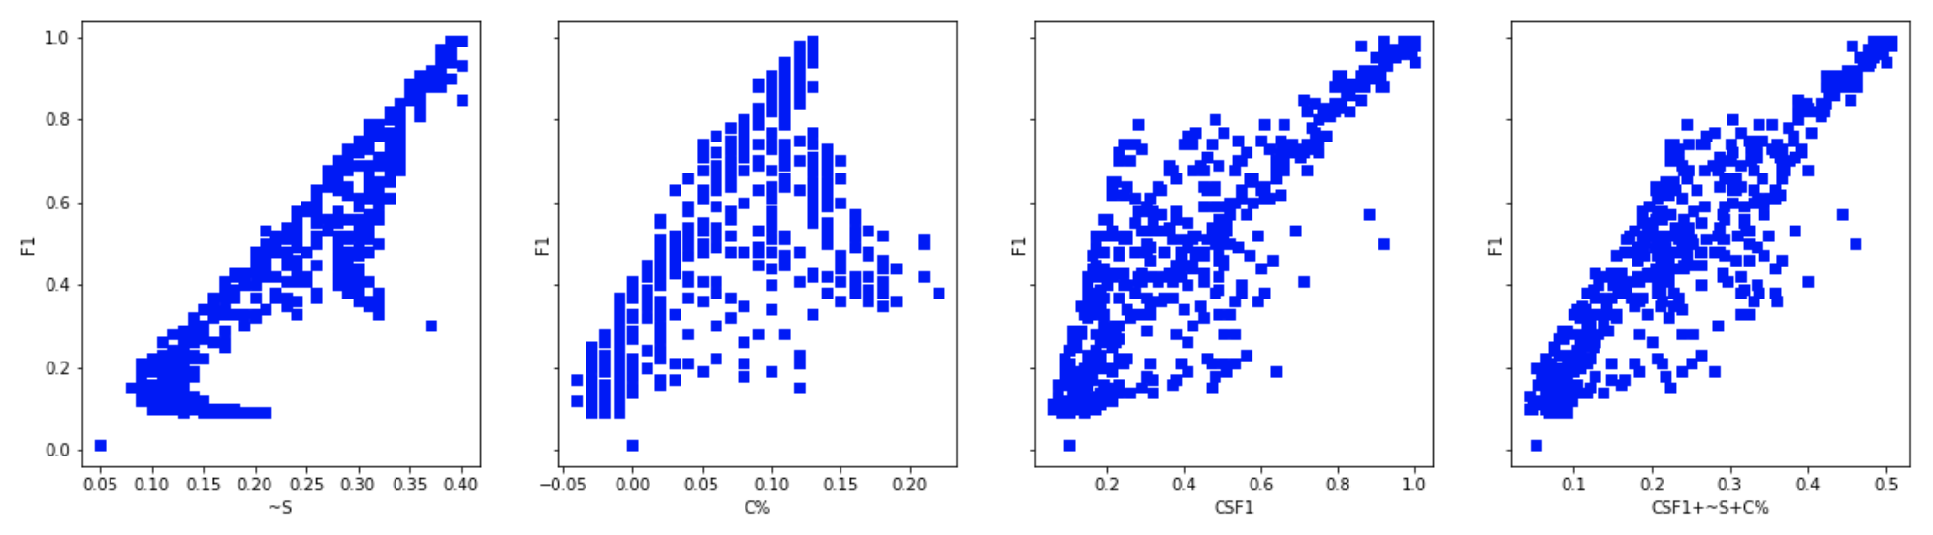


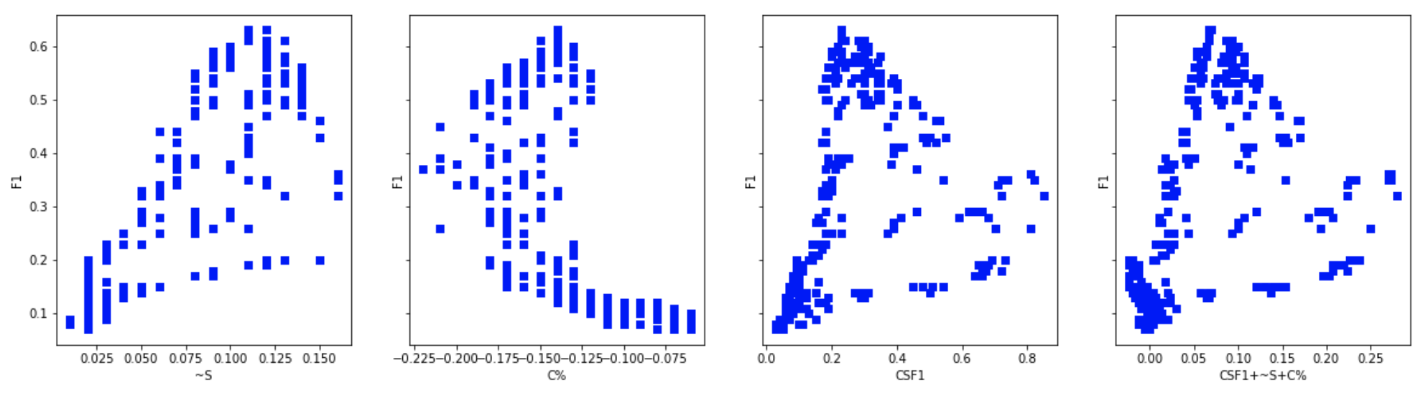

Case 5: Unsupervised Text Segmentation (Different corpora)
English, Train: Brown, Test: Brown 1000
English, Train: Brown, Test: MagicData 100
https://github.com/aigents/pygents/blob/main/notebooks/nlp/english/en_tokenizer_auto.ipynb
Russian, Train: RusAge, Test: RusAge 1000
Russian, Train: Brown, Test: MagicData 100
https://github.com/aigents/pygents/blob/main/notebooks/nlp/russian/ru_tokenizer_auto.ipynb
Chinese, Train: CLUE News, Test: CLUE News 1000
Chinese, Train: Brown, Test: MagicData 100
https://github.com/aigents/pygents/blob/main/notebooks/nlp/chinese/zh_tokenizer_auto.ipynb
https://github.com/aigents/pygents/blob/main/notebooks/nlp/tokenization/brown/tokenization_brown_en_ru_zh.ipynb

Slide 34
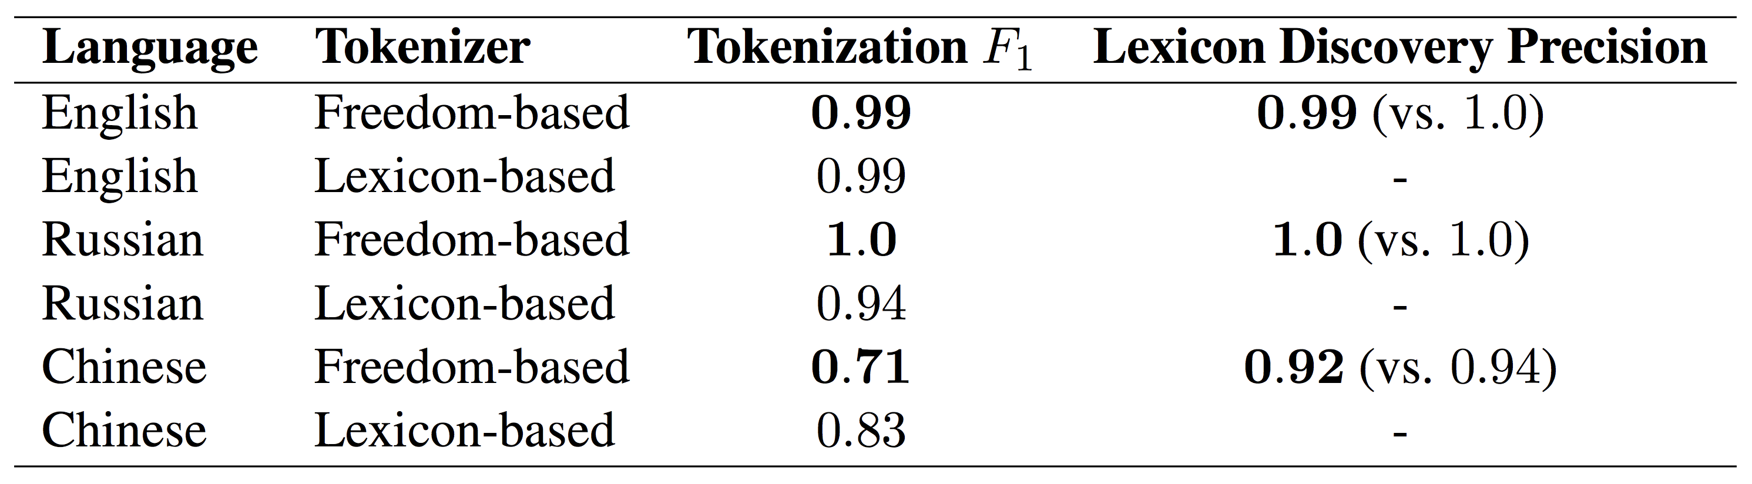
Case 5: Unsupervised Text Segmentation
(“Freedom”-based Tokenization against
Lexicon-based one, referring to Rule-based)
*
*
*
*Lexicon-based Tokenization - greedy/beam search on word length (optimal) or frequency
https://aclanthology.org/2022.emnlp-main.239/
https://ieeexplore.ieee.org/document/10347856
https://link.springer.com/chapter/10.1007/978-3-031-44865-2_1

Slide 35




Case 6: Unsupervised Character Category Learning
Agglomerative Clustering in space of Transitions
RusAge Test/Small, Cosine Similarity
https://aclanthology.org/2022.emnlp-main.239.pdf

Slide 36
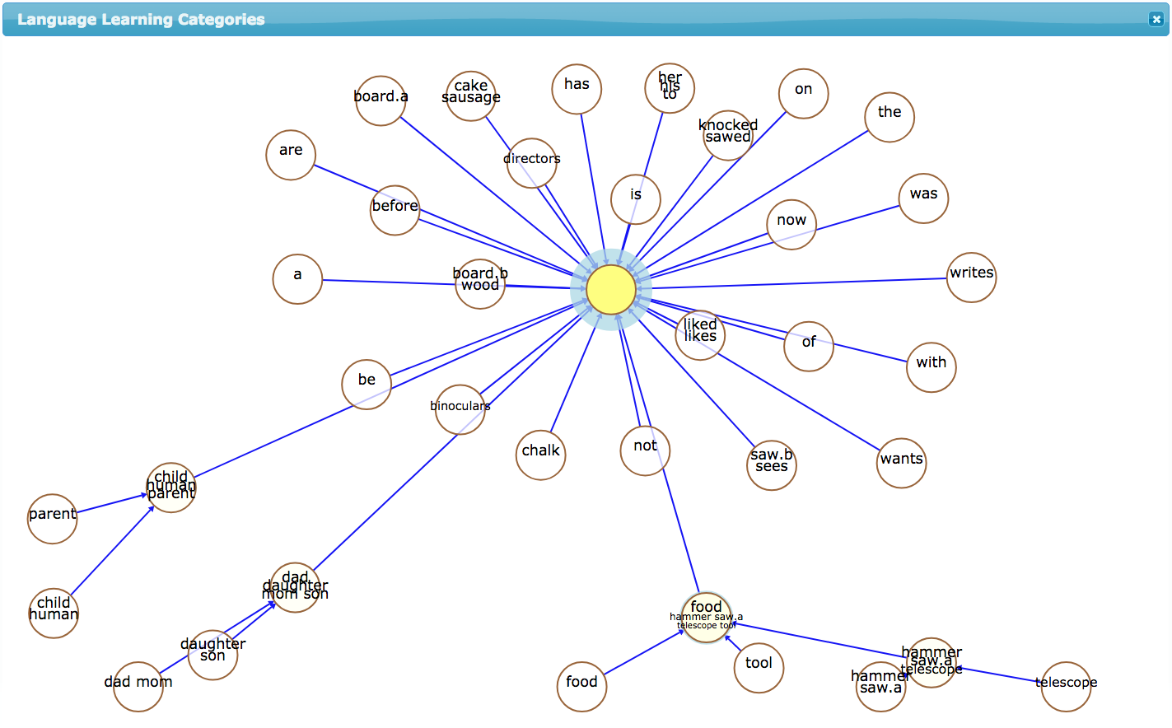
Case 7: Unsupervised Ontology Learning on Parses
POC-English
corpus
https://www.springerprofessional.de/unsupervised-language-learning-in-opencog/15995030
https://www.springerprofessional.de/en/programmatic-link-grammar-induction-for-unsupervised-language-le/17020348

Slide 37
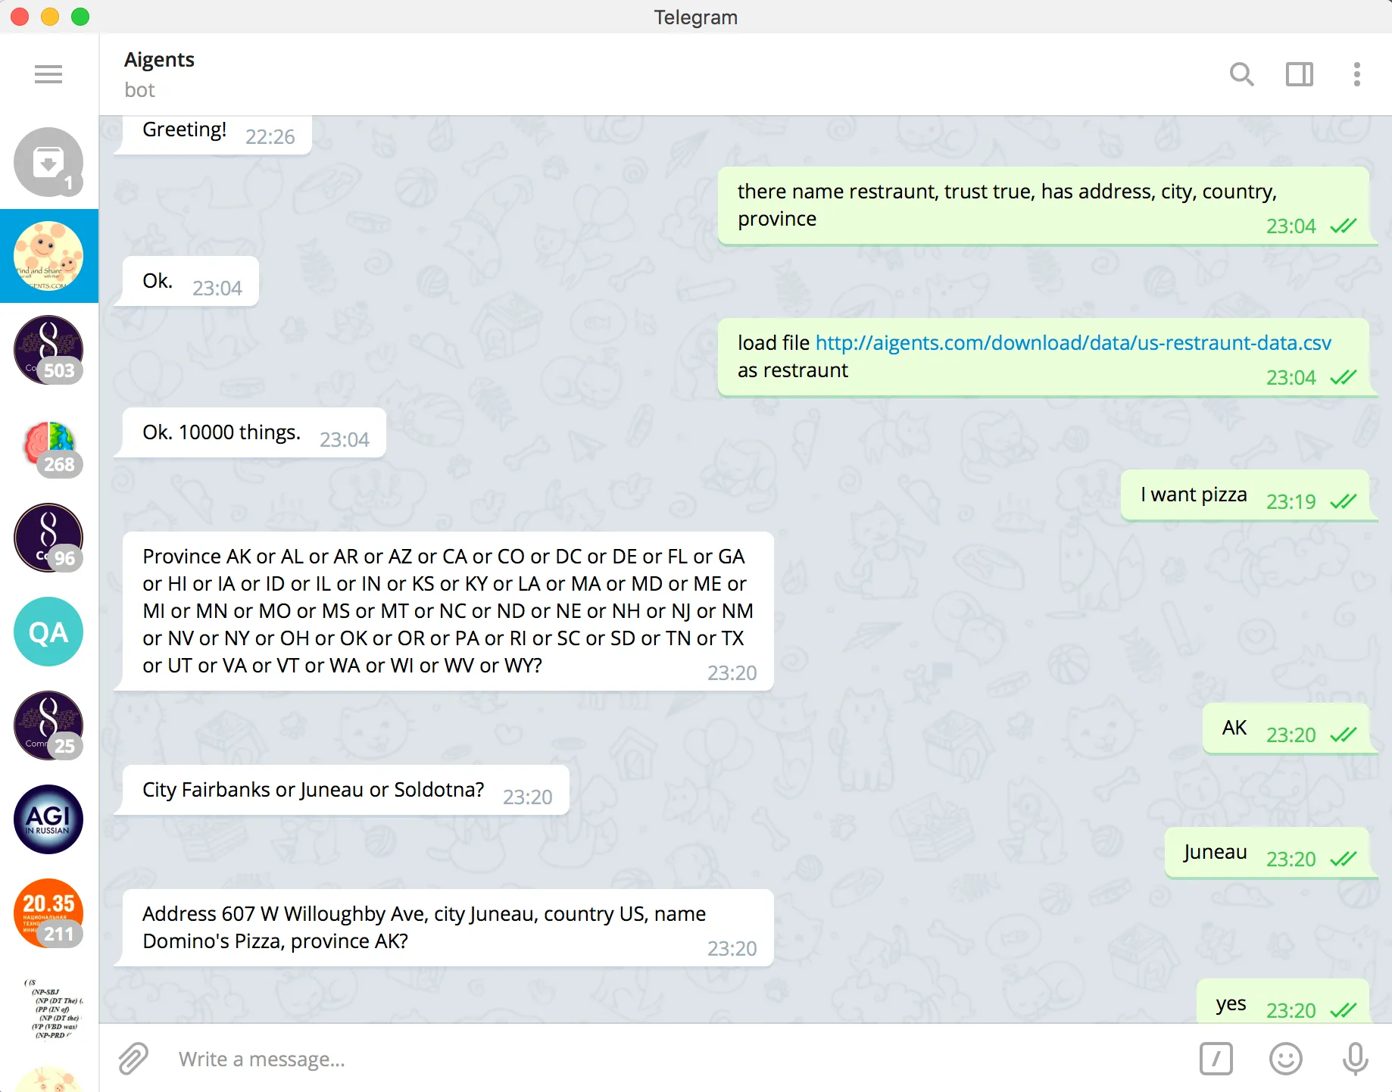
Case 8: Data-driven Conversational Intelligence
Location
W.Willoughvby 607, Juneu, AK, US
Cuisine type
Italian
Fast-food
Place category
Dynamic data-driven dialog flow minimizing uncertainty
Just add RAG augmentation?
https://t.me/AigentsBot
https://blog.singularitynet.io/chat-with-your-data-using-aigents-bots-99b76cae65f2

Slide 38

Case 9: Graph-based contextual language generation
Hand
giving
#noun
#verb
#body-part
#interaction
#process
#language
#mood
#hand_giving
#english
#russian
#indicative
#imperative
#hand
#give
SEQ
->
SEQ
<-
AND
AND
AND
SEQ
->
SEQ
->
hand
give
given
рука
руку
подана
подай
руку
подай
подай
руку

Slide 39
Welcome to the Interpretable Natural Language Processing Community and Series of Workshops
Telegram English
https://t.me/internlp
Telegram Russian
https://t.me/agibots
INLP Workshops
https://aigents.github.io/inlp/
Extended presentation in Russian
https://www.youtube.com/watch?v=PRmST_EnJsc

Slide 40
Thank You and Welcome!
Anton Kolonin
akolonin@aigents.com
Messengers: akolonin
AIGENTS
https://agirussia.org
https://aigents.com

