Slide 1




Unsupervised Lexicon and Punctuation Discovery
Anton Kolonin
akolonin@aigents.com
Facebook: akolonin
Telegram: akolonin
https://agirussia.org
AIGENTS
https://aigents.com

Slide 2



Something about Human Intuition?
Language 1
Language 2
Language 3

Slide 3
Goal: Discovering NLP patterns (words, punctuation, phrases) for unsupervised language learning (Aigents® “Deep Patterns”)
NOUN
VERB
SUBJECT PREDICATE OBJECT
OR
OR
“procedure”
“drug”
“negative effect”
“positive effect”
“disease”
OR
OR
OR
OR
AND
AND
cold
aspirin
treat
reduces
OR
head
tylenol
acetylsalicylic acid
treats
reduce
existential
frustration
acetaminophen
anxiety
acetaminophen may significantly reduce feelings of existential anxiety
https://ieeexplore.ieee.org/document/7361868
https://github.com/aigents/aigents-java
https://www.springerprofessional.de/unsupervised-language-learning-in-opencog/15995030
https://www.springerprofessional.de/en/programmatic-link-grammar-induction-for-unsupervised-language-le/17020348
https://github.com/singnet/language-learning/

Slide 4
Motivation
Absence of explicit start/stop tags in continuous streams of spaces in experiential (reinforcement/self-reinforcement) learning with delayed/sparse feedback
Complex, cumbersome, unreliable and expensive language-specific tokenization process for unsupervised language learning in NLP
Low quality of unsupervised parsing and tokenization learning based on mutual information and conditional probabilities
https://www.youtube.com/watch?v=2LPLhJKh95g
https://www.springerprofessional.de/neuro-symbolic-architecture-for-experiential-learning-in-discret/20008336
https://github.com/aigents/aigents-java/tree/master/src/main/java/net/webstructor/agi
https://www.springerprofessional.de/unsupervised-language-learning-in-opencog/15995030
https://www.springerprofessional.de/en/programmatic-link-grammar-induction-for-unsupervised-language-le/17020348
https://github.com/singnet/language-learning/
https://scholarsarchive.byu.edu/cgi/viewcontent.cgi?article=6983&context=etd

Slide 5
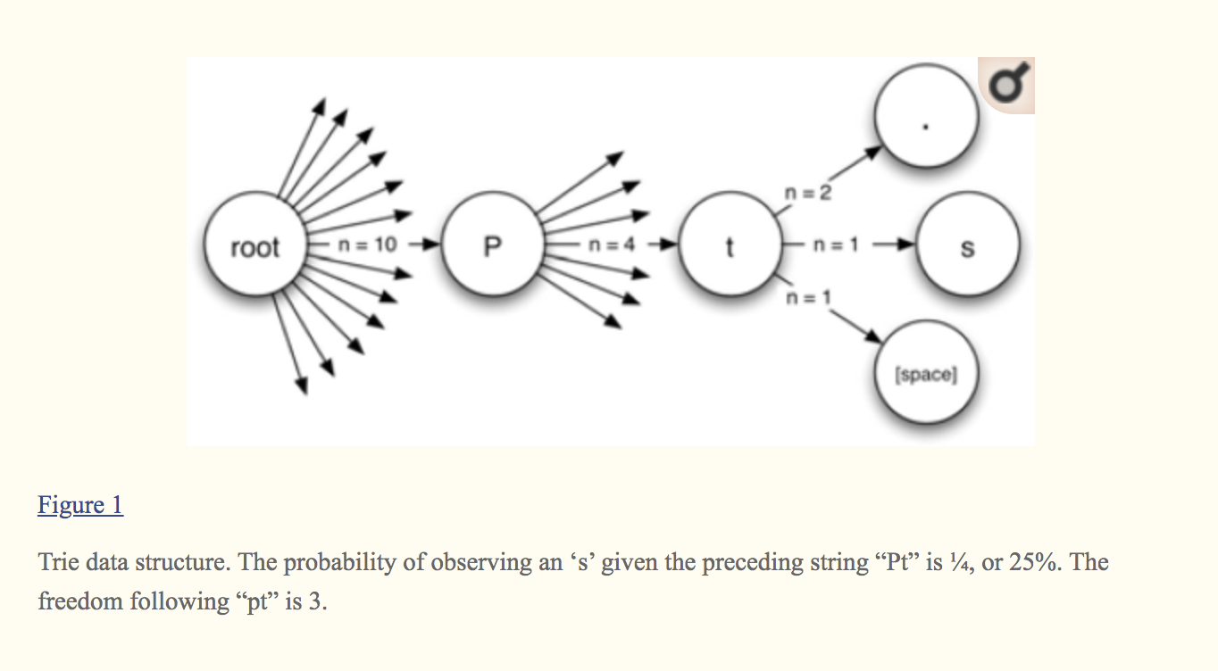
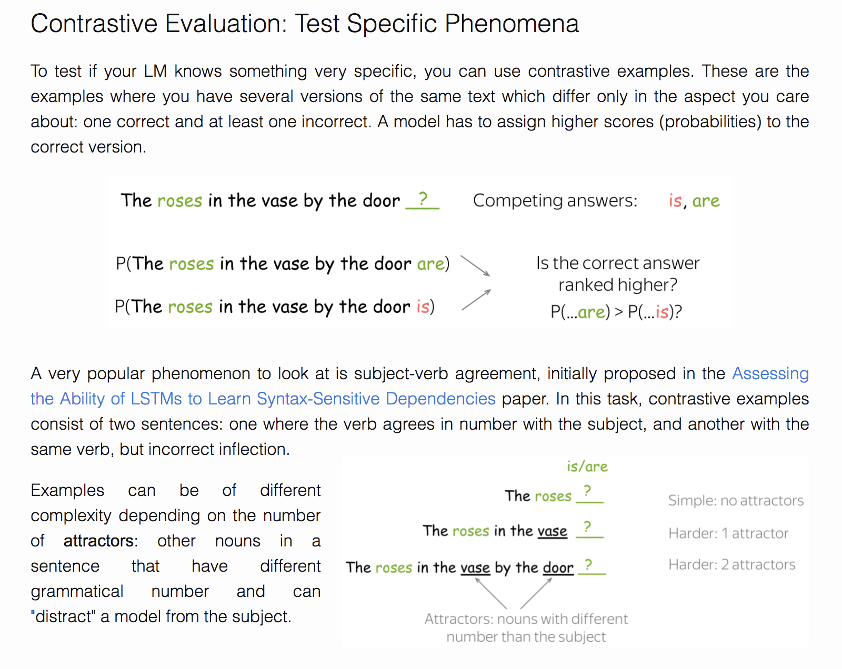
Tokenization or Text Segmentation as Language Modeling
Metrics/Indicators:
Mutual Information¹
Conditional Probability^{1,2}
Transition Freedom^{2,3}
¹ https://scholarsarchive.byu.edu/cgi/viewcontent.cgi?article=6983&context=etd
² https://www.ncbi.nlm.nih.gov/pmc/articles/PMC2655800/
³ Karl Friston.The free-energy principle: a unified brain theory?
https://www.nature.com/articles/nrn2787
https://lena-voita.github.io/nlp_course/language_modeling.html

Slide 6
Claims
Transition Freedom (TF) appears to be superior (over Mutual Information and Conditional Probability) for unsupervised text segmentation (tokenization).
English and Russian require one specific way (variance) of handling the TF while Chinese requires a bit different specific way (derivative-based “peak values”) for the same purpose.
Tokenization quality for Russian and English may be as high as F1=0.96-1.0, depending on training and testing corpora while for Chinese the minimum is F1=0.71-0.92, depending on the assessment assumptions.
Larger training corpora does not necessarily effect in better tokenization quality, while compacting the models eliminating statistically weak evidence typically improve the quality.
TF-based tokenization appear quality same or better than lexicon-based one for Russian and English while for Chinese appears the opposite (as it could be anticipated).
Doing Russian and English tokenization with removed spaces makes the situation similar to Chinese with reasonable quality on lexicon-based tokenization but much worse results on TF-based one.
https://arxiv.org/abs/2205.11443
https://github.com/aigents/pygents

Slide 7
Corpora and Methodology
Train corpora
Chinese
CLUE News 2016 Validation – 270M
CLUE News 2016 Train – 8,500M
English
Brown – 6M
Gutenberg Children – 29M
Gutenberg Adult – 140M
Social Media – 68M
All above – combined
Russian
RusAge Test – 141M
RusAge Previews – 825M
Test corpus
Parallel Chinese/English/Russian
– 100 multi-sentence statements on finance
Metrics/Indicators:
Ngram (Character)
Probability or Conditional Transition Probability (p-/p+)
Deviation (dvp-/dvp+)
Derivative (dp-/dp+)
Transition Freedom (f-/f+)
Deviation (dvf-/dvf+)
Derivative (df-/df+)
Hyper-parameters:
Combination of Ngram ranks N ([1],[2],[3],[1,2],[1,2,3],…)
Threshold for model compression
Threshold for segmentation
Evaluations:
Tokenization F1, on set of tokens found comparing to delimiter-based (English/Russian) or Jieba (Chineze)
Precision on set of tokens found comparing to reference lexicons

Slide 8
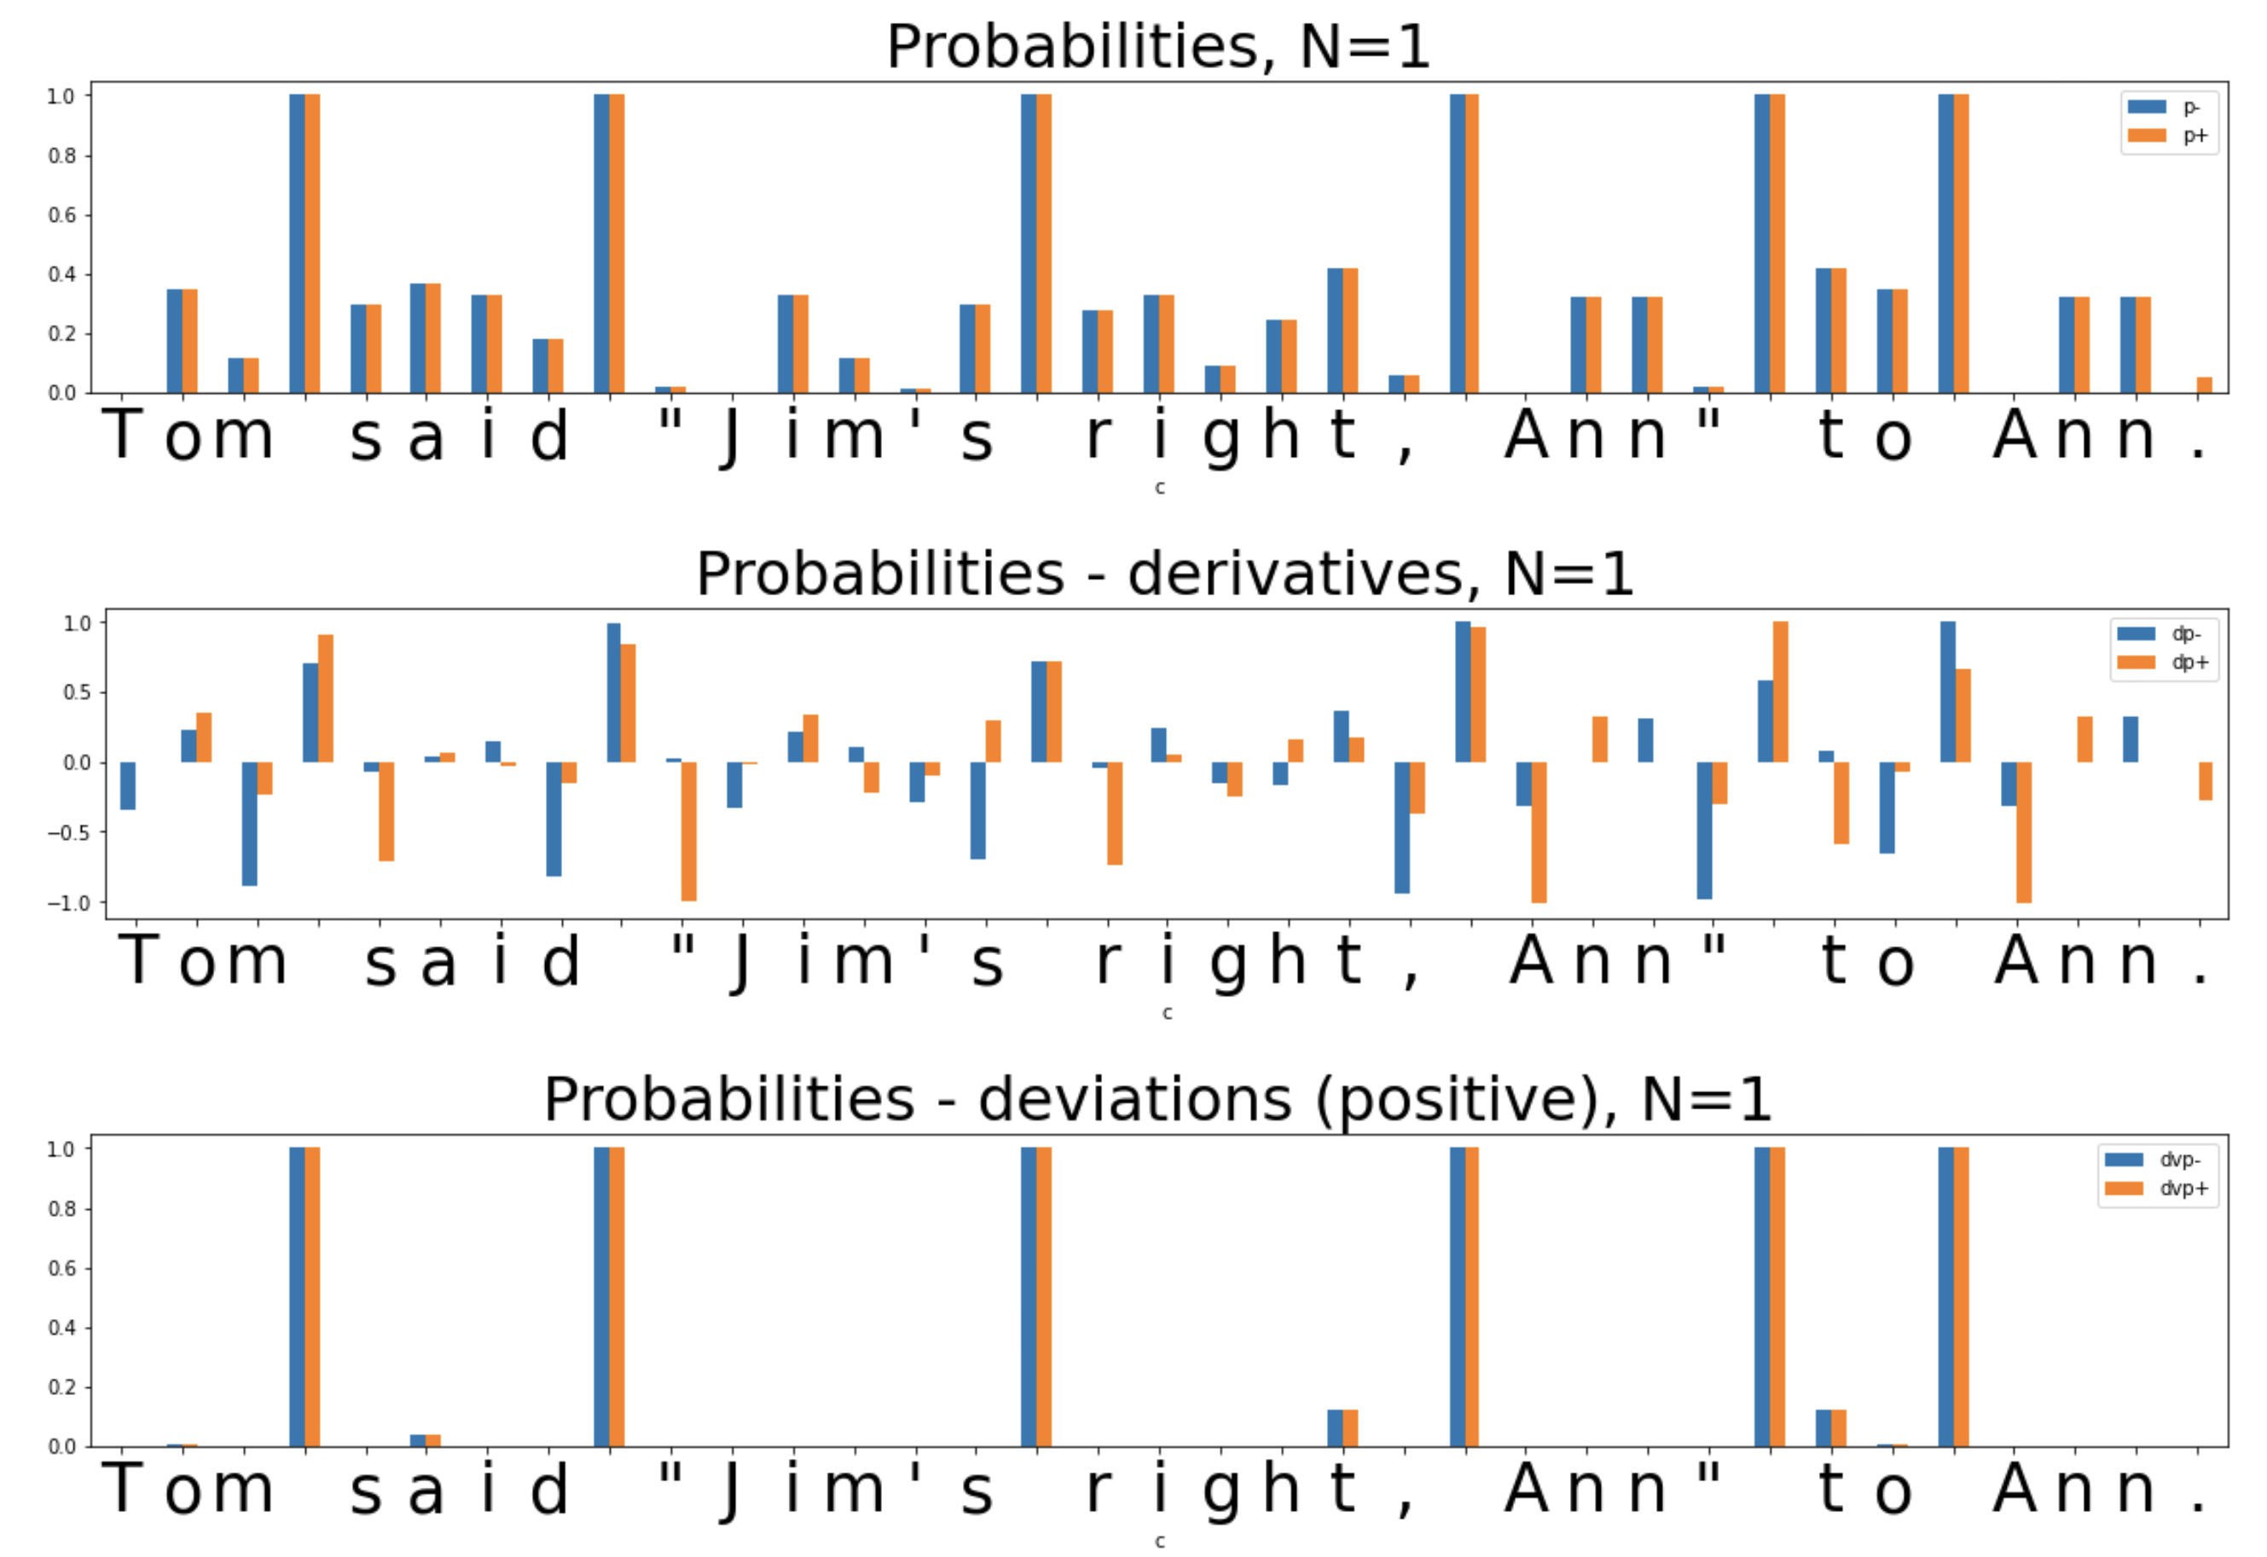
Unsupervised Text Segmentation (Tokenization)
Metrics/Indicators:
Ngram (Character)
Probability

Slide 9

Unsupervised Text Segmentation (Tokenization)
Metrics/Indicators:
Ngram (Character)
Conditional
Probability
(of Transition)
P(Ngram_{n+1})/P(Ngram_{n})
P(“m ”)/P(“m”)

Slide 10
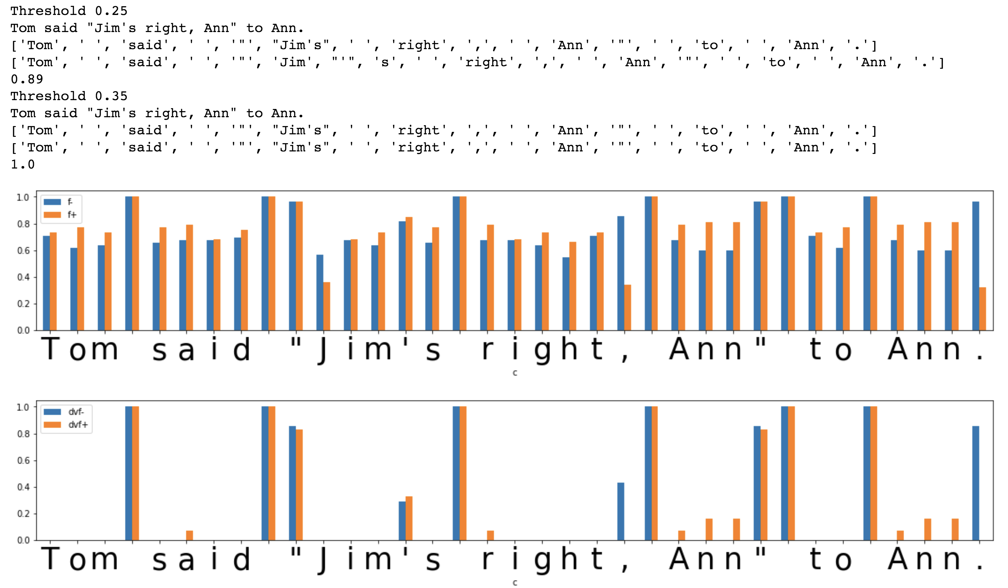
Unsupervised Text Segmentation (Tokenization)
Metrics/
Indicators:
Transition
Freedom
Deviation
(Freedom
of Transition)
https://www.ncbi.nlm.nih.gov/pmc/articles/PMC2655800/

Slide 11
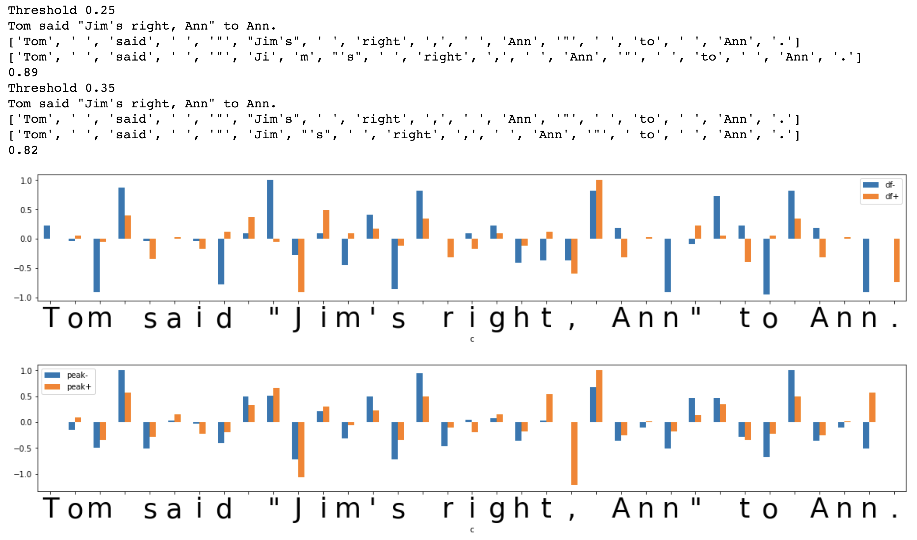
Unsupervised Text Segmentation (Tokenization)
Metrics/
Indicators:
Transition
Freedom
Derivative
and “Peak”
(Freedom
of Transition
“Peak”)
https://www.ncbi.nlm.nih.gov/pmc/articles/PMC2655800/

Slide 12
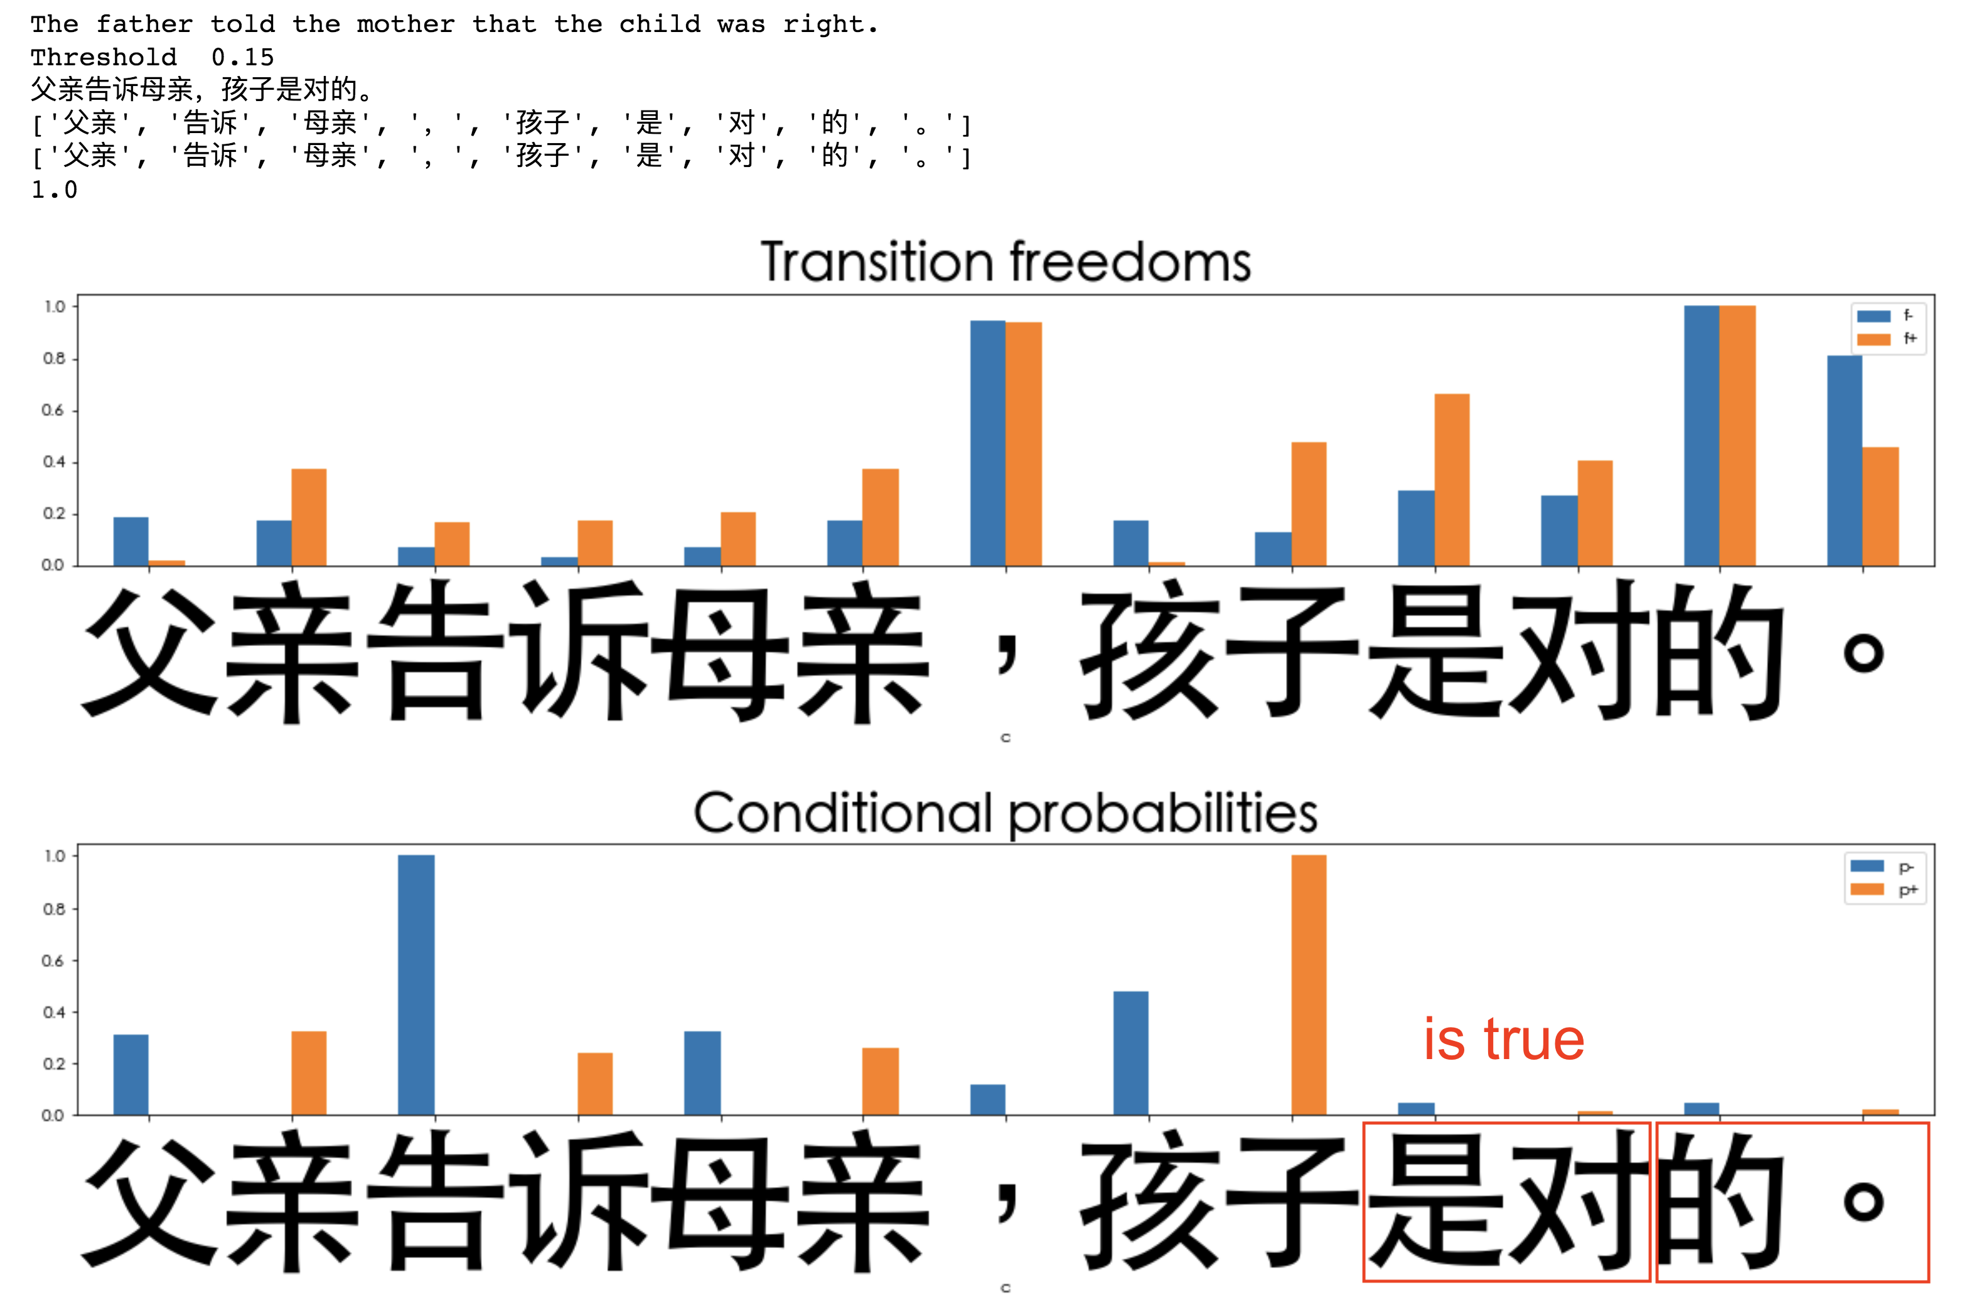
Unsupervised Text Segmentation (Tokenization)
Metrics/Indicators:
Transition
Freedom
Deviation
Conditional
Probability
(of Transition)

Slide 13
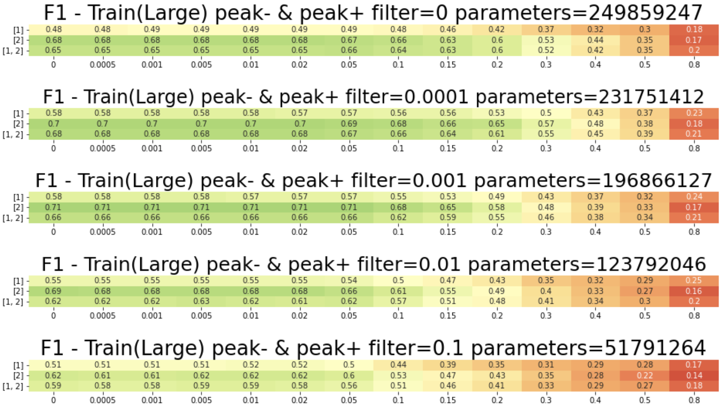
Unsupervised Text Segmentation (Tokenization)
Chinese
Hyper-
Parameters:
TF “Peak”
Threshold
for model
compression
Combination
of Ngram N-s
Threshold for
segmentation

Slide 14
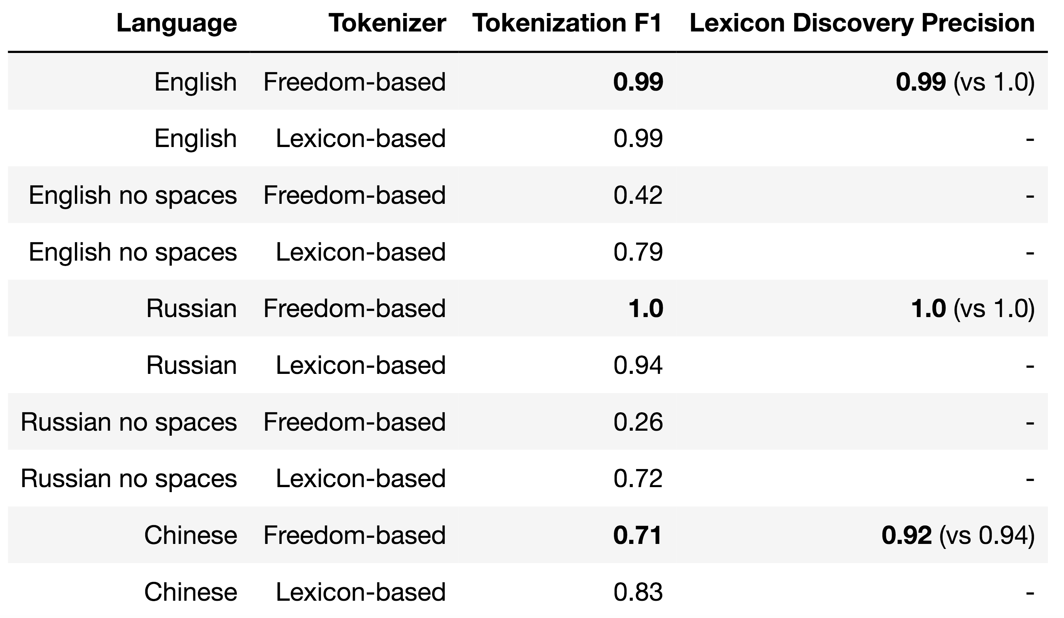
Results – Freedom-based Tokenization against Lexicon
Lexicon-based Tokenization - greedy/beam search on word length (optimal) or frequency

Slide 15




Unsupervised Character Category Learning
Agglomerative Clustering in space of Transitions
RusAge Test/Small, Cosine Similarity

Slide 16
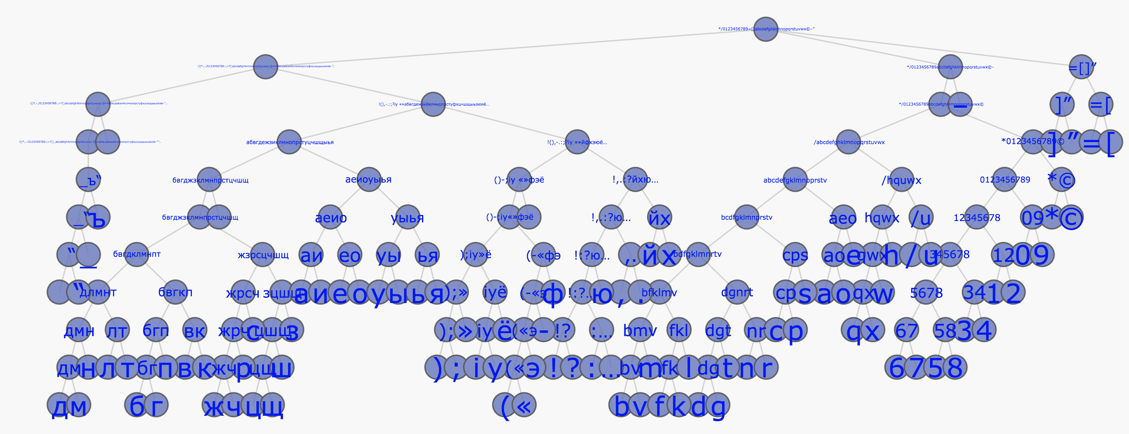
Unsupervised Character Category Learning
Agglomerative Clustering in space of Transitions
RusAge Previews/Full, Jackard Similarity

Slide 17
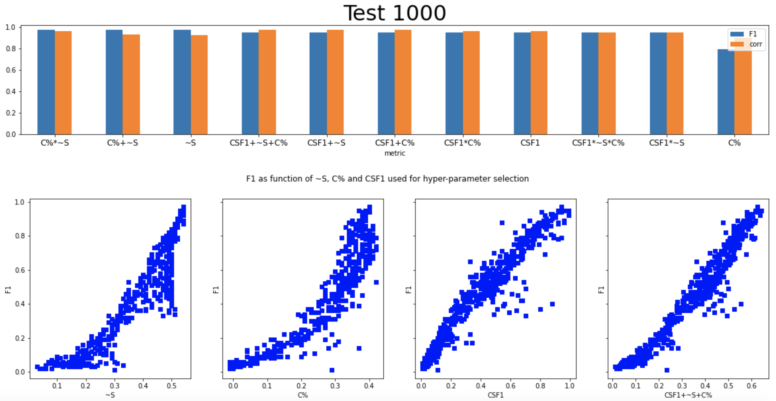
Self-tuning Hyperparameters – English (TF variance)

Slide 18
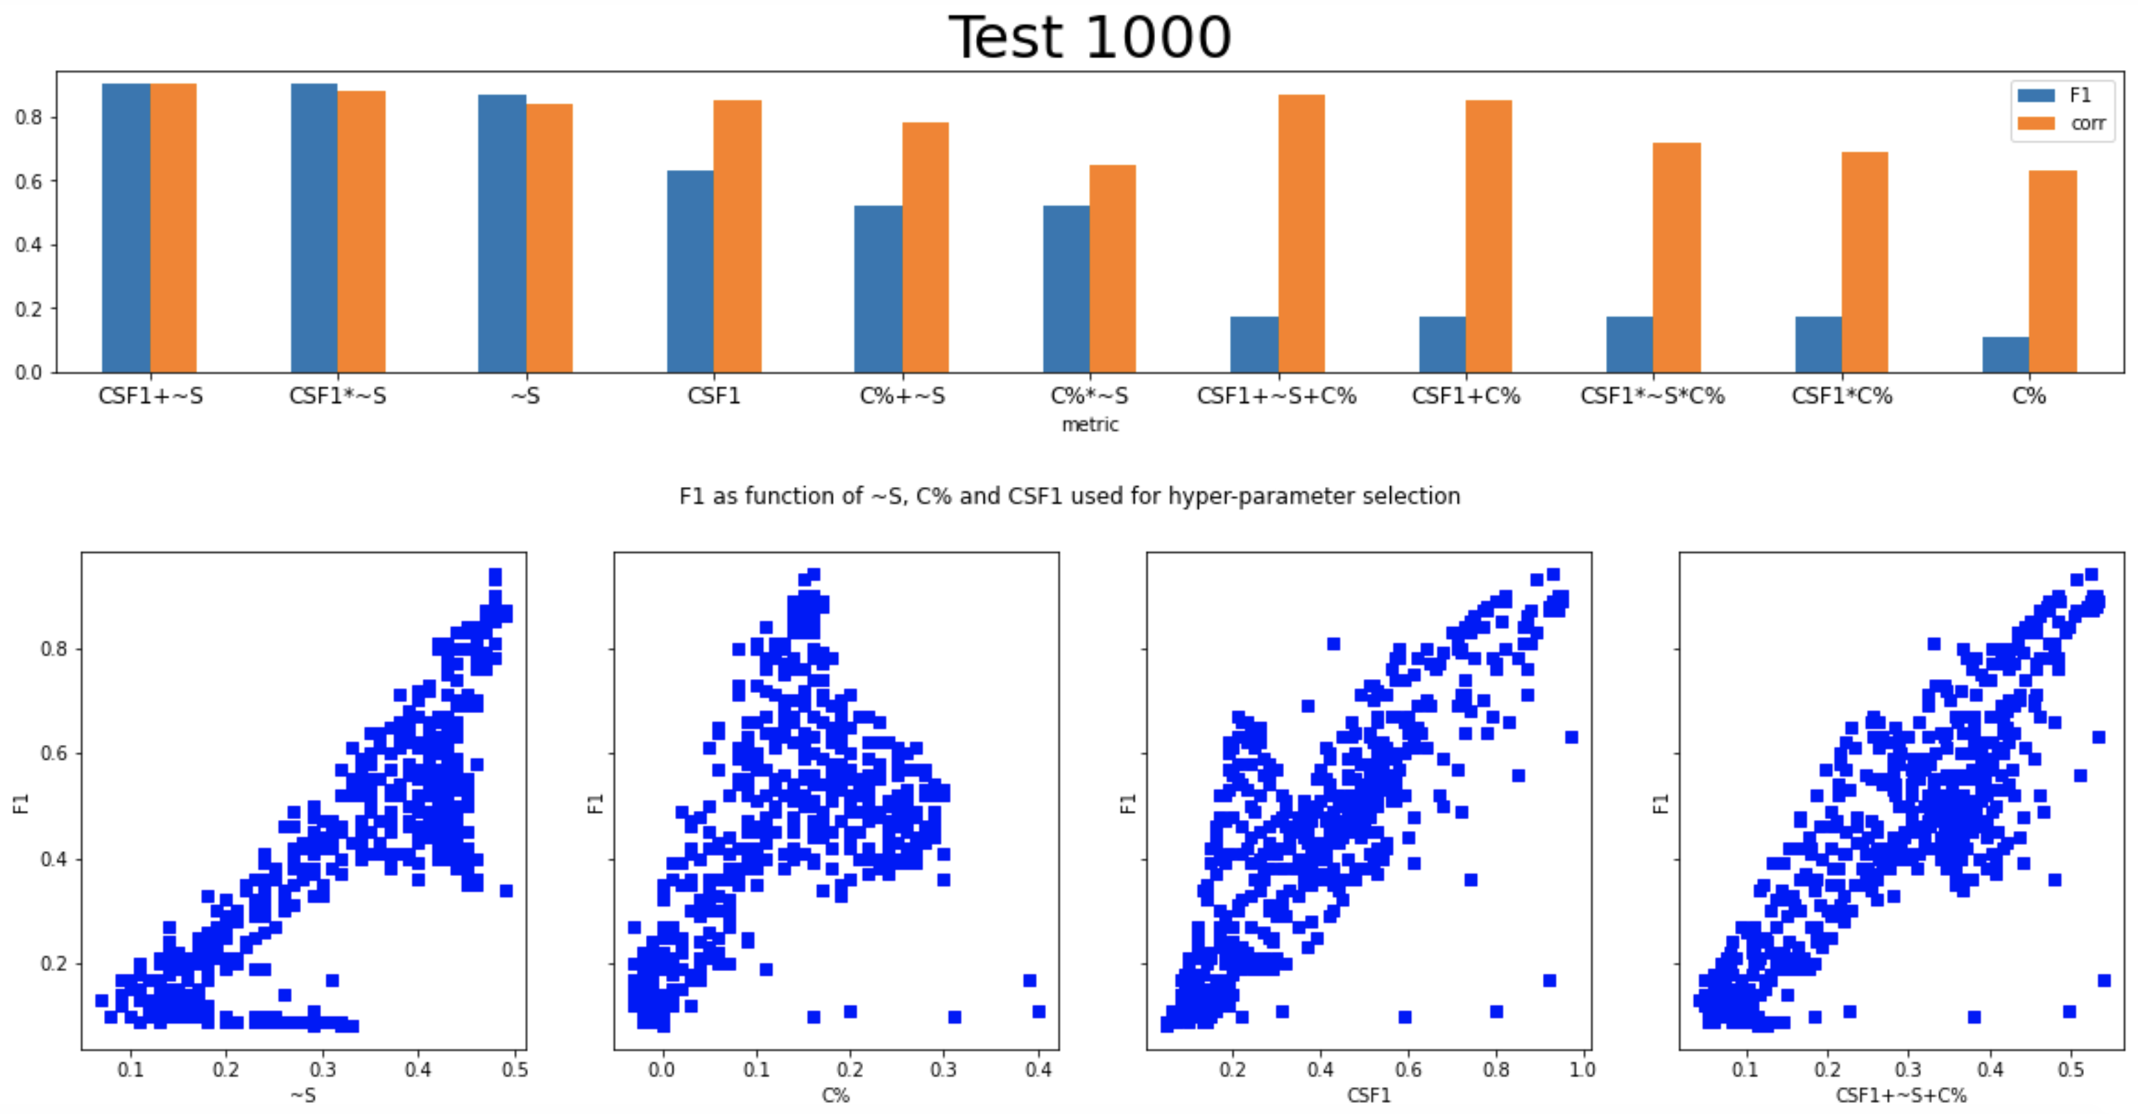
Self-tuning Hyperparameters – Russian (TF variance)

Slide 19
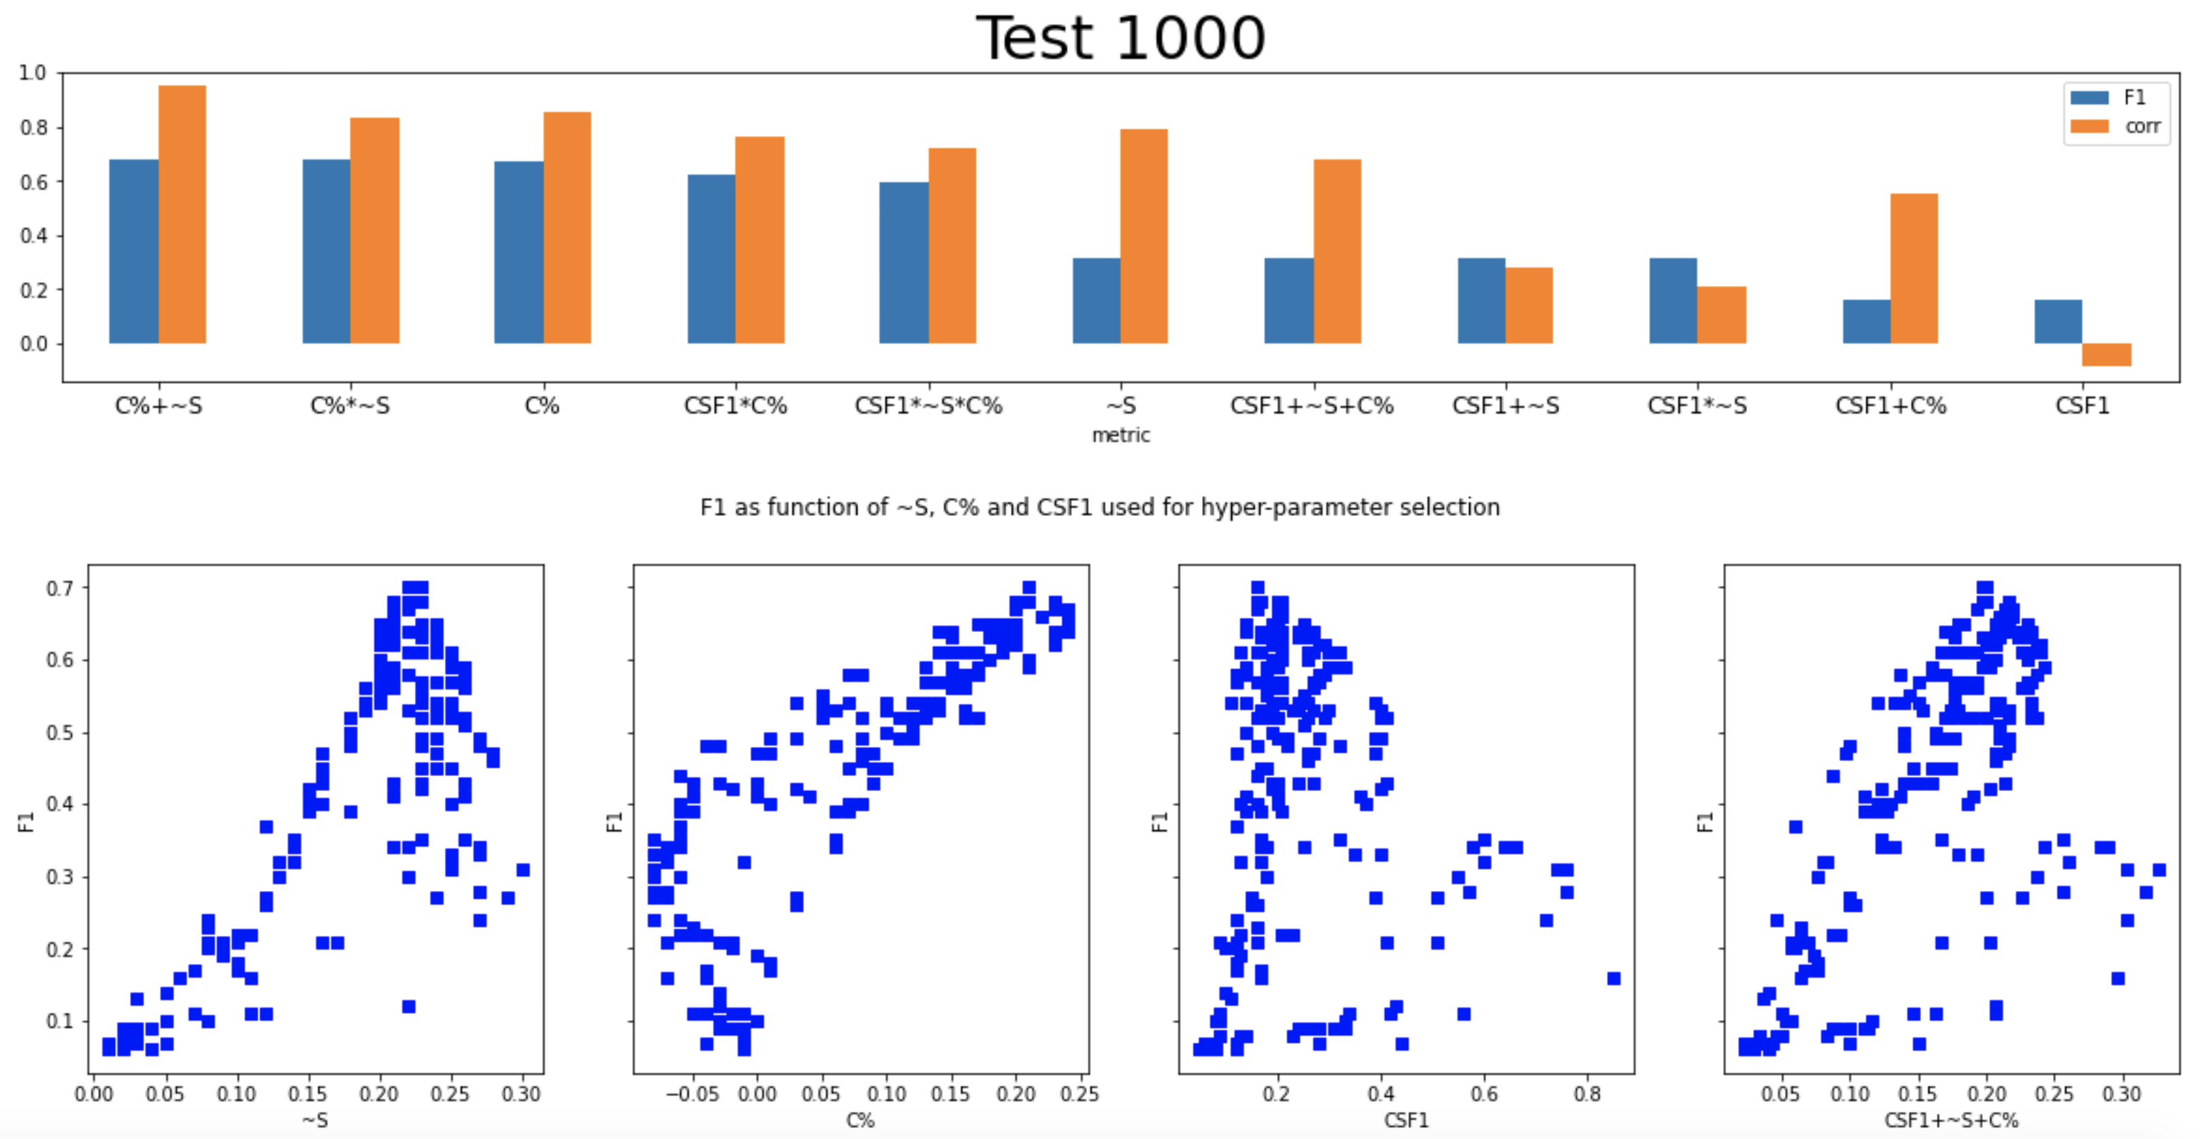
Self-tuning Hyperparameters – Chinese (TF “peak”)

Slide 20
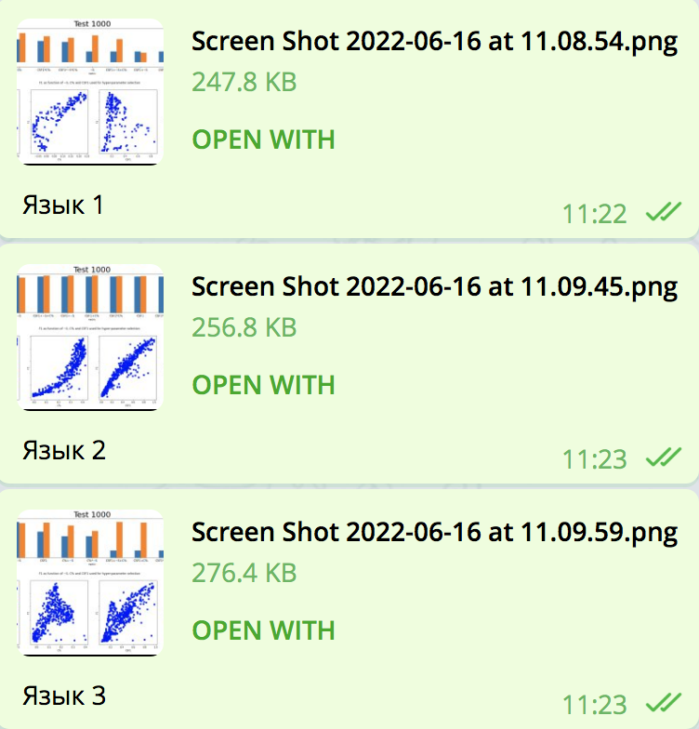
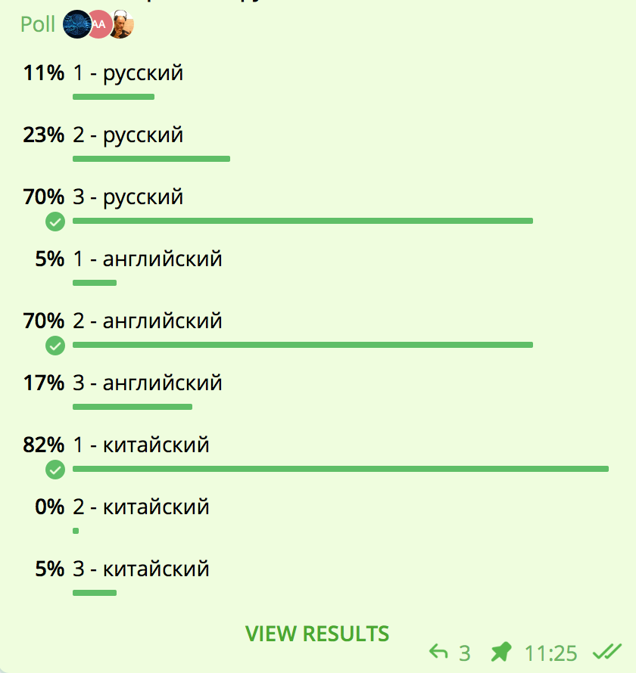
Something about Human Intuition!
Russian
Russian
Language 1
Russian
English
English
Language 2
English
Chinese
Chinese
Chinese
Language 3

Slide 21
Conclusion and Further Work
Unsupervised Tokenization based on Transition Freedom (TF) recall and precision appears good enough as initial approximation for further applications of self-reinforcement learning as part of interpretable unsupervised learning of natural language.
Optimal thresholds and specific TF-based metrics are specific to language. The process and policy of their discovery and adjustment should be further explored.
Clustering or parts of speech on space of transition graphs may provide some insights on morphology and punctuation structure of low-resource and domain-specific languages.
Hybridization of TF-based tokenization approach with lexicon-based one might be efficient for low-resource and domain-specific languages.
Further unsupervised grammar learning experiments can be run on the basis of suggested unsupervised tokenization approach.
Applications for other Experiential Learning environments, including the ones with delayed/sparse feedback.
Using Reinforcement Learning techniques with self-reinforcement on historical data under Unsupervised Learning setup.
https://arxiv.org/abs/2205.11443
https://github.com/aigents/pygents

Slide 22
Thank You and Welcome!
Anton Kolonin
akolonin@aigents.com
Facebook: akolonin
Telegram: akolonin
https://agirussia.org
AIGENTS
https://aigents.com

