Slide 1




Experiential Learning from Sequential Data
Anton Kolonin
akolonin@aigents.com
Facebook: akolonin
Telegram: akolonin
https://agirussia.org
AIGENTS
https://aigents.com

Slide 2
Motivation
Identifying successful/unsuccessful sequential experiences for experiential learning for global (self)reinforcement
Discovering NLP patterns such as words and punctuation for further unsupervised language learning
https://arxiv.org/abs/2205.11443
https://github.com/aigents/pygents
Unsupervised Learning of Temporal Abstractions with Slot-based Transformers
Anand Gopalakrishnan, Kazuki Irie, Jürgen Schmidhuber, Sjoerd van Steenkiste
https://arxiv.org/abs/2203.13573

Slide 3
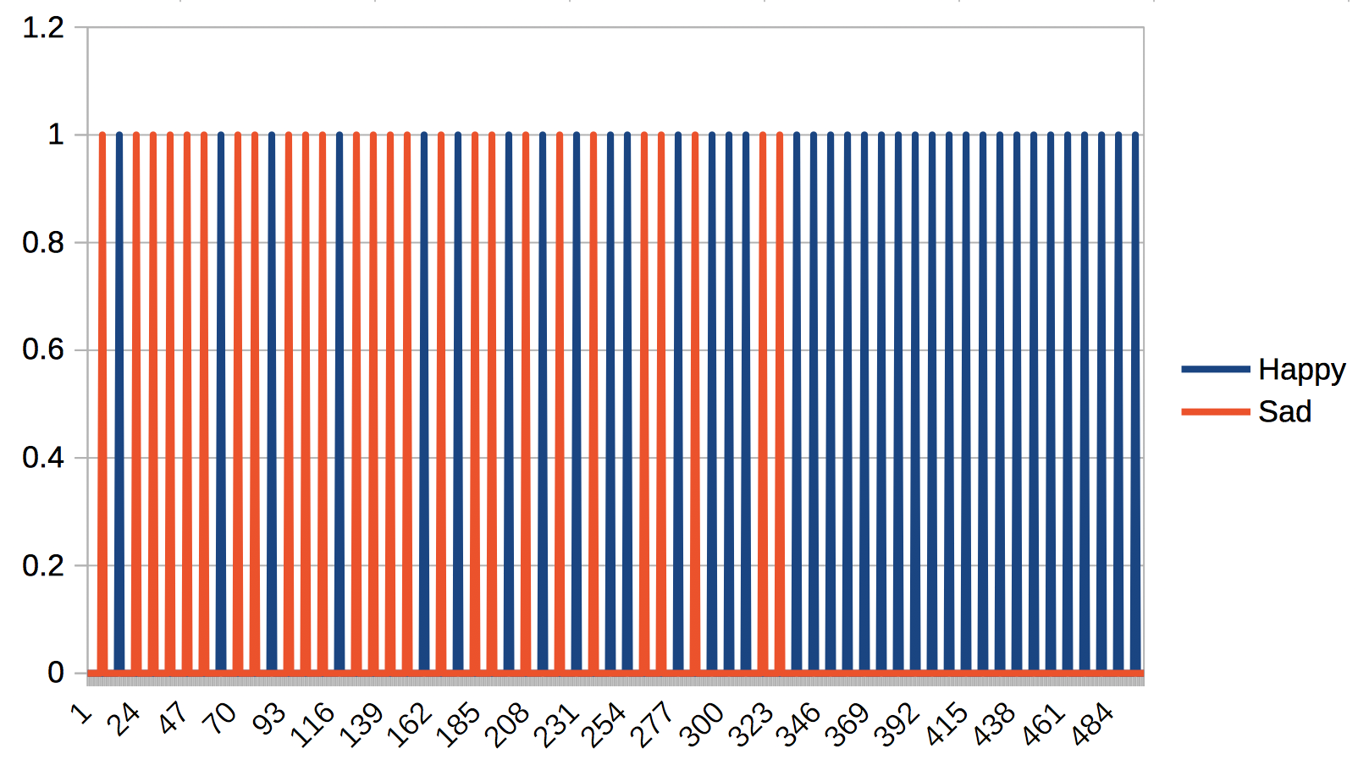

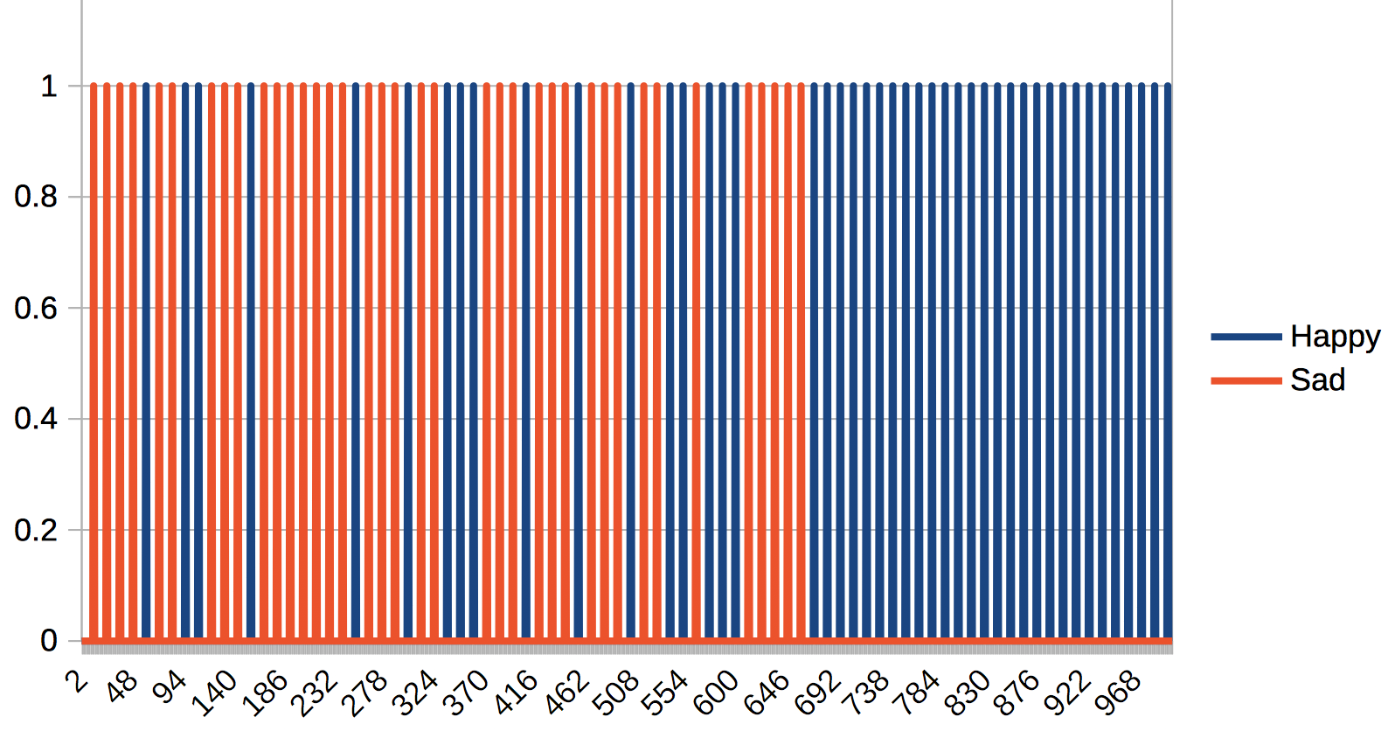
Identifying successful/unsuccessful sequential experiences for experiential learning with global (self)reinforcement
2 X 6 50 epochs
Sad(t)
Happy(t)
Left(t)
Stay(t)
Right(t)
Xball(t)
Yball(t)
Xracket(t)
Sad(t)
Happy(t)
Agent
6 X 8 1000 epochs
Comp-
ressor
Predicates
Base Values
Pre-
dictor
Models
Evidence Log
Move(t)
Decider
Action Log
https://www.youtube.com/watch?v=2LPLhJKh95g
https://www.springerprofessional.de/neuro-symbolic-architecture-for-experiential-learning-in-discret/20008336
https://github.com/aigents/aigents-java/tree/master/src/main/java/net/webstructor/agi

Slide 4
Ontology and Grammar (“Discrete”)
predicate
argument
Pixel
Move
Happy
Boolean
Number
Horizontal
False
True
statement :=
predicate(argument)
Row
Column
Left
Center
Right
Pixel(1,0)
Pixel(4,1)
Happy(False)
=>
Move(Left)
Pixel(0,2)
Pixel(4,2)
Happy(False)
=>
Move(Right)
Pixel(3,4)
Pixel(4,4)
Happy(False)
=>
Move(Left)
Pixel(0,4)
Pixel(4,3)
Happy(True)
=>
Move(Left)
Global
Feedback
https://www.youtube.com/watch?v=2LPLhJKh95g

Slide 5
Ontology and Grammar (“Functional”)
predicate
argument
Position
Happy
Move
RacketX
BallX
BallY
Boolean
Horizontal
Vertical
False
True
statement :=
predicate(argument)
Left
Center
Right
Top
Center
Bottom
BallY(Top)
BallX(Left)
RacketX(Left)
Happy(False)
=> Move(Left)
BallY(Top)
BallX(Center)
RacketX(Center)
Happy(False)
=> Move(Right)
BallY(Bottom)
BallX(Right)
RacketX(Right)
Happy(False)
=> Move(Right)
BallY(Bottom)
BallX(Right)
RacketX(Right)
Happy(True)
=> Move(Left)
Global
Feedback
https://www.youtube.com/watch?v=2LPLhJKh95g

Slide 6
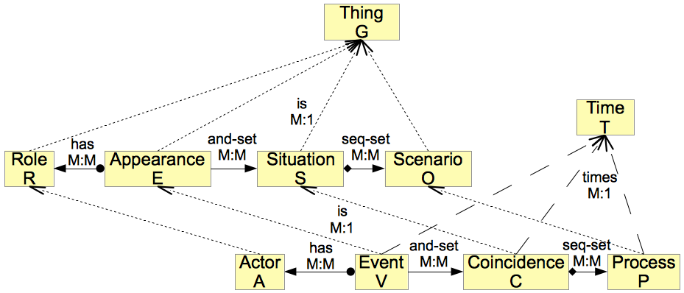
Foundation (Generic) Activity Ontology
https://arxiv.org/abs/1807.02072

Slide 7
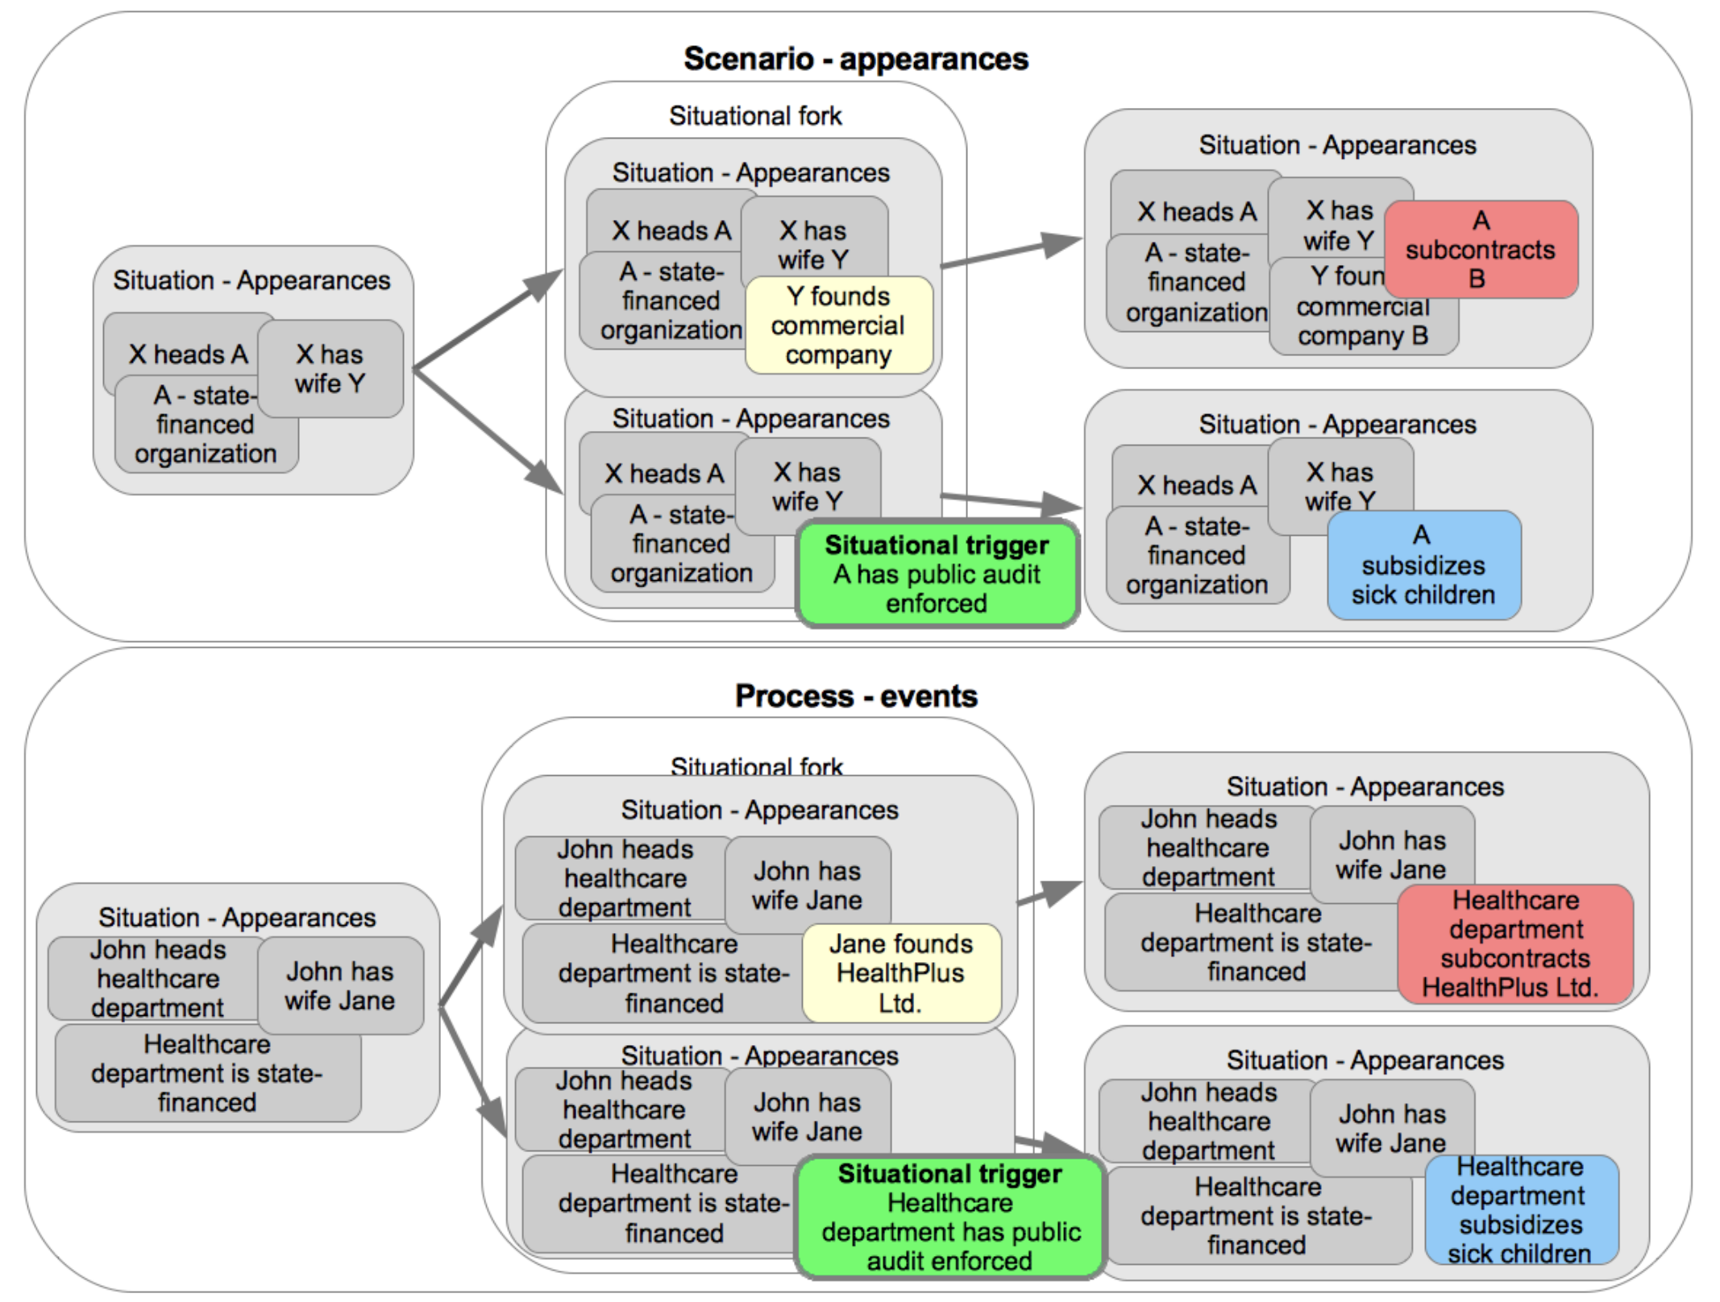
Upper (Domain) Activity Ontology Example
https://arxiv.org/abs/1807.02072

Slide 8
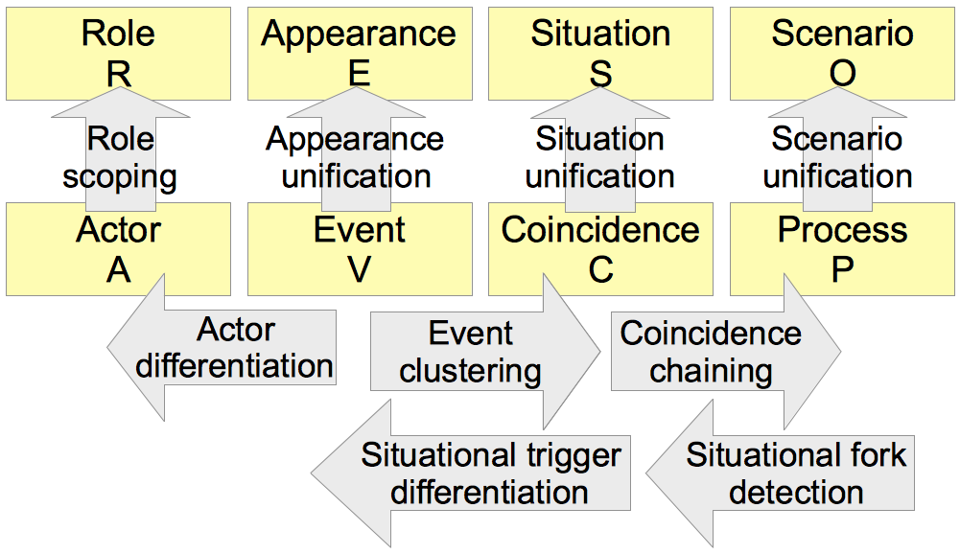
Scenario Mining in Process Data
https://arxiv.org/abs/1807.02072

Slide 9
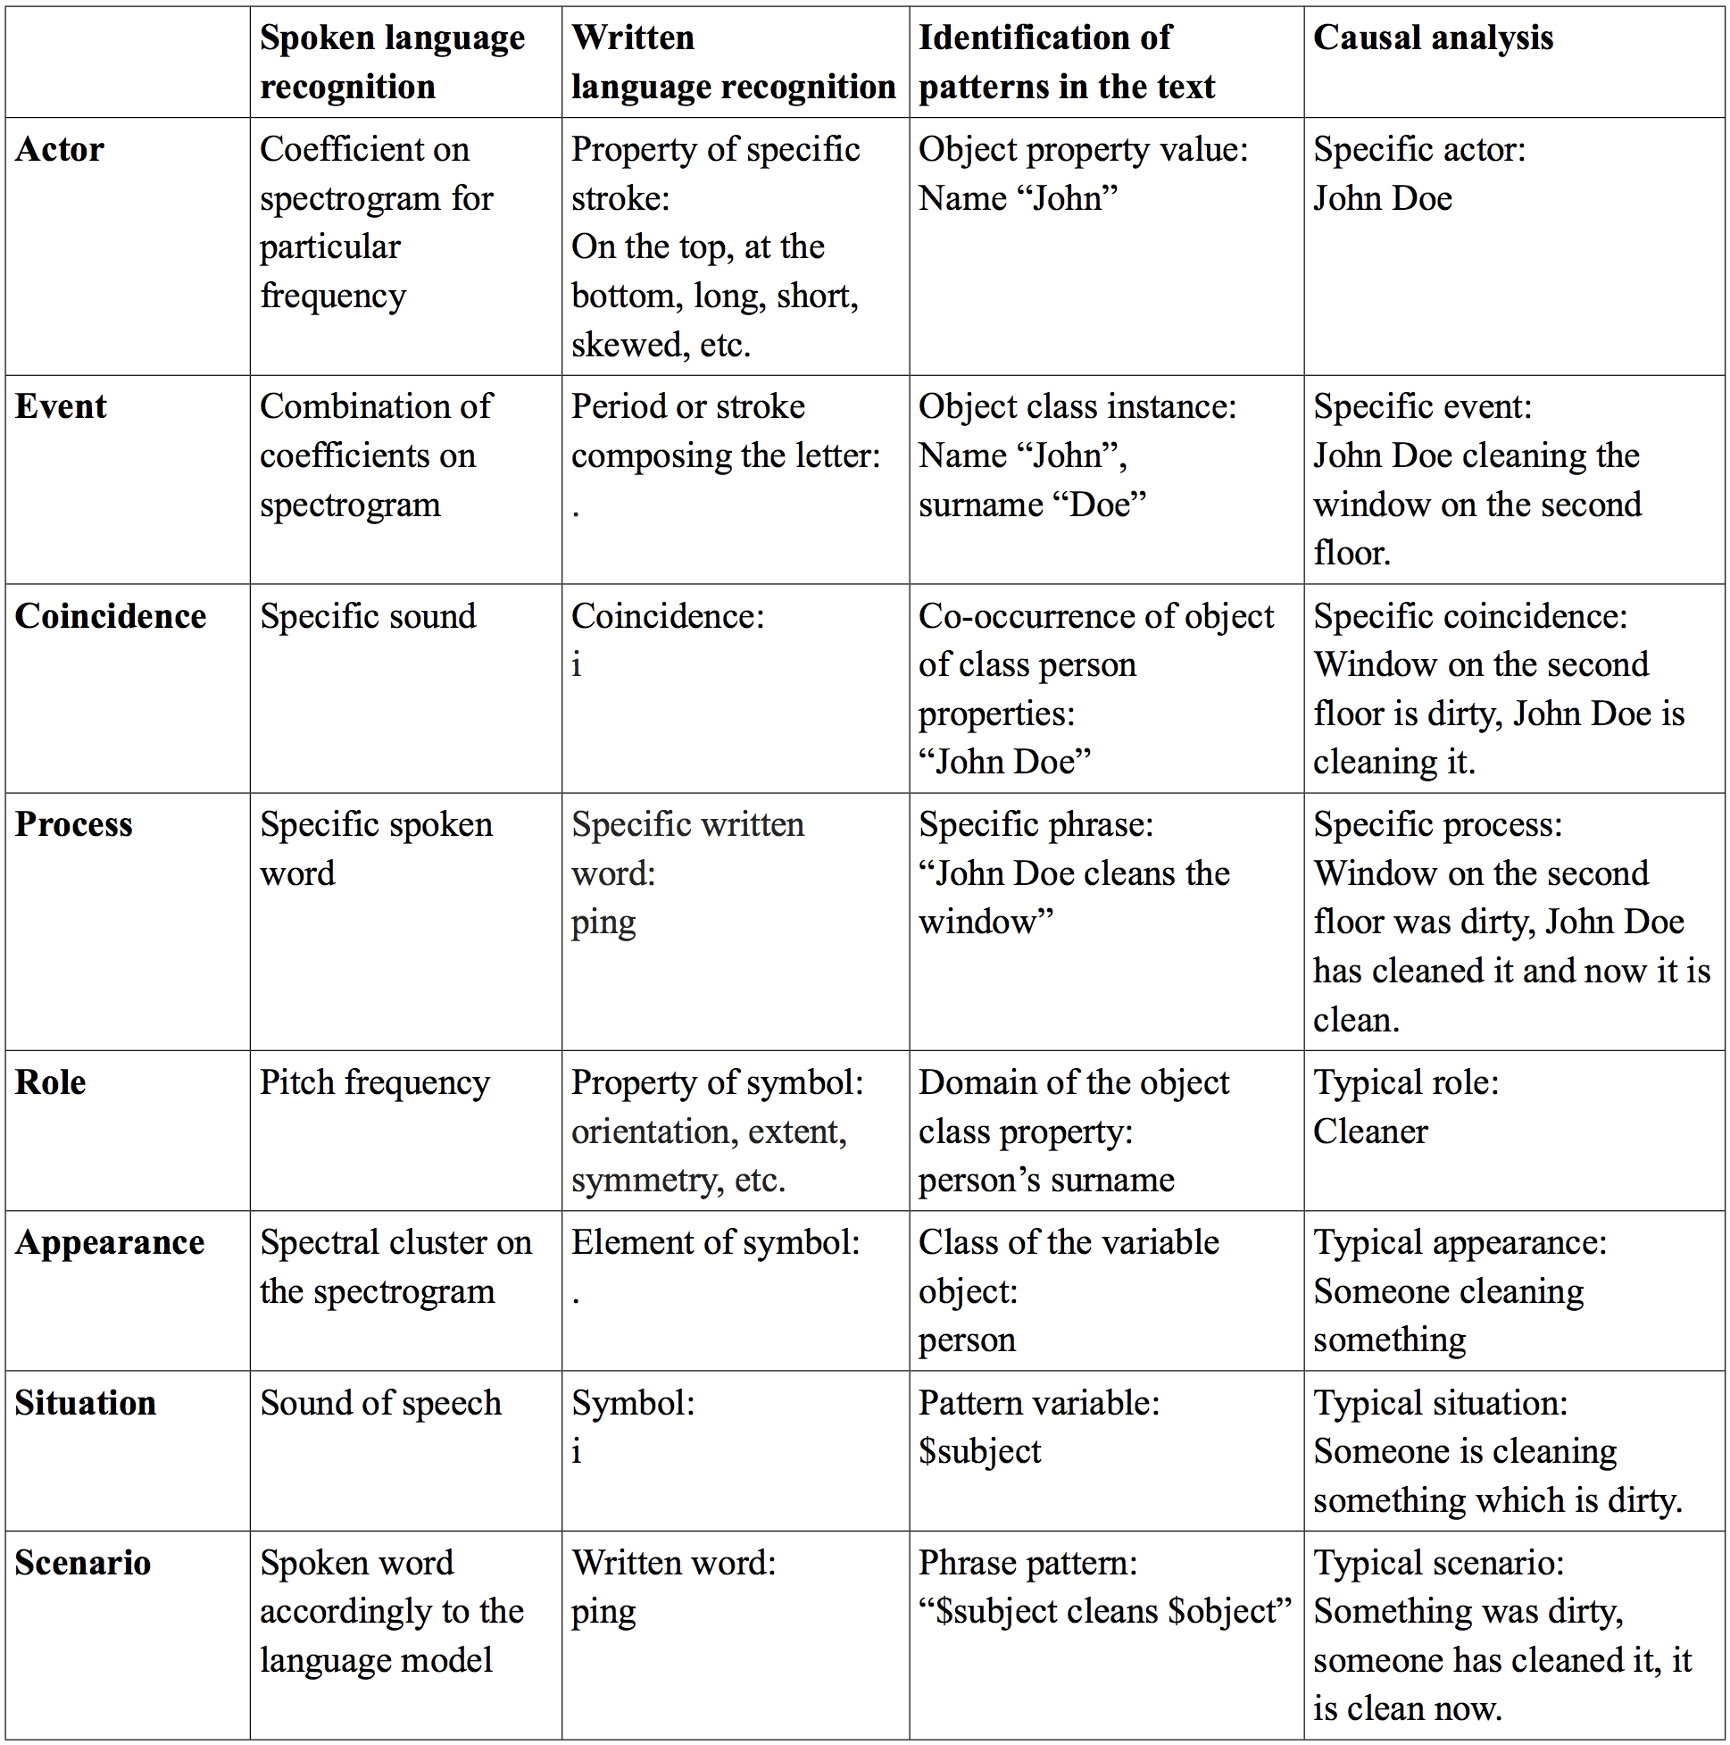
Applications other than NLP and Experiential/Reinforcement Learning
Everything is a Process of a Scenario!
https://arxiv.org/abs/1807.02072

Slide 10
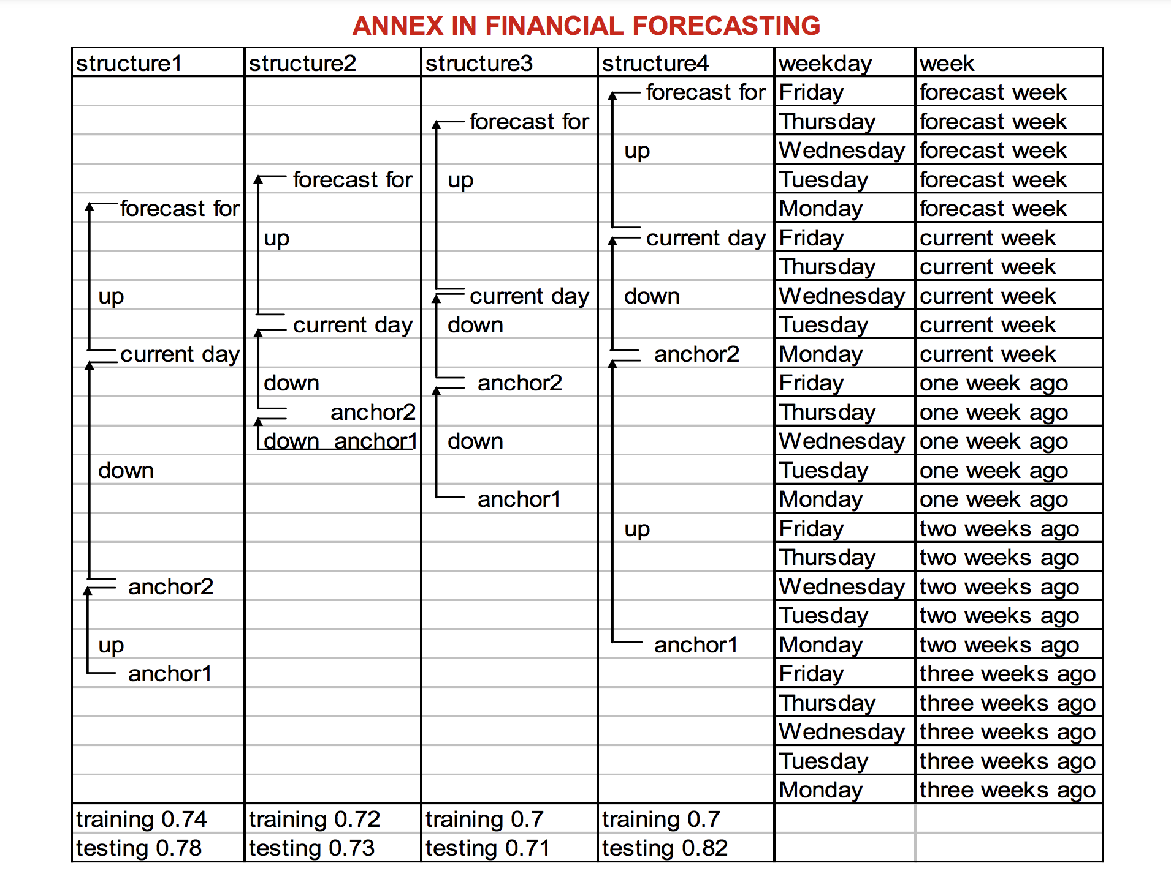
Evgeni Vityaev’s Invariant Structures
Mining temporally invariant structures (“scenarios”) in historical time series data recording financial “processes” with the Discovery system.
http://www.math.nsc.ru/AP/ScientificDiscovery/PDF/data_mining_for_financial_applications.pdf
Symbolic Methodology in Numeric Data Mining:
Relational Techniques for Financial Applications
Boris Kovalerchuk, Evgenii Vityaev, Husan Yusupov
https://arxiv.org/pdf/cs/0208022.pdf
Brain Principles Programming
Evgenii Vityaev, Anton Kolonin, Andrey Kurpatov,
Artem Molchanov
https://arxiv.org/abs/2202.12710

Slide 11
Narrow AGI for Market Making Agent
Super-
visor
MM Agent
Comp-
ressor
Knowledge
Base Values
goal(return(high),loss(low))
Outer environment
Inferred Models
cause(price(high),order(ask))
Predictor
Observed Evidence
feel(price(high),t1)
Perception: price(high)
Decider
Directed Action Log
make(order(ask),t2)
Action: order(ask)
Time line
Evgenii E. Vityaev Purposefulness as a Principle of Brain Activity // Anticipation: Learning from the Past, (ed.) M. Nadin. Cognitive Systems Monographs, V.25, Chapter No.: 13. Springer, 2015, pp. 231-254.
Anton Kolonin: Neuro-symbolic architecture for experiential learning in discrete and functional environments // AGI-2021 Conference Proceedings, 2021

Slide 12
Operational Space for Market Making
Perceptions/Data
Market:
OCHLVs
Trades
LOB(levels)
Media:
News
Actions:
ask(price,size,order)
bid(price,size,order)
cancel(order)
buy(size)
sell(size)
PreProcessing
Feature Building
Classification
MM Agent
Compressor
Predicates Graph
Base Values
goal(be(rich))
Metrics/Signals
Market:
Price Diff / Log Return
Trend Indicators
Volatility/STD
SMA
CMF
Sell/Buy Imbalance
Ask/Bid Imbalance
Media:
Sentiment
CBT Distortions
Predictor
Inferred Models
cause(price(up),order(ask))
Trading Bot
(Policy/Strategy)
Observed Evidence
feel(price(high),t1)
Decider
Directed Action Log
make(order(ask),t2)
Parameters:
spread(%)
cancellation(policy)
refresh(time)
etc.
https://arxiv.org/abs/2204.13265

Slide 13
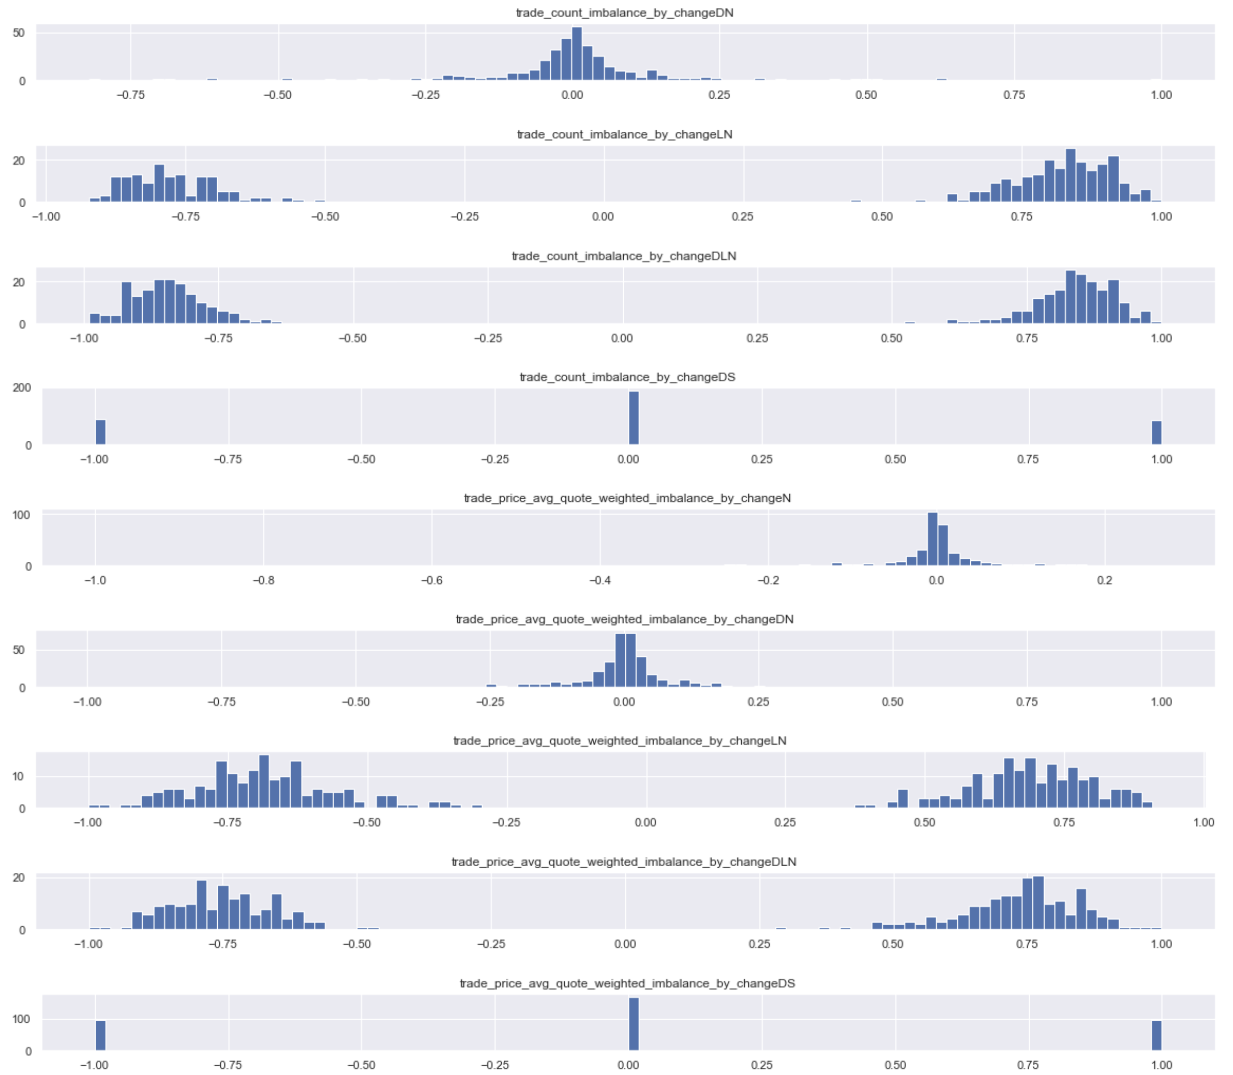
Operational Space for Market Making
More Metrics
Simplified
MM Agent
Compressor
Predicates Graph
Base Values
goal(be(rich))
Predictor
Inferred Models
cause(price(up),order(ask))
Observed Evidence
feel(price(high),t1)
Decider
Directed Action Log
make(order(ask),t2)
Metrics/Signals
Market:
Price Diff
Parameters:
spread(%)
cancellation(policy)
https://arxiv.org/abs/2204.13265

Slide 14
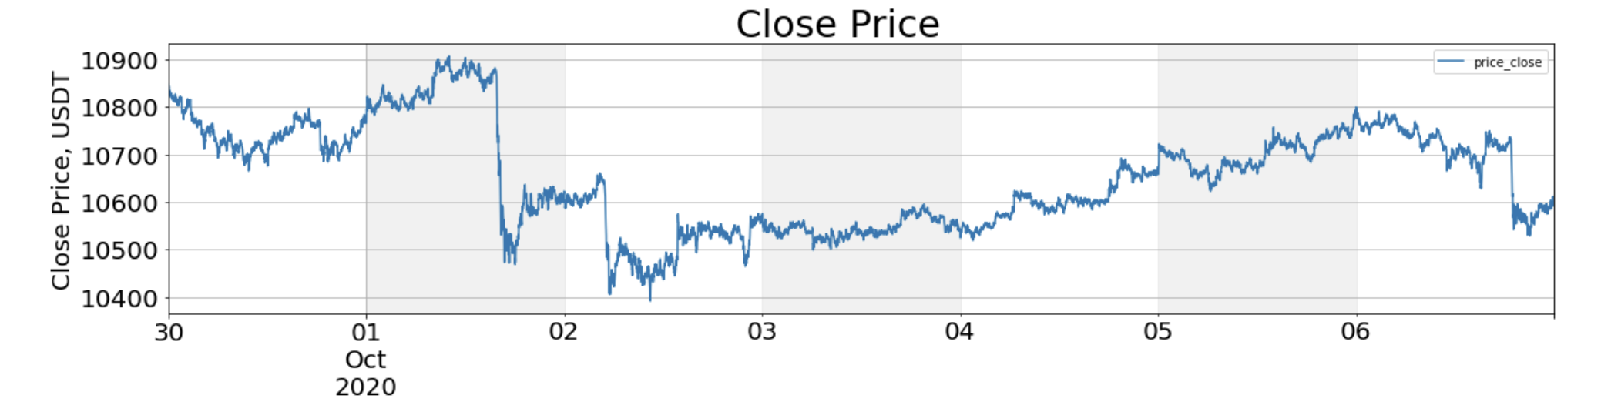
Symbolizing Market Conditions?
More Metrics
Flat
Crash
Crash
Flat
Up
Up
Crash
A1
A2
B1
B2
C1
C2
C3
A2
B1
C2
D2
E2
F2
A1
B2
C1
D1
E1
F1
A1
B2
C1
D1
E1
F1
A2
B1
C2
D2
E2
F2
A1
B1
C3
D2
E2
F3
A1
B1
C3
D2
E2
F3
A1
B2
C1
D1
E1
F3
D1
D2
E1
E2
F1
F2
F3
Time

Slide 15
Quantification for Symbolization
Resume:
"K-means" works, with evaluation of optimal number of clusters based on either of the following:
1. Maximizing "Silhouette Coefficient" (SC), which appears more human-intuitive but does not work for K=1
https://en.wikipedia.org/wiki/Silhouette_(clustering)
https://towardsdatascience.com/silhouette-coefficient-validating-clustering-techniques-e976bb81d10c
2. Minimizing "Normalized Centroid Distance" (NCD) - based on "minimum description length" idea, works for K=1, does not align with human "reductionist" intuition for diverse distributions (tends to create more clusters than needed)
https://www.researchgate.net/publication/221020638_Cluster_Validity_Measures_Based_on_the_Minimum_Description_Length_Principle
3. Minimizing "Normalized Centroid Distance times Centroids" (NCDC) - extends NCD multiplying it by number of clusters to penalize creation of too many clusters, works for K=1, more human-intuitive than NCD but less human-intuitive than SC
4. Using SC+ (maximize SC if it is above threshold 0.65 or minimize NCDC otherwise) - seems generally optimal from human intuition perspective
https://github.com/aigents/pygents/blob/main/notebooks/cluster/distribution_modes.ipynb

Slide 16
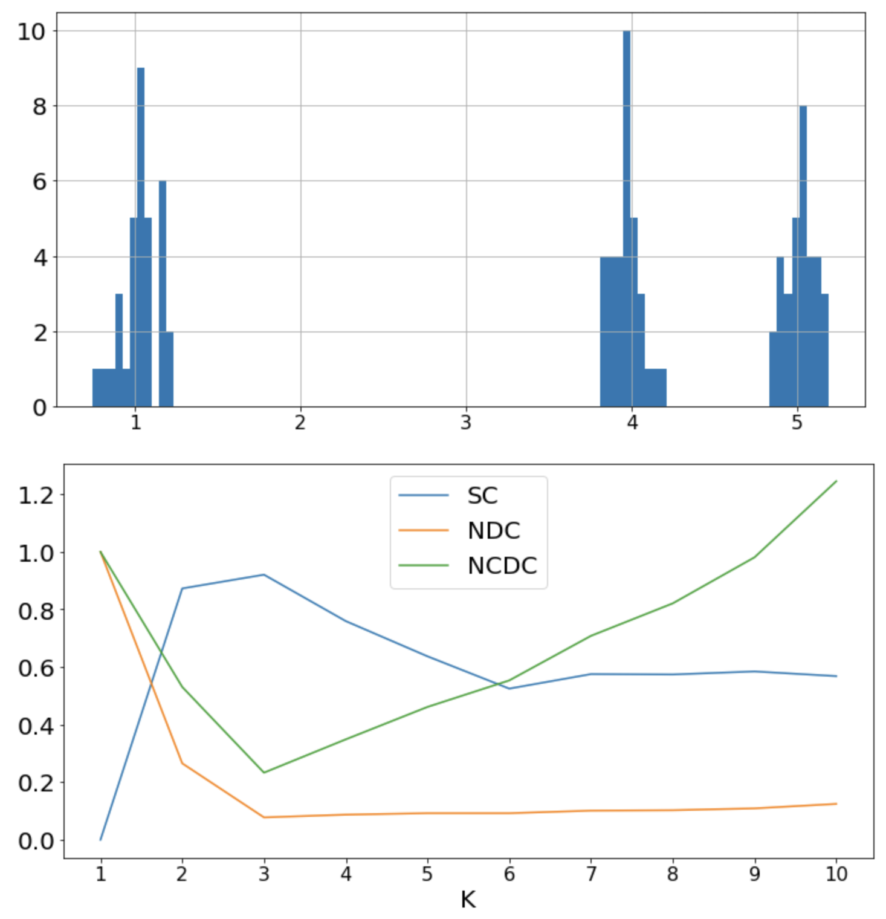
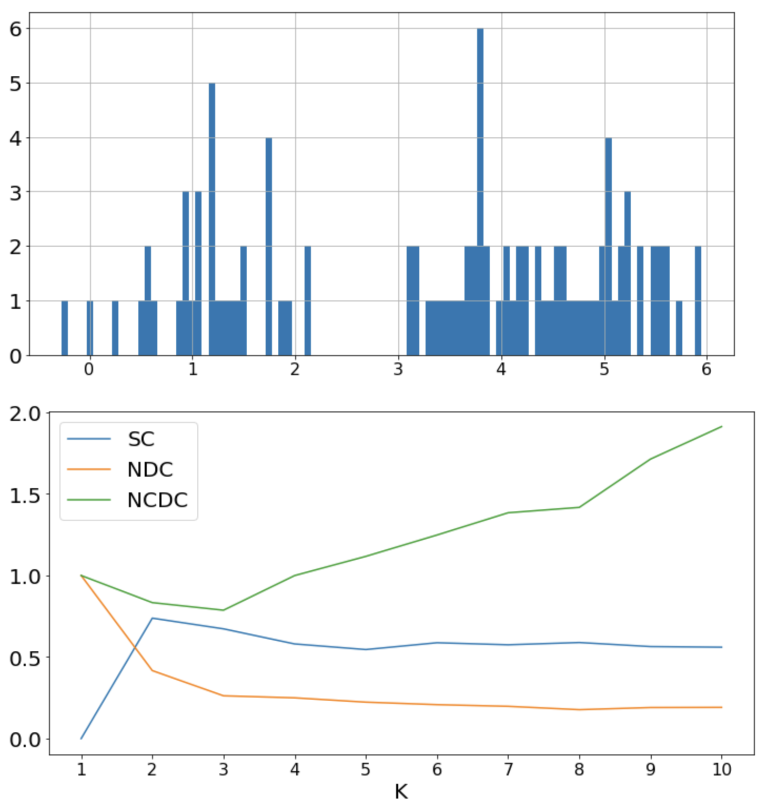
Quantification Measures

Slide 17
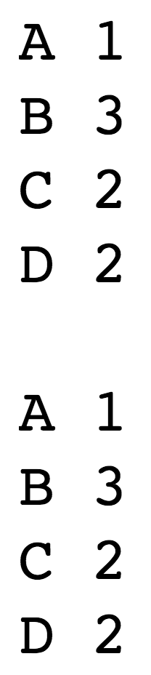
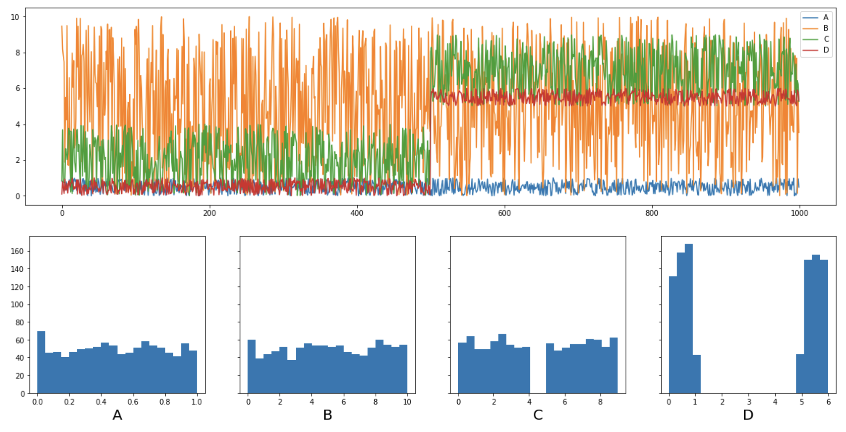
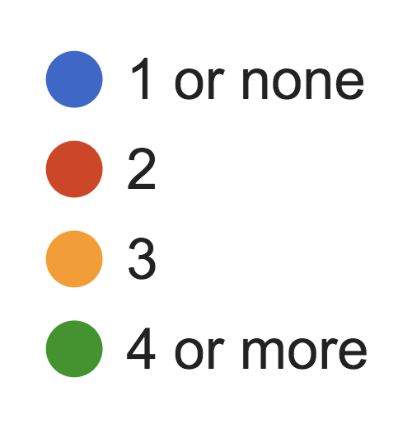
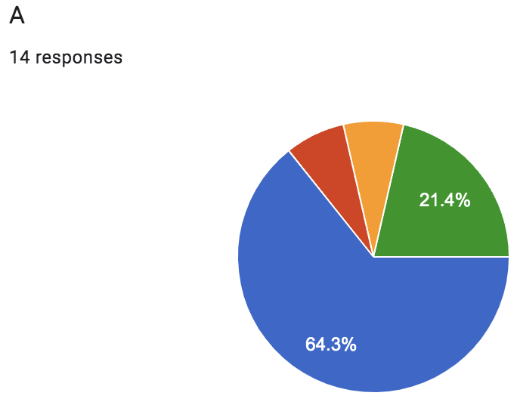
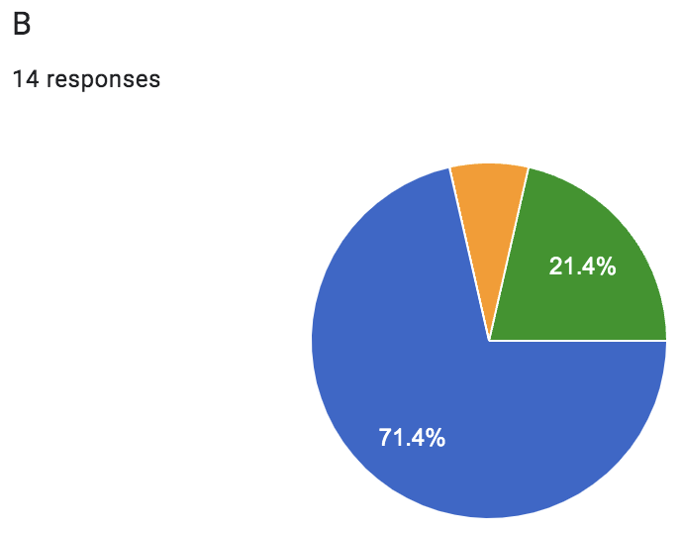
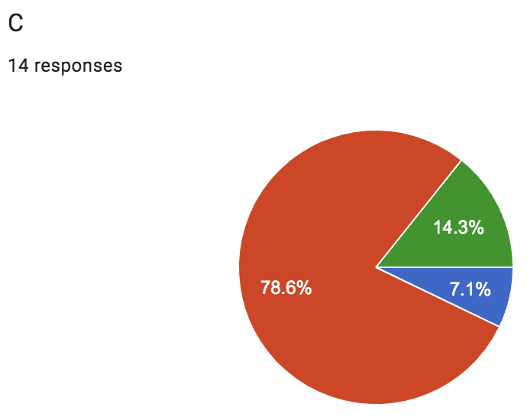
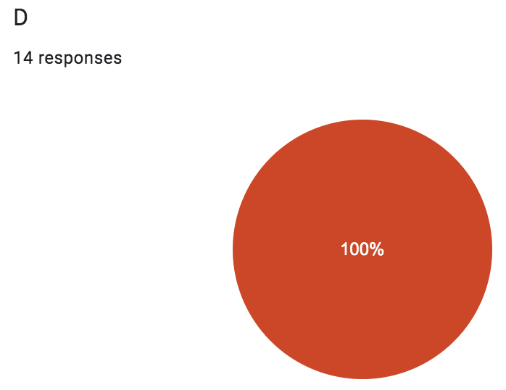
Quantification - 1
NCDC
Human
SC+
A 1
B 1
C 2
D 2
Human

Slide 18
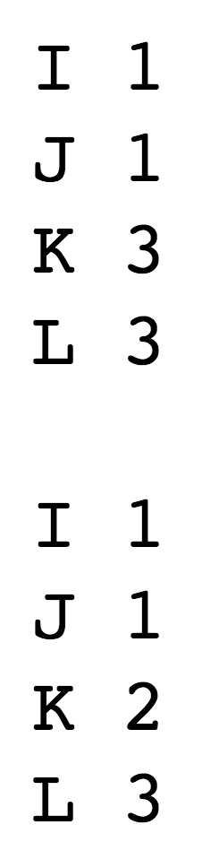
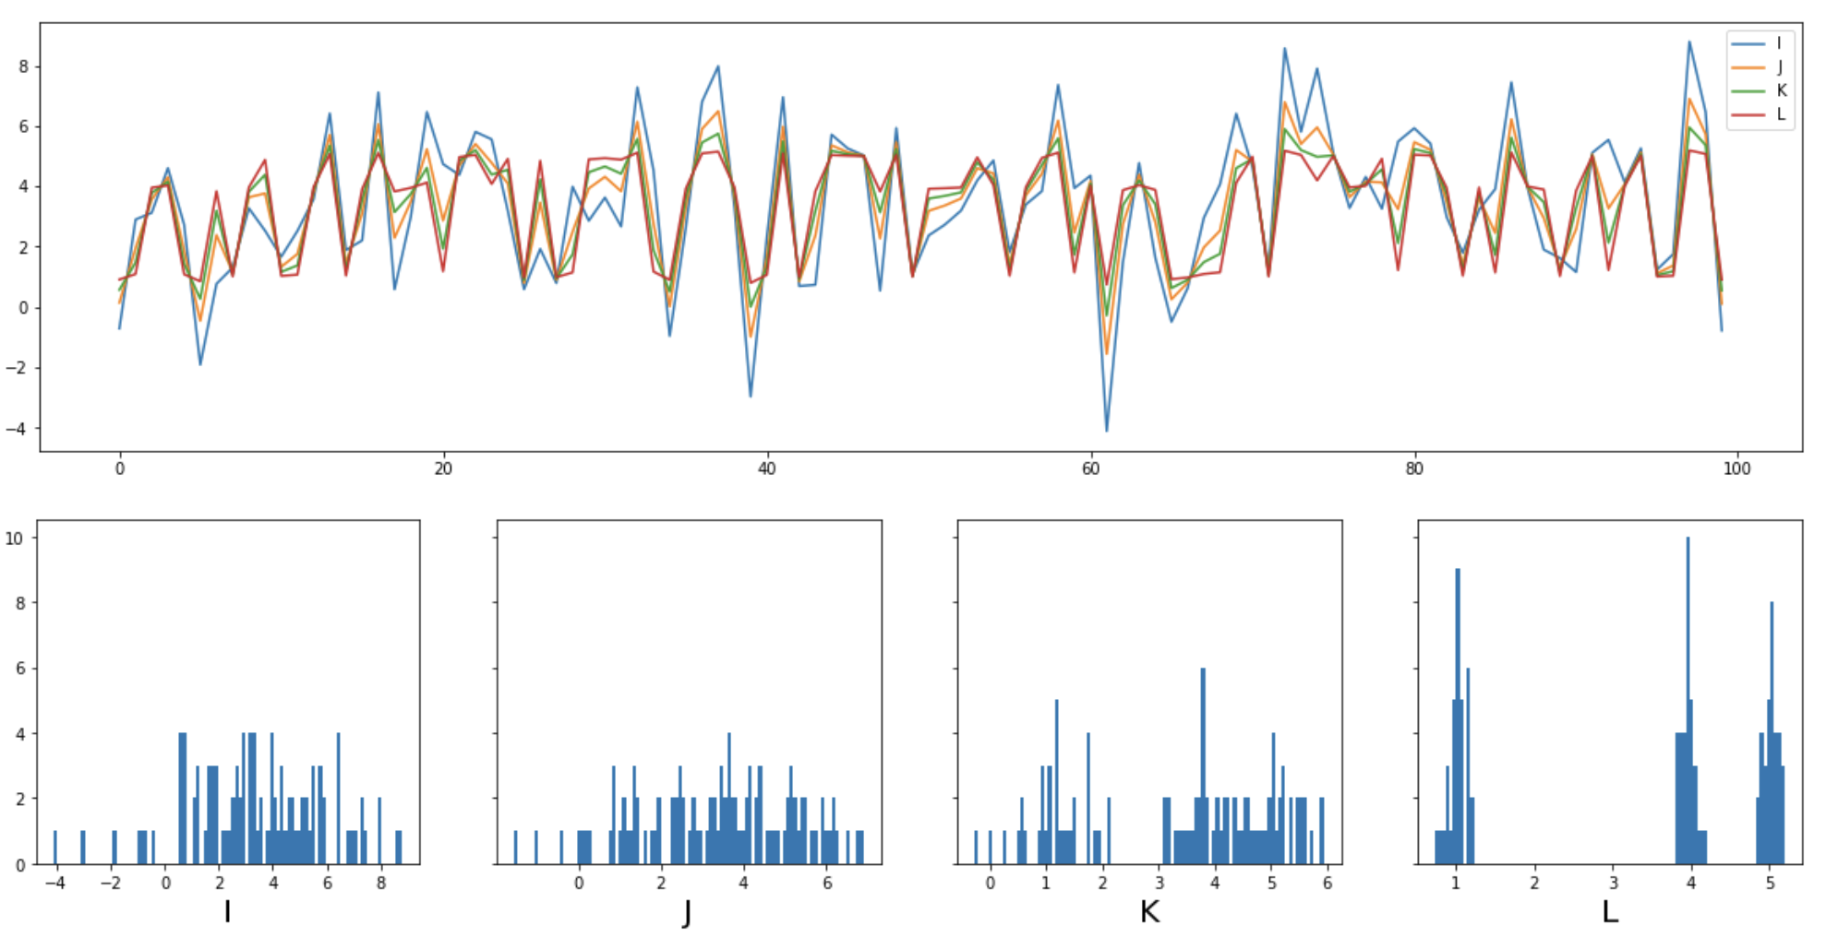
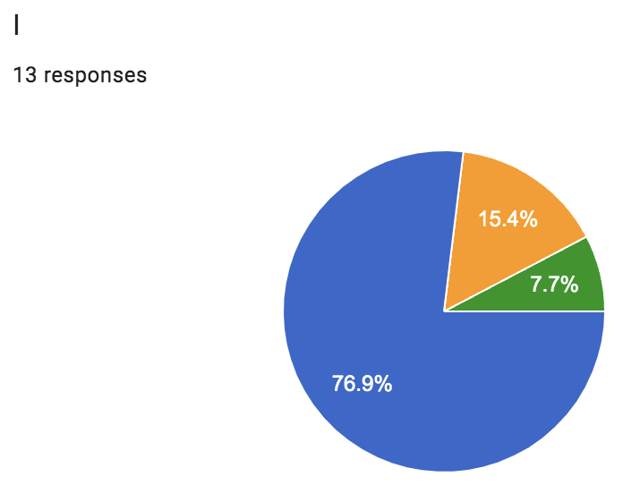
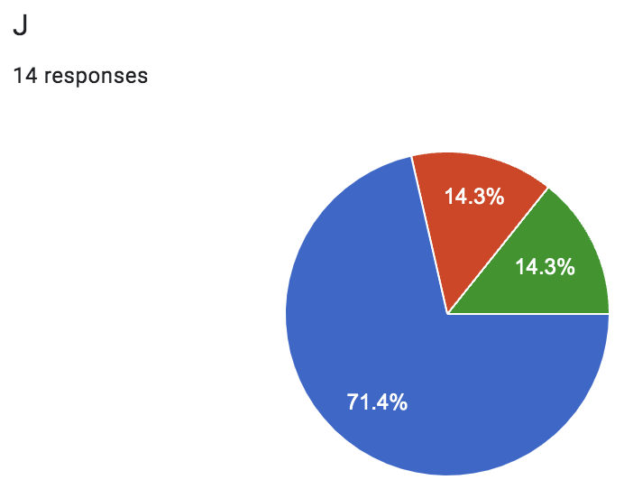
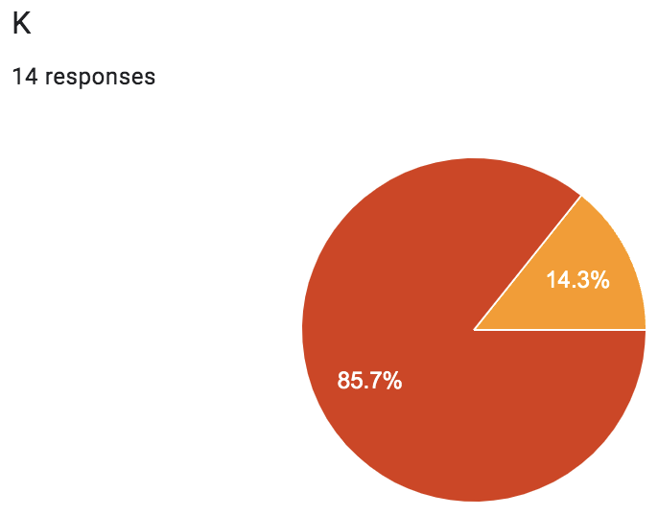
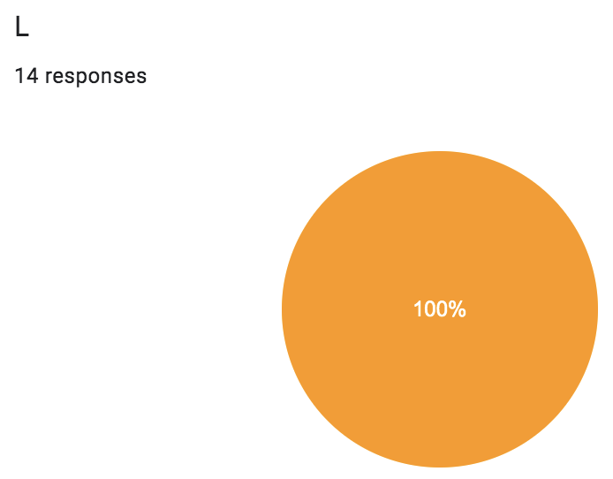
Quantification - 2
NCDC
Human
SC+
I 1
J 1
K 2
L 3
Human

Slide 19
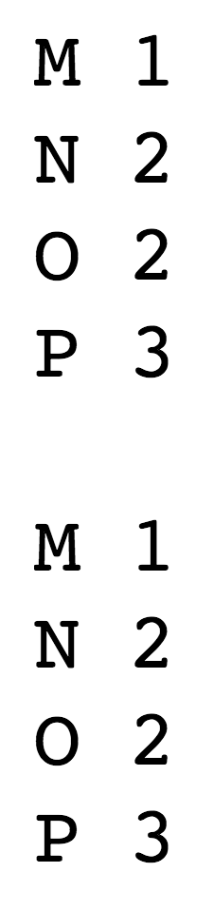
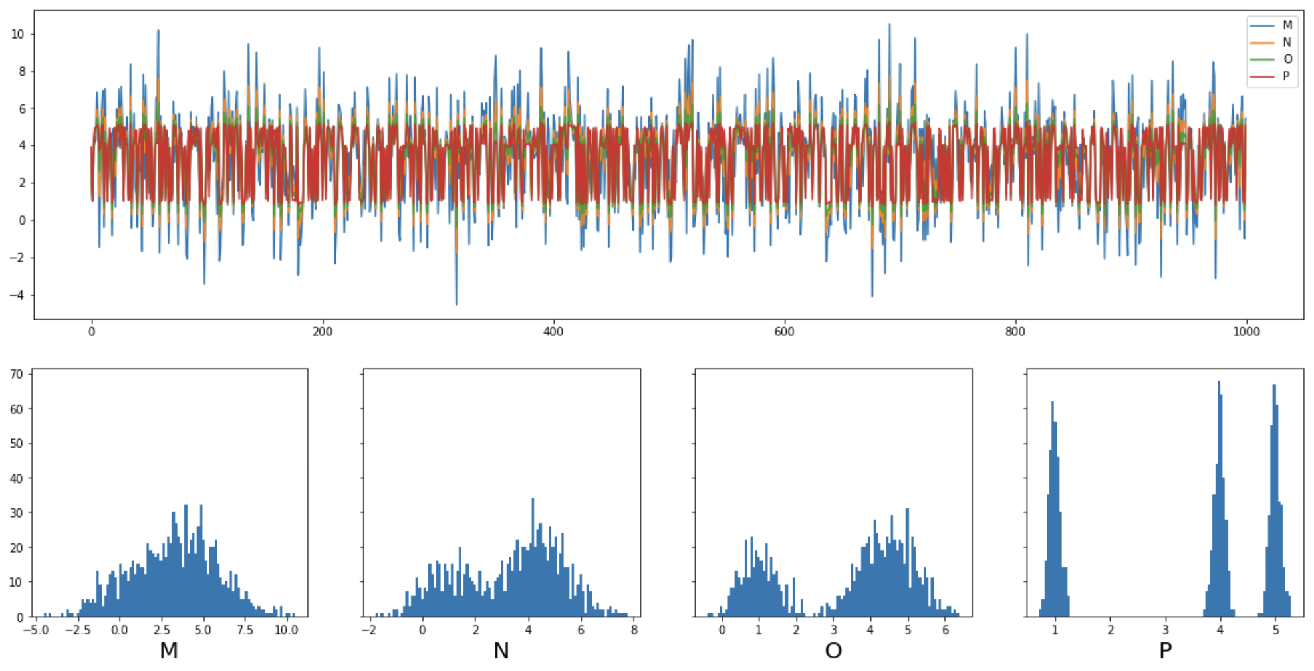
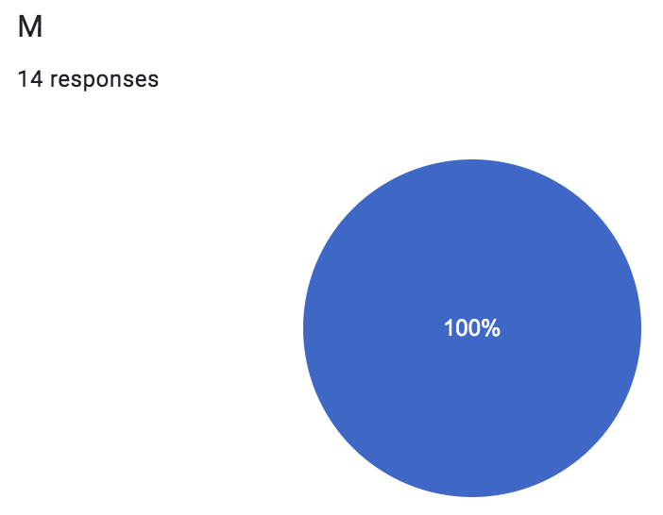
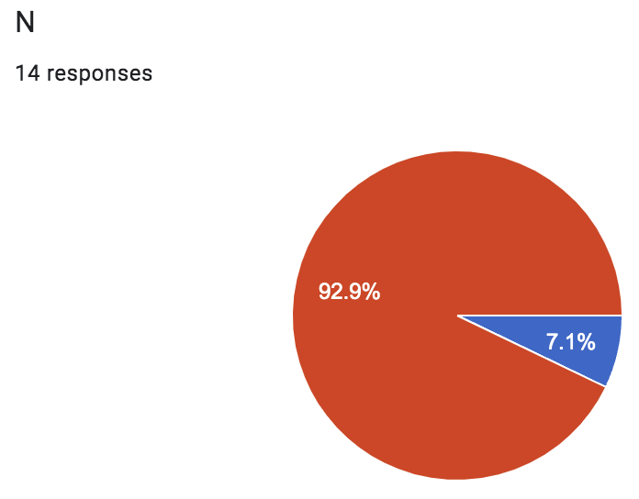
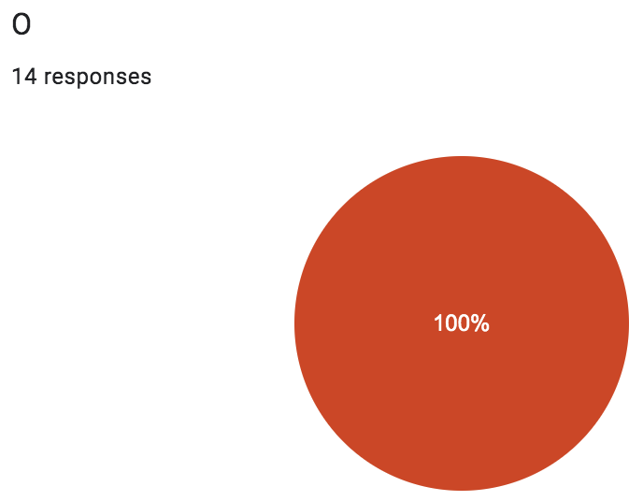

Quantification - 3
NCDC
Human
SC+
M 1
N 2
O 2
P 3
Human

Slide 20
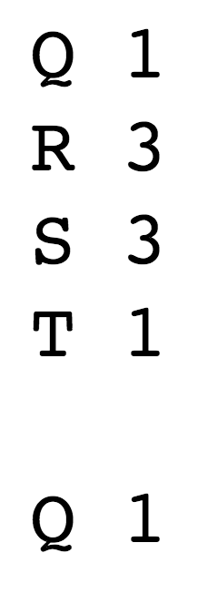
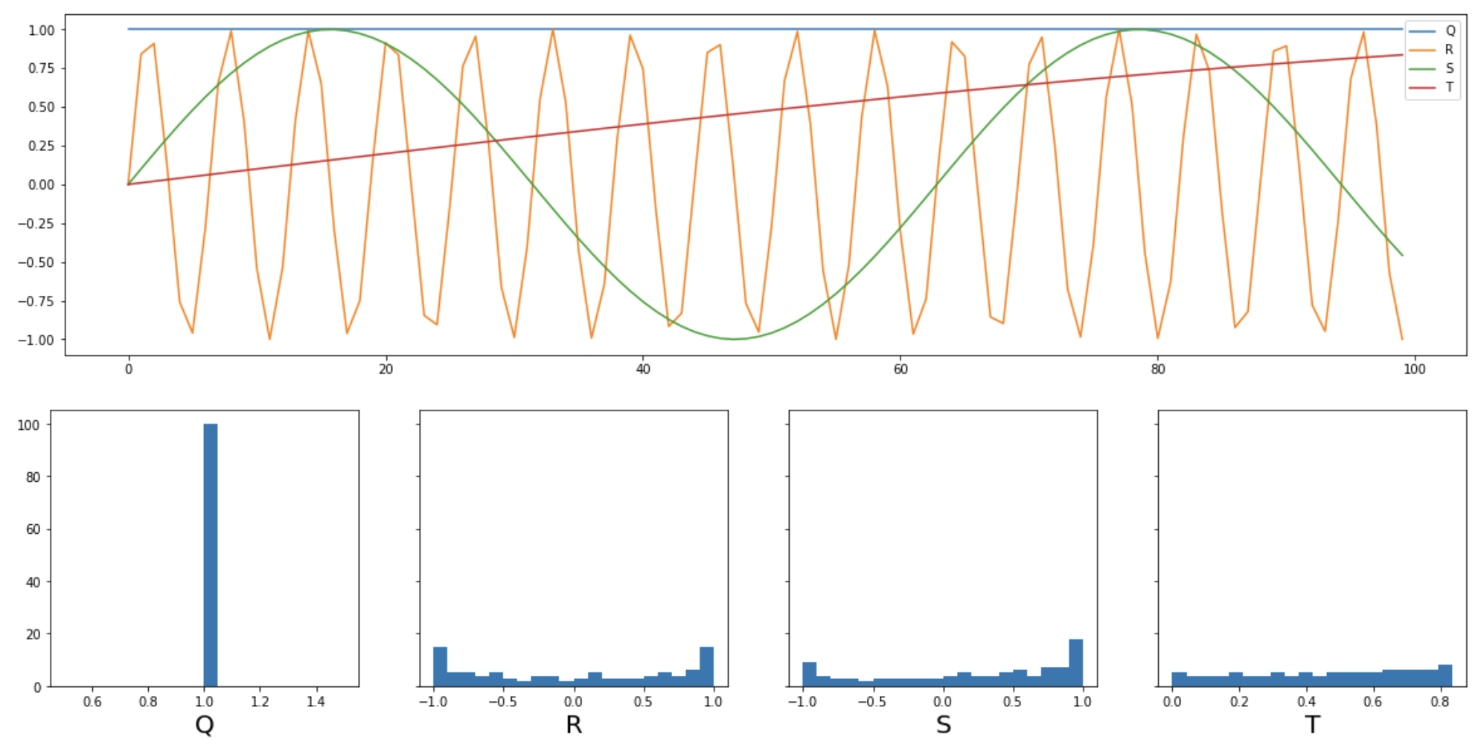
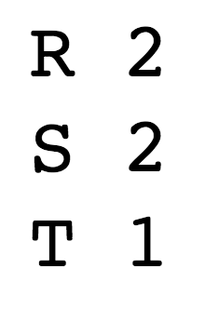
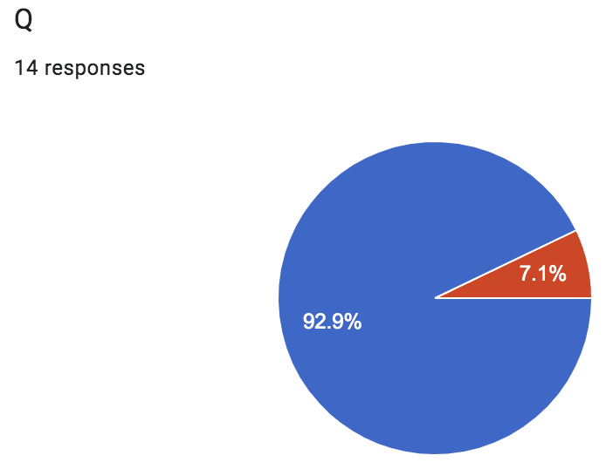
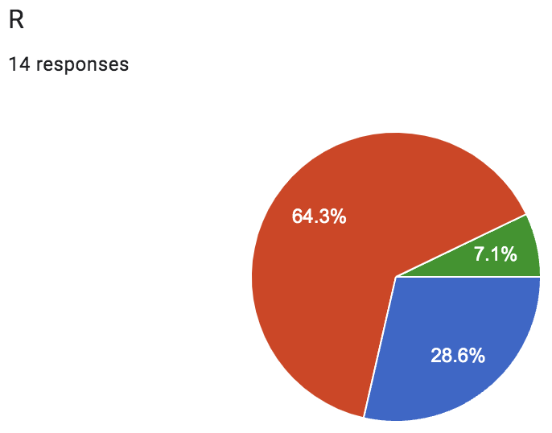
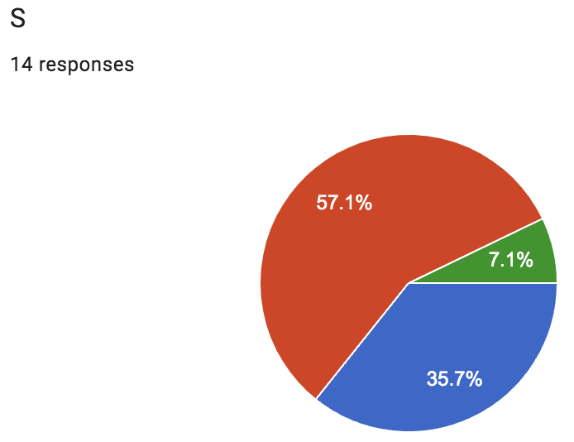
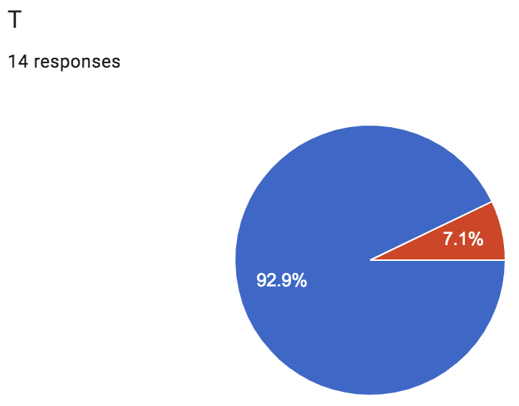
Quantification - 4
NCDC
Human
SC+
Q 1
R 2
S 2
T 1
Human

Slide 21
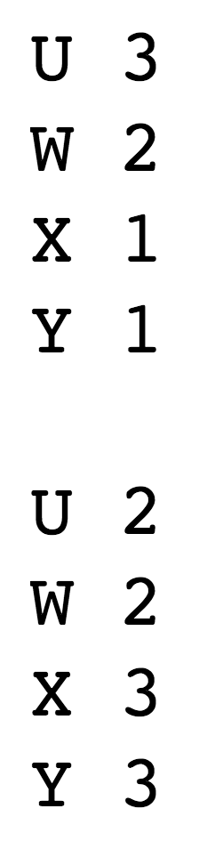
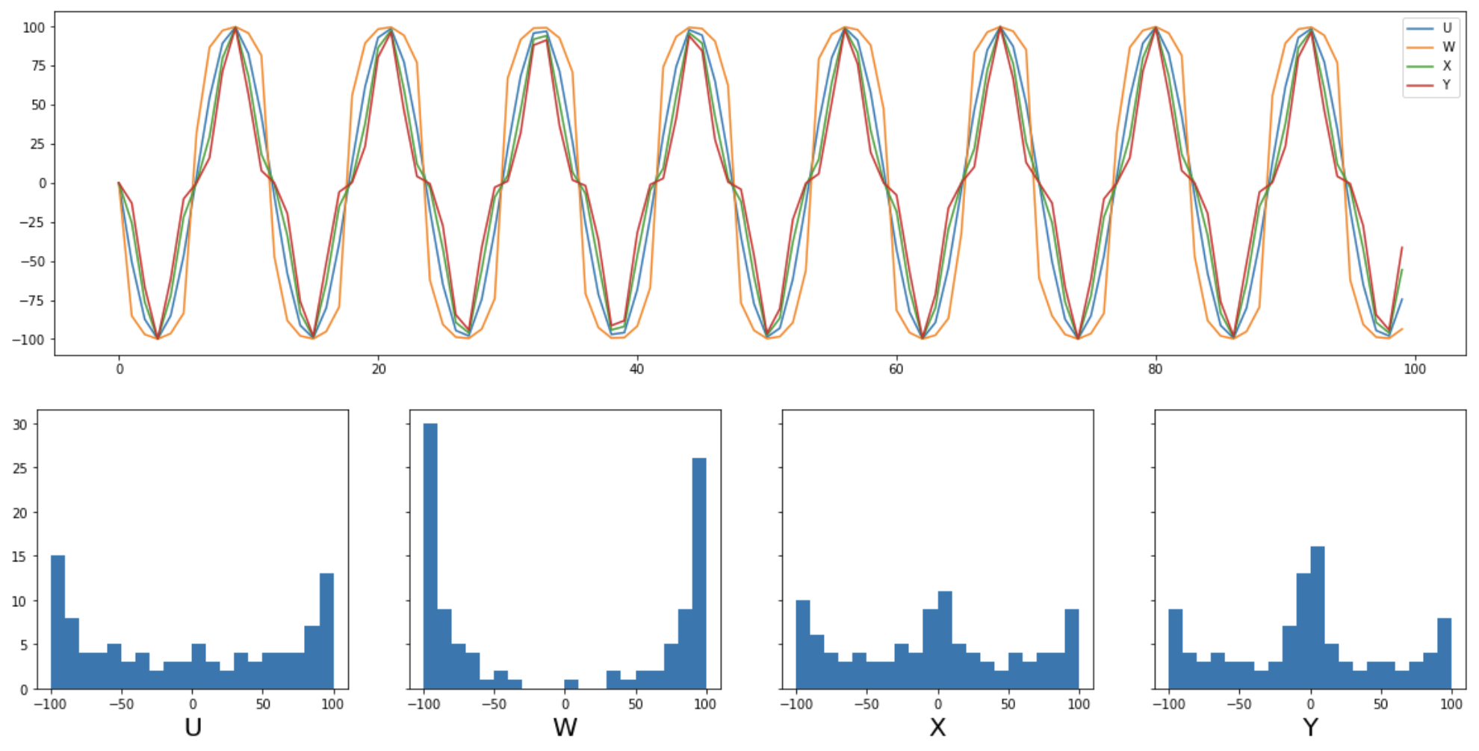
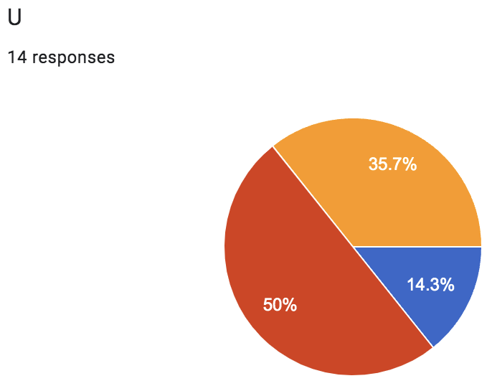
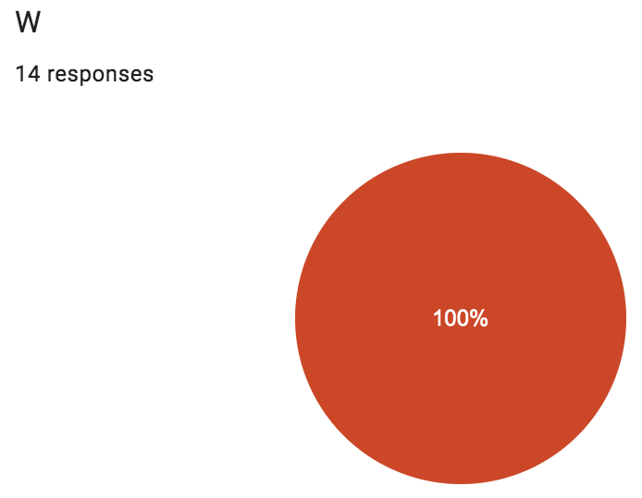
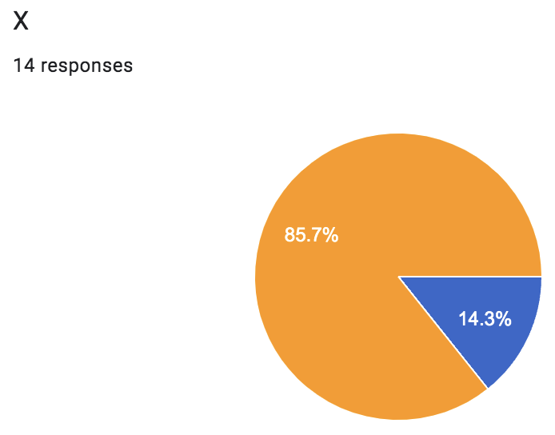
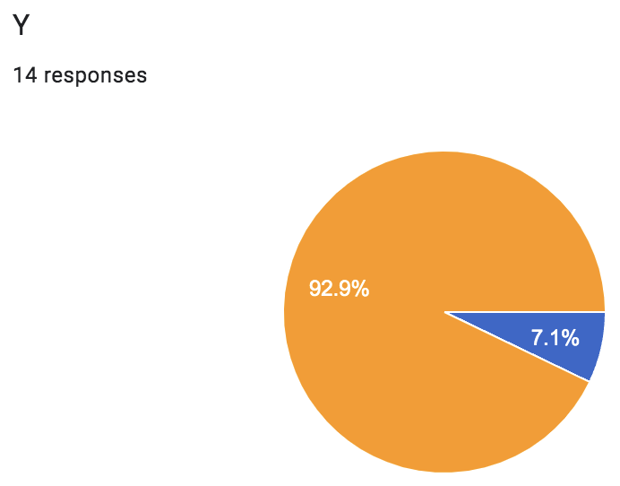
Quantification - 5
NCDC
Human
SC+
U 2
W 2
X 3
Y 3
Human

Slide 22
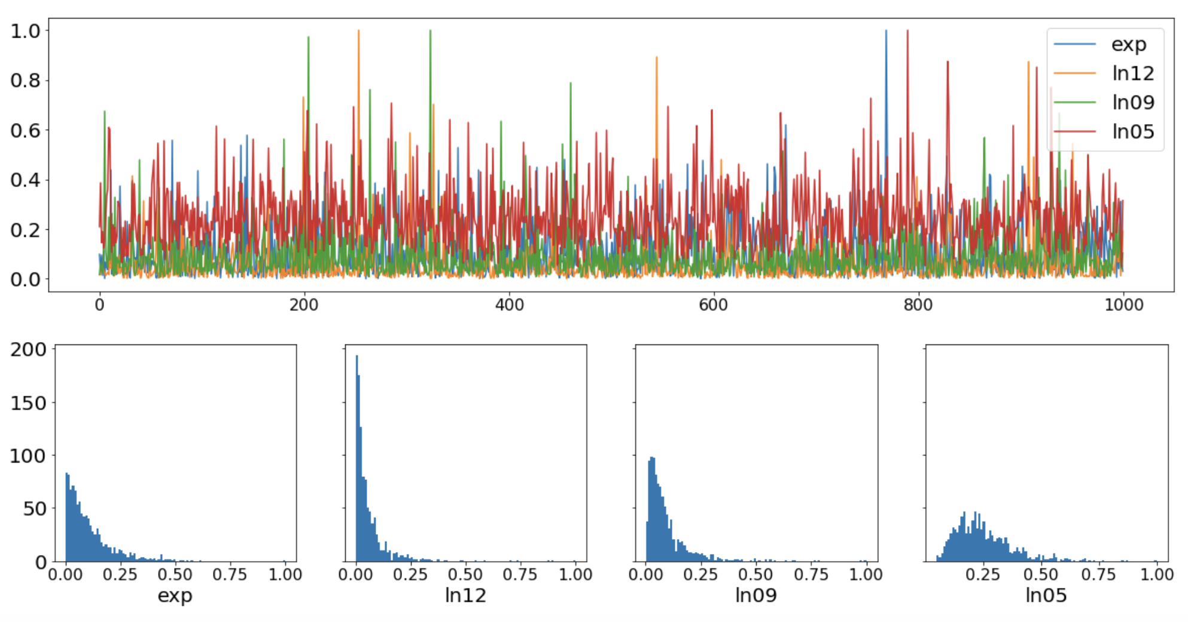
Quantification – 6
exp 1
ln12 1
ln09 1
ln05 1
NCDC
exp 2
ln12 2
ln09 2
ln05 1
SC+
exp 2
ln12 2
ln09 2
ln05 1
Human

Slide 23
Quantification: Human vs. Machine
Evaluate with "Fleiss’ kappa" (FK) and "Krippendorff’s alpha" (KA)
https://en.wikipedia.org/wiki/Fleiss%27_kappa
https://stackoverflow.com/questions/51919897/is-fleiss-kappa-a-reliable-measure-for-interannotator-agreement-the-following-r
https://bmcmedresmethodol.biomedcentral.com/articles/10.1186/s12874-016-0200-9
https://www.statsmodels.org/dev/generated/statsmodels.stats.inter_rater.fleiss_kappa.html
NCDC vs. SC+: 0.55, 0.56 (Moderate agreement)
Humans vs. humans: 0.59, 0.59 (Moderate agreement)
NCDC vs. humans: 0.47, 0.48 (Moderate agreement)
SC+ vs. humans: 0.92, 0.92 (Almost perfect agreement)

Slide 24
Adaptive Multi-Strategy Agent
Simulation &
Backtesting
Framework
Market Data
Real
Exchange
Adaptive
Multi-Strategy
Agent
Virtual MM
Real MM
Virtual P&L
Real P&L
Single-Strategy
Agent
(Virtual)
Control
Single-Strategy
Agent
Selection
Single-Strategy
Agent
Single-Strategy
Agent
(Real)
Single-Strategy
Agent
Single-Strategy
Agent
Single-Strategy
Agent
Single-Strategy
Agent
Single-Strategy
Agent
Single-Strategy
Agent
Single-Strategy
Agent
Single-Strategy
Agent
Single-Strategy
Agent
Single-Strategy
Agent
Single-Strategy
Agent
https://arxiv.org/abs/2107.07769

Slide 25
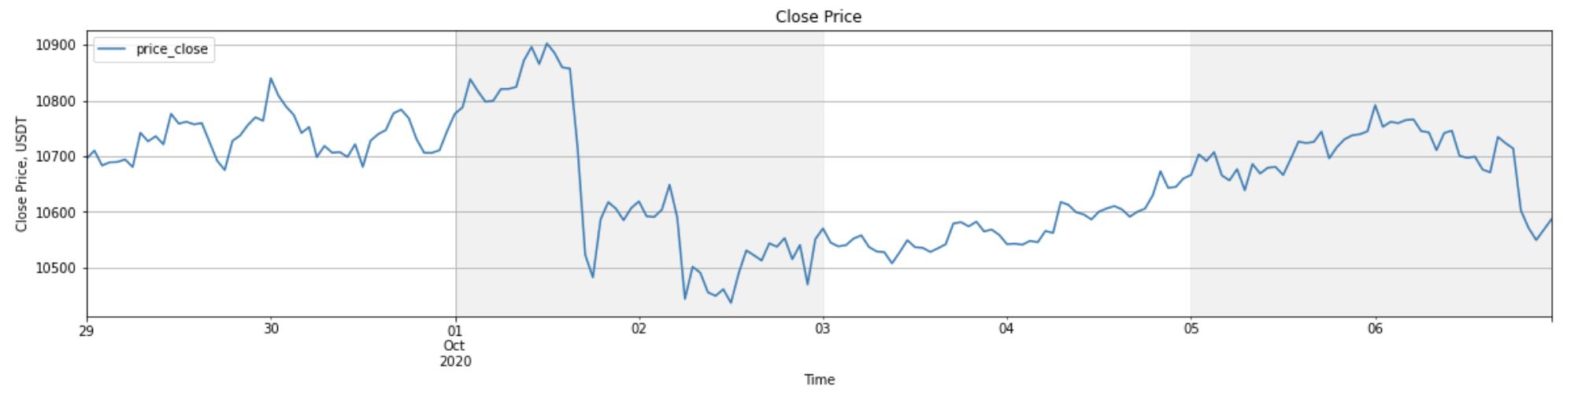
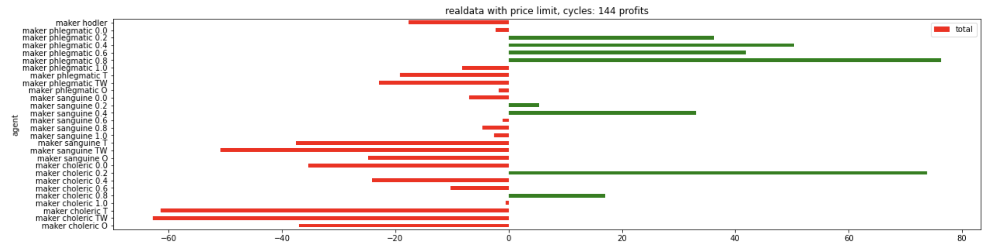
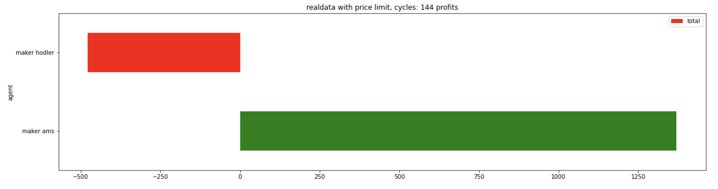
Trading with multiple Strategies at a Time
BTC/
USDT
Hodler
Order Grid
Marker
Making
P & L
Grid
Adaptive
Multi
Strategy
Agent
P & L
Hodler
Adaptive

Slide 26
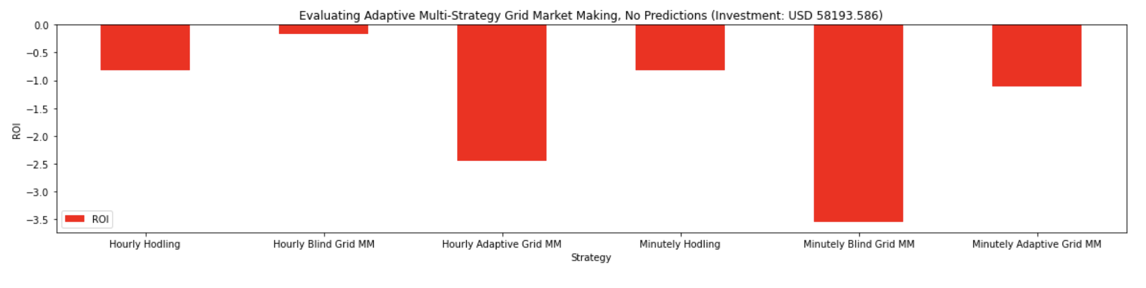
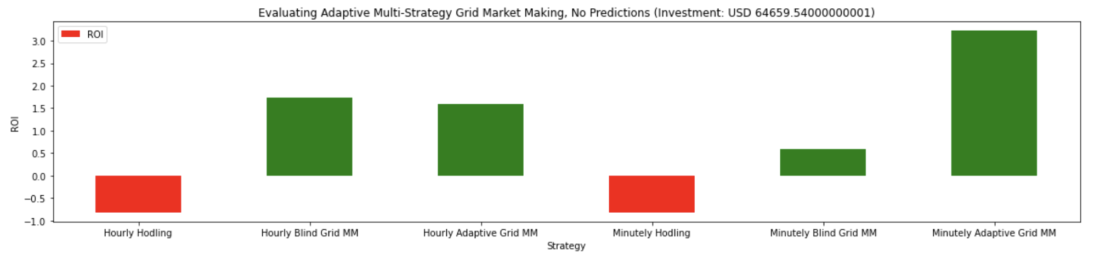
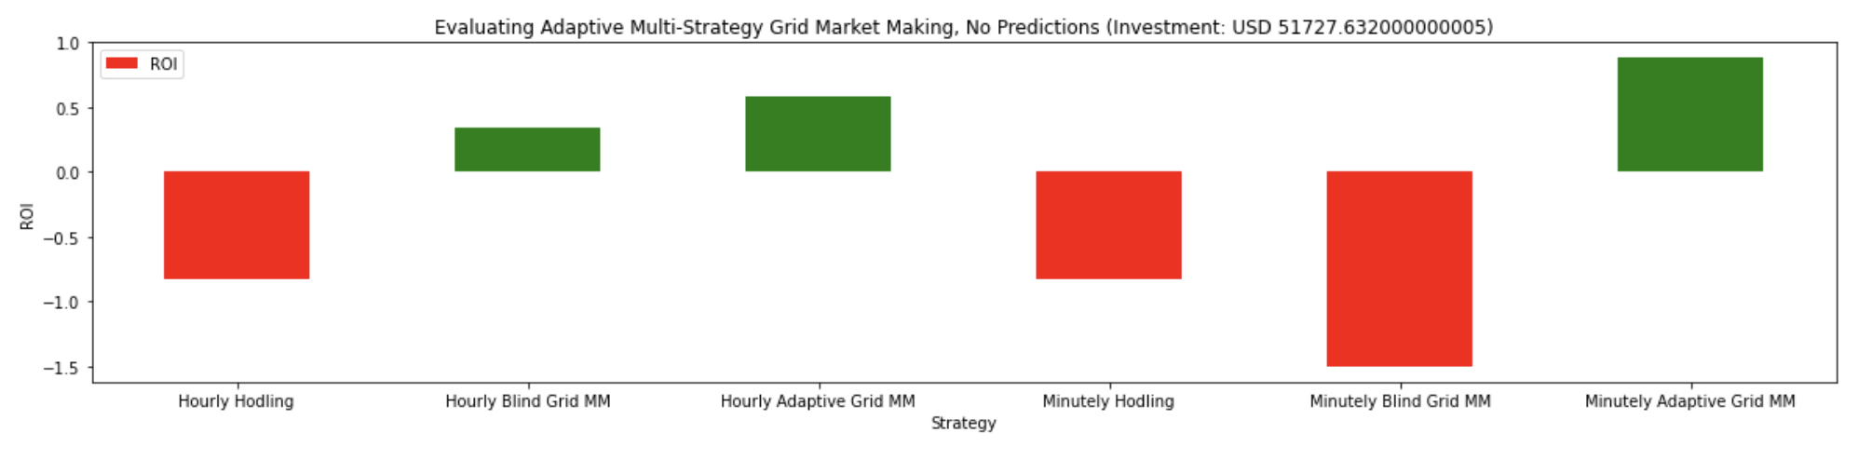
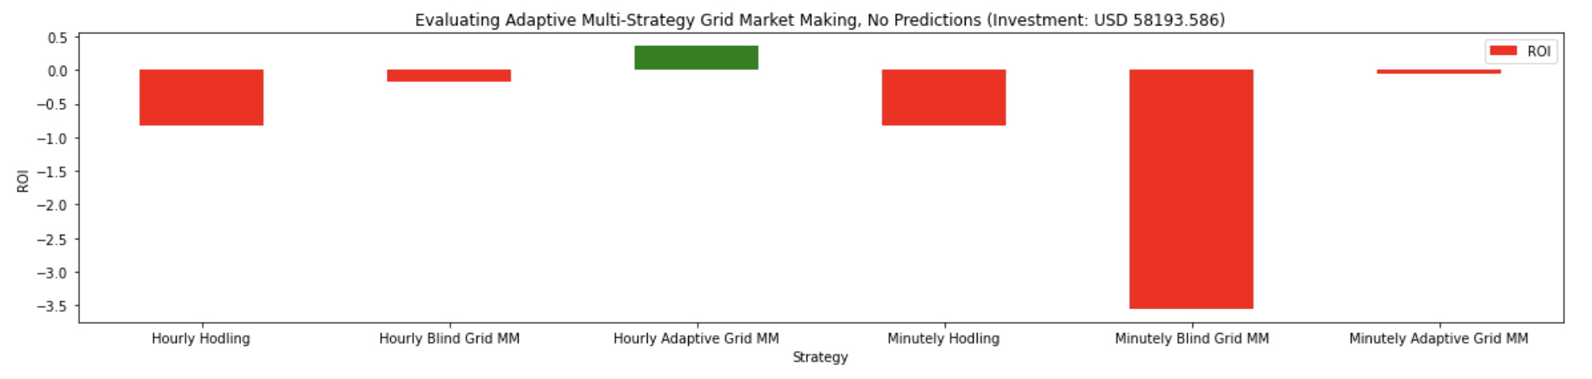





Overall ROI for adaptive MM strategy
BTC/
USDT
6 days testing interval
“Basic/Simple” Strategy
“NIOX Maker” Strategy
“Hummingbot Pure MM” Strategy
Hodler Grid Adaptive Hodler Grid Adaptive
Hours Minutes
1 day strategy update interval (6 days)
Hodler Grid Adaptive Hodler Grid Adaptive
Hours Minutes
2 days strategy update interval (6 days)
1% ROI
1% ROI
3% ROI
Hodler Grid Adaptive Hodler Grid Adaptive
Hours Minutes
3 days strategy update interval (6 days)
Hodler Grid Adaptive Hodler Grid Adaptive
Hours Minutes

Slide 27

Process Mining in Business Log Data
https://www.puzzledata.com/process-mining_eng/

Slide 28
Scenario Mining in Process Data Example
Internet navigation routes when searching for “Forester” cars
http://auto.ru/
“subaru”
http://auto.ru/cars/subaru/all/
“forester”
http://auto.ru/cars/subaru/all/
“subary”
http://auto.drom.ru/subaru/
Goal
http://www.drom.ru/
“cars”
http://auto.drom.ru/
“forester”
http://auto.drom.ru/subaru/forester/
http://www.e1.ru/
“auto”
http://auto.e1.ru/
“passenger”
http://auto.e1.ru/car/
“subary”
http://auto.e1.ru/car/subaru/
“forester”
http://auto.e1.ru/car/subaru/forester/
Generalized click-through scenario when searching for products
Start
Category
Brand
Model
Goal
Top Category
Sub-category

Slide 29

Text Grounding on Non-Text Events
Everything is a Graph and can be framed with Link Grammar!
Linas Veptstas, 2021
https://arxiv.org/abs/1901.01341
https://aigents.github.io/inlp/2021/slides/

Slide 30
Discovering NLP patterns such as words or phrase structures for unsupervised language learning (Aigents® “Deep Patterns”)
NOUN
VERB
SUBJECT PREDICATE OBJECT
OR
OR
“procedure”
“drug”
“negative effect”
“positive effect”
“disease”
OR
OR
OR
OR
AND
AND
cold
aspirin
treat
reduces
OR
head
tylenol
acetylsalicylic acid
treats
reduce
existential
frustration
acetaminophen
anxiety
acetaminophen may significantly reduce feelings of existential anxiety
https://ieeexplore.ieee.org/document/7361868
https://github.com/aigents/aigents-java
https://www.springerprofessional.de/unsupervised-language-learning-in-opencog/15995030
https://www.springerprofessional.de/en/programmatic-link-grammar-induction-for-unsupervised-language-le/17020348
https://github.com/singnet/language-learning/

Slide 31
Issues to Address
Absence of explicit start/stop tags in continuous streams of spaces in experiential (reinforcement/self-reinforcement) learning with delayed/sparse feedback
Complex, cumbersome, unreliable and expensive language-specific tokenization process for unsupervised language learning in NLP
Low quality of unsupervised parsing and tokenization learning based on mutual information and conditional probabilities
https://www.youtube.com/watch?v=2LPLhJKh95g
https://www.springerprofessional.de/neuro-symbolic-architecture-for-experiential-learning-in-discret/20008336
https://github.com/aigents/aigents-java/tree/master/src/main/java/net/webstructor/agi
https://www.springerprofessional.de/unsupervised-language-learning-in-opencog/15995030
https://www.springerprofessional.de/en/programmatic-link-grammar-induction-for-unsupervised-language-le/17020348
https://github.com/singnet/language-learning/
https://scholarsarchive.byu.edu/cgi/viewcontent.cgi?article=6983&context=etd

Slide 32


Tokenization or Text Segmentation as Language Modeling
Metrics/Indicators:
Mutual Information¹
Conditional Probability^{1,2}
Transition Freedom^{2,3}
¹ https://scholarsarchive.byu.edu/cgi/viewcontent.cgi?article=6983&context=etd
² https://www.ncbi.nlm.nih.gov/pmc/articles/PMC2655800/
³ Karl Friston.The free-energy principle: a unified brain theory?
https://www.nature.com/articles/nrn2787
https://lena-voita.github.io/nlp_course/language_modeling.html

Slide 33
Claims
Transition Freedom (TF) appears to be superior (over Mutual Information and Conditional Probability) for unsupervised text segmentation (tokenization).
English and Russian require one specific way (variance) of handling the TF while Chinese requires a bit different specific way (derivative-based “peak values”) for the same purpose.
Tokenization quality for Russian and English may be as high as F1=0.96-1.0, depending on training and testing corpora while for Chinese the minimum is F1=0.71-0.92, depending on the assessment assumptions.
Larger training corpora does not necessarily effect in better tokenization quality, while compacting the models eliminating statistically weak evidence typically improve the quality.
TF-based tokenization appear quality same or better than lexicon-based one for Russian and English while for Chinese appears the opposite (as it could be anticipated).
Doing Russian and English tokenization with removed spaces makes the situation similar to Chinese with reasonable quality on lexicon-based tokenization but much worse results on TF-based one.
https://arxiv.org/abs/2205.11443
https://github.com/aigents/pygents

Slide 34
Corpora and Methodology
Train corpora
Chinese
CLUE News 2016 Validation – 270M
CLUE News 2016 Train – 8,500M
English
Brown – 6M
Gutenberg Children – 29M
Gutenberg Adult – 140M
Social Media – 68M
All above – combined
Russian
RusAge Test – 141M
RusAge Previews – 825M
Test corpus
Parallel Chinese/English/Russian
– 100 multi-sentence statements on finance
Metrics/Indicators:
Ngram (Character)
Probability or Conditional Transition Probability (p-/p+)
Deviation (dvp-/dvp+)
Derivative (dp-/dp+)
Transition Freedom (f-/f+)
Deviation (dvf-/dvf+)
Derivative (df-/df+)
Hyper-parameters:
Combination of Ngram ranks N ([1],[2],[3],[1,2],[1,2,3],…)
Threshold for model compression
Threshold for segmentation
Evaluations:
Tokenization F1, on set of tokens found comparing to delimiter-based (English/Russian) or Jieba (Chineze)
Precision on set of tokens found comparing to reference lexicons

Slide 35

Unsupervised Text Segmentation (Tokenization)
Metrics/Indicators:
Ngram (Character)
Probability

Slide 36

Unsupervised Text Segmentation (Tokenization)
Metrics/Indicators:
Ngram (Character)
Conditional
Probability
(of Transition)
P(Ngram_{n+1})/P(Ngram_{n})
P(“m ”)/P(“m”)

Slide 37

Unsupervised Text Segmentation (Tokenization)
Metrics/
Indicators:
Transition
Freedom
Deviation
(Freedom
of Transition)
https://www.ncbi.nlm.nih.gov/pmc/articles/PMC2655800/

Slide 38

Unsupervised Text Segmentation (Tokenization)
Metrics/
Indicators:
Transition
Freedom
Derivative
and “Peak”
(Freedom
of Transition
“Peak”)
https://www.ncbi.nlm.nih.gov/pmc/articles/PMC2655800/

Slide 39

Unsupervised Text Segmentation (Tokenization)
Metrics/
Indicators:
Transition
Freedom
Deviation
(varying “N”)

Slide 40

Unsupervised Text Segmentation (Tokenization)
English
Hyper-
Parameters:
TF
Threshold
for model
compression
Combination
of Ngram N-s
Threshold for
segmentation

Slide 41

Unsupervised Text Segmentation (Tokenization)
Chinese
Hyper-
Parameters:
TF
Threshold
for model
compression
Combination
of Ngram N-s
Threshold for
segmentation

Slide 42

Unsupervised Text Segmentation (Tokenization)
Chinese
Hyper-
Parameters:
TF “Peak”
Threshold
for model
compression
Combination
of Ngram N-s
Threshold for
segmentation

Slide 43

Unsupervised Text Segmentation (Tokenization)
Metrics/Indicators:
Transition
Freedom
Deviation
Conditional
Probability
(of Transition)

Slide 44

Results – Freedom-based Tokenization against Lexicon
Lexicon-based Tokenization - greedy/beam search on word length (optimal) or frequency

Slide 45




Unsupervised Character Category Learning
Agglomerative Clustering in space of Transitions
RusAge Test/Small, Cosine Similarity

Slide 46

Unsupervised Character Category Learning
Agglomerative Clustering in space of Transitions
RusAge Previews/Full, Cosine Similarity

Slide 47

Unsupervised Character Category Learning
Agglomerative Clustering in space of Transitions
RusAge Previews/Full, Jackard Similarity

Slide 48
Conclusion and Further Work
Unsupervised Tokenization based on Transition Freedom (TF) recall and precision appears good enough as initial approximation for further applications of self-reinforcement learning as part of interpretable unsupervised learning of natural language.
Optimal thresholds and specific TF-based metrics are specific to language. The process and policy of their discovery and adjustment should be further explored.
Clustering or parts of speech on space of transition graphs may provide some insights on morphology and punctuation structure of low-resource and domain-specific languages.
Hybridization of TF-based tokenization approach with lexicon-based one might be efficient for low-resource and domain-specific languages.
Further unsupervised grammar learning experiments can be run on the basis of suggested unsupervised tokenization approach.
Applications for other Experiential Learning environments, including the ones with delayed/sparse feedback.
Using Reinforcement Learning techniques with self-reinforcement on historical data under Unsupervised Learning setup.
https://arxiv.org/abs/2205.11443
https://github.com/aigents/pygents

Slide 49



Something about Human Intuition?
Language 1
Language 2
Language 3

Slide 50

Self-tuning Hyperparameters – English (TF variance)

Slide 51

Self-tuning Hyperparameters – Russian (TF variance)

Slide 52

Self-tuning Hyperparameters – Chinese (TF “peak”)

Slide 53


Something about Human Intuition!
Russian
Russian
Language 1
Russian
English
English
Language 2
English
Chinese
Chinese
Chinese
Language 3

Slide 54
Thank You and Welcome!
Anton Kolonin
akolonin@aigents.com
Facebook: akolonin
Telegram: akolonin
https://agirussia.org
AIGENTS
https://aigents.com

