Slide 1


Unsupervised Clustering and Segmentation – why and how?
Anton Kolonin
akolonin@aigents.com
Facebook: akolonin
Telegram: akolonin
https://www.nsu.ru/
https://agirussia.org
AIGENTS
https://aigents.com

Slide 2
Clustering and Segmentation
Мммм
л р
аааа
ы у
Мама мыла раму

Slide 3
Clustering and Segmentation
_
м
а
л
о
ы
н
ш
у
ма
ло
мы
ла
на
шу
мало_мама_мыла_нашу_машу_мылом

Slide 4
Clustering and Segmentation
_
м
а
л
о
ы
н
ш
у
ма|ло
ма|ма
мы|ла
на|шу
ма|шу
мы|лом
мало|_|мама|_|мыла|_|нашу|_|машу|_|мылом
мало_мама_мыла_нашу_машу_мылом

Slide 5
Clustering and Segmentation
_
м
а
л
о
ы
н
ш
у
м|а
л|о
м|ы
л|а
н|а
ш|у
_
ма
ло
мы
ла
на
шу
м
ма|ло
ма|ма
мы|ла
на|шу
ма|шу
мы|лом
_ мало мама мыла нашу машу мылом
мало|_|мама|_|мыла|_|нашу|_|машу|_|мылом
мало_мама_мыла_нашу_машу_мылом

Slide 6
Clustering and Segmentation
мама_мыла_машу маша_мыла_маму
маша_ела_кашу мама_ела_кашу
маша_ела_суши мама_ела_суши
маша_ела_мало_каши
мама_ела_мало_суши

Slide 7
Motivation
Identifying successful/unsuccessful sequential experiences for experiential learning for global (self)reinforcement
Discovering NLP patterns such as words and punctuation for further unsupervised language learning
https://arxiv.org/abs/2205.11443
https://github.com/aigents/pygents
Unsupervised Learning of Temporal Abstractions with Slot-based Transformers
Anand Gopalakrishnan, Kazuki Irie, Jürgen Schmidhuber, Sjoerd van Steenkiste
https://arxiv.org/abs/2203.13573

Slide 8
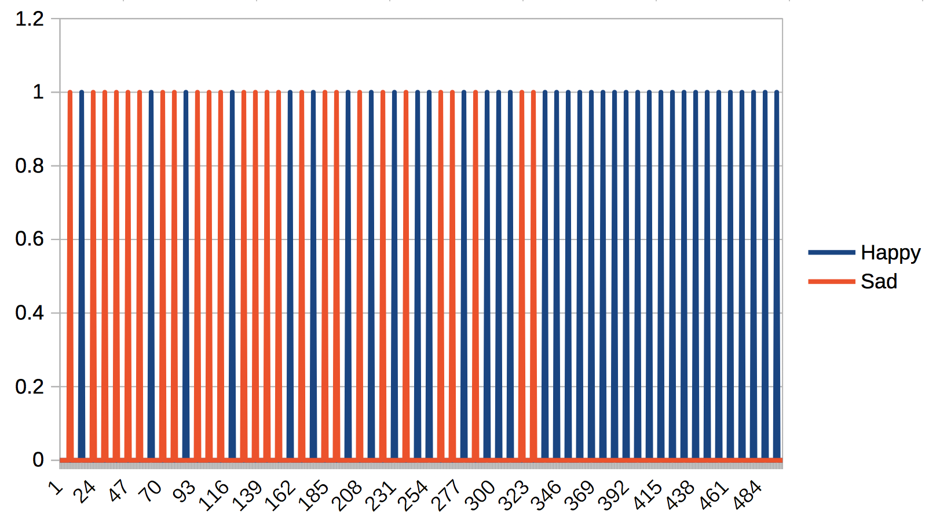

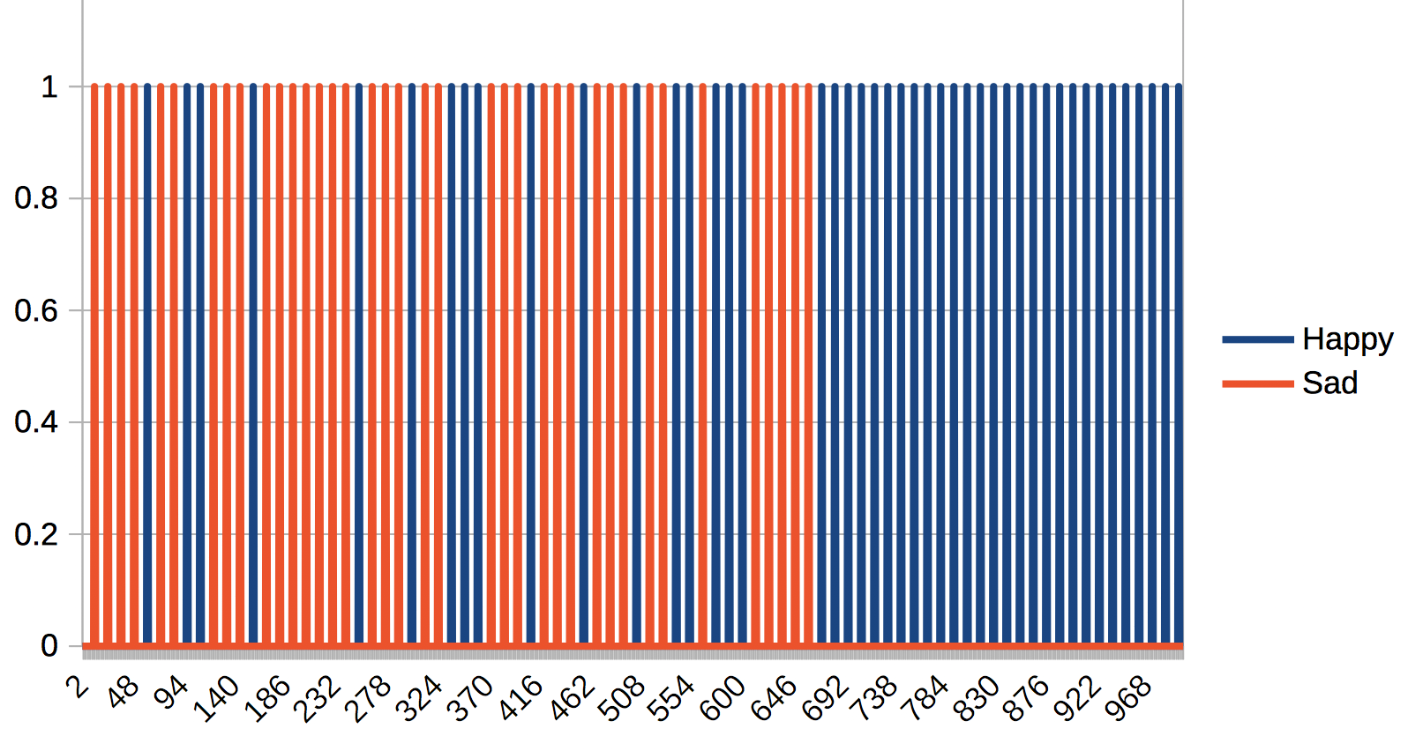
Identifying successful/unsuccessful sequential experiences for experiential learning with global (self)reinforcement
2 X 6 50 epochs
Sad(t)
Happy(t)
Left(t)
Stay(t)
Right(t)
Xball(t)
Yball(t)
Xracket(t)
Sad(t)
Happy(t)
Agent
6 X 8 1000 epochs
Comp-
ressor
Predicates
Base Values
Pre-
dictor
Models
Evidence Log
Move(t)
Decider
Action Log
https://www.youtube.com/watch?v=2LPLhJKh95g
https://www.springerprofessional.de/neuro-symbolic-architecture-for-experiential-learning-in-discret/20008336
https://github.com/aigents/aigents-java/tree/master/src/main/java/net/webstructor/agi

Slide 9
Ontology and Grammar (“Discrete”)
predicate
argument
Pixel
Move
Happy
Boolean
Number
Horizontal
False
True
statement :=
predicate(argument)
Row
Column
Left
Center
Right
Pixel(1,0)
Pixel(4,1)
Happy(False)
=>
Move(Left)
Pixel(0,2)
Pixel(4,2)
Happy(False)
=>
Move(Right)
Pixel(3,4)
Pixel(4,4)
Happy(False)
=>
Move(Left)
Pixel(0,4)
Pixel(4,3)
Happy(True)
=>
Move(Left)
Global
Feedback
https://www.youtube.com/watch?v=2LPLhJKh95g

Slide 10
Ontology and Grammar (“Symbolic”)
predicate
argument
Position
Happy
Move
RacketX
BallX
BallY
Boolean
Horizontal
Vertical
False
True
statement :=
predicate(argument)
Left
Center
Right
Top
Center
Bottom
BallY(Top)
BallX(Left)
RacketX(Left)
Happy(False)
=> Move(Left)
BallY(Top)
BallX(Center)
RacketX(Center)
Happy(False)
=> Move(Right)
BallY(Bottom)
BallX(Right)
RacketX(Right)
Happy(False)
=> Move(Right)
BallY(Bottom)
BallX(Right)
RacketX(Right)
Happy(True)
=> Move(Left)
Global
Feedback
https://www.youtube.com/watch?v=2LPLhJKh95g

Slide 11
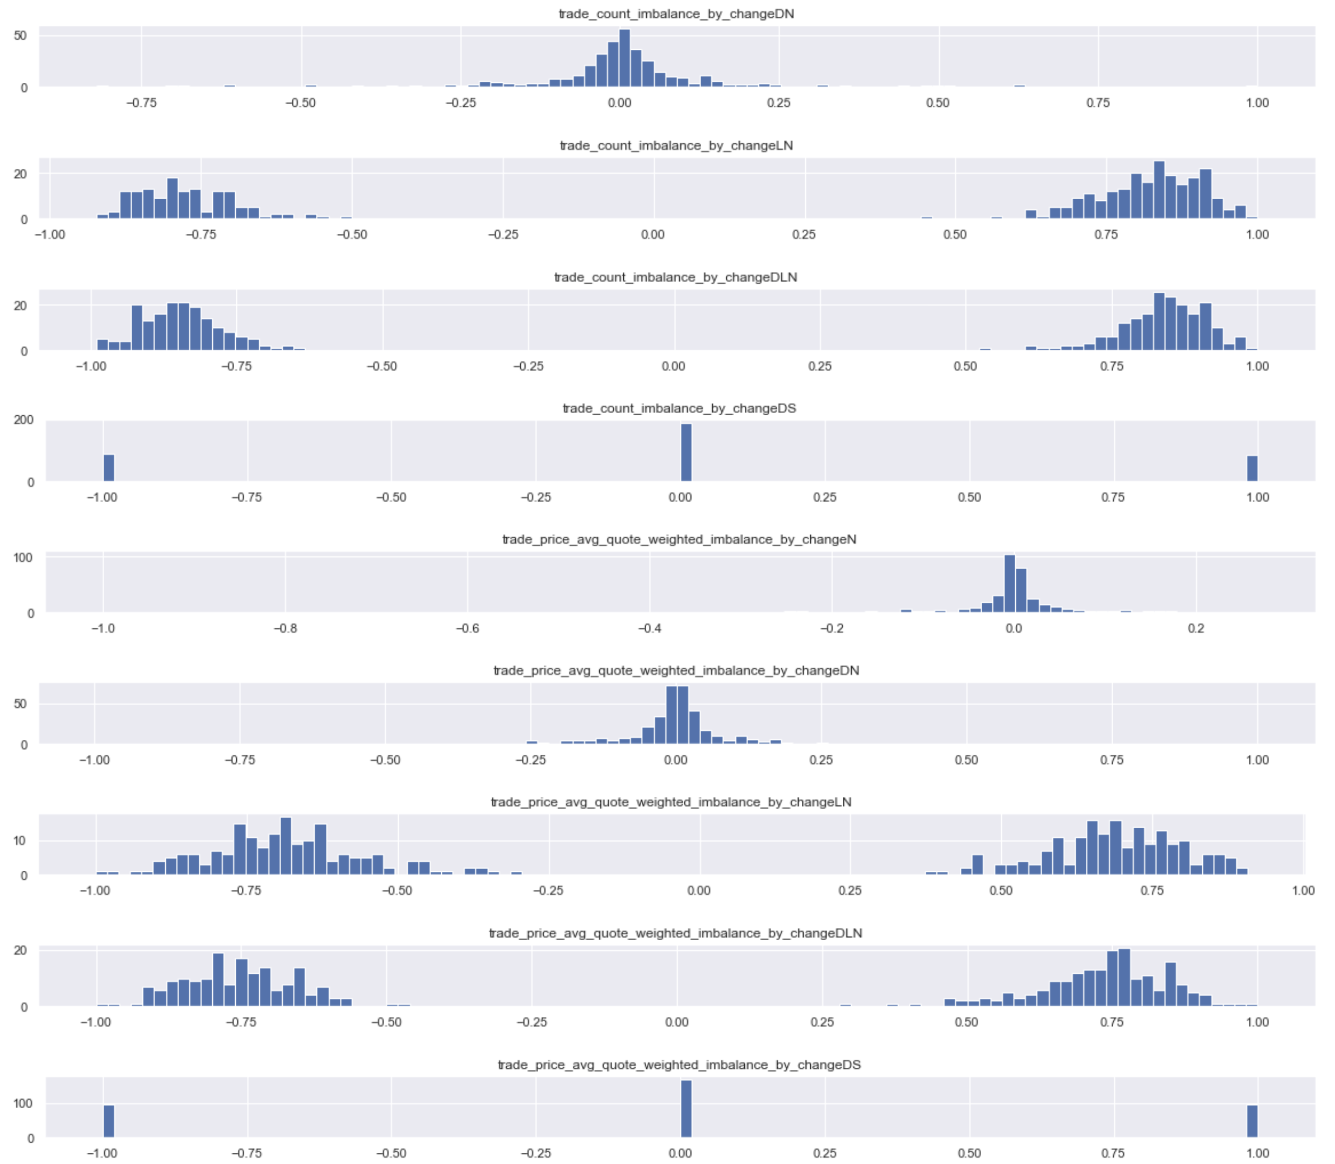
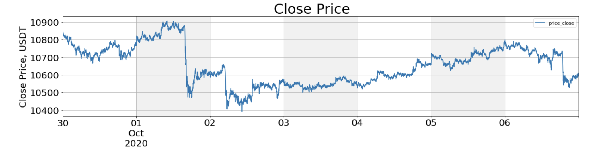
“Symbolizing” Market Conditions
Quantifying Time Series Metrics
Flat
Crash
Crash
Flat
Up
Up
Crash
A1
A2
B1
B2
C1
C2
C3
A2
B1
C2
D2
E2
F2
A1
B2
C1
D1
E1
F1
A1
B2
C1
D1
E1
F1
A2
B1
C2
D2
E2
F2
A1
B1
C3
D2
E2
F3
A1
B1
C3
D2
E2
F3
A1
B2
C1
D1
E1
F3
D1
D2
E1
E2
F1
F2
F3
Time

Slide 12
Discovering NLP patterns such as words or phrase structures for unsupervised language learning (Aigents® “Deep Patterns”)
NOUN
VERB
SUBJECT PREDICATE OBJECT
OR
OR
“procedure”
“drug”
“negative effect”
“positive effect”
“disease”
OR
OR
OR
OR
AND
AND
cold
aspirin
treat
reduces
OR
head
tylenol
acetylsalicylic acid
treats
reduce
existential
frustration
acetaminophen
anxiety
acetaminophen may significantly reduce feelings of existential anxiety
https://ieeexplore.ieee.org/document/7361868
https://github.com/aigents/aigents-java
https://www.springerprofessional.de/unsupervised-language-learning-in-opencog/15995030
https://www.springerprofessional.de/en/programmatic-link-grammar-induction-for-unsupervised-language-le/17020348
https://github.com/singnet/language-learning/

Slide 13
Unsupervised Clustering
No magic K values and thresholds are known!!!

Slide 14
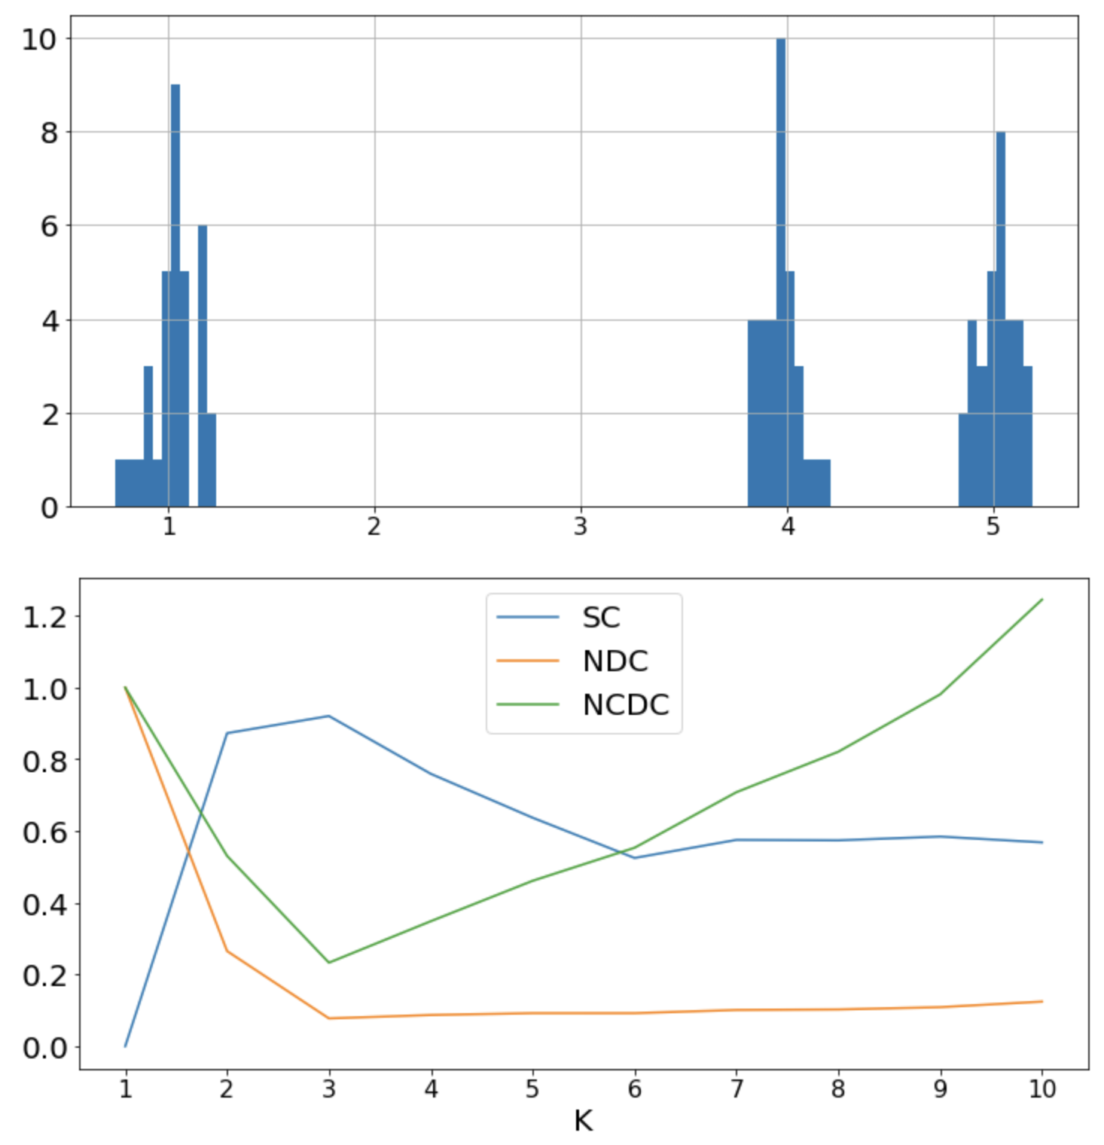
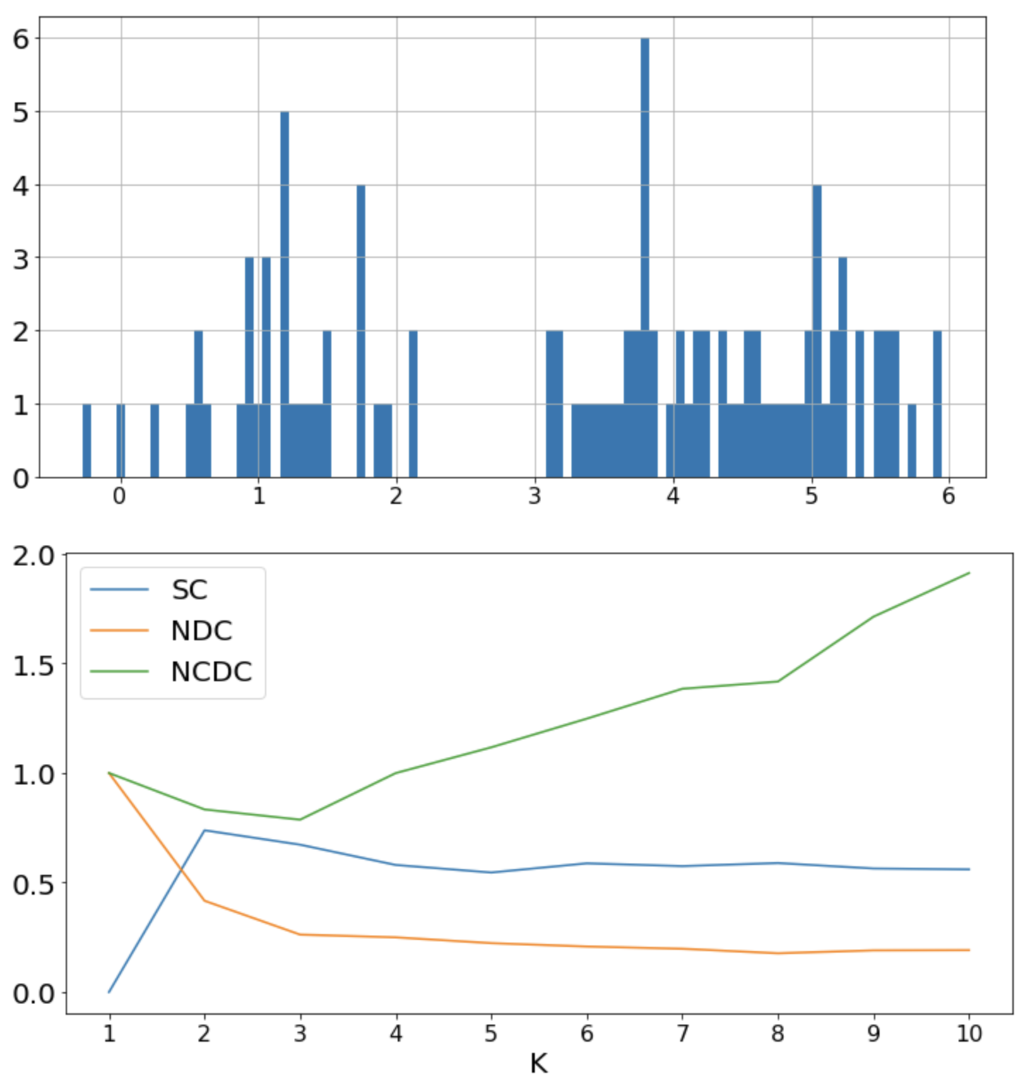
Quantification (1-D Clustering) Measures

Slide 15
Quantification for Symbolization
Resume:
"K-means" works, with evaluation of optimal number of clusters based on either of the following:
1. Maximizing "Silhouette Coefficient" (SC), which appears more human-intuitive but does not work for K=1
https://en.wikipedia.org/wiki/Silhouette_(clustering)
https://towardsdatascience.com/silhouette-coefficient-validating-clustering-techniques-e976bb81d10c
2. Minimizing "Normalized Centroid Distance" (NCD) - based on "minimum description length" idea, works for K=1, does not align with human "reductionist" intuition for diverse distributions (tends to create more clusters than needed)
https://www.researchgate.net/publication/221020638_Cluster_Validity_Measures_Based_on_the_Minimum_Description_Length_Principle
3. Minimizing "Normalized Centroid Distance times Centroids" (NCDC) - extends NCD multiplying it by number of clusters to penalize creation of too many clusters, works for K=1, more human-intuitive than NCD but less human-intuitive than SC
4. Using SC+ (maximize SC if it is above threshold 0.65 or minimize NCDC otherwise) - seems generally optimal from human intuition perspective
https://github.com/aigents/pygents/blob/main/notebooks/cluster/distribution_modes.ipynb

Slide 16
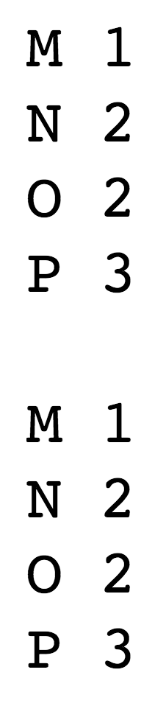
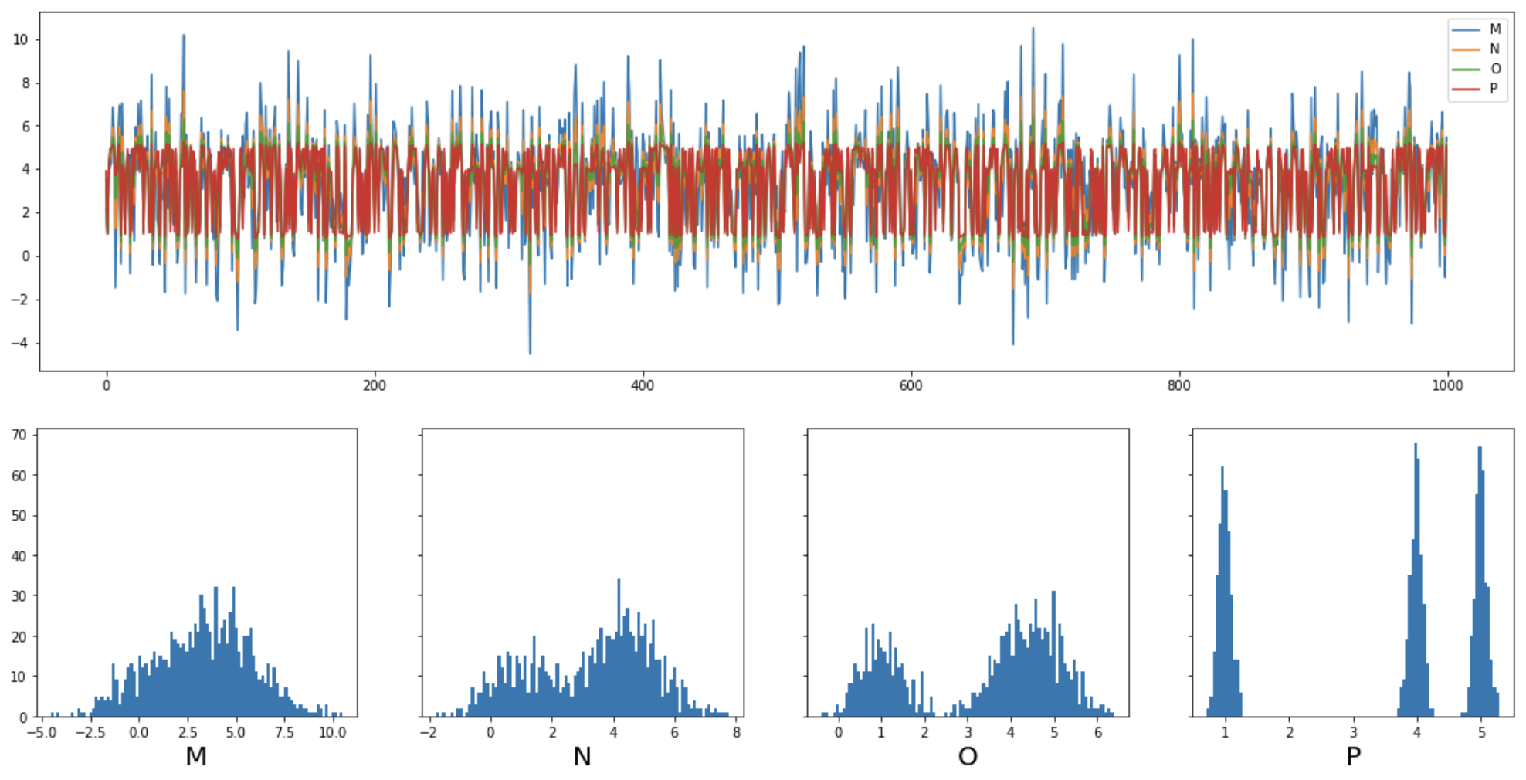
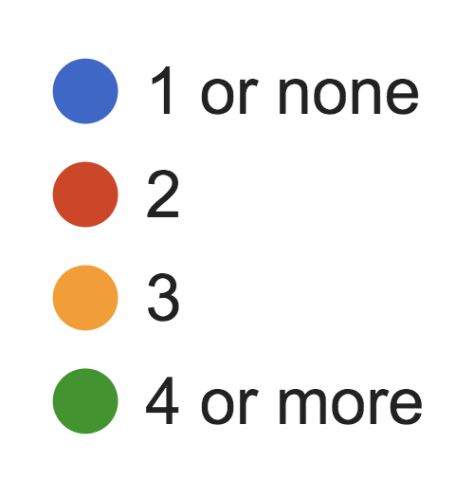
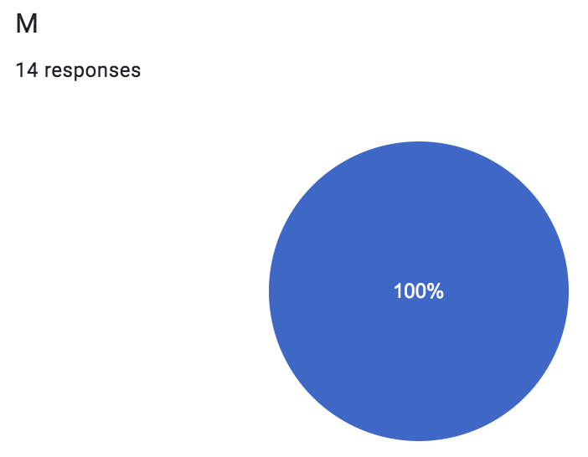
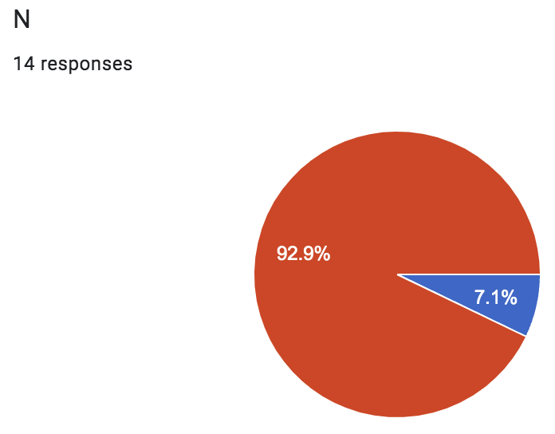
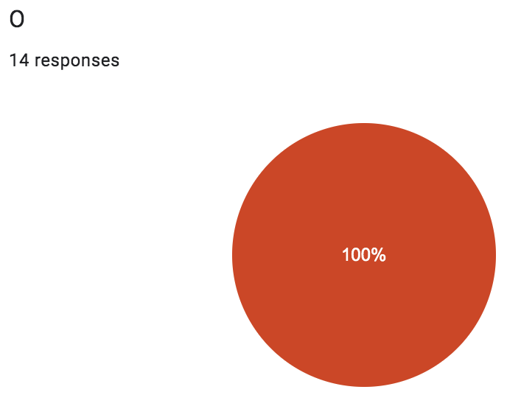
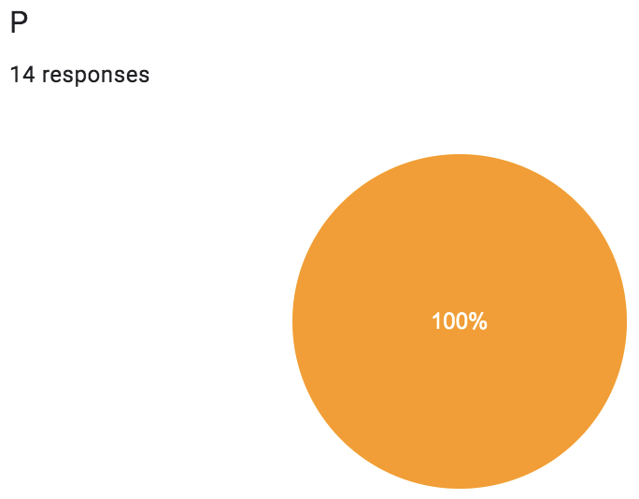
Quantification – Example 1
NCDC
Human
SC+
M 1
N 2
O 2
P 3
Human

Slide 17
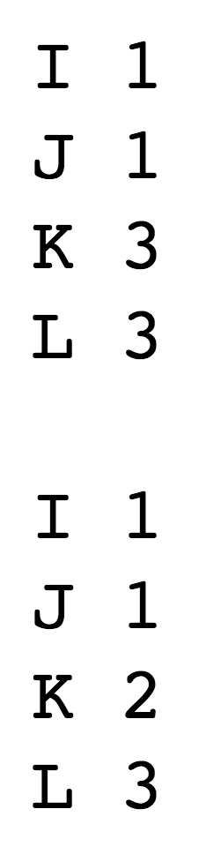
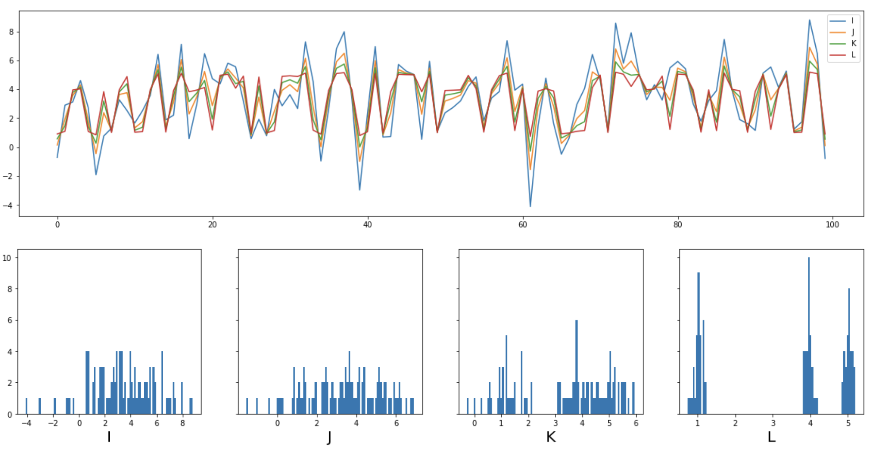
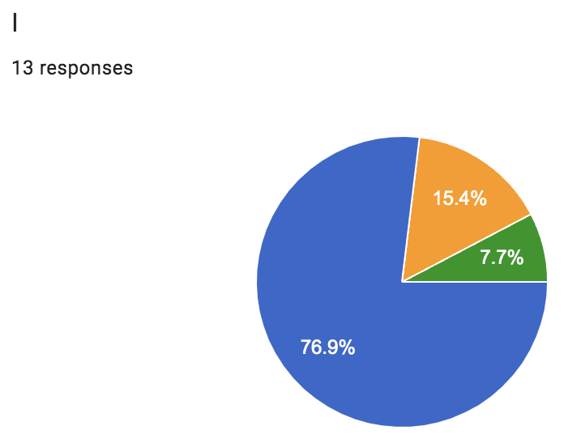
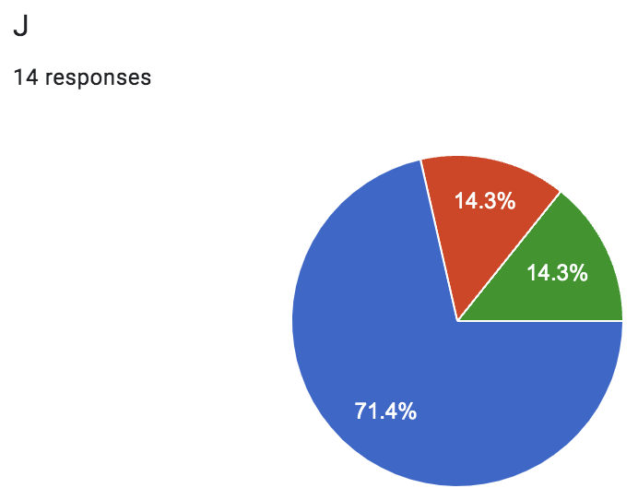
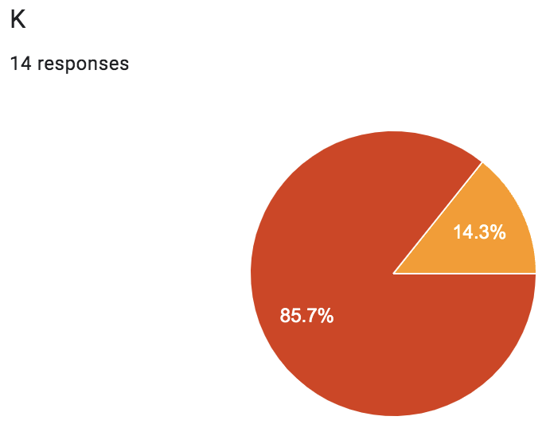

Quantification – Example 2
NCDC
Human
SC+
I 1
J 1
K 2
L 3
Human

Slide 18
Quantification: Human vs. Machine
Evaluate with "Fleiss’ kappa" (FK) and "Krippendorff’s alpha" (KA)
https://en.wikipedia.org/wiki/Fleiss%27_kappa
https://stackoverflow.com/questions/51919897/is-fleiss-kappa-a-reliable-measure-for-interannotator-agreement-the-following-r
https://bmcmedresmethodol.biomedcentral.com/articles/10.1186/s12874-016-0200-9
https://www.statsmodels.org/dev/generated/statsmodels.stats.inter_rater.fleiss_kappa.html
NCDC vs. SC+: 0.55, 0.56 (Moderate agreement)
Humans vs. humans: 0.59, 0.59 (Moderate agreement)
NCDC vs. humans: 0.47, 0.48 (Moderate agreement)
SC+ vs. humans: 0.92, 0.92 (Almost perfect agreement)

Slide 19
Unsupervised Segmentation
No stop/start/break tokens, lexicons and rules are known!!!

Slide 20
Issues to Address
Absence of explicit start/stop tags in continuous streams of spaces in experiential (reinforcement/self-reinforcement) learning with delayed/sparse feedback
Complex, cumbersome, unreliable and expensive language-specific tokenization process for unsupervised language learning in NLP
Low quality of unsupervised parsing and tokenization learning based on mutual information and conditional probabilities
https://www.youtube.com/watch?v=2LPLhJKh95g
https://www.springerprofessional.de/neuro-symbolic-architecture-for-experiential-learning-in-discret/20008336
https://github.com/aigents/aigents-java/tree/master/src/main/java/net/webstructor/agi
https://www.springerprofessional.de/unsupervised-language-learning-in-opencog/15995030
https://www.springerprofessional.de/en/programmatic-link-grammar-induction-for-unsupervised-language-le/17020348
https://github.com/singnet/language-learning/
https://scholarsarchive.byu.edu/cgi/viewcontent.cgi?article=6983&context=etd

Slide 21
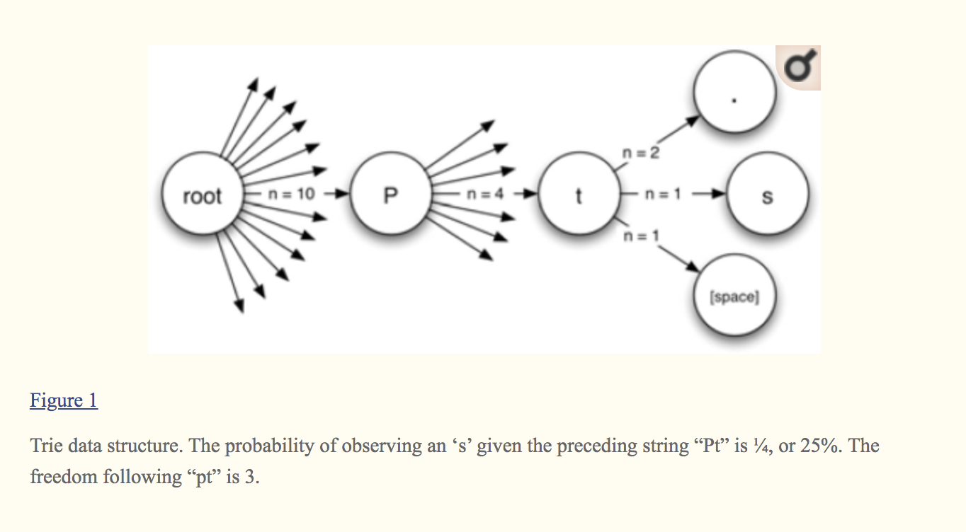
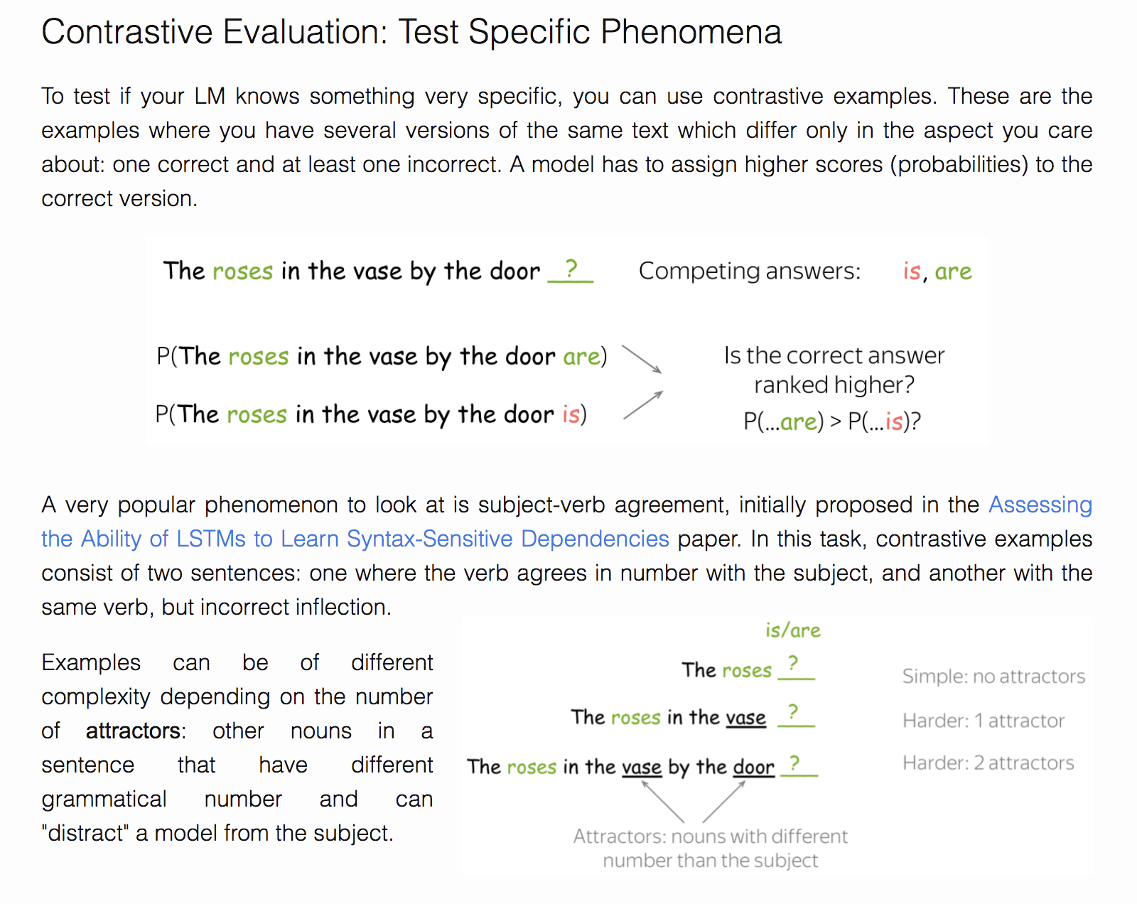
Tokenization or Text Segmentation as Language Modeling
Metrics/Indicators:
Mutual Information¹
Conditional Probability^{1,2}
Transition Freedom^{2,3}
¹ https://scholarsarchive.byu.edu/cgi/viewcontent.cgi?article=6983&context=etd
² https://www.ncbi.nlm.nih.gov/pmc/articles/PMC2655800/
³ Karl Friston.The free-energy principle: a unified brain theory?
https://www.nature.com/articles/nrn2787
https://lena-voita.github.io/nlp_course/language_modeling.html

Slide 22
Claims
Transition Freedom (TF) appears to be superior (over Mutual Information and Conditional Probability) for unsupervised text segmentation (tokenization).
English and Russian require one specific way (variance) of handling the TF while Chinese requires a bit different specific way (derivative-based “peak values”) for the same purpose.
Tokenization quality for Russian and English may be as high as F1=0.96-1.0, depending on training and testing corpora while for Chinese the minimum is F1=0.71-0.92, depending on the assessment assumptions.
Larger training corpora does not necessarily effect in better tokenization quality, while compacting the models eliminating statistically weak evidence typically improve the quality.
TF-based tokenization appear quality same or better than lexicon-based one for Russian and English while for Chinese appears the opposite (as it could be anticipated).
Doing Russian and English tokenization with removed spaces makes the situation similar to Chinese with reasonable quality on lexicon-based tokenization but much worse results on TF-based one.
https://arxiv.org/abs/2205.11443
https://github.com/aigents/pygents

Slide 23
Corpora and Methodology
Train corpora
Chinese
CLUE News 2016 Validation – 270M
CLUE News 2016 Train – 8,500M
English
Brown – 6M
Gutenberg Children – 29M
Gutenberg Adult – 140M
Social Media – 68M
All above – combined
Russian
RusAge Test – 141M
RusAge Previews – 825M
Test corpus
Parallel Chinese/English/Russian
– 100 multi-sentence statements on finance
Metrics/Indicators:
Ngram (Character)
Probability or Conditional Transition Probability (p-/p+)
Deviation (dvp-/dvp+) from mean
Derivative (dp-/dp+) and “Peak”
Transition Freedom (f-/f+)
Deviation (dvf-/dvf+) from mean
Derivative (df-/df+) and “Peak”
Hyper-parameters:
Combination of Ngram ranks N ([1],[2],[3],[1,2],[1,2,3],…)
Threshold for model compression
Threshold for segmentation
Evaluations:
Tokenization F1, on set of tokens found comparing to delimiter-based (English/Russian) or Jieba (Chineze)
Precision on set of tokens found comparing to reference lexicons

Slide 24
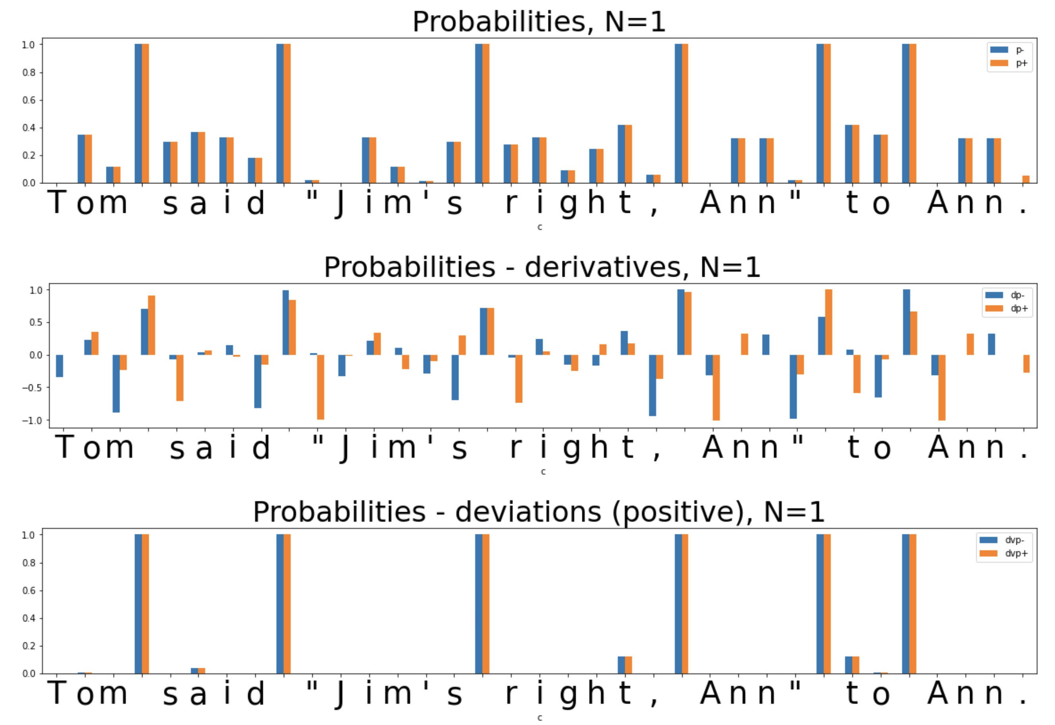
Unsupervised Text Segmentation (Tokenization)
Metrics/Indicators:
Ngram (Character)
Probability

Slide 25

Unsupervised Text Segmentation (Tokenization)
Metrics/Indicators:
Ngram (Character)
Conditional
Probability
(of Transition)
P(Ngram_{n+1})/P(Ngram_{n})
P(“m ”)/P(“m”)

Slide 26
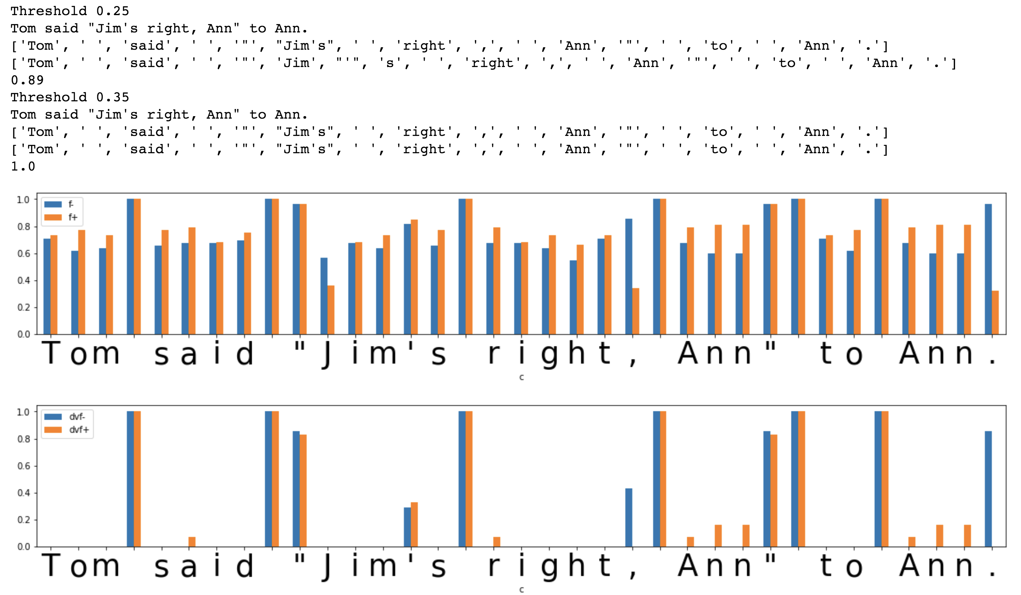
Unsupervised Text Segmentation (Tokenization)
Metrics/
Indicators:
Transition
Freedom
(Freedom of
Transition)
Transition
Freedom
Deviation
https://www.ncbi.nlm.nih.gov/pmc/articles/PMC2655800/

Slide 27
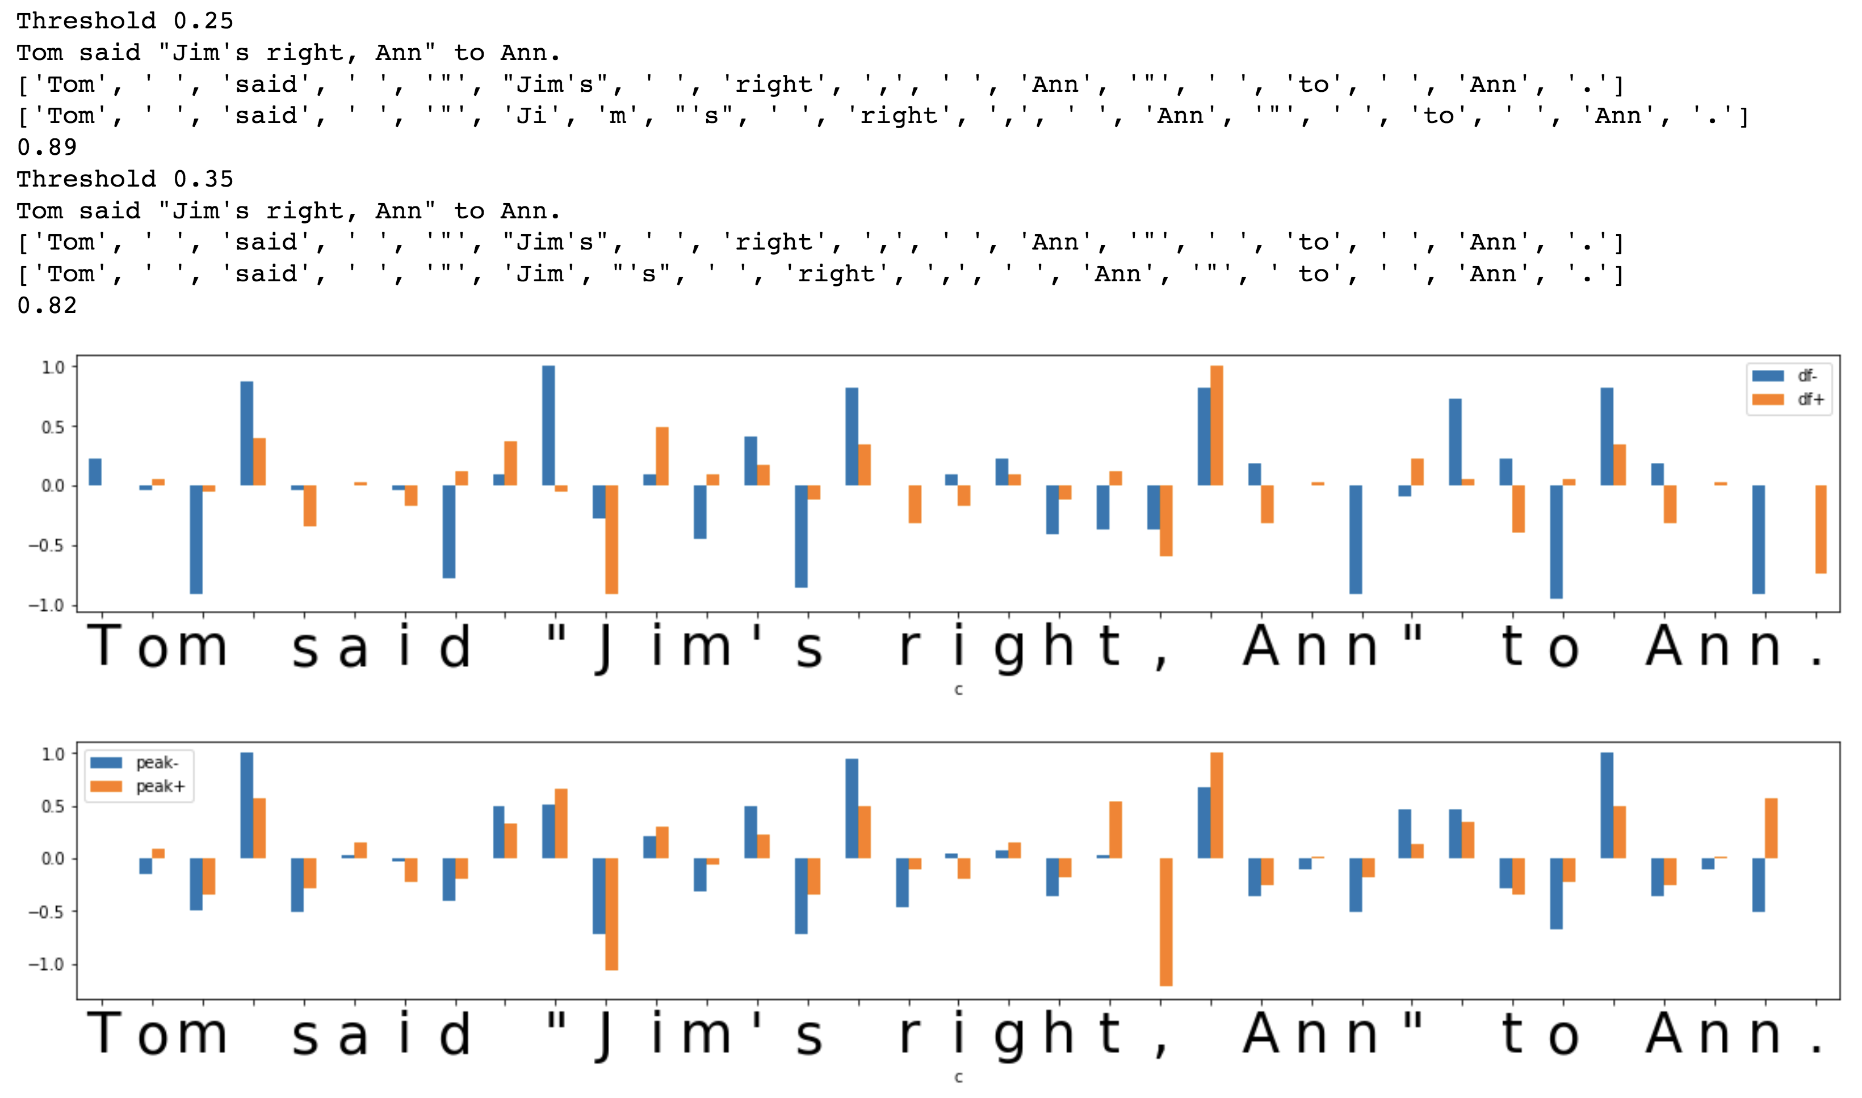
Unsupervised Text Segmentation (Tokenization)
Metrics/
Indicators:
Transition
Freedom
(Freedom of
Transition)
Derivative
Transition
Freedom
“Peak”)
https://www.ncbi.nlm.nih.gov/pmc/articles/PMC2655800/

Slide 28
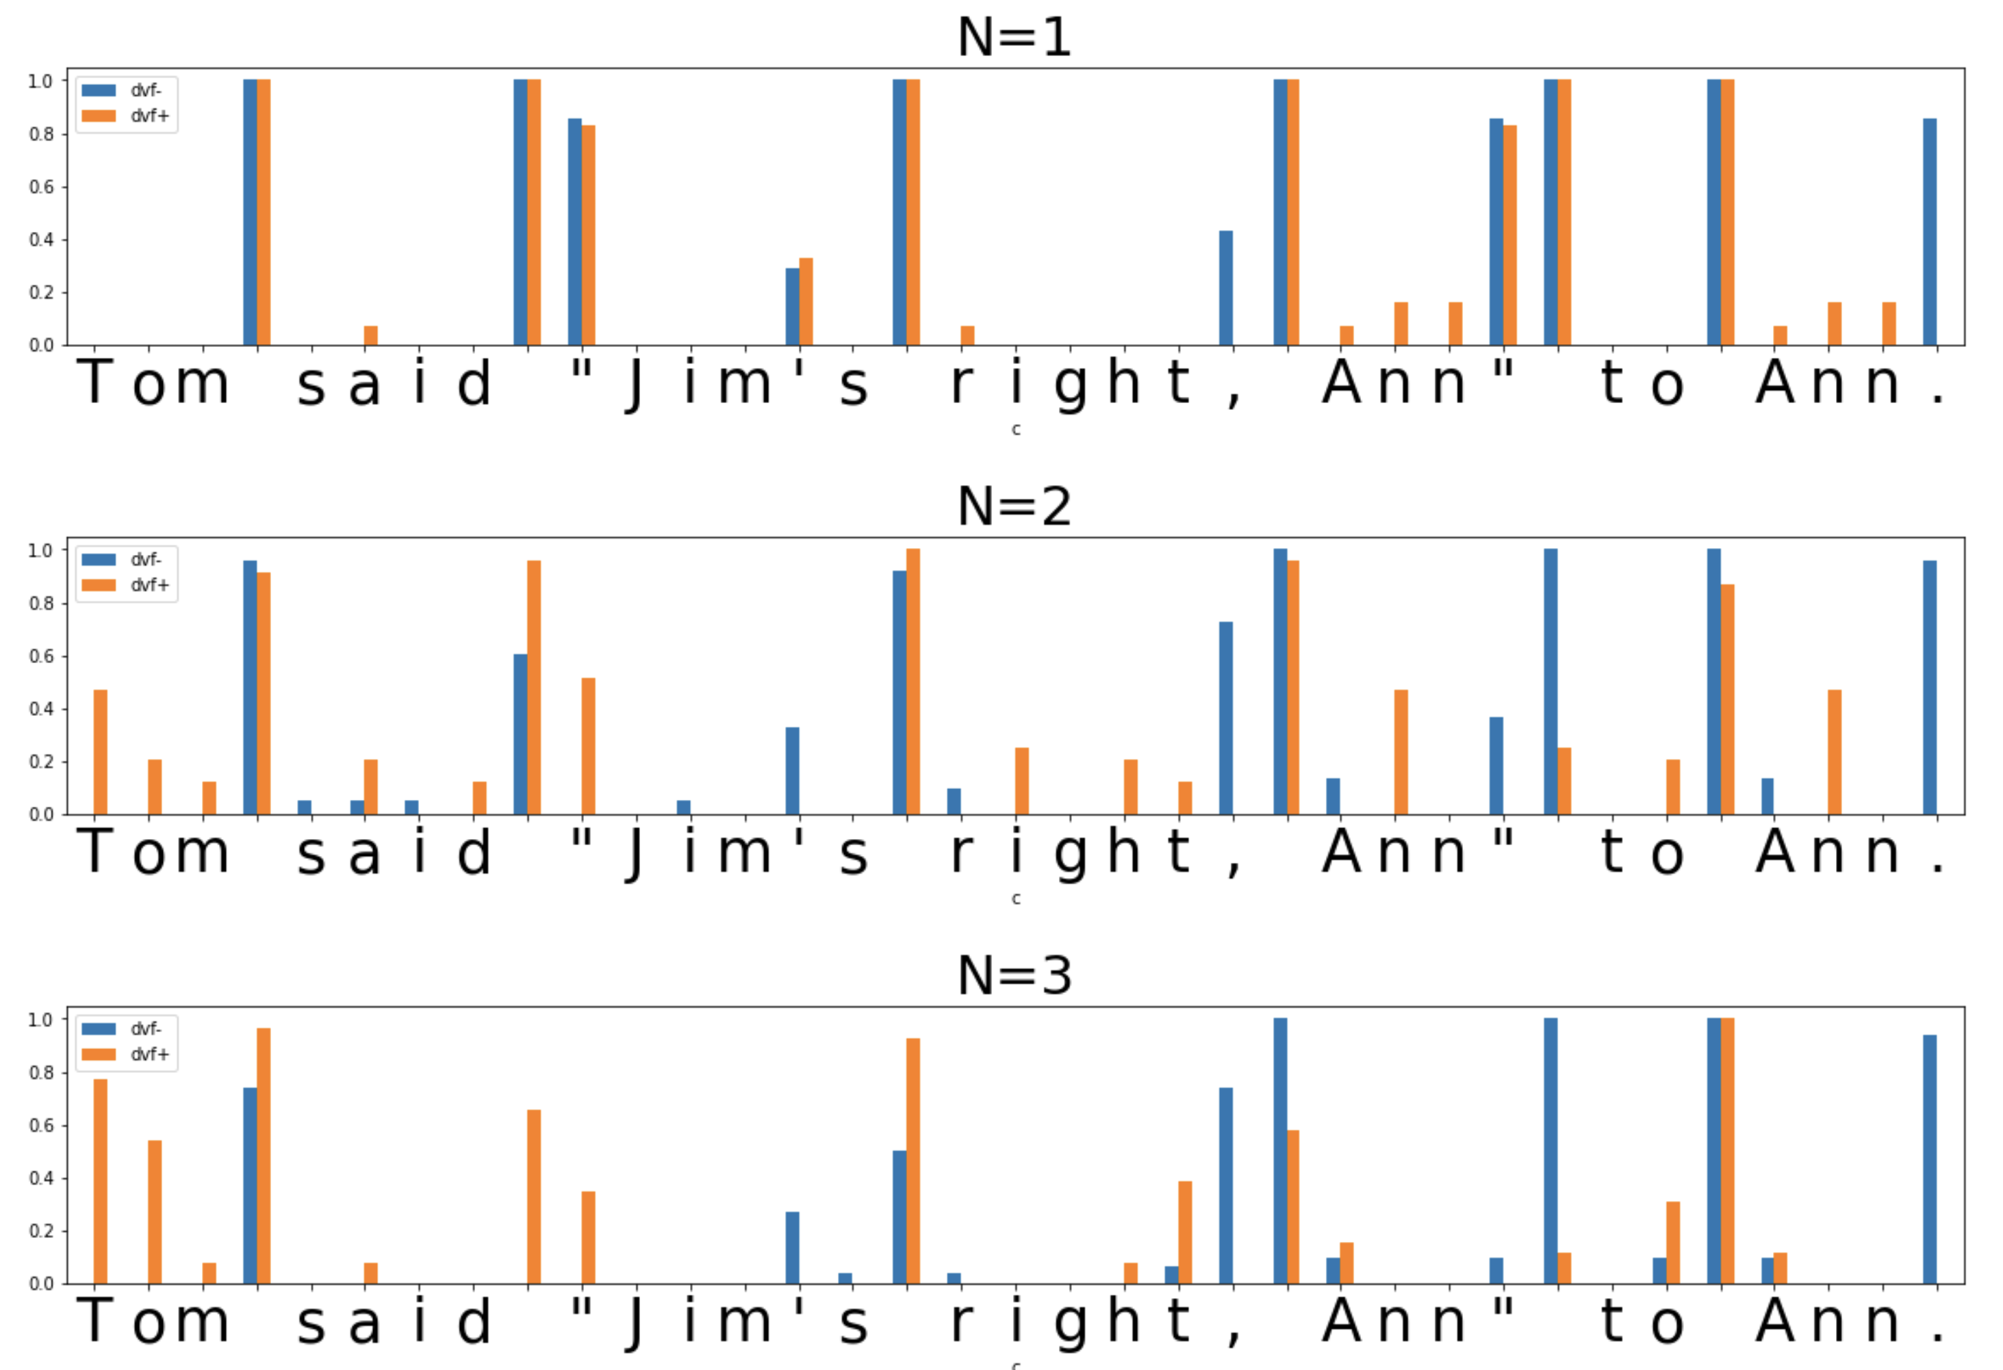
Unsupervised Text Segmentation (Tokenization)
Metrics/
Indicators:
Transition
Freedom
Deviation
(varying “N”
of N-gram)

Slide 29
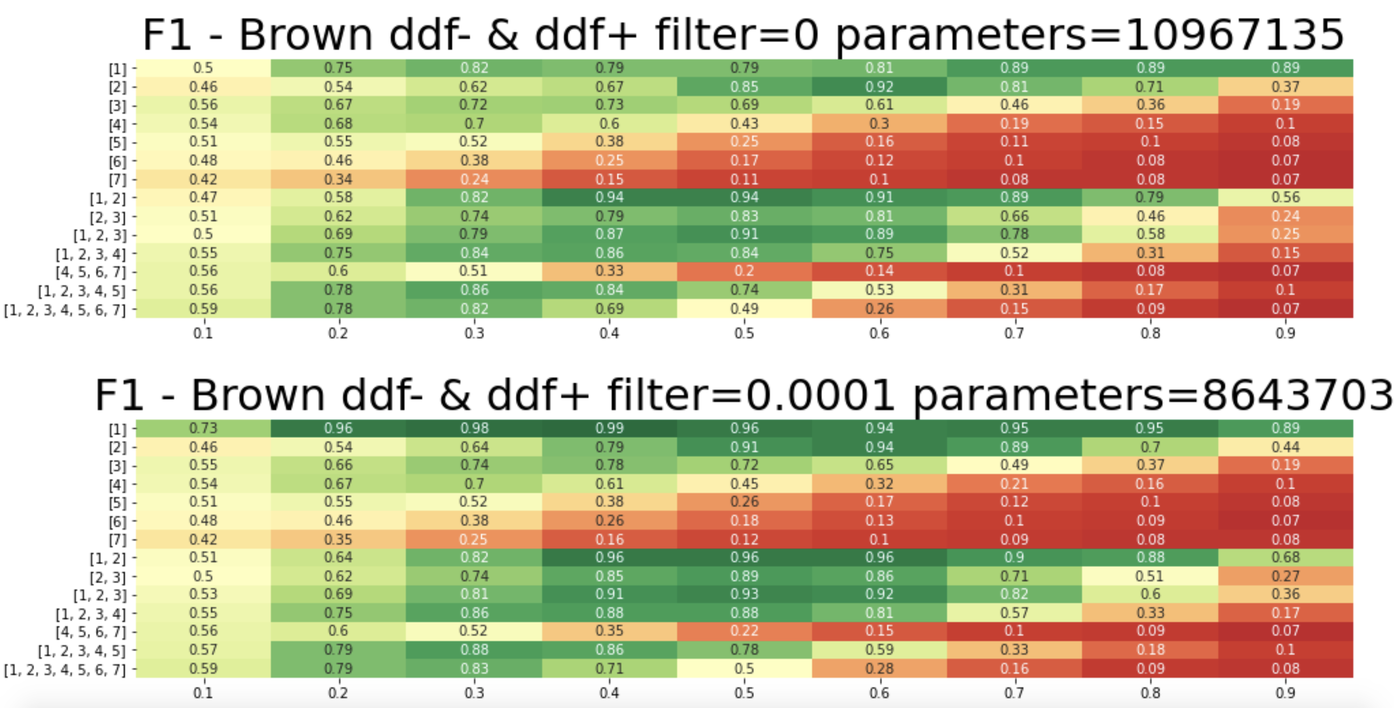
Unsupervised Text Segmentation (Tokenization)
English
Hyper-
Parameters:
Metric:
Transition
Freedom
Threshold
for model
compression
Combination
of Ngram N-s
Threshold for
segmentation

Slide 30
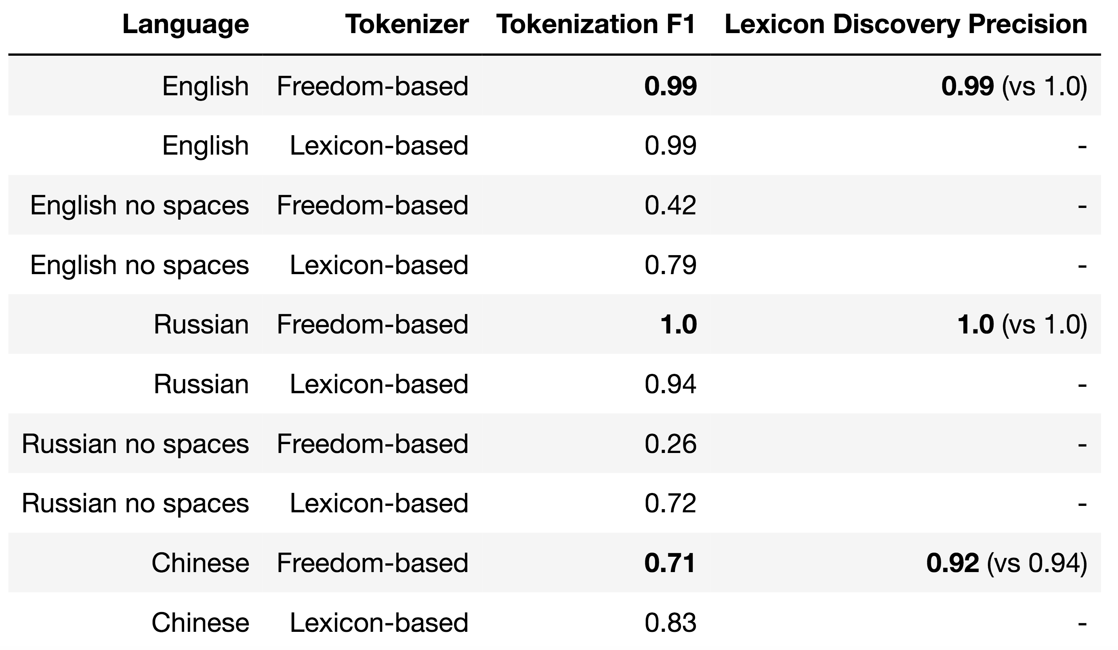
Results – Freedom-based Tokenization against Lexicon
Lexicon-based Tokenization - greedy/beam search on word length (optimal) or frequency

Slide 31




Unsupervised Character Category Learning
Agglomerative Clustering in space of Transitions
RusAge Test/Small, Cosine Similarity

Slide 32
Conclusion and Further Work
Unsupervised Tokenization based on Transition Freedom (TF) recall and precision appears good enough as initial approximation for further applications of self-reinforcement learning as part of interpretable unsupervised learning of natural language.
Optimal thresholds and specific TF-based metrics are specific to language. The process and policy of their discovery and adjustment should be further explored.
Clustering or parts of speech on space of transition graphs may provide some insights on morphology and punctuation structure of low-resource and domain-specific languages.
Hybridization of TF-based tokenization approach with lexicon-based one might be efficient for low-resource and domain-specific languages.
Further unsupervised grammar learning experiments can be run on the basis of suggested unsupervised tokenization approach.
Applications for other Experiential Learning environments, including the ones with delayed/sparse feedback.
Using Reinforcement Learning techniques with self-reinforcement on historical data under Unsupervised Learning setup.
https://arxiv.org/abs/2205.11443
https://github.com/aigents/pygents

Slide 33



Something about Human Intuition?
Language 1
Language 2
Language 3

Slide 34
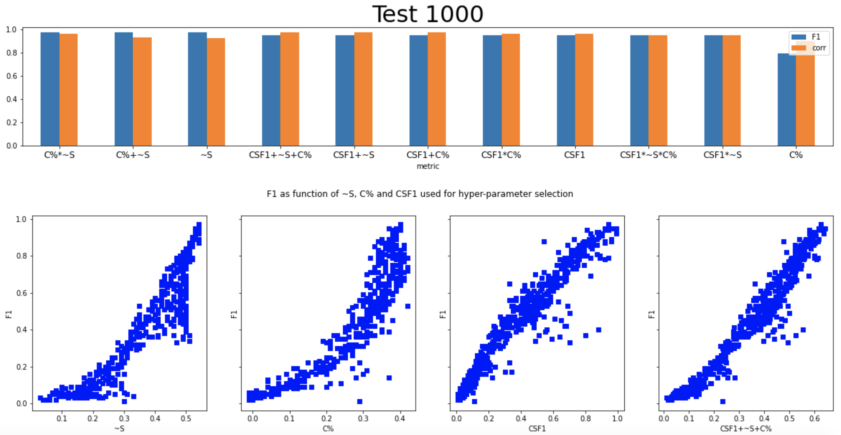
Self-tuning Hyperparameters – English (TF variance)

Slide 35
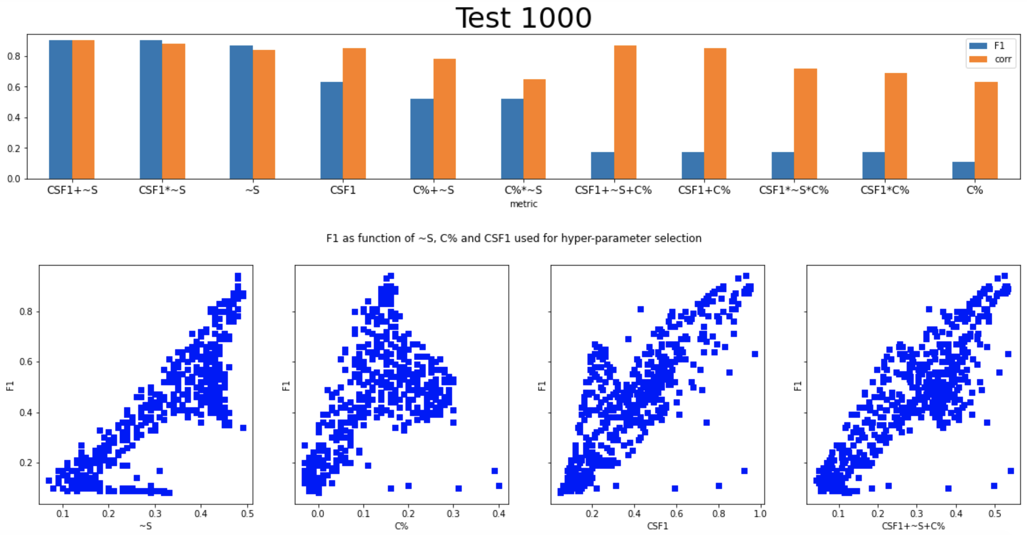
Self-tuning Hyperparameters – Russian (TF variance)

Slide 36
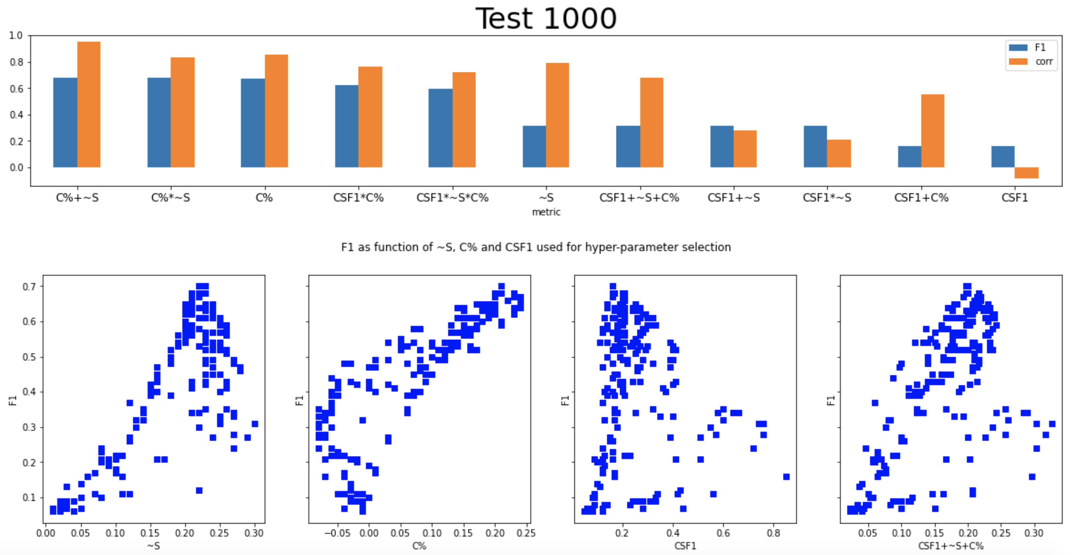
Self-tuning Hyperparameters – Chinese (TF “peak”)

Slide 37
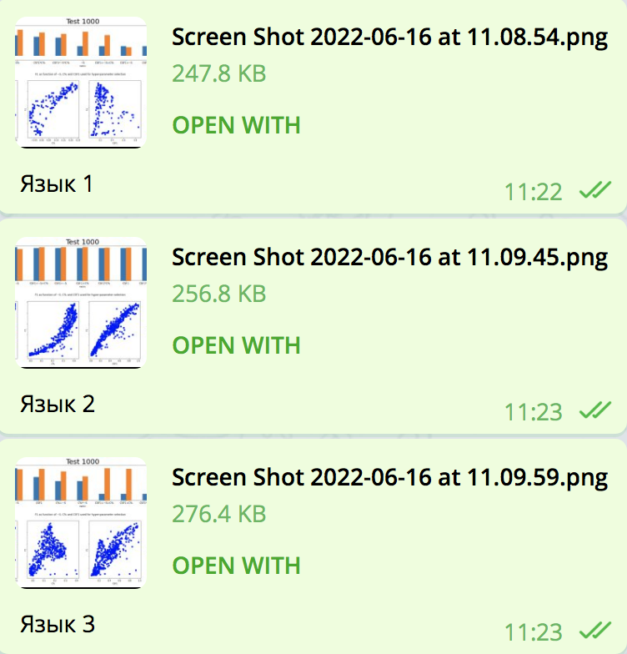
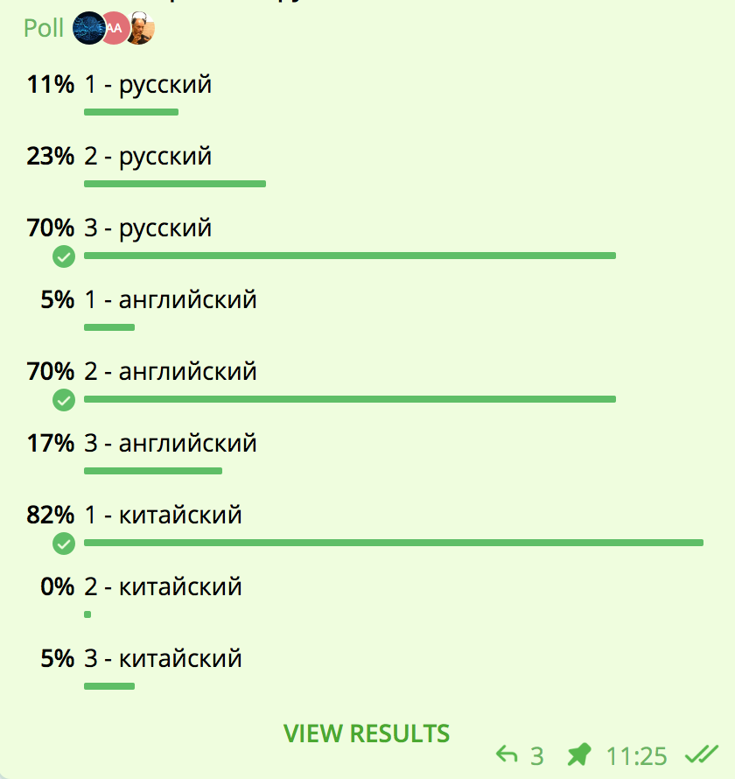
Something about Human Intuition!
Russian
Russian
Language 1
Russian
English
English
Language 2
English
Chinese
Chinese
Chinese
Language 3

Slide 38
Thank You and Welcome!
Anton Kolonin
akolonin@aigents.com
Facebook: akolonin
Telegram: akolonin
https://www.nsu.ru/
https://agirussia.org
AIGENTS
https://aigents.com

