Slide 1
General Research Methods
Research Methods in CS
Plagiarism
Week 2

Slide 2
What is Research?
A search for knowledge
A scientific and systematic search for significant information on a specific topic
A careful investigation through search for new facts in any branch of knowledge
A voyage of discovery

Slide 3
Research is…
defining and redefining problems
formulating hypothesis or suggested solutions
collecting, organizing and evaluating data
making deductions and reaching conclusions
and finally testing the conclusions carefully to determine whether they fit the hypothesis formulated

Slide 4
Research Models
broadly speaking there are two major types of research models or research paradigms:
quantitative- also known as traditional, positivist, experimental, or empiricist as advanced by authorities such as Comte, Mill, Durkheim, Newton, Locke
qualitative- constructivist, naturalistic, interpretive, postpositivist or postmodern perspective as advanced by Dithey, Kant, Wittgenstein (latter), Foucault, Miles and Huberman

Slide 5
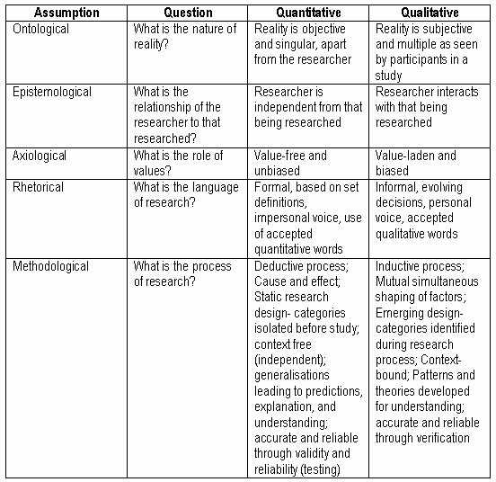

Slide 6
Research Methodology
defines:
what constitutes a research activity,
utilises or is applicable to a model, and therefore specifies concepts and related statements
what methods to apply, how to measure progress, and what constitutes success
also specifies how to communicate about an area of research activity (structure, deliverables)

Slide 7
Research Methodologies
different kinds of research questions require different kinds of approaches – various methodologies have emerged to deal with them
we will consider only those that have immediate relevance to CS/IS interestingly you could apply any of these approaches to CS:
mostly because of the fact that CS is an applied discipline and therefore lends itself to a range of different interpretations
also because CS is multidisciplinary and so its theoretical and methodological basis is in many different disciplines and therefore makes many kinds of research project possible

Slide 8
Research Methodologies
How do I know which research methodology to choose?
Ask your supervisors or others who have worked directly in the application domain that you are interested in studying, and/or
Look at significant papers in your field and attempt to determine what methodology they are using

Slide 9
Research Methodologies
How do I know whether my question is worth researching?
Be aware that your problem will change and evolve- in my opinion let it! The problem will change (get more complex as your reading and research increases). Early on if it doesn’t get more complex then it may be that the problem is not really appropriate.
If your problem appear to be getting more complex then that’s often a good sign- your work is substantial.

Slide 10
Research Design Formats
Introduction
Context (Statement of the Problem)
Purposes of the Study
Research Questions or Objectives or Hypotheses
Theoretical Perspective
Definition of Terms
Delimitations and Limitations of the Study
Review of the Literature
Methods
Research Design
Sample, Population, or Subjects
Instrumentation and Materials
Variables in the Study
Data Analysis
Appendices: Instruments

Slide 11
Research objectives
to discover answers to questions through the application of scientific procedures
to find out the truth which is hidden and which has not been discovered as yet
to gain familiarity with a phenomenon or to achieve new insights into it (known as exploratory or formulative research studies
to determine the frequency with which something occurs or with which it is associated with something else (known as diagnostic research studies)
to test a hypothesis of a causal relationship between variables (known as hypothesis-testing research studies)

Slide 12
Research motivations
Aspire to get a research degree along with career benefits
Aspire to take up the challenge in solving the unsolved problems
Desire to get intellectual joy of doing a creative work
Aspire to do research to serve the society
Seek to get recognition and respect
Directives of government
Employment conditions
Curiosity about new things
Social thinking and awakening

Slide 13
Research approaches
Descriptive Research vs. Analytical Research
Descriptive research includes surveys and fact-finding enquiries of different kinds
describes the state of affairs as it exists at present
suitable for social sciences and business and management studies
researcher has no control over the variables
reports what has happened or what is happening
survey methods of all kinds fall under descriptive research, including comparative and correlation techniques
Analytical research makes a critical evaluation of the material by analyzing facts and information already available

Slide 14
Research approaches
Applied Research vs. Fundamental Research
Applied Research is to find a solution for an immediate problem facing a society or an industrial / business organization
concentrates on discovering a solution for some pressing practical problem
Fundamental or Pure Research is mainly concerned with generalizations
concentrates on the formulation of a theory
focused towards formulation of theories that may have a broad base of applications either at present or for future which adds more materials to the already existing organized body of scientific knowledge

Slide 15
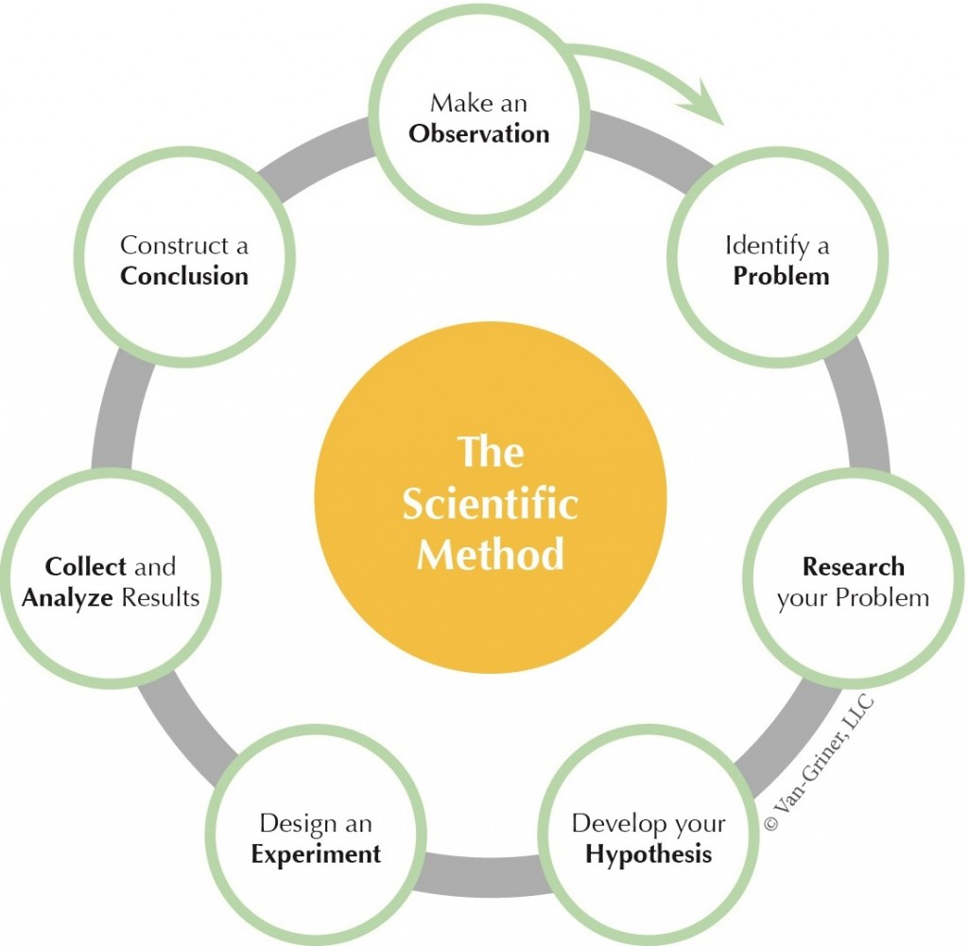

Slide 16
Research Process
Finding a research Advisor/Guide
The ideal advisor might have the following traits:
Has research interests in common with the scholar
Has a national or international reputation among researchers
Has grant support for research
Has successfully directed students in the past
Has a reputation as a fair and reasonable advisor
Has a high probability of staying at the university
Has an active research group
Good indicators are strong publications in major journals, some grant support, and a good teaching record

Slide 17
Research Process
Finding a Topic and Beginning Research
Getting Research Ideas
Becoming an Active Reader and Listener
Exposing Yourself to Research
Directed Study
Formulating the Research Problem: Develop the Nucleus of an Idea
Extensive Literature Survey
Choosing an Idea
Stay Active

Slide 18
Measure of Good Research
Good research is systematic
Good research is logical
Good research is empirical
Good research is replicable

Slide 19
Plagiarism

