Slide 1


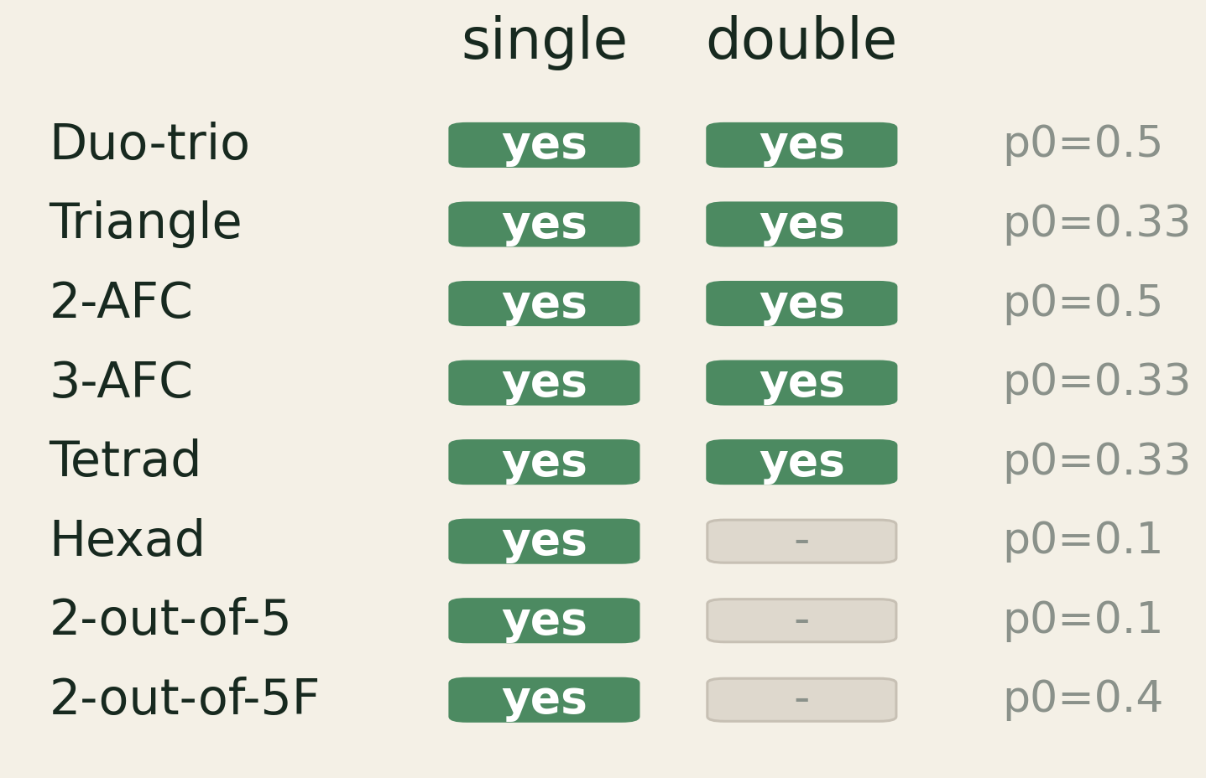
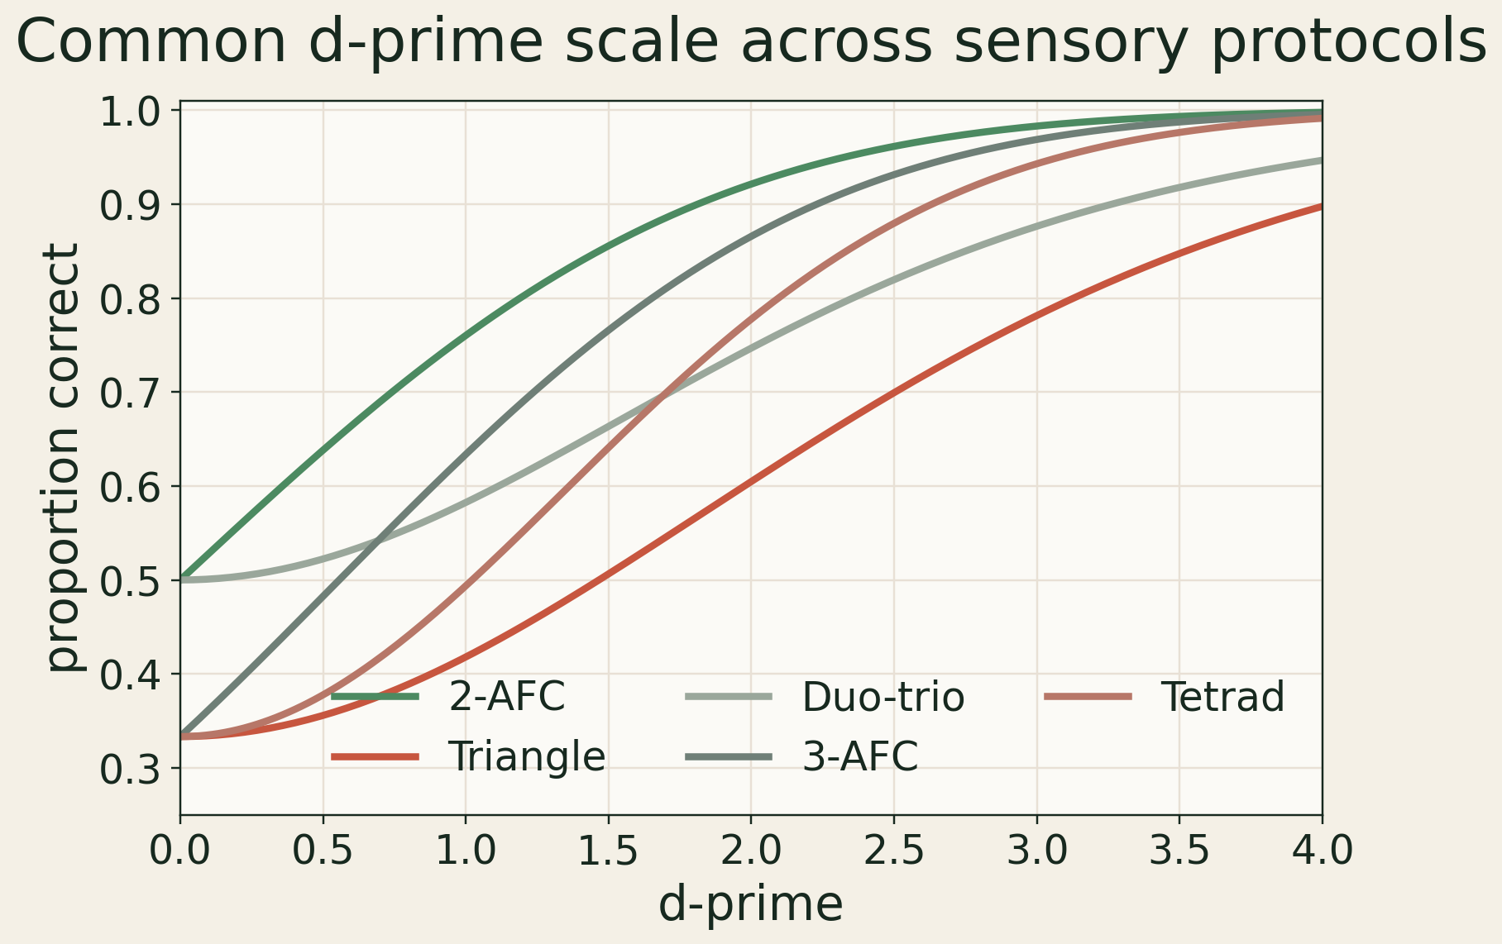
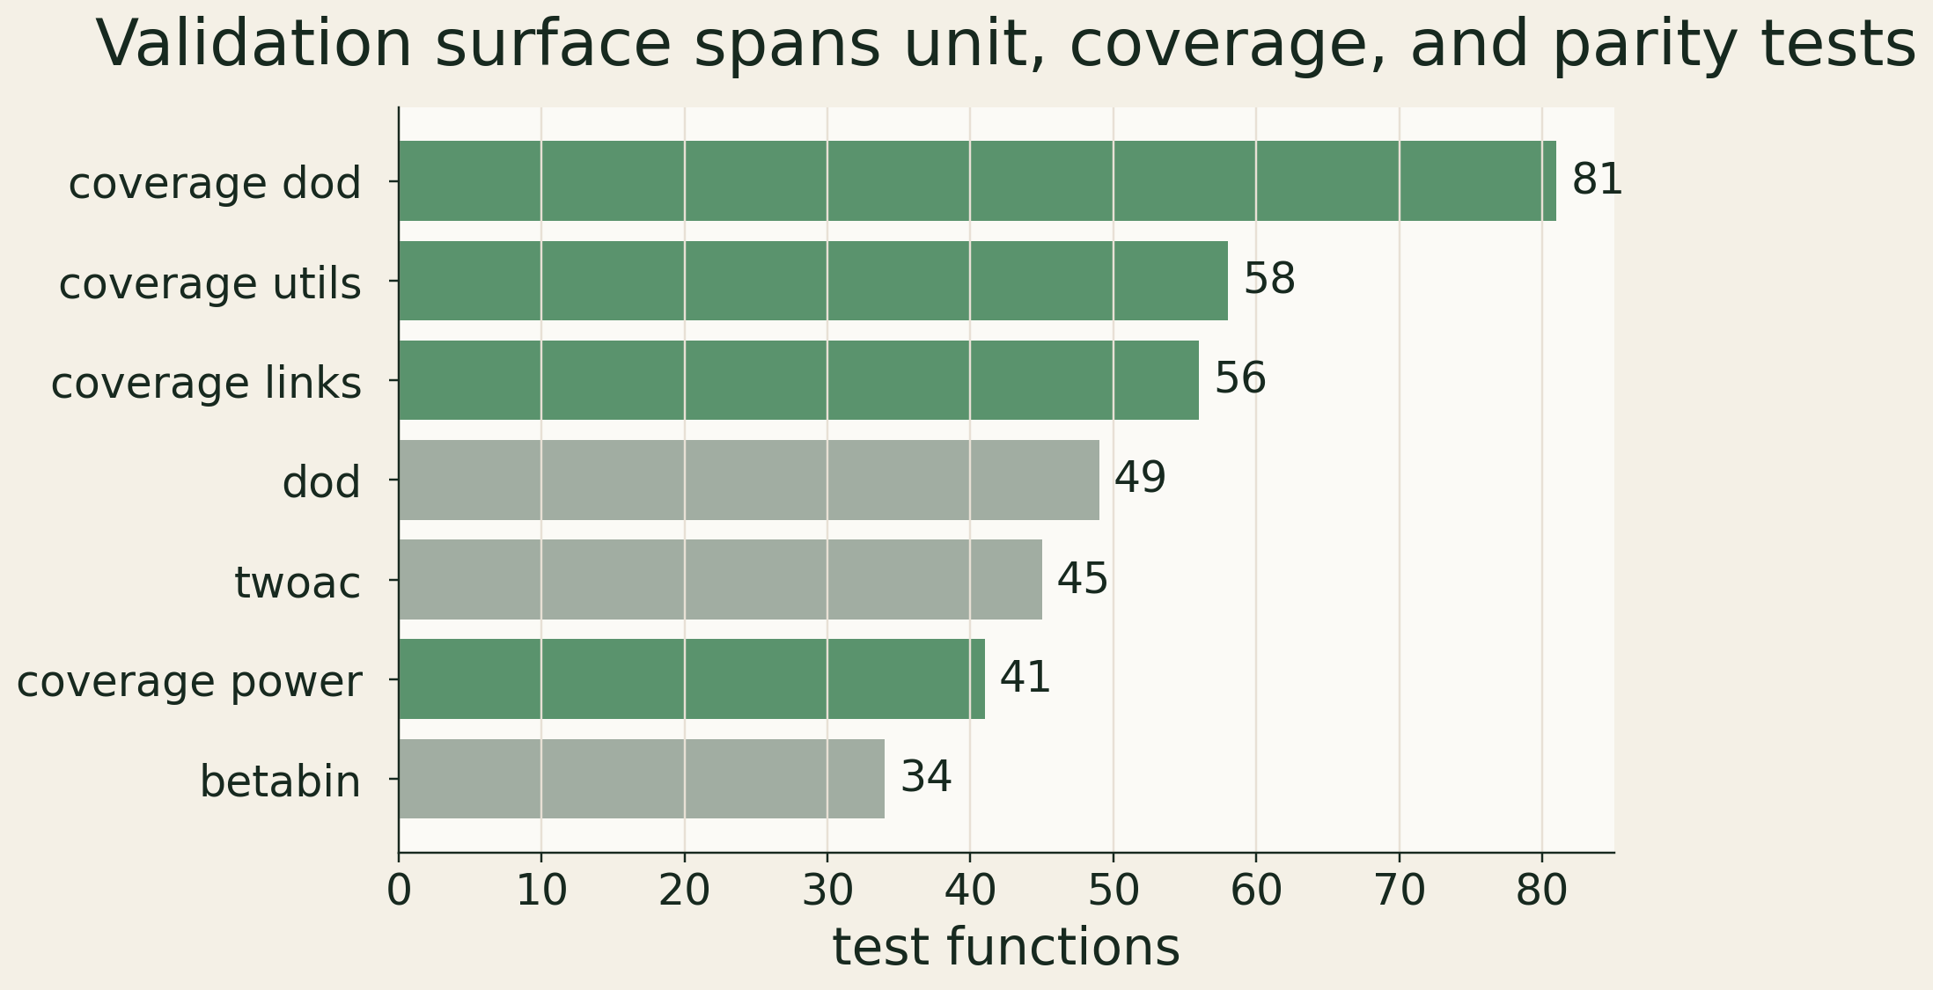

Introducing sensPy
Enabling the gold standard analyses of sensR
for sensometricians using Python
SciPy-native signal detection tools with sensR parity, typed results, and interactive visualizations
aigora
John M. Ennis¹ | Bartosz Smulski²
¹ Aigora, Richmond, United States | ² Aigora, Warsaw, Poland
Why this matters
Evidence at a glance
sensPy brings sensR-style sensory discrimination into Python without leaving SciPy, dataclasses, or Plotly.
13
740+
protocol variants
automated tests
8 single + 5 double
851 collected cases
Gold standard
Python-native
forced-choice coverage
parity + boundary cases
Preserve the sensR numerical contract.
Typed objects, plots, and planning tools.
1.5.3
Plotly
Golden fixtures keep the Python port tied to the R reference.
Designed for notebooks, pipelines, and interactive review.
sensR fixture
interactive figures
CRAN reference
psychometric + ROC
The result: validated migration for sensory teams already working in Python.
golden parity data
audit-ready outputs
Numerical parity target: 3-6 decimal places.
Protocol coverage
Psychometric functions
Common d-prime scale, protocol-specific guessing.
One API maps Pc, Pd, and d-prime.
Validation surface
Advanced models
BB
SD
ROC
Beta-Binomial
Same-Different
SDT analysis
overdispersed panel data
Thurstonian criterion model
AUC + rating data
panel variability
criterion effects
decision curves
Validation is built into the architecture.
sensR fixtures -> SciPy kernels -> dataclass results -> Plotly figures
Golden sensR fixtures run beside unit, model, power, and plotting tests.
Also included: 2-AC, DOD, A-not-A, d-prime tests, posthoc, simulation, power, and sample-size planning.
Conclusion
sensPy brings the sensR contract into Python: validated sensory discrimination, typed results, and interactive figures in one workflow.
What changes for sensometricians
Validated migration
One reporting scale
Modern outputs
Keep sensR-backed decisions in Python notebooks and pipelines.
Pc, Pd, d-prime, intervals, and power share one API.
Typed results and Plotly figures are easier to audit and reuse.
Same statistical contract; modern workflow surface.
Protocol differences stay explicit and comparable.
Results travel as objects, not loose console output.
References: sensR package, CRAN v1.5-3, doi:10.32614/CRAN.package.sensR; Brockhoff & Christensen (2010), doi:10.1016/j.foodqual.2009.04.003; Macmillan & Creelman; SciPy; Plotly.
sensPy
github.com/aigorahub/sensPy | package v0.2.0

