Slide 1
Aigul Saiapova
Data Bootcamp
Figures for Midterm #1
Prof. Mike Waugh

Slide 2
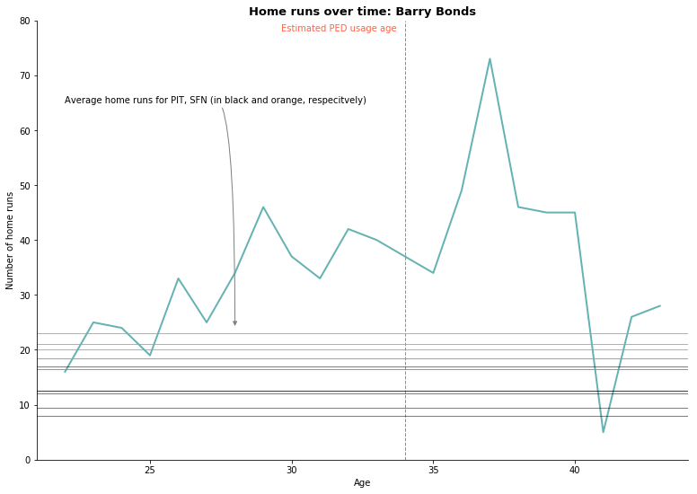

Slide 3
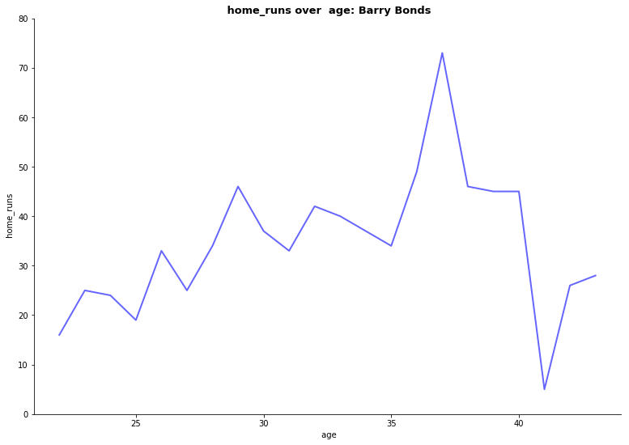

Slide 4
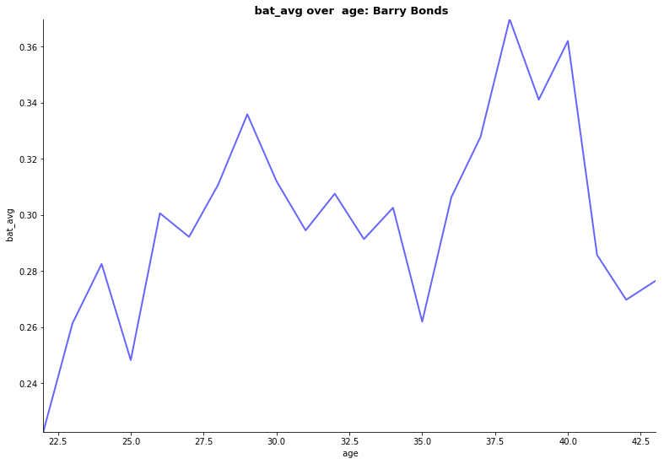

Slide 5
