Slide 1
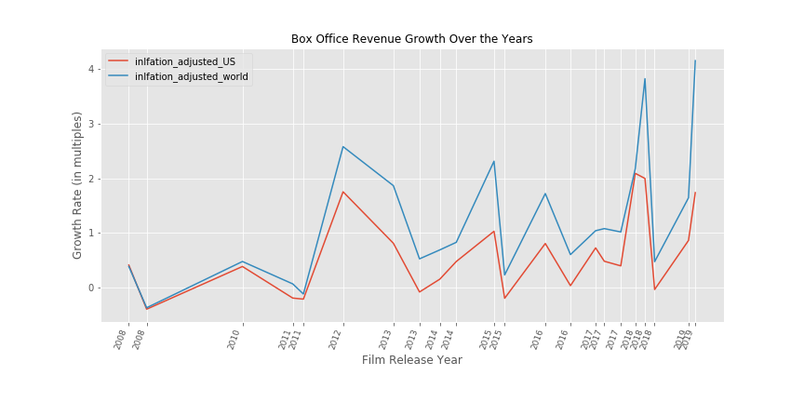
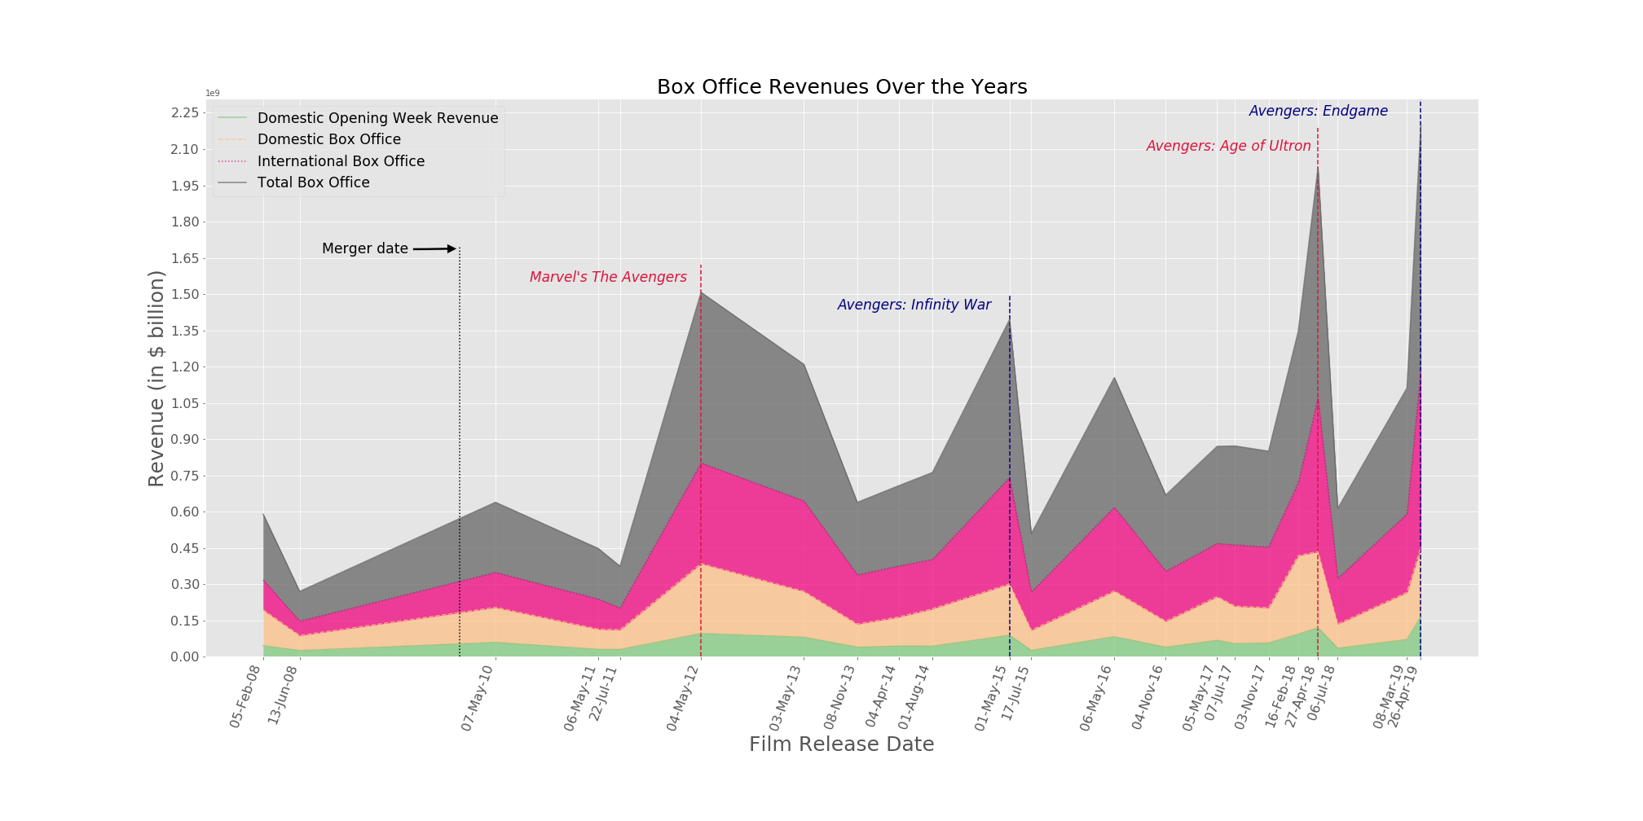
Marvel box office revenues have been growing over time in all market segments: domestic and international.

Slide 2
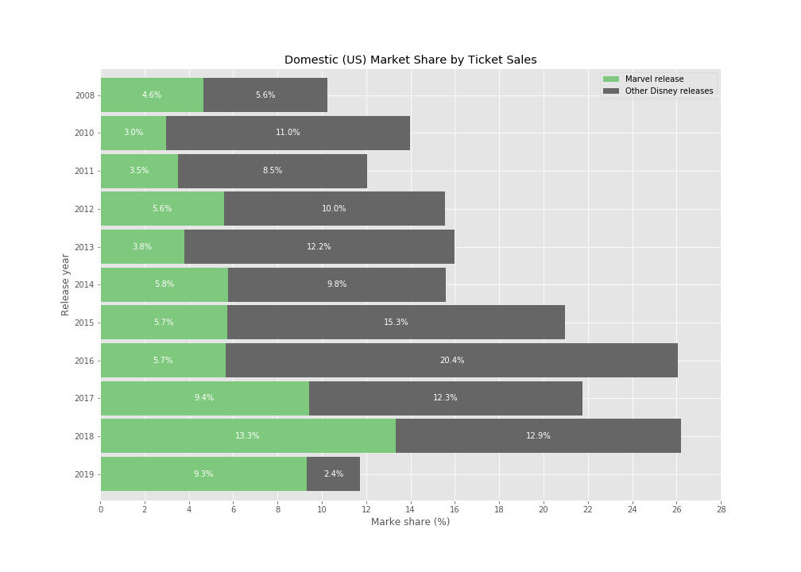
Marvel represents a considerable share of Disney’s strong performance in the film market.

Slide 3
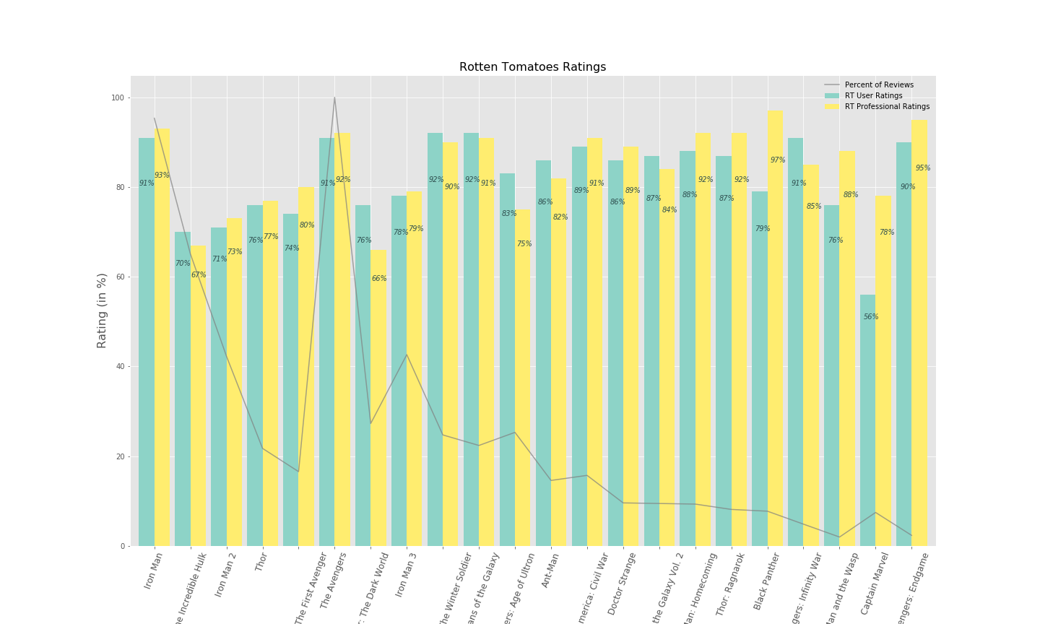
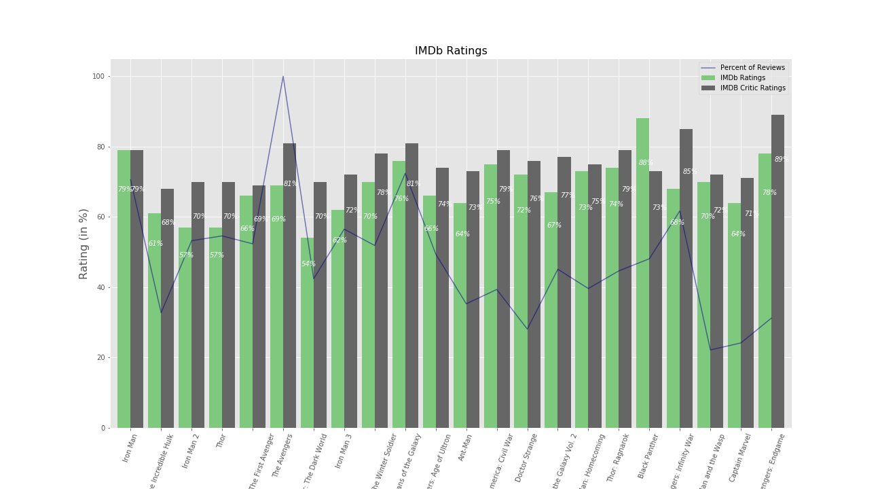
Film ratings have remained relatively consistent, so film quality has not contributed to increased success.

Slide 4
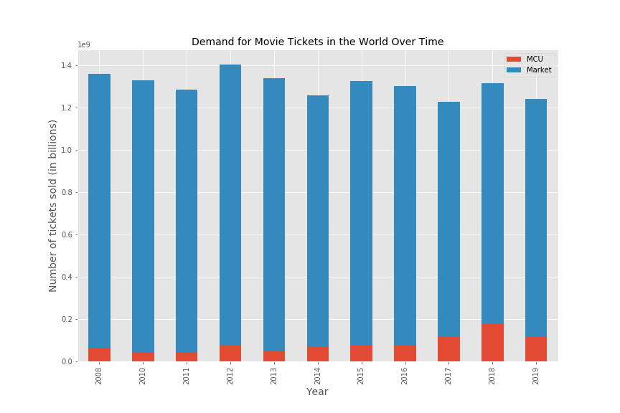
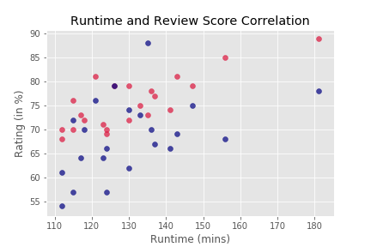
Marvel’s increasing success goes against the general dynamic of the film market, and there is a potential relationship between runtime, review score, and success.

Slide 5
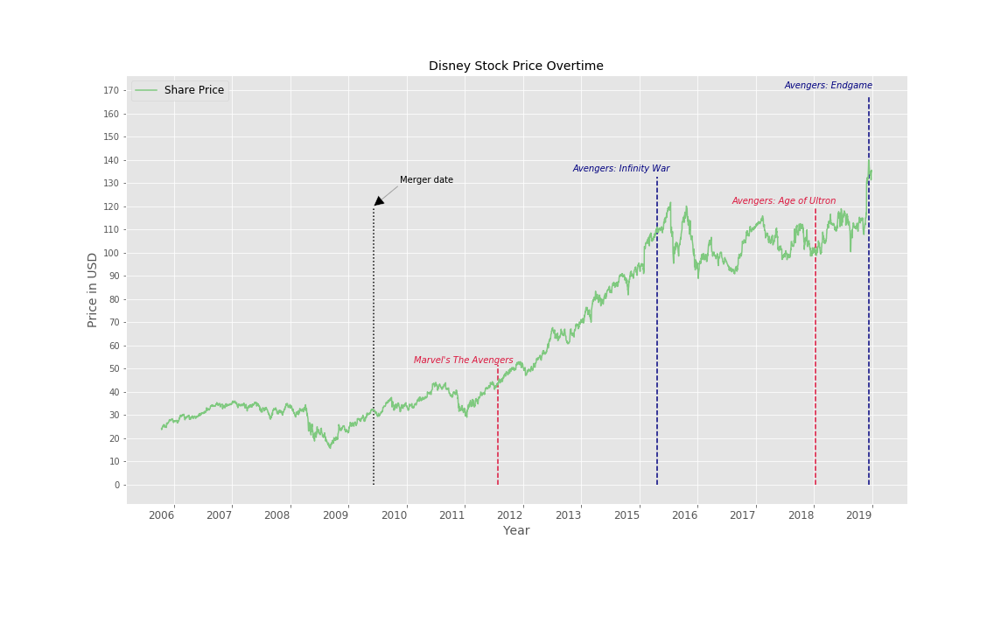
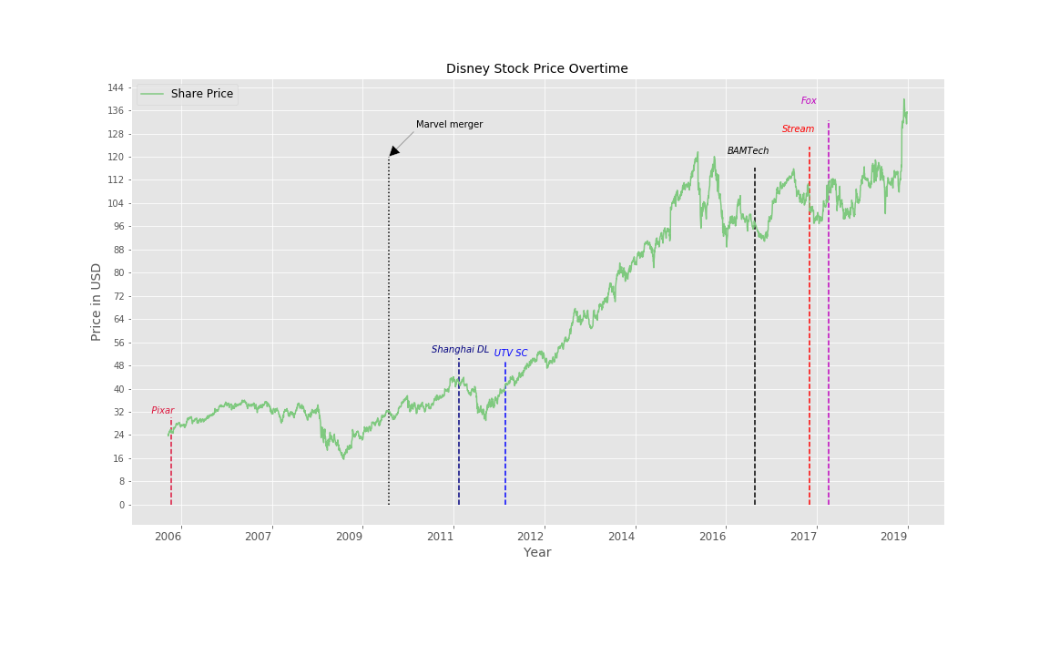
Standout box office successes are correlated to increased stock prices, however other factors can also be correlated as confounding variables.

