Slide 1
PRE-SOLICIATION CONFERENCE AND VENDOR EXPO
2020 Census Integrated Communications Contract
U.S. Census Bureau
Friday, December 18, 2015
10:00 a.m. to 2:00 p.m.

Slide 2
WELCOME AND OPENING REMARKS
Jeannie Shiffer
Associate Director for Communications

Slide 3
2020 Census Operational Plan
Lisa M. Blumerman
Associate Director for Decennial Census Programs

Slide 4
The Decennial Census
Purpose:
To conduct a census of population and housing and disseminate the results to the President, the States, and the American People
Primary Uses of Decennial Census Data:
Apportion representation among states as mandated by Article 1, Section 2 of the United States Constitution:
Draw congressional and state legislative districts, school districts and voting precincts
Enforce voting rights and civil rights legislation
Distribute federal dollars to states
Inform federal, tribal, state, and local government planning decisions
Inform business and nonprofit organization decisions (e.g., where to locate, size of the market)
Provide population benchmark for nearly every other United States survey
  Representatives and direct Taxes shall be apportioned among the several States which may be included within this union, according to their respective Numbers … The actual Enumeration shall be made within three Years after the first Meeting of the Congress of the United States, and within every subsequent Term of ten years, in such Manner as they shall by Law direct.

Slide 5
The Decennial Census
The 2020 Census Environment
2020 Census
Constrained fiscal environment
Rapidly changing use of technology
Information explosion
Distrust in government
Informal, complex living arrange-ments
A mobile population
Declining response rates
Increasingly diverse population
The 2020 Census is being conducted in a rapidly changing environment, requiring a flexible design that takes advantages of new technologies and data sources while minimizing risk to ensure a high quality population count.

Slide 6
The 2020 Census
Goals and Key Innovation Areas
Overarching Goal: To count everyone once, only once, and in the right place
Challenge Goal: Conduct a 2020 Census at a lower cost per housing unit (adjusted for inflation) than the 2010 Census, while maintaining high quality results
Focus on Four Key Innovation Areas
Reengineering Address Canvassing
Optimizing
Self-Response
Utilizing Administrative Records and Third-Party Data
Reengineering Field Operations

Slide 7
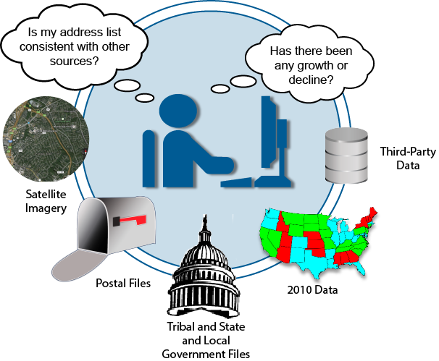
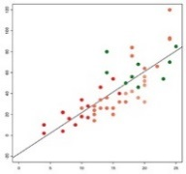
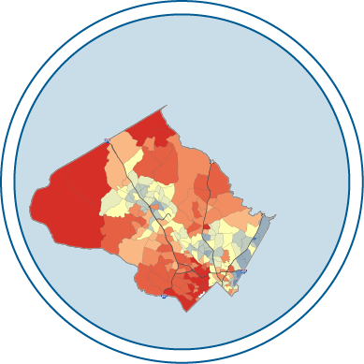


The 2020 Census: Establish Where to Count
Reengineering Address Canvassing
Reduce the nationwide In-Field Address Canvassing by developing innovative methodologies for updating and maintaining the Census Bureau’s address list and spatial database throughout the decade.
In-Office Address Canvassing
Where Should We Start?
Continual Research and Updating
Ongoing Process for
In-Office Canvassing
In-Field Address Canvassing
Address List and Spatial Database

Slide 8
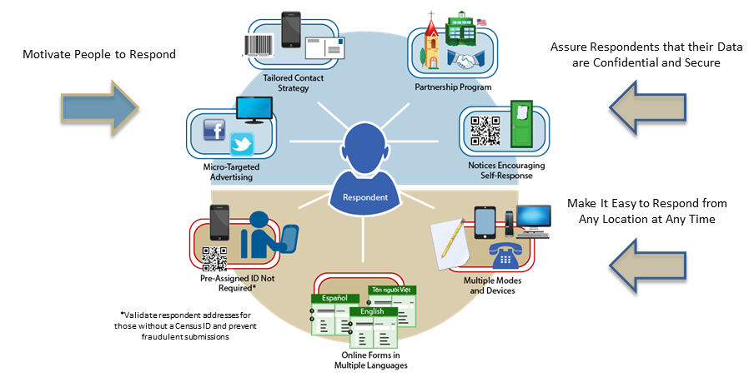
The 2020 Census: Motivate People to Respond
Optimizing Self-Response
Generate the largest possible self-response, reducing the number of households requiring follow-up.

Slide 9







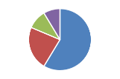





The 2020 Census: Count the Population
Reengineering Field Operations
Use technology to more efficiently and effectively manage the 2020 Census fieldwork.
Streamlined Office and Staffing Structure
Increased use of
Technology
Increased Management and Staff Productivity
Automated and optimized work assignments
Automated recruiting, training, payroll and expense reporting
Ability to conduct address updates and enumeration on same device
Reduced paper and manual processing
Increased visibility into case status for improved workforce management
Redesigned quality assurance operations
Improved communications
Area Manager of Operations
Census Field Managers
Census Field Supervisors
Listers and Enumerators

Slide 10
The 2020 Census: Count the Population
Utilizing Administrative Records and Third-Party Data
Use information people have already provided to reduce expensive in-person follow-up.
Improve the Quality of the Address List
Validate incoming data from federal, tribal, state, and local governments
Update the address list
Increase Effectiveness of Advertising and Contact Strategies
Support the micro-targeted advertising campaign
Create the contact frame
(e.g., email addresses and telephone numbers)
Validate Respondent Submissions
Validate respondent addresses for those without a Census ID and prevent fraudulent submissions
Reduce Field Workload for Followup Activities
Remove vacant and nonresponding occupied housing units from the
nonresponse followup workload
Optimize the number of contact attempts

Slide 11
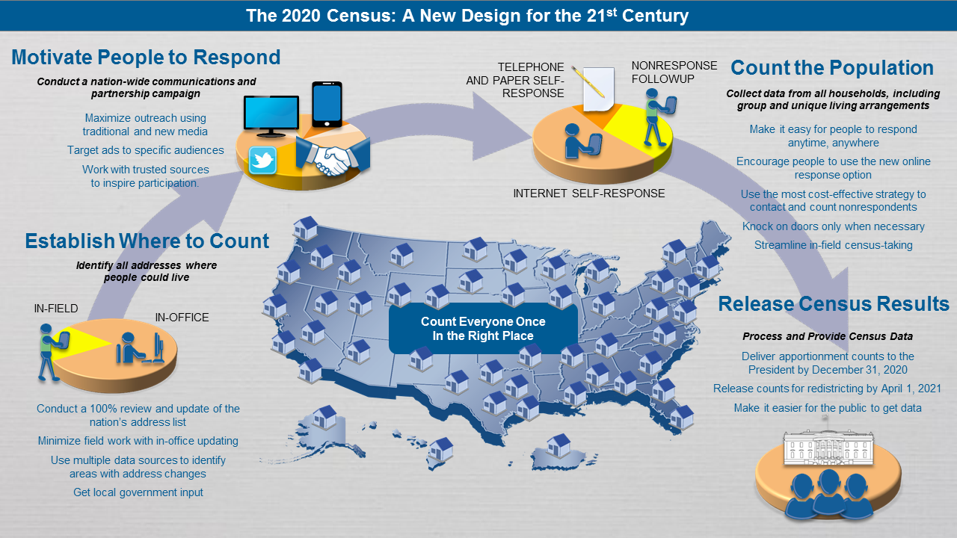
The 2020 Census
A New Design for the 21st Century

Slide 12
Overview of the 2020 Census Integrated Partnership and Communications (IPC) Program
Tasha Boone, Decennial Directorate
Kendall Johnson, Communications Directorate

Slide 13
2020 Census
The Mission
Count everyone once, only once, and
in the right place.

Slide 14
2020 Census
Purpose of the Integrated Partnership and Communications (IPC) Program
To communicate the importance of participating in the 2020 Census to the entire population of the 50 states, the District of Columbia, Puerto Rico and Island Areas:
  Engage and motivate people to self-respond, preferably via the Internet
  Raise and keep awareness high throughout the entire 2020 Census to encourage response

Slide 15
2020 Census
Components of the IPC Program
Partnership
Establishing relationships that matter …
Connecting with trusted organizations to carry the decennial message through a vast network across the country.
Social Media
Leveraging interactive communications to build conversations…
Creating a 24/7 movement through real-time access, education and inspiration.
Public Relations
Creating a chorus of Census conversations…
Surround every household in the country with credible, memorable messages through trusted conversations that motivate people to complete the decennial census.
Advertising
Leveraging all relevant communication channels to create mass participation…
Reaching audiences through mediums they are familiar with to inform, educate and inspire to respond.
Statistics in Schools
Providing ongoing statistical literacy education and outreach to students in Kindergarten, middle school, and high school, including tribal schools, home schools, and Head Start.
Supports statistics education by providing grade-appropriate classroom activities and resources in math and history that are aligned to national standards and complement existing lesson plans.
Earned Media
Creating widespread awareness and education to drive mass participation…
Using the vast media network to reach people through an identifiable source.
Social
Media
Partnership
Earned Media
Public
Relations
Advertising
Statistics
in Schools
Notes:
Yellow Box Text for Animations
Partnership
Establishing relationships that matter …
Connecting with trusted organizations to carry the decennial message through a vast network across the country.
Social Media
Leveraging interactive communications to build conversations…
Creating a 24/7 movement through real-time access, education and inspiration.
Public Relations
Creating a chorus of Census conversations…
Surround every household in the country with credible, memorable messages through trusted conversations that motivate people to complete the decennial census.
Statistics in Schools
Providing ongoing statistical literacy education and outreach to students in Kindergarten, middle school, and high school, including tribal schools, home schools, and Head Start.
Supports statistics education by providing grade-appropriate classroom activities and resources in math and history that are aligned to national standards and complement existing lesson plans.
Advertising
Leveraging all relevant communication channels to create mass participation…
Reaching audiences through mediums they are familiar with to inform, educate and inspire to respond.
Earned Media
Creating widespread awareness and education to drive mass participation…
Using the vast media network to reach people through an identifiable source.

Slide 16
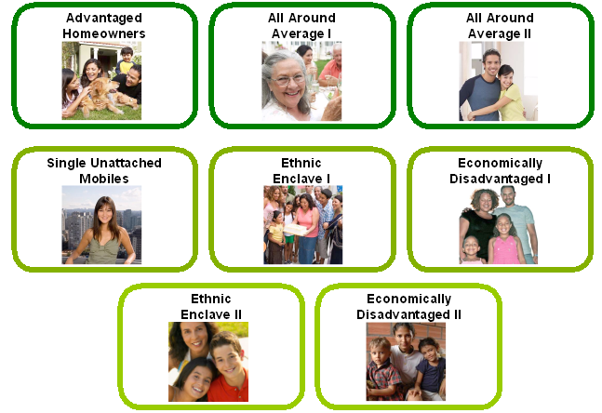
2010 Census
Audience Segmentation
2010 Census Program for Evaluations and Experiments (CPEX) – This page contains the evaluations, experiments, and assessments from the 2010 Census. http://www.census.gov/2010census/about/cpex.php
2015 Planning Database – This page contains the 2015 Planning Database. The planning database assembles a range of housing, demographic, socio-economic, and census operational data that can be used for survey and census planning. http://www.census.gov/research/data/planning_database/2015/

Slide 17
2010 Census
Language Program
Approved audience/language list for the paid media effort increased by 14 languages to a total of 28
Original Funding
English
Spanish
Mandarin
Cantonese
Vietnamese
Korean
Tagalog/Taglish
Russian
Polish
Arabic
French Creole
Japanese
Hindi/Hinglish
Khmer (Cambodia)
American Recovery Reinvestment Act (ARRA)
Portuguese
French
Italian
German
Yiddish
Farsi
Armenian
Ukranian
Greek
Hmong
Laotian
Thai
Urdu (Pakistan)
Bengali

Slide 18
2010 Census
Advertising Campaign
Census 2000
2010 Census
National Buys includes media purchased as part of any audience plan, including Diverse Mass, Black, Hispanic, etc.
18

Slide 19
2010 Census
Campaign Phases
JANUARY
FEBRUARY
MARCH/APRIL
MAY/JUNE
Awareness
Motivation
Support
Education

Slide 20
2010 Census
Top Lessons Learned
Integrate Census Bureau subject matter experts into all phases of the 2020 Census Integrated Partnership and Communications Program
Align timing, funding, and design decisions between the development of the Integrated Partnership and Communications Program Plan and the Census Bureau’s operational milestones to effectively support all phases of the 2020 Census
Establish more specific program metrics for the Integrated Partnership and Communications Program to assist in evaluation and assessment
Incorporate ever-advancing technology into the ICC planning process to ensure optimal communication and that Census response systems are used.

Slide 21
2010 Census
Top Lessons Learned (Continued)
The success of the ICC was in part due to getting real-time market data for the first time and being able to analyze it, then making in-market adjustments.
Engage stakeholders early and often.
Improve the understanding and transparency of the media buying process among key stakeholders and the Paid Media community.
An earlier start allows for the development and validation of a brand identity that can be used across all programs and channels to ensure a cohesive look and feel.

Slide 22
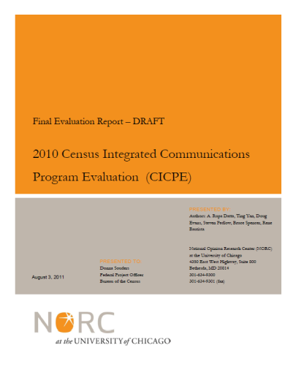
2010 Census
Evaluation of the Campaign
Overview and Purpose
NORC at the University of Chicago was selected to conduct the evaluation
Upon completion of the evaluation, their final report was to identify whether the ICP achieved its goals:
  Increase mail response rate
  Improve overall accuracy and reduce the differential undercount
  Improve cooperation with enumerators
Findings/Challenges
It was difficult to evaluate the campaign. NORC did not have all the data they needed to evaluate the components effectively, as data collection began after the program started.
2020 Recommendations
Involve independent evaluation contractor earlier in the campaign
The independent evaluation contractor and the 2020 ICC contractor need to develop metrics together to approximately measure and evaluate the campaign

Slide 23
2015 Census Test: Optimizing Self-Response
Communications Research
Goals: Test insights will support these 2020 Census goals: Increase opportunities to engage hard-to-count populations.
  Increased self-response to reduce NRFU and related costs.
  Tested communication activities to inform the 2020 communication program.
Objectives: Implement a comprehensive and integrated communications program in the Savannah media market.
  Motivated self-response, especially online.
  Answered communications research questions regarding the use and impact of micro-targeted digital advertising.

Slide 24
2015 Census Test: Optimizing Self Response
Communications Research (Continued)
What were the effects of integrating and combining digital advertising and micro-targeted ads with other traditional communications, such as mail postcards and letters, earned media coverage, computer-automated phone calls, broadcast and radio ads, and outreach through partnerships?
Specifically, we explored the effects on: Internet and overall self-response rates
  Internet and self-response rates of housing units targeted by specific mail-out strategies
  Socio-demographic characteristics of internet responders

Slide 25
2015 Census Test: Optimizing Self-Response
Paid Advertising
Types of Digital Micro-Targeted Advertising
Demographic: age, sex, race, device type used
  Example: Focused on 65+ in Beaufort County, SC
Behavioral: past online behavior and/or lifestyle data
  Example: Focused on those in select ZIP codes in Chatham County, GA, who have visited Spanish language websites in the past
Geographic: location (ZIP code, block group)
Contextual: content with which users are currently engaging

Slide 26
2015 Census Test: Optimizing Self-Response
Landscape
Test focused on Savannah designated market area (DMA)
  20 counties (17 in Georgia and 3 in South Carolina)
  106 ZIP codes
Attempted to replicate key census communications elements
  Earned media
  Partnership and outreach
  Television and radio advertising
  Print and out-of-home advertising
  Digital advertising and social media
Influencer phone calls (60,000 calls)
Mailings to sample of households (120,000 HHs)
No Non-Response Follow Up (NRFU)

Slide 27
The 2020 Census
The 2020 Census Key Upcoming Activities
2016 Address Canvassing Test
2016 Census Test (April 1st Census Day)
Anticipated Award of Contract for the 2020 Census Questionnaire Assistance (CQA)
Anticipated Award of Integrated Communications Contract
2017 Census Test (April 1st Census Day)
Topics to Congress – by March 31, 2017
Local Update of Census Addresses – Invitations sent to governmental entities to participate in review of our Master Address File and is complete in 2018
2018 End-to-End Test (April 1st Census Day)
Question Wording to Congress – by March 31, 2018.
Census Day – April 1, 2020
Nonresponse Follow-up – Begins in late April and continues until late June/early July
Apportionment Counts to the President – by December 31, 2020
Redistricting Counts to the States – by March 31, 2021
2016
2017
2018
2020
2021

Slide 28
REQUEST FOR PROPOSAL (RFP) DISCUSSION
Cory Harris, Acquisition Division
Benjamin Banyasz, Acquisition Division

Slide 29
2020 Census Request for Proposal (RFP)
What Are We Looking For?
The Census Bureau is looking to award a contract to plan, design, integrate, produce, implement, and assess an integrated communications program in support of the U.S. Census Bureau’s 2020 Decennial Census.

Slide 30
2020 Census Request for Proposal (RFP)
Contract Overview
Full and open competition
One single award Indefinite Delivery Indefinite Quantity (IDIQ) contract
Task Order Types: Firm Fixed Price (FFP), Time and Material (T&M), or a hybrid of both FFP and T&M
Period of Performance: One (1) base year and five (5) option years
Aggressive subcontracting goals with plenty of opportunity for small businesses

Slide 31
2020 Census Request for Proposal (RFP)
RFP Format
RFP format is divided by sections:
  A – Solicitation, Offer and Award (SF 33)
  B – Supplies or Services and Prices/Cost
  C – Description/Specifications/Statement of Work
  D – Packaging and Marking
  E – Inspection and Acceptance
  F – Deliveries or Performance
  G – Contract Administration Data
  H – Special Contract Requirements
  I – Contract Clauses
  J – Attachments
  K – Representations, Certifications and Other Statements of Offerors
  L – Instructions, Conditions and Notices to Offerors
  M – Evaluation Factors for Award

Slide 32
2020 Census Request for Proposal (RFP)
Section C: Description/Specifications/Statement of Work
Background information about the decennial census; experience from previous censuses; operational planning for the 2020 Census; and goals for the 2020 Census
Information regarding measuring contractor’s performance, small business subcontracting, and the Participation Plan
Performance-based statement of work – description of required services

Slide 33
2020 Census Request for Proposal (RFP)
Section C: Performance Work Statement
Services may include, but are not limited to:
Research and Data Analytics
Strategic Planning, Program Development, and Integration
Communications Support for Decennial Census Operations and Other Programs
Field Recruitment Advertising and Communications
Traditional Advertising and Media Buying
Digital Advertising and Other Communications Technologies
Social Media
Public Relations
Communications Planning and Materials for the Partnership Program
Statistics in Schools Program
Website Development and Digital Engagement
Rapid Response Activities
Project and Financial Management
Stakeholders Relations
Communications Support for the 2020 Census Data Dissemination

Slide 34
2020 Census Request for Proposal (RFP)
Section L: Instructions, Conditions, and Notices to Offerors
Provides guidelines on the acquisition process, how proposals shall be submitted, and what shall be included in the proposal to be evaluated under Section M – Evaluation Factors for Award.

Slide 35
2020 Census Request for Proposal (RFP)
Section M: Evaluation Factors for Award (Continued)
Provides the manner in which the Census Bureau will evaluate the information provided in response to Section L – Instructions, Conditions and Notices to Offerors.

Slide 36
2020 Census Request for Proposal (RFP)
Section M: Evaluation Factors for Award
Technical Evaluation Factors (in descending order of importance):
Factor 1 – Technical Approach, Management Approach, and Designated Market Area (DMA) Exercise
Subfactor 1A – Technical Approach
Subfactor 1B – Management Approach
Subfactor 1C – DMA Exercise
Factor 2 – Participation Plan and Small Business Subcontracting Approach
Subfactor 2A – Participation Plan
Subfactor 2B – Small Business Subcontracting Approach
Factor 3 – Similar Experience, Key Personnel, and Past Performance
Subfactor 3A – Similar Experience
Subfactor 3B – Key Personnel
Subfactor 3C – Past Performance

Slide 37
2020 Census Request for Proposal (RFP)
Section M: Evaluation Factors for Award (Continued)
Price Evaluation Factor:
Factor 4 – Price
Price comparison will be conducted based on the firm fixed price (FFP) for overall project management for the entire lifecycle of the contract and the FFP for the DMA Exercise.
Other price information required (fees, other cost provisions* and labor rates) will be used to assess accuracy and completeness, realism, reasonableness, and risk.
* Includes subcontracting fees, fringe benefits, G&A, overhead, and profit

Slide 38
2020 Census Request for Proposal (RFP)
Tentative Milestone Schedule
Date(s)* | Activity
December 28, 2015 | Vendors submit questions to the Census Bureau on the draft RFP
January 8, 2016 | Census Bureau issues written responses to questions on the draft RFP
January 19, 2016 | Census Bureau issues final RFP
January 22, 2016 | Vendors submit questions to the Census Bureau on the final RFP
January 27, 2016 | Census Bureau issues written responses to questions on the final RFP
February 18, 2016 | Offerors submit written proposals to the Census Bureau
March 25, 2016 | Census Bureau announces competitive range determination
April 11 to May 5, 2016 | Census Bureau conducts oral presentations and discussions with vendors in the competitive range
May 20, 2016 | Offerors submit final proposal revisions to the Census Bureau
May 23 to July 15, 2016 | Census Bureau conducts final evaluation and consensus
August 17, 2016 | Census Bureau makes source selection (award) announcement
*Dates are subject to change

Slide 39
SMALL BUSINESS PARTICIPATION
Dijon Ferdinand, Acquisition Division
Small Business Representative for
U.S. Census Bureau

Slide 40
2020 Census Small Business Participation
Market Research
Request for Information (RFI) released on FedBizOpps on October 1, 2014.
Received 32 responses from small (19) and large (13) businesses.
Census Bureau held market research meetings with small and large companies .

Slide 41
2020 Census Small Business Participation
Market Research Continued…
What the Census Bureau has learned from industry:
Sources – There exists adequate and abundant sources in the private sector to satisfy Government requirements.
Contract Type – Indefinite Delivery Indefinite Quantity (IDIQ) contract is the most favored type of contract, with Firm Fixed Price (FFP) and Time and Materials (T&M) task orders. Cost reimbursement tasks are not favored.
Types of Companies – All types of companies are interested in serving as the prime including management consulting, research and data analytics, public relations, as well as full-service communications companies (not just advertising companies.)
Incentives – Monetary incentives are not the most important type of incentive that would motivate a contractor; companies are more interested in good past performance ratings.
Small Businesses – Small businesses play an important role in the contract due to the myriad of services they provide. However, the size, scope and complexity of this contract would put a burden on and financially jeopardize small firms if they acted as the prime.

Slide 42
2020 Census Small Business Participation
Subcontracting Goals
It is the Census Bureau’s goal to assist the Department of Commerce in meeting or exceeding the statutory goals for small businesses. With that said, the Census Bureau is interested in pursuing aggressive small business subcontracting under this contract. The Census Bureau is encouraging contractors to achieve small business subcontracting goals to the maximum extent possible. In Section C.7, the FY 2015 Department of Commerce Operating Unit Small Business Subcontracting Goals are provided for your information.
FY 2015 Department of Commerce Operating Unit Small Business Subcontracting Goals:
For this contract, the Contractor shall establish, maintain, and adhere to a Small Business Subcontracting Plan that commits the maximum practicable opportunity for small businesses within the contract.
Small Business | 49%
Small Disadvantaged Business | 12%
8(a) Business | 6%
Woman-Owned Small Business | 10%
HUBZone Small Business | 3%
Veteran-Owned Small Business | 4%
Service-Disabled Veteran-Owned Small Business | 3%

Slide 43
2020 Census Small Business Participation
Networking Opportunities
There will be a Vendors Expo held directly after this Pre-Solicitation Conference for networking opportunities for small and large businesses.
Please take advantage of this time to exchange ideas, network with other companies, and present capabilities and/or experiences to each other.
Furthermore, the agency hopes the event will promote teaming arrangements for this procurement and upcoming opportunities.

Slide 44
2020 Census Small Business Participation
Contact Information
Acquisition Division’s E-Mail (for this solicitation):
acq.2020.comm@census.gov
Acquisition Division’s Website (for this solicitation):
http://www.census.gov/about/business-opportunities/opportunities/vender-opps/2014-10-15-2020-comm.html
U.S. Census Bureau – Small Business:
Dijon (DJ) Ferdinand – 301-763-1822
Department of Commerce, Office of Small and Disadvantaged
Business Utilization:
LaJuene Desmukes – 202-482-8102

Slide 45
QUESTIONS AND ANSWERS (Q&A)
Kendall Johnson
Communications Directorate

Slide 46
QUESTIONS ON THE DRAFT RFP
Send questions on the Draft RFP to:
acq.2020.comm@census.gov
No later than 3:00 p.m. EST on Monday, December 28, 2015

Slide 47
CLOSING REMARKS
Thank you for your participation in the conference and vendor expo.
Kendall Johnson
Communications Directorate

