Slide 1
创新研究课程 科研项目短课

Slide 2
Course Syllabus 课程大纲
Content 内容 | 课时 | 课程说明 | 课后练习 | 备注
Version control – Git & Github, learn to write ReadMe | 3 |  | Write a readme file and upload to Github | README: https://classroom.udacity.com/courses/ud777 Git: https://classroom.udacity.com/courses/ud123 Github: https://classroom.udacity.com/courses/ud456 https://classroom.udacity.com/courses/ud775
Latex for scientific writing | 3 |  | Download CVPR latex template and upload to Github | The Not So Short Introduction to Latex (PDF)
Python tutorial | 3 |  | Finish a demo script and upload to Github | http://cs231n.github.io/python-numpy-tutorial/
Computer Vision and Opencv | 3 |  | Finish a demo script and upload to Github | http://cs231n.stanford.edu/2017/ https://docs.opencv.org/3.4/d9/df8/tutorial_root.html
Viola-Jones face recognition | 3 |  | Final assignment | https://docs.opencv.org/3.4/d7/d8b/tutorial_py_face_detection.html
Introduction to deep learning | 3 |  | -- | https://www.coursera.org/learn/ai-for-everyone/

Slide 3
Today’s agenda: Latex Tutorial
History and software installation
Input Files
Typesetting Text
Mathematical Formulae
Specialties

Slide 4
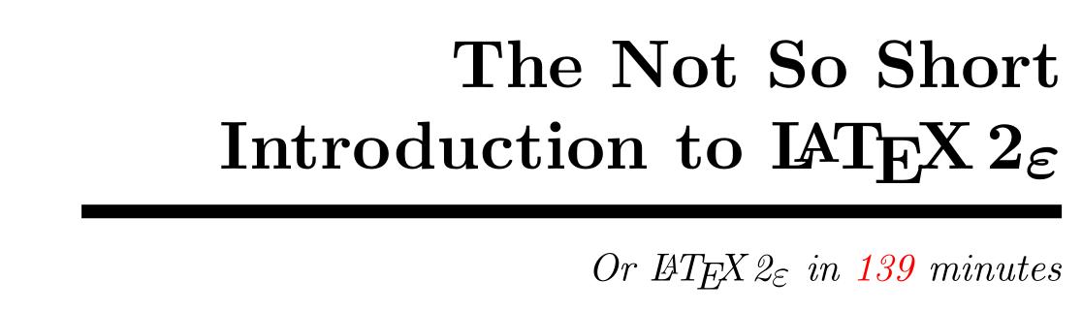

Slide 5
Software Installation
1. WinEdt: http://www.winedt.com/index.html
is a powerful and versatile all-purpose text editor for Windows with a strong predisposition towards the creation and compilation of LaTex documents.
2. MikTex: https://miktex.org/
is an up-to-date implementation of Tex/Latex and related programs.
Notes:
(anyone here use Linux or Mac OS?)

Slide 6
Why Latex
LATEX is a typesetting system that is very suitable for producing scientific and mathematical documents of high typographical quality.
科学论文（会议，期刊）
本科/硕士/博士毕业论文

Slide 7
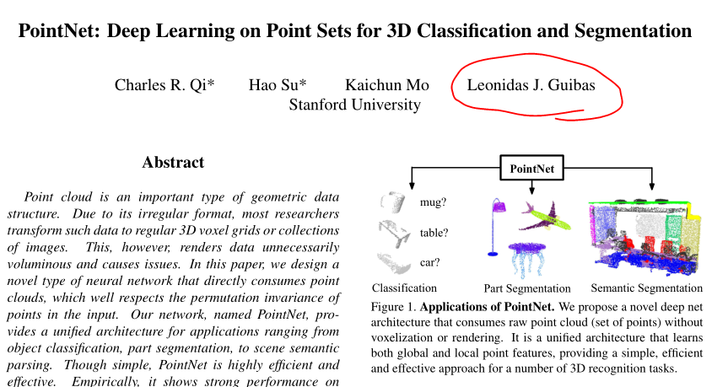
A bit of History
TEX is a computer program created by Donald E. Knuth in 1982
Notes:
TEX is a computer program created by Donald E. Knuth in 1982
Leonidas J. Guibas
PointNet

Slide 8
This is quite different from the WYSIWYG
normally not possible to see the final output while typing the text,
Notes:
What you see is what you get.
This is quite different from the WYSIWYG approach that most modern word processors, such as MS Word or LibreOffice. With these applications, authors specify the document layout interactively while typing text into the computer. They can see on the screen how the final work will look when it is printed.
When using LATEX it is not normally possible to see the final output while typing the text, but the final output can be previewed on the screen after processing the file with LATEX. Then corrections can be made before actually sending the document to the printer.

Slide 9
Layout design
Examples:
The font size and the numbering of headings
The line length
Notes:
Typographical design is a craft. Unskilled authors often commit serious formatting errors by assuming that book design is mostly a question of aesthetics—“If a document looks good artistically, it is well designed.” But as a document has to be read and not hung up in a picture gallery, the readability and understandability is much more important than the beautiful look of it. Examples:
The font size and the numbering of headings have to be chosen to make the structure of chapters and sections clear to the reader.
• The line length has to be short enough not to strain the eyes of the reader, while long enough to fill the page beautifully.

Slide 10
Advantages
Professionally crafted layouts
The typesetting of mathematical formulae
Even complex structures such as footnotes, references, table of contents, and bibliographies can be generated easily.
Encourages authors to write well-structured texts.
highly portable and free
Notes:
• Professionally crafted layouts are available, which make a document really look as if “printed.”
• The typesetting of mathematical formulae is supported in a convenient way.
• Even complex structures such as footnotes, references, table of contents, and bibliographies can be generated easily.
• Free add-on packages exist for many typographical tasks not directly supported by basic LATEX. For example, packages are available to
include POSTSCRIPT graphics or to typeset bibliographies conforming
to exact standards. Many of these add-on packages are described in
The L A T E X Companion [3].
• L A T E X encourages authors to write well-structured texts, because this
is how L A T E X works—by specifying structure.

Slide 11
Latex Input Files

Slide 13
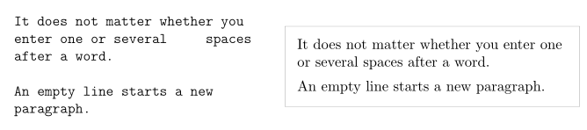
Spaces
Notes:
“Whitespace” characters, such as blank or tab, are treated uniformly as “space” by LATEX. Several consecutive whitespace characters are treated as one “space”. Whitespace at the start of a line is generally ignored, and a
single line break is treated as “whitespace”.
An empty line between two lines of text defines the end of a paragraph. Several empty lines are treated the same as one empty line.

Slide 14
Special Characters
Notes:
The backslash character \ can not be entered by adding another backslash in front of it (\\); this sequence is
used for line breaking. Use the \textbackslash command instead.

Slide 15
Latex Commands
case sensitive
• They start with a backslash \ and then have a name consisting of letters only.
Command names are terminated by a space, a number or any other ‘non-letter.’
• They consist of a backslash and exactly one non-letter.
• Many commands exist in a ‘starred variant’ where a star is appended to the command name.
Notes:
LATEX ignores whitespace after commands.
If you want to get a space after a command, you have to put either an empty parameter {} and a blank or a special spacing command after the command name. The empty parameter {} stops LATEX from eating up all the white space after the Command name.

Slide 16
Command with parameters
\command[optional parameter]{parameter}

Slide 17
Comments: %
it ignores the rest of the present line, the line break, and all whitespace at the beginning of the next line.
Notes:
When LATEX encounters a % character while processing an input file, it ignores the rest of the present line, the line break, and all whitespace at the beginning of the next line.

Slide 18
Input File Structure

Slide 19
\documentclass{...}: This specifies what sort of document you intend to write
\usepackage{...} commands to influence the style of the whole document, or load packages
\begin{document}
…
\end{document}
Notes:
Now you enter the text mixed with some useful Latex commands. At
the end of the document you add the
The area between \documentclass and \begin{document} is called the preamble.

Slide 20
Files You Might Encounter
.tex LATEX or TEX input file. Can be compiled with latex.
.sty LATEX Macro package. Load this into your LATEX document using the \usepackage command.

Slide 21


Big Projects

Slide 22
Typesetting Text

Slide 23

Special Characters and Symbols
Quotation Marks
Dashes and Hyphens, Tilde(~), Slash(/), Degree Symbol (◦)
Notes:
Yes I know the rendering is not ideal, it’s really a back-tick or grave
accent (‘) for opening quotes and vertical quote (’) for closing, despite what
the font chosen might suggest.

Slide 24
International Language Support
\usepackage[UTF8]{ctex} 中文

Slide 25
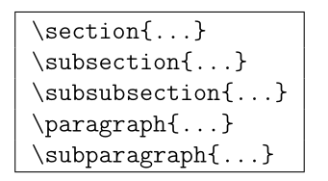
Titles, Chapters, and Sections
\section*{Help}.
Notes:
All sectioning commands listed above also exist as “starred” versions.
A “starred” version of a command is built by adding a star * after the command name.
This generates section headings that do not show up in the table
of contents and are not numbered. \section*{Help}.

Slide 26
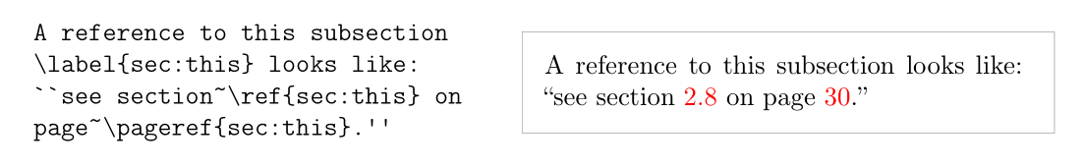
Cross References

Slide 27

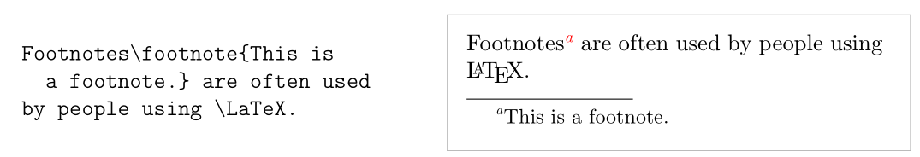
Footnotes

Slide 28
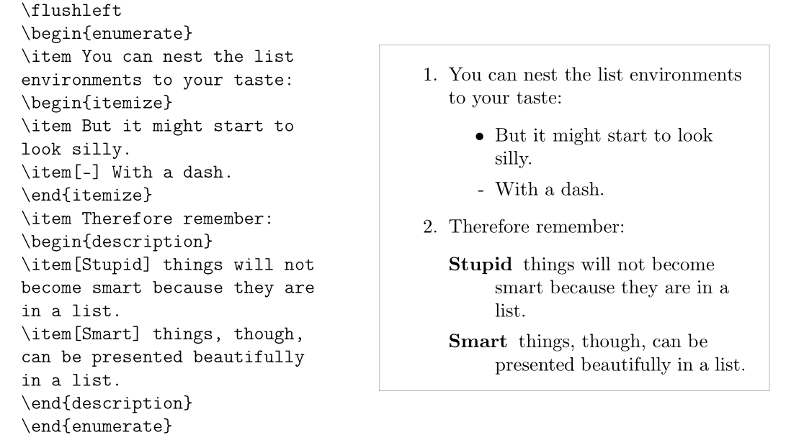
Environment: Itemize, Enumerate, and Description

Slide 29

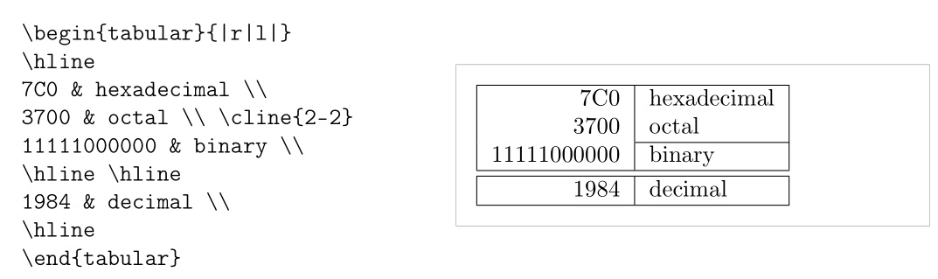
Tabular
Notes:
The tabular environment can be used to typeset beautiful tables with optional horizontal and vertical lines. LATEX determines the width of the columns automatically.

Slide 30


Graphics and Images

Slide 31
Typesetting Mathematical Formulae

Slide 32
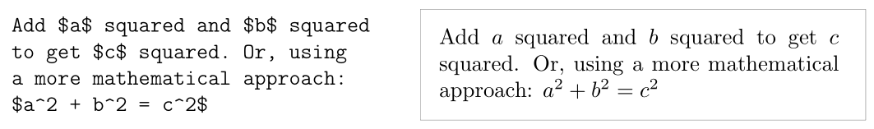
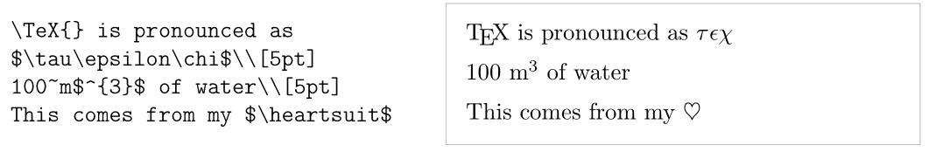
Single Equations
Notes:
A mathematical formula can be typeset in-line within a paragraph (text
style), or the paragraph can be broken and the formula typeset separately
(display style). Mathematical equations within a paragraph are entered be-
tween $ and $:

Slide 33
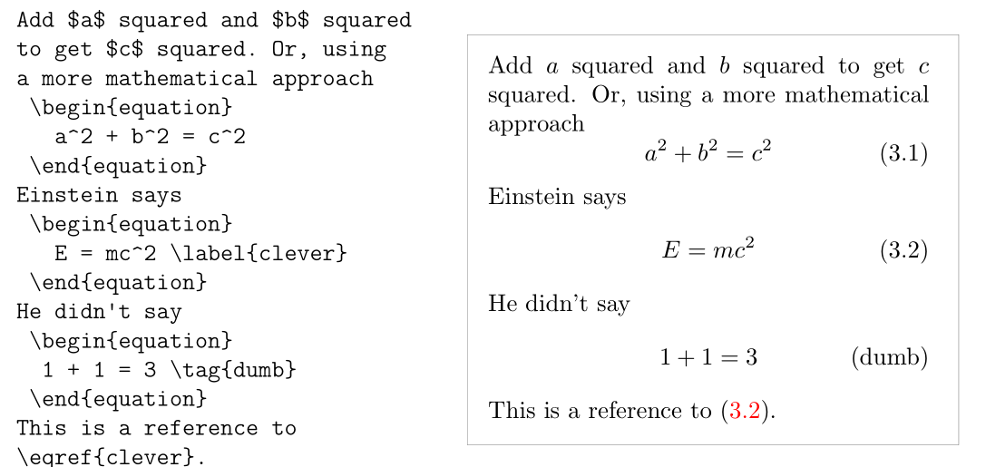
Single Equations
Notes:
If you want your larger equations to be set apart from the rest of the paragraph, it is preferable to display them rather than to break the paragraph apart.
To do this, you enclose them between \begin{equation} and \end{equation}.
2 You can then \label an equation number and refer to it somewhere else in the text by using the \eqref command.
If you want to name the equation something specific, you \tag it instead.

Slide 34
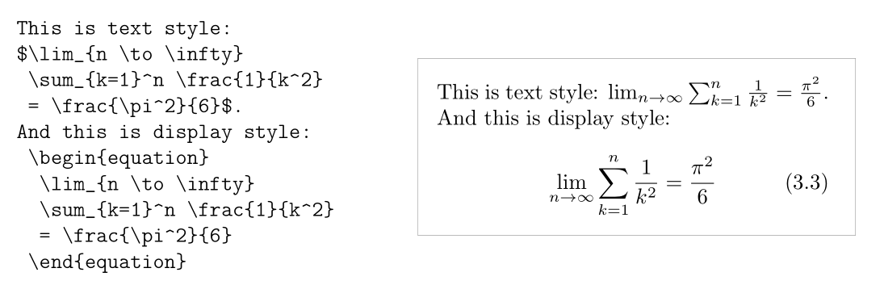
text style and display style equations

Slide 35
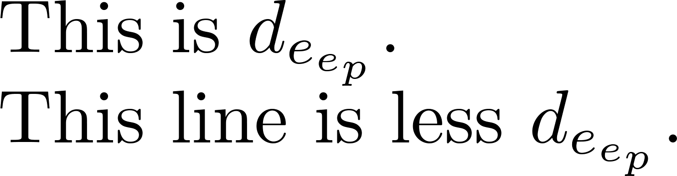

Slide 36
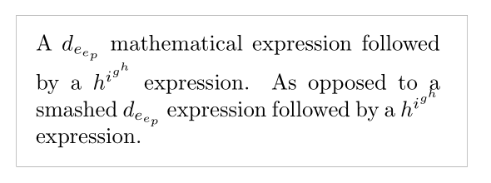
Quiz
Notes:
In text style, enclose tall or deep math expressions or sub expressions in \smash. This makes L A T E X ignore the height of these expressions. This keeps the line spacing even.

Slide 37

Quiz

Slide 38
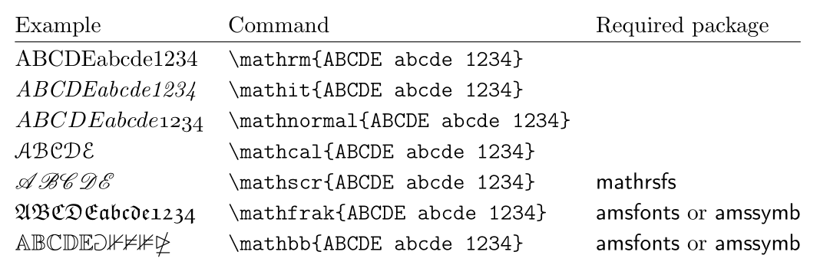
Math fonts Quiz

Slide 39
Lowercase Greek letters
\alpha, \beta, \gamma, …,
uppercase letters are entered as \Gamma, \Delta,

Slide 40
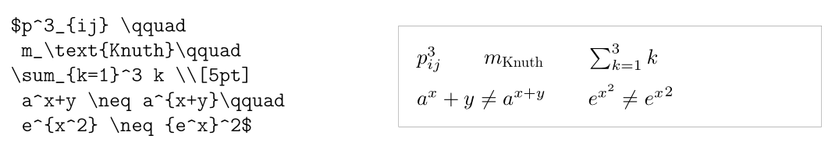
Exponents, Superscripts and Subscripts
Notes:
can be specified using the ^ and the _ characters. Most math mode commands act only on the next character, so if you want a command to affect several characters, you have to group them together using curly braces: {...}.

Slide 41
Specialities

Slide 42

Bibliography
@MISC{Viola01rapidobject, author = {Paul Viola and Michael Jones}, title = {Rapid object detection using a boosted cascade of simple features }, year = {2001} }

Slide 43
Demo

Slide 44
Assignment
Update the “upstream” repo from: https://github.com/stevenwudi/AI_Precourse_2019 to your local git repo.
Copy CVPR2019 Template: http://cvpr2019.thecvf.com/files/cvpr2019AuthorKit.zip (Or from AI_Precourse\Week2_LATEX folder)
Read the file of egpaper_for_review.tex and modify the file to your_name.tex only one page. Modification the file for collect related works on “Face Detection” or “Face Recognition” (Paper citations should come from CVPR, ICCV, ECCV, IJCV, PAMI) Title, abstract, citation (Reference), one math formula one table one image.
Compile to pdf file and add the your_name.tex and your_name.pdf to the AI_Precourse\Week2_LATEX folder
Push the new change to your “origin” repo and create a pull request so that you change will be seen by the “upstream”

