Slide 1
Please group together with your Operating System
MacOS?
-> Please sit to the left
Linux?
-> Please sit in the middle
Windows?
-> Please sit to the right

Slide 2
First Steps Towards Your Own AI Application
Setting up the key tools for local AI development

Slide 3
Overview of the AI Service Center

Slide 4


AI-Service Centers
kisz@hpi.de hpi.de/kisz
KISSKI
Hannover I Göttingen I Kassel
Sensible and Critical Infrastructure
Medicine & Energy
KISZ-BB
ADVISORY
Berlin I Brandenburg
Education- and Advisory Services,
Application of AI in Business & Society
WestAI
Bonn | Fraunhofer | Aachen | Jülich | Dortmund | Paderborn
Multimodal, Large and Transferable AI Models
EDUCATION
INFRASTRUCTURE
hessian.AISC
Darmstadt
Explainability, Generalisability
and Contextual Adaptation
RESEARCH

Slide 5




ADVISORY
AI Advisory
General Questions regarding AI,
Computing Infrastructure,
Model, Architecture, Framework Selection
AI Pilot Projects (3 months)
Understanding and Identifying the Use Case
Specifying the Use Case
Developing a Solution
Finalizing and Documenting
Cooperations
Co-organized Network Meetings or Workshops
Start-up Support
All of the above
Support with Networking
HPI ECOSYSTEM
kisz@hpi.de hpi.de/kisz

Slide 6
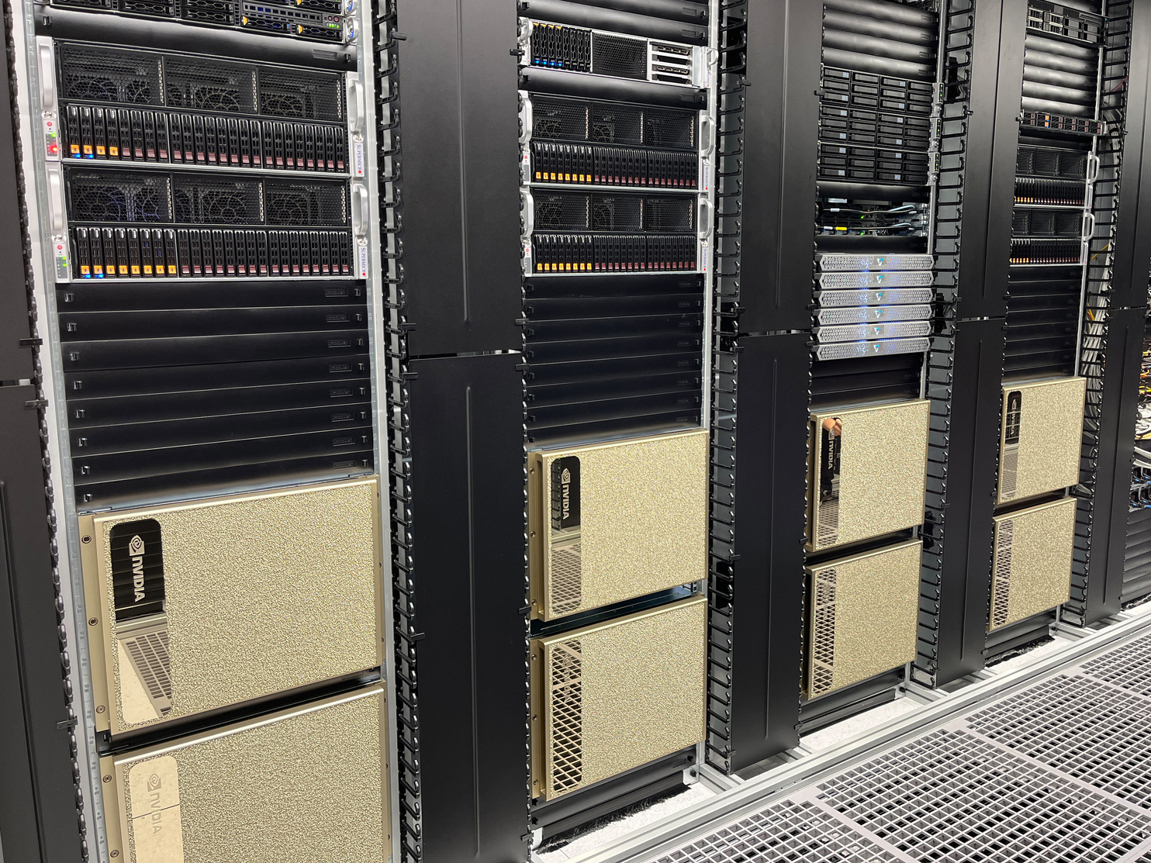
Infrastructure
Training
8 x 8 NVIDIA H100 GPU
Inference
5 x 8 NVIDIA A30 GPU
ARM Server
Ampere Altra Max M128-30 CPU
2 x NVIDIA L40 GPUs
GPU Server
AMD Epyc CPU
8 x NVIDIA L40S GPU
Edge
ARMv8 CPU
NVIDIA Jetson AGX Module
Storage
1.5 PB NVRAM
Network
400 Gb/s Infiniband
200 Gb/s Ethernet
kisz@hpi.de hpi.de/kisz

Slide 7

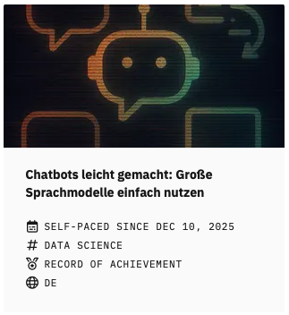
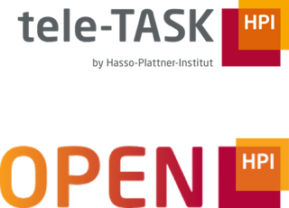
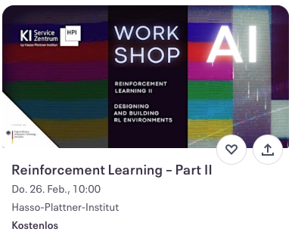
Talks
kisz@hpi.de hpi.de/kisz
EDUCATION
& TRAINING
MOOCs
Work
shops

Slide 8
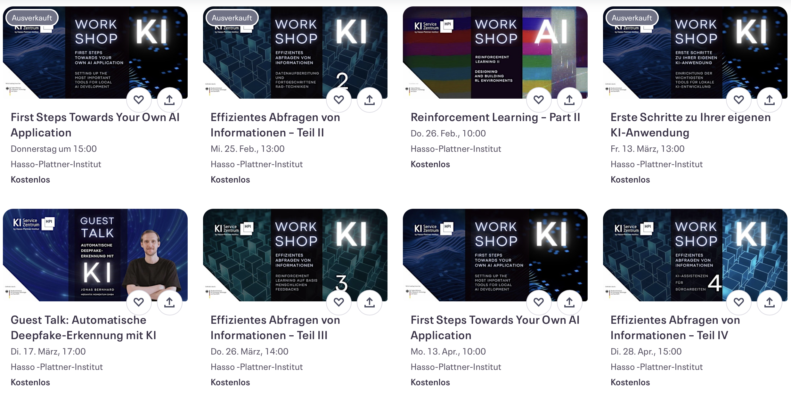

Slide 9
Let's get to know each other
What is your background?
What is your motivation coming here today?
Are you familiar with VSCode, Git, Docker, Python, … ?

Slide 10
Goal: Set up your environment
VS Code
WSL
Git
Python
UV
Ollama
Docker Desktop
Example Application: Local Chatbot

Slide 11
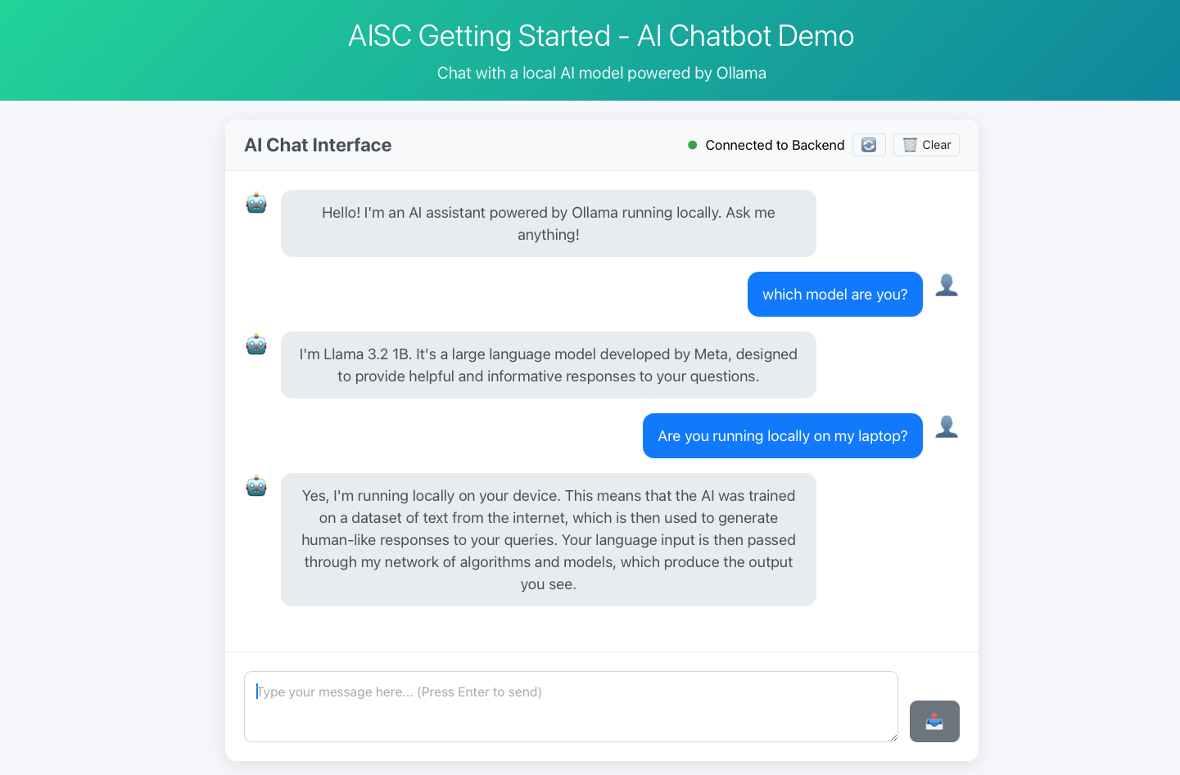
Overview of the software

Slide 12

Visual Studio Code (VS Code)
Code-Editor:
Lightweight
Cross-platform
Expandable with extensions
Supports various tools:
Python, Jupyter Notebook, Git, Docker, SSH
Integration of coding assistants (e.g., Claude)

Slide 13

GitHub & Git
Platform for version control of code
Development, version control, review, and documentation

Slide 14

Python
General-purpose programming language with key libraries for AI and data science
NumPy: numerical computing
PyTorch: neural networks
Librosa: audio processing
…
Extensive learning resources and tutorials available
Suitable for data processing, model training, ...

Slide 15

UV
Fast Python package and project manager
Handles package installation and dependency management
Creates reproducible development environments, ensuring consistent package versions
Ensures code runs reliably across different machines and operating systems
Windows 10, 11, XP
Linux Mint, Ubuntu, Debian
MacOS

Slide 16
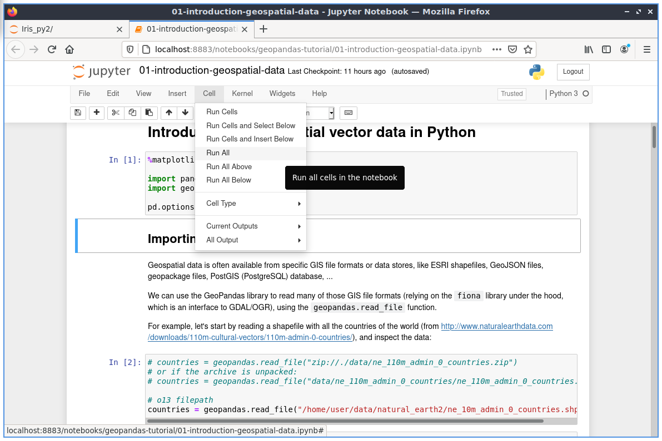
Jupyter notebooks
Supports code, narrative text, equations (Markdown), and visualizations
Ideal for exploratory data analysis, prototyping, and teaching
Code cells can be executed independently --> Easy debugging

Slide 17

Docker
Container platform for packaging reproducible runtime environments
Enables applications to run consistently across machines, servers, and high-performance clusters (HPC)
Solves "works on my machine" problem
Ideal for complex software stacks

Slide 18
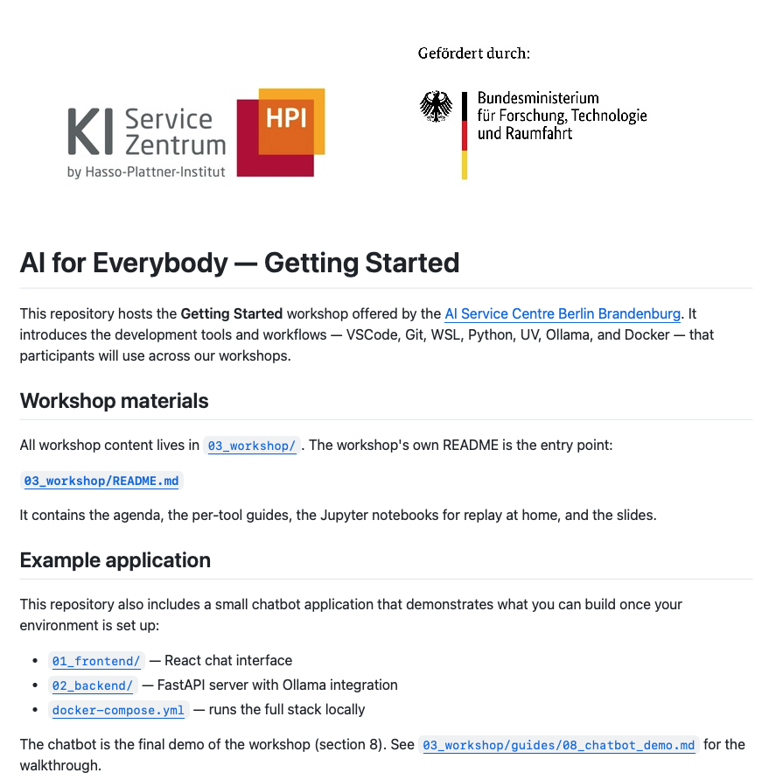
https://github.com/aihpi/workshop-getting-started

Slide 19
Finished? Check out our upcoming workshops, talks and online courses!

Slide 20
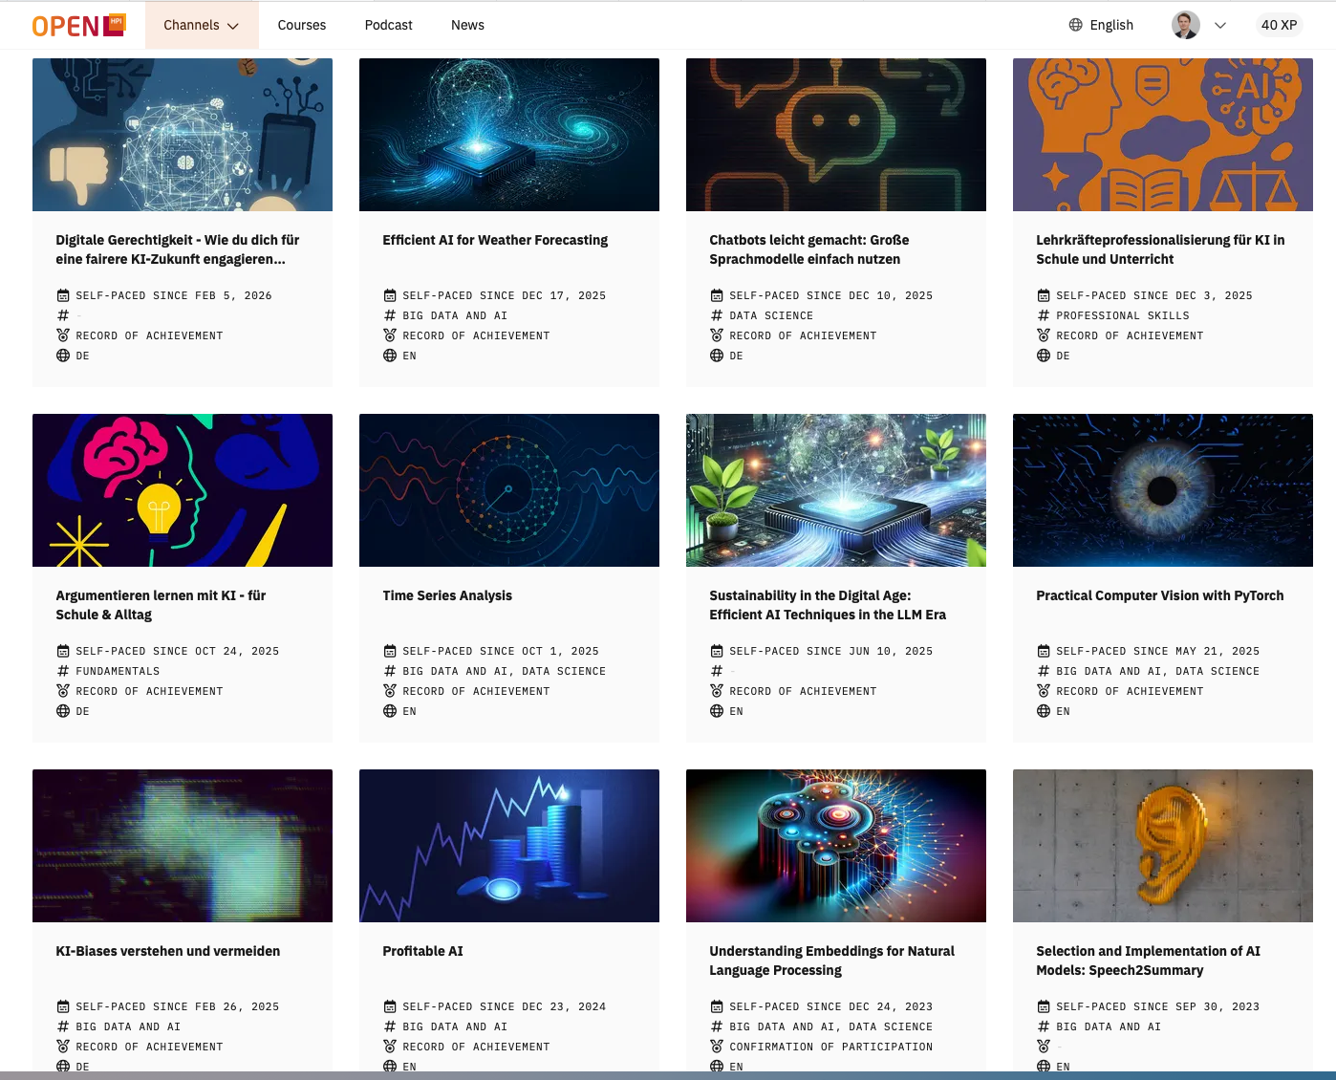
Finished? Check out our upcoming workshops, talks and online courses!

Slide 21

kisz@hpi.de hpi.de/kisz
Your opinion is important!
QR code for the feedback form

