Slide 1

Which tools may your AI agent use?
MCP in practice: finding use cases and vetting servers safely
Jill Barvencik · David Goll
AI Service Center Berlin-Brandenburg (HPI)
September 9, 2026
20 min concepts → 10 min example → 20 min your own use case → 10 min discussion

Slide 2
What is an agent?
“An LLM agent runs tools in a loop to achieve a goal.”

Slide 3
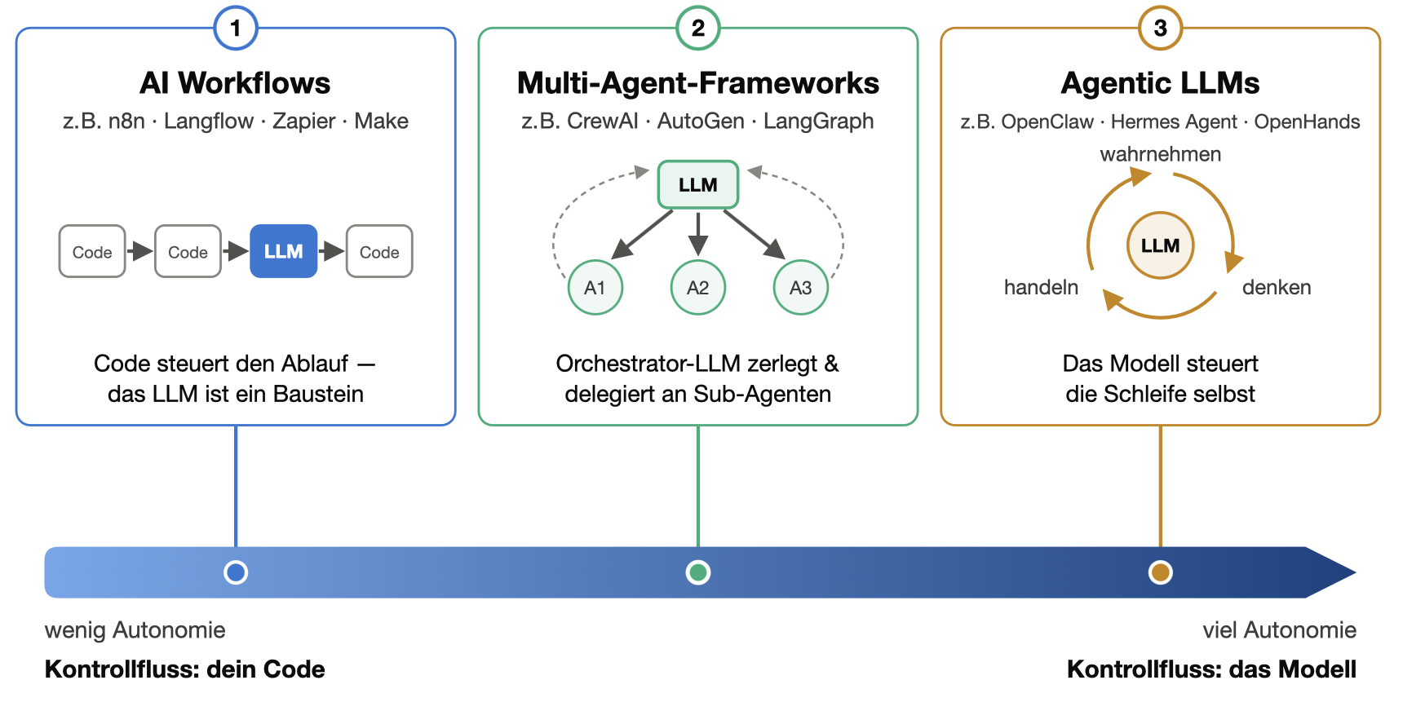
Three kinds of “AI agents” (LLM)

Slide 4
Example: email AI assistant
FAQ (database)
a tool it can call
New email
info@ mailbox
The model reads it
decides per email
tool call loop
Drafts a reply
never sends itself
A human reviews & sends
Calendar
a tool it can call
→ Category 1 or 3
(depending on how much decision-making power is left to the model)

Slide 5
Model Context Protocol (MCP)
MCP is an open-source standard for connecting AI applications to external systems.
“A USB-C port for AI applications.”
JSON-RPC 2.0

Slide 6
How MCP works
Building block | What the server offers | Example
Resources | Data it can read | Files, databases, …
Tools | Actions the model can call | get_local_weather, draft_email, …
Prompts | Predefined workflows | “summarize & triage this ticket”

Slide 7
How does the model choose a tool?
name: get_forecast
description: "Daily weather forecast for a city. Use for
questions about rain, temperature or wind
on a specific date."
inputs: city (text), date (date)
!
Descriptions and everything a tool returns are text that steers your agent.

Slide 8
Security: who do you trust?
A connected server acts with the permissions you gave it.
Risk | What can happen
Excessive permissions | the server gets an admin token although it only needed to read
Exposed secrets | an API key sits in plain text in a config file
Prompt Injection | an incoming email hides instructions, and the agent executes them
Tool Poisoning | a tool description hides instructions nobody sees in the UI
Rug Pull | a vetted server changes its tool descriptions after an update
Supply Chain | a server impersonates a known provider and BCCs every email to a third party
Private data
the agent can read it
The Lethal Trifecta
all three = SECURITY RISK
Untrusted content
anyone can send it
An outbound channel
email, web, API
Never combine more than two of these capabilities!
https://simonwillison.net/2025/Jun/16/the-lethal-trifecta/

Slide 9
What can go wrong?
May 2025 · GitHub MCP demonstrated
Prompt injection + overly broad token
Source: Invariant Labs
https://invariantlabs.ai/blog/mcp-github-vulnerability
A malicious public issue tricks an agent into copying data from a private repo into a public pull request.
Sep 2025 · postmark-mcp in the wild
Supply Chain
Source: Koi Security
https://thehackernews.com/2025/09/first-malicious-mcp-server-found.html
A fake email server behaves normally for months, then quietly BCCs every email to an external address.
2025 · MCPoison · CVE-2025-54136 in the wild
Rug pull on a trusted config
Source: Check Point Research
https://research.checkpoint.com/2025/cursor-vulnerability-mcpoison/
An already approved MCP config is modified afterwards; code runs without re-approval.
Three different failure modes: a hijacked agent · a malicious server · a trusted config changed unnoticed.

Slide 10
Limiting the risks
1
Least privilege the agent gets its own account, minimal scopes, short-lived keys.
2
Sandbox run local servers in a Docker container: limits what the process can reach (file system, network, system) if it misbehaves.
3
Human in the loop a human approves everything irreversible: send, delete, pay, publish.
4
Rule of Two (Meta) at most 2 of the 3 trifecta properties per agent; the third only behind an approval.
5
Trust the source prefer verified or first-party servers; treat updates like software updates.
6
Keep logs if something goes wrong, you want to know what the agent did.
Assume the agent can be hijacked, and make that survivable.

Slide 11
MCP security checklist
# | Question
1 | Who provides it? first-party · verified · unknown
2 | What can it do on your behalf? read-only vs. irreversible
3 | Where does your data go? local code vs. remote cloud
4 | Does the combination become dangerous? Trifecta / Rule of Two
5 | Could you live with the worst case?
Verdict →
use
use with conditions
not in this context
Tools: official registry · MCP Inspector · mcp-scan
A listing is not a security certification.

Slide 12
How do I find an MCP server?
Official registry
Large catalogs
Catalogs with security ratings
Official vendor servers
registry.modelcontextprotocol.io
pulsemcp.com (+ use cases)
github.com/mcp
mcpservers.org
smithery.ai
mcpsafe.org
mcprisk.org
Google
Notion
Figma
Scalable Capital
…
maintained by the MCP project,
(hard to navigate)
browse by provider, category, and popularity
Vendors increasingly ship their own servers
First question for every use case: does an official server exist?

Slide 13
Demo: Connect Claude with Gmail and Google Calendar
FAQ (database)
a tool it can call
New email
test@gmail.com inbox
The model reads it
decides per email
tool call loop
Drafts a reply
never sends itself
A human reviews & sends
Calendar
a tool it can call

Slide 14
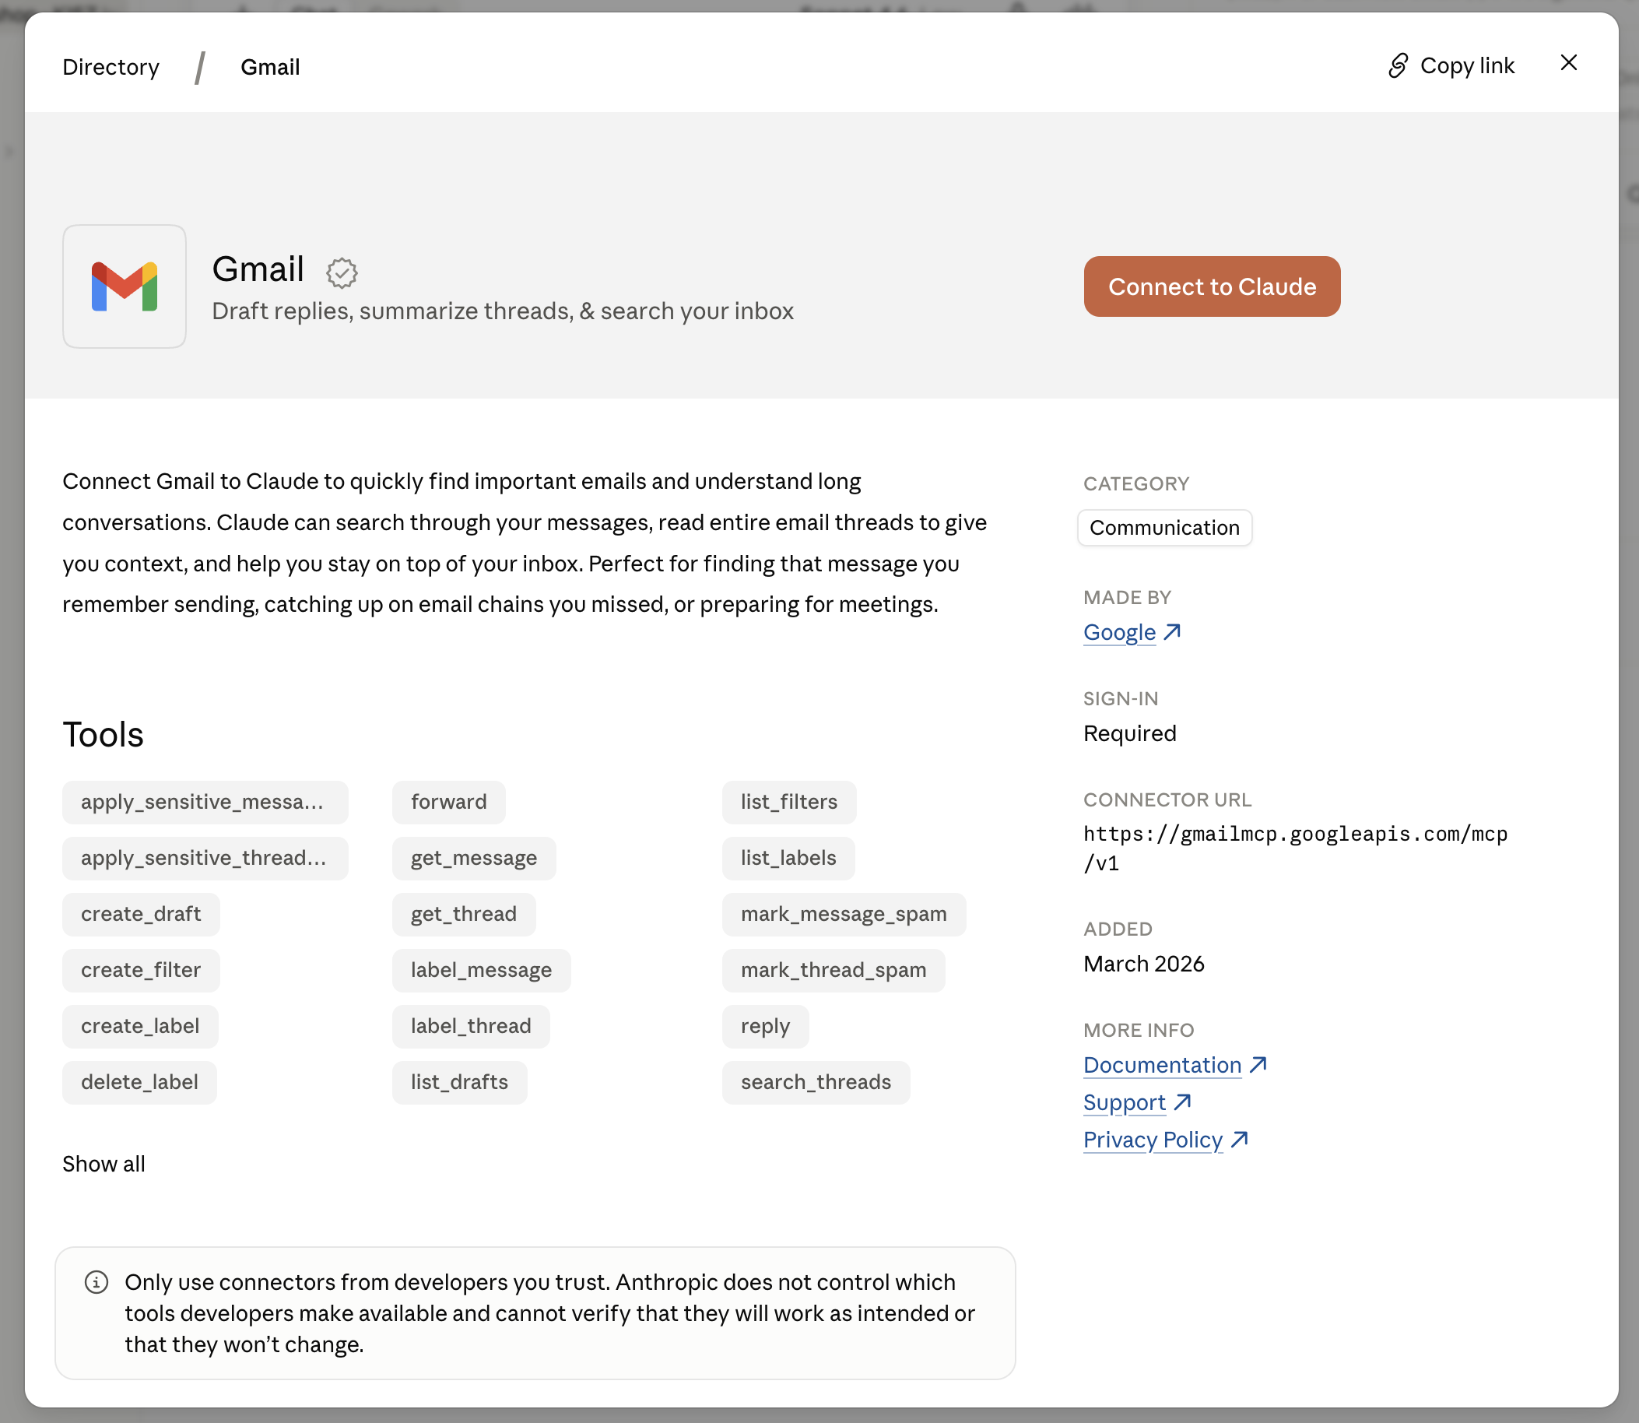
Demo · Step 1: find and assess servers
What to look for
Who built it?
Checklist Q1
What can it do on your behalf?
Checklist Q2

Slide 15
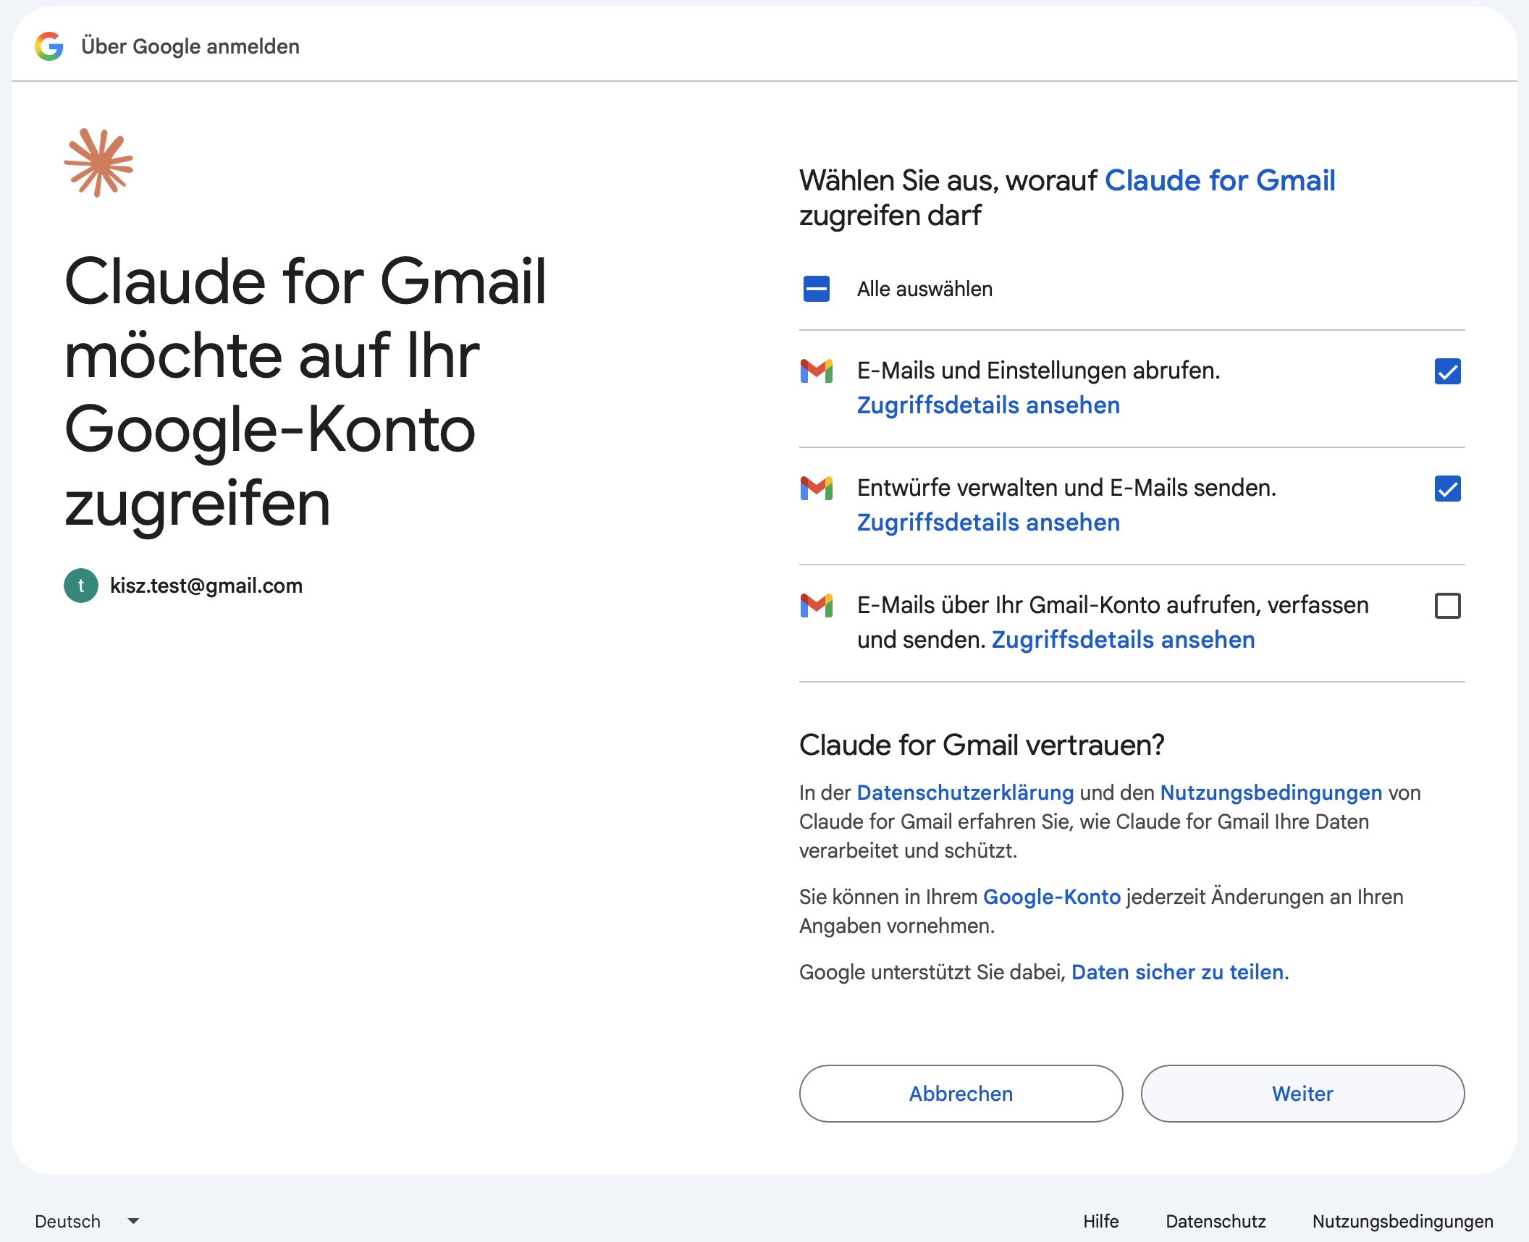
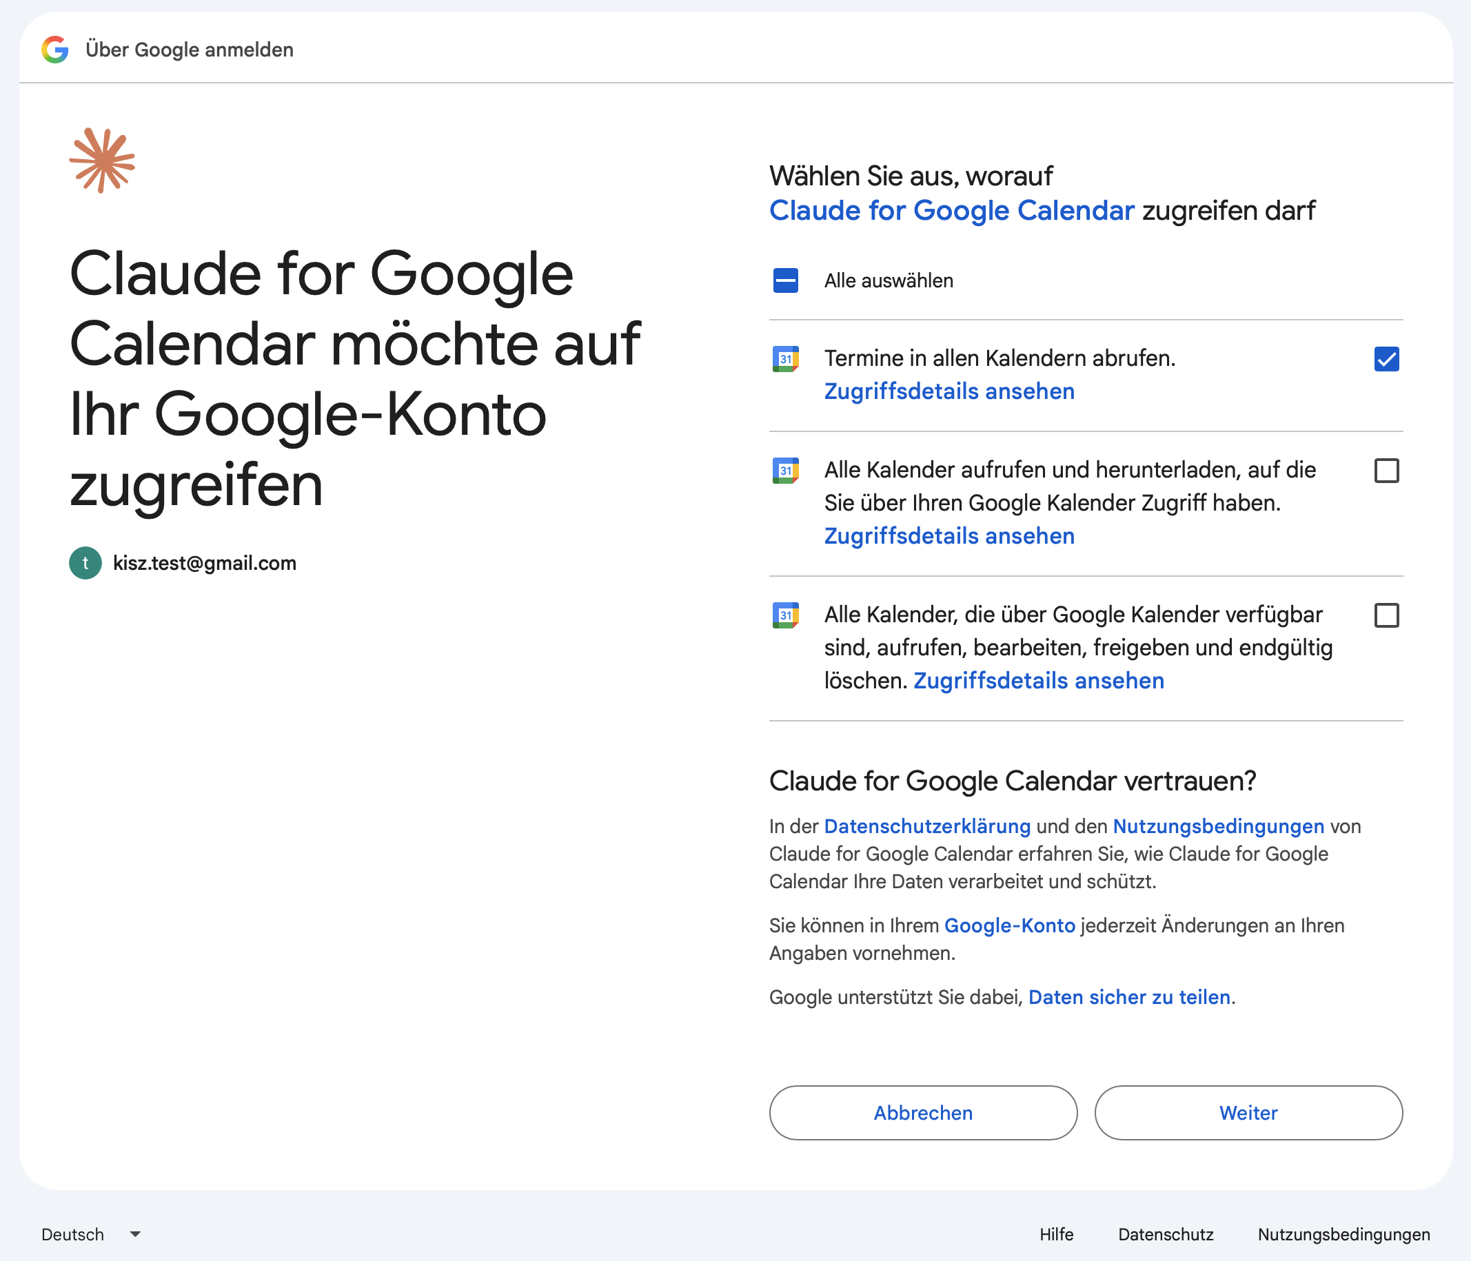
Demo · Step 2: connect with least privilege
A · Gmail permission dialog
B · Google Calendar permission dialog
Grant only what the task needs. Gmail: read + draft. Calendar: read only.

Slide 16
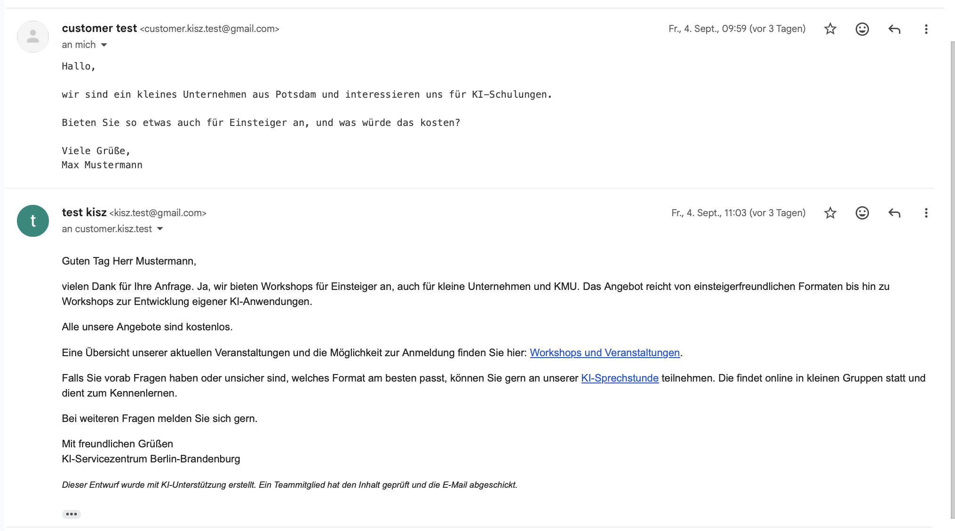
Demo
Unread emails -> agent
Question → FAQ answer
Booking → calendar → free slot
otherwise → escalate
Only drafts are created!
Human-In-The-Loop

Slide 17
Your turn: design your own agentic workflow
About 20 minutes · pen and paper
1
Pick a recurring task
2
Fill in the worksheet idea, 2–3 example requests, why an agent?, why an MCP server?
3
Find suitable MCP servers registry.modelcontextprotocol.io, pulsemcp.com, github.com/mcp, mcpservers.org, smithery.ai, mcpsafe.org, mcprisk.org, …
4
Run each server through the checklist Verdict ● ● ●
5
Note next steps toward a pilot owners · access · approval
Afterwards: 3-minute pitches. Your idea, your server(s), your verdict.

Slide 18
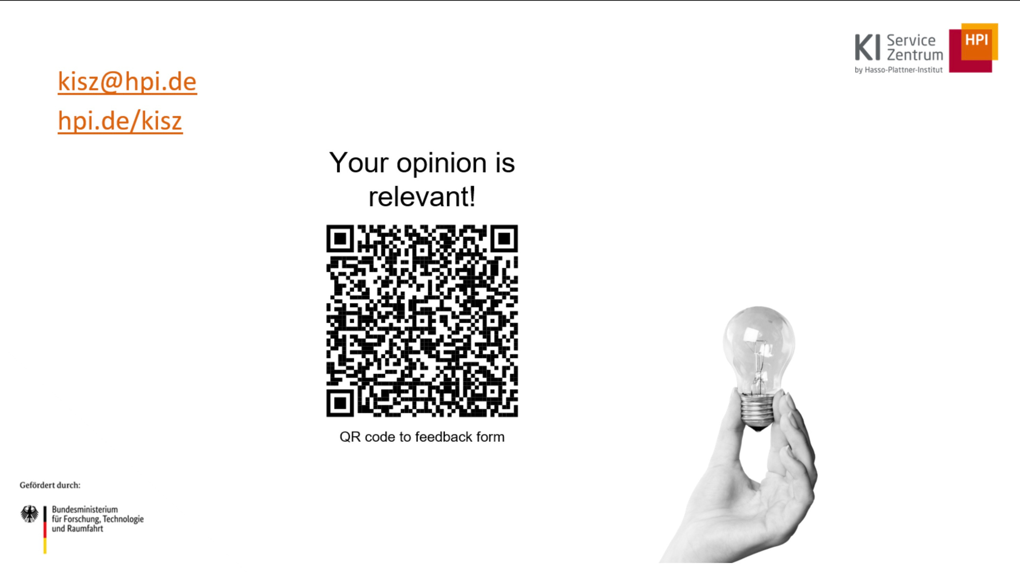

Slide 19
Backup · Isn't this just another API?
 | Classic API (REST, gRPC) | MCP
Contract | one per service, each different | one fixed interface for every tool
Integration | at development time: read docs, write glue code | at runtime: tools/list → model context
User | a developer | the model, reading descriptions
Model
function calling
Host
translates the call
MCP
a protocol
Server
wraps a system
Existing API
REST, database, files
Underneath it is JSON-RPC; the model still does ordinary function calling, so any model works.
Precedents: LSP (editors × languages), ODBC (apps × databases). A server usually wraps an existing API: MCP sits in front of your services, it does not replace them.

Slide 20
Backup · What actually goes over the wire
1 · Discovery: tools/list
2 · Execution: tools/call
// request
{ "method": "tools/list" }
// response
{ "tools": [ {
"name": "get_forecast",
"description": "Daily weather forecast
for a city. Use for …",
"inputSchema": { "city": "string",
"date": "string" }
} ] }
// request
{ "method": "tools/call",
"params": { "name": "get_forecast",
"arguments": { "city": "Berlin",
"date": "2026-09-05" } } }
// response
{ "content": [ { "type": "text",
"text": "Berlin, 5 Sept: 19 °C, light rain" } ] }
Plain JSON-RPC · discovery at runtime · the description is a prompt.
inputSchema is ordinary JSON Schema. The host passes name, description, and schema to the model in its native function-calling format; the model never sees MCP itself.

Slide 21
Under the hood: MCP speaks JSON
Every message between client and server is a JSON object (standard: JSON-RPC 2.0).
→ { "method": "tools/list" } // What can you do?
← { "tools": [ { "name": "get_local_weather",
"description": "Weather forecast for a city …",
"inputSchema": { "city": "string", "date": "string" } } ] }
→ { "method": "tools/call", // Please execute
"params": { "name": "get_local_weather",
"arguments": { "city": "Berlin", "date": "2026-09-09" } } }
← { "content": [ { "type": "text",
"text": "Berlin, 9 Sept: 19 °C, light rain" } ] }
Language-independent – any client talks to any server (Python, TypeScript, Go …)
Structured & verifiable – parameters are typed via JSON Schema, the model produces valid calls
Fits function calling – LLMs already speak JSON Schema, so it maps 1:1
Human-readable – directly traceable in MCP Inspector
The model does not write JSON-RPC – the host translates between model call and protocol.

