Slide 1


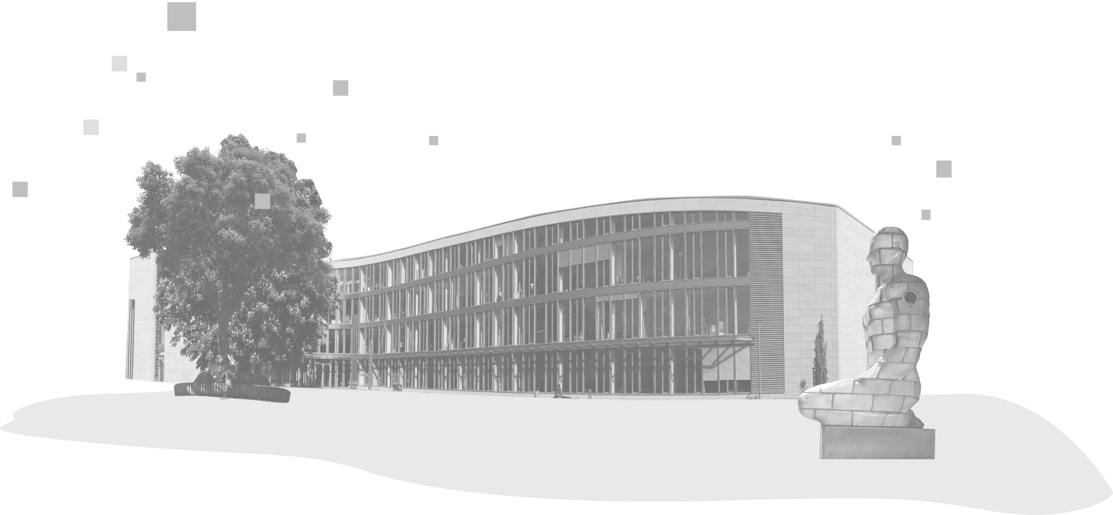

AI GRID SUMMIT
HANDS-ON RAG
Build your own document Q&A system
Felix Boelter | Mario Tormo Romero
AI Service Centre Berlin-Brandenburg | 14 October 2026
Notes:
S0, 22 minutes with the AI Service Centre and the install, 5 of them buffer for setup problems. 1:45 in total, mostly in the notebooks, with a 5-minute break after notebook 3 and 5 minutes for questions at the end. The participant list is going round.

Slide 2

PARTICIPANT LIST
The list is going round now. Please sign in while everyone is still seated.
START THE INSTALL NOW
It downloads about 2 GB, so let it run while we talk.
Name
Institution
Email
git clone https://github.com/aihpi/workshop-rag-basics.git
cd workshop-rag-basics
uv sync
The printout stays with the workshop lead. Please hand it back at the end.
Needs uv and Git, from the
workshop-getting-started guide.
2
Notes:
Pass the list round now, not at the end. Get everyone to start git clone and uv sync now: it's about 2 GB on the workshop Wi-Fi, and it runs while we talk about the AI Service Centre. Collect the list at the end.

Slide 3
01
AI SERVICE CENTRE
BERLIN-BRANDENBURG
Who we are and what you can use.
3
Notes:
S0. About 6 minutes for slides 3 to 7: the main reason we are here. The install from slide 2 runs meanwhile.

Slide 4








FOUR AI SERVICE CENTRES
Göttingen | Kassel | Hannover
Sensitive and critical infrastructure, medicine & energy
Potsdam | Berlin
Education and consulting, AI in business & society
Bonn | St. Augustin | Aachen | Jülich | Dortmund
hpi.de/ki-servicezentrum
AI hardware, consulting and training; multimodal and transferable models
AI SERVICE CENTRES
Darmstadt
Explainability, generalisability and contextual adaptation
Goal: lower the barriers to putting AI to work in society and business
4
Notes:
Four centres across Germany. Our site in Potsdam and Berlin covers education, consulting and the use of AI in business and society.

Slide 5

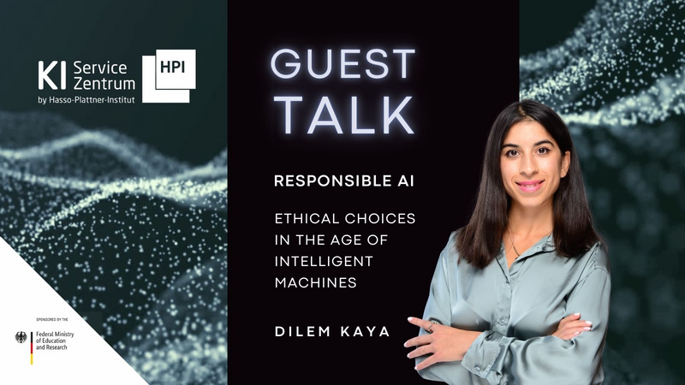




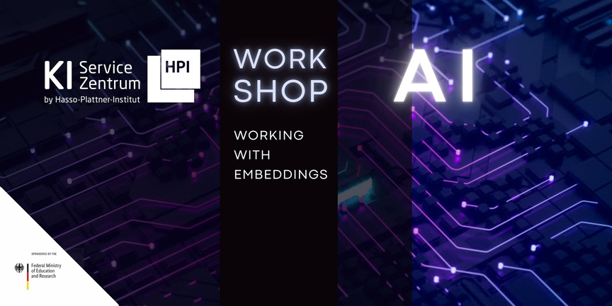
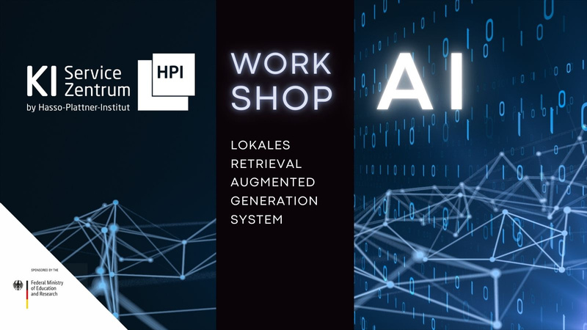



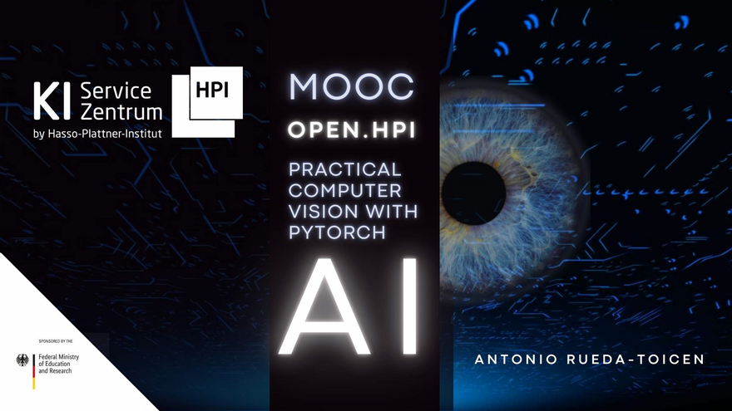

EDUCATION
Talks
tele-task.de/series/1463
• Guest talks on research and innovation
Work-
shops
Newsletter
aimaker.community
• Hands-on topics
• For example: speech2summary, Docker for ML, semantic search
MOOCs
open.hpi.de/channels/ai-service-center
• ChatGPT: what does generative AI mean for society?
• Profitable AI
• Understanding and avoiding AI bias
5
Notes:
Everything is free and open. Newsletter via the QR code on the left.

Slide 6
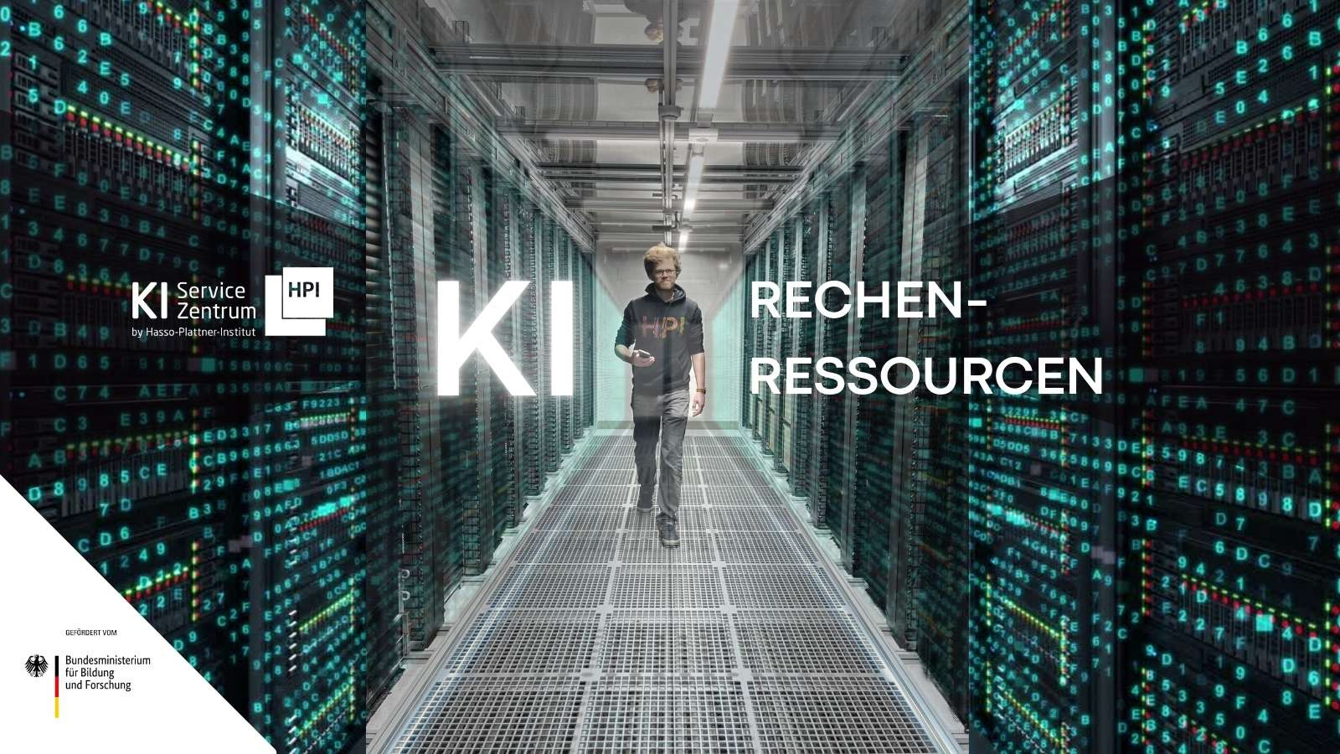

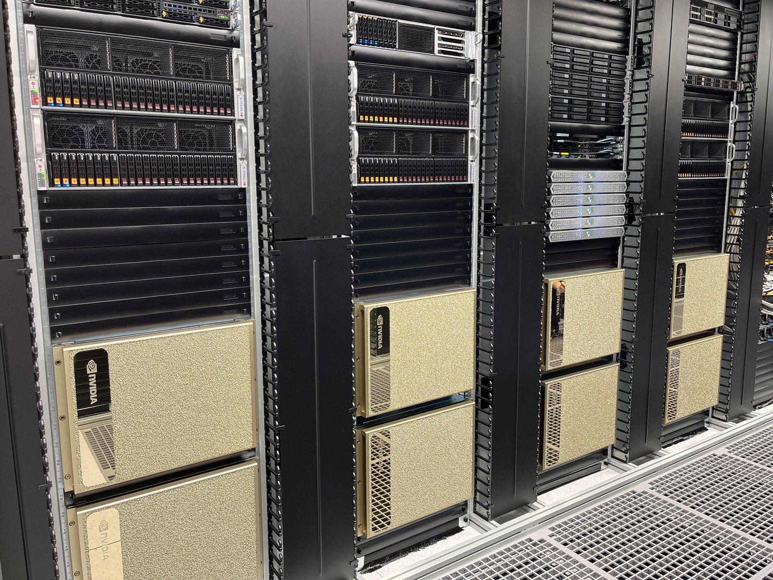
INFRASTRUCTURE
• Access free of charge
• No production use
◦ Data should be anonymised or synthetic
◦ No hosting of products
• Reporting & publication by users
• Existing rights stay with users
• New rights stay with users
◦ Usage rights granted for research and teaching
aisc.hpi.de · request access
Training
• 64 NVIDIA H100 GPUs
Inference
• 40 NVIDIA A30 GPUs
ARM server
• Ampere Altra Max M128-30 CPU
• 2× NVIDIA L40 GPUs
GPU server
• AMD Epyc CPU
• 8× NVIDIA L40S GPUs
Edge
• ARMv8 CPU
• NVIDIA Jetson AGX modules
Neuromorphic
• 288 SpiNNaker2 chips
Storage
• 1.5 PB NVRAM
Network
• 400 Gb/s InfiniBand
• 200 Gb/s Ethernet
6
Notes:
Free to use, no production use. Request access at aisc.hpi.de.

Slide 7
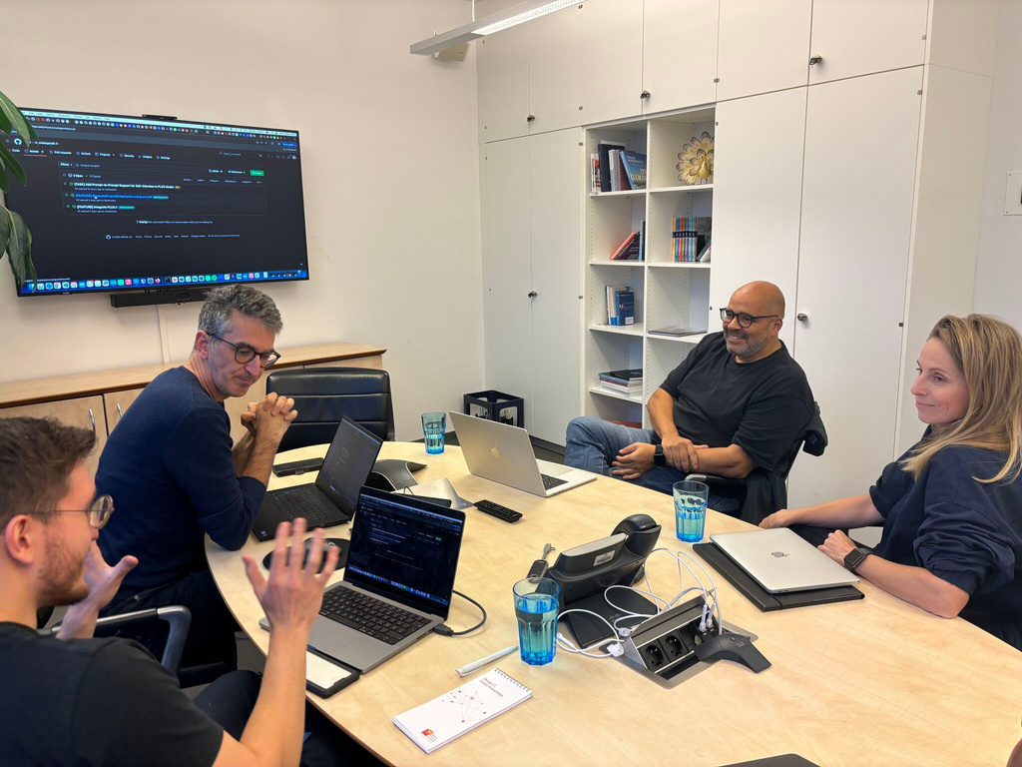


CONSULTING
AI office hours
• AI infrastructure
• AI models & frameworks
• AI use cases
AI pilot projects
• Co-developing a prototype
• Applications every three months
• Selection criteria such as AI maturity and public benefit
• Results are published
Collaborations
• Jointly organised network meetings
Past AI pilot projects
• Generating maths problems
• Generating plain language
• Generating upcycling ideas
• Reducing food waste
• Dating documents by handwriting
Book office hours
Apply now!
7
Notes:
Concrete call to action: book office hours (QR on the left), apply for a pilot project, which opens every three months (QR on the right). Bridge: today's models run on exactly this infrastructure; here is what you will build on it.

Slide 8
BY 1:45 YOU HAVE
1
A chatbot on your laptop that answers from your own PDF.
2
Every claim links to the page it came from, with a score that says how well it is backed.
3
A list of what to check before you trust it.
AGENDA
0:00
0:22
0:35
0:48
1:01
1:06
1:22
1:40
Welcome · AISC · setup
1 · Chat
2 · Documents
3 · Search
Break
4 · RAG + score
5 · Your PDF · transfer
Q&A
Every notebook block: a minute of slides, then the notebook (time-boxed), then a quick check.
8
Notes:
Read the three lines aloud. Ask: is this what you came for? Write anything that doesn't fit on the whiteboard; we come back to it at the end (slide 24).

Slide 9
ARCHITECTURE
1
INGESTION
INFERENCE
2
once · notebooks 2 + 3
every question · notebooks 3 + 4
Documents
Question
PDFs
asked by the user
Embedding model
LLM
Answer
BASICS
Text in, vector out
language model
with sources
Vector database
Relevant passages
Index for similarity search
go into the prompt
Once, ahead of time, the documents are read and cut into chunks. The embedding model turns every chunk into a vector, a list of numbers that captures its meaning. The vectors go into the vector database.
For every question, the same model turns the question into a vector and searches the same database. The closest chunks go to the language model with the question, and it answers with sources.
9
Notes:
Every box on this picture is one notebook. Ingestion happens once, inference with every question; the same embedding model in both. Ask: do we agree on the route?

Slide 10
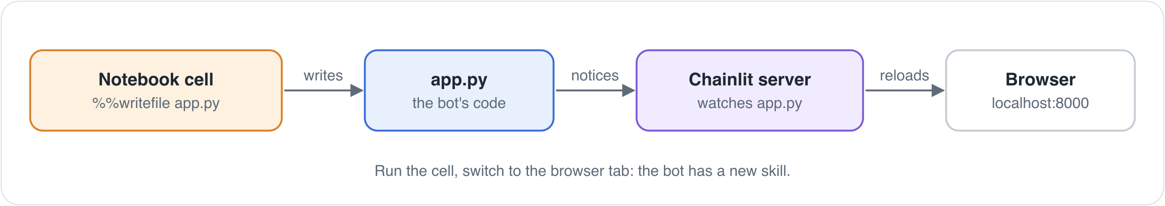
SETUP
1
Install (started on slide 2)
git clone https://github.com/aihpi/workshop-rag-basics.git
cd workshop-rag-basics
uv sync
2
Add the key
cp .env.example .env
open -e .env # Windows: notepad .env
# paste the key from the whiteboard after LLM_API_KEY=
Cells that start with %%writefile app.py write the chatbot. Chainlit notices the change and reloads it in your browser at localhost:8000.
HANDS-ON
Check, and fetch Docling's models
3
uv run python check_setup.py
CHAT MODEL
4
Start
gemma-4-31b
uv run jupyter lab
EMBEDDING MODEL
octen-embedding-8b
Done when check_setup.py prints You're ready for the workshop.
RUNS ON
our own infrastructure in Potsdam
10
Notes:
Key on the whiteboard now. check_setup.py downloads about 500 MB of Docling models the first time; notebook 1 works before that finishes. Anyone whose uv sync is still running: raise a hand. Ask: everyone sees 'You're ready'?

Slide 11
TALKING TO AN LLM
NOTEBOOK 1 · 6 MIN
IN THIS NOTEBOOK
localhost:8000
• Connect to the model through the gateway
• Ask about a detail from one of our papers
• Build a chatbot that remembers and streams
In Kage et al. (2018), what were the lifetime-encoded beads loaded with, and which lifetimes did they have?
✓ The model answers. Would you rely on it?
YOUR TURN · IN THE CHATBOT · + ONLY IF TIME
HANDS-ON
1
Personality: change the system prompt
+
Bonus: show how long each answer took
Solutions are folded away under each exercise.
11
Notes:
S1. 6 minutes. Domain in one sentence, before they ask: Kage et al. is bioanalytics, flow cytometry; tiny beads are told apart by how long they glow after a flash of light. Nobody needs to understand the paper, they only judge an answer about it. Time box, then continue: nobody waits for the bonuses. Don't say whether the answer is right, and don't hint. They decide in five minutes.

Slide 12
WOULD YOU RELY ON IT?
Hands up.
Remember your letter.
NOTEBOOK 1
The model answered the Kage question. Would you rely on this answer?
A yes, as it is
B yes, after a quick check
C no
CHECKPOINT
12
Notes:
Rely on it means, for example, cite it in your report or pass it on as a fact. Count hands per letter, write the numbers on the whiteboard. No reveal, no hint: notebook 4 comes back to it.
If most say A: 'It sounds convincing, doesn't it? Keep that in mind.' Nothing more; the reveal does the rest.
If most say B: ask 'What would your quick check be?' Collect two or three answers on the whiteboard. They usually are: google it (then you still have to read the paper), ask again (another answer, still no source), look it up in the paper (which page?). A quick check without a source is not quick.
If most say C: ask 'Then what is it good for?' Without a source you can't use the answer at all. RAG is what makes it usable.

Slide 13
HALF RIGHT, AND YOU CAN'T
TELL WHICH HALF
01
02
03
No access to
your documents
Similar instead
of right
RAG decides what
the answer is built on
Language models are trained mostly on public data. Your lab reports and paywalled papers are unknown to them.
When the right information is missing, the model falls back on related material: values from similar papers end up in the answer about yours.
Retrieval-augmented generation sets which documents an answer may use, and cites the page.
MOTIVATION
13
Notes:
Whatever you voted: you had no way to know. It sounded right, and to check it you would have had to read the paper. That is the problem. Notebook 4 checks your own answer against the passages it finds in the paper. So first the model needs our documents in a form it can search: that is notebook 2.

Slide 14
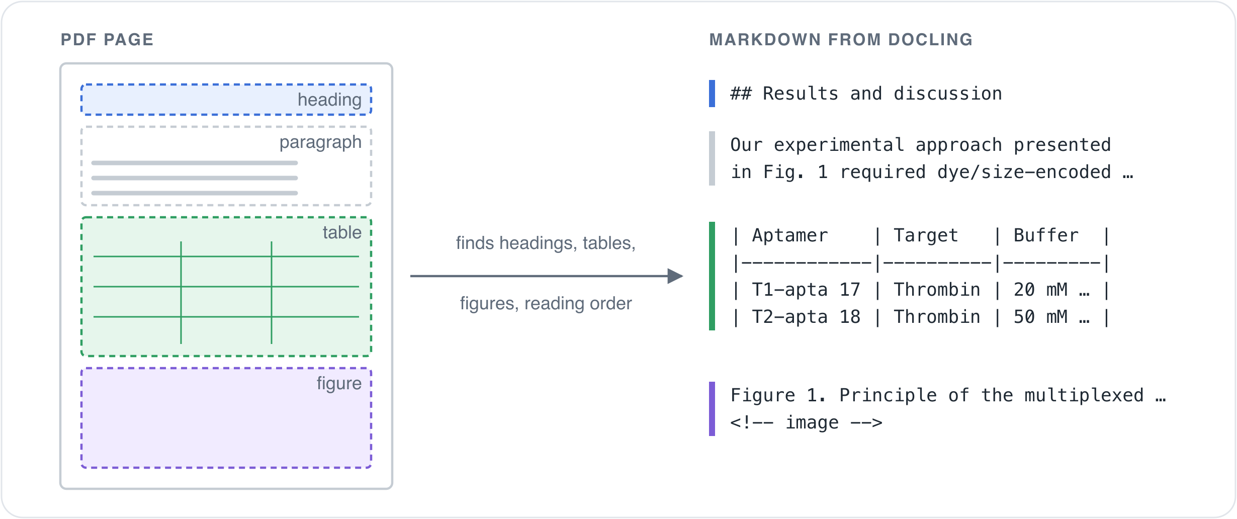
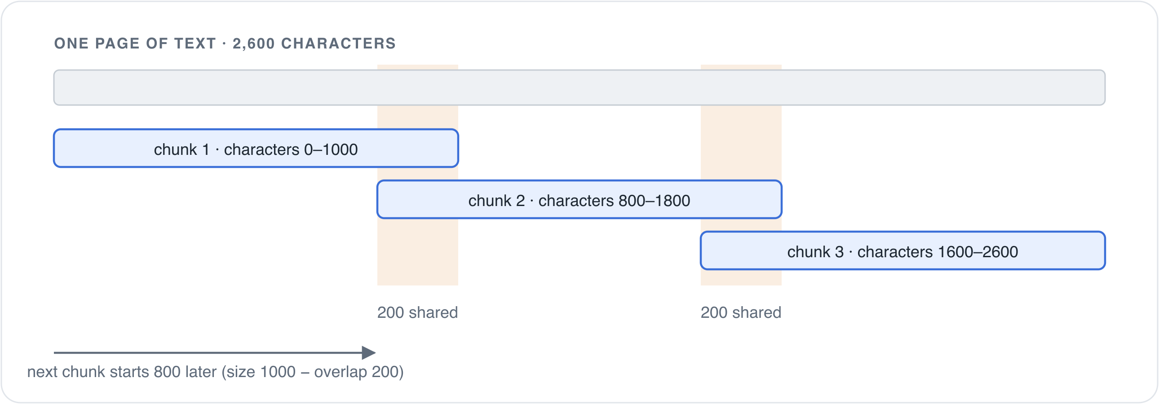
READING DOCUMENTS
NOTEBOOK 2 · 7 MIN
HANDS-ON
A PDF stores where to draw each letter. Docling finds headings, paragraphs and tables, and writes Markdown.
We cut chunks of 1000 characters; a new one starts every 800, so neighbours share 200.
YOUR TURN · + ONLY IF TIME
1
Where are the cuts? 300 and 3000, in the notebook
+
Bonus: only the tables, in the chatbot
14
Notes:
S2. 7 minutes. Time box, then continue: nobody waits for the bonuses. Before you move on: everyone sees the 'saved … chunks' line (chunks.json)? Docling needs about a minute for the three papers; talk through the Markdown while it runs. GrundschutzKI cuts at headings instead; that is in the appendix.

Slide 15
WHAT DID YOU FIND?
Vote by show of hands.
Answers on the next slide.
NOTEBOOK 2
NOTEBOOK 2 · YOUR TURN
What happened to the tables when Docling read the papers?
What happens with smaller chunks, 300 characters instead of 1000?
A They were dropped
B They became loose lines of numbers
C They stayed tables, in Markdown
A Fewer chunks, and tables stay whole
B More chunks, and more of them cut through a table
C Nothing changes
CHECKPOINT
15
Notes:
Read out, hands up.

Slide 16
WHAT WE FOUND
NOTEBOOK 2
NOTEBOOK 2 · YOUR TURN
What happened to the tables when Docling read the papers?
What happens with smaller chunks, 300 characters instead of 1000?
C They stayed tables, in Markdown
B More chunks, and more of them cut through a table
CHECKPOINT
All 5 tables in the three papers came through with their rows and columns, searchable like any other text.
Over the three papers: 1434 chunks instead of 197, so more borders fall inside a table. At 3000: 67 chunks.
NEXT
We have good chunks. How do we find the right ones for a question?
16
Notes:
Reveal. Anyone see something different? These are the numbers from exercise 1: all three papers. Ask who saw a table row split over two chunks on Schmidt page 3.

Slide 17
SEARCH
NOTEBOOK 3 · 8 MIN
IN THIS NOTEBOOK
localhost:8000
• Embed sentences and compare how similar they are
• Store all chunks in Qdrant, in memory
• Turn the bot into a search engine, no LLM yet
What were the lifetime-encoded beads loaded with?
Kage_2018_SciReports.pdf, p. 2 (score 0.73)
› … loaded with different organic fluorophores …
Kage_2018_SciReports.pdf, p. 3 (score 0.64)
› Table 1. Lifetime codes and respective luminophores …
YOUR TURN · IN THE CHATBOT · + ONLY IF TIME
HANDS-ON
1
Fewer, better results: pick a score cutoff
+
Bonus: ask in German
What is the capital of France?
Solutions are folded away under each exercise.
Kage_2018_SciReports.pdf, p. 6 (score 0.17) …
17
Notes:
S3. 8 minutes. Time box, then continue: nobody waits for the bonuses. Before you move on: everyone sees the 'saved … chunks' line (index.json)? Make them ask the France question before you explain anything.

Slide 18
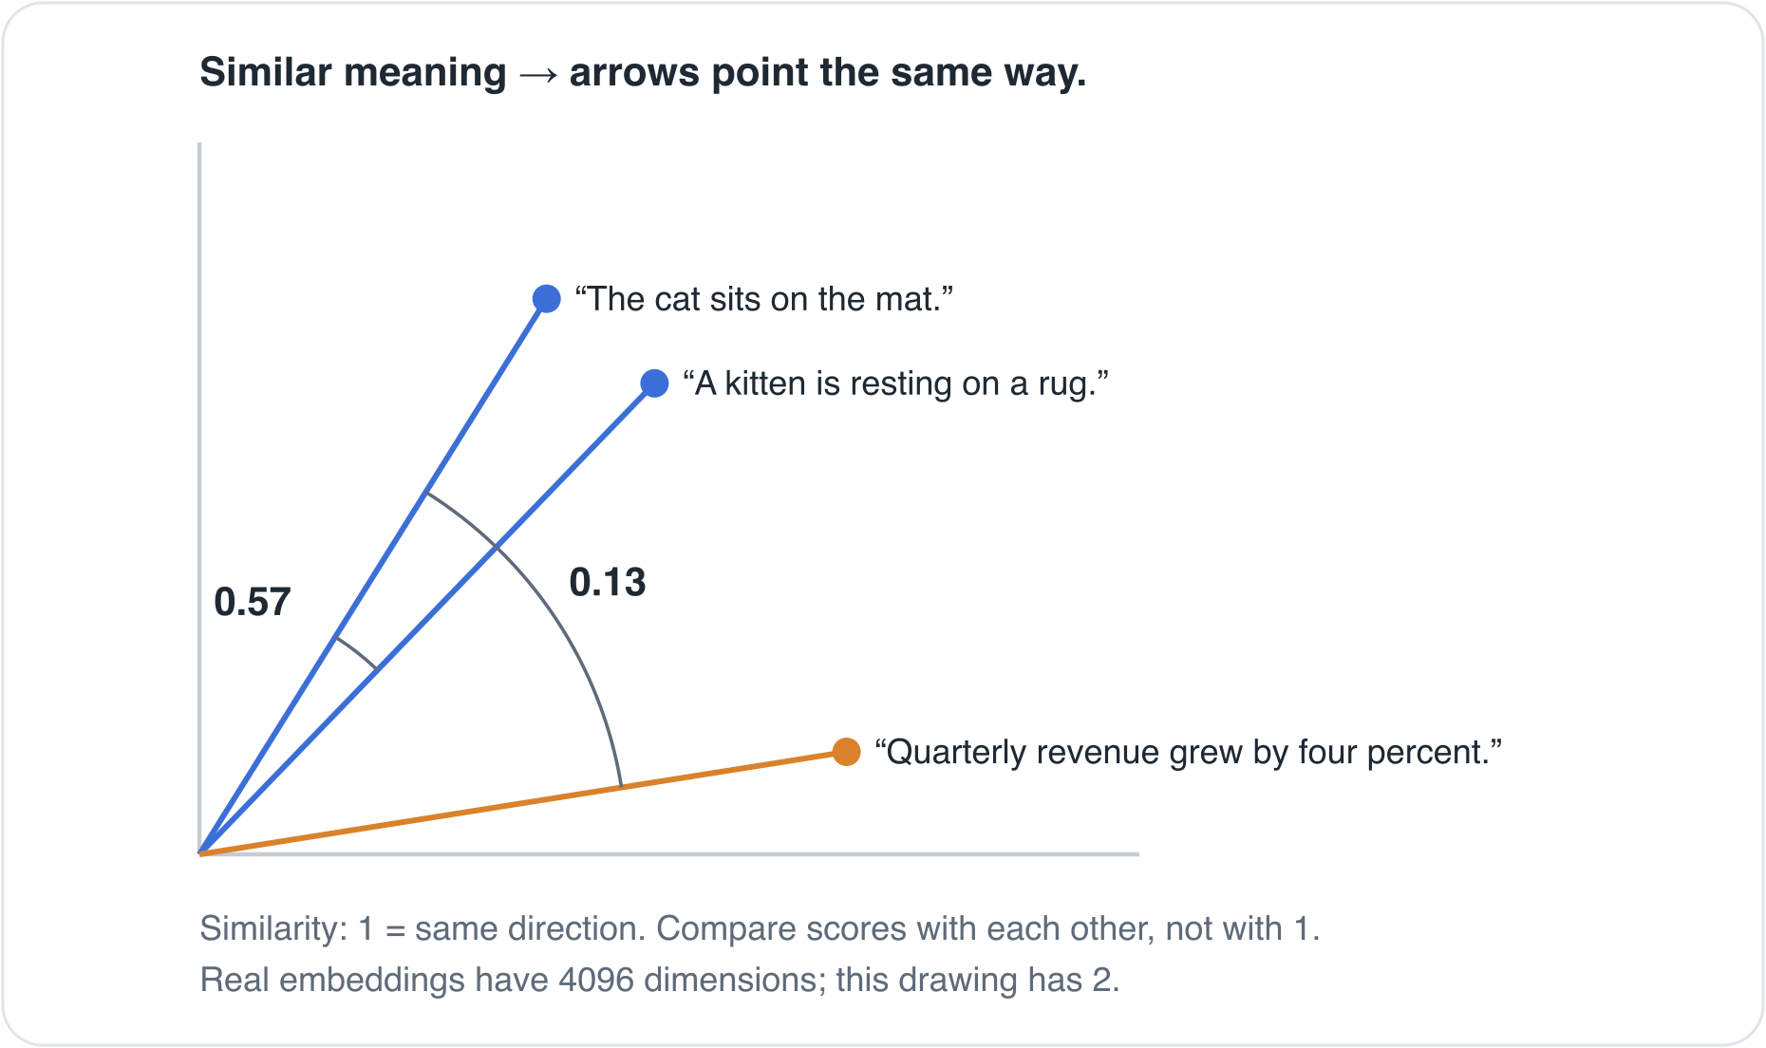
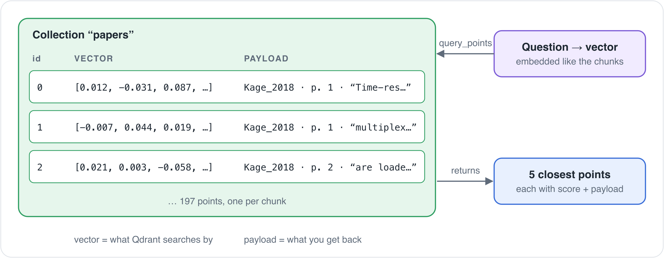
WHY DID FRANCE GET A HIT?
BASICS
1 An embedding model turns text into a list of numbers, 4096 with ours. Similar meaning, similar direction.
2 Search returns the closest chunks, however far away they are.
3 Qdrant stores one point per chunk: the vector, and a payload with text, file and page.
18
Notes:
The cat and kitten numbers are the ones they just saw. Then ask the room: which part of the system knows the page number of a chunk? The payload in Qdrant, written at ingestion from Docling's page numbers; not the LLM, not the embedding model. Ask: do we know what we've built so far?

Slide 19
BREAK
5 minutes. Behind? Finish notebook 3 now: notebook 4 needs its index.json.
19
Notes:
Five minutes, start a visible timer. Walk round: anyone without index.json runs notebook 3 to the end now.

Slide 20
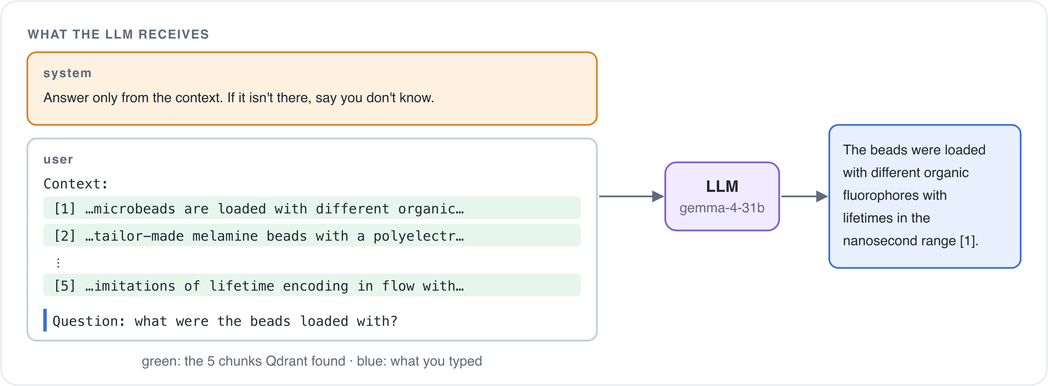
RETRIEVAL-AUGMENTED GENERATION
NOTEBOOK 4 · 11 MIN
RETRIEVE
the 5 closest chunks
AUGMENT
the prompt with them, numbered [1] to [5]
GENERATE
the answer, citing those numbers
HANDS-ON
Every [n] leads to a chunk, and every chunk remembers its file and page.
localhost:8000
What were the beads in Kage et al. loaded with?
YOUR TURN · + ONLY IF TIME
✓ The answer cites [1], [2]. Compare it with notebook 1.
1
How much context? 2 chunks instead of 5
+
Bonus: strict or not
+
Bonus: show the evidence; follow-up questions
20
Notes:
S4. 11 minutes. Time box, then continue: nobody waits for the bonuses. Same question as notebook 1. Let them click a source. Strict-or-not is a bonus today; it comes back on the checklist on slide 24.

Slide 21
WOULD YOU STILL RELY ON IT?
THE NOTEBOOK 1 ANSWER, JUDGED IN NOTEBOOK 4 (ONE RUN)
WHAT THE PAPER SAYS · TABLE 1, PAGE 3
✓ The beads were loaded with quantum dots (QDs).
✗ Three different types of quantum dots, to create distinct lifetime signatures.
✗ One type had a short lifetime of about 10 ns.
✗ One type had a medium lifetime of about 25 ns.
✗ One type had a long lifetime of about 50 ns.
✗ The beads were used as fiducial markers to correct for drift during imaging.
Organic dyes in PMMA beads
1.7 to 7.9 ns
Quantum dots in melamine beads
22.6 ns
CHECKPOINT
faithfulness 0.17
With RAG you don't read the paper either: click [1], and page 3 opens.
21
Notes:
Go back to the vote on the whiteboard. The ✗ lines are what nobody could see; one claim (quantum dots) was right, and the paper box shows the real values. You only know once you check the source, and RAG makes that one click. This is one run; everyone sees their own notebook 1 answer judged, with its own claims and score.
If most said A: five of six claims had no backing in the chunks, and the paper box shows they are wrong. You would have used them.
✗ means not backed by the five chunks, not automatically false: a true claim the search missed gets ✗ too. That is why the click matters.
If most said B: point at the quick checks on the whiteboard. This click is the quick check.
If most said C: right instinct, and now there is a way to check.
Ask: do we see how far we've come? Then: that held on our papers; does it hold on yours?

Slide 22
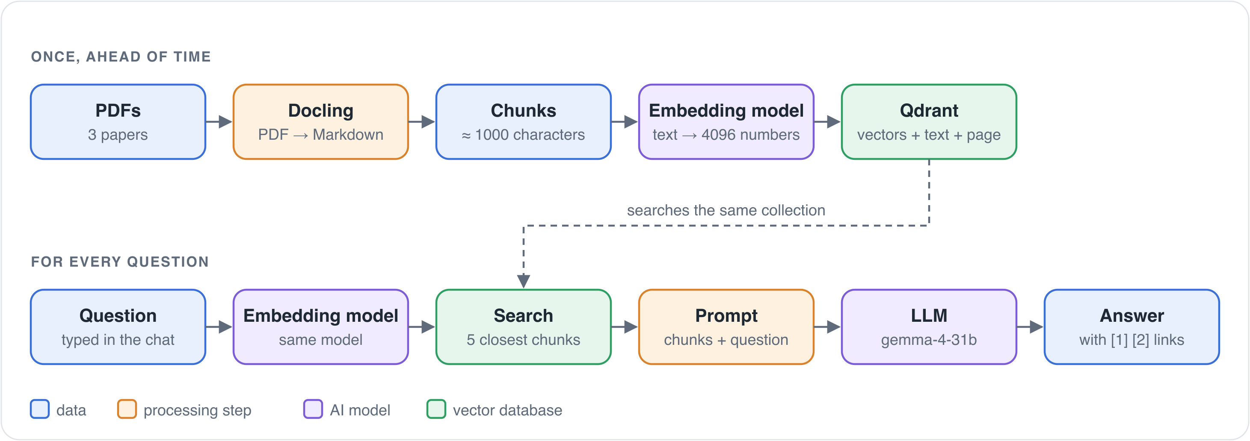
PUTTING IT TOGETHER
NOTEBOOK 5 · 6 MIN
YOUR TURN · IN THE CHATBOT · + ONLY IF TIME
1
Your own document: attach a PDF, ask, check the page and the score
+
Bonus: chat with this document only
HANDS-ON
PIECE · NOTEBOOK
Read a PDF with Docling
2
Cut into chunks
2
Turn text into vectors
3
Store and search in Qdrant
3
Answer from the chunks
4
Cite the page
4
Score the answer
4
Your own PDF
5
Your PDF goes to the AISC gateway in Potsdam. Test or public documents only.
22
Notes:
S5. 6 minutes. Time box, then continue: nobody waits for the bonuses. The score is already in the app. Expect at least one answer that is worse than on the papers; that's the point. A scanned PDF has no text layer, and with OCR off the bot gets nothing to answer from.

Slide 23
YOUR OWN DOCUMENTS
QUESTION 1
QUESTION 2
Which documents would you use this for?
What do you expect to go wrong first, and why?
TRANSFER
One sentence each, round the room.
23
Notes:
One sentence each, for example 'my 200 papers on X; I expect the tables to break, because ...'. Above 12 people, tables of four, one sentence per table. Then the next slide. If someone asks why not put all PDFs in the prompt: cost per question, page citations, and collections larger than any context window.

Slide 24
YOUR OWN DOCUMENTS
QUESTION 1
QUESTION 2
Which documents would you use this for?
What do you expect to go wrong first, and why?
TRANSFER
WHAT OFTEN GOES WRONG
Scanned PDFs · tables · questions across several documents
BEFORE YOU TRUST AN ANSWER · THE LIST IS AT THE END OF NOTEBOOK 5
1
Click the source
2
Low score: check the ✗ claims
3
High score: still check what's missing
4
Scanned PDF or tables? Check what went in
5
Several documents? Search may miss one
6
Costly if wrong? Keep "say you don't know"
24
Notes:
After the round: compare with what people said. Then the list promised on slide 8: read it out, one line each; every line is something they saw today. Point 6 is the strict-or-not bonus from notebook 4. Close the loop with the whiteboard list from slide 8. Ask: can you repeat it on your own?

Slide 25

WHERE TO TAKE THIS
Today
The template
Fixed 1000-character chunks
Structure-aware chunkers, chosen per data source
Qdrant in memory, rebuilt on every start
Qdrant server, ingested once, updated when files change
Vector search only
Hybrid search: vectors plus keyword matching
Faithfulness, one answer at a time
An evaluation app that compares setups
NEXT STEPS
The template
Office hours
Pilot projects
aihpi/pilotproject-rag-template on GitHub
Stuck on your own collection? Book a slot.
Build it with us; applications every three months.
25
Notes:
The template is where a real project starts. Office hours if you get stuck on your collection: the same offers as on slide 7. SENTRA and GrundschutzKI (appendix) are two pilot projects built this way.

Slide 26

YOUR FEEDBACK COUNTS
We shape our next workshops around your answers. Two minutes is enough.
kisz@hpi.de
hpi.de/kisz
Felix Boelter | Mario Tormo Romero
KEEP GOING
github.com/aihpi/workshop-rag-basics · this workshop
github.com/aihpi/pilotproject-rag-template · template
26
Notes:
1:40: five minutes for questions. Leave the QR code up while they come in. Contact: kisz@hpi.de.

Slide 27
APPENDIX
Background for questions. Not part of the main path.
27
Notes:
Everything after this slide is for questions and for reading afterwards.

Slide 28
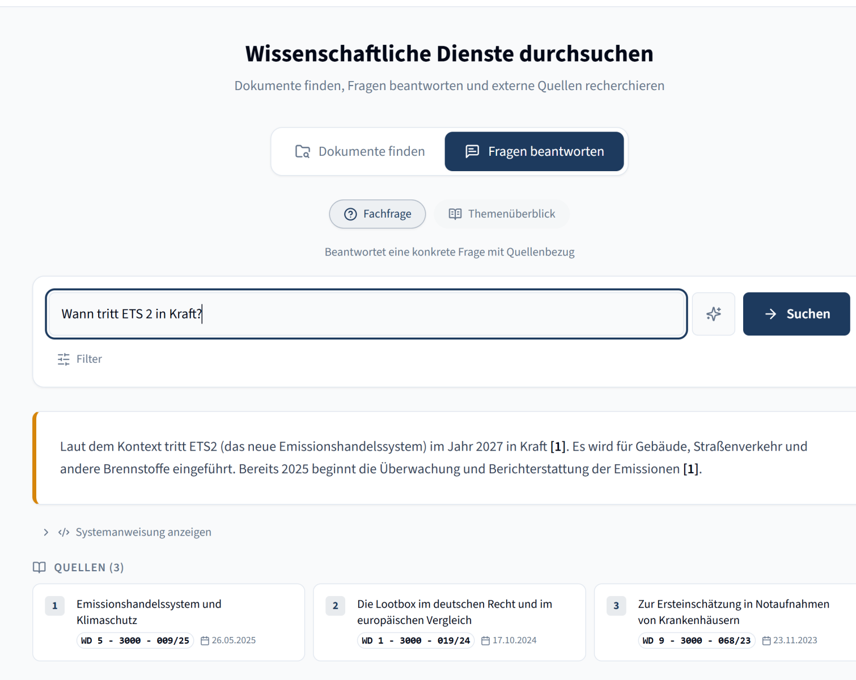
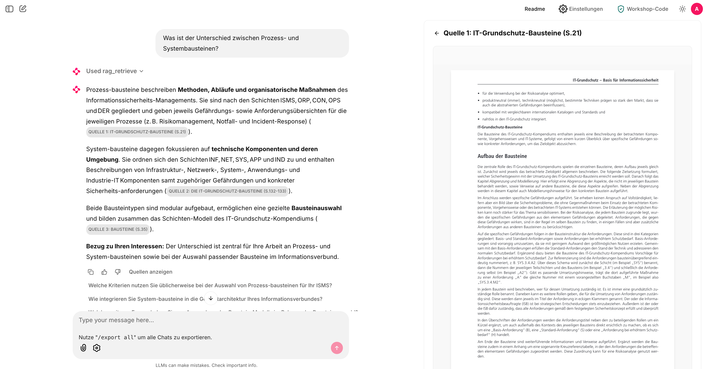
RAG IN PRACTICE
IN PRACTICE
SENTRA
GrundschutzKI
Research Services of the German Bundestag: semantic search across expert reports, an AI summary, every statement traced to its report.
IT baseline protection: questions in plain language, a short answer with a jump link, the BSI original open next to it.
github.com/aihpi/pilotproject-sentra
github.com/aihpi/pilotprojekt-GrundschutzKI
Semantic search · an AI summary · sources for transparency. Today you build the same thing, small.
28
Notes:
No live demo today, just these two to show RAG in real use. SENTRA: up to 2000 requests a year at the Bundestag's research services. GrundschutzKI: do-it-yourself instead of external consulting, also with NIS2 in mind.

Slide 29
FROM DOCUMENT TO CHUNKS
STEP 1 · DOCLING READS THE PAGE
STEP 2 · CUT INTO CHUNKS
BASICS
A PDF only stores where to draw each letter. Docling finds headings, paragraphs, tables and figures, and writes Markdown.
Our notebook: every 1000 characters, with 200 overlap. Simple, the same for every document, but it may cut through a table.
GrundschutzKI: at every heading, because the BSI standards are clearly structured. A chunk keeps its title. Docling ships several such chunkers.
29
Notes:
3 minutes. One method of many: fixed size with overlap is what the notebook does. Structured documents chunk better along headings.

Slide 30
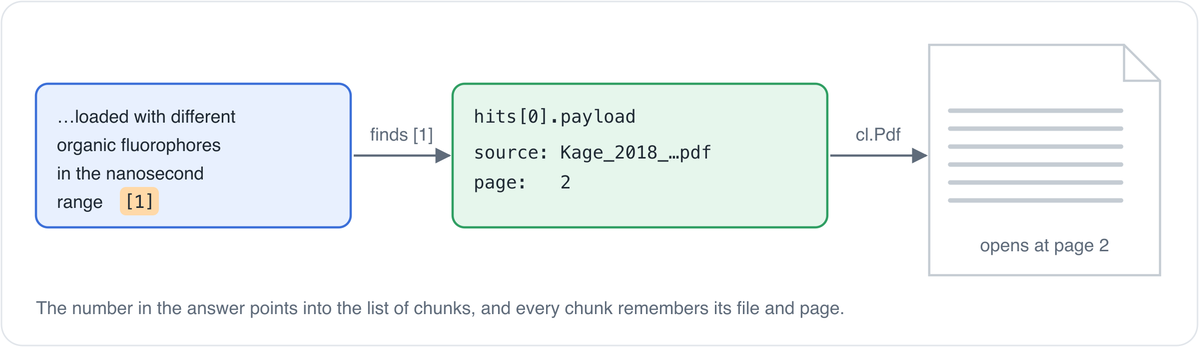
PROMPT AND CITATIONS
RETRIEVE
the 5 closest chunks
AUGMENT
the prompt with them, numbered [1] to [5]
GENERATE
the answer, citing those numbers
BASICS
Every [n] leads back to a chunk, and every chunk remembers its file and page. That is all a citation is.
30
Notes:
3 minutes. RAG = retrieve, augment, generate. Citations are bookkeeping, not magic.

Slide 31
IS THE ANSWER ANY GOOD?
You scored faithfulness in notebook 4. Changed the chunk size or the number of chunks? Measure whether it helped. Neither score needs a hand-written correct answer.
Faithfulness
Relevance
Is every claim backed by the retrieved chunks?
Does the answer address the question?
supported claims ÷ all claims
similarity(questions from the answer, real question)
EVALUATION
A judge model splits the answer into claims and checks each one against the chunks. 0.5 means half the claims have no source.
A judge model writes the questions this answer would fit; their embeddings are compared with the question that was asked.
In the template: both scores for every answer, a badge in the chat, and an evaluation app that compares configurations. Built on Ragas.
31
Notes:
1 to 2 minutes, a recap: they built faithfulness themselves in notebook 4. Relevance is new. Link it to the exercises: limit 2 versus 15, chunk size 300 versus 3000 are exactly the changes you would measure this way.

