Slide 1
The problem: embeddings are big — and big is slow
Each text chunk is stored as one float32 vector: 384 numbers × 4 bytes = 1.5 KB.
Our 100k-chunk slice of German Wikipedia already needs 154 MB; 100M chunks would be ~150 GB.
These vectors must sit in RAM for fast search — so memory is both the bottleneck and the bill.
Exact float32 search already costs 3.7 ms/query (~271 q/s) on just 100k vectors.
Can we shrink the vectors without wrecking retrieval quality? — that is what turbovec does.

Slide 2
How it works (1/4): an embedding is just a list of numbers
An embedding turns a piece of text into ~384 numbers — coordinates that place similar meanings close together.
Search means: find the chunks whose coordinates sit nearest to the question's coordinates.
Today each number is a float32: 32 bits, about 7 digits of precision.
That is like writing every measurement to 7 decimals when you only need one — most of those bits never change the answer.

Slide 3
How it works (2/4): round the numbers into a few buckets
turbovec keeps only a handful of levels per number: 2 bits = 4 levels, 3 bits = 8, 4 bits = 16.
Each number is snapped to its nearest level — like naming a colour from a 16-crayon box instead of millions of shades.
A per-vector scale places those few levels where that vector's values actually lie, so little is lost.
32 bits → 2 bits is 16× fewer bits per number; the whole index shrinks almost as much. This is called quantization.

Slide 4
How it works (3/4): why rounding doesn't break search
To rank nearest neighbours you only need relative positions, not exact values.
Rounding nudges every point a little but keeps it in roughly the same place — neighbours stay neighbours.
So the right answers still land near the top: at 4-bit we keep 93% of them, at 2-bit 82%.
Want the last bit of quality back? Re-rank just the top hits using the original float32 vectors.

Slide 5
How it works (4/4): why smaller is also faster
Searching means reading every stored vector and comparing it to the query — work that is limited mostly by memory speed.
Smaller codes mean far less data to move, so search speeds up roughly in step with the shrink.
turbovec compares the packed codes directly — it never unpacks them back to float32 first.
It leans on special CPU instructions (SIMD: AVX-512 on x86, NEON on ARM) that crunch many numbers at once.

Slide 6
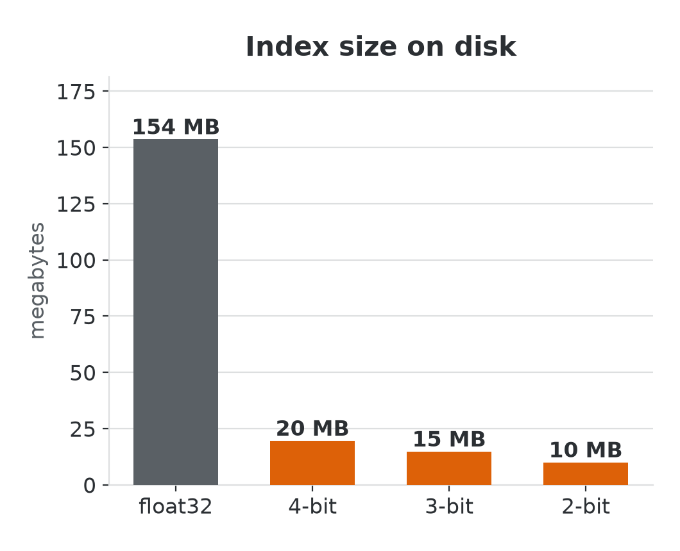
Results on Wikipedia (1/2): up to 15× smaller
100k chunks, dim 384. Baseline float32 = 154 MB.
4-bit: 19.6 MB (7.8× smaller), recall@10 = 0.934
3-bit: 14.8 MB (10.4× smaller), recall@10 = 0.897
2-bit: 10.0 MB (15.4× smaller), recall@10 = 0.816
More bits → better recall; fewer bits → smaller index.

Slide 7
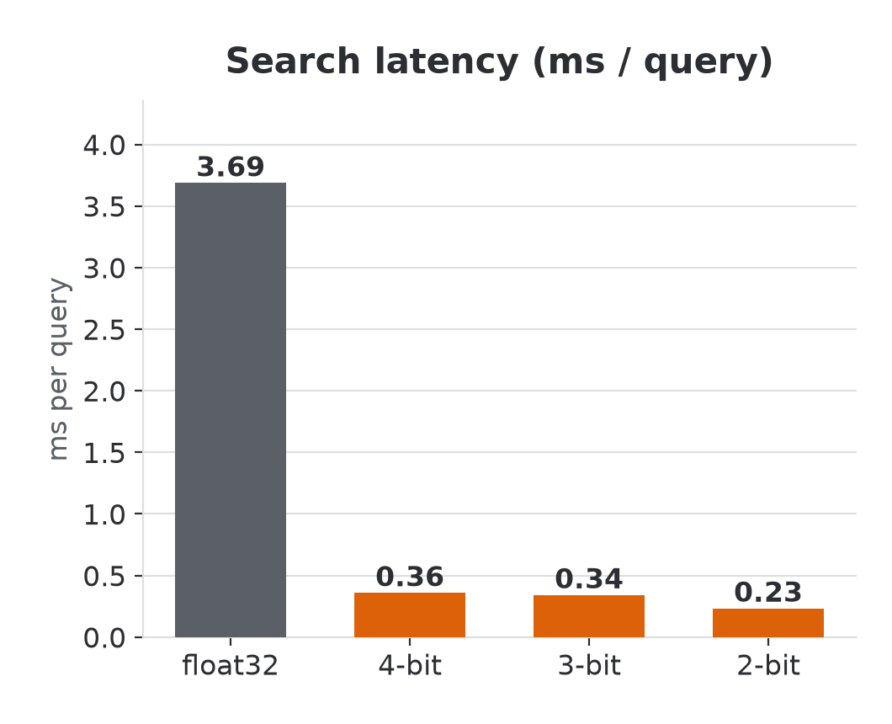
Results on Wikipedia (2/2): up to 16× faster
Exact float32 search: 3.69 ms/query (~271 q/s).
4-bit: 0.36 ms/query (10.3× faster, ~2791 q/s)
3-bit: 0.34 ms/query (10.8× faster, ~2931 q/s)
2-bit: 0.23 ms/query (15.8× faster, ~4299 q/s)
Speed-up tracks compression: search is memory-bandwidth bound, so smaller codes run faster.

Slide 8
Three questions this raises
How low can we go? Is 2-bit's ~0.82 recall good enough, or do we re-rank the top candidates with float32?
Does it hold on our data and at scale? These are 100k German-Wikipedia chunks with minilm — what about 10M+ vectors and our domain embeddings (qwen3 / octen)?
Where does it fit in the stack? Drop-in for our vector DB or a separate index? How does it compose with query transformation, MCP tools and ingestion?

