Slide 1
Efficient Information Retrieval /
Reinforcement Learning from Human Feedback
Local Retrieval Augmented-Generation System

Slide 2

Attendance list

Slide 3

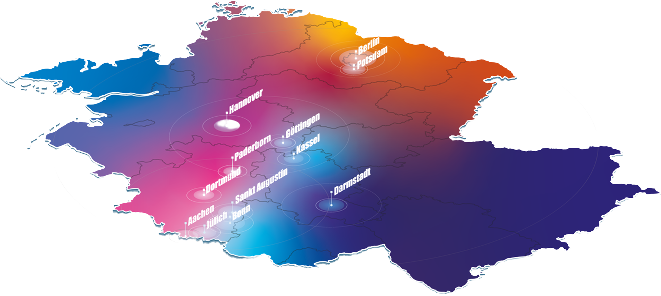

Four AI service centers in Germany
https://hpi.de/ki-servicezentrum/
Overview
Goal:
Reducing barriers to implementing AI applications in society and industry.

Slide 4
AI Service Center
Berlin Brandenburg
AISC
Forschung
Bildung
Infrastruktur
Beratung
Structure

Slide 5
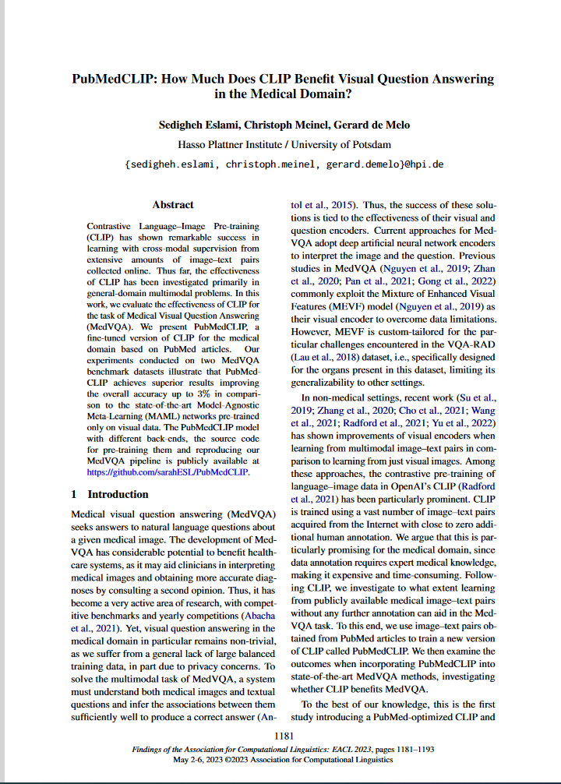
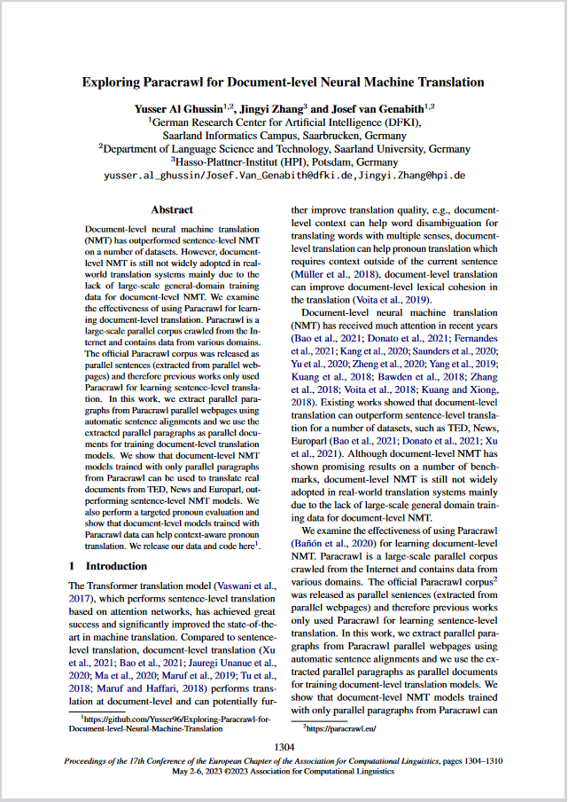
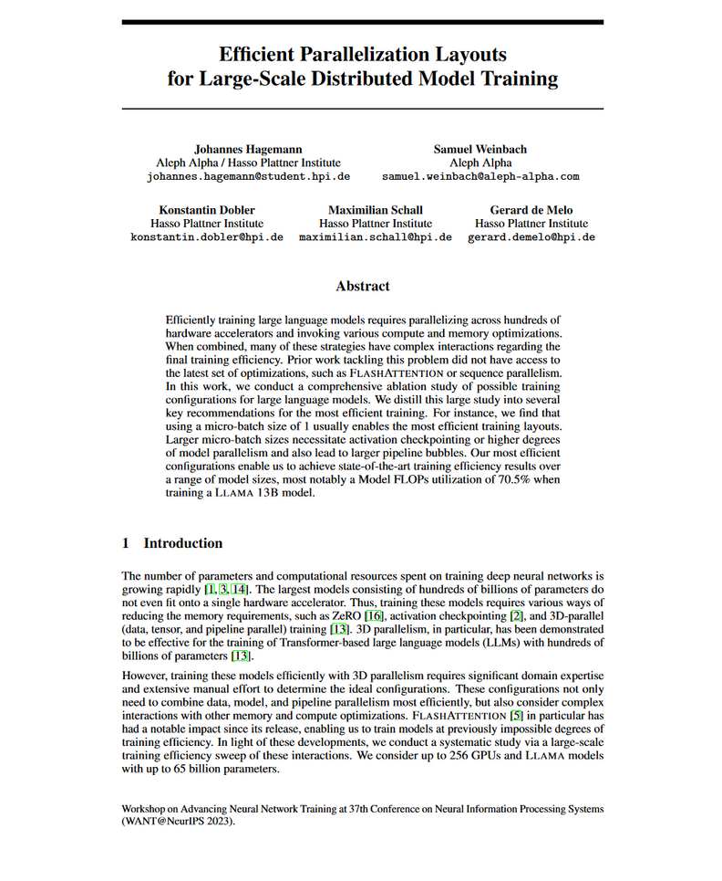
  AI methods research
  AI operations research
Research

Slide 6



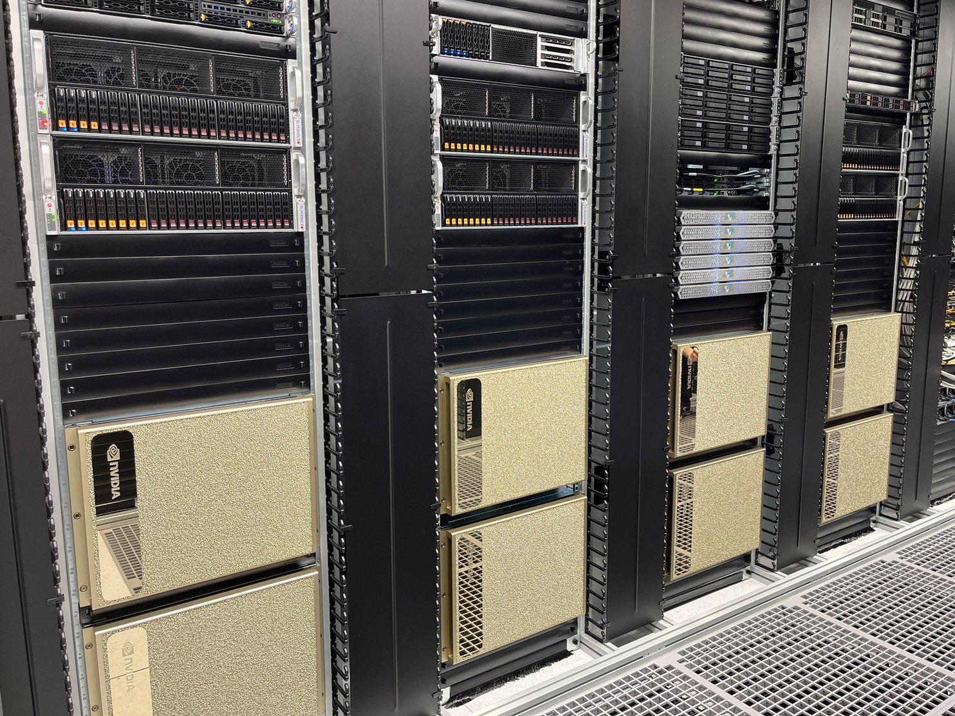


  Free access
  No production use
    Data should be anonymized or synthesized
    No hosting of products
  Reporting & publication by users
  Existing rights remain with users
  New rights remain with users
    Usage rights granted for research and teaching
Access request
aisc.hpi.de
Infrastructure
Training
  64 NVIDIA H100 GPU
Inference
  40 NVIDIA A30 GPU
ARM Server
  Ampere Altra Max M128-30 CPU
  2 x NVIDIA L40 GPUs
GPU Server
  AMD Epyc CPU
  8 x NVIDIA L40S GPU
Edge
  ARMv8 CPU
  NVIDIA Jetson AGX Module
Neuromorphic
  288 SpiNNaker2 Chips
Storage
  1.5 PB NVMe
Network
  400 Gb/s Infiniband
  200 Gb/s Ethernet

Slide 7


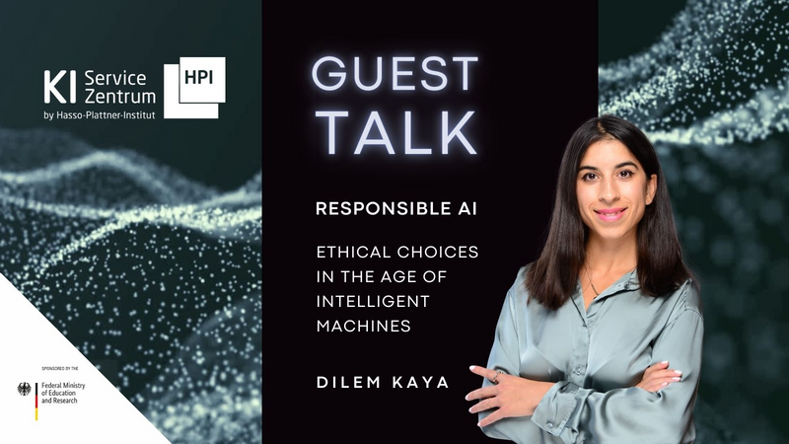










Talks
tele-task.de/series/1463
  Guest lectures on research and innovation
Newsletter
Work
shops
Education
aimaker.community
  Hands-on topics
  Example topics: Speech2summary, Docker for ML, semantic search
MOOCs
open.hpi.de/channels/ai-service-center
  ChatGPT: What does generative AI mean for society?
  Profitable AI
  Understanding and avoiding AI biases

Slide 8

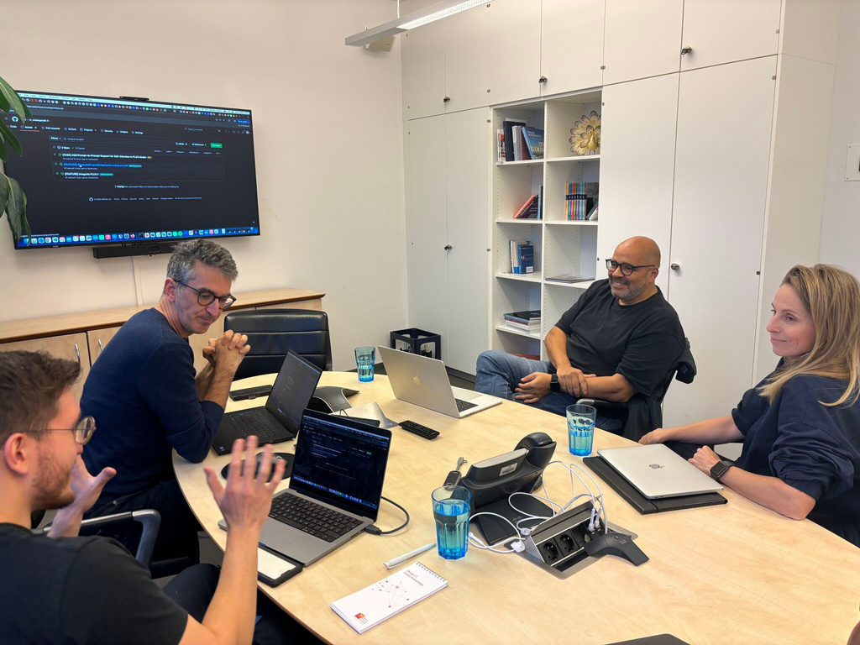
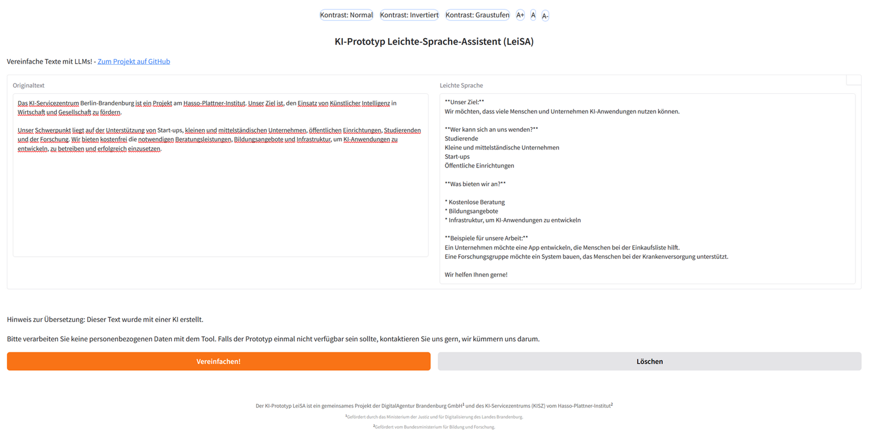

AI consultation hours
  Answering questions:
    about AI infrastructure
    about AI models & frameworks
    about AI use cases
AI pilot projects
  Co-development of a prototype
  Application every three months
  Selection criteria, e.g. AI maturity, public benefit
  Publication of results
Cooperation
  Jointly organized network meetings
Book a consultation
Consulting
Previous AI pilot projects
  Generation of math problems
  Generation of easy language
  Generation of upcycling suggestions
  Reduction of food waste
  Dating by handwriting
github.com/aihpi/leichte-sprache
Apply now!

Slide 9
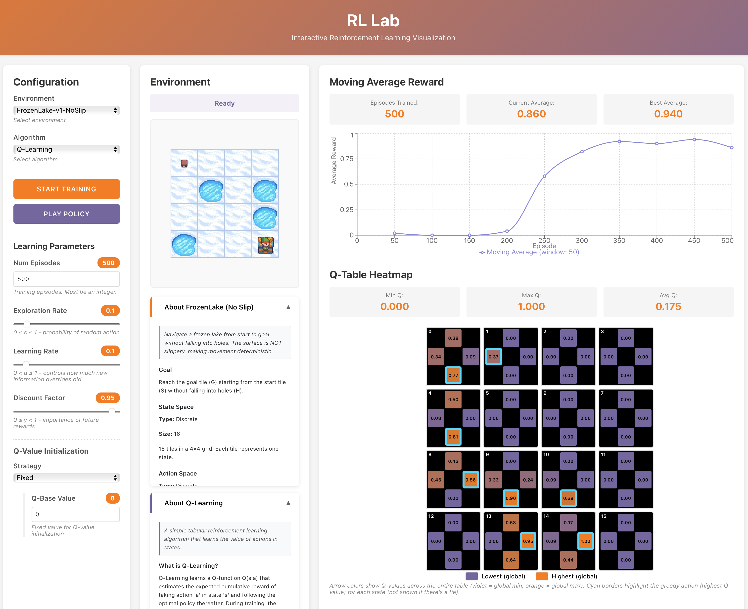

Other Workshops
Reinforcement Learning Workshop Series
RL I - Introduction
RL II - Application

Slide 10

Notes:
Sensing bezieht sich auf das Messen/Erfassen/Wahrnehmen von Daten
Instrumente der Wahrnehmung sind menschliche Sinnesorgane u. technische Hilfsgeräte
Technische Hilfsgeräte lassen sich unterteilen in autonome Geärte (z.B. Internet of Things) u. nicht-autonome Geräte (z.B. Smartphone)

Slide 11
“Our chatbot gives wrong or unclear answers”
“We don't know whether our RAG system is reliable”
“Answers are inconsistent or unhelpful”
“Evaluating our RAG system takes too long”
Motivation

Slide 12
Evaluate RAG systems systematically and optimize them iteratively
Understand how answer quality can be improved and how “quality” can be measured
Learning objectives

Slide 13
Basics: evaluation & alignment of a RAG system
  RAGAS metrics
Practice and discussion
  Implement RAGAS metrics in notebooks
  Evaluate and adjust the RAG system
Outlook on RLHF, RLAIF
Agenda

Slide 14


Slide 15

Context LLM
Training LLM
Docs
Data Filtering & cleaning
Tokenization
Pretraining
(Next Token Prediction)
Supervised Fine Tuning
RLHF/RLAIF
Query
LLM
Response

Slide 16
Context RAG
Vector DB
Relevant Context
Query
Embedding
LLM
Response
Embedding
Docs
Chat history / task metadata

Slide 17
Evaluation and alignment of a RAG system
Are the right documents retrieved, or is important information missing?
Is the answer supported by the context, or is it hallucinated?
Is the problem in the retrieval or in the model?
Where exactly is my RAG system broken?
How do I prevent unwanted or poor answers?
How do you evaluate and optimize a model in areas without clear success metrics?
Evaluation
Alignment

Slide 18
RAGAS – Overview
RAGAS = Retrieval Augmented Generation Assessment Suite
What: framework for the evaluation of RAG systems; uses metrics and LLMs as evaluators
Goal: helps locate errors in the system
Where it fits:
Vector DB
Relevant Context
Query
Embedding
LLM
Response
RAGAS
retrieval
RAGAS
generation
Embedding
Docs
Chat history / task metadata

Slide 19
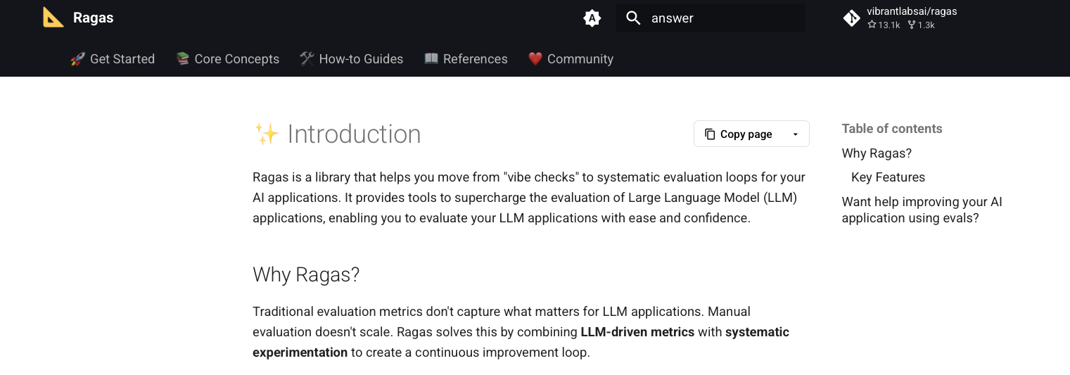
RAGAS – Overview
https://docs.ragas.io

Slide 20

Notebook 01
Notes:
Sensing bezieht sich auf das Messen/Erfassen/Wahrnehmen von Daten
Instrumente der Wahrnehmung sind menschliche Sinnesorgane u. technische Hilfsgeräte
Technische Hilfsgeräte lassen sich unterteilen in autonome Geärte (z.B. Internet of Things) u. nicht-autonome Geräte (z.B. Smartphone)

Slide 21

Setup Instructions
Already have the repository from RAG II workshop installed?
NO
YES
Start fresh
git clone https://github.com/aihpi/workshop-ragV2.git
cd workshop-ragV2
Option A — I don't need my old changes
git fetch origin
git reset --hard origin/main
Option B — I want to keep my old changes
git checkout -b my-workshop2-changes
git add -A && git commit -m "My workshop 2 work"
git checkout main
git fetch origin
git reset --hard origin/main
Step 2: Install dependencies
scripts/setup_notebooks_kernel.sh
Step 3: Open notebooks/00_setup.ipynb
Select kernel Python (workshop-ragV2) and run all cells.
Enter the provided API key (valid until 08.04.26):
sk-UKXFOGt1nz_IYNcd52IWnw
Step 4: Have a break and wait for others to finish

Slide 22
Notes:
Sensing bezieht sich auf das Messen/Erfassen/Wahrnehmen von Daten
Instrumente der Wahrnehmung sind menschliche Sinnesorgane u. technische Hilfsgeräte
Technische Hilfsgeräte lassen sich unterteilen in autonome Geärte (z.B. Internet of Things) u. nicht-autonome Geräte (z.B. Smartphone)

Slide 23
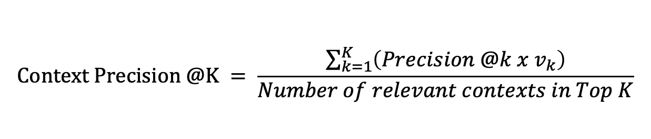
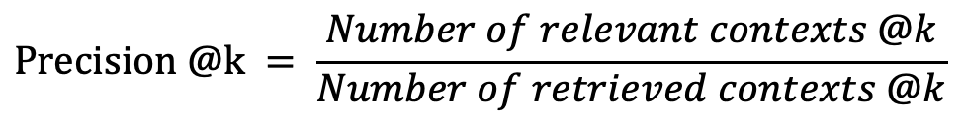
RAGAS – Context Precision – Retrieval Metric
The metric measures the ability to rank relevant text passages in the retrieved context of a given query higher than irrelevant ones
$$Context Precision @K = \frac{\sum_{k=1}^{K}{\left(Precision @k x v_{k}\right)}}{Number of relevant contexts in Top K}$$
How well are the relevant hits placed in the ranking
$$Precision @k = \frac{Number of relevant contexts @k}{Number of retrieved contexts @k}$$
Share of relevant hits
$K$ is the total number of contexts and $v_{k}\text{∈}\left\{0,1\right\}$ is an indicator of whether the context is relevant (1 = relevant, 0 = irrelevant)

Slide 24
RAGAS – Context Precision – Example
Ranking: 1 ✅, 2 ❌
Ranking: 1 ❌, 2 ✅
Context Precision = 1/1 = 1
Context Precision = 0.5/1 = 0.5
How well are the relevant hits placed in the ranking
Precision@1= 1/1 = 1
Precision@2= 1/2 = 0.5
Precision@1= 0/1 = 0
Precision@2= 1/2 = 0.5
Share of relevant hits
only relevant hits are counted, with v=1

Slide 25
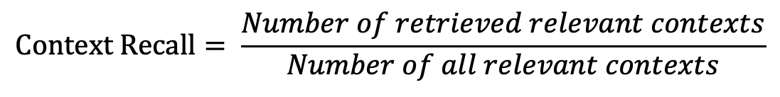
RAGAS – Context Recall – Retrieval Metric
The metric measures how many of the relevant hits were retrieved
$$Context Recall= \frac{Number of retrieved relevant contexts}{Number of all relevant contexts}$$

Slide 26
RAGAS – Context Recall – Example
Question:
Retrieval:
Context Recall:
“What colors does a traffic light have?”
(3 relevant facts: Red, Yellow, Green)
“Red”
“Yellow”
Retrieved: 2 relevant
Total available: 3
Context Recall = 2/3 = 0.67

Slide 27

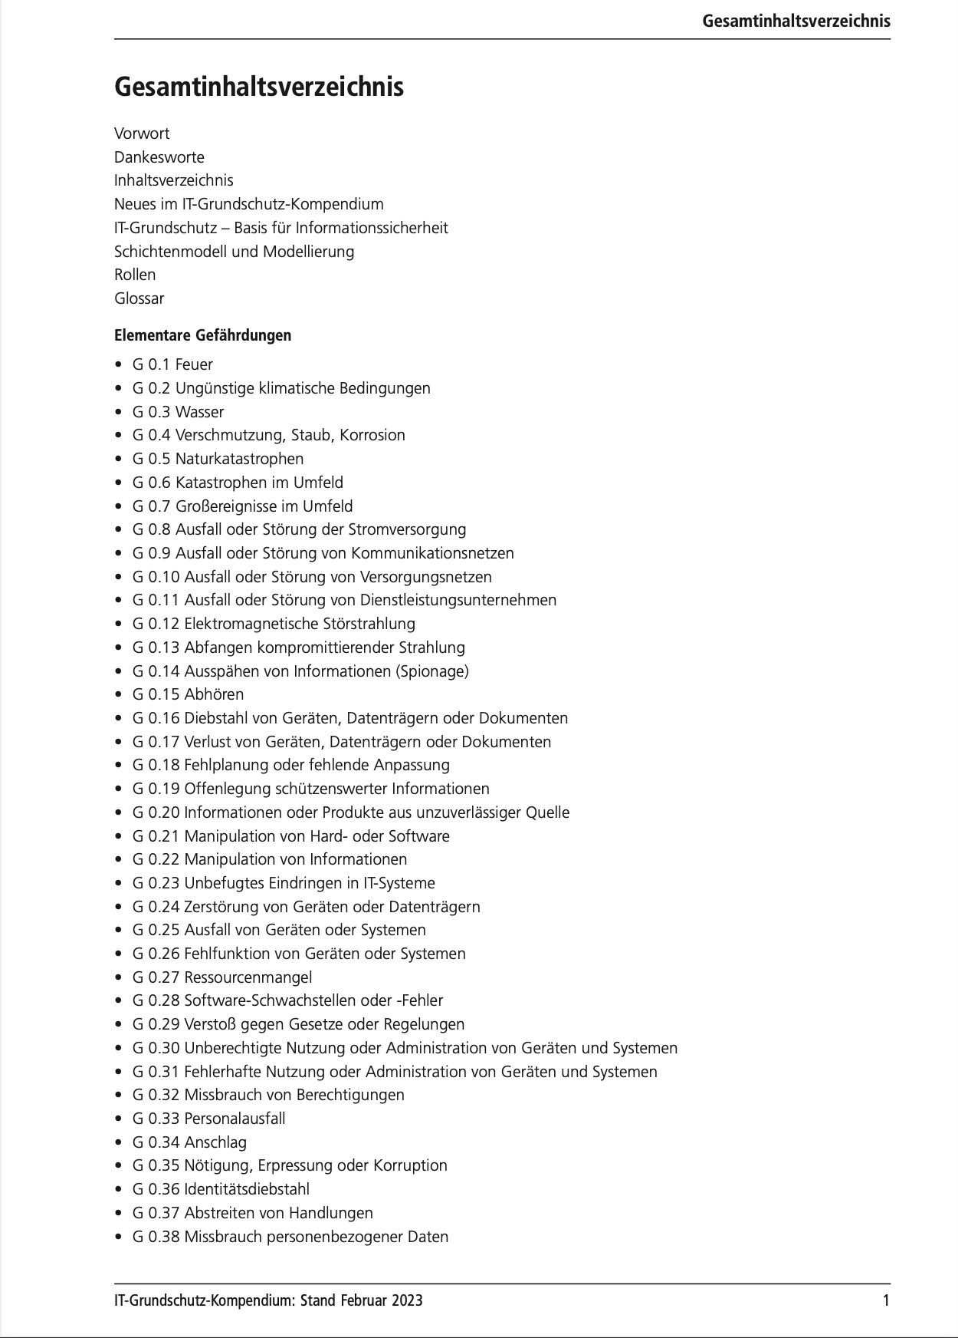
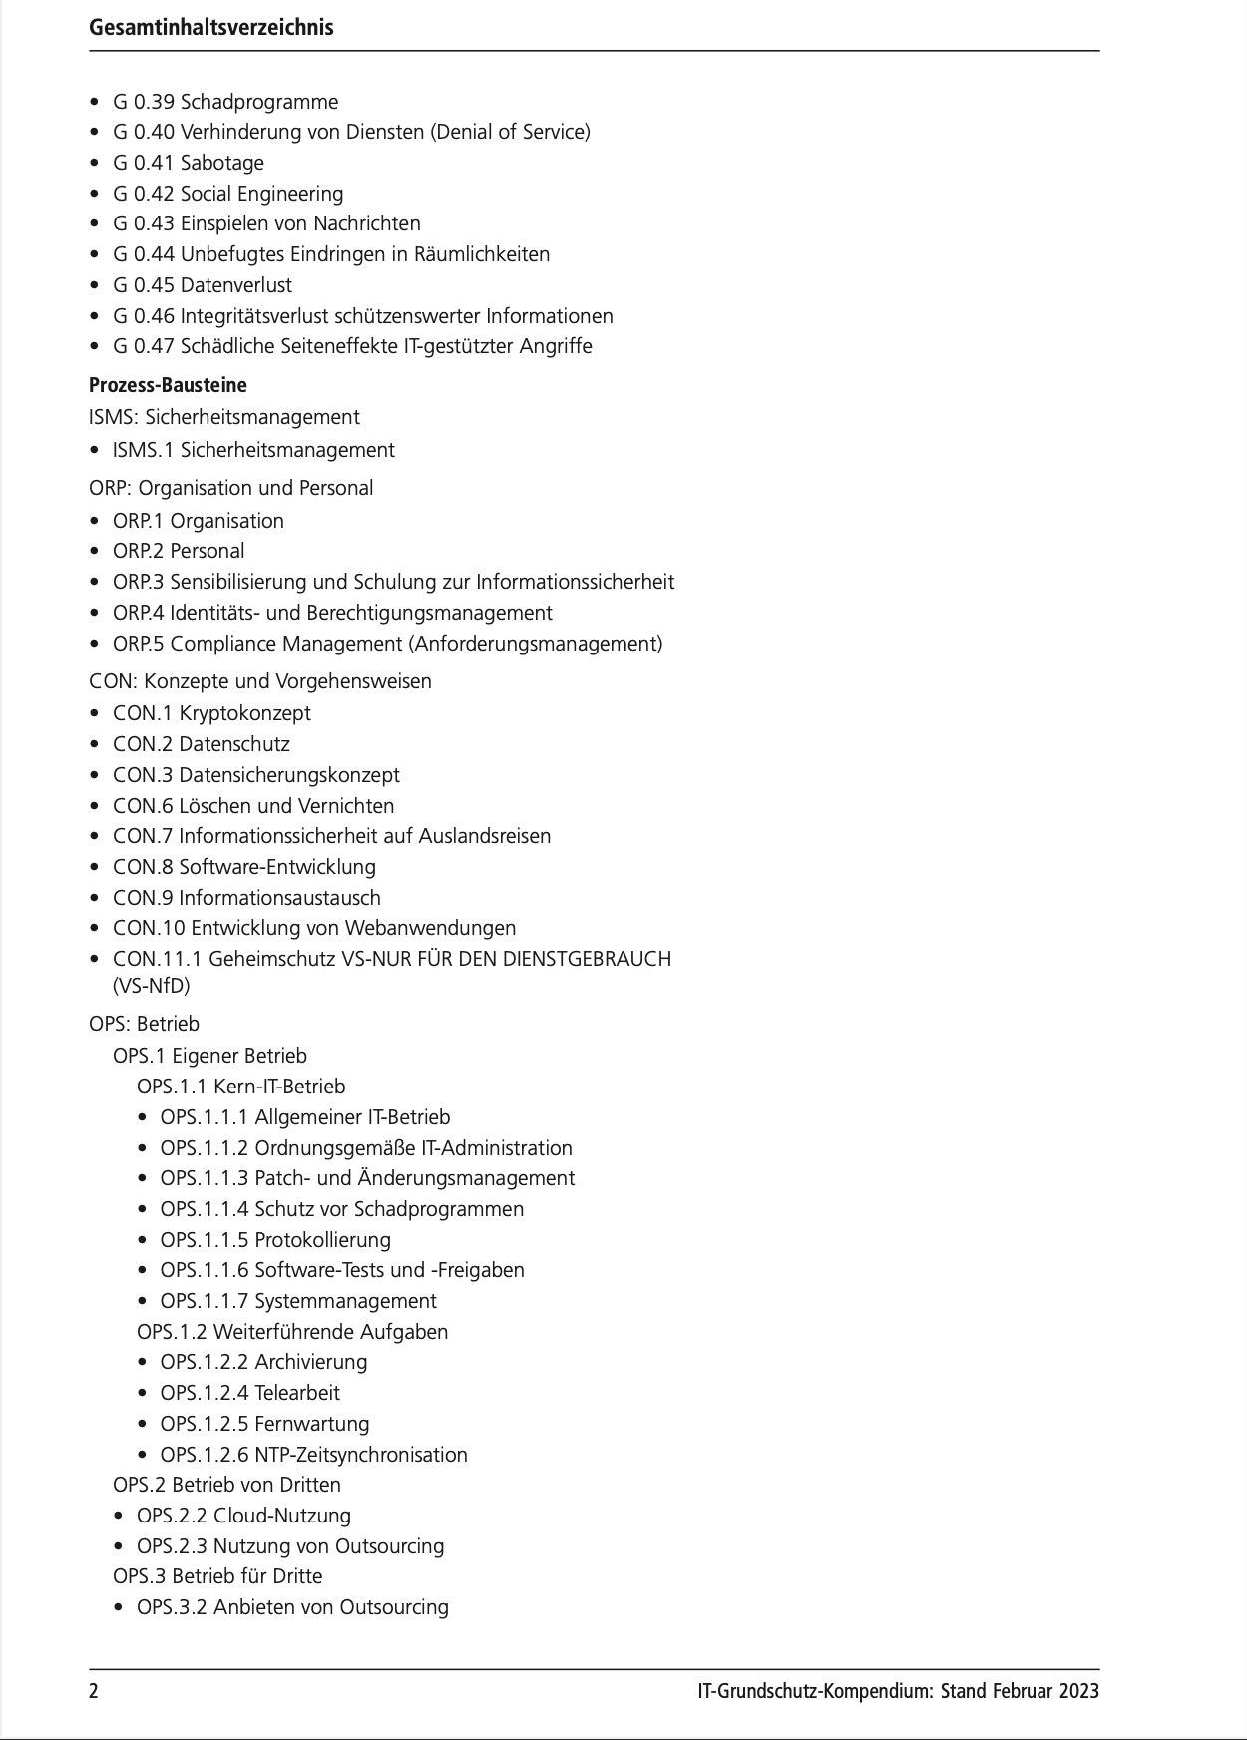
Real-world example
IT-Grundschutz-Kompendium (858 pages) of the German Federal Office for Information Security (BSI)
…
https://www.bsi.bund.de/DE/Themen/Unternehmen-und-Organisationen/Standards-und-Zertifizierung/IT-Grundschutz/IT-Grundschutz-Kompendium/it-grundschutz-kompendium_node.html

Slide 28
Notebook 02 & 03
Notes:
Sensing bezieht sich auf das Messen/Erfassen/Wahrnehmen von Daten
Instrumente der Wahrnehmung sind menschliche Sinnesorgane u. technische Hilfsgeräte
Technische Hilfsgeräte lassen sich unterteilen in autonome Geärte (z.B. Internet of Things) u. nicht-autonome Geräte (z.B. Smartphone)

Slide 29
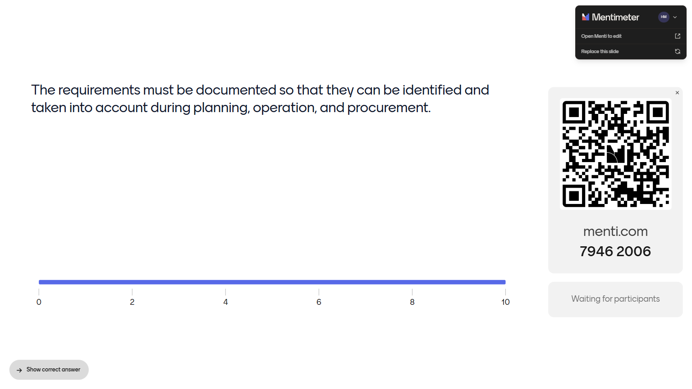

Slide 30
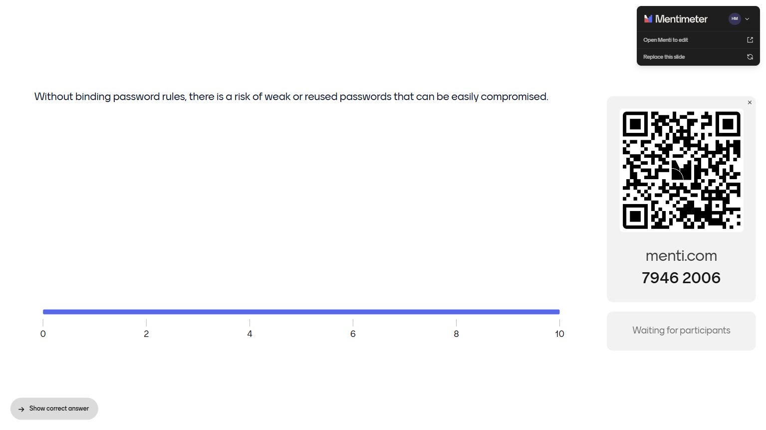

Slide 31
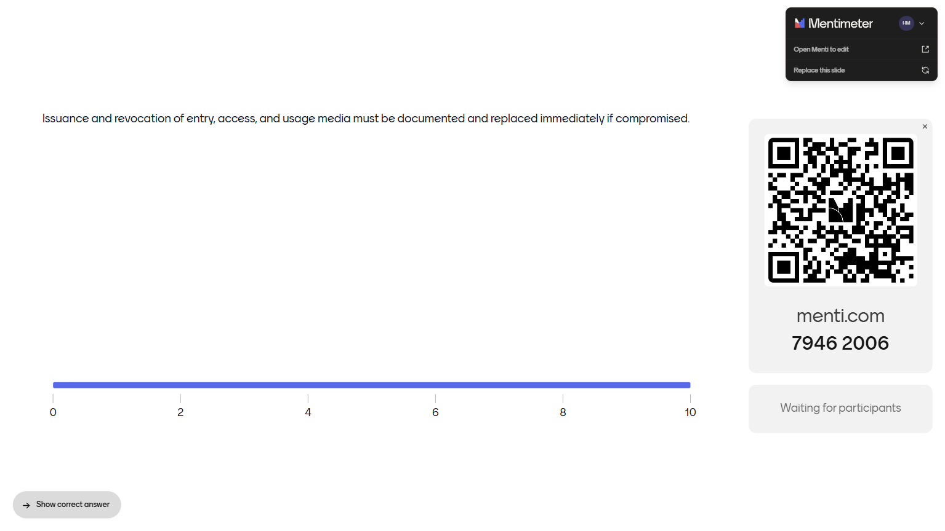

Slide 32
What is a claim?
Everyday, whole
A claim is a sentence that states something.
Everyday, granular
Every clause that states something is a claim: main clause and subordinate clause count separately.
Logic
A claim is something that can be true or false on its own. Every element of a list counts for every action it belongs to.
Working definition
A claim is the smallest part of the reference answer that can be checked at one place in the Kompendium.

Slide 33


Slide 35
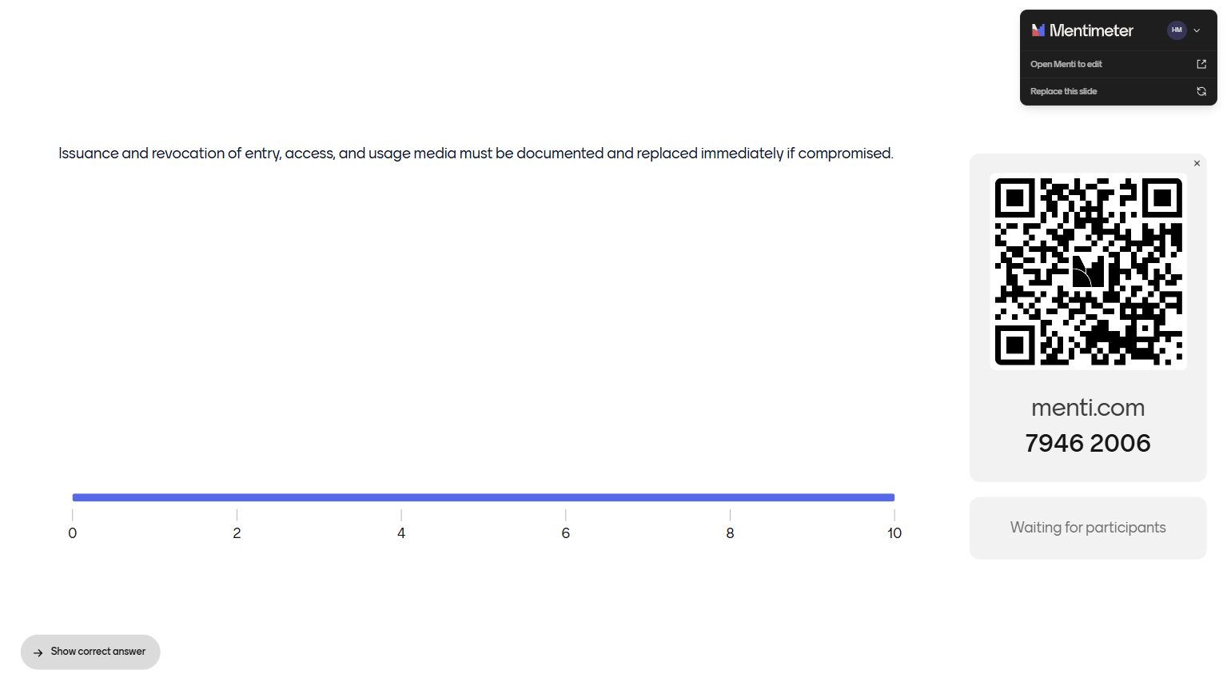

Slide 36
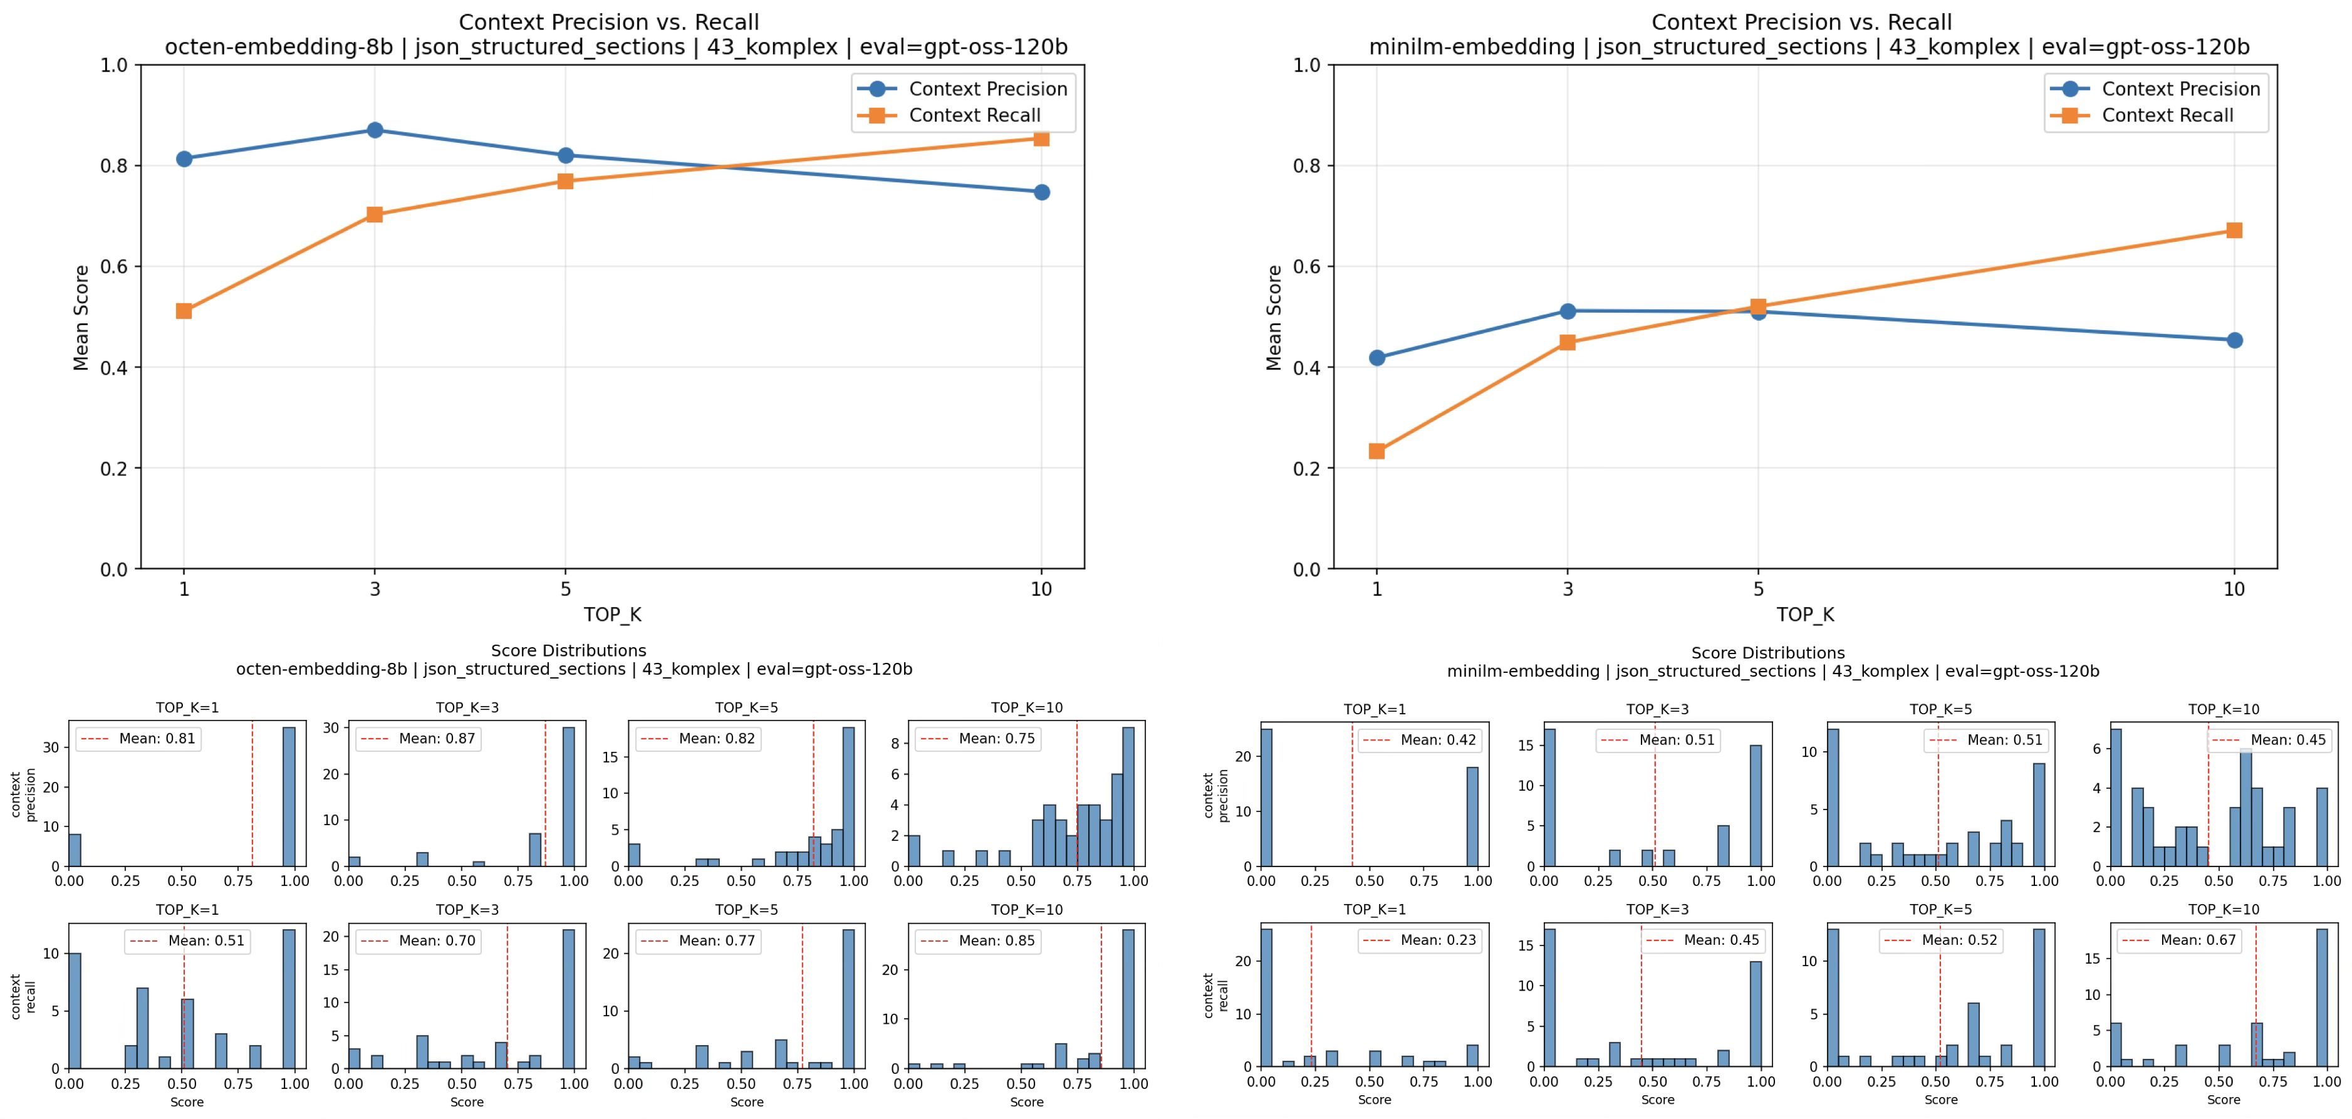
Experiment 1 - Change Embedding Model

Slide 37
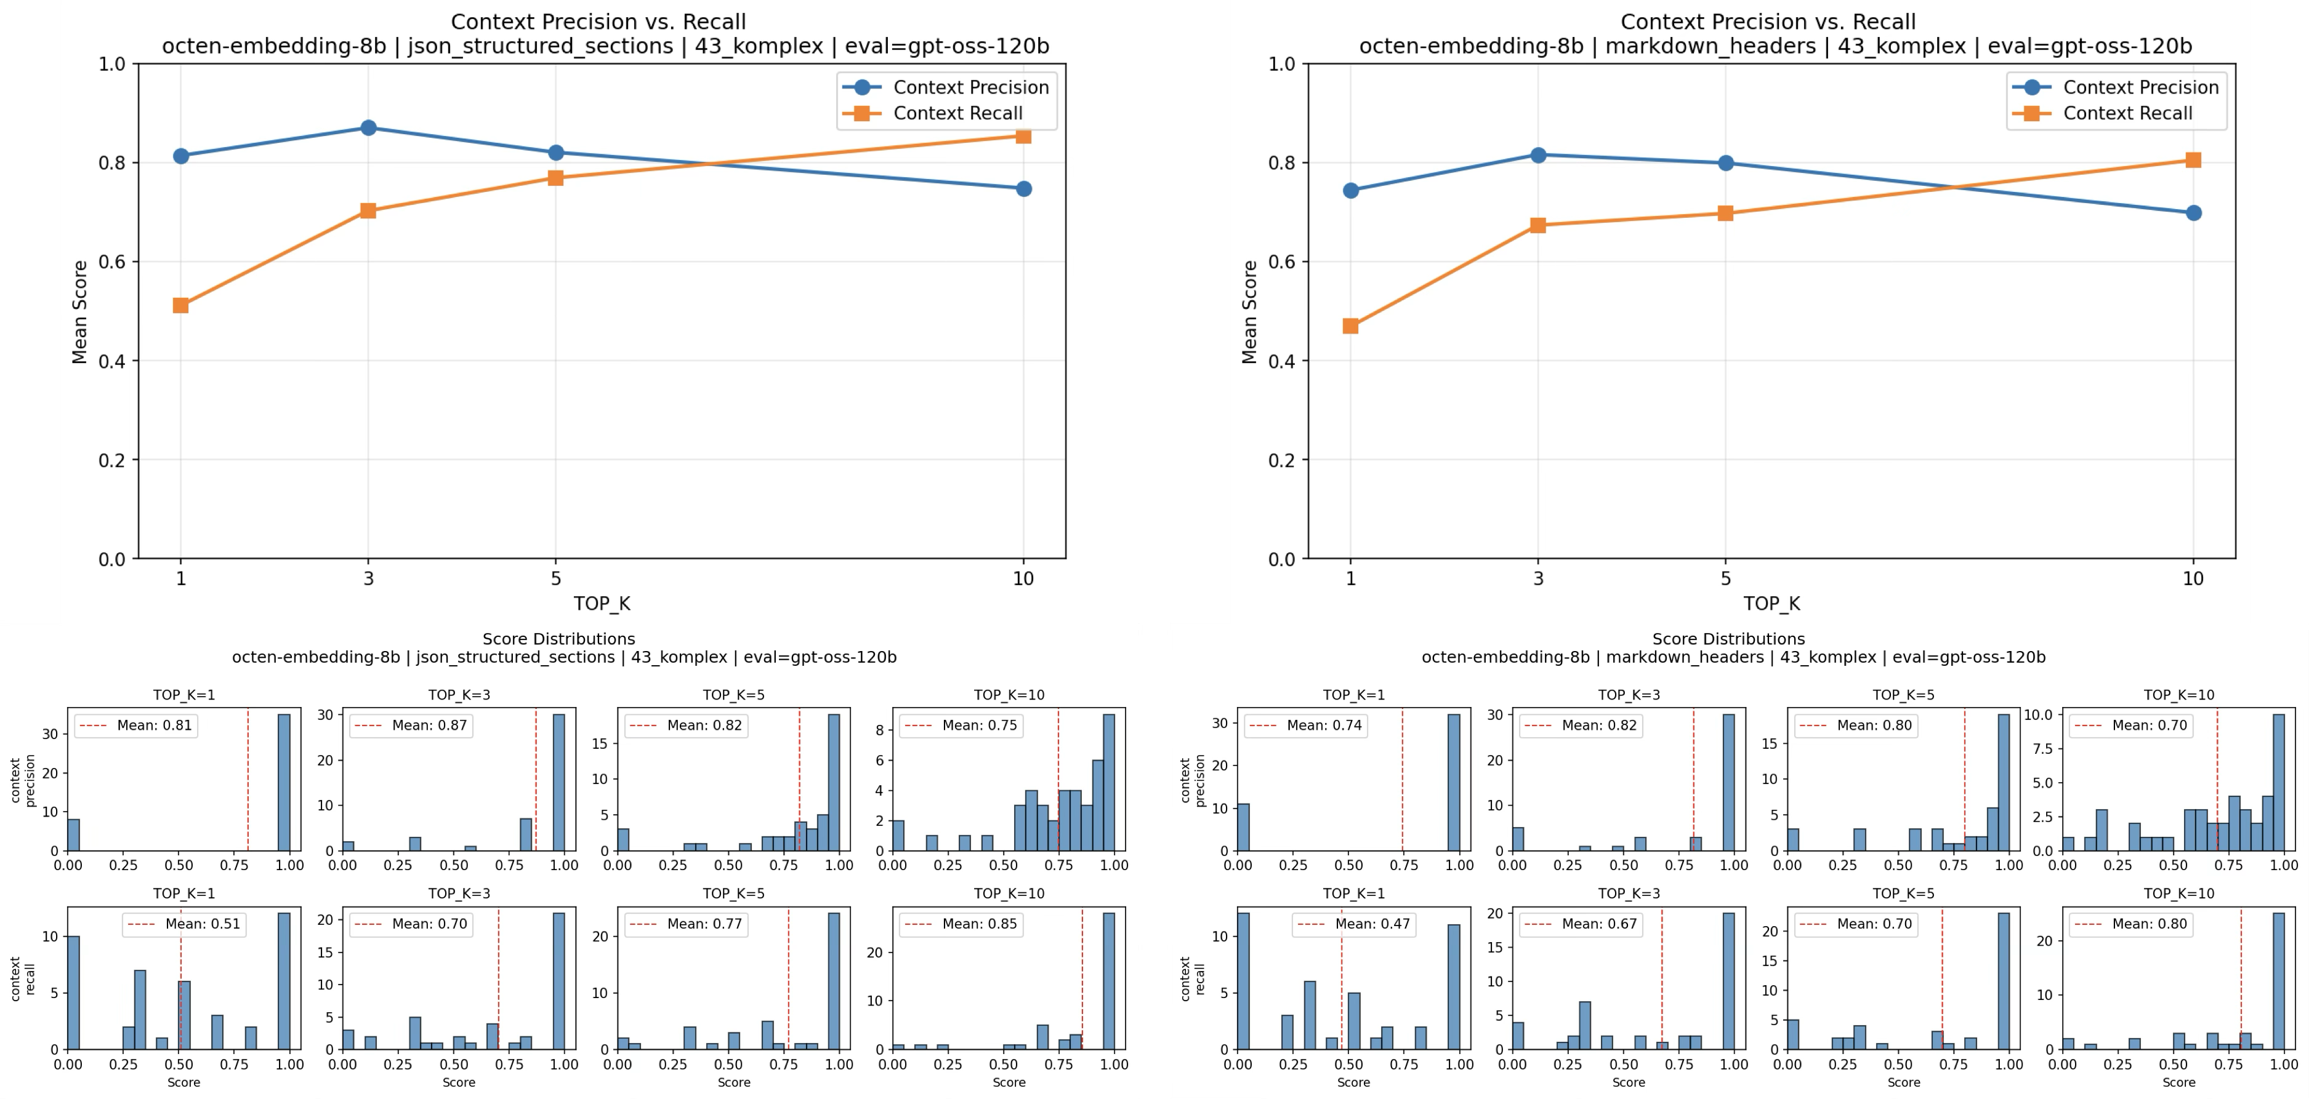
Experiment 2 - Change Chunking Method

Slide 38
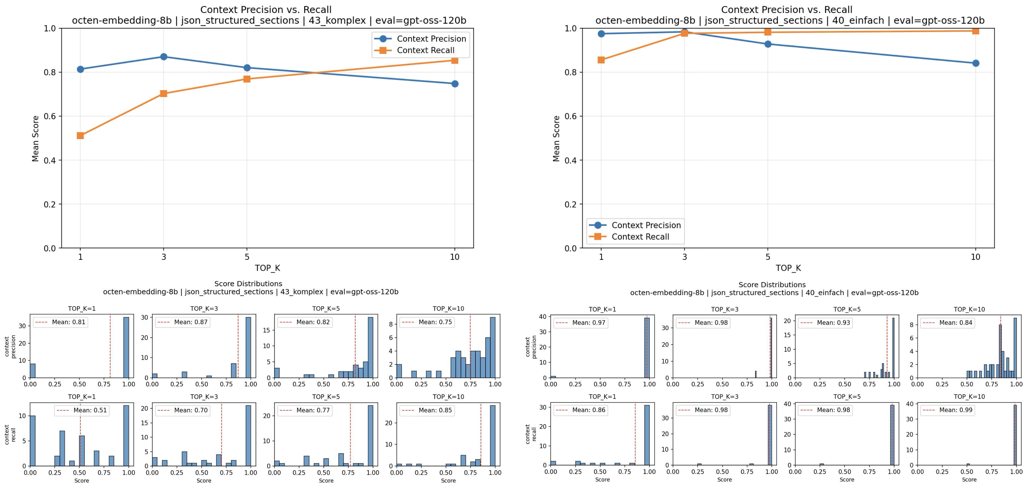
Experiment 3 - Change Dataset

Slide 39
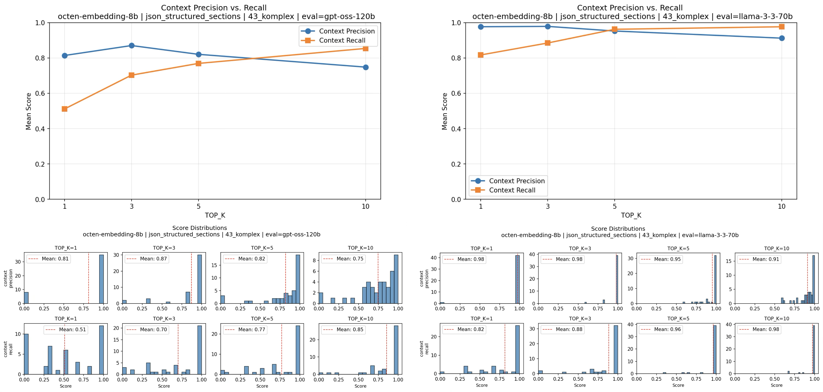
Experiment 4 - Change Evaluator LLM

Slide 40
Experiments – Takeaway message
1. The embedding model has the biggest impact on the quality of your RAG system.
Everything else (chunking, generation, evaluation) builds on it.
2. Choose chunking method and TOP_K to fit your documents.
The TOP_K experiment shows where the best trade-off between precision and recall lies.
3. The test dataset should reflect the desired behavior of the RAG system.
In practice, this is the biggest effort.
4. The quality of the evaluator LLM determines how meaningful the metrics are.

Slide 41
Notes:
Sensing bezieht sich auf das Messen/Erfassen/Wahrnehmen von Daten
Instrumente der Wahrnehmung sind menschliche Sinnesorgane u. technische Hilfsgeräte
Technische Hilfsgeräte lassen sich unterteilen in autonome Geärte (z.B. Internet of Things) u. nicht-autonome Geräte (z.B. Smartphone)

Slide 42
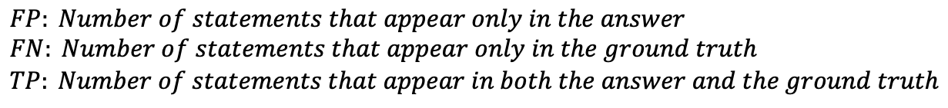
RAGAS – Answer Correctness – Generation Metric
The metric measures how factually correct and semantically similar the answer is to the ground truth
Measures how many statements in the answer are factually correct, taking missing or incorrect statements into account
$$Answer Correctness=0.75 \frac{|TP|}{\left|TP\right|+0.5(\left|FP\right|+\left|FN\right|) }+0.25 Semantic Similarity$$
$$FP: Number of statements that appear only in the answer \\ FN: Number of statements that appear only in the ground truth \\ TP: Number of statements that appear in both the answer and the ground truth$$

Slide 43
RAGAS – Answer Correctness – Example
Question:
Answer:
TP=2 (Red, Yellow)
FP=1 (Blue)
FN=1 (Green missing)
“What colors does a traffic light have?”
“Red, Yellow and Blue”
Ground Truth:
“Red, Yellow and Green”
$$Answer Correctness=0,75 \frac{2}{2+0,5(1+1) }+0,25 Semantic Similarity$$
Usually the cosine similarity of the embeddings of answer and ground truth

Slide 44
RAGAS – Faithfulness – Generation Metric
The metric measures how factually consistent an answer is with the retrieved context.
It ranges from 0 to 1, with higher values indicating better agreement.
$$Faithfulness= \frac{Number of statements in the answer supported by the retrieved context}{Number of all statements in the answer}$$

Slide 45
RAGAS – Faithfulness – Example
Question:
Retrieval:
Answer:
“What colors does a traffic light have?”
“A traffic light has the colors Red, Yellow and Green”
“A traffic light has the colors Red, Yellow and Blue”
Faithfulness = 2/3 = 0.67

Slide 46
Notebook 04
Notes:
Sensing bezieht sich auf das Messen/Erfassen/Wahrnehmen von Daten
Instrumente der Wahrnehmung sind menschliche Sinnesorgane u. technische Hilfsgeräte
Technische Hilfsgeräte lassen sich unterteilen in autonome Geärte (z.B. Internet of Things) u. nicht-autonome Geräte (z.B. Smartphone)

Slide 47
Evaluation and alignment of a RAG system
Are the right documents retrieved, or is important information missing?
Is the answer supported by the context, or is it hallucinated?
Is the problem in the retrieval or in the model?
Where exactly is my RAG system broken?
How do I prevent unwanted or poor answers?
How do you evaluate and optimize a model in areas without clear success metrics?
Evaluation
Alignment

Slide 48
RLHF & RLAIF – Overview
RLHF = Reinforcement Learning with human feedback
RLAIF = Reinforcement Learning with AI feedback
What: method for aligning model behavior
Goal: produce better answers, adapt to human preferences, reduce unwanted behavior
Where it fits: part of LLM training
Training LLM
Docs
Data Filtering & cleaning
Tokenization
Pretraining
(Next Token Prediction)
Supervised Fine Tuning
RLHF/RLAIF

Slide 49
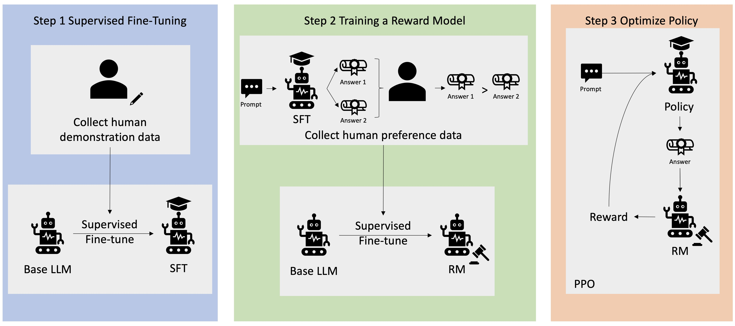
RLHF and RLAIF – How it works

Slide 50
RLHF & RLAIF – Comparison
Aspect | RLHF | RLAIF
Feedback | Rating by humans | Rating by an LLM (AI as a judge)
Quality | Very high, close to human preferences | Depends on quality & prompt of the judge
Scalability | Limited by human rating | Scales well through automation
Cost | High due to time & effort of human raters | High due to computing resources, but scales better
Bias | Human biases | Bias of the judge model
Use case | High-quality, critical alignment data | Large data volumes & automated training
Optimization method | PPO, DPO | PPO, DPO

Slide 51

Notes:
Sensing bezieht sich auf das Messen/Erfassen/Wahrnehmen von Daten
Instrumente der Wahrnehmung sind menschliche Sinnesorgane u. technische Hilfsgeräte
Technische Hilfsgeräte lassen sich unterteilen in autonome Geärte (z.B. Internet of Things) u. nicht-autonome Geräte (z.B. Smartphone)

Slide 52


Slide 53


kisz@hpi.de hpi.de/kisz
Your opinion matters!
QR code to the feedback form

