Slide 1




Workshop
How to use our HPC Cluster
Felix Boelter and David Goll
Notes:
Sie kennen das: Man sucht ewig im Netz oder in eigenen PDFs, nur um einen Text zu schreiben oder zu verbessern. Könnten KI-Modelle das nicht übernehmen? Genau das schauen wir uns in ‚Chatbots leicht gemacht – Große Sprachmodelle einfach nutzen‘ an.

Slide 2












KI-Servicezentrum Berlin-Brandenburg
kisz@hpi.de hpi.de/kisz
BERATUNG
Göttingen I Kassel I Hannover
Sensible und kritische Infrastrukturen
Medizin & Energie
BILDUNG
INFRA-
STRUKTUR
Potsdam | Berlin
Bildungs- und Beratungsangebote,
Einsatz von KI in Wirtschaft & Gesellschaft
Bonn | St. Augustin | Aachen | Jülich | Dortmund | Paderborn
KI-Hardware, KI-Beratung, KI-Schulungen sowie multimodale und transferierbare KI-Modelle
FORSCHUNG
Darmstadt
Erklärbarkeit, Generalisierbarkeit
und kontextuelle Anpassung
Ziel:
Barrieren der Implementierung von KI-Anwendungen in Gesellschaft und Wirtschaft reduzieren
Hasso-Plattner-Institut gGmbH
  Bildet mit Universität Potsdam die Digital Engineering Fakultät
  Vereint Forschung, Lehre mit den Vorteilen einer privat finanzierten, gebührenfreien Institution
  Besteht aus Einrichtungen wie der E-School, der D-School,
  dem Mittelstandsdigitalzentrum und dem KI-Servicezentrum

Slide 3




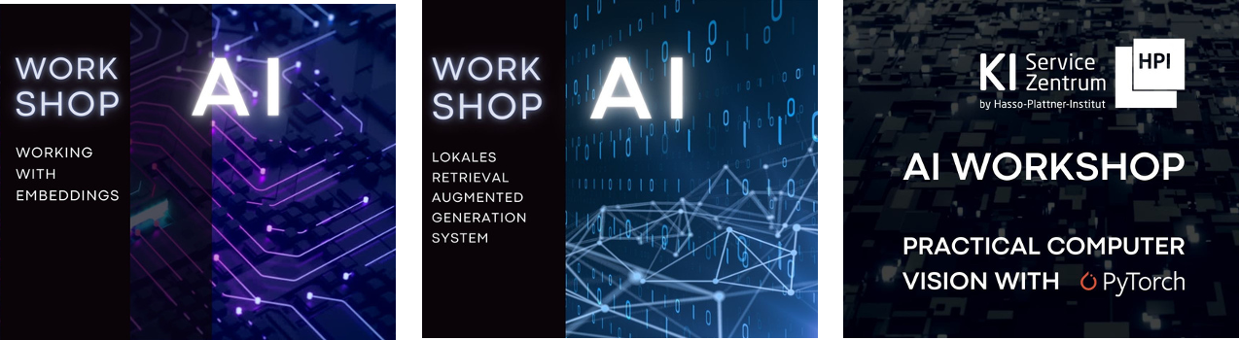


Talks
tele-task.de/series/1463
  Gastvorträge zu Forschung und Innovation
Newsletter
Work
shops
BILDUNG
aimaker.community
  Praxisnahe Themen
  Beispielthemen: Speech2summary, Docker für ML, semantische Suche​
MOOCs
open.hpi.de/channels/ai-service-center
  ChatGPT: Was bedeutet generative KI für unsere Gesellschaft?
  Profitable KI
  KI Biases verstehen und vermeiden

Slide 4

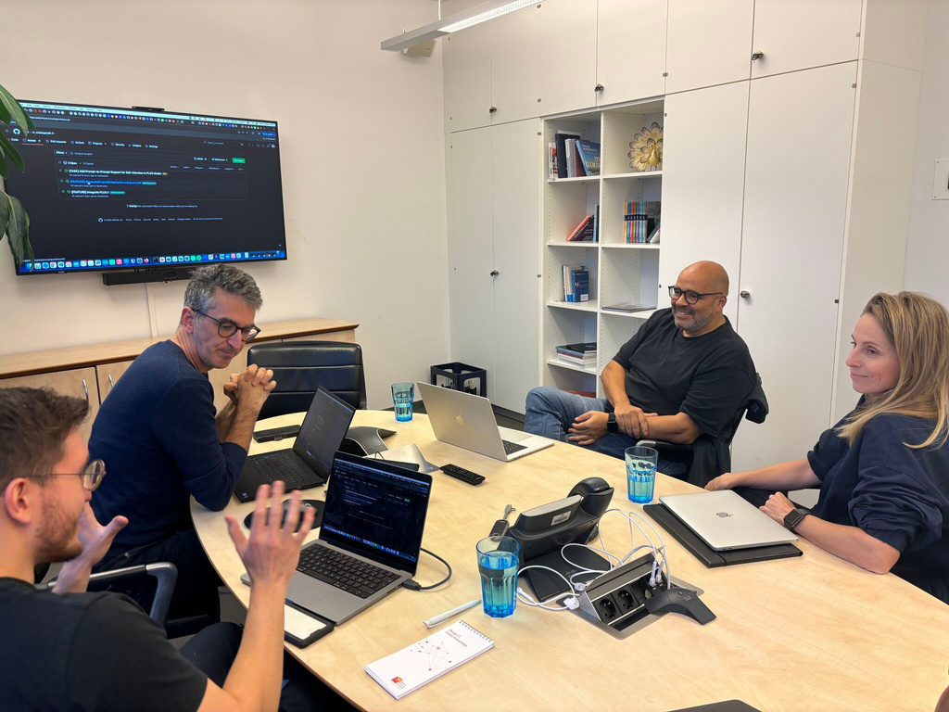
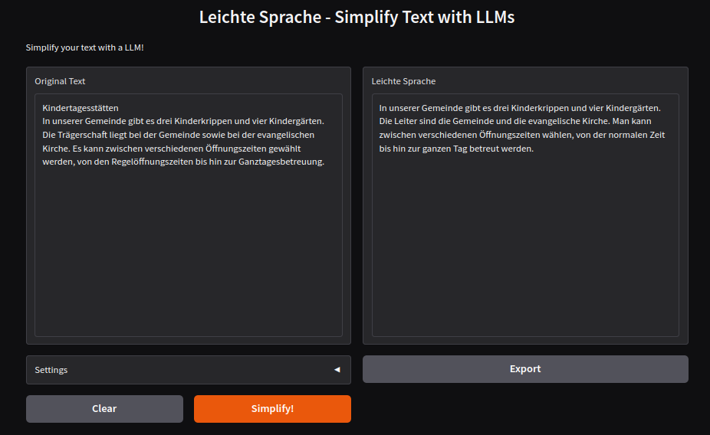

KI-Sprechstunde
  Beantwortung von Fragen:
    zu KI-Infrastruktur
    zu KI-Modellen & Frameworks
KI-Pilotprojekte
  Co-Entwicklung eines Prototyps
  Bewerbung alle drei Monate
  Auswahlkriterien z.B. KI-Reife, Gemeinwohl
  Veröffentlichung der Ergebnisse
Kooperationen
  Gemeinsam organisierte Netzwerktreffen
Sprechstunde buchen
BERATUNG
Bisherige KI-Pilotprojekte
  Generierung Mathematik-Problemen
  Leichte Sprache
  Generierung von Upcycling Vorschlägen
  Reduzierung von Food Waste
  Datierung mittels Handschrift
github.com/aihpi/leichte-sprache
Jetzt bewerben!

Slide 5


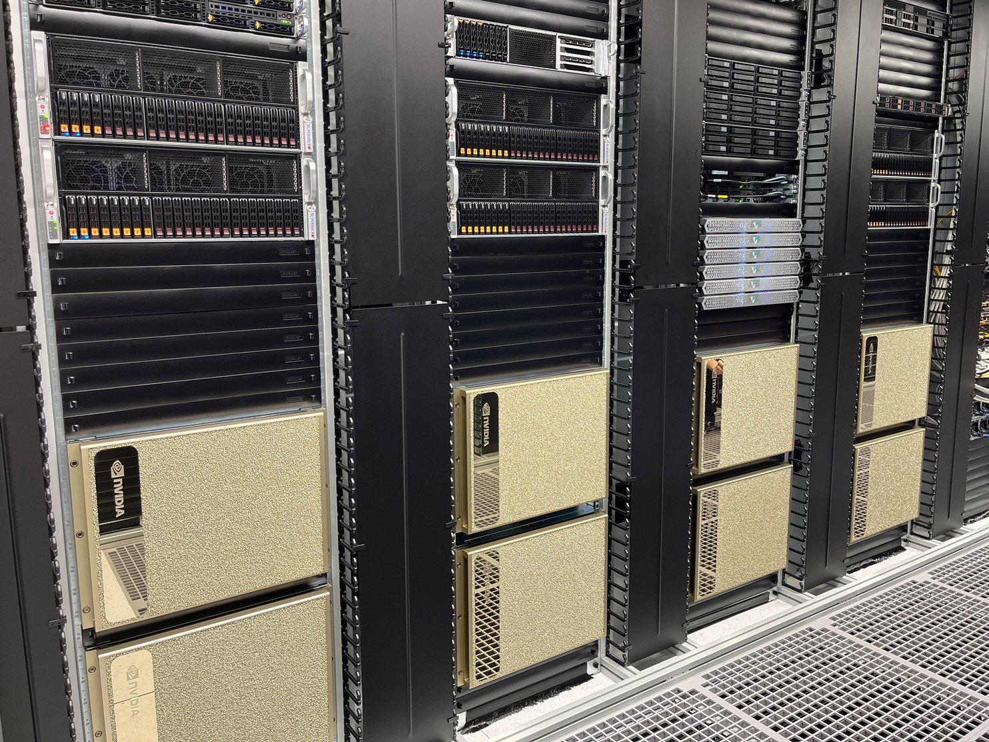
  Zugang kostenfrei
  Kein Produktionsbetrieb
    Daten sollten anonymisiert oder synthetisiert sein
    kein Hosting von Produkten
  Reporting & Veröffentlichung durch Nutzende
  Altrechte bleiben bei Nutzenden
  Neurechte bleiben bei Nutzenden
    Einräumen von Nutzungsrechten für Forschung und Lehre
Zugangsanfrage
aisc.hpi.de
Training
  64 NVIDIA H100 GPU
Inferenz
  40 NVIDIA A30 GPU
ARM Server
  Ampere Altra Max M128-30 CPU
  2 x NVIDIA L40 GPUs
GPU Server
  AMD Epyc CPU
  8 x NVIDIA L40S GPU
Edge
  ARMv8 CPU
  NVIDIA Jetson AGX Module
Neuromorph
  288 SpiNNaker2 Chips
Speicher
  1.5 PB NVRAM
Netwerk
  400 Gb/s Infiniband
  200 Gb/s Ethernet
INFRASTRUKTUR

Slide 6
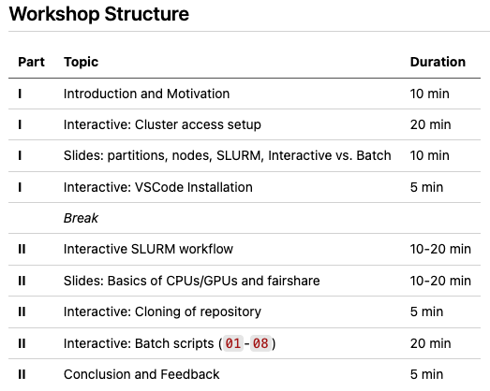
AGENDA
Notes:
Damit Sie wissen, wohin die Reise geht: Zuerst klären wir die Motivation. Warum überhaupt Chatbots? Und dann die Kompetenzen, die Sie hier mitnehmen. Danach stelle ich die Werkzeuge vor und zeige eine kurze Demo. Zum Schluss erkläre ich, wie der Kurs aufgebaut ist.
Beginnen wir also mit Punkt eins – der Motivation.

Slide 7

Motivation
  Scale: Train models that don’t fit on consumer hardware
Speed: Powerful GPUs, run experiments in parallel
Freedom: Submit and disconnect
Collaboration: Shared environment across your team
Cost: Free for AISC projects

Slide 8
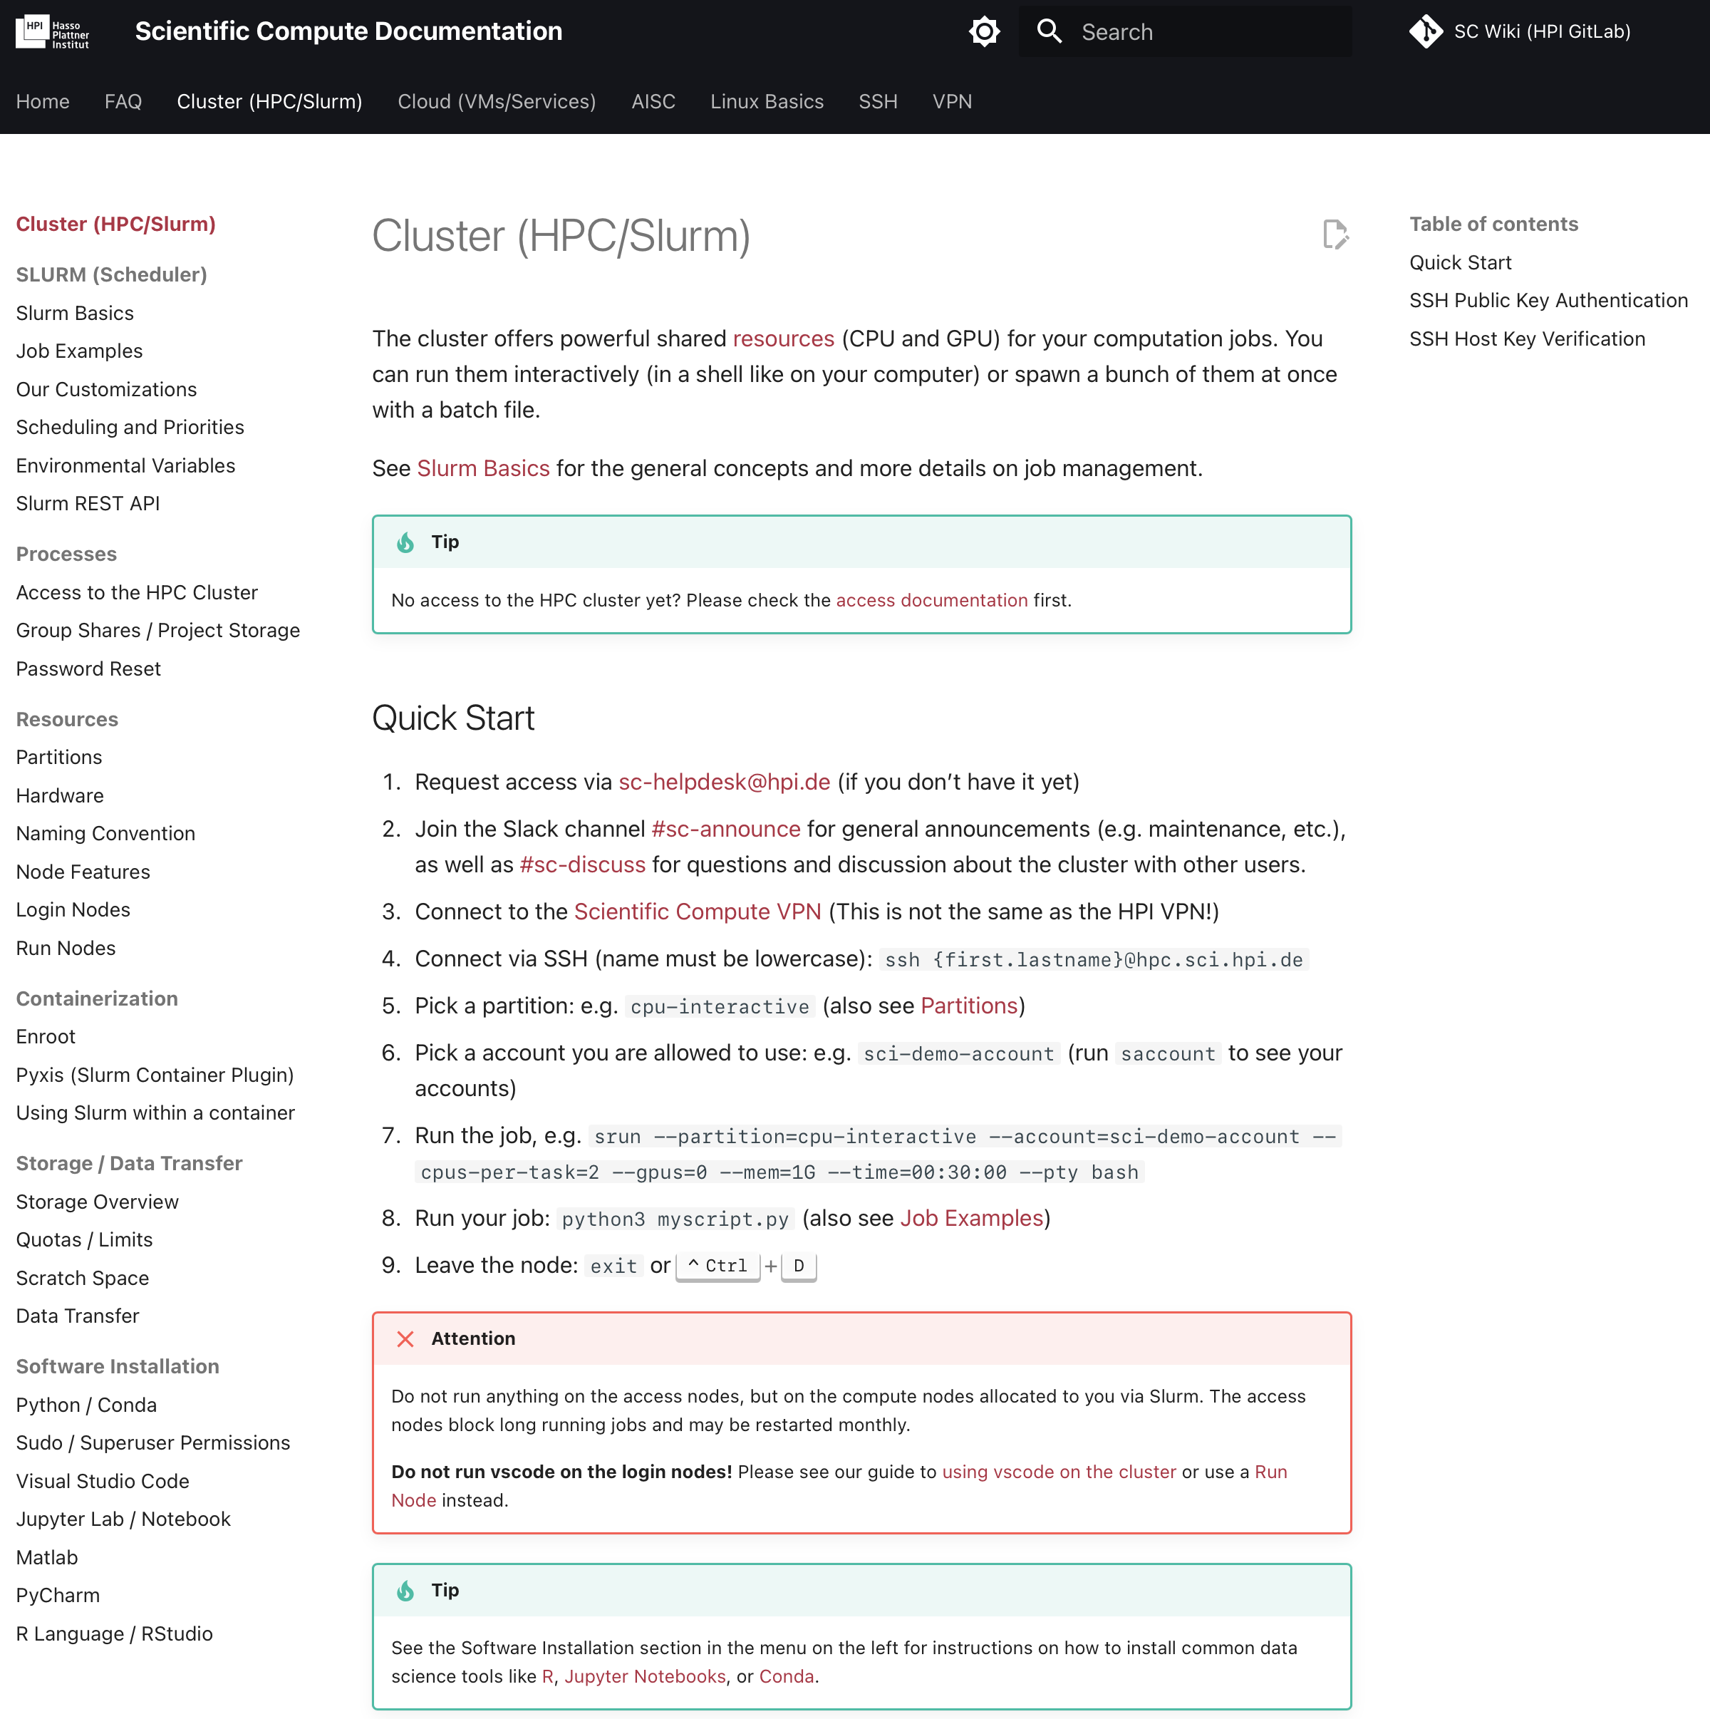
Documentation
Please make yourself familiar with the HPC documentation!
If you have questions or need assistance, consult our FAQ or reach out to us:
For technical issues:
aisc-helpdesk@hpi.de
For organizational issues:
ki-servicezentrum@hpi.de

Slide 9
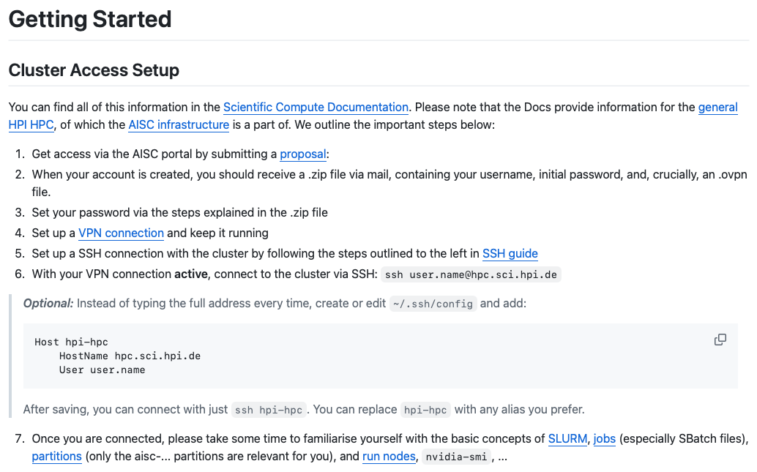
https://github.com/aihpi/workshop-slurm
Initial Setup

Slide 10

Cluster Basics

Slide 11
Cluster Basics
Cluster = many computers (nodes) connected over a network
Each node has its own CPUs, RAM, (sometimes) GPUs, …
Three types of nodes on our cluster
  1. Login node (lx01)
    Entry point, like a lobby
    Used only for file management, submitting jobs, …
  2. Run node (rx01/rx02)
    Lightweight interactive work, VSCode, …
    Shared usage. Per-user limit: 4 CPUs, 8GB RAM
  3. Compute node (gx[07-14], gx15v1, gx17v1, …)
    Any computation (also interactive), ML training, data processing, …
    Exclusive usage. Via SLURM only!
Nodes

Slide 12
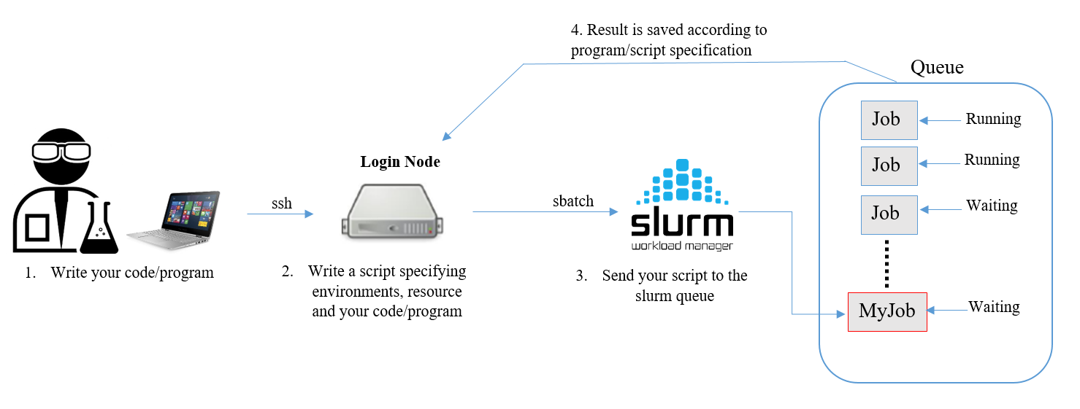
What is SLURM?
  Job scheduler: manages who gets what resources and when
  You request resources through SLURM
  Jobs are prioritised based on availability and fairness
SLURM Basics
Image source: https://support.pdc.kth.se/doc/run_jobs/queueing_jobs/

Slide 13
Partition: group of nodes with shared rules (time limits, hardware type)
Partition | Time Limit | Use Case
pot-hpi-aisc-shortrun | 1h | Quick interactive tests (no sbatch)
pot-hpi-aisc-interactive | 8h | Interactive terminal, testing
pot-hpi-aisc-batch | 7 days | Long training runs (only accessible via sbatch jobs)
Key Concepts
Account: Your project’s billing code. In our case it is always `aisc`.
—> You can find out which accounts you have via `saccount`
Quality of Service (QOS): Used to prioritize certain jobs. We use `aisc`.
—> You will likely not need to use this

Slide 14
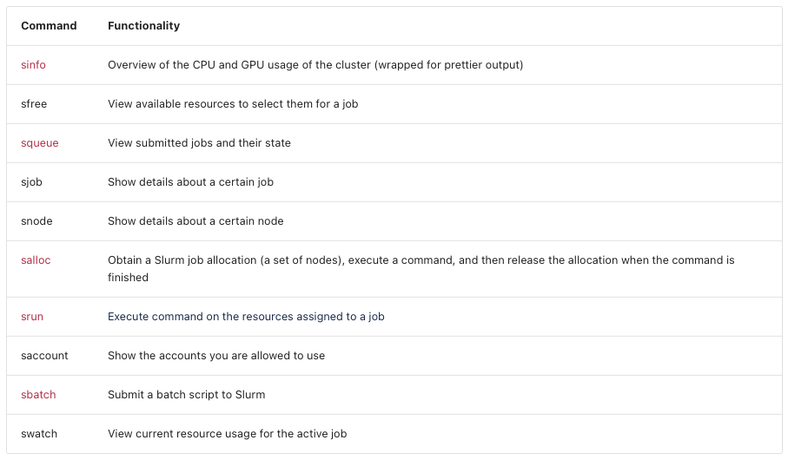
SLURM Commands
https://docs.sc.hpi.de/cluster/SLURM/Basics/

Slide 15
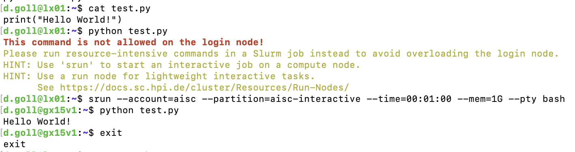
 | Interactive |  | Batch
Command | srun | salloc/sblock | sbatch
Output | Live in terminal | Live in terminal | Written to log file
Best for | Quick commands, sanity checks | Interactive work | Training runs, anything serious
Two ways to work on compute nodes

Slide 16
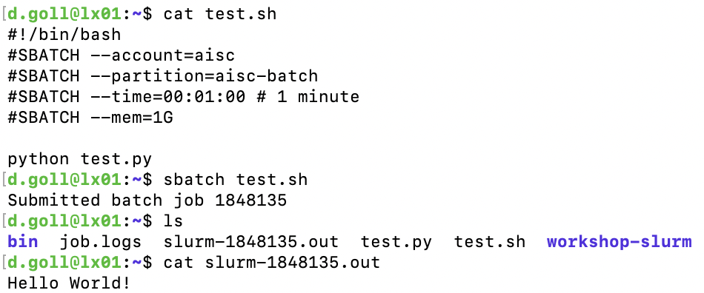
 | Interactive |  | Batch
Command | srun | salloc/sblock | sbatch
Output | Live in terminal | Live in terminal | Written to log file
Best for | Quick commands, sanity checks | Interactive work | Training runs, anything serious
Two ways to work on compute nodes

Slide 17
Where to run things:
- rx01/02 are for lightweight tasks only, not a substitute for compute nodes
Resource usage:
- Always specify expected time/memory usage!
Batch jobs:
- Prefer sbatch over interactive jobs for anything serious
Being a good cluster citizen:
- Don’t leave idle interactive sessions running. Release resources you’re not using.
Read the Terms of Usage: https://docs.sc.hpi.de/Terms-of-Usage
Rules and Best Practices

Slide 18
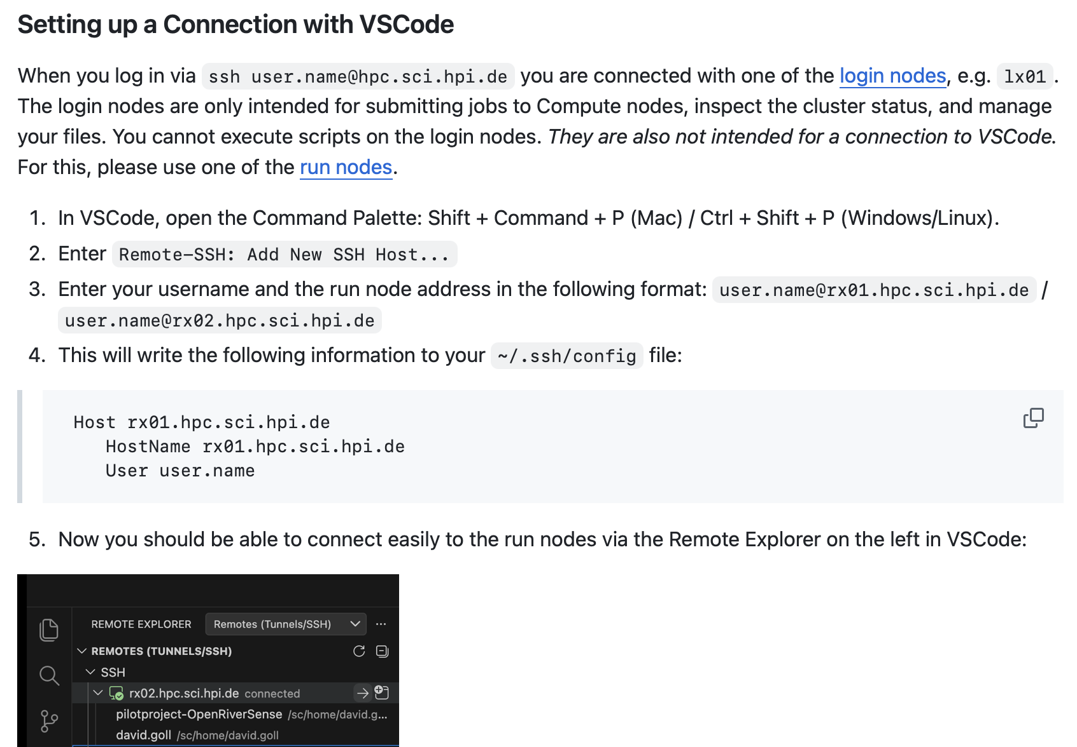
VSCode Setup

Slide 19
Short Break

Slide 20
Interactive SLURM
Using our Cluster with VSCode interactively.
Follow along!

Slide 21
Part II
CPUs, GPUs & AI Workloads

Slide 22
Central Processing Unit
Few powerful cores, optimized for sequential tasks
Handles logic, branching, control flow, I/O
Our H100 nodes:
    2x Intel Xeon 8480C, 112 cores (224 threads)
CPU
CPU
Core 1
Core 2
Core 3
Core 4
Each core handles one task at a time
Core 5
Core 6
Core 7
Core 8

Slide 23
Graphics Processing Unit
Originally designed for rendering pixels on screen
Thousands of small, simple cores working in parallel
One H100 has 16,896 CUDA cores (vs 112 CPU cores on the same node)
Key insight: the same parallelism that renders pixels also powers matrix multiplications in neural networks
GPU
GPU
Thousands of cores each doing one simple operation

Slide 24
CPU excels at
GPU excels at
Data loading and preprocessing (pandas, file I/O)
Control flow and branching logic
Classical ML models (sklearn, XGBoost on small data)
Orchestrating the training pipeline
Matrix multiplications (core of every neural network)
Model Training and Inference
Applying the same operation to lots of data in parallel
(Single Instruction Multiple Data, SIMD)
CPU vs GPU

Slide 25
CPU
GPU
CPU
Load data
Forward pass
Log metrics
Augmentations
Compute loss
Save checkpoint
Create batch
Backward pass
CPU + GPU
Update weights
Loop
CPU feeds data, GPU does the math
CPU too slow → GPU sits idle ("CPU bottleneck")
Request both in SLURM: --cpus-per-task and --gpus
Rule of thumb: 4-8 CPUs per GPU
Our H100 nodes: up to 14 CPU cores per GPU available

Slide 26
CPU + RAM
System Memory (~2 TB)
GPU + VRAM
GPU Memory
(80 GB)
Data Transfer
(PCIe / NVLink)
RAM vs VRAM
RAM (system memory):
  used by the CPU. Holds your dataset, preprocessing pipelines, OS, and everything else. Our H100 nodes have ~2 TB.
VRAM (GPU memory):
  dedicated memory on the GPU. Holds model weights, activations, and gradients during training. An H100 has 80 GB.

Slide 27
CPU + RAM
System Memory (~2 TB)
GPU + VRAM
GPU Memory
(80 GB)
Data Transfer
(PCIe / NVLink)
RAM vs VRAM
7B parameter model in fp16 ≈ 14 GB just for weights. Add activations and gradients → easily fills 80 GB
Out of RAM → job gets killed
Out of VRAM → CUDA out of memory

Slide 28
Training
Input
Layer 1
…
Layer N
Loss
Update all layers
Inference
Input
Layer 1
…
Layer N
Output
Training vs Inference
Training: forward + backward pass, store activations, update weights. Repeat millions of times.
Inference: forward pass only. Less VRAM, less compute.
H100s (80 GB) for training, A30s (24 GB) for inference.
Our inference infrastructure runs on Kubernetes with ArgoCD.
Future workshop planned for model deployment.

Slide 29
Data Parallelism
GPU 1
Model
Batch 1
…
Average across
GPUs & update
GPU 8
Model
Batch 8
Data
Multi-GPU
Same model copied to every GPU, each gets a different batch
GPUs compute in parallel, then sync gradients
Most common approach, scales training speed roughly linearly
Frameworks: torchrun, Hugging Face Accelerate, DeepSpeed
This is what we will use in the hands-on exercise

Slide 30
Model Parallelism
GPU 1
Layer 1-3
…
GPU 8
Layer 22-24
Output
Data
Multi-GPU
Model is split across GPUs, each holds a portion of the layers
Needed when the model doesn't fit on a single GPU
Example: 70B LLM in fp16 ≈ 140 GB, doesn't fit on one H100 (80 GB)
More complex to set up, use when data parallelism isn't enough
More common in inference, where large models need multiple GPUs just to be loaded
Start with one GPU, scale up when you hit a bottleneck

Slide 31
GPU | Count | VRAM | Best for
H100 | 64 | 80 GB | Large model training, multi-GPU jobs
A30 | 40 | 24 GB | Inference, smaller training, interactive queues
L40s | 8 | 48 GB | Mixed workloads
L40 | 2 | 48 GB | Mixed workloads (ARM server)
Our GPUs at a Glance
Note: pot-hpi-aisc-interactive runs on A30s,
pot-hpi-aisc-batch runs mainly on H100s.
H100 Nodes (gx07-gx14)
2x Intel Xeon 8480C, 112 cores / 224 threads
~2 TB RAM · 8x H100 80 GB per node · 28 TB NVMe
NDR InfiniBand + 100G Ethernet
→ 14 CPU cores and ~256 GB RAM per GPU

Slide 32
Fairshare
Note: Your priority recovers over time when you're not using resources
Everyone wants GPUs. SLURM Fairshare decides who goes first.
Use more → priority drops. Stop using → priority recovers.
Check your score: sshare -u $USER
Test your pipeline in pot-hpi-aisc-interactive first, then submit long runs via pot-hpi-aisc-batch.
Important: don't request more than you need, don't leave jobs idle.

Slide 33
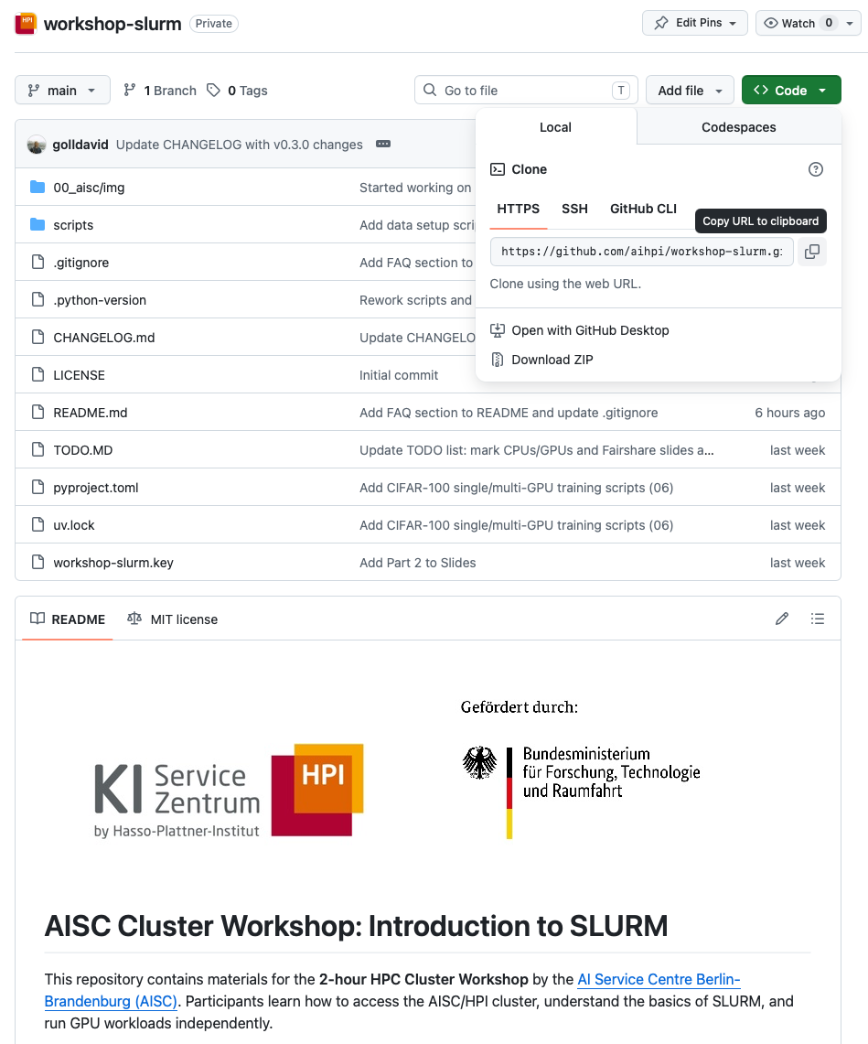
Clone the repository
github.com/aihpi/workshop-slurm

Slide 34
SBATCH Jobs
Submit jobs via scripts.
Follow along!

Slide 35


kisz@hpi.de hpi.de/kisz
Ihre Meinung ist uns wichtig!
QR-Code zum Feedback-Formular

