Slide 1
StringProject2020

Slide 2
Authors
Александър Игоров Христов - Developer
aihristov18@codingburgas.bg
Георги Калоянов Георгиев - Manager
gkgeorgiev18@codingburgas.bg
Желязко Александров Иванов - Developer
zaivanov18@codingburgas.bg
Дани Станимиров Димов - Designer
dsdimov18@codingburgas.bg

Slide 3
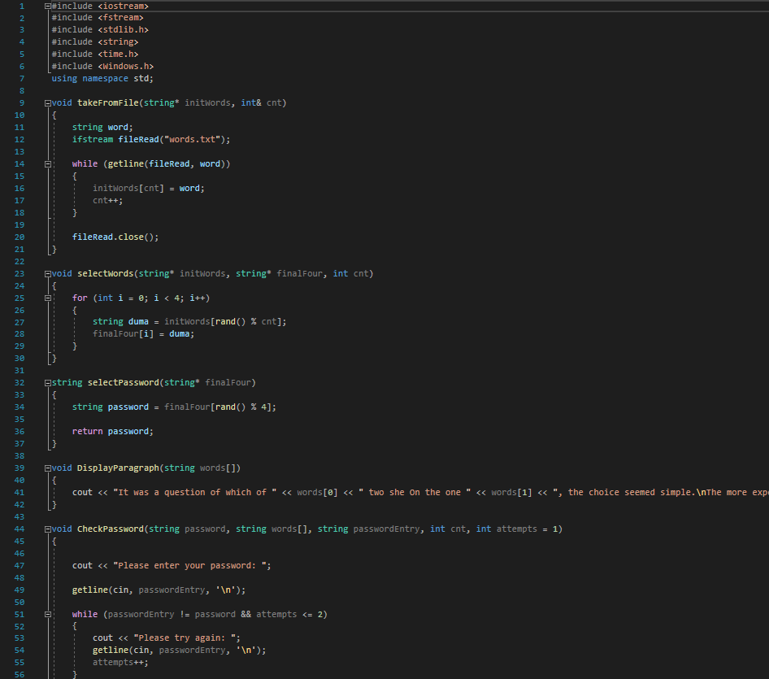
Our Project
Our project is a minigame about finding passwords.

Slide 4
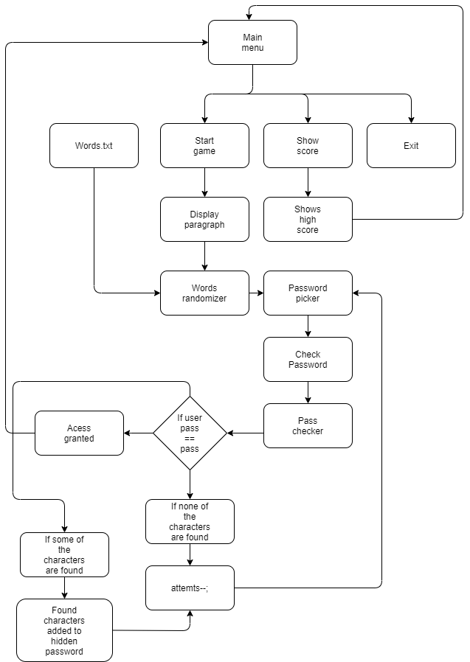
Diagram

Slide 5
Any questions?

Slide 6
Thanks for your patience!

