Slide 1
Mining GitHub Projects for API Refactoring Opportunities
JEET MEHTA
PRATIKSHA KAP
SHREYA SR
SNEHA SHANKAR

Slide 2
Overview
Problem definition
Github mining
Static parsing
Results and Inference of Static parsing
Dynamic analysis using Instrumentation
Results and Inference of Dynamic analysis

Slide 3

Problem Definition
Mining GitHub to get projects built by Maven and apply filter criteria
Identifying API Refactoring opportunities:
API methods that are never used; They can be removed or deprecated in the next library version
Argument(s) of the API function that is mostly constant in all projects and thus can be in-lined
Performing static and dynamic analysis to identify such opportunities

Slide 4
Github mining
Google BigQuery was used to mine “good” Java repositories.
BigQuery has hosted complete GitHub code base in form of DBMS. Thus mining is simple using SQL like queries.
BigQuery keeps it updated using GitHub event stream.
Why BigQuery?
Stores the repository file structure.
Stores every file content in byte and string format
Supports searching by language and watch-count
GitHub and GHtorrent didn’t give access to file structure or the internal content.

Slide 5
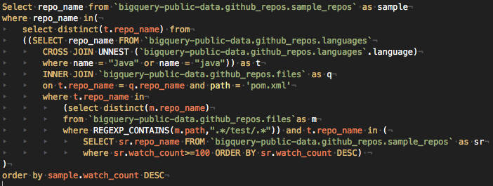
Notes:
Name = “Java”
Path = “pom.xml”
Conatins(m.path, “.*/test/.*)
Watch >= 100

Slide 6
POM Parsing
Pom files are dependency management files used by Maven to build projects.
Recursively parsed all POM files for every repository to obtain the API and its corresponding version used.
Selected the top 4-5 API’s and the most used version for it.
For every API along with its version, separated the corresponding repositories using it to run Static & Dynamic Analysis.

Slide 7
Top Results of POM Parser
Api Name | Version | No. of Repositories
Junit | 4.12 | 87
HttpClient | 4.5.3 | 13
Google Guava | 19.0 | 15
Slf4j | 1.7.25 | 17
Commons-io | 2.4.0 | 18
Commons-lang | 2.6.0 | 15
JavaxServlet | 3.1.0 | 21

Slide 8

Static Parsing
Parse the API source code and create it’s AST.
Visit every public method declaration and extract the following information:
Fully qualified function name
Number of parameters
Fully qualified type of each parameter

Slide 9


Slide 10


Slide 11


Slide 12


Slide 14
Fully Qualified Function Name
APIStorage
Parameter List

Slide 15
Parsing the source code of repository
Parse the source code of the repository
Look for all the function invocation of API methods
JavaParser along with JavaSymbolResolver is used to parse all .java files.
JavaSymbolResolver needs all referred jars and the other source files of the repository to resolve the fully qualified names, return types of expressions.

Slide 16
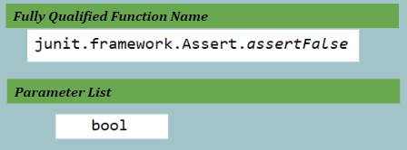
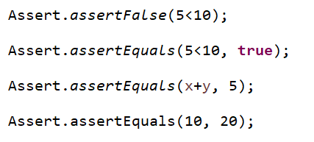
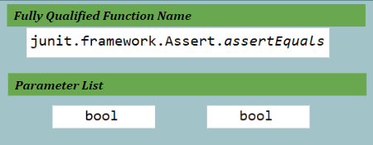
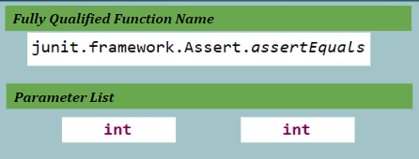
1
1
1
2

Slide 17
ApiStorage Equals method
ApiStorage equals method is overridden to store method expression calls in the Hash Map
The conditions for equality are:
Fully Qualified Name must be same.
They should take same number of arguments.
Every passed argument must be of same type/sub-type of the parameter defined in the function declaration. (Useful when coded on interfaces or auto-casting)
Thus this handles function overloading.

Slide 18
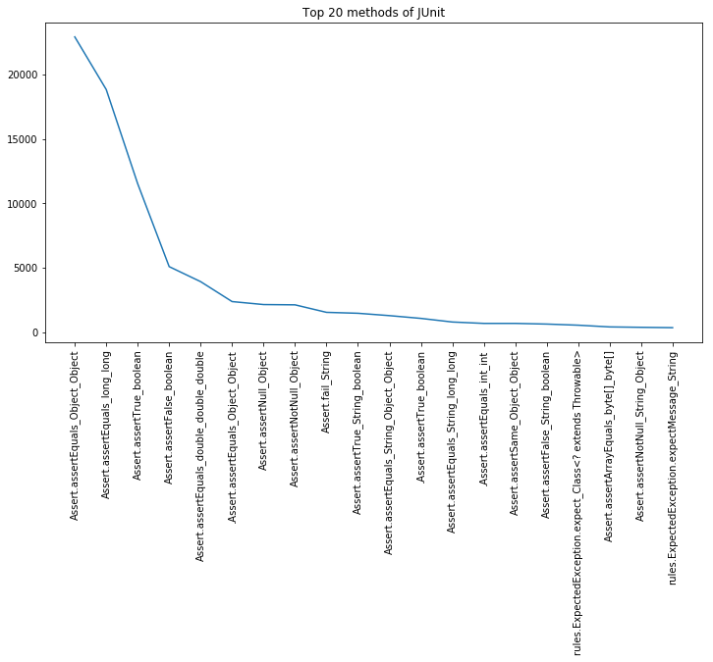
Results and Analysis
JUnit
86 Repositories
Total number of functions in Junit = 719

Slide 19
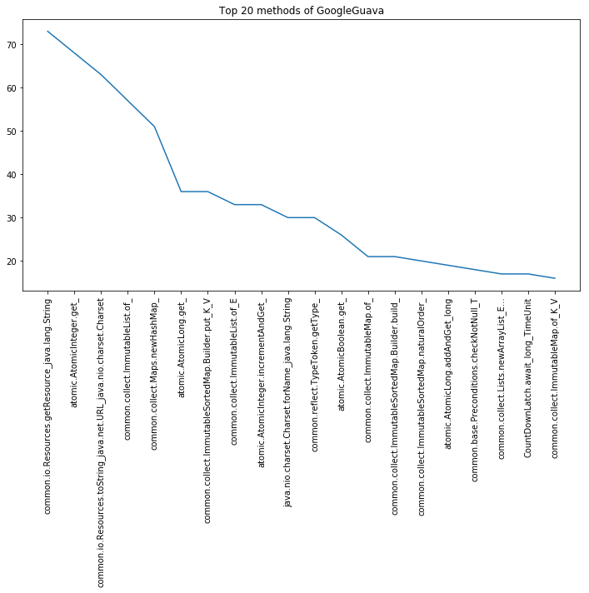
GoogleGuava
12 repositories
Total number of functions = 8220
Other Static Analysis figures are available here

Slide 20
Percentage of Functions Not Used
Api Name | No. of Public functions | %of functions never used
Junit | 719 | 83.3
Google Guava | 8229 | 98.06
JavaxServlet | 512 | 72.46
Slf4j | 253 | 77.45
Commons-lang | 1782 | 93.08
Commons-io | 727 | 95.71
HttpClient | 2185 | 99.11

Slide 21
Inference
The functions which are never used could be removed/deprecated
In some case we saw these public functions are called from other public functions of API (over-loading), may be they could be made private
Currently the number of functions to be removed is large which is a bit misleading as we have parsed a small set of repositories due to lack of computing power
But our code is scalable enough to run on a bigger set of repositories to get more assuring results.

Slide 22
Dynamic Analysis
Runtime analysis by running github projects
Made use of maven tests
Why is this needed?
To capture actual number of function calls
To capture runtime values of arguments
How can this be done?
Instrumentation

Slide 23
Instrumentation
What is Instrumentation?
Inject code during runtime
We inject code to capture the runtime parameters
Approaches we tried: (Pros and cons)
Instrumentation using javassist
Instrumenting API source files by code injection

Slide 24
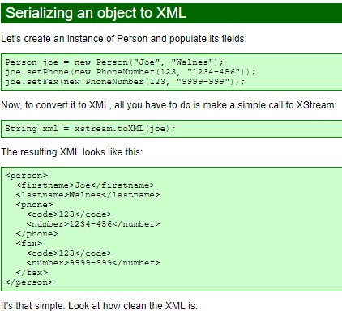
XStream
XStream is a simple library to serialize objects to XML and back again

Slide 25
Implementation
Use JDT to parse the source files of the API and get the line numbers and parameter names of public non-abstract method declarations
Instrumented only the methods which have a body
Created myXstreamClass at the highest level in the API source code
Instrumented code consists of:
Code to procure the parameter types
Calls to the myXstreamClass utility functions for each parameter
Code to write the serialized output

Slide 26
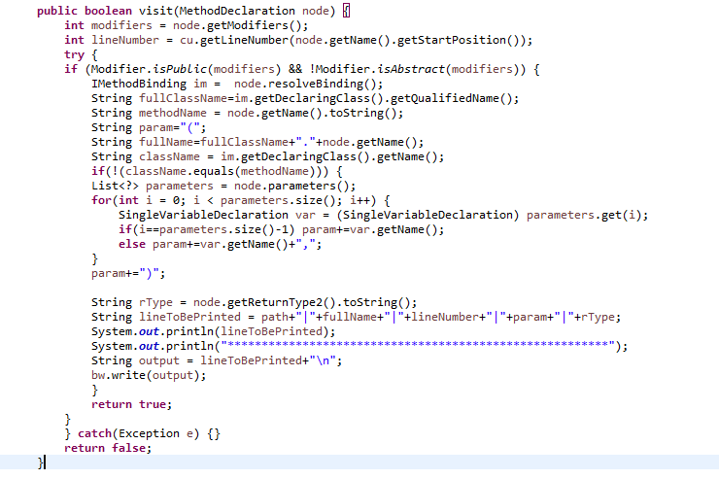
MethodParser

Slide 27

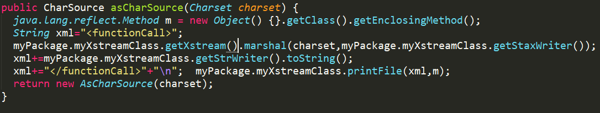
<code>

Slide 28
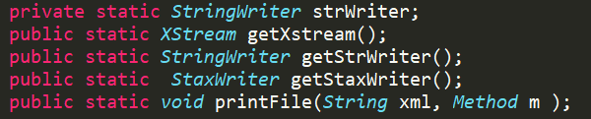
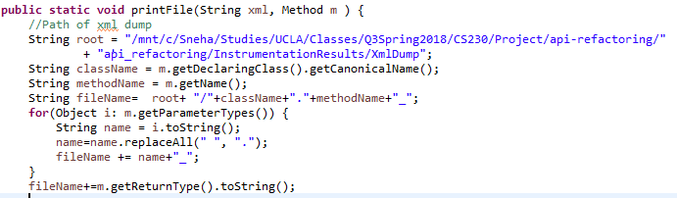
Serializing the objects

Slide 29
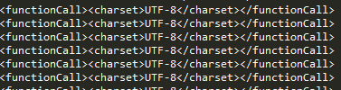
XML dumps

Slide 30
Results and Analysis
APIs we instrumented:
JUnit 4.12
Httpclient 4.5.3
google guava 19.0
commons-io 2.4.0
slf4j-api 1.7.25

Slide 31
Refactoring suggestions
junit.framework.Assert.assertEquals
#Calls | %Similarity | Similar parameter | Similar value
12007 | 99.7 | message | <null></null>

Slide 32
Refactoring suggestions
org.apache.httpcomponents/httpclient
Function | Calls | %Similarity | Similar Parameter | Value
HttpRequestBase.setURI | 259 | 76.24 | uri | <uri>/</uri>
CookieSpecRegistry.lookup | 179 | 96.68 | name | <string>default</string>
SchemeRegistry.get | 467 | 82.51 | name | <string>default</string>
SchemeRegistry.getScheme | 467 | 82.51 | name | <string>http</string>

Slide 33
Refactoring suggestions
org.apache.http.conn.scheme.SchemeRegistry.getScheme
#Calls | %Similarity | Similar parameter | Similar value
467 | 82.51 | name | <string>http</string>

Slide 34
Refactoring suggestions
com.google.common.collect.RegularImmutableList.listIterator
#Calls | %Similarity | Similar parameter | Similar value
13903 | 99.98 | index | <int>0</int>

Slide 35
More results
API | Functions Instrumented | Functions called from maven tests | Function Coverage
JUnit | 427 | 165 | 38.64%
Apache httpclient | 1501 | 238 | 15.85%
Google guava | 2137 | 65 | 3.04%
commons-io | 253 | 12 | 4.74%
slf4j-api | 332 | 12 | 3.60%
Complete statistics of dynamic analysis:
https://docs.google.com/spreadsheets/d/1oDhQtXnJiwJps31GsHzbTiI2Ig7oERYuVGynEMDk7gU/edit?usp=sharing

Slide 36
Inference
Dynamic analysis helps us find arguments which remain constant across many API calls
API functions which are rarely used can be determined given a large set of projects
Comparison with static analysis:
Dynamic calls are more than static calls

Slide 37
Challenges & Threats to validity
Challenges:
Certain APIs require special environment setup
Many projects using the same version of API is difficult
Each github project has a different structure. So difficult to instrument using javassist and have a java agent for each project
Threats to validity:
Requires large number of projects to have a perfect analysis
Metric required to distribute counts across many projects
We only use maven tests. Can the API functions be invoked by some other means?

Slide 38
Acknowledgement
Tianyi Zhang for continuous guidance and support
http://javaparser.org Javaparser used for Static Analysis
https://tomassetti.me/resolve-method-calls-using-java-symbol-solver/
https://jboss-javassist.github.io/javassist/ Javassist
References

Slide 39
Thank You

