Slide 1
What Is Applied Machine Learning in Python?
Applied Machine Learning (ML) in Python means using machine learning algorithms and tools to solve real-world problems — not just studying the theory.
It focuses on how to implement, train, test, and deploy models using Python libraries like:
scikit-learn — for building and evaluating ML models
pandas & numpy — for data cleaning and preparation
matplotlib & seaborn — for data visualization
joblib or pickle — for saving trained models
So “applied” means hands-on — actually coding the pipeline:
Data → Clean → Train Model → Evaluate → Predict → Deploy

Slide 2
Typical Machine Learning Workflow (Applied)
Step | Description | Example in Python
1. Data Collection | Load data from CSV, SQL, API, or cloud | pd.read_csv("sales.csv")
2. Data Cleaning | Handle missing values, outliers, scaling | df.fillna(0)
3. Feature Engineering | Convert raw data into model-friendly inputs | pd.get_dummies(df)
4. Model Selection | Choose algorithm (Regression, Decision Tree, etc.) | LinearRegression()
5. Training | Fit model on training data | model.fit(X_train, y_train)
6. Evaluation | Check accuracy, precision, recall, R², etc. | model.score(X_test, y_test)
7. Prediction | Predict on unseen data | model.predict(X_new)
8. Deployment | Save & use model in production | joblib.dump(model, "model.pkl")

Slide 3
Core Algorithms You’ll Learn & Apply
Category | Algorithm | Python Implementation
Supervised Learning | Linear Regression, Logistic Regression, Decision Trees, Random Forests, SVM | from sklearn.linear_model import LinearRegression
Unsupervised Learning | K-Means, PCA (Dimensionality Reduction) | from sklearn.cluster import KMeans
Ensemble Learning | Random Forest, Gradient Boosting, XGBoost | from sklearn.ensemble import RandomForestClassifier
Model Evaluation | Confusion Matrix, ROC Curve, Cross Validation | from sklearn.metrics import classification_report

Slide 4
Libraries Commonly Used
Library | Purpose
pandas | Data manipulation and preprocessing
numpy | Numerical computing and arrays
matplotlib / seaborn | Visualization
scikit-learn | Core ML algorithms and pipelines
statsmodels | Statistical modeling
joblib / pickle | Model saving/loading

Slide 5
Typical Course or Training Modules (Applied ML in Python)
Module | Topics
Module 1: ML Foundations | Supervised vs Unsupervised, Bias-Variance, Overfitting
Module 2: Data Preprocessing | Cleaning, Encoding, Normalization
Module 3: Regression Models | Linear, Polynomial, Ridge, Lasso
Module 4: Classification Models | Logistic, KNN, SVM, Decision Tree, Random Forest
Module 5: Clustering & Dimensionality Reduction | K-Means, PCA
Module 6: Model Evaluation | Accuracy, ROC, Cross Validation
Module 7: Model Deployment | Save/Load models, Streamlit dashboards
Capstone Project | Real dataset (finance, HR, sales, IoT, etc.)

Slide 6
Feature | Jupyter Notebook | JupyterLab
Interface | Classic, simple, single-page view | Modern IDE-style with tabs, panels, file browser
URL | http://localhost:8888/tree | http://localhost:8888/lab
Files view | One file at a time | Multiple notebooks, terminals, text files in tabs
Best for | Beginners, focused single notebook work | Advanced users, multi-file projects
Extensibility | Limited | Highly extensible (Git, TensorBoard, VSCode-like)
Performance | Lightweight | Slightly heavier but more capable
Integrated Console / Terminal | No | Yes — built-in terminal, markdown, data viewer

Slide 7
AI/ML Architecture
Anaconda- JupyterLab or Notebook Practice

Slide 8
https://www.kaggle.com/datasets
https://datasetsearch.research.google.com/
https://www.data.gov/
https://data.gov.in/
https://data.europa.eu/en
https://registry.opendata.aws/
https://open.canada.ca/en/open-data/
https://data.gov.uk/
https://data.nasa.gov/
https://open.gsa.gov/data/
https://opendatainception.io/
https://dataportals.org/
https://www.huggingface.co/datasets
https://www.worldbank.org/en/data
https://data.worldbank.org/
https://www.zenodo.org/
https://data.openaccess.cambridge.org/ (Cambridge)
https://www.science.gc.ca/site/science/en/open-science/datasets-and-portals
https://opendata.ox.ac.uk/
https://data.okfn.org/
https://data.overheid.nl/en/
https://data.go.jp/en/index.html
https://data.gov.sa/en
https://data.gov.ph/
https://github.com/awesomedata/awesome-public-datasets

Slide 9
Step | Phase | Purpose
1️⃣ | Problem Definition | Define target variable and objective
2️⃣ | Data Understanding | Load and inspect the HR dataset
3️⃣ | Data Cleaning & Preprocessing | Handle missing values, encode categorical, scale features
4️⃣ | EDA (optional visuals) | Quick overview — correlations and distributions
5️⃣ | Model Training | Train multiple classification models
6️⃣ | Model Evaluation | Accuracy, Precision, Recall, F1, ROC
7️⃣ | Model Saving | Persist with joblib
8️⃣ | Dashboard / Prediction App (optional) | Streamlit / FastAPI demo interface
Phase-1 Project (Current One): Predictive Model — 8-Step AI/ML Pipeline
🎯 Objective:
Use the uploaded HR-Employee-Attrition dataset to build a Predictive AI/ML model that classifies whether an employee will attrite (Yes/No).
This project will strictly follow the 8-step practical ML workflow we already discussed:

Slide 10
Type | Key Question It Answers | Nature | Example (HR Attrition)
1️⃣ Descriptive Analytics | “What happened?” | Retrospective | % of employees left, average tenure, satisfaction level
2️⃣ Diagnostic Analytics | “Why did it happen?” | Investigative | Attrition is higher among employees with overtime or low salary
3️⃣ Predictive Analytics | “What will happen?” | Machine Learning | Model predicts who is likely to leave next
4️⃣ Prescriptive Analytics | “What should we do about it?” | Actionable / Optimization | Recommend retention actions (e.g., salary raise, workload reduction)
Understanding the Four Analytics Types

Slide 11
Phase | Analytics Type | Timing | Purpose
Data Understanding | Descriptive | Before Model | Summarize what’s in data
Data Diagnostics | Diagnostic | Before Model | Understand causes
Model Training | Predictive | During Model | Predict outcomes
Business Strategy | Prescriptive | After Model | Recommend actions
Model Analytics during Model Development

Slide 12
QUARTILE- How It’s Calculated (Step-by-Step)
Let’s use Age again as an example.
1️⃣ Sort all ages (1,470 values) from smallest to largest.
2️⃣ Find positions that mark the 25th, 50th, and 75th percentiles:
25% (Q1) = the value at 0.25 × 1470 = 367.5th position → 367th or 368th smallest age.
50% (Q2) = 0.50 × 1470 = 735th position → this is the median.
75% (Q3) = 0.75 × 1470 = 1102.5th position → around the 1102nd value.
📘 So the value listed at 25% (Q1 = 30) means:
If you line up all employees by age from youngest to oldest, the 367th employee’s age is 30.
That’s the cutoff where 25% of employees are younger than or equal to 30.

Slide 13
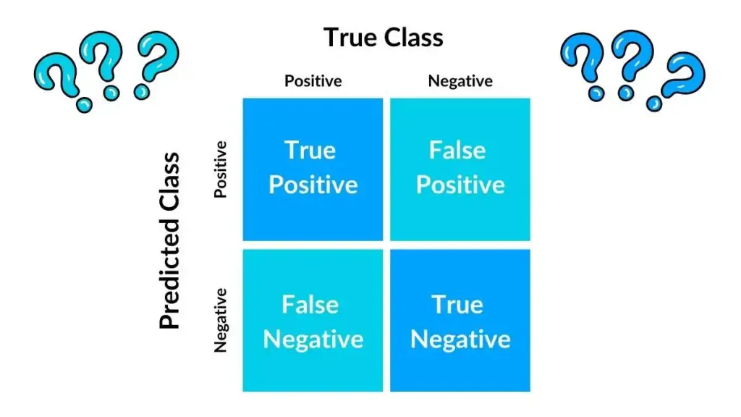
What Is a Confusion Matrix?
A Confusion Matrix is a simple 2×2 table that shows how well your classification model performed — comparing the actual labels to the predicted labels.
It’s called “confusion” because it shows where the model is confused between classes (i.e., predicting “Yes” when it should be “No,” etc.).

Slide 14
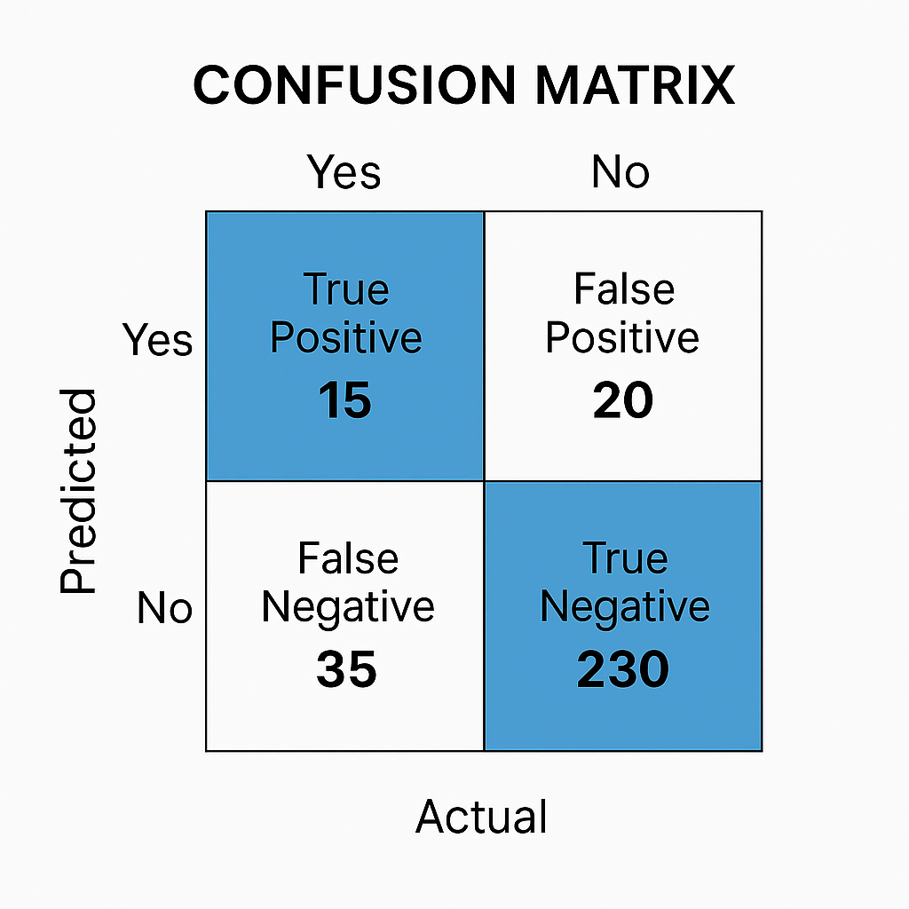

Slide 15
Understanding the Layout
The confusion matrix shows Predicted vs Actual outcomes:
 | Actual: Yes (Attrition) | Actual: No (Stayed)
Predicted: Yes | True Positive (TP) = 15 | False Positive (FP) = 20
Predicted: No | False Negative (FN) = 35 | True Negative (TN) = 230

Slide 16
Meaning of Each Cell
Cell | Description | HR Attrition Example
True Positive (TP = 15) | Model correctly predicted attrition. | 15 employees predicted to leave actually left.
False Positive (FP = 20) | Model predicted attrition but they stayed. | 20 employees predicted to leave but actually stayed.
False Negative (FN = 35) | Model predicted they’ll stay but they left. | 35 employees left even though model predicted they’d stay.
True Negative (TN = 230) | Model correctly predicted they’ll stay. | 230 employees predicted to stay actually stayed.

Slide 17
Key Metrics Derived from It
Metric | Formula | What It Measures
Accuracy | (TP + TN) / Total | Overall correctness
Precision | TP / (TP + FP) | Of predicted “Yes,” how many were truly “Yes”
Recall (Sensitivity) | TP / (TP + FN) | Of actual “Yes,” how many did we detect
F1-Score | 2 × (Precision × Recall) / (Precision + Recall) | Balance between precision & recall

Slide 18
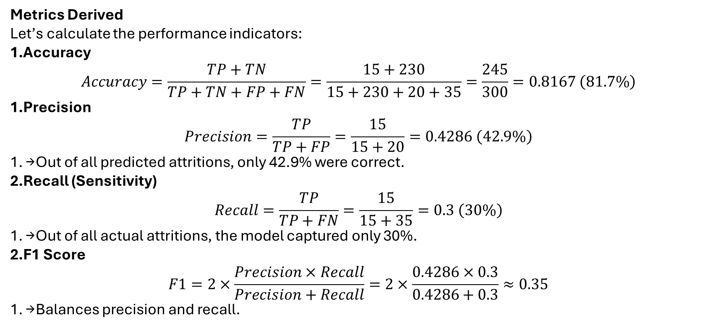
Metrics Derived
Let’s calculate the performance indicators:
Accuracy
$$Accuracy=\frac{TP+TN}{TP+TN+FP+FN}=\frac{15+230}{15+230+20+35}=\frac{245}{300}=0.8167 \left(81.7\%\right)$$
Precision
$$Precision=\frac{TP}{TP+FP}=\frac{15}{15+20}=0.4286 \left(42.9\%\right)$$
→ Out of all predicted attritions, only 42.9% were correct.
Recall (Sensitivity)
$$Recall=\frac{TP}{TP+FN}=\frac{15}{15+35}=0.3 \left(30\%\right)$$
→ Out of all actual attritions, the model captured only 30%.
F1 Score
$$F1=2×\frac{Precision×Recall}{Precision+Recall}=2×\frac{0.4286×0.3}{0.4286+0.3}≈0.35$$
→ Balances precision and recall.

Slide 19
Now Your XGBoost Classification Report Explained
precision recall f1-score support
0 0.88 0.98 0.93 247
1 0.78 0.30 0.43 47
accuracy 0.87 294
macro avg 0.83 0.64 0.68 294
weighted avg 0.86 0.87 0.85 294

Slide 20
Class 0 — Attrition = No (Employees Stayed)
✅ Interpretation: The model handles the majority class very well.
Metric | Value | Meaning
Precision (0.88) | Of all employees the model predicted as staying, 88% really stayed.
Recall (0.98) | The model correctly identified 98% of all employees who actually stayed.
F1-score (0.93) | Excellent balance — model is very good at predicting “No Attrition.”
Support (247) | There were 247 actual “No” cases in test data.

Slide 21
Class 1 — Attrition = Yes (Employees Left)
⚠️ Interpretation: The model struggles to catch all attrition cases — it’s cautious (predicts fewer “Yes”), leading to higher precision but lower recall.
Metric | Value | Meaning
Precision (0.78) | When the model predicts someone will leave, it’s correct 78% of the time.
Recall (0.30) | But it detects only 30% of all actual leavers — missing 70%.
F1-score (0.43) | Moderate performance because of low recall.
Support (47) | There were 47 actual “Yes” cases.

