Slide 1
LEDGER SENTINEL
AI-Assisted Fraud Detection for Tally Prime Journal Entries
ICAI AICA Level 2 Capstone Project
Prepared by Rupalakshmi
Including a live, verified integration with a real TallyPrime instance via MCP

Slide 2
Problem Statement
Journal-entry testing under SA 240 requires auditors to identify unusual entries that may indicate fraud — but with thousands of entries per period and limited time, manual sampling systematically misses the small, deliberately-disguised entries that matter most.
7,778
journal entries
screened per run
278
fraud patterns
planted for testing
Our objective:
Build an AI-assisted tool that screens 100% of journal entries exported from Tally Prime, ranks them by a transparent, rule-based risk score, and gives the auditor a plain-language explanation for every entry flagged — turning a sampling exercise into a full-population screen, without ever letting the AI decide what counts as fraud.
SA 240
the audit standard
this tool supports
Ledger Sentinel · AICA Level 2 Capstone
Problem Statement

Slide 3
Solution Overview — Input · Process · Output (IPO)
INPUT
PROCESS
OUTPUT
Tally Day Book Export
Rules + AI Explanation
Ranked Working Paper
Journal vouchers exported from Tally Prime (or pulled live via MCP): date, accounts, amount, narration, user and edit-log fields.
➝
10 weighted red-flag rules score every entry, plus a separate Rule 11 vendor-level screen for structured/“little-by-little” payments; an AI layer explains only the entries already flagged — it never decides what's suspicious.
➝
A risk-ranked list, plain-language explanations, follow-up questions, and a live dashboard — ready for auditor review and sign-off.
Ledger Sentinel · AICA Level 2 Capstone
Solution Overview

Slide 4
Input — What the Tool Reads
Every voucher is read with the same 12 fields, whether it comes from a file export or a live MCP pull:
Synthetic test dataset
voucher_id
7,778
total vouchers (1 year, UAE trading company)
date / time / day_of_week
278
planted fraud entries
created_by / created_by_name
altered_by / altered_date
9
distinct fraud patterns
debit_account / credit_account
42
ledger accounts
amount
8
simulated user accounts
narration
9 fraud patterns planted:
Weekend/after-hours · post year-end backdating · near approval limit · round amounts to suspense · same-user create/alter · duplicate invoices · vendor bank-detail changes · old-voucher late edits · structured disbursement to a vendor (caught separately by Rule 11)
Ledger Sentinel · AICA Level 2 Capstone
Input

Slide 5
Process — Rules Engine + AI Explanation
1 — Rules engine (deterministic, auditable)
Three AI backend modes
10 independently-weighted rules each test one red flag (timing, amounts, narration, accounts, user behaviour) and return a score. Every fired rule is combined into a single weighted-average risk score — never a simple sum — so even a heavily-flagged entry is scored honestly rather than maxed out. A separate Rule 11 watches cumulative payments per vendor over time, to catch structuring that no single-entry rule can see — reported on its own, never folded into that weighted average.
Template (default)
zero-config, deterministic, always works
risk_score = ( Σ score × weight for fired rules ) / ( Σ 100 × weight for all rules ) × 100
Local — LM Studio
private, nothing leaves the machine
2 — AI explanation layer (explains, never decides)
Cloud — Claude API
For only the highest-ranked entries, an AI layer writes a plain-language explanation, two follow-up questions for management, and a draft working-paper note — strictly from the rule reasons already captured. Like a metal detector and a tour guide: the rules decide what's flagged, the AI only explains why.
richer natural-language explanations
Ledger Sentinel · AICA Level 2 Capstone
Process

Slide 6
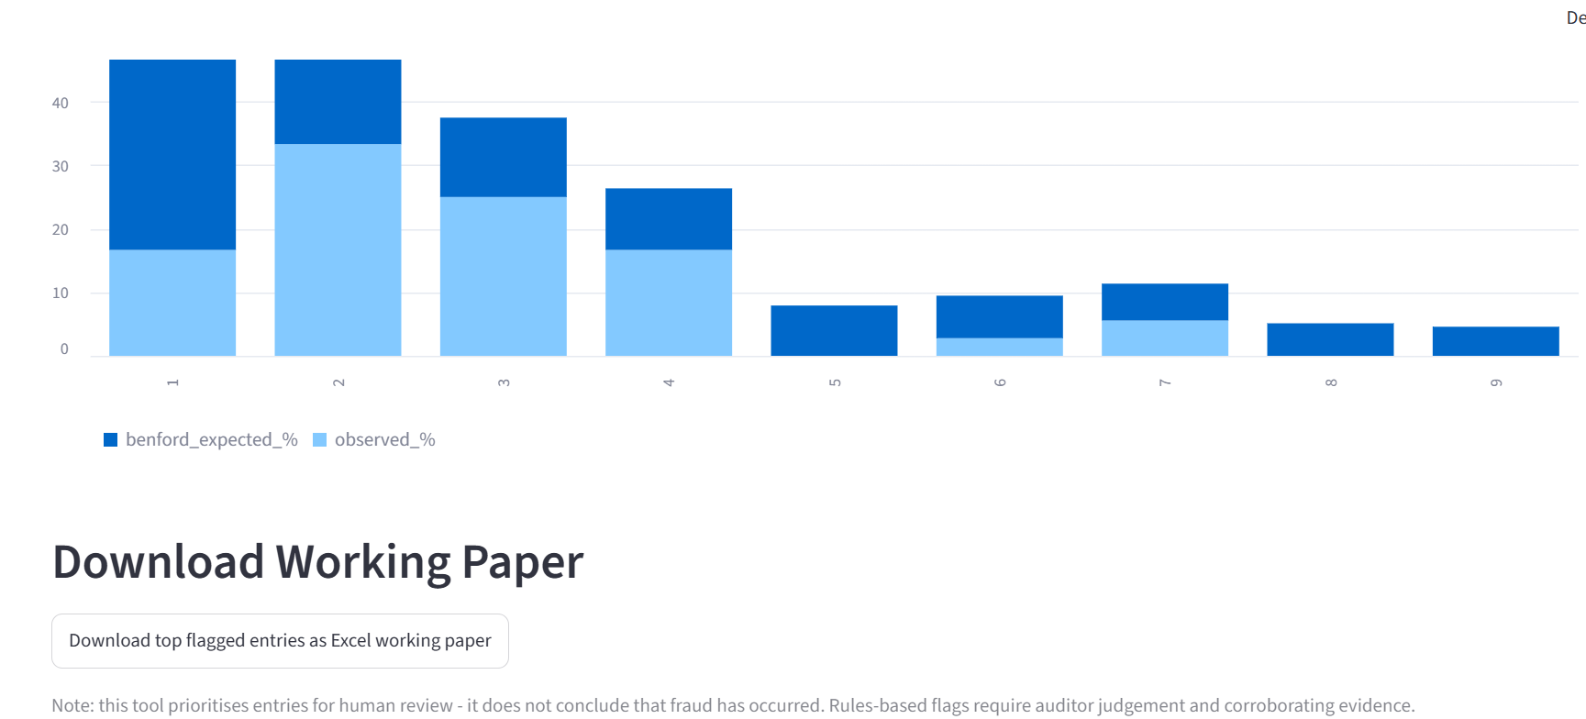
Output — Results on the Synthetic Dataset
57.9%
6 / 9
Honest about ties, not just gaps
163 vouchers tie on one exact score at the cutoff — a single "top 278" number would hide that. We report both tiers honestly. A separate Rule 11 screen adds 10 more catches (0 false positives) on top, for a combined 61.5%–75.9%.
fraud caught unambiguously
(161 of 278, 4 false calls —
up to 72.3% if a tied/borderline
band is also reviewed)
fraud types caught at a
perfect 100% catch rate
Deliverables produced
Risk-scored voucher list (all 7,778, ranked 0–100, plus a separate Rule 11 vendor flag)
Auditor Working Paper (top 50, explained, sign-off ready)
Interactive Streamlit risk dashboard
One-click live Tally → MCP → Excel pipeline
Benford's-Law and Rule 11 vendor screens (separate dashboard views, never blended into the ranked list)
Ledger Sentinel · AICA Level 2 Capstone
Output

Slide 7
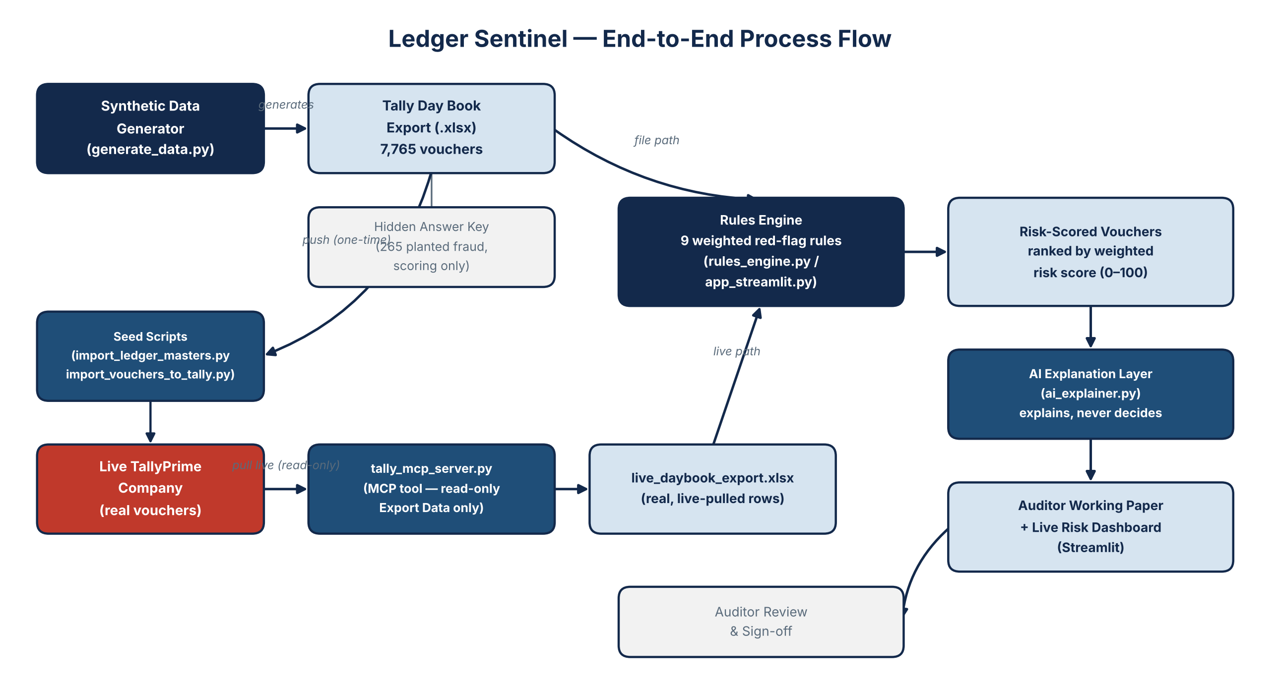
End-to-End Process Flow
Ledger Sentinel · AICA Level 2 Capstone
Process Flow

Slide 8
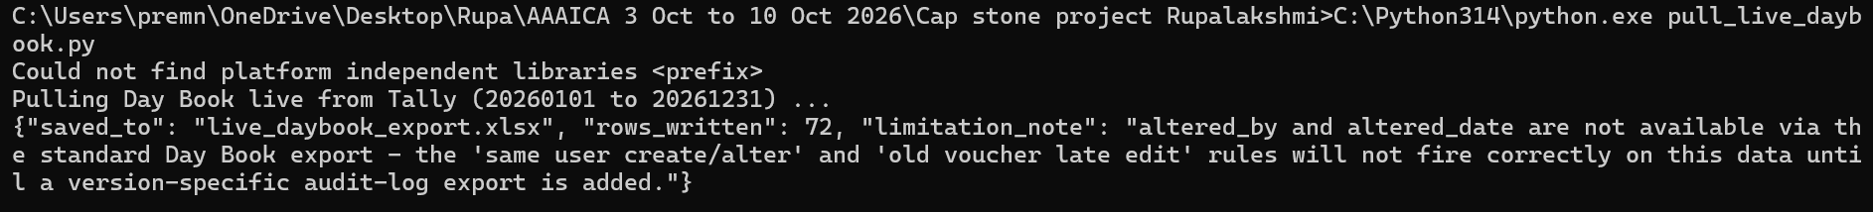
Stretch Goal — Live Tally ↔ MCP Integration
Verified live against a real, running TallyPrime instance on 15 October 2026 — not a simulation.
1
2
3
4
Chart of accounts pushed
Synthetic vouchers written
Day Book pulled back — live
Scored by the rules engine
27 ledger masters created in Tally — 0 errors
Real "Journal" vouchers created via Tally's XML/HTTP gateway
Read-only MCP tool call recovers real rows from Tally
Genuine live data, never seen by the rules before
Strictly read-only by design
tally_mcp_server.py only ever sends "Export Data" requests. Writing synthetic data into Tally for this demo was done by separate, clearly-labelled seed scripts — the MCP tool itself never needs write access.
Real terminal output: live pull succeeded, real rows recovered into live_daybook_export.xlsx
Ledger Sentinel · AICA Level 2 Capstone
Live Integration

Slide 9
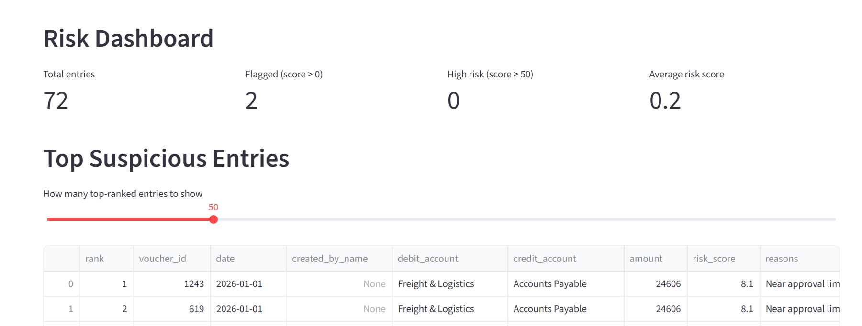
Live Result — Real Tally Data in the Dashboard
72 real vouchers, pulled live from Tally — 2 genuinely flagged for sitting just under the AED 25,000 approval limit, scored by rules that had never seen this data before.
Ledger Sentinel · AICA Level 2 Capstone
Live Result

Slide 10
Limitations & Ethical Guardrails
What this tool is
Known constraints (stated openly)
Rules prioritise entries for human review — they never conclude that fraud occurred.
TallyPrime's Educational edition caps vouchers created and rows exported per call — a licence-tier limit, not a defect in the integration.
The AI only explains already-flagged entries; it never decides what counts as suspicious.
Benford's-Law screening is explicitly framed as "a screen, not proof," and only recommended for 5,000+ records.
Tally's standard Day Book export omits altered_by / altered_date / exact time, so rules needing those fields under-fire on live-pulled data — stated openly, not hidden. Rule 11 needs a genuine quiet baseline period per vendor before it can flag anything — a real engagement would need a full prior year of vendor history for it to work.
Every explanation traces back to the specific rule(s) that fired — the system stays fully auditable.
Ledger Sentinel · AICA Level 2 Capstone
Limitations & Ethics

Slide 11
Conclusion & Next Steps
Ledger Sentinel turns journal-entry testing from a sample into a full-population screen — transparent, auditable, and now proven against a real, live TallyPrime instance.
1
Expand the rule set and tune thresholds against a real client's actual approval limits
2
Extend live Tally coverage to include edit-log / audit-trail fields
3
Pilot the tool on one real engagement's journal-entry testing, under full auditor supervision
Thank you
Rupalakshmi · Ledger Sentinel · AICA Level 2 Capstone

