Slide 1
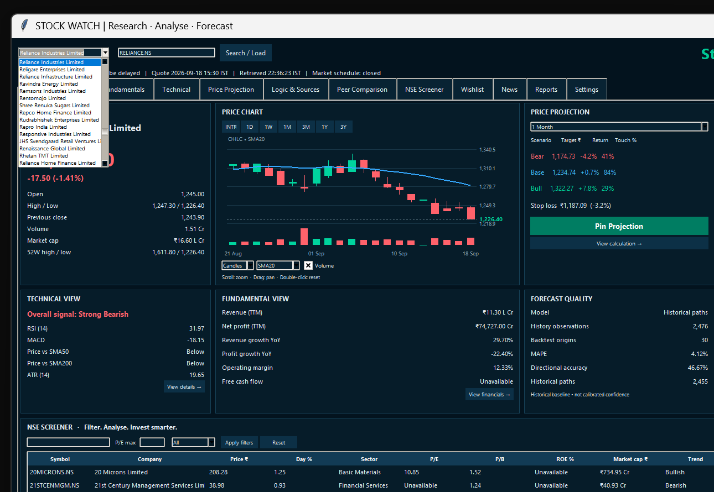
STOCK WATCH
Research • Analyse • Forecast
AI-enabled Indian stock research,
forecasting and screening application
Market Tracking
Bull / Bear Forecast
NSE Screener
Presented by
CA Umesh Goud
Project Submission
Working Stock Watch prototype

Slide 2
Problem statement & project objective
Why Stock Watch was created
THE PROBLEM
STOCK WATCH SOLUTION
Market data, ratios, charts and news are spread across multiple websites.
Future-price views are often difficult to verify or compare over time.
Manual stock screening across NSE companies is time-consuming.
Users need one place to track projections against actual market prices.
Live / Latest Price
Bull vs Bear Forecast
→
Charts, OHLC, market status and timestamps
Two scenarios with probabilities totalling 100%
Logic & Sources
Projection Wishlist
Model, backtest, data source and calculation trail
Pin forecasts and compare actual vs projected
NSE Screener
Peer & News Review
Filter companies by valuation, growth, sector and trend - WIP
Compare relevant companies and review recent news

Slide 3
How the application works
A transparent workflow from market data to measurable projection performance
USER WORKFLOW
1
Search company
Autocomplete from NSE universe
2
Analyse
Chart + technical + fundamentals + peers
3
Forecast
Bull / Bear targets + probability + stop loss
4
Verify logic
Data source + backtest + model methodology
5
Pin projection
Immutable snapshot stored locally
6
Track performance
Actual vs projected until expiry date

Slide 4
Architecture & technology
Python provides the intelligence; HTML/CSS/JavaScript provides the user experience
Market Data
yfinance initially
+ future live API
HTML / CSS / JS
Python Backend
SQLite
Reports
Modern dashboard
+ Plotly charts
Business logic
+ orchestration
Wishlist, settings,
projection history
PDF exports
Analysis Engine
Technical +
Fundamental
Forecast Engine
Bull / Bear
Probability + Stop Loss
LOCAL-PC DESIGN
Wishlist, projection history, preferences, cache and reports stay on the user's Windows PC.
Future-ready: the same provider layer can accept a licensed real-time feed later.

Slide 5
Horizon-specific forecasting logic
Different time horizons use different information — not arbitrary percentage multiplication
INTRADAY / 1 DAY
1 WEEK
1 MONTH
Recent returns
Momentum
Volume
Intraday trend
ATR
Volatility
Momentum
Technical indicators
Volume
Market trend
Technical trend
Volatility
Market / sector relative strength
3 MONTHS
1 YEAR
3 YEARS
Technical + fundamentals + sector
Fundamental growth
Valuation
Profitability
Sector & market regime
Long-term fundamentals
Revenue / profit growth
Valuation
Capital efficiency
Industry trends
Long-term historical behaviour
RULE: Do not simply multiply current price by arbitrary percentages; the selected horizon determines which data and features receive emphasis.

Slide 6
Value delivered & conclusion
What Stock Watch demonstrates as a project
VALUE DELIVERED
LIMITATIONS / NEXT STEPS
One interface for market data, ratios, technicals, forecasts and peers.
Transparent Bull/Bear probabilities instead of unexplained target prices.
Projection Wishlist creates an audit trail of what the model predicted.
Actual-vs-projected tracking converts forecasting into measurable performance.
NSE Screener helps shortlist companies using valuation, growth and trend filters.
Local storage keeps personal project data on the user's own PC.
yfinance is useful for research but not guaranteed exchange-grade real-time data.
Forecasts are model-generated estimates and depend on the quality of available data.
Future enhancement: licensed live market feed, stronger news sentiment and broader validation.
CONCLUSION
Stock Watch combines research, forecasting, screening and post-forecast tracking in one practical desktop application.
Thank You
Presented by CA Umesh Goud

