Slide 1

Next-Gen Indian Statutory Payroll & AI Tax Advisory System
Capstone Submission — AY 2026–27
Author
Joydeep Datta
joydeep.datta@gmail.com
Discipline
Full-Stack Vibe Coding & LLM Systems Engineering
Statutory Scope
Indian Income Tax Act (AY 2026–27) · EPF · ESI · Professional Tax
Tech Stack
React 19 · TypeScript · Express · Google Gen AI SDK
Date: September 25, 2026

Slide 2
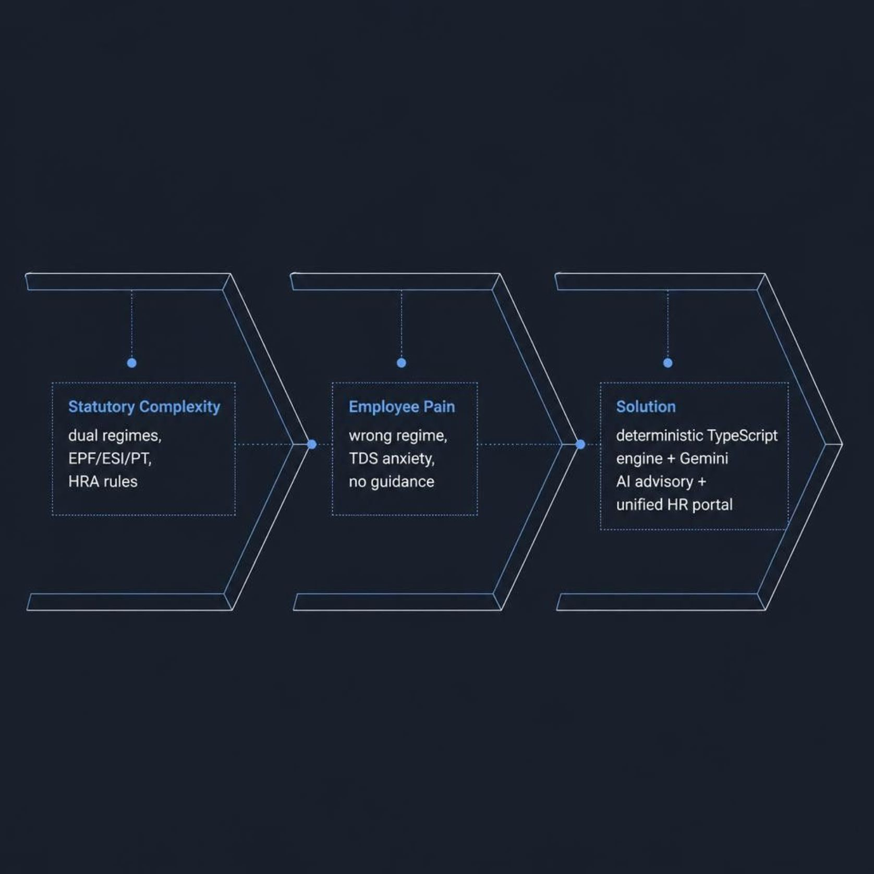
CONTEXT & OBJECTIVES
The Indian Payroll & Tax Dilemma
🏛️ Statutory Maze
Dual Old/New regimes for AY 2026–27; standard deductions of ₹75,000 vs ₹50,000; Section 87A rebate caps; EPF 12% with optional ₹15,000 wage ceiling; ESI on gross wages ≤ ₹21,000; state-specific Professional Tax; and the three-condition HRA exemption under Section 10(13A).
😟 Employee Pain Points
Wrong regime selection costs employees thousands. Last-minute investment-proof anxiety, opaque TDS deductions, and zero access to personalized HR guidance compound the problem year after year.
✅ Capstone Solution
Deterministic, auditable TypeScript calculations paired with a Google Gemini AI advisor and a unified HR/employee self-service portal — transparent, explainable, and enterprise-ready.

Slide 3
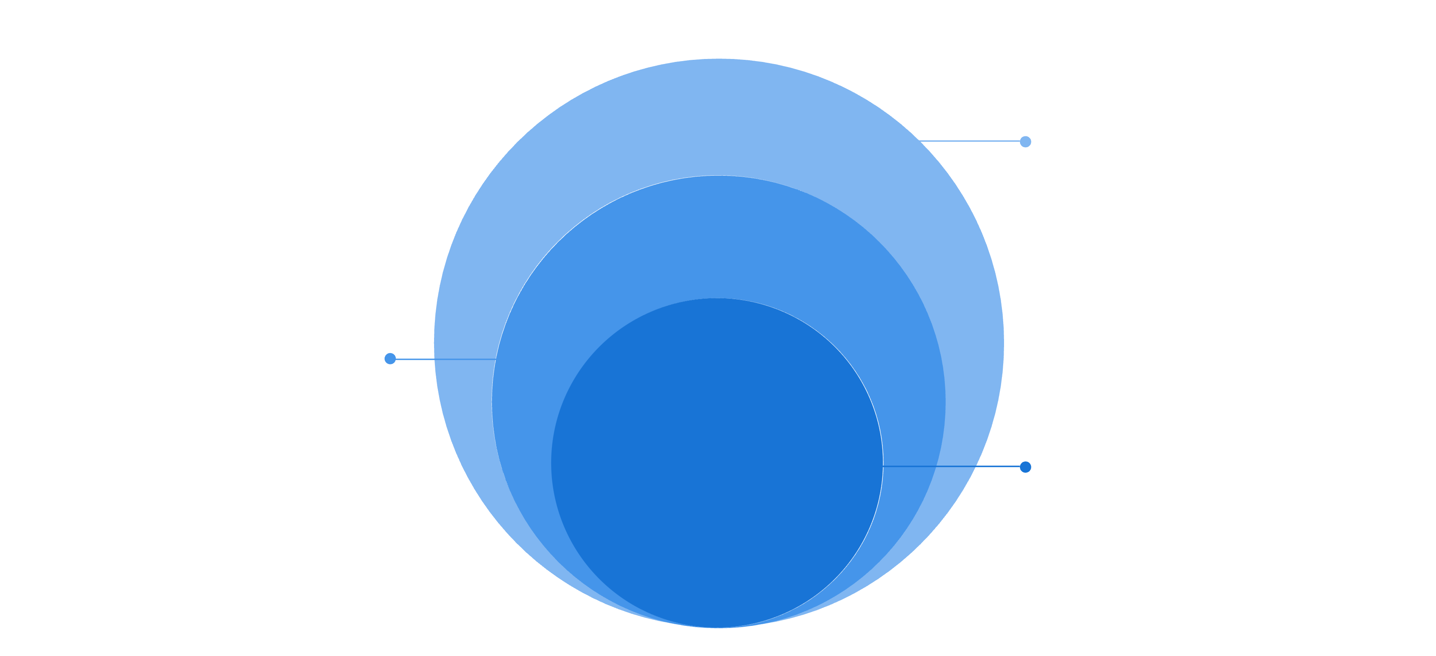
SYSTEM ENGINEERING
Architecture & Full-Stack Technology
AI & Integrations
Google Gemini → deterministic payroll engines + exports
Server Layer
Express secure AI proxy and endpoint isolation
UI Layer
React 19 SPA with TypeScript and Tailwind
Frontend
Backend & AI
React 19 · strict TypeScript · Vite 6
Tailwind CSS v4 · Lucide icons
html2canvas · jsPDF · pptxgenjs
Node.js / Express / tsx server
Secure endpoint isolation for API keys
@google/genai · timeout & model fallback
xlsx export engine

Slide 4

FEATURE DELIVERABLES
Core Application Modules
Master Salary Structuring
April–March Payroll Run
Full CTC breakdown with PF wage-ceiling toggle and component configuration.
Gross-to-net register with EPF/EPS, ESI, PT, and progressive TDS computation.
Employee Self-Service
Declarations & HRA
Payslip downloads and regime declarations through a dedicated employee portal.
Chapter VI-A (80C/80D/24b), HRA rent entry and landlord PAN validation.
Old vs New Simulator
Gemini AI Advisor
Live side-by-side regime comparison with real-time tax differential insights.
Smart Tax Advisor and persistent floating Copilot powered by Google Gemini.
Prototype Limitation: Comprehensive statutory edge-case testing is still in progress. The application requires full validation against the Income Tax Act, 2025 and applicable new forms/rules before any production deployment.

Slide 5

CORE LOGIC & PRECISION
Deterministic Indian Tax Engine
New Regime Slabs — AY 2026–27
HRA Exemption — Section 10(13A)
Income Range | Rate | Std. Deduction
₹0 – ₹3,00,000 | Nil | ₹75,00087A rebate ≤ ₹7L net
₹3L – ₹7L | 5%
₹7L – ₹10L | 10%
₹10L – ₹12L | 15%
₹12L – ₹15L | 20%
Above ₹15L | 30%
Exempt amount = minimum of three conditions:
Progressive TDS Smoothing
Monthly TDS = (Projected Annual Tax − Tax Deducted to Date) ÷ Remaining Months, re-computed each payroll run to prevent year-end spikes.
Legal tax and bank-deduction math must remain deterministic — never LLM-generated. Verify all slabs against current law before production use.
Old Regime Slabs
Income Range | Rate
₹0 – ₹2,50,000 | Nil
₹2.5L – ₹5L | 5%
₹5L – ₹10L | 20%
Above ₹10L | 30%
₹50,000 std. deduction · 80C/80D/80CCD(1B) · 4% cess on total tax.
① Actual HRA received
② Rent paid − 10% of Basic
③ 50% Basic (metro) / 40% (non-metro)

Slide 6



AI ADVISORY
Google Gemini Integration & Circuit-Breaker Architecture
Context Ingest
Gemini Cascade
12s Abort & Rules
Advisor UI & Copilot
Design Principle: AI advises and explains — deterministic TypeScript code computes all statutory liabilities. The AI layer never overwrites calculated tax figures.

Slide 7
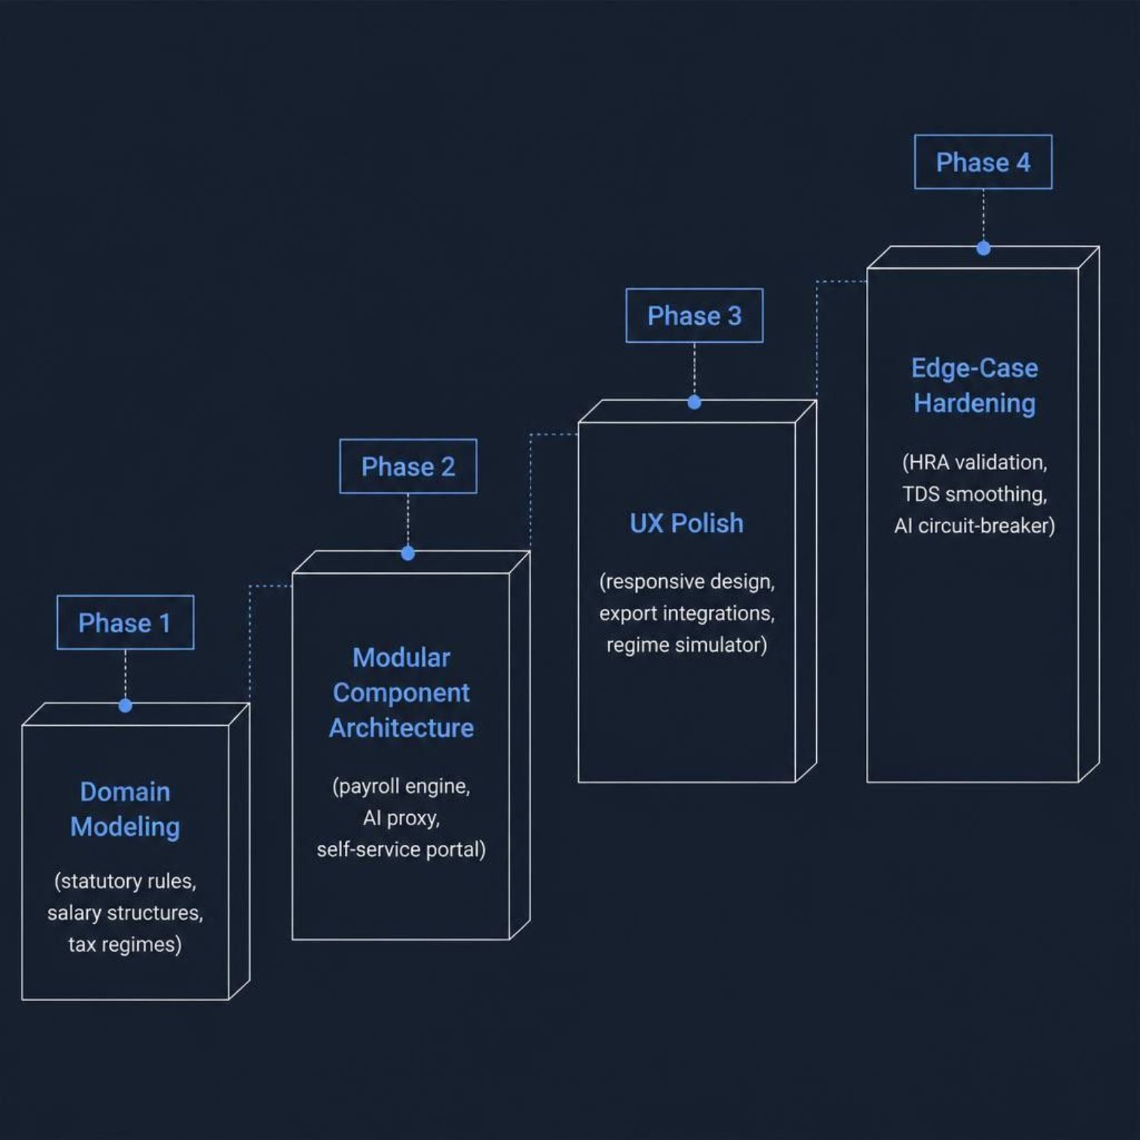
METHODOLOGY
Vibe Coding: From Idea to Enterprise Prototype
What Is Vibe Coding?
High-velocity, intent-driven development where natural-language prompts and domain specifications guide AI-assisted code generation, testing, and iterative refinement — compressing weeks of scaffolding into focused engineering sprints.
Quality Controls Applied
Strict TypeScript interfaces across all domain boundaries
tsc --noEmit and Vite production builds as CI gates
Clean separation: UI components · pure calculation utilities · server API routes

Slide 8
SECURITY REVIEW
Data Security, Confidentiality & Privacy
✅ Current Strengths
⚠️ Prototype Gaps to Address
API Key Isolation
Calculation Integrity
Session State
BOLA / IDOR Risk
GEMINI_API_KEY confined to server layer — never exposed to client bundle.
Deterministic engine ensures statutory figures are never AI-mutated.
In-memory client-side sessions — no persistent server-side authentication.
Employee objects accepted directly by AI routes — server-side authorization required.
Graceful Degradation
PII at Rest
Statutory Obligations
Timeout-based fallback to rule-based CA guidance when Gemini is unavailable.
PAN, Aadhaar, and bank data currently unencrypted — field-level encryption needed.
DPDP Act 2023 consent · IT Act Sec 192 · Form 24Q/Form 16 · immutable audit logs required for salary changes, regime locks, and declaration approvals.

Slide 9

ENTERPRISE READINESS
Production Checklist & Deployment Roadmap
Pillar | Target Control | Prototype Status
Authentication | SAML/OIDC SSO · MFA enforcement | In-memory session only
Authorization | Server-side RBAC · tenant isolation | Client-side role flags
Data Persistence | Relational DB · AES-256 at rest | No persistent store
PII Protection | Field-level encryption: PAN, Aadhaar, bank | Plaintext in state
Audit Logging | Append-only immutable ledger | Not yet implemented
Infrastructure | Docker/Cloud Run · WAF · autoscaling · DDoS protection · multi-region failover | Local dev server
All items marked ⚠️ are scoped for post-prototype hardening before any production or regulated-environment deployment.

Slide 10
CONCLUSION & FUTURE SCOPE
Achievements, Learnings & What's Next
Key Achievements
Explore the Prototype
Full-stack dual-regime engine for AY 2026–27
Six core modules with HR and employee views
Resilient Gemini advisory with CA fallback
Excel, PDF payslip, and PPTX export pipelines
GitHub Repository
Live Application
github.com/joydeepdatta-lab/B89Capstone-Joydeep-Datta
payroll16092026.ai.studio
Key Learnings
Conversational specs accelerate prototyping significantly
Strict TypeScript interfaces prevent domain drift
Legal math belongs in deterministic code — never AI
Continuous compilation catches defects early
Important: Prototype for demonstration and academic evaluation only. Statutory rules and all production security controls require final professional validation before regulated deployment.
Future Roadmap
Submitted by Joydeep Datta · September 25, 2026
Direct NEFT/NACH bank integration
Form 16 Part A/B + Income Tax Act 2025 new forms
Biometric attendance & automated LOP processing
Cloud SQL · enterprise SSO · SOC 2 readiness
Expanded statutory testing & edge-case validation

